Slide 1
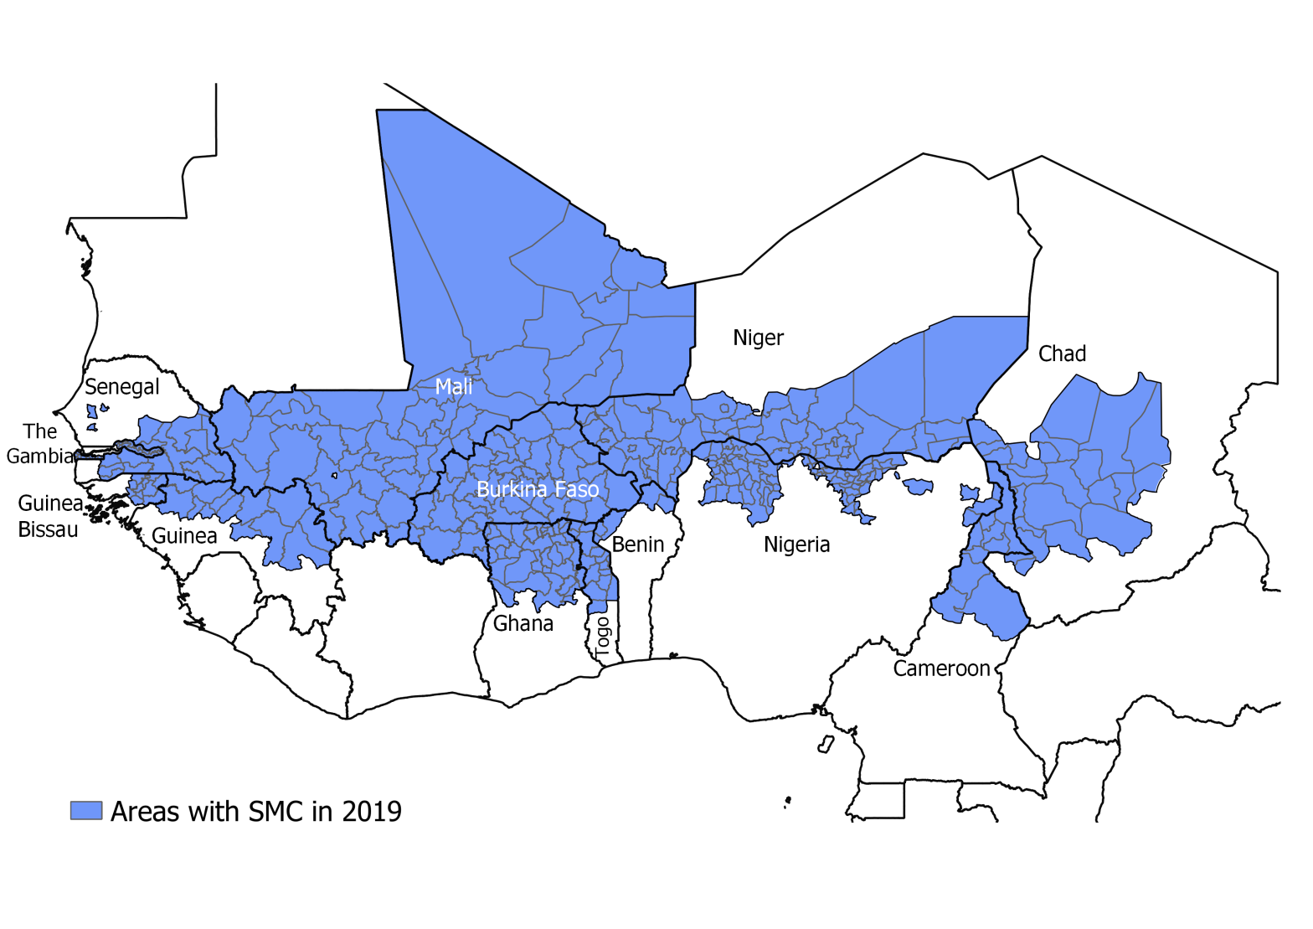
NMCPs from Benin, Burkina Faso, Cameroon, Chad, The Gambia, Ghana, Guinea, Guinea Bissau, Mali, Senegal, Niger, Nigeria and Togo
University of Thies : Jean Louis Ndiaye, Ibrahima Mbaye, Amadou Seck, Ndeye Fatou Diop
LSHTM: Paul Milligan, Susana Scott, Paul Snell, Lucy Bell
WHO/TDR : Corinne Merle, Nines Lima
MMV : Andre Tchouatieu, Abena Poku-Awuku
Notes:
With funding from the European and Developing Countries Clinical Trials Partnership (EDCTP), the OPT-SMC project will support 14 countries in West Africa and Central Africa to conduct implementation research on SMC, working in partnership with the University of Thiès in Senegal, TDR, Medicines for Malaria Venture (MMV), and the London School of Hygiene and Tropical Medicine (LSHTM).

Slide 2
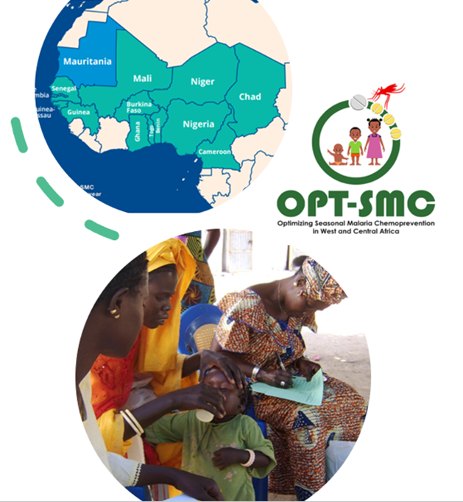
Objectives of OPT-SMC
Strengthening the capacities of the NMPs implementing SMC:
To define research priorities for optimizing SMC effectiveness
for conducting IR/OR projects for improving SMC effectiveness
Promote inter-country collaboration, sharing of information and expertise

Slide 3
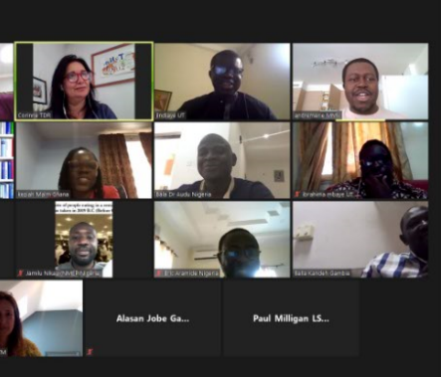
Activities conducted so far
Kick off meetings: 19th and 20th May 2020 (all NMCP teams attended)
Catch up meeting every 1-2 months with project team and NMCPs
Communication
Communication at ASTMH conference
Participation in EDCTP Forum
NMCP WhatsApp group
1-1 regular calls to each country NMCP
Development of logo
Development of website
Quarterly newsletters sent to all NMCPs

Slide 4
Research projects already funded
GUINEA 1 : Adapting delivery to reach children in mining areas
GUINEA 2 : implementation of recommendations
GHANA : Assessing Coverage of Seasonal Malaria Chemoprevention Among Children 3-59 months
BENIN : A case-control study to assess the efficacy of SMC in children aged 3-59 months in the Municipalities of Malanville-Karimama and Kandi-Gogounou-Segbana
NIGERIA : Facilitators and barriers to the uptake of Seasonal Malaria Chemoprevention Programme in Nigeria: a mixed method approach

Slide 5
Research projects about to start

Slide 6
MALI Evaluation of the quality of drug administration (SPAQ) of SMC to children aged 3 to 59 months using three approaches in the Dioila health district, Koulikoro region
Key research questions
Reducing the operational cost of SMC,
Improving SMC treatment adherence
Methods : Comparison of 3 approaches and estimate protective efficacy
Routine SMC (1st dose given by CHW – Doses 2 and 3 given by caregivers)
SMC - DOT (3 doses Directly observed treatment by CHW)
SMC Plus (1st dose given by CHW – Doses 2 and 3 given by caregivers followed up by volunteers )
Data collection :
Community Qualitative Survey (focus groups, in-depth interviews etc.)
Quantitative study : data collection before and after strategies implementation
Study site : Health District of Dioila / Region Koulikoro
Research collaborators : Malaria Research and Training Center (MRTC)
Ethics approval : obtained
Study status : start with 2022 SMC campaign if ECOWAS embargo ended

Slide 7
NIGER Adapting the target groups for Seasonal Malaria Chemoprevention
Research questions
What is the real SMC impact on Malaria morbidity and mortality?
Is is relevant to target older age range 5-10 years old?
Methods
5-year retrospective study of malaria morbidity and mortality
Prospective studies in pilot areas
Study site :
5 Health Districts (Niamey V, Balleyara, Dakoro, Magaria, and Boboye)
Research Collaborators : CERMES
Ethics approval : Obtained
Study status : start planned before 2022 SMC campaign

Slide 8
BURKINA FASO Evaluating the determinants for poor SMC coverage
Key questions they want to address
Improving SMC Coverage particularly in urban areas,
Understanding factors explained inequalities in SMC coverage
Methods
Qualitative Survey : semi-structured interviews and focus groups
Quantitative study : coverage survey after each cycle and data from routine information
Study site : 8 Health Districts
4 districts with lower coverage (Boulmiougou, Signoghin, Bogodogo, Do)
4 districts with high coverage (Koudougou, Ouahigouya, Dédougou et Banfora)
Research collaborators : Nouna Research Center
Ethics approval : not yet
Study status : start with 2022 SMC campaign

Slide 9
CHAD : Malaria indicators in Chad from 2017-21 and the link to SMC recommendations
Research questions
Are districts in Sudan zone with longer season, eligible for SMC?
What is the level of adherence to dose 2 and 3?
What is the therapeutic efficacy of SP+AQ ?
Is SMC justified in the 5-10 age group?
Methods
Descriptive and analytical study of malaria 2017-2021
Use existing data
Expected outcomes
Monthly incidence of malaria by health district, all ages and for children
Malaria stratification, Seasonality of malaria by zone
SMC eligibility by health district, Number of cycles required
Ethics approval : not yet
Study status : start in 2022

Slide 10
Others countries : Gambia, Cameroon, Guinea Bissao,Senegal, Togo, Mauritania
Cameroon
What are the best options to increase the impact of SMC on malaria morbidity and mortality (waiting for Ethical approval)
Gambia
Assessment of Adherence to the SMC treatment
Guinea Bissao
Assessment of SMC impact on malaria incidence in 3 regions: Bafata Gabu Tomball
Senegal
Mechanistic model for a cost-effective evaluation of SMC
Economic evaluation of DOT 3 days
Togo (and Mauritania)
In the process of identification of research partner and research questions

Slide 11
Others activities
Support to countries for facilitating the training for community drug distributors. Development of short videos posted on YouTube.
Support to the countries to evaluate the impact of COVID-19 on SMC delivery. Survey conducted in 13 countries
Technical support: visits by PMT members to Guinea Bissau and Nigeria
Workshop on Qualitative research: Introduction to basic principles and methods of data collection
Webinar : Introduction of RTS/S vaccine for malaria
Plans to visit Chad and Togo

Slide 12
Next steps
Q2 2022: Continued assessment of the capacity building needs
Q2-Q4 2022: conduct of a training programme for strengthening NMPs capacities for OR/IR based on the needs assessment done
Q2 2022: conduct in collaboration with Global Malaria programme of a workshop for:
Evaluating the quality of the data collected programmatically in DIHS2 or other surveillance system
measuring and understanding how to analyse key indicators to better inform SMC implementation

Slide 13
Next steps
Country projects
Finalization of the development of research projects for the 2022 SMC campaigns
Support countries for analyzing the results of ongoing research projects
Encourage countries to seek support for coverage surveys, and other activities beyond the budget of the project
Combining SMC with effective interventions to improve its impact
RTSS vaccine
Transmission blocking drugs

Slide 14
NMCP: Benin, Burkina Faso, Cameroon, Chad, Ghana, Gambia, Guinea, Guinea Bissau, Mali, Niger, Nigeria, Senegal, Togo and Mauritania
THANK YOU !!!!
Notes:
With funding from the European and Developing Countries Clinical Trials Partnership (EDCTP), the OPT-SMC project will support 14 countries in West Africa and Central Africa to conduct implementation research on SMC, working in partnership with the University of ThièsMa in Senegal, TDR, Medicines for Malaria Venture (MMV), and the London School of Hygiene and Tropical Medicine (LSHTM).

