Slide 1

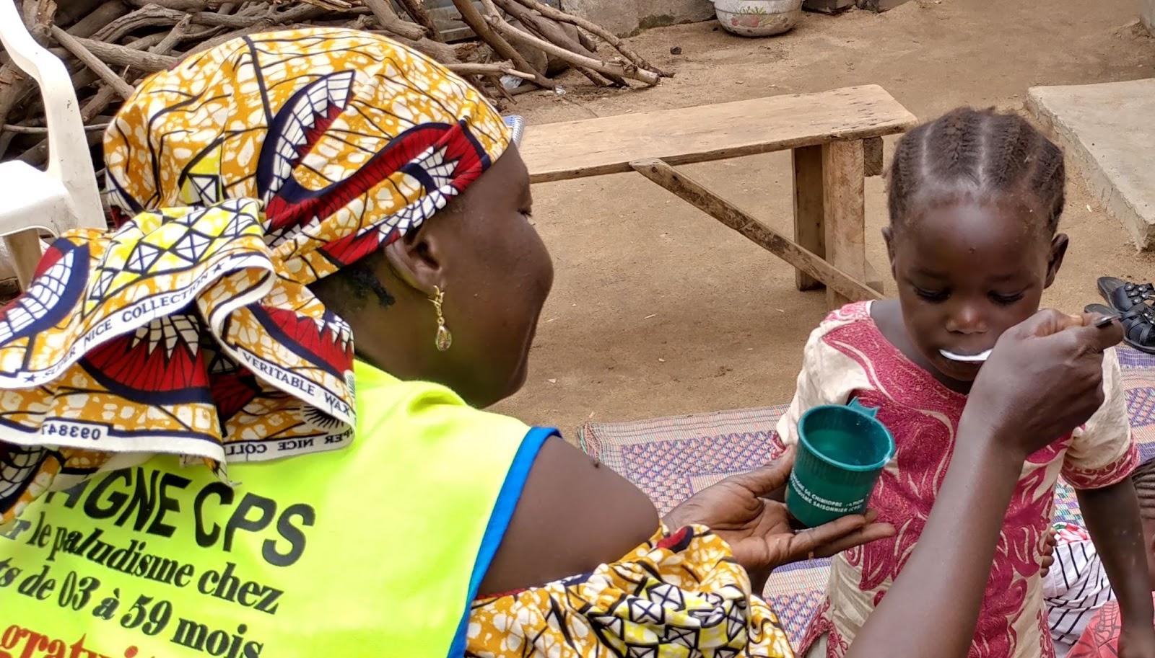

2022 SMC Alliance Meeting
Session V: Funding for SMC: A Round Table Discussion

Slide 2
Funding SMC: Realities
SMC requires routine, annual funding
SMC target populations continue to increase
Population increase
SMC reach
Interest in expanding SMC
Increased cycles
Broader age ranges
Additional communities
While funding for SMC specifically has significantly increased, malaria budgets flatlined since 2010 and have limited resources (and an increasing number of potential interventions)
Competing priorities for donor and domestic funding (pandemic preparedness, security, etc)

Slide 3
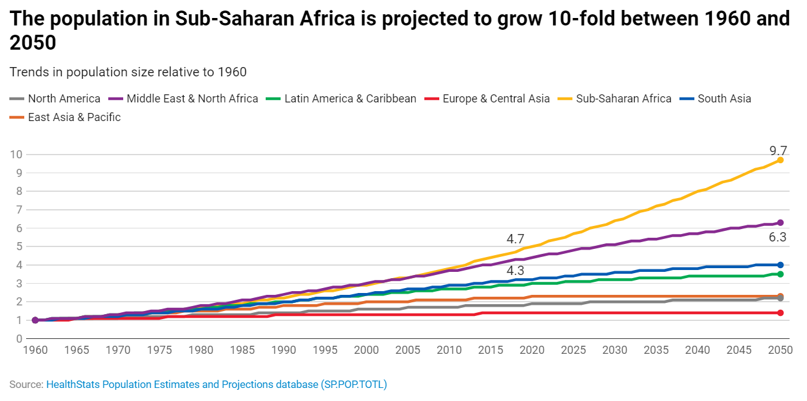
Population growth

Slide 4
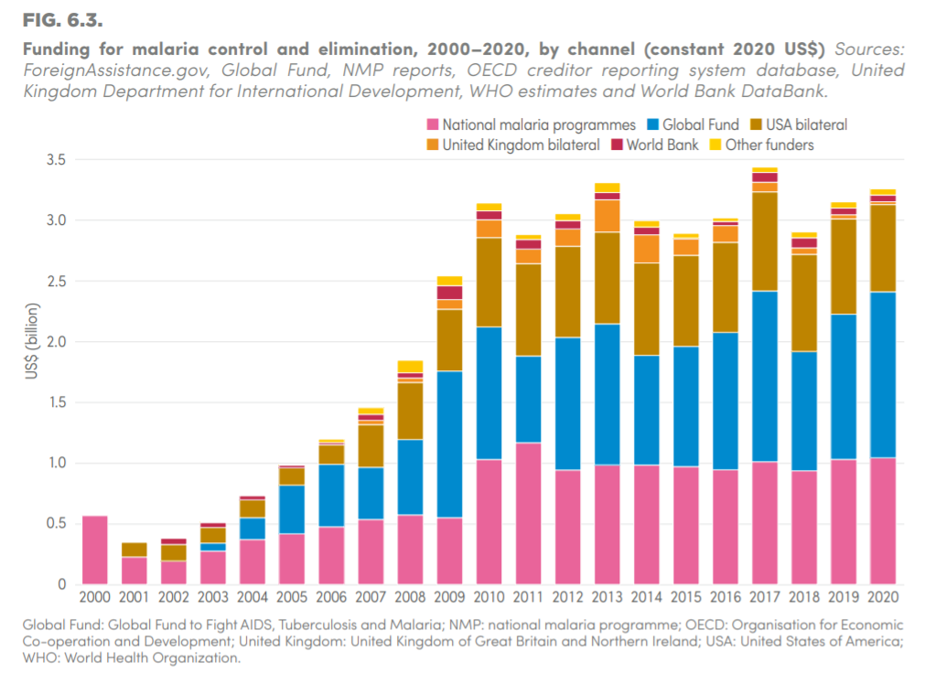
Malaria funding largely flat from 2010-2020

Slide 5
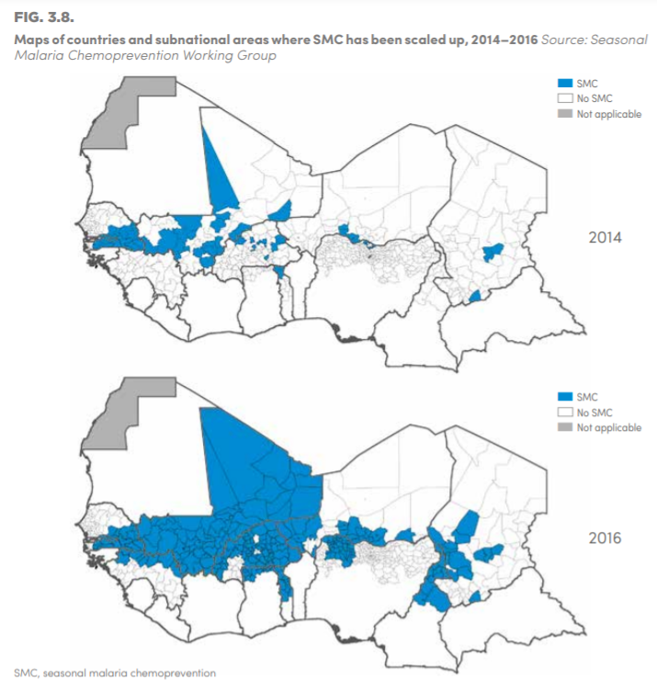
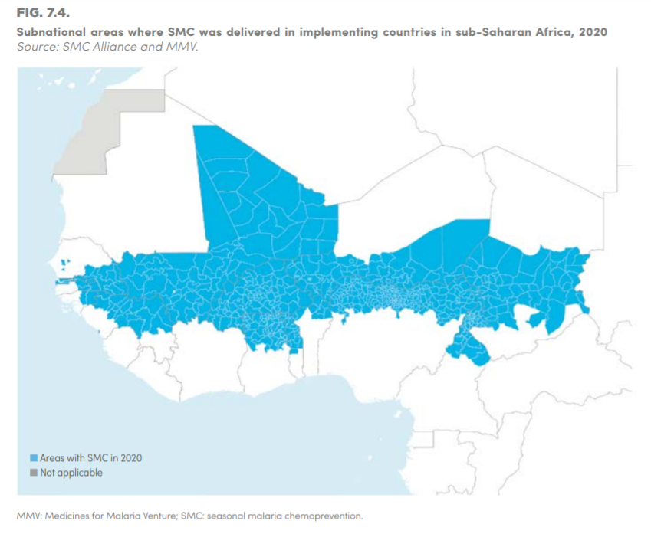
SMC scale-up 2014-2020, mostly to children aged 3-59 months
Notes:
From various years of WMR. Shows SMC districts covered in 2014, 2016 and 2020. Rapid expansion!

Slide 6

Funding SMC: Are there efficiencies to be found?
Are integrated campaigns more cost efficient?
Leveraging multiple campaigns?
Integrated enumeration?
Sharing digital tools across campaigns?
Other?
Does digitalization of campaigns lower costs (after start-up)?
Staffing of campaigns – could SMC be incorporated in CHW TORs?
Can stratification of supervision based on historical performance work?
Are there cost efficiencies from Covid-19 adaptations that should be continued?

Slide 7
Funding SMC: What are the possibilities?
Could care givers be given multiple cycles of SMC medicines at one visit (similar to antiretroviral therapy (ARV) programs)?
What lessons could be learned from ARV programs?
Could SMC be delivered via the routine health system (rather than monthly campaigns)?
What would this entail?
What cost savings might be had?
Are there non-traditional sources of funding?
Examples?

Slide 8
Let’s talk! (let’s mentimeter?)

