Slide 1

Monitoring drug resistance to support the ongoing use of chemopreventive treatments
Cally Roper, Lucy Okell
London School of Tropical Medicine & Hygiene
Imperial College London

Slide 2
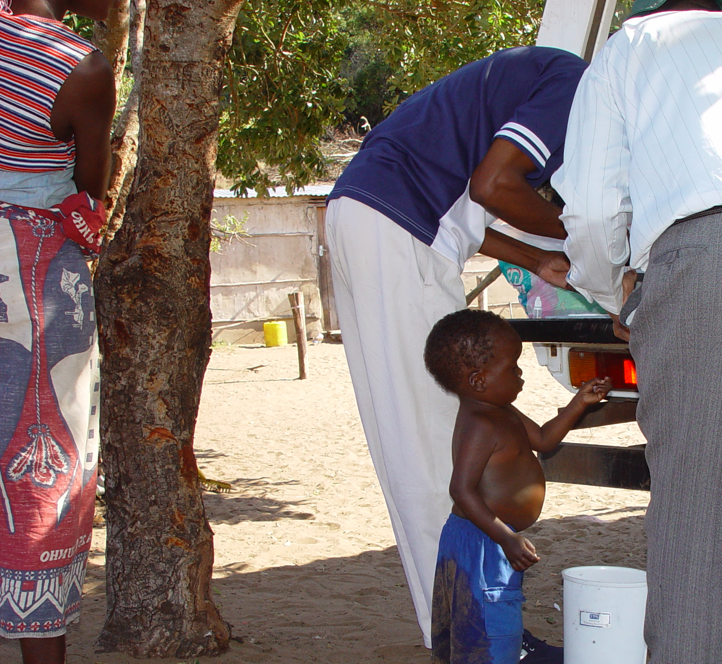
Example: SP sulphadoxine pyrimethamine
used in IPTp, IPTi , and in combination with AQ for SMC.
The resistance determinants are well characterized.

Slide 3
dhfr mutations: pyrimethamine resistance
Codon Sensitive | 16 Ala (A) GTT | 50 Cys (C) TGT | 51 Asn (N) AAT | 59 Cys (C) TGT | 108 Ser (S) AGC | 140 Val (V) GTT | 164 Ile (I) ATA
Resistant | Val (V) GTT | Arg (R) CGT | Ile(I) ATT | Arg (R) CGT | Asn (N) AAC Thr (T) ACC | Leu (L) CTT | Leu (L) TTA
Codon Sensitive | 16 Ala (A) | 50 Cys (C) | 51 Asn (N) | 59 Cys (C) | 108 Ser (S) | 140 Val (V) | 164 Ile (I)
single |  |  |  |  | Asn (N)
double |  |  | Ile(I) |  | Asn (N)
double |  |  |  | Arg (R) | Asn (N)
triple |  |  | Ile(I) | Arg (R) | Asn (N)
quadruple |  |  | Ile(I) | Arg (R) | Asn (N) |  | Leu (L)
Notes:
Varying resistance with combinations of mutations
After SP came into use as firstline treatment saw triple mutant form become predominant throughout Africa

Slide 4
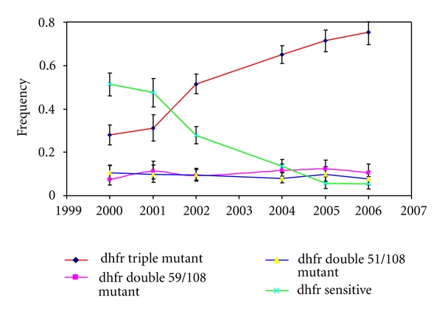
Kilombero Ulanga
Malisa et al 2011
Notes:
Example from Tanzania molecular surveillance in community surveys when SP replaced CQ as firstline treatment for malaria in 2001.

Slide 5
dhps mutations: sulphadoxine resistance
Codon Sensitive | 431 Ile (I) ATA | 436 Ser (S) TCT | 437 Ala (A) GCT | 540 Lys (K) AAA | 581 Ala (A) GCG | 613 Ala (A) GCC
Resistant | Val (V) GTA | Ala (A) GCT Cys (C) TGT Phe (F) TTT | Gly (G) GGT | Glu (E) GAA | Gly (G) GGG | Ser (S) TCC Thr (T) ACC
Codon | 431 | 436 | 437 | 540 | 581 | 613
sensitive | Ile (I) | Ser (S) | Ala (A) | Lys (K) | Ala (A) | Ala (A)
double mutant |  |  | Gly (G) | Glu (E)
triple mutant |  |  | Gly (G) | Glu (E) | Gly (G)
437 mutant |  |  | Gly (G)
436+437 mutant |  | Ala (A) | Gly (G)
EAST AFRICA
WEST and CENTRAL
AFRICA

Slide 6
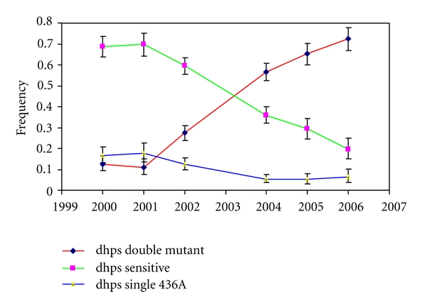
Kilombero Ulanga
Malisa et al 2011
Notes:
Tanzanian example rapid increase year on year after SP became firstline treatment in 2001.

Slide 7
Increase was associated with diminishing SP efficacy
Data from Khatib et al 2012 and Malisa et al 2010 and 2011
Notes:
Increase was associated with diminishing SP efficacy

Slide 8
dhps 540 mutation , broad regional differences in distribution
Notes:
This is 540 in surveys since 2010 –recent picture.
East West division still apparent.

Slide 9
dhps 581 mutation
4 primary foci
Notes:
There is more heterogeneity in 581 mutation
Foci in east Africa 540 with 581 associated with failure in IPTi and IPTp
New emergence of 581 in West AFrica
Admin area level1 are more useful to capture geographic variation

Slide 10
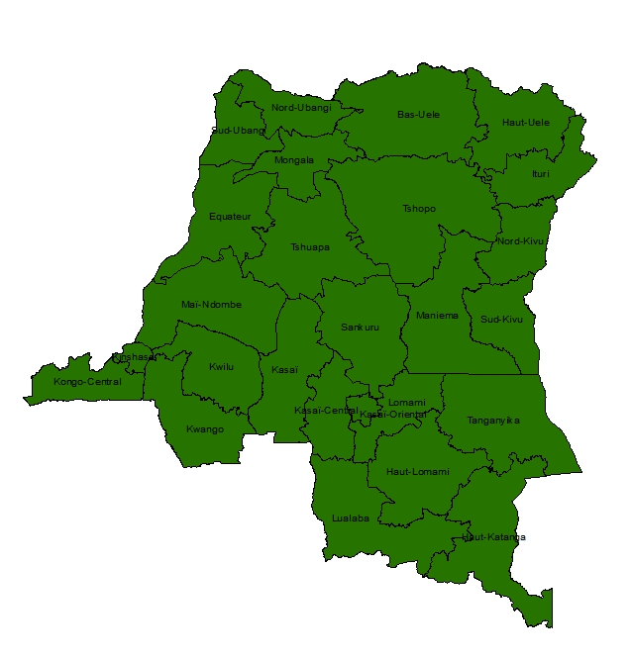
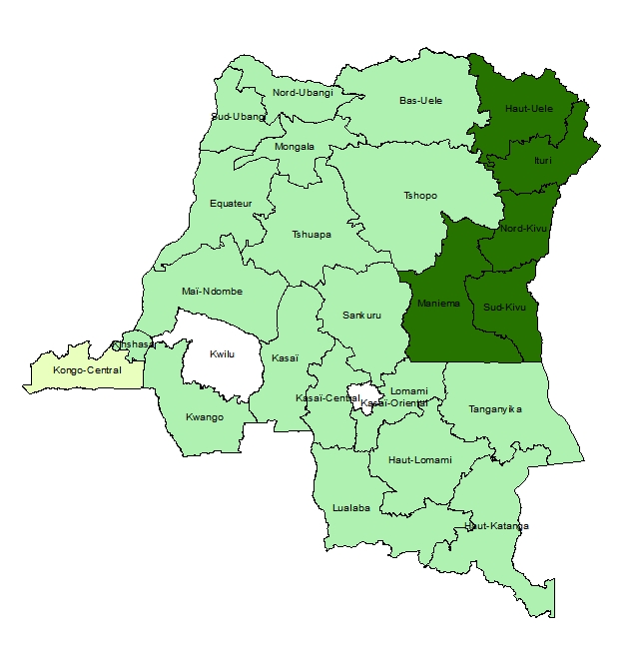
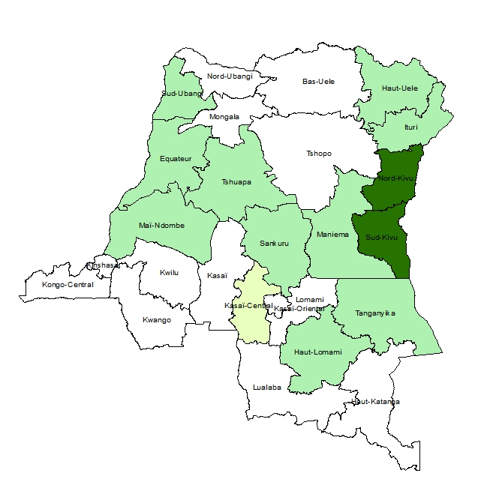
The primary determinants of SP resistance in Africa. Illustrative example DRC 2013-2014
dhfr triple
dhps 540
dhps 581
0
0 – 0.1
0.1 - 0.5
0.5 - 1
Illustrative example DRC 2013-2014
(figure; van Lenthe 2019, data; Aydemir 2018).
Notes:
Example DRC

Slide 11
Level 1 administrative areas
with
dhps 540 prevalence surveyed
2010-present.
Notes:
Looking at Admin level 1 areas where there is available data ….
Requires more structured approach to surveillance?

Slide 12
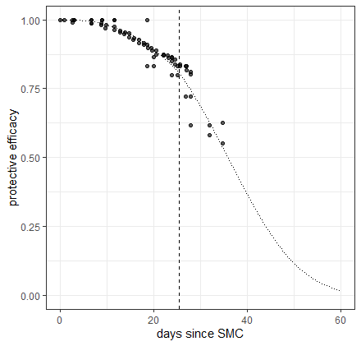
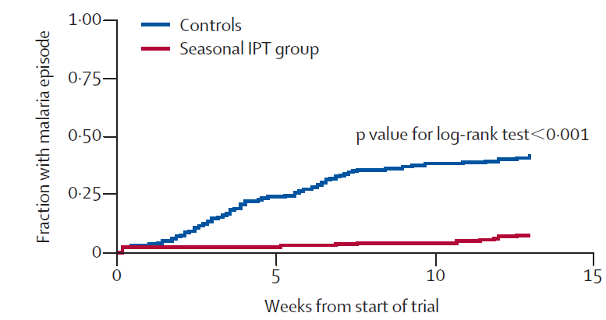
Analysing effect of resistance on protective efficacy: baseline
Duration of protection: SP
Reinfection over time since treatment
(PCR-corrected)
Drug protection profile
Cuomo-Dannenburg, Okell 2020 in prep
Cisse 2006 Lancet
Probability of protection
Probability clinical malaria
time
Days given SP
days

Slide 13
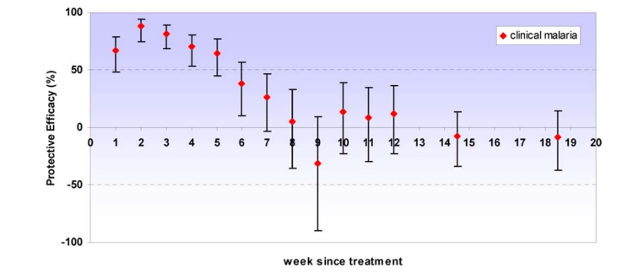
Duration of protection from SP
Cairns 2009 PLoS ONE
IPTi efficacy depends on local prevalence of dhfr and dhps mutations
Griffin 2010 PLoS ONE

Slide 14
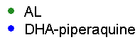
Duration of protection: amodiaquine
Assume constant incidence, multiplied by probability of protection at each time step.
Fit model within Bayesian framework
PCR-corrected reinfections. Reinfection rate depends on EIR, drug protection & age
Blue = AL
Green = AS-AQ
AS-AQ
AL
Bretscher, Okell 2020 BMC Med. AL vs AS-AQ. WWARN IPD meta-analysis

Slide 15
Duration of protection: amodiaquine by resistance markers
Mutation prevalence effect on duration of protection by AQ
Mean duration = 9-18 days
Bretscher, Okell 2020 BMC Med. AL vs AS-AQ

Slide 16
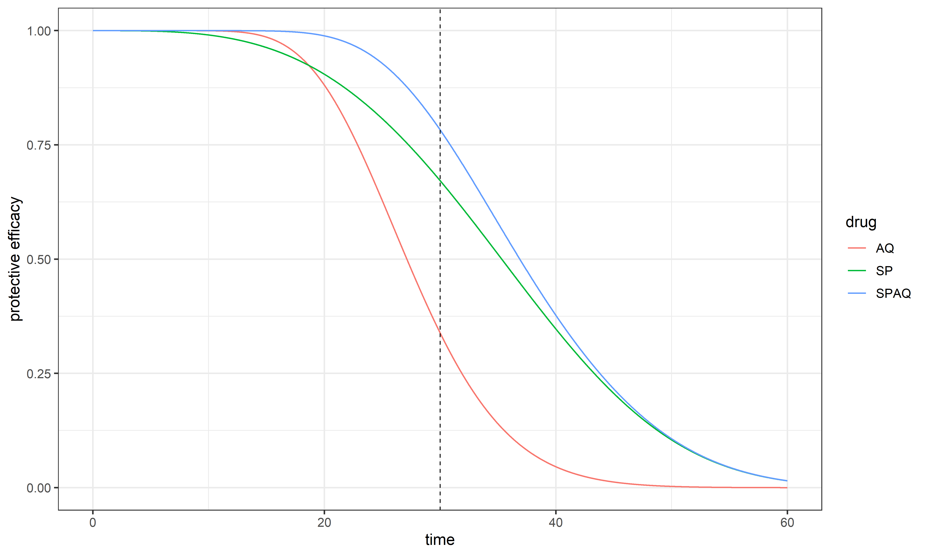
Predictions of IPTi and SMC efficacy according to local prevalence of molecular markers
Protective efficacy
time
Disentangling SP and AQ protection
(Cuomo-Dannenburg unpublished)
Predictions of IPTi and SMC efficacy according to local resistance

Slide 17
Acknowledgements

Slide 18
Trends in AQ-resistance-associated mutations

Slide 19
dhps mutations: sulphadoxine resistance
Codon Sensitive | 431 Ile (I) ATA | 436 Ser (S) TCT | 437 Ala (A) GCT | 540 Lys (K) AAA | 581 Ala (A) GCG | 613 Ala (A) GCC
Resistant | Val (V) GTA | Ala (A) GCT Cys (C) TGT Phe (F) TTT | Gly (G) GGT | Glu (E) GAA | Gly (G) GGG | Ser (S) TCC Thr (T) ACC
Codon | 431 | 436 | 437 | 540 | 581 | 613
sensitive | Ile (I) | Ser (S) | Ala (A) | Lys (K) | Ala (A) | Ala (A)
437 mutant |  |  | Gly (G)
436+437 mutant |  | Ala (A) | Gly (G)
Triple mutant |  | Ala (A) | Gly (G) |  | Gly (G)
Quadruple | Val (V) | Ala (A) | Gly (G) |  | Gly (G)
VAKGS | Val (V) | Ala (A) | Gly (G) |  | Gly (G) | Ser (S)
WEST and CENTRAL
AFRICA
Notes:
Particularly in the light of the newly emerging 581 withour 540 in West Africa….. Which the some of the talks to follow in this session will be reporting on.

Slide 20
Analysis plan
Combining data from different sources using a Bayesian approach:
1) Estimate efficacy at clearance using data from clinical trials where molecular markers and efficacy measured at the same time (Picot et al)
2) Include ecological analysis within the model by matching nearby molecular surveys with clearance efficacy data
3) Duration of protection: from trials plus protective efficacy during IPTi and IPTc studies.
Impute missing data where possible e.g. PCR correction, mutations that were not measured.

