Slide 1
REDUCING THE COST OF SMC
SMC ANNUAL REVIEW & PLANNING MEETING
1st - 3rd Mars 2022
Presented by :
Dr Dorothy Achu,
Permanent Secretary
NMCP Cameroon

Slide 2
PLAN
Introduction
Drivers of cost in SMC
Cost trends with current strategy
Perspectives to reduce cost

Slide 3
INTRODUCTION
SMC implementation started in a project mode with high costs related to training, M&E and research but has been scaled up into national strategies requiring more cost-effective approaches
Funding for SMC as for other malaria interventions has not inceased significantly over the past 10 years meanwhile guidelines for SMC are becoming more flexible requiring coverage of more geographic zones (longer seasons) and other age-groups at risk
Although SPAQ still remains effective in several countries, the increase in the prevalence of resistance markers may lead to reduce efficacy of the drug and thus requiring new drugs which are more expensive

Slide 4
DRIVERS OF COSTS
Number of actors (training and payment)
Number of cycles
Duration of each cycle
Strategy (door-to-door vs fixed) – DOT
Supervision
Additional material (chalk, cards, markers, cups, spoons….)

Slide 5
COST TRENDS WITH CURRENT STRATEGY
Year | 2016 | 2017 | 2018 | 2020 | 2021
Number Eligible Districts* | 45 | 45 | 45 | 45 | 46
Number of cycles | 3 | 4 | 4 | 4 | 4
Target | 1,387,534 | 1,549,250 | 1,611,831 | 1,684,428 | 1,724,859
Total funded (USD) | 3,889,166 | 5,114,204 | 5,259,300 | 4,279,675 | 3,459,995
Cost per child treated | 2.8 | 3.3 | 3.3 | 2.5 | 2.0

Slide 6
PERSPECTIVES TO REDUCE COST: ROUTINE MODE
12 health districts
Mobilization and distribution will be carried out by the existing CHW assisted by a distributor depending on his/her workload
Door-to-door distribution that will last four to seven days (depending on the number of CHWs and the target catchment population) – DOT on first dose
50 eligible children to be treated per day
Mobilization / children enumeration
Carried out only in cycle 1 and will last 5 days
The CHW will update of the household count (regular activity of CHWs), with inclusion the number of children aged 3 to 59 months counted
Supervision
The health district, health areas and health facility staff will lead the supervision of CHWs (fewer proximity supervisors)

Slide 7
ADVANTAGES OF THE ROUTINE SMC
Strengthening the ownership of the SMC by the health districts and local communities for sustainability
Implementation of SMC beyond four months for health district long transmission period, with minimum operations and affordable costs
Strengthening malaria case management during SMC: CHWs will be able to screen and treat malaria cases in febrile children during household visits
Payment of actors is facilitated: since the CHWs are already registered in the payment system,
The reduction of the number of actors leads to a reduction of the cost the SMC

Slide 8
BUDGET CAMPAIGN VS BUDGET ROUTINE
CAMPAIGN 2021
CAMPAIGN + ROUTINE 2022
Total Budget: US $ 3,459,995
Total budget: US $ 3,170,818
With consideration of 5 cycles in 3 health districts
Final budget will show up the gain of the routine strategy

Slide 9
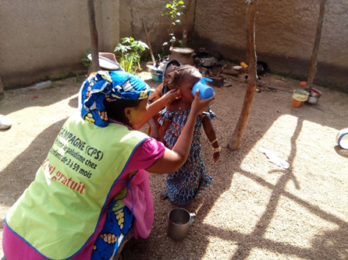
THANKS

