Slide 1
Measuring effectiveness of SPAQ
Issaka Sagara, MD, PhD
MRTC, Mali
SMC Alliance review and planning 2022
02 March 2022

Slide 2
Molecular markers of resistance to SP and AQ: results of large-scale surveys 2016,2018 (ACCESS-SMC)
How drug resistance will affect SMC preventive efficacy
Methods of measuring SMC effectiveness

Slide 3
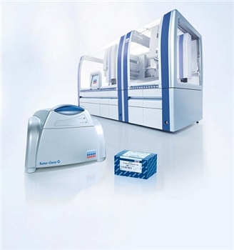
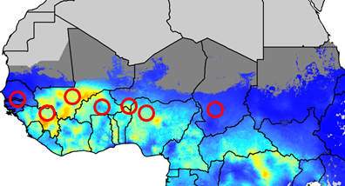
Surveys to monitor molecular markers of AQ and SP Resistance
Community surveys in 7 countries:
2016, before introduction of SMC (except Gambia which started SMC in 2014)
2018, after 2 years of SMC
Two age groups: 2000 children eligible for SMC (3-59 months)
2000 individuals aged 10-30 years, too old for SMC
Probability sampling, all eligible residents in selected households included
Questionnaire including recent antimalarial intake
Total 28,000 samples at baseline and 28,000 post-intervention
Parasite detection by PCR, typing for resistance markers in positive samples
DNA extraction using robotic platform
Pfcrt genotyping using real-time PCR
CVMNK, CVIET
Direct sequencing
Pfmdr1 (86 and 184)
Pfdhfr ( 51, 59 and 108)
Pfdhps (431, 436, 437, 540, 581 and 613)
2015
2016
SMC
2017
SMC
2018
SMC

Slide 4
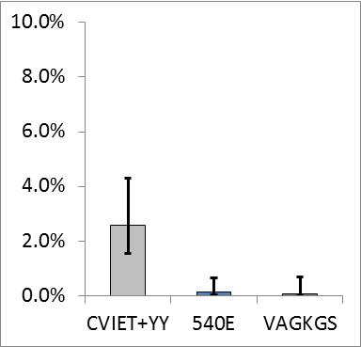
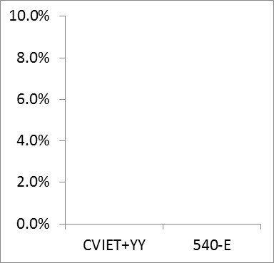
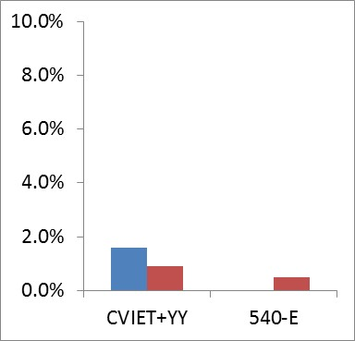
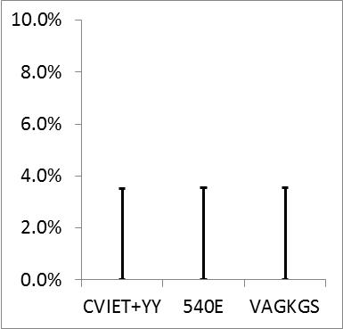
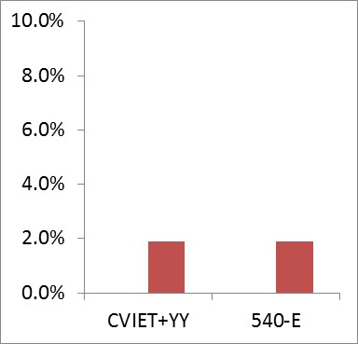
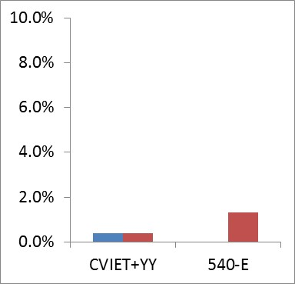
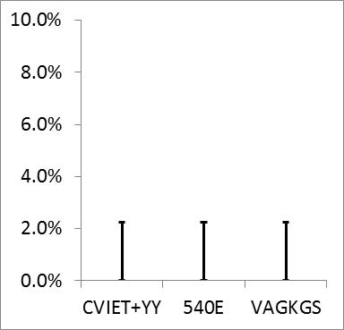
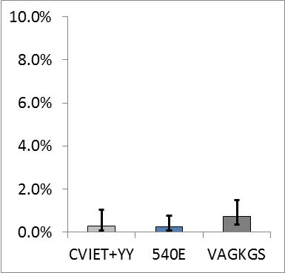
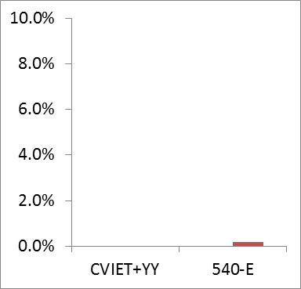
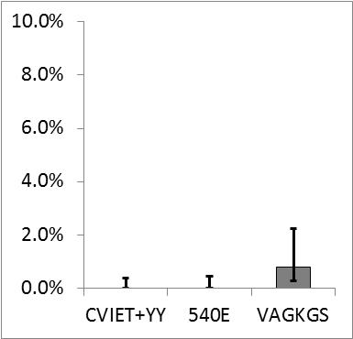
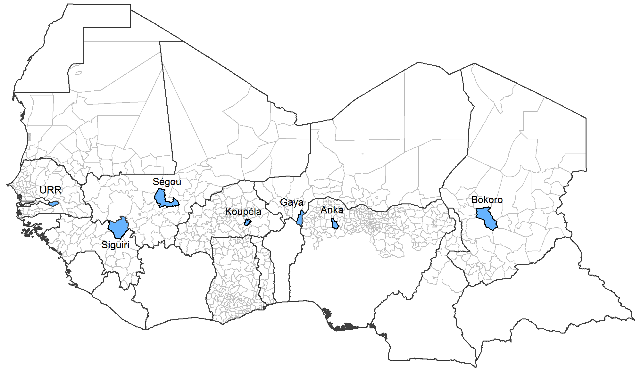
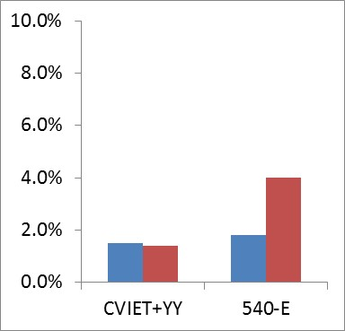
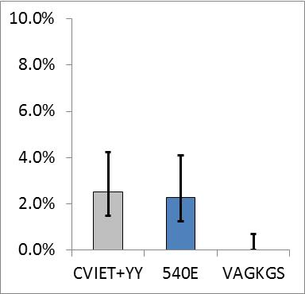
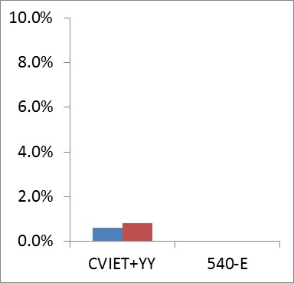
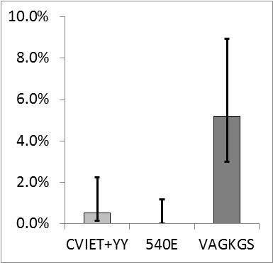
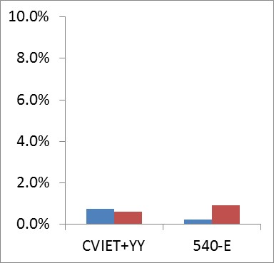
ACCESS-SMC partnership (2020) Lancet 396: 1829–40
8.0%
25%
24%
2016
2018
27%
2.9%
All countries combined
16%
Prevalence of molecular markers of resistance to SMC drugs in the 10-30 age group.
Amodiaquine resistance (prevalence of the combination pfcrt-CVIET+pfmdr1-86Y+pfmdr1-184Y),
and SP resistance (prevalence of the mutation pfdhps-540E).
Key markers uncommon but clear evidence of increase in markers of SP resistance.

Slide 5
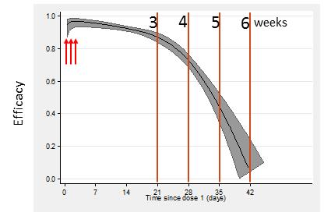
SMC with SP+AQ provides a high degree of protection for about 28 days
Resistance, when it appears, is likely to manifest as a shortening of the duration of protection
#

Slide 6
Infection can occur when the drug concentration falls below the Minimum Inhibitory Concentration (MIC)
Resistance increases the MIC and shortens the duration of prophylaxis
Drugs with a long, flat tail to the concentration curve (e.g. piperaquine) will exhibit more rapid shortening of prophylaxis.
Notes:
As the concentration of a slowly eliminated antimalarial in the blood declines, it continues to suppress the growth of newly acquired infections as
they emerge from the liver. Eventually, however, concentrations fall below the minimum inhibitory concentration (MIC) for the prevalent parasites, and parasite expansion is possible. It follows, then, that the duration of prophylaxis (i.e., the length of time after an antimalarial treatment dose for which newly acquired infections are suppressed) is determined by the concentrations of the drugs used (determined by dose and pharmacokinetics) and the sensitivity of the prevalent
parasites. The more resistant the parasites are, the shorter is the duration of prophylaxis.

Slide 7
Methods of measuring effectiveness of SMC drugs:
1. Randomized controlled trial
  Estimates incidence rate ratio; measures % protection, profile (duration) of protection over time
2. Case control study
  Estimates incidence rate ratio; measures % protection, profile (duration) of protection over time
3. Parasite clearance study
  Measures ability of the drugs to clear parasitaemia, in children with asymptomatic infection
Notes:
RCT: Gold standard method but may be challenged ethically. Sample size: depends on incidence rate (about 1000-2000?).
Case control study: requires care in selection of controls and adjust for confounders. Sample size: about 300 cases and 600 controls.
Measures biological effect of drugs in clearing parasitaemia (but does not measure prophylactic effect). Sample size: about 200 infected individuals.

Slide 8
SMC Efficacy: Case control studies
Efficacy (% reduction in incidence) estimated <28 days and 29-41 days after SMC, relative to no SMC or SMC more than 6 weeks ago
Cases: children under 5yrs presenting at the clinic with fever and malaria (P.falciparum) infection confirmed by microscopy
Home visit to complete questionnaire and ask about SMC treatments
From the same neighbourhood, the same day, two control children recruited for each case
Dates of SMC treatments that year determined from SMC card, from caregiver recall, and from administration records
Information collected on potential confounders (e.g. bednet use, caregiver wealth and education)
<28 days
29-41 days
42+ days
Notes:
Is SMC efficacy as good in routine use as in ideal conditions of clinical trials? If administration is not well supervised efficacy could be affected by poor administration, poor adherence, drug quality issues, etc. So it is important to measure efficacy in routine programmes. Also, SMC will select for resistance, we don’t know how soon this will happen, efficacy monitoring is important to provide early warning of loss of efficacy. Case control studies are used to determine the protective efficacy of vaccines and other preventive interventions used in public health programmes.
It is not ethically acceptable to compare malaria incidence in treated and untreated children in a cohort study, but it is possible to determine efficacy by noting that children who develop malaria are less likely to have received SMC than children who remain free of malaria, so by comparing the proportion of malaria cases who had received SMC in the previous 4 weeks, with the proportion of children in the general population (the controls) who had received SMC in the previous 4 weeks, the protective efficacy can be calculated.

Slide 9
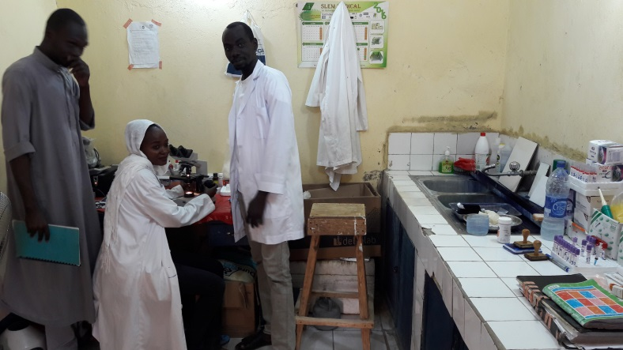
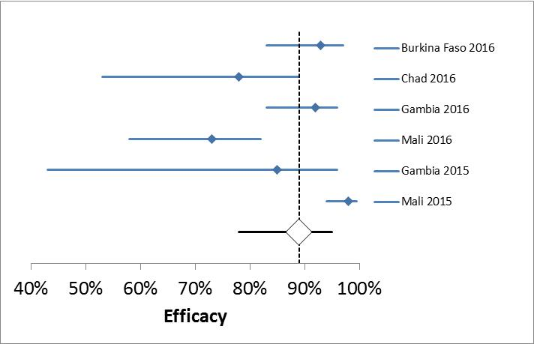
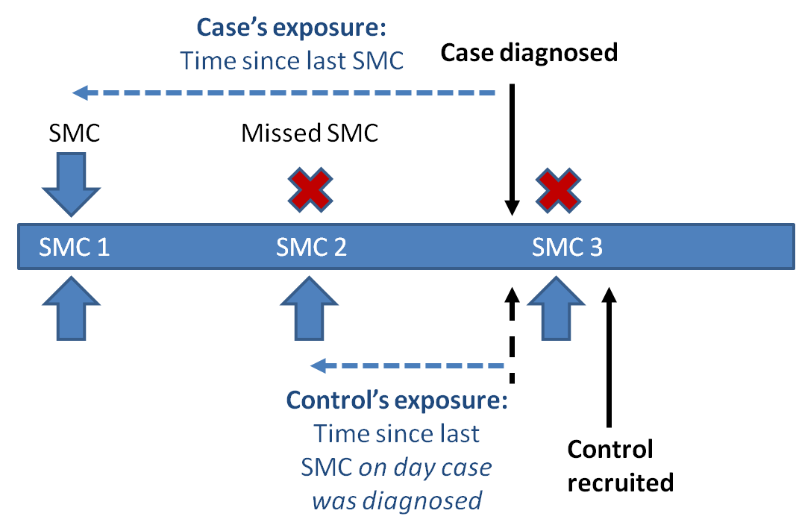
Efficacy: case-control method
Hilé Hudjaj health centre, N’Djamena
Efficacy of monthly treatments:
89% (95%CI 78%,95%) up to 4 weeks
62% (95%CI 46%, 73%) in weeks 5-6
no protection after 6 weeks
Notes:
In clinical trials the efficacy of monthly treatment, over the 4 weeks from treatment, was about 90%. Efficacy in routine programmes can be lower if the process is not well supervised, so case control studies are used to measure the efficacy in practice. A series of these were completed, showing a very high degree of efficacy over 4 weeks and, in line with what we know about these drugs, much lower efficacy in the next 5-6 weeks and then no protection after 6 weeks. Agrees with high adherence observed in surveys.

Slide 10
Efficacy results
 | Cases | Controls
2016:
Burkina Faso | 459 | 918
Chad | 199 | 398
The Gambia | 248 | 497
Mali | 341 | 682
2015:
The Gambia | 226 | 451
Mali | 252 | 504
Notes:
Overall estimate 89% efficacy over 28 days, declining rapidly after this period, similar to that observed in clinical trials

Slide 11
In vivo treatment efficacy of SP + AQ during the AZ-SMC trial Project in Bougouni district, Mali
~2000 children < 5 years old (at first of SMC cycle) were screened for P. falciparum infection at the end-of-season survey in 2016 (~9% P. falciparum infection rate)
153 asymptomatic children with P. falciparum infection were recruited and treated with SP+AQ in 3 days as DOT (i.e. 5th SMC cycle) and followed for 28 days

Slide 12
28-day treatment efficacy protocol in children 7 to 63 months old in 2016 in Bougouni district, Mali
Total |  |  | 153 | %95%CI
ACPR | PCR unadjusted |  | 147 | 96.1 (91.5, 98.2)
 | PCR adjusted |  | 152 | 99.3 (95.4, 99.9)
Treatment failures | Early treatment failure |  | 1
 | Late clinical failure |  | 0
 | Late parasitological failure | Recrudescences | 0
 |  | Reinfections | 5
(Cairn et al Plos Med 2020)

Slide 13
In vivo treatment efficacy of SP + AQ during the World Bank scale project in Kadiolo and Tominian districts in 2018 in Mali
1757 children < 5 years old were screened for P. falciparum infection by RDT and then confirmed by microscopy during the SMC distribution by HCWs
171 asymptomatic children with P. falciparum infection by microscopy were recruited and treated with SP+AQ in 3 days as DOT and followed for 28 days

Slide 14
28-day treatment efficacy protocol in children< 5 years old in 2018 in Kadiolo and Tominian district, Mali
Outcomes | Kadiolo n=86 (%) | Tominian n=85 (%) | Total N=171(%)
ETF(%) | 2 (2.3) | 5 (5.9) | 7 (3.2)
LCF(%) | 0 | 0 | 0
LPF(%) | 4 (4.6) | 12 (14.1) | 16 (9.2)
ACPR(%) | 82 (95.3) | 68 (80.0%) | 148 (86.5)
Molecular correction (n=21)
Recrudescence | 0/5 | 1/16 (6.3%) | 1/21 (4.8%)
New infection | 5/5 (100%) | 15/16 (93.8%) | 20/21 (95.2%)
Molecular corrected ACPR(%) | 86 (100) | 84(98.8%) | 170 (99.4)
Notes:
(World Bank funded study, unpublished)

Slide 15



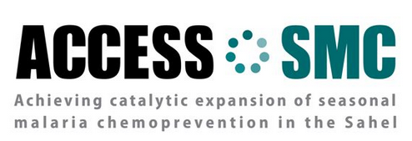

Acknowledgments
Burkina Faso: IRSS, PNLP, MC
Chad: CSSI, PNLP, MC
Gambia: MRC, NMCP, CRS
Guinea: UGANC, PNLP, CRS
Mali: MRTC, PNLP, CRS
Niger: CERMES, EpiCentre, PNLP, CRS
Nigeria: ERIC, JEDIMA, NMEP, MC
Senegal: UCAD, PNLP
SMC Working group: C Rwagacondo, M-R Fabry, H Jakou, M Kalleh, JL Ndiaye, P Batienon
WHO/TDR; WHO Safety and Vigilance; CAPM Rabat; WHO GMP
CRS
MC
LSHTM
UNITAID
World Bank

