Slide 1
Chemoprevention efficacy studies (CPES)
Charlotte Rasmussen
Pascal Ringwald

Slide 2
Context
Guidelines for chemoprevention interventions are currently being reviewed
Use of chemoprevention is likely to be further expanded in coming years
In some countries there has a relatively low uptake of chemoprevention; one of the reasons sited is concerns over resistance and efficacy

Slide 3
Drug efficacy
Drug efficacy: Capacity of an antimalarial medicine to achieve the therapeutic objective when administered at a recommended dose, which is well tolerated and has minimal toxicity
Poor drug quality
Comorbidities
Poor adherence
Immunity
Drug efficacy
Incorrect dosage
Resistance
Pharma-cokinetics
Factors affecting efficacy

Slide 4
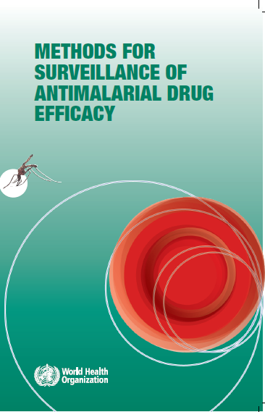
Efficacy studies
Therapeutic Efficacy Studies (TES)
Follow-up and procedures in accordance with standard protocol
Gold standard for monitoring treatment efficacy to inform treatment policy
Follow-up group of patients with uncomplicated malaria to monitor treatment outcome
WHO recommends that TES are done in sentinel sites at least once every 2 years
Supplemented by information on molecular markers of resistance
Information on treatment efficacy cannot be used as a surrogate for chemoprevention efficacy
Molecular markers of drug resistance are a useful but imperfect tool of predicting the efficacy of chemoprevention strategies
Need to establish a standard protocol to monitor efficacy of chemoprevention

Slide 5
Draft CPES protocol
Key requirements of a protocol to study chemoprevention efficacy | Provide information on the parasitaemia during follow-up period Collect data comparable across location and time of a good enough quality to inform policy Studies that can be done on a routine basis
Study population | Individuals with no malaria symptoms eligible for a given chemoprevention as per the recommendations
Site section criteria include | Sufficient number of individuals targeted for the chemoprevention intervention in the site to make reaching a targeted sample size feasible Trained, motivated personnel capable of recruiting and following up study participants, collecting samples and providing malaria treatment as needed Availability of facilities to store samples and supplies securely, and stain slides Information on the local epidemiology of malaria
Main study outcome | Study participants identified with asexual parasitaemia by microscopy during follow-up period from day 4 to day 28/42
Additional study outcomes include | Days to reported failure Prevalence of molecular marker(s) of resistance to chemoprevention drug(s) at Day 0 and in any parasites detected after Day 4

Slide 6
Key aspects of the draft CPES protocol
0
1
2
7
14
21
28
DAYS
Follow-ups
Clinical malaria | Study participant identified as having malaria at enrolment or during follow-up, must receive treatment as per the national treatment guidelines
Supervision of treatment | All medicine must be given under direct supervision
Follow-up period | 28/42 days after start of chemoprevention administration with a drug with a short half-life
Days of participant follow-up | Weekly follow-up days (Days 7, 14, 21, 28..) + any day that study participants have symptoms
Reinfection/ recrudescence markers | Blood collected on day 0 and day of failure to be analysed for markers of new infection /recrudescence
Drug resistance markers | Analysis of markers of drug resistance in DBS collected on day 0 for study participants with parasitaemia Analysis of markers of drug resistance in DBS collected for study participants with parasitaemia during follow-up
.

Slide 7
System of resistance and efficacy surveillance
Drug | Molecular markers
 | Gene | Mutation
4-aminoquinolines
Chloroquine | Pfcrt | K76T + different sets of mutations at other codons (including C72S, M74I, N75E, A220S, Q271E, N326S, I356T and R371I)
 | Pfmdr1 (in combination with Pfcrt mutations only) | N86Y, Y184F, S1034C, N1042D and D1246Y
Amodiaquine (mannich base) | Yet to be validated | Studies show that amodiaquine selects for Pfmdr1 mutations
Piperaquine | Pfpm2–3 Pfcrt | Pfpm2–3 increased copy number Detected in vivo: T93S, H97Y, F145I, I218F, C350R Detected in vitro: T93S, H97Y, F145I, I218F, M343L, G353V
Antifolates
Pyrimethamine | Pfdhfr | N51I, C59R, S108N and I164L
Sulfadoxine | Pfdhps | S436A/F, A437G, K540E, A581G and A613T/S
Proguanil | Pfdhfr | A16V, N51I, C59R, S108N and I164L
Amino-alcohols
Lumefantrine | Yet to be validated | Studies show that lumefantrine selects for Pfmdr1 mutations (N86)
Mefloquine | Pfmdr1 | Pfmdr1 increased copy number
Quinine | Yet to be validated
Mannich base
Pyronaridine | Yet to be validated
Naphthoquinone
Atovaquone | Pfcytb | Y268N/S/C
Sesquiterpene lactones
Artemisinin and its derivatives | PfK13 | List of candidate and validated markers developed
Chemoprevention efficacy surveillance needs to be part of a wider system of resistance and efficacy surveillance that also includes:
Surveillance of molecular markers
Therapeutic efficacy studies

Slide 8
Next steps
Partners are planning to implement studies of chemoprevention efficacy
Lessons learned from these studies and well work ongoing with statisticians will be used to adjust the protocol
An updated document on surveillance of antimalarial drug efficacy is planned this year and will include:
Therapeutic efficacy studies
Integrated drug efficacy studies, and
Chemoprevention efficacy studies.

