Slide 1





Facilitators and Barriers to Uptake of Seasonal Malaria Chemoprevention (SMC) in Nigeria:
A Qualitative Approach
Conducted By
National Malaria Elimination Programme, Nigeria
In
Collaboration

Slide 2
Study Objectives
Aim is to determine facilitators and barriers to uptake of SMC among children aged 3-59months in selected States in Nigeria
Specifically,
  knowledge of malaria whether it affects uptake of SMC, and to examine
  perceived effect of SMC on their children's health,
  experiences and attitudes of caregivers concerning the concept of SMC,
  experiences and attitudes of caregivers concerning the regimen of the chemoprevention
  preferred mode of delivery/place of administration of SMC by caregivers
  health workers’ attitudes and experiences regarding delivery of SMC
  to determine if (ii)-(vi) above affects uptake of SMC
Our Vision - a malaria free Nigeria; Our goal – to reduce malaria burden to pre-elimination levels and bring malaria-related mortality to zero

Slide 3
Methodology
Purposively selected 5 States:
  Kano, Kebbi, Kwara, Nasarawa & Yobe
  Two LGAs in each State
  Two Wards/Communities in each LGA
  Based on performance in SMC in last round
Study Population:
  Caregivers-mothers, fathers, guardians
  Community-Directed Distributors (CDDs), LM, CM
  Community Leaders
  LGA Malaria Focal Person
  Director of Public Health/Disease Control and Malaria Programme Manager
National Programme Officers/Partners:
  National Coordinator NMEP, Malaria Consortium, WHO, PMI, GF
Our Vision - a malaria free Nigeria; Our goal – to reduce malaria burden to pre-elimination levels and bring malaria-related mortality to zero

Slide 4
Methodology
Data Collection:
Key Informant Interviews
In-Depth Interviews
Focus Group Discussions
FGDs conducted in local languages (Hausa/Yoruba) translated into English and transcribed verbatim
Interviews conducted in local language or English
State | FGDs | In-depth interviews | Total
Kano | 16 | 24 | 40
Kebbi | 16 | 20 | 36
Kwara | 16 | 20 | 36
Nasarawa | 16 | 21 | 37
Yobe | 16 | 20 | 36
Key Informant Interviews (National level/Partners) |  |  | 5
Total (FGDs & IDIs) | 80 | 105 | 185
Total (FGDs, IDIs & KII) |  | 105 | 190
Our Vision - a malaria free Nigeria; Our goal – to reduce malaria burden to pre-elimination levels and bring malaria-related mortality to zero

Slide 5
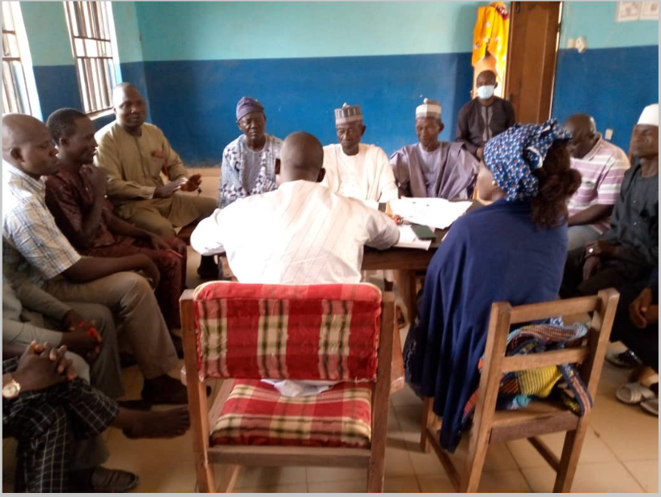
Methodology
Data Analysis
Content Analysis and Thematic Analysis
Ten Thematic Areas identified
Narration of the results produced
Our Vision - a malaria free Nigeria; Our goal – to reduce malaria burden to pre-elimination levels and bring malaria-related mortality to zero

Slide 6
Results
Ten Thematic Areas Identified from Analysis:
Major health problems in the communities;
Knowledge of Seasonal Malaria Chemoprevention (SMC) among caregivers;
Extent of SMC’s coverage;
Knowledge of malaria among caregivers and its effect on SMC uptake;
Perceived effects of SMC on children’s health among caregivers;
Caregivers’ experience of and attitude towards SMC;
Barriers to SMC uptake;
Caregivers preferred mode of delivery/place of administration;
Health workers/CDDs experience and attitude regarding delivery of SMC;
Recommendations on how to upscale SMC Uptake
Our Vision - a malaria free Nigeria; Our goal – to reduce malaria burden to pre-elimination levels and bring malaria-related mortality to zero

Slide 7
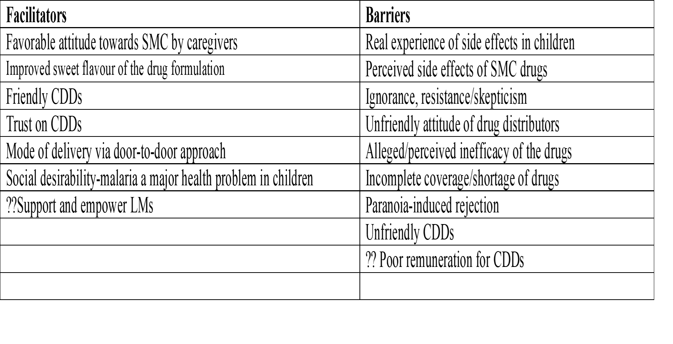
Summary of Facilitators and Barriers
Our Vision - a malaria free Nigeria; Our goal – to reduce malaria burden to pre-elimination levels and bring malaria-related mortality to zero

Slide 8
Other Related Issues
Logistics challenges; attendant sheet shortage; delay in getting tally sheet and requisition;
Issues related to credibility of Recruitment Process for CDDs
Dissatisfaction with Remuneration for CDDs, LMs, CMs
Identified barriers include:
perceived side effects, ignorance, negative attitudes of CDDs, alleged inefficacy of the drugs, incomplete coverage/shortage of drugs
Identified facilitators include:
mode of delivery of drug, favorable attitude towards SMC by caregivers, positive attitudes of the CDDs
Our Vision - a malaria free Nigeria; Our goal – to reduce malaria burden to pre-elimination levels and bring malaria-related mortality to zero

Slide 9
Conclusions
Widespread acceptance of SMC
Isolated cases of rejection/hesitancy
Isolated cases of missed households/children
Isolated cases of hard-to-reach areas
Identified several facilitators and barriers: perceived side effects, ignorance, attitude of CDDs, alleged inefficacy of the drugs, incomplete coverage/shortage of drugs, mode of delivery of drug and social desirability of campaign
Our Vision - a malaria free Nigeria; Our goal – to reduce malaria burden to pre-elimination levels and bring malaria-related mortality to zero

Slide 10
Recommendations
Address the concerns of the caregivers/programme managers with respect to:
Perceived side effects of the SMC,
Ignorance/skepticisms about SMC,
Shortage of drugs and logistical challenges
Negative attitudes of the CDDs
Strengthen delivery of SMC via house-to-house campaign and
Motivate and support the CDDs to ensure continued trust by the communities
Our Vision - a malaria free Nigeria; Our goal – to reduce malaria burden to pre-elimination levels and bring malaria-related mortality to zero

Slide 11
Acknowledgements
University Iba Der Thiam of Thies (UIDT)
London School of Hygiene (LSHTM)
Medicines for Malaria Venture (MMV)
World Health Organization (WHO)
European and Developing Countries Clinical Trials Partnership (EDCTP)
Our Vision - a malaria free Nigeria; Our goal – to reduce malaria burden to pre-elimination levels and bring malaria-related mortality to zero

Slide 12
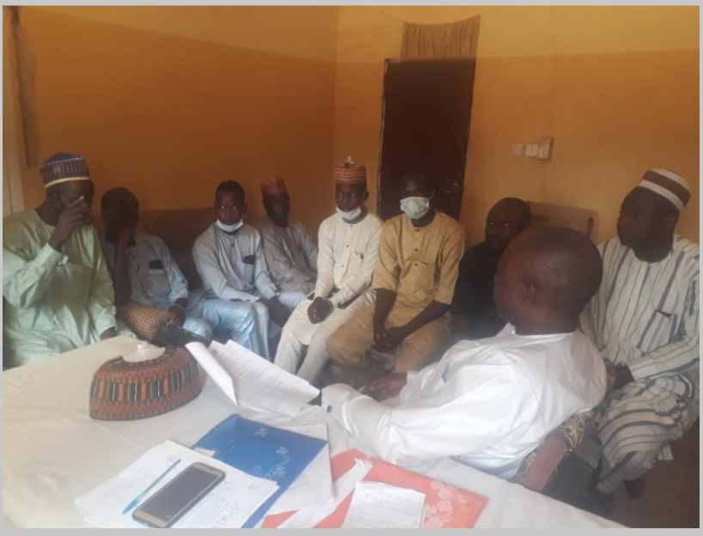

Our Vision - a malaria free Nigeria; Our goal – to reduce malaria burden to pre-elimination levels and bring malaria-related mortality to zero

