Slide 1
Monitoring Seasonal Malaria Chemoprevention and Intermittent Prevention Treatment in pregnant women efficacy through Ante Natal Clinics in South-east Senegal
Prof Jean Louis Ndiaye
SMC alliance annual meeting
March 2nd 2022

Slide 2
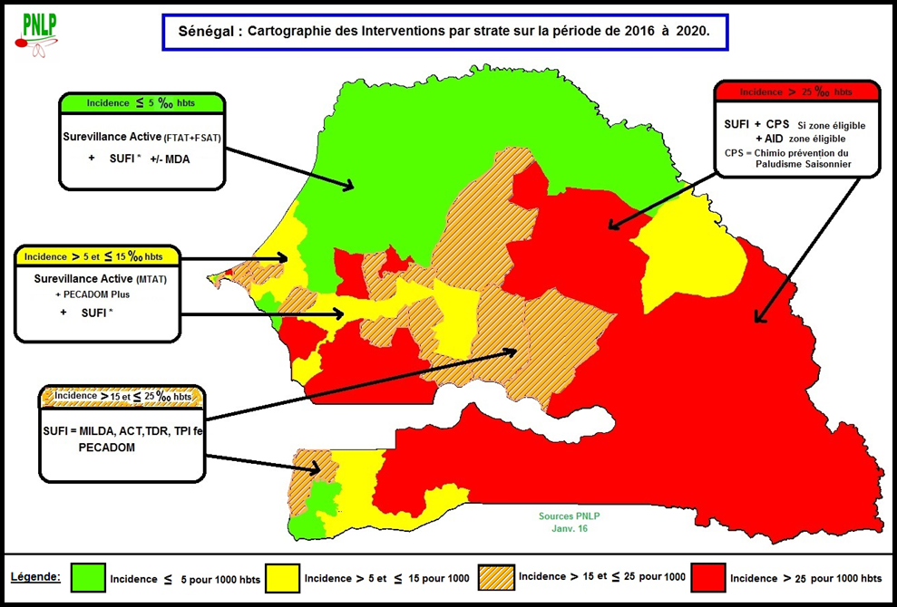
Introduction
Malaria, a major public health problem in south Senegal
Chemopreventive strategies implemented
Children : SMC with SP + AQ since 2014
Pregnant women : IPTp with SP since 2004
Drug pressure = propagation of resistance
Important to carefully monitor the resistance markers
Cross sectional surveys in the general population
costly and need to be repeated periodically
Monitor molecular markers of SP AQ resistance among pregnant women attending ANC ?

Slide 3
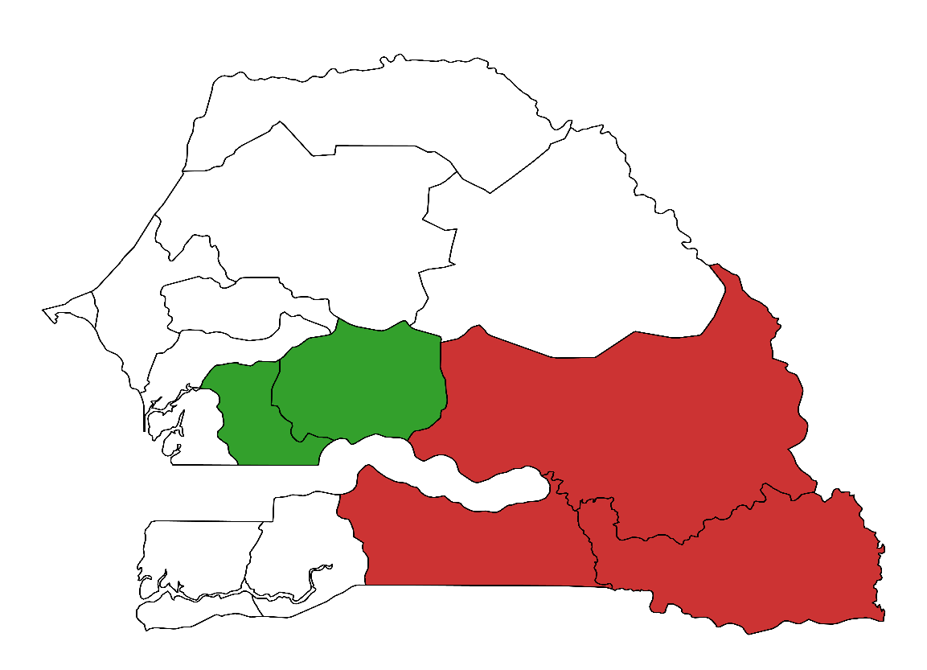
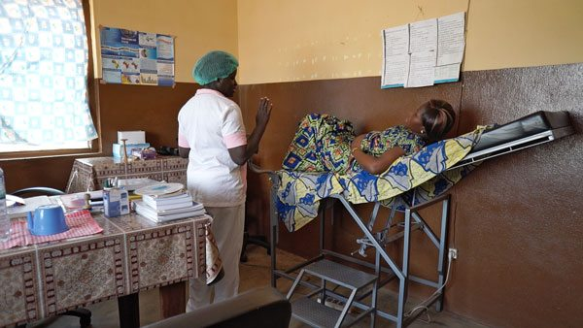
Methodology using ANCs
Cross-sectional surveys in 2018
SMC zones (Tambacounda - Velingara): 4 Health posts
All women who came to ANC with a positive RDT
Cross-sectional surveys in 2019
SMC zones ( Tambacounda Velingara Saraya Kédougou ): 8 Health posts
Non SMC zones (Kaffrine - Ndoffane): 3 Health posts
All women who came to ANC
Lab activities :
RTPCR
HRM
Kaolack
Kaffrine
Tambacounda
Kolda
Kedougou

Slide 4
Distribution of parasite carriage in the study population
A) Depending of gravidity and SP intake
B) Depending of zones and year
 | Total N=1049 | PCR + (%)
Primigravidae | 236 | 148 (62,71)
Multigravidae | 813 | 451 (55,47)
SP - | 399 | 270 (67,67)
SP + | 650 | 329 (50,61)
Year | Positive Tests | SMC Zones (%) | Non SMC Zones (%)
2018 (N=172) | RDT | 100 | NA
 | PCR | 81,4 | NA
2019 (N=878) | RDT | 35 | 0,9
 | PCR | 63,4 | 18,2
Notes:
Var ATS, more sensible

Slide 5
P. falciparum dihydropteroate synthase (Pfdhps) genes between primigravidae and multigravidae
Haplotype | Primigravidae n (%) N=148 | Multigravidae n (%) N=451
S436A-A437G | 10 (6.76) | 22 (4.88)
S436A-A613S | 5 (3.38) | 20 (4.43)
S436A-A581G | 2 (1.35) | 10 (2.22)
A437G-A613S | 3 (2.03) | 6 (1.33)
A581G-A613S | 9 (6.08) | 32 (7.10)
S436A-A437G-A581G | 0 | 1 (0.22)
S436A-A437G-A613S | 5 (3.38) | 14 (3.10)
A437G-A581G-A613S | 4 (2.70) | 14 (3.10)
Notes:
The prevalence of resistance haplotypes found in the dhps gene was very low,

Slide 6
P. falciparum dihydrofolate reductase (Pfdhfr) genes between primigravidae and multigravidae
Haplotype | Prmigravidae n (%) N=148 | Multigravidae n (%) N=451
N51I-C59R | 103 (69.59%) | 292 (64.75%)
S108N-I164L | 0 | 1 (0.22%)
51I-C59R-S108N | 0 | 6 (1.33%)
N51I-C59R-I164L | 13 (8.78%) | 30 (6.65%)
Notes:
while in the dhfr gene there were also low prevalence of all resistant haplotypes except for the IRNL double mutation. For these two genes there was no significant difference between primigravida and multigravida

Slide 7
Evaluation of changes in P. falciparum multidrug resistance gene (Pfmdr1)
A= between primigravidae and multigravidae
B= depending on SP intake
Haplotype | Primi (%) N=148 | Multi (%) N=451
YYND | 31 (20.95) | 40 (8.87)
NFND | 75 (16.63) | 16 (10.81)
YFND | 2 (1.35) | 20 (5.10)
YYDD | 6 (4.05) | 23 (4.84)
Haplotype | SP- N=270 | SP+ N=329 | p-value
YYND | 31 (20.95) | 40 (8.87) | 0.4236
NFND | 75 (16.63) | 16 (10.81)
YFND | 2 (1.35) | 20 (5.10) | 0.0198
YYDD | 6 (4.05) | 23 (4.84)
Notes:
Mdr gene the prevalence were low but there was a significant difference between the primigravida and the multigravida for the YFND and YYDD double mutations (p=0.019).
for the YFND and YYDD double mutations of the mdr gene, the prevalence were higher in those who had taken SP (p=0.019) compared to those who had not taken SP (p=0.019).

Slide 8
Conclusion
Although high use of IPTp & SMC drugs : SP AQ still effective
Absence of the mutation K540E
Absence of the quintuple mutation
Low prevalence of I164L mutation
Regular monitoring is essential
Monitoring can be done during ANCs
Restrict to women for their first ANC

Slide 9
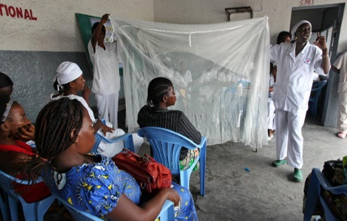
Thank you

Slide 10
Extra slides

Slide 11
Evaluation of changes in P. falciparum dihydropteroate synthase (Pfdhps) depending on SP intake
Haplotype | SP- N=270 | SP+ N=329
S436A-A437G | 17 (6.30%) | 15 (4.56%)
S436A-A613S | 15 (5.56%) | 10 (3.04%)
S436A-A581G | 4 (1.48%) | 8 (2.43%)
A437G-A613S | 4 (1.48%) | 5 (1.52%)
A581G-A613S | 21 (7.78%) | 20 (6.08%)
S436A-A437G-A581G | 1 (0.37%) | 0
S436A-A437G-A613S | 9 (3.33%) | 10 (3.04%)
A437G-A581G-A613S | 6 (2.70%) | 12 (3.65%)

Slide 12
Evaluation of changes in P. falciparum dihydrofolate reductase (Pfdhfr ) depending on SP intake
Haplotype | SP- N=270 | SP+ N=329
N51I-C59R | 188 (69.63%) | 207 (62.92%)
S108N-I164L | 1 (0.37%) | 0
51I-C59R-S108N | 3 (1.11%) | 3 (0.91%)
N51I-C59R-I164L | 24 (8.89%) | 19 (5.78%)

