Slide 1
SMC-IMPACT
UPDATE
The SMC Alliance review and planning meeting 2022
Dr André Tchouatieu - MMV
March 3rd 2022

Slide 2
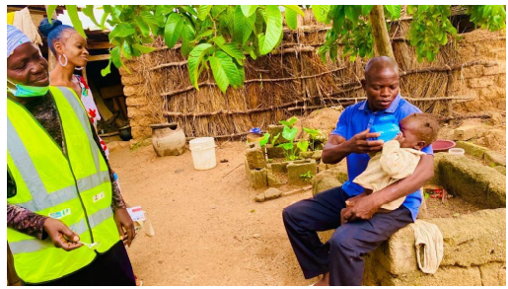
Overview
Background
Areas implementing SMC from 2014-2021
The SMC-IMPACT project
- Objectives
- Project structure
Key achievements in 2021
Main challenges and solution
Way forward

Slide 3
Background
SMC reduced malaria cases during the transmission season by 75%, and severe cases by 75% in clinical trials in children 3-59 months (WHO 2011)
SMC has proved to be very effective in reducing malaria cases and deaths in young children when introduced through national programs (Access-SMC 2020)
From ~1 million children in 2014, about 32 million children (3-59mths) were reached in 2020 in the Sahel region during 3 to 4 months SMC campaign. However, there are still some gaps to cover
Changing environment and epidemiological considerations are increasing SMC demand and may increase SMC potential for malaria control

Slide 4
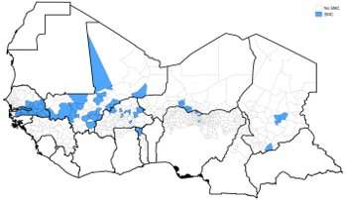
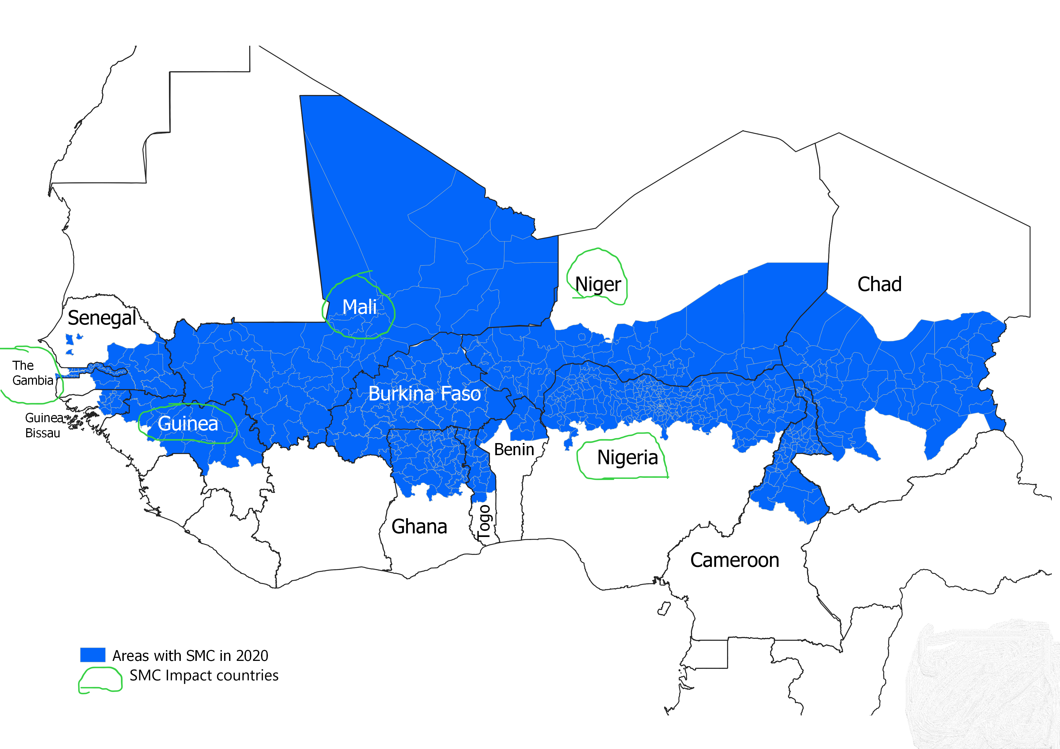
Areas implementing SMC 2014 – 2021
2014
2021

Slide 5
The SMC-IMPACT project : Objectives
Contributing to cover the remaining gaps for the current eligible target
Contribute to the body of evidence about
  Efficacy and cost effectiveness of increasing SMC to 5-10 years old
  Additional impact of adding one month of SMC coverage during the transmission season
Development of SPAQ presentation for 5-10 years old
Contributing to increase knowledge about PyAS (new ACT) and introduction in malaria endemic countries as an alternative therapeutic option

Slide 6
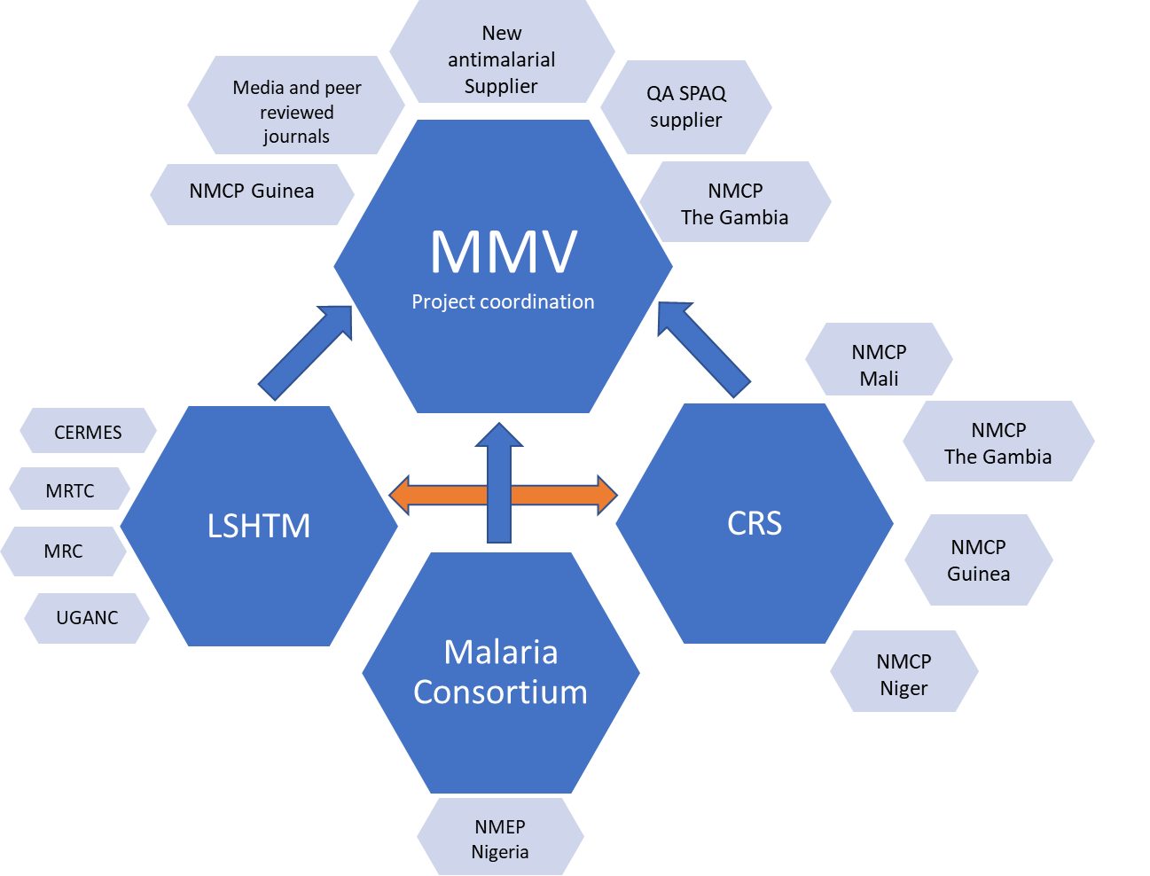





The SMC-IMPACT project structure;
countries and partners
Malaria Consortium, CRS, LSHTM and MMV have worked together in the pass on the Access SMC project to successfully scale up SMC
Confidential – internal use only

Slide 7
Key achievements so far
Project official launch in march 2021
4 countries implemented the IMPACT –SMC project in 2021
Nigeria
  Introduction of SMC in two LGAs in Bauchi State (Ningi and Tafawa Balewa),
Guinea and Mali,
  Pilot extension of SMC to 5 months in Dabola distrit (Guinea) and In Yianfolila and Niena (Mali)
The Gambia
  Inclusion of children 5 – 10 years in URR and CRR

Slide 8
Key achievements so far
In 2021 across The Gambia, Guinea and Mali, the total number of children reached were:
  115,414 aged 3–59 months (5th cycle of SMC)
  22,368 aged 60–119 months
In Nigeria:
  • 271,905 aged 3–59 months in two new LGAs in Bauci state

Slide 9
Two Different Dosages of SPAQ 5-10 yrs
Outcome 4: Quality-assured, higher strength of SPAQ developed
Without centralized WHO guidelines, Senegal and Mali are using different dosages for the same age group >> manufacturers do not have clear indications to develop a product ready for use
 | Mali (2 years pilot) |  |  | Senegal (7 years routine implementation)
Age groups | Day 1 | Day 2 | Day 3 | Day 1 | Day 2 | Day 3
3-11 months | SP (250/12.5mg) AQ (75mg) | AQ (75mg) | AQ (75mg) | SP (250/12.5mg) AQ (75mg) | AQ (75mg) | AQ (75mg)
12-59 months | SP (500/25mg) AQ (150mg) | AQ (150mg) | AQ (150mg) | SP (500/25mg) AQ (150mg) | AQ (150mg) | AQ (150mg)
5-7 years | SP (500/25mg) AQ (225mg) | AQ (225mg) | AQ (225mg) | SP (750/37.5mg) AQ (225mg) | AQ (225mg) | AQ (225mg)
8-10 years | SP (750/37.5mg) AQ (300mg) | AQ (300mg) | AQ (300mg)

Slide 10
Rationale for the Senegalese dosage
The calculation of the weight – age dosing for SPAQ in children 5 -9 years old in Senegal was based on an Anthropometry dataset with 2520 observations from Niakhar 2007. The therapeutic ranges considered for the various drugs are as follows:
  AQ base 10mg/kg, range 7.5 to 15mg/kg
  Sulfadoxine: 25mg/kg: the recommendation considered was that 25mg/kg is minimum rather than median and should not exceed 70mg/kg.
  Pyrimethamine: 1.25 mg/kg range 1.25 – 3.50 mg/kg
AQ
Sulfadoxine
Pyrimethamine

Slide 11
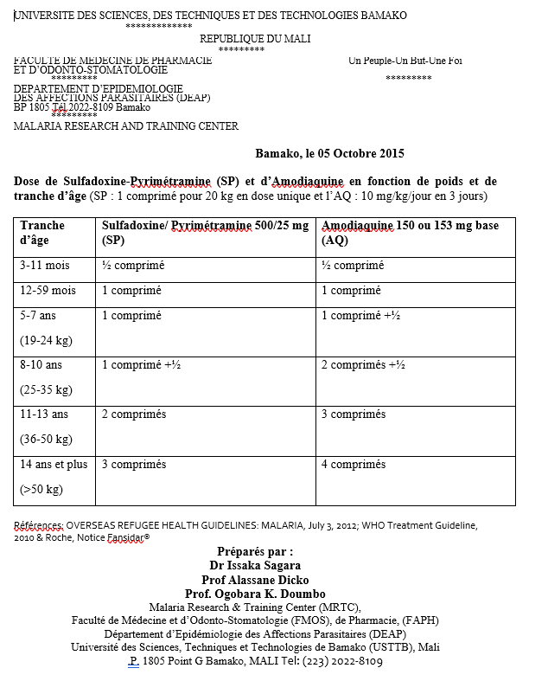
Rationale for the dosage in Mali
Dose per weight
  SP: 1 tab (500/25mg) / 20 kg Design
  AQ: 10mg/kg /d Tab 150 mg
 | Sulfadoxine (mg/kg) | Pyrimethamine (mg/kg) | AQ (mg/kg/day) | AQ (mg/kg/day)
5 – 7 years | 20.8 - 26.3 | 1.04 – 1.31 | 9.37 – 11.84 | 9.37 – 11.84
8 – 10 years | 21.4 – 30 | 1.07 – 1.5 | 10.71 – 15 | 10.71 – 15
Adjustment for the pilot study in Kita and Bafoulabe
5 – 7 years | 20.8 - 26.3 | 1.04 – 1.31 | 9.37 – 11.84
8 – 10 years | 21.4 – 30 | 1.07 – 1.5 | 8.57 – 12
All children remain within the therapeutic margins for AQ and P, but underdosed (<25mg/kg as minimum) for S for the older/heavier children within the groups

Slide 12

Roadmap to a validated SPAQ dosing for 5-10 years old children
MMV
Advisory committee consensus
WHO-GMP
Validation of the consensus and guidelines update
WHO-PQ
Request for expression of interest
Mfrs
WHO-PQ
Formulation development and dossier submission
SPAQ 5-10 years old is prequalified
Internal process between GMP and PQ to be confirmed
Based on existing data, avoiding as much as possible new studies (Pk or others)
No current clarity and precision on the new guidelines process
Manufacturers are ready and have developed prototypes based on the dosage from Senegal

Slide 13
Key achievements so far
Outcome 5: Health workers trained on the use of pyronaridine-artesunate (PyAs) as treatment for uncomplicated malaria
129 health workers were trained on the correct administration of PyAs in the Sigiri province of Guinea.
250 people reached out in a plea campaign for expending PyAS introduction across Guinea
Marketing authorization of PyAs in Guinea was renewed.
First stocks of PyAs ordered and delivery in progress

Slide 14
Main challenges
COVID- related challenges
Delays in importing SMC drugs
Increased costs of international transportation and freight of SMC commodities
Online meetings, video conferences and calls, emails and webinars to replace coordination meeting, in person field visits due to Covid-19 travel restrictions
Field realities changes from the time of project design
Changes in the logistics and implementation
Change in targeted area and number of children as well
Changes in SMC distribution strategy for a new target (school children)

Slide 15
Way forward
Launch project implementation in Niger in 2022 (CRS & NMCP)
Continue implementation in the 2 LGAs in Bauci State Nigeria with addition of a 5th cycle from 2022 (MC & NMEP)
Continue pilot implementation in Mali, The Gambia and Guinea (CRS & NMCPs)
Start of data collection for impact and cost effectiveness assessment in Guinea, Mali, Niger and The Gambia in 2022 (LSHTM & local research institutions)
Consensus on SPAQ 5 – 10 years dosing and selection of a manufacturer in 2022 (MMV)
Effective pilot introduction of PyAS in Sigiri district in Guinea (NMCP)

Slide 16
Thank You

