Slide 1
SEASONAL MALARIA CHEMOPREVENTION
MONITORING & EVALUATION SUB-GROUP
Update to the Annual Meeting 2022
SMC M&E Sub-Group of the SMC Alliance
For questions or feedback, email: ceddis@psi.org

Slide 2
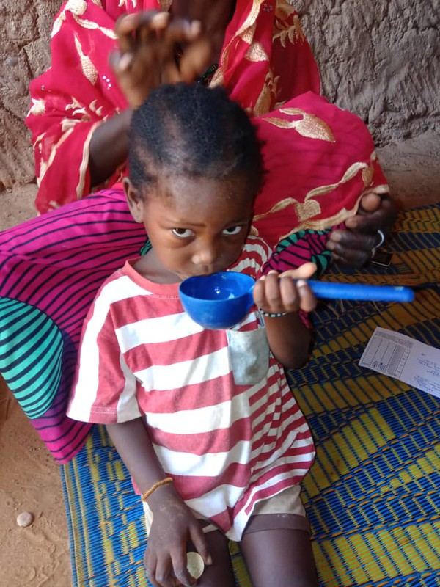

Terms of the Reference
First met on 6 November 2020
Terms of Reference finalized in January 2021
Purpose: provide a platform where members of the SMC community can share challenges and best practices in M&E and discuss, collectively develop and harmonize tools
Goal: to discuss and agree on a minimum set of core standardized metrics for reporting coverage and adherence
Membership: balance of scientific and programmatic knowledge and experience and geographic representation
Focus area: to support NMP and WHO efforts on the annual World Malaria Report chapter on SMC

Slide 3
Achievements in 2021
January: finalized TOR
February: introduced ourselves at SMC Alliance annual meeting and invited more participants
March: draft second edition of the SMC Field Guide shared with Sub-Group; performance framework (PF) reviewed as a priority
June: draft PF disseminated via email and a webinar
July – October: continued working on other elements of the SMC M&E Toolkit:
  standardized end of campaign report outline
  updated pharmacovigilance chapter
  data collection tools used by community distributors
  guidance on independent monitoring surveys
November: NMCP directors asked to convene country consultations on the PF

Slide 4
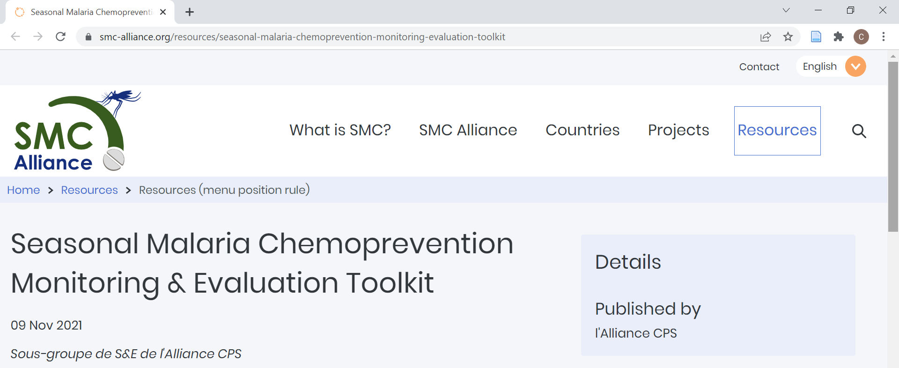
SMC Alliance Website Resources
English: https://www.smc-alliance.org/resources/seasonal-malaria-chemoprevention-monitoring-evaluation-toolkit

Slide 5
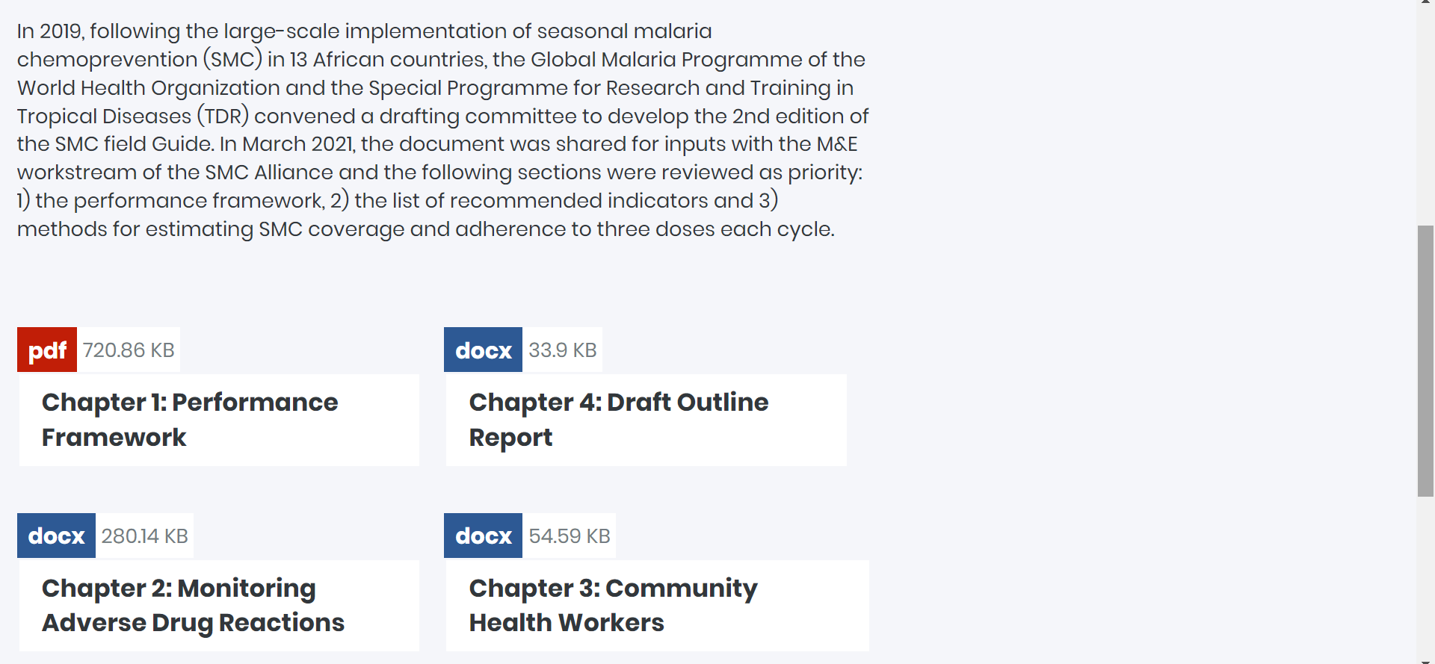
SMC Alliance Website Resources continued

Slide 6
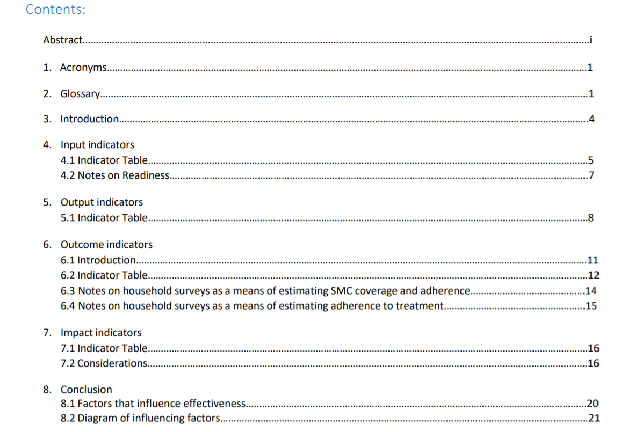
Chapter 1: Performance Framework (Draft)

Slide 7
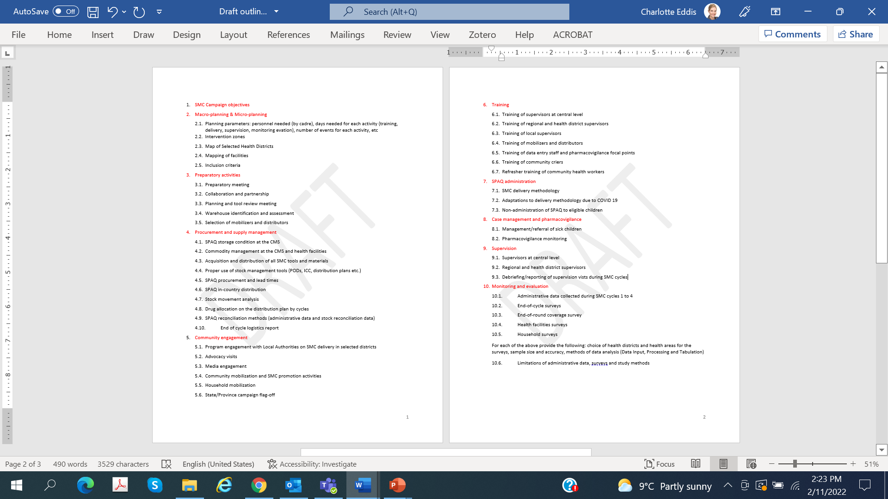
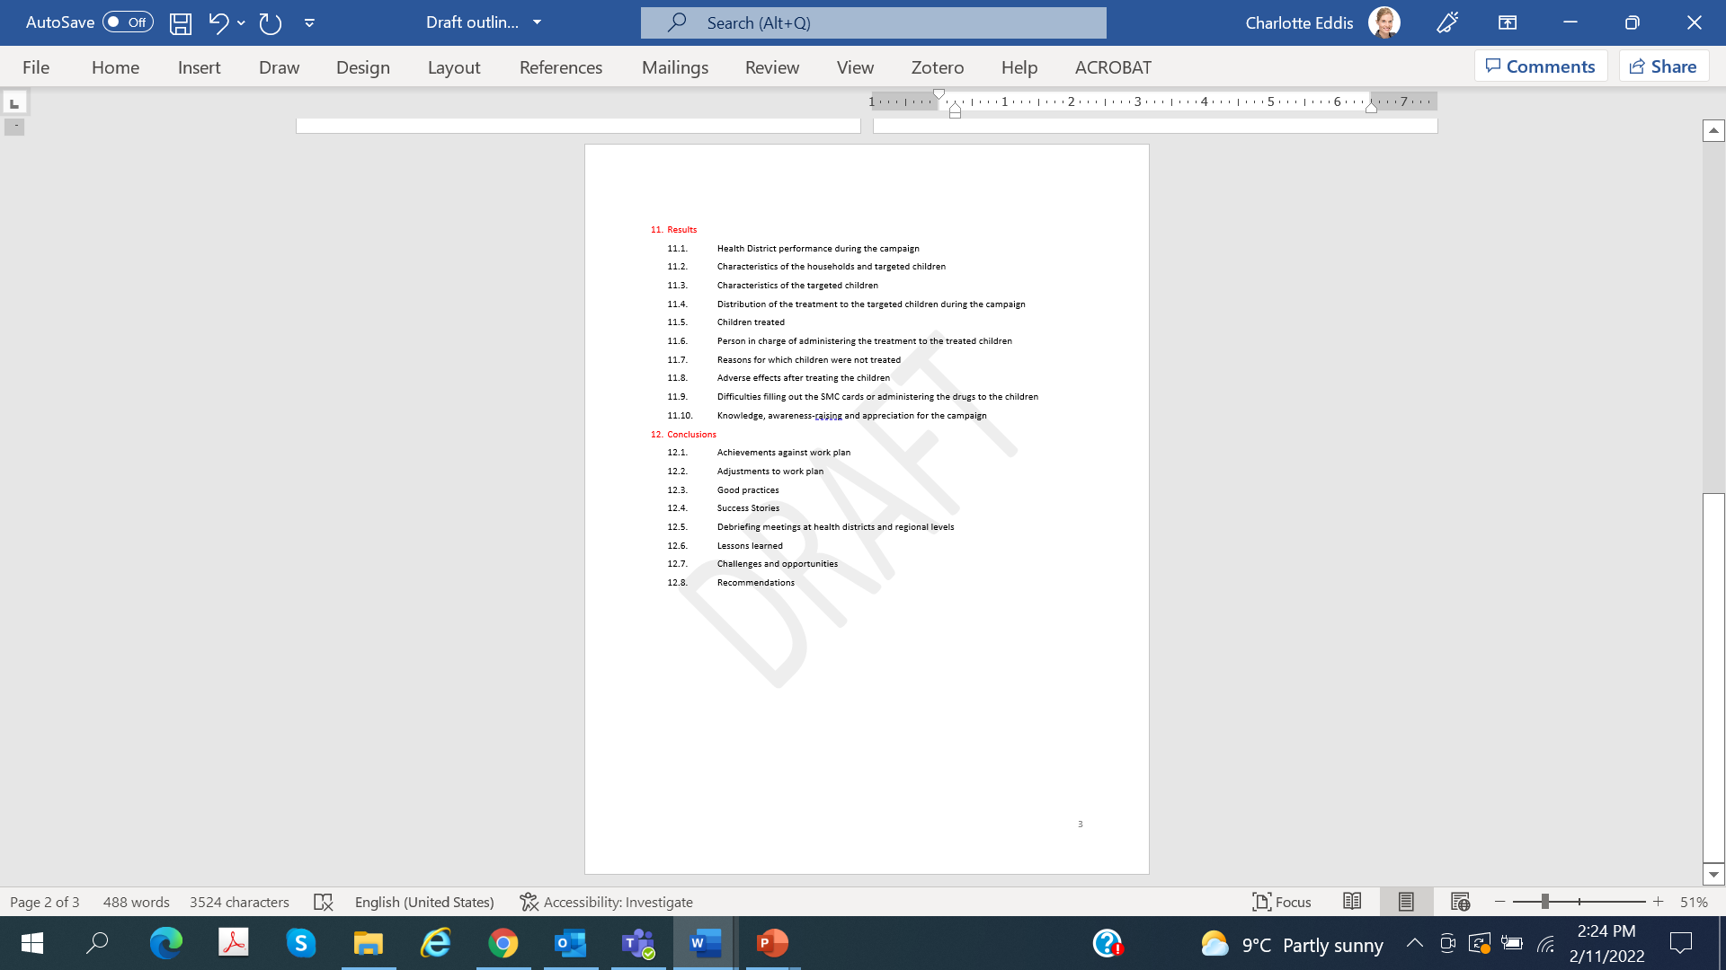
Chapter 4: Campaign Report Outline (Draft)

Slide 8
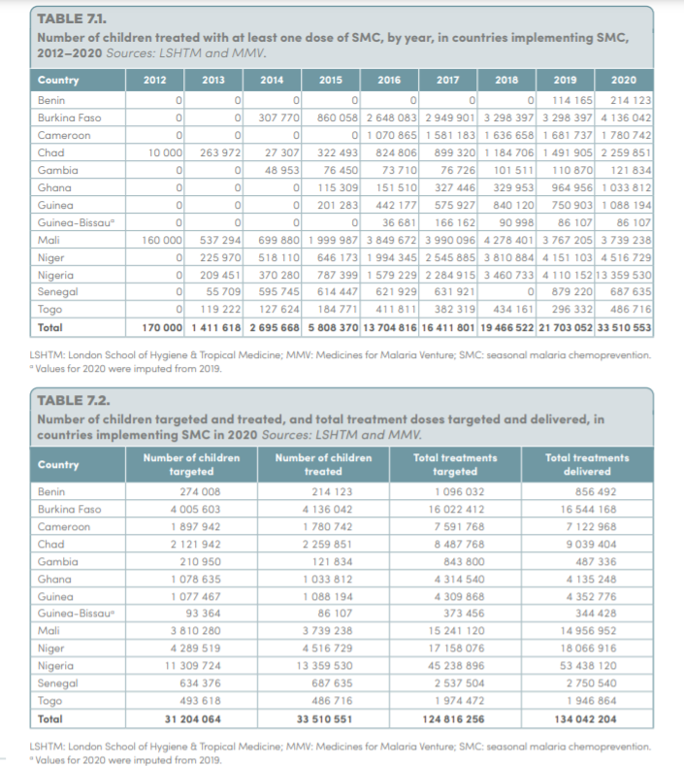
World Malaria Report 2021 SMC section

Slide 9
MMV data request 1 is often completed

Slide 10
MMV data request 2 is rarely completed

Slide 11
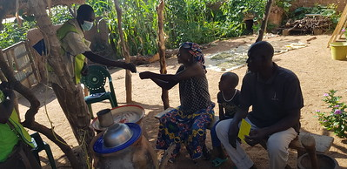
Plans for 2022
  Incorporate feedback received from Country Consultations into the PF
  Continue with other sections of the SMC M&E toolkit
  Support the World Malaria Report 2022 SMC chapter

