Slide 1
Updates from WHO-GMP
David Schellenberg
Science Adviser
SMC Annual Review & Planning Meeting
3 March 2022

Slide 2
The 3 steps in the pathway to achieve impact
New recommendations implemented and achieve impact
1
Better anticipate
products or strategies that are likely to be key in future efforts to control and eliminate malaria
2
Develop recommendations
for countries on "what to do" and what malaria control products to use based on the best available evidence
3
Optimize uptake
of the recommendations by improving the way they are shared and updated
Feedback loop
— lessons from front-line workers and implementers feed back into the overall process

Slide 3
Better anticipate
“Horizon scanning” – what is coming down the R&D pipeline
Vaccines
RTS,S +/- SMC
R21
Monoclonal antibodies (mAb)
Preferred Product Characteristics
Vaccines
mAb
Drugs for chemoprevention

Slide 4
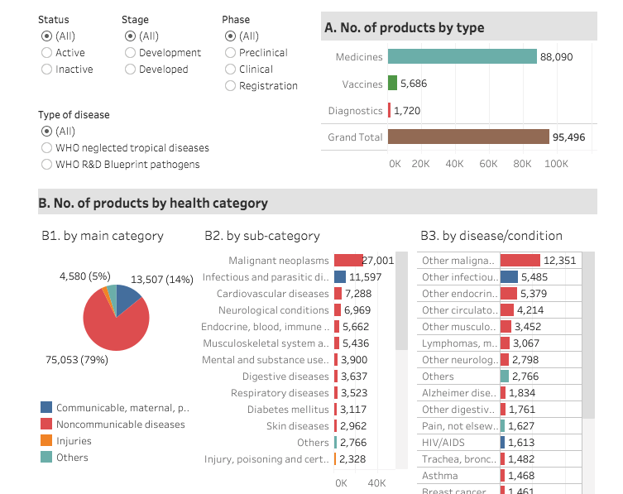
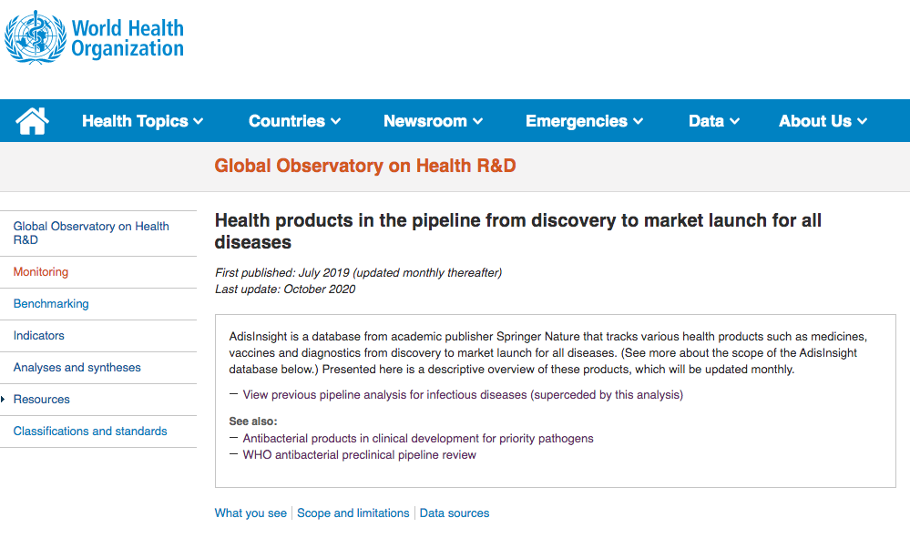
WHO Global Health Observatory
Overview
https://www.who.int/observatories/global-observatory-on-health-research-and-development/monitoring/health-products-in-the-pipeline-from-discovery-to-market-launch-for-all-diseases
03/03/2022
4

Slide 5
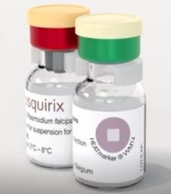
The RTS,S malaria vaccine development
Oct 2021
WHO recommends widespread use
2016
WHO recommendation
for pilot implementation
Dec 2021
Gavi Board decision to fund RTS,S vaccine roll-out
2015
EMA positive scientific opinion granted
Discovery
Pre-clinical
Phase 1
Phase
2
Phase
3
Malaria Vaccine Implementation Programme
1984
1987
1995
First clinical tests in adults begin in US, followed by trials in adults in Africa
2004
Proof of concept demonstrated in African children, then in infants
2009
Phase 3 trial in 11 sites in seven African countries
2015
Phase 3 final results published
2019
National Regulatory Approval; Vaccine launch in routine programme
in Ghana, Kenya, Malawi
2021
Pilot evaluations 24-month analysis on safety and impact

Slide 6
Layering of malaria interventions increases access to preventive tools
Ghana Midline Feasibility Household Survey Children 12-23 months (conducted 18 months after vaccine introduction)
Using insecticide-treated net (69%)
NOT using an ITN (31%)
63%**
72%*
15% use ITN but unvaccinated
55% use ITN and vaccinated
22% don’t use ITN but vaccinated
9% don’t use ITN and unvaccinated
Vaccinated with dose 1 of RTS,S (77%)
*72% of children not sleeping under ITNs received the first dose of RTS,S;
**63% of children not vaccinated with RTS,S slept under an ITN
Vaccination coverage is estimated for those with vaccination record or recall (in implementation areas only)
Source: HHS data from KHRC Ghana
Notes:
This slide shows how adding a malaria vaccine to current interventions increases access and reduces gaps to malaria prevention tools.
These results are from the Ghana midline HHS. You can see that 69% of children slept under an ITN and 77% received RTS,S dose 1. But these are not the same children. By layering the interventions, we go from 69% of children benefiting from preventive interventions to 91%. Among those not using a net, 72% received the vaccine, and among those not receiving the vaccine, X% used an ITN. It is this 55% of children who are receiving optimal benefit and protection, from the combination of ITNs and the malaria vaccine. And we now need to learn how to leverage the new cooperative relationship of the EPI and NMCPs to get these children under ITNs, and these children vaccinated, and these children over here (9%) that currently are not protected by either intervention protected.

Slide 7
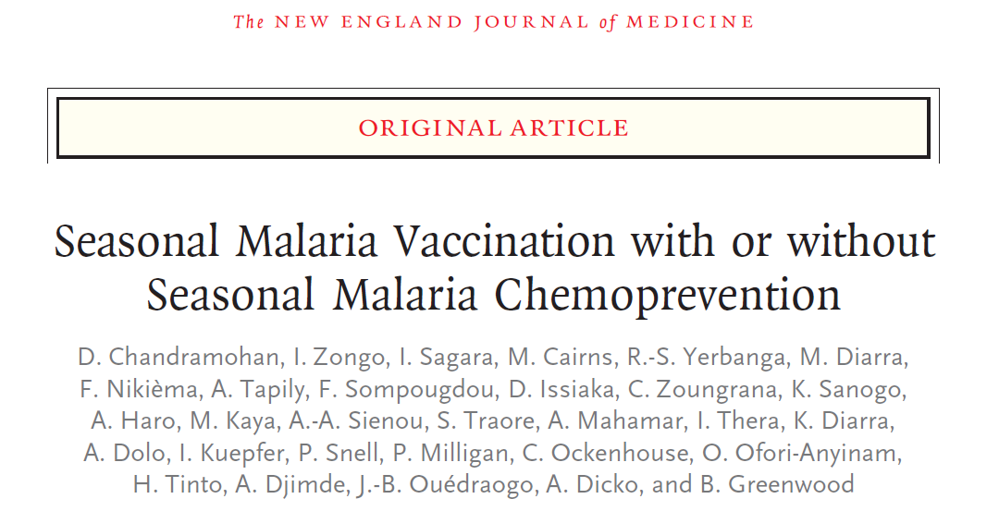
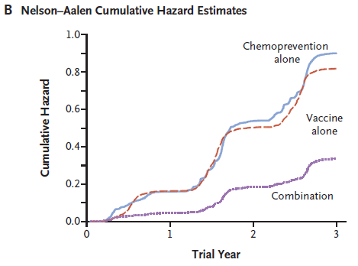
Interventions may produce synergistic effects

Slide 8
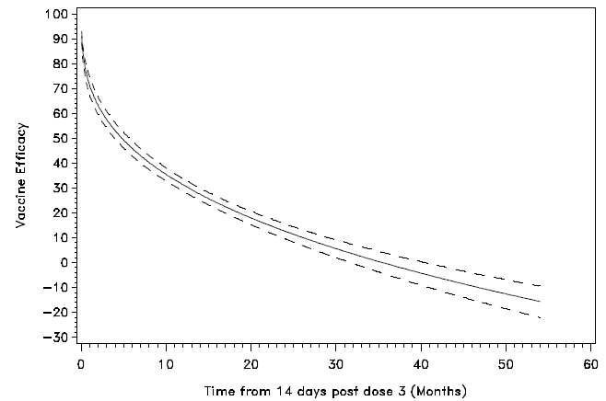
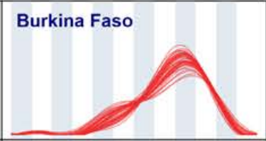
Another malaria vaccine in development - R21 / Matrix-M
Recently started Phase 3 evaluation in seasonal and perennial transmission settings
Likely comparable efficacy to RTS,S/AS01 vaccine
RTS,S vaccine efficacy wanes over time
Intensely seasonal malaria transmission in Burkina Faso
RTS,S phase 3 trial
VE in Nanoro 6 months follow-up
72% (60-80)
Source: PLoS Med 11(7): e1001685. doi:10.1371/journal.pmed.1001685.
Figure S6, panel A:
R21 phase 2 trial
VE in Nanoro 6 months follow-up
77% (67-84)
Source: Lancet. doi.org/10.1016/S0140-6736(21)00943-0
DOI:https://doi.org/10.1016/S0140-6736(15)60721-8. Figure S6
Strategic timing of vaccination in relation to peak transmission likely to be a critical determinant of apparent efficacy

Slide 9
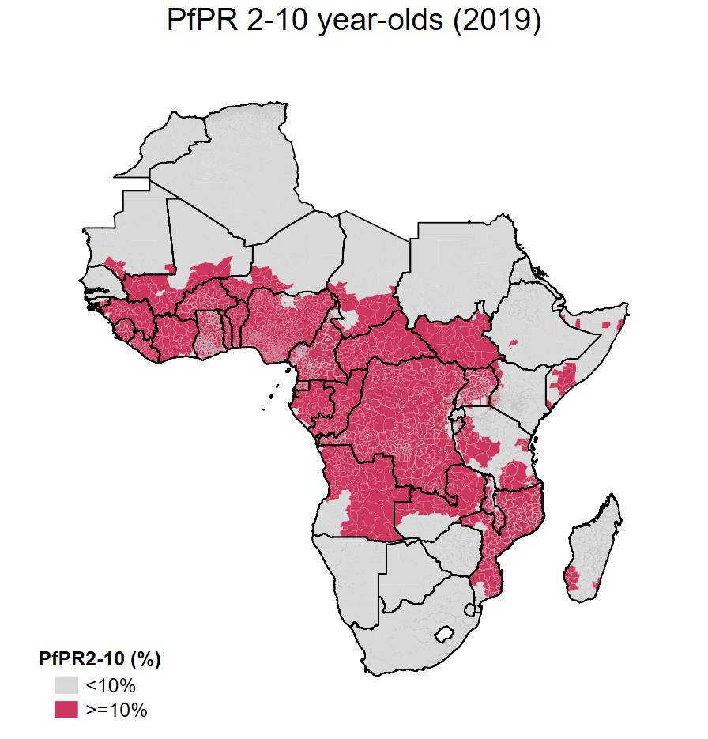
An allocation framework for malaria vaccines
October 2021: WHO recommends the RTS,S/AS01 malaria vaccine be used for the prevention of P. falciparum malaria in children living in regions with moderate to high transmission as defined by WHO.
Allocation Framework to guide where limited supply should go
Supply¹
Demand
1 vaccine, single manufacturer
Supply limited, ramping up with target to reach 15 million doses/yr
RTS,S product transfer to Bharat Biotech started, expected to be completed by 2029, the latest
Capacity expansion requires attention and likely ext. support
Candidate R21/Matrix-M in Ph3
Expected to be high
Could exceed 80-100 million doses/year (based on Gavi’s latest forecast)
Plasmodium falciparum parasite prevalence (PfPR₂₋₁₀) estimates, 2019
1/ WHO Malaria Vaccine Global Market Study, available:
https://www.who.int/publications/m/item/who-malaria-vaccine-global-market-study-september-2021
MVIP update 24 February 2022

Slide 10
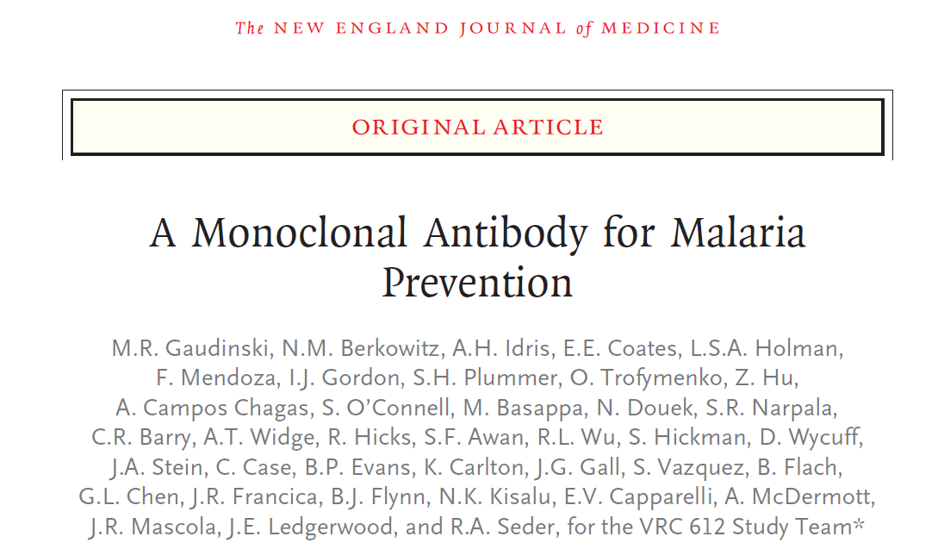
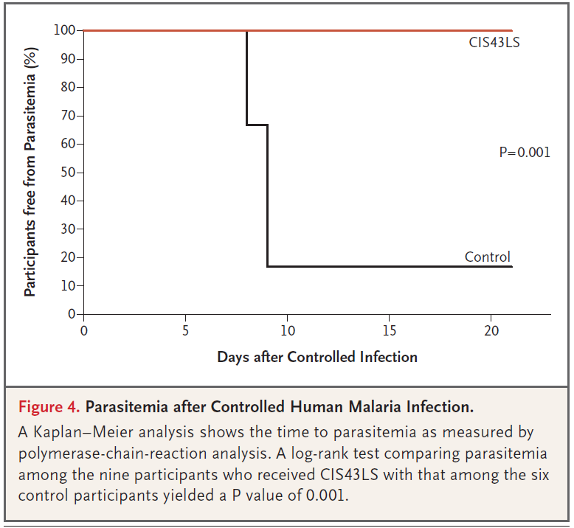

Slide 11
The 3 steps in the pathway to achieve impact
New recommendations implemented and achieve impact
1
Better anticipate
products or strategies that are likely to be key in future efforts to control and eliminate malaria
2
Develop recommendations
for countries on "what to do" and what malaria control products to use based on the best available evidence
3
Optimize uptake
of the recommendations by improving the way they are shared and updated
Feedback loop
— lessons from front-line workers and implementers feed back into the overall process

Slide 12
Draft revisions to chemoprevention recommendations – key points
Underlying principle: a treatment course of an effective antimalarial will clear any existing, and prevent new, malaria infections for a period of time
Updated chemoprevention recommendations reflect a paradigm shift to provide greater flexibility to NMPs to adapt control strategies to suit their settings
No longer specify strict age groups, transmission intensity thresholds, numbers of doses or cycles, or specific drugs
Each chemoprevention recommendation will be accompanied by a summary of available research evidence, an explanation of how this was used to inform the recommendation and key practical considerations to support implementation

Slide 13
Chemoprevention – unlocking the preventive power of medicines
Seasonal Malaria Chemoprevention (SMC)
Perennial Malaria Chemoprevention (includes the former ‘IPTi’)
Intermittent Preventive Treatment in pregnancy (IPTp)
Mass Drug Administration (MDA) for burden reduction in moderate/high transmission settings
New use cases
School children
Post-discharge malaria chemoprevention (PDMC)

Slide 14
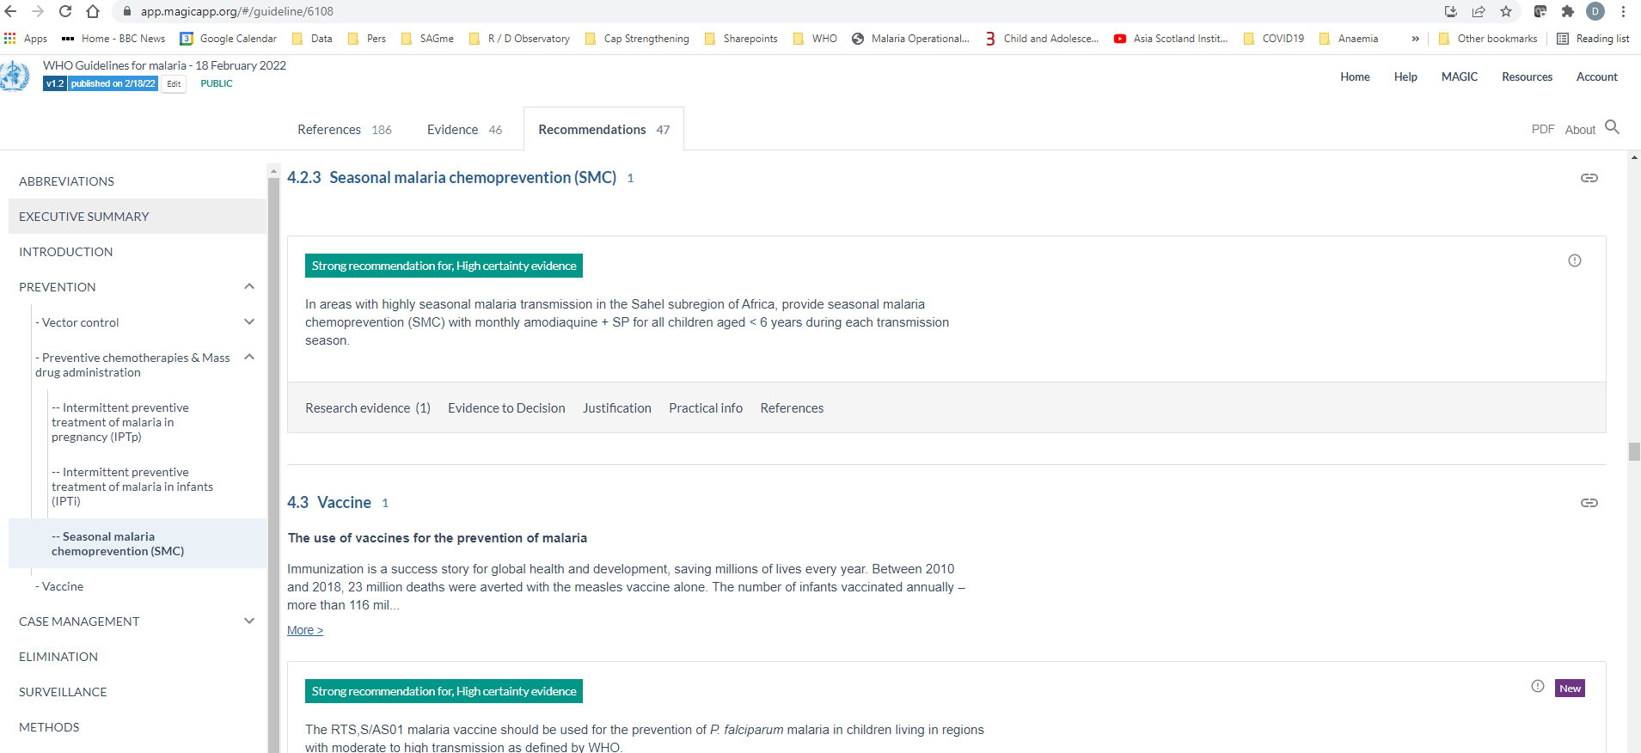
Presentation of recommendations
https://app.magicapp.org/#/guideline/6108

Slide 15
Presentation of recommendations
https://app.magicapp.org/#/guideline/6108

Slide 16
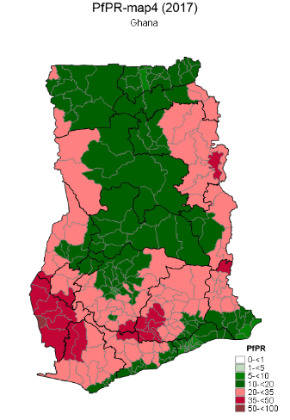
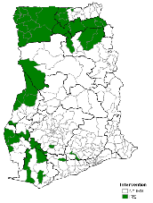
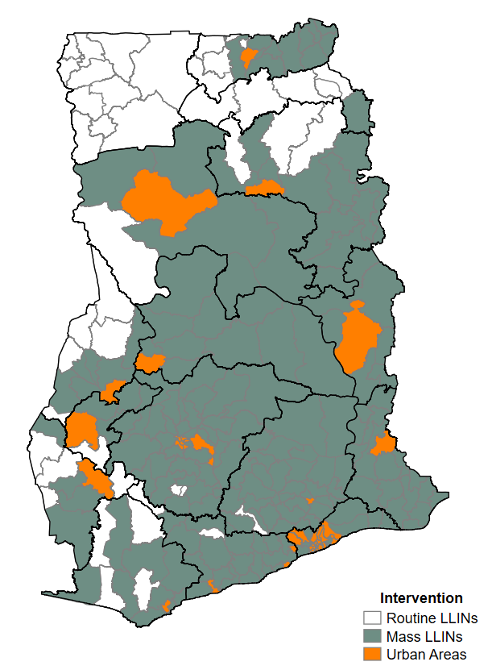
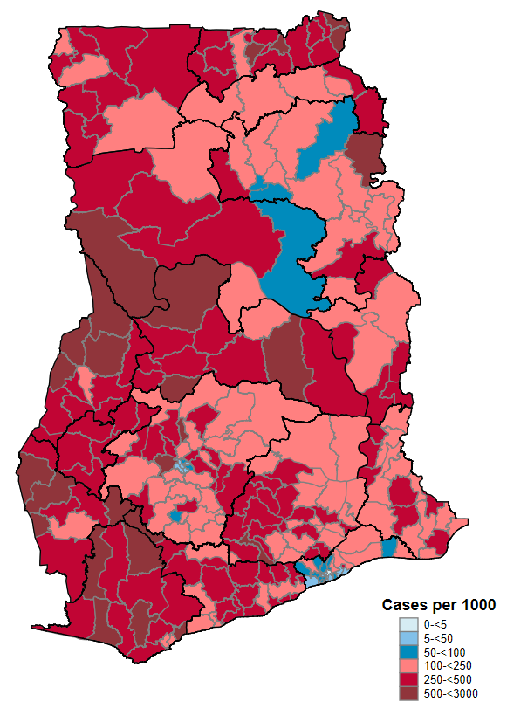
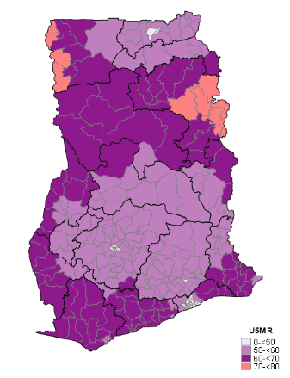
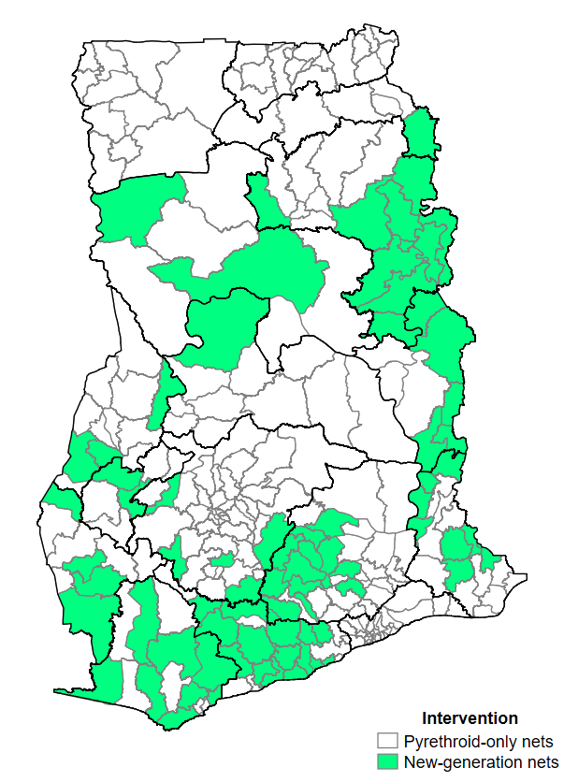
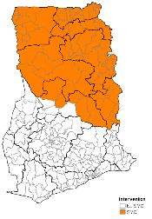
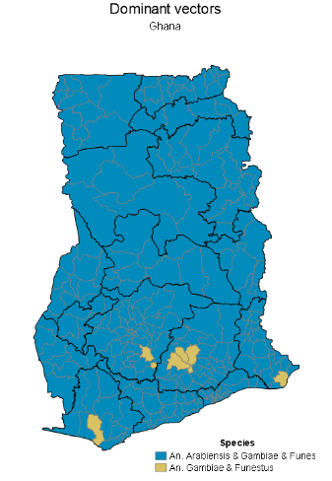
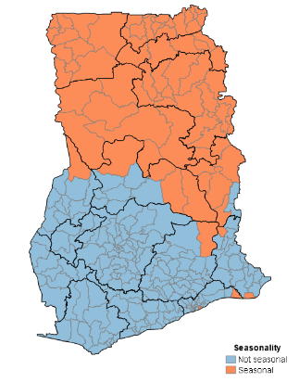
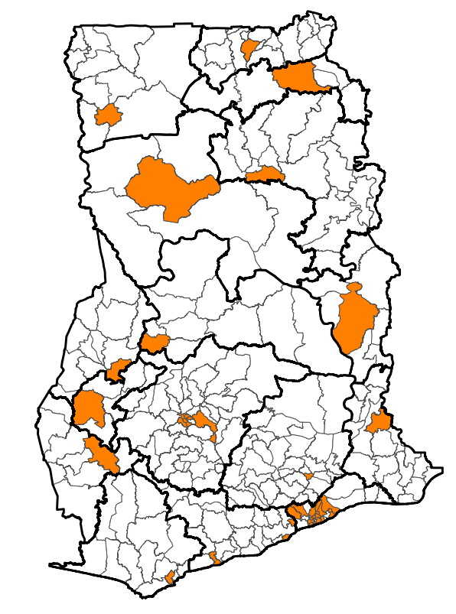
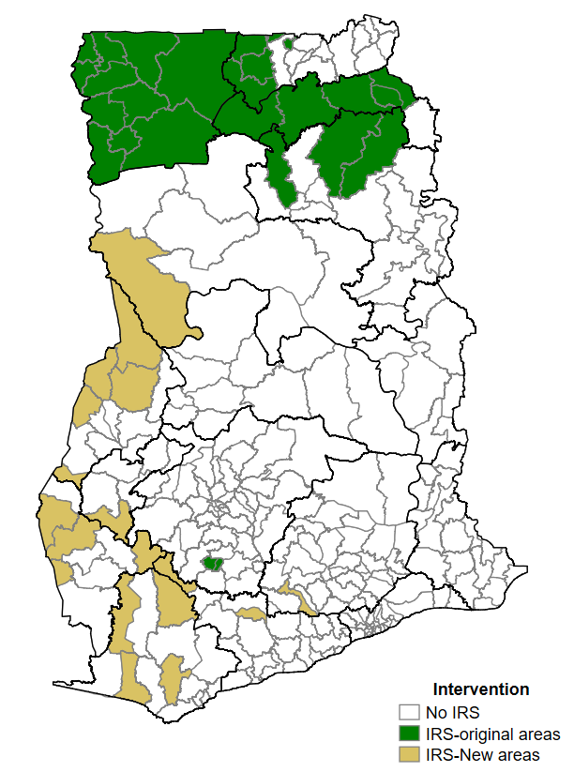
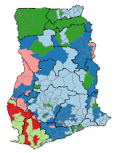
Subnational tailoring of malaria control: analytical approach
Malaria Strategic Plan development
Intervention targeting: For each intervention, identify the operational unit that meets criteria + operational feasibility
Resource allocation and prioritization
Operational Unit (district or equivalent)
Stratification: Hierarchical ordering of one or multiple layers of information to make decisions
Funded Operational plan
WHO recommended interventions*
(Target according to transmission setting, age group, seasonality, efficacy, access etc.)
LLIN, IRS, LSM,
IPTp, IPTi, SMC,
CM (Public HF, iCCM, private)
Indicators
Epidemiology
IRS
LLINs
Incidence
Prevalence
Mathematical models may be used for resource prioritization through cost-effectiveness analysis of different scenarios
Mortality
PBO
SMC
Entomology
Prioritization: Prioritizing intervention to achieve maximum impact within a resource envelope
Implications:
Less commodities
Reduced coverage targets,
Higher efficiency threshold
Equity
Climate & Seasonality
Mathematical models used to evaluate different scenarios and quantify impact of sub-nationally tailored intervention mixes
Urbanization
IRS
LLINs
& PBO
…
Health systems
Drug resistance
Conflict zones
Land use
etc
National Strategic Plan Intervention Mix Map & informed goals
Costing of national strategic plan
How much it costs
How much there is available
*for each intervention, WHO has:
Recommendation
Good practice statement
Country adaptation
Additional considerations for targeting
$$$
$

Slide 17
Summary
Exciting opportunities for malaria prevention
New tools & strategies to complement existing approaches
Updated and new recommendations to guide use (chemoprevention update Q3.2022)
Enhanced use of local data to optimise mixes of interventions and maximise the impact of available resources
Strategic deployment of interventions – chemoprevention, vaccines, other
Opportunities to standardise monitoring – generic ChemoPrevention Efficacy Study (CPES) protocol being piloted
Learn across chemoprevention strategies and settings
Avoid silos: interact & iterate with intervention mixes, learning with time
Design M&E / implementation/operational research studies carefully, share results, strengthen guidance

Slide 18
Thank you

