Slide 1
Seasonal Malaria Chemoprevention (SMC)
2021 Campaign activities review
2022 & 2023 campaigns planning
Ghana

Slide 2
Planned vs actual number of children treated
2021 Campaign
Coverage ( % eligible Children who received full number of treatments)
Pharmacovigilance data
Key challenges and success
2021 funding: Planning vs effective disbursements
2022 - 2023 targets
2022-2023 Campaigns
Funding commitments: 2022 & 2023 planning, gaps

Slide 3
Country map showing SMC implementing districts
2021 map (Covered)
2022 map (targets)

Slide 4
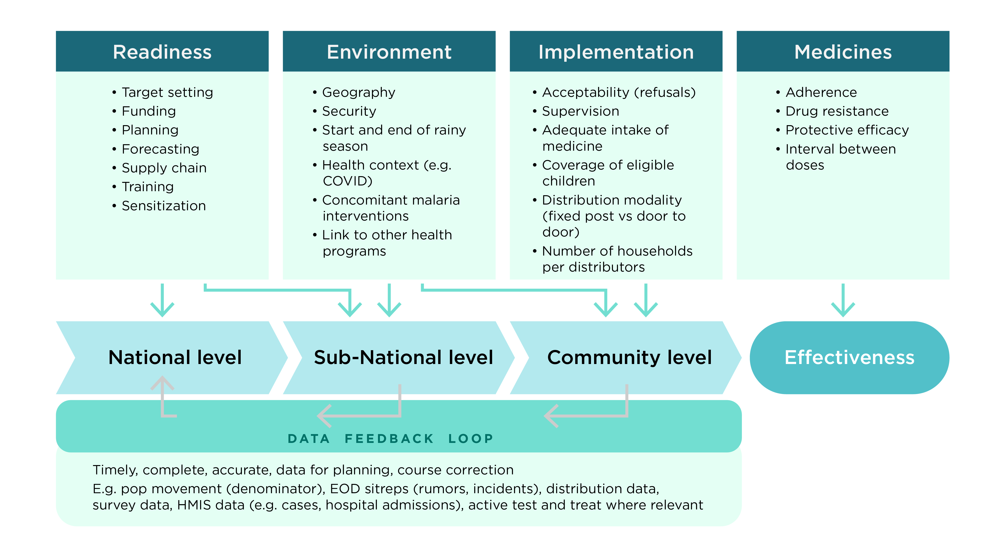
Monitoring and Evaluation (1)
Diagram showing factors that may influence effectiveness of SMC programs

Slide 5
SMC monitoring of coverage , adherence and efficacy (2)
How do you monitor completeness of coverage ?
Use an electronic data collection application (SiCapp) to monitor coverage on daily basis
Advantages of the methodology used: Real time detection of poor performing districts which helps coordinators to provide special assistance to these district
Disadvantages: Challenge with internet network coverage in a few districts
Have you ever performed a coverage survey in the country ?
Yes - conducted a coverage survey for the 2020 SMC (completed in Feb 2021)
When was the last one ?
February 2021
Is there a coverage survey planned in 2022 ?
No - none planned yet

Slide 6
SMC monitoring of coverage , adherence and efficacy (3)
How do you monitor adherence ?
Community Health Volunteers (CHVs) revisit household on days 2 and 3
Advantages of the methodology used: CHVs have the opportunity to immediately correct non-adherence
Disadvantages: Increased workload on CHVs and it is time consuming
How do you monitor efficacy
Use case control studies
Advantages of the methodology used: it is an easier way to measure the efficacy in practice
Disadvantages: potential recall bias

Slide 7
Number of confirmed cases of malaria in SMC areas in 2021, by month
North-East Region
Month | Under 5 years |  | > 5 years
 | Girls | Boys | Girls | Boys
January | 900 | 840 | 2123 | 1296
February | 801 | 710 | 1114 | 573
March | 834 | 692 | 1426 | 852
April | 757 | 797 | 1191 | 843
May | 634 | 625 | 1986 | 1168
June | 1263 | 1301 | 2919 | 1610
July | 3455 | 3588 | 7706 | 5214
August | 3289 | 3437 | 7868 | 4938
September | 3012 | 3189 | 7669 | 4692
October | 3287 | 3272 | 7929 | 5002
November | 2161 | 2372 | 5014 | 3252
December | 1449 | 1422 | 3602 | 2449

Slide 8
Number of confirmed cases of malaria in SMC areas in 2021, by month
Northern Region
Month | Under 5 years |  | > 5 years
 | Girls | Boys | Girls | Boys
January | 3053 | 3206 | 7266 | 3361
February | 2434 | 2619 | 6004 | 2936
March | 1957 | 2203 | 4670 | 2086
April | 1677 | 1862 | 3987 | 1795
May | 1702 | 1607 | 4895 | 2161
June | 3938 | 4002 | 7697 | 3930
July | 6373 | 6638 | 14072 | 7740
August | 4850 | 4966 | 12166 | 6802
September | 4401 | 4599 | 11893 | 6121
October | 5592 | 5824 | 11630 | 6924
November | 4759 | 5359 | 9343 | 4995
December | 3189 | 3463 | 7900 | 3663

Slide 9
Number of confirmed cases of malaria in SMC areas in 2021, by month
Savannah Region
Month | Under 5 years |  | > 5 years
 | Girls | Boys | Girls | Boys
January | 906 | 1033 | 1981 | 979
February | 846 | 927 | 1901 | 875
March | 882 | 895 | 1809 | 875
April | 750 | 808 | 1798 | 933
May | 861 | 975 | 1816 | 995
June | 2134 | 2208 | 3825 | 2127
July | 2090 | 2224 | 4790 | 2800
August | 1578 | 1694 | 4947 | 2731
September | 1949 | 1491 | 4181 | 2535
October | 1735 | 1836 | 4755 | 3026
November | 1924 | 2147 | 3858 | 2608
December | 1195 | 1251 | 2804 | 1495

Slide 10
Number of confirmed cases of malaria in SMC areas in 2021, by month
Upper East Region
Month | Under 5 years |  | > 5 years
 | Girls | Boys | Girls | Boys
January | 4328 | 4643 | 13903 | 7915
February | 4462 | 4641 | 12104 | 6400
March | 4047 | 4117 | 10058 | 5036
April | 2562 | 2742 | 7822 | 3466
May | 2426 | 2615 | 9023 | 4249
June | 3012 | 3391 | 9661 | 4850
July | 7825 | 8036 | 21909 | 13631
August | 7230 | 7114 | 26610 | 15658
September | 9224 | 9839 | 35872 | 20845
October | 9634 | 9684 | 36331 | 21436
November | 6980 | 7137 | 23947 | 13815
December | 5636 | 5696 | 17167 | 10059

Slide 11
Number of confirmed cases of malaria in SMC areas in 2021, by month
Upper West Region
Month | Under 5 years |  | > 5 years
 | Girls | Boys | Girls | Boys
January | 2562 | 2763 | 6293 | 3523
February | 2112 | 2190 | 4971 | 2719
March | 1869 | 1985 | 4620 | 2548
April | 1528 | 1631 | 3846 | 2120
May | 1481 | 1538 | 3997 | 2444
June | 3742 | 4195 | 7832 | 5165
July | 7665 | 7936 | 17300 | 12115
August | 3355 | 3427 | 14385 | 9899
September | 3238 | 3326 | 13885 | 9563
October | 5260 | 5273 | 19313 | 13383
November | 4115 | 4345 | 12230 | 8325
December | 3433 | 3665 | 7990 | 5272

Slide 12
Number of confirmed cases of malaria in SMC areas in 2021, by month
Oti Region
Month | Under 5 years |  | > 5 years
 | Girls | Boys | Girls | Boys
January | 1690 | 1835 | 4433 | 2176
February | 1519 | 1709 | 3783 | 2006
March | 1474 | 1587 | 4353 | 2320
April | 1702 | 1907 | 4490 | 2334
May | 1501 | 1573 | 4473 | 2485
June | 1603 | 1779 | 4843 | 2646
July | 2049 | 2085 | 6026 | 3298
August | 1232 | 1335 | 6666 | 3893
September | 1130 | 1268 | 6143 | 3509
October | 1250 | 1444 | 6375 | 3645
November | 1393 | 1572 | 5332 | 3184
December | 1769 | 1843 | 5073 | 2817

Slide 13
Number of confirmed cases of malaria in SMC areas in 2021, by month
Bono East Region (5/11 Districts)
Month | Under 5 years |  | > 5 years
 | Girls | Boys | Girls | Boys
January | 1074 | 1089 | 2488 | 1393
February | 876 | 868 | 2153 | 1171
March | 839 | 811 | 1883 | 957
April | 809 | 755 | 1516 | 884
May | 949 | 967 | 2214 | 1312
June | 1331 | 1300 | 3041 | 1740
July | 1677 | 1672 | 3560 | 2322
August | 1100 | 1117 | 4597 | 2860
September | 1258 | 1313 | 4936 | 2981
October | 1285 | 1304 | 4468 | 2658
November | 1221 | 1283 | 3296 | 2070
December | 1069 | 1233 | 2690 | 1719

Slide 14
Experiences of combining SMC with other Public Health interventions
Successes
Way forward
North East Region added Vitamin A supplementation to Cycles 3 and 4 which helped the region to achieve high Vit A coverage in 2021
To plan with each region on the feasibility of combining SMC with other public health interventions in 2022

Slide 15
Experiences of combining SMC with other Public Health interventions
Challenges
Proposed / applied solutions
Community health volunteers complained about the workload and asked for an increment in their daily allowance
To increase the number of community health volunteers and/or daily allowance

Slide 16
Objectives and results of Evaluation and Research in 2021 (1 slide per evaluation and Research)
SMC Coverage Survey
Objectives
To estimate the coverage of 2020 SMC
To determine proportion of treated children who were outside the SMC age range
To determine adherence to dosing protocol
To identify the barriers associated with SMC uptake
Results
Coverage
All regions met the 80% target for all rounds - Northern region had the highest coverage , 98.9% in Cycle 1, 99.6% in Cycle 2, 98.3% in Cycle 3 and 96.6% in cycle 4
Almost all regions saw marginal reduction in coverage as the campaign progressed
More than 87% of the children received all four cycles
Treatment of children above the age limit (59 months)
cycle 1 - 1% (25) of children dosed;
cycle 2 - 0.7%
cycle 3 - 0.4%
cycle 4 - 0.4%

Slide 17
Objectives and results of Evaluation and Research in 2021 (1 slide per evaluation and Research)
SMC Coverage Survey - 2
Adherence to protocols
A total of 2210 (80.6%) of caregivers received information on side effects
About 95.8% ensured DOTS on day one
A total of 2414 (92.4%) received all three required doses
Barriers to uptake
Over-tasking volunteers
Taste and the smell of SMC medicines
Clients charged for management of adverse drug reactions
Logistic distribution gaps
Recommandations:
To maintain and further improve SMC uptake
Increase number volunteers and/or daily allowances
Provide SMC logistics timely
Coat of the tablets especially AQ – to improve taste and smell
Treat all adverse drug reactions free of charge

Slide 18
Pharmacovigilance
Non- serious SMC-related ADRs |  | Serious SMC-related ADRs |  | Number of SMC-related ADRs registered in vigi-flow | Number that recovered
Description | Number | Description | Number
Vomiting | 403
Fever | 145
Diarrhoea | 87
Others
Weakness Pruritus/Rash Anorexia Abdominal pain | 125
Pruritus/Rash
Anorexia
Total | 760 | 0 | 0 | Yet to receive data from FDA | all

Slide 19
Key success in SMC planning and delivery
Successes
Way Forward
Some volunteers moved very early in the morning or in the evening/night to dose children when caregivers were available
Most volunteers and supervisors strictly follow the Covid-19 prevention protocols
Any adverse drug reaction was immediately reported to the pharmacovigilance team and the affected child sent to the nearest health facility for prompt management
A Chief in Pru East District supported the campaign by giving supervisors boats and canoes to help reach children everywhere in the district
Meet with RHDs of all eligible regions and plan for 2022 SMC
Support IT unit to update SiCapp
Continue discussions possible expansion (No. of rounds, age-group and geographical area)
Procurement of adequate number of android tablets – to avoid tablet retrieval after each round
Strengthen collaboration with neighbouring countries

Slide 20
Key challenges in SMC planning and delivery
Challenges
Proposed/ applied Solutions
Life jackets – more needed - OR and BER
Inadequate number of vehicles; frequent breakdown of vehicles
Network issues (data synchronization
Medications for treatment of common ADRs are not available in some Health Centres (eg Hydrocortisone, ORS, Antihistamines)
Volunteers – lower number of volunteers used by the districts leading to volunteer fatigue
Missing/damaged android tablets and chargers
Procure more life jackets
Rent some vehicles to complement our fleet
Trained CHVs to record data in offline mode and synchronize data when internet connectivity available
Encourage all Regional Health Directorates to ensure that medicines for ADR treatment are available in all health centres during SMC
Increase the number of CHV and/or daily allowances
Sensitize CHVs on how to keep/handle the android tablets

Slide 21
Targets – futures campaigns
 | 2022 | 2023 | 2024
Number of districts eligible for SMC | 72 | 72 | 72
Number of districts targeted | 72 | 72 | 72
Number of children eligible in targeted districts Mention if considering extension to older children | 1,386,721 | 1,425,694 | 1,465,848
Planned cycles (3, 4 or 5) | 4 | 4 | 4
Gap of children not covered

Slide 22
SMC funding: planned funding vs disbursements & Gaps
Years | Partners financial contributions ($) |  | Domestic Fundings ($) |  | Gaps
 | Commitments | Effective disbursements | Commitments | Effective disbursements
2021 | 4,047,530.66 | 4,047,530.66 | 2,352,381 | 2,352,381 | 0
2022 | 4,549,965.47 | 4,549,965.47 | 2,621,149 | 2,621,149 | 918,207.29
2023 | 4,549,965.47 | Not Yet | 2,678,525 | Not Yet | 1,269,439.5

Slide 23
Technical assistance received / planned / requested
Years | Areas | Identified Partner | Estimated cost
Received 2021 | Optimising delivery and coverage Safety Monitoring (Pharmacovigilance) | Impact Malaria (PMI) 2. Food and Drugs Authority
Requested / Needed 2022 | Optimising delivery and coverage Safety Monitoring (Pharmacovigilance) | Impact Malaria (PMI) 2. Food and Drugs Authority
Requested / Needed 2023 | Optimising delivery and coverage Safety Monitoring (Pharmacovigilance) | Impact Malaria (PMI) 2. Food and Drugs Authority

Slide 24
Implementation Adaptations in 2022
Will you integrate other public Health interventions? If yes, which ones and how (which partners involved )?
Integration will depend on the needs of each of the eligible regions/districts
Which changes will you make to overcome challenges experienced in previous campaigns?
Procurement of adequate number of android tablets – to avoid tablet retrieval after each round
Encourage all Regional Health Directorates to ensure that medicines for ADR treatment are available in all health centres during SMC

Slide 25
Research priorities and timelines
What are the research priorities you implemented in 2021
SMC coverage survey
What are the two research priorities for SMC moving forward and when do you intend to implement them?
Conduct efficacy study on AQ and SP (including monitoring of molecular markers of resistance) (2023)
If known, who are the identified partners for completing this research ?
SMC coverage survey : Under the OPT-SMC project
Efficacy study: Noguchi Memorial Institute of Medical research (University of Ghana)
Estimated budget required
SMC coverage survey : 60,000USD
Efficacy study: 70,000USD

Slide 26
Key lessons learnt / innovation in 2021
Implementation – general
Lessons Learnt
Early Planning results in smooth implementation
Early engagement with stakeholders (especially traditional/opinion leaders) is key to a successful campaign implementation
Some caregivers refuse dosing of their children - charged for previous ADR treatment
Some communities were completely cut off, making boats and life jackets a necessity in SMC implementation
The need to have strategies to follow up on mobile populations. Inhabitants of flooded communities migrate to dry lands, resulting in population issues – follow-up in subsequent cycles difficult

Slide 27
Key lessons learnt / innovation in 2021
Implementation – general
Innovations
Some districts/health facilities gave some incentives to volunteers (eg. not joining long queues at the OPDs)
In addition to the use of the SMC videos in training, supervisors shared with volunteers, to serve as a reference tool
Added Vitamin A supplementation to cycles 3 and 4, which helped the region achieve high Vit A Coverage (NER)

Slide 28
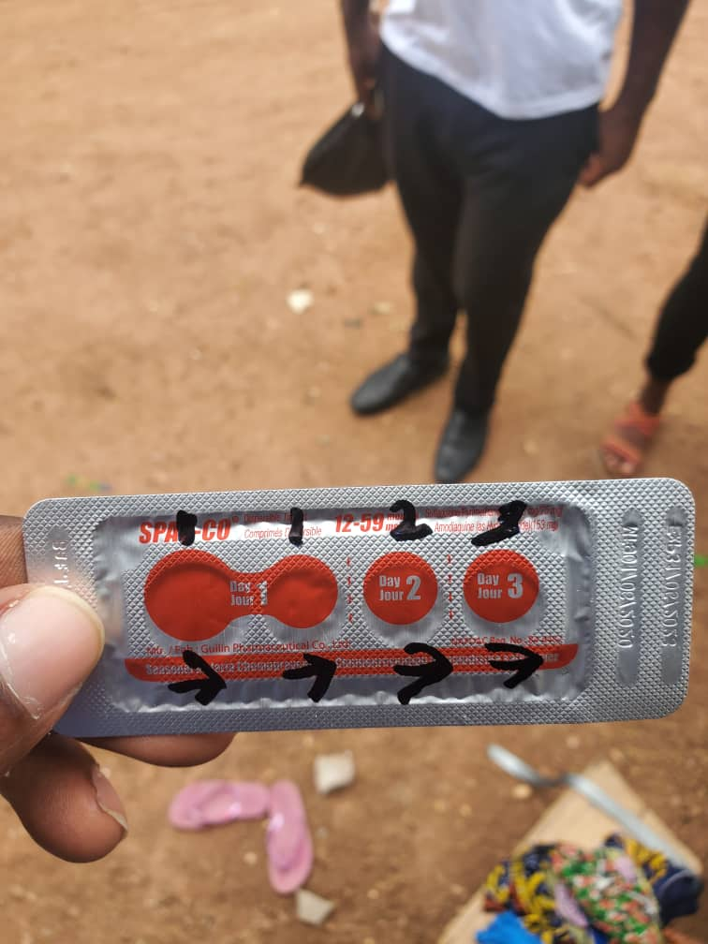
Key lessons learnt / innovation in 2021
Innovations

Slide 29
Key lessons learnt / innovation in 2021
Community Health Volunteers/Supervisors
Lessons Learnt
Selecting volunteers from within the same community makes acceptance rate high
Including role plays in the training of volunteers and supervisors minimizes errors during implementation
Providing daily performance feedback to supervisors helps to improve performance and curtails challenges early
Innovations
Volunteers who could not use the android app were not left out - they were used as SBCC agents

Slide 30
Key lessons learnt / innovation in 2021
SBCC
Lessons Learnt
Continuous monitoring of SBCC activities before, during and after each cycle helps to assess the level of awareness and take necessary action when needed, to increase uptake
Administering SMC medicines to the children of Health workers and opinion leaders causes other caregivers to have confidence in the exercise, increasing uptake
Innovations
Used local champions as agents for SBCC - facilitated uptake (NR)

Slide 31
Key lessons learnt / innovation in 2021
PSM
Lessons Learnt
Rain coats and wellington boots supplied - greatly motivated volunteers and supervisors which helped to improve performance
Providing some volunteers with torchlights may improve coverage - most caregivers leave to farm at dawn and return late in the evening (some volunteers visited homes at dawn and went back in the evening/night)
Innovations
Engaged drone supply services to provide transportation of medicines for management of ADR in health facilities (NER)

Slide 32
Thank you

