Slide 1
Seasonal Malaria Chemoprevention (SMC)
2021 Campaign activities review
2022 & 2023 campaigns planning
NIGERIA

Slide 2
Planned vs actual number of children treated
2021 Campaign
Coverage ( % eligible Children who received full number of treatments)
Pharmacovigilance data
Key challenges and success
2021 funding: Planning vs effective disbursements
2022 - 2023 targets
2022-2023 Campaigns
Funding commitments: 2022 & 2023 planning, gaps

Slide 3
Country map showing SMC implementing districts
2021 map (Covered)
2022 map (targets)

Slide 4
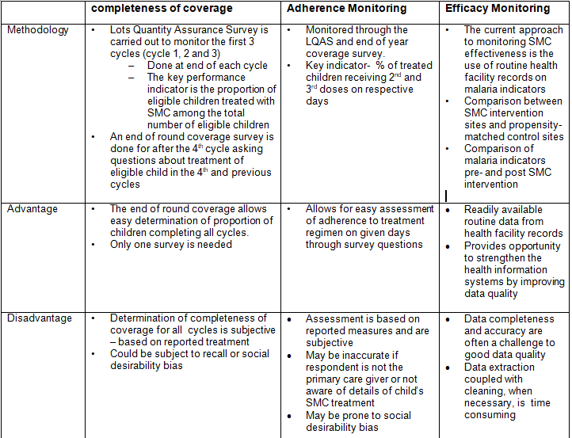
SMC monitoring of coverage , adherence and efficacy

Slide 5
Number of confirmed cases of malaria in SMC areas in 2020, by month
DHIS-2.
States: 9 states
Month | Under 5 year | 5 years and above
January | 257,033 | 340,998
February | 266,655 | 362,312
March | 280,583 | 370,396
April | 279,086 | 366,277
May | 212,369 | 279,545
June | 227,696 | 303,337
July | 278,122 | 370,226
August | 329,571 | 487,845
September | 364,234 | 532,141
October | 427,665 | 606,714
November | 316,128 | 432,835
December | 285,553 | 402,233

Slide 6
Experiences of combining SMC with other Public Health interventions
Sucesses
Way forward
Increase in the coverage of vitamin A supplementation using the door-to-door approach increased from 1.2% within the previous 6 months at baseline to 82.3% at end line after SMC+VAS integrated campaign
Cost analysis showed integration of Vitamin A to a usual SMC cycle has only an additional cost of $0.2 per child covered with both SMC and VAS
The feasibility and acceptability of integration of VAS with SMC was demonstrated among implementers and caregivers of under-five children.
To disseminate the findings of the IR
Decision-making on operational guidelines for scale-up of VAS integration with SMC to all SMC eligible states in Nigeria.

Slide 7
Experiences of combining SMC with other Public Health interventions
Challenges
Proposed / applied solutions
VAS reporting done via the routine HMIS while SMC campaigns are reported through adhoc campaign reporting system.
Concerns about extra workload when integrated
Explored alignment of reporting for both interventions.
Added an extra implementation day to account for the extra workload. The cost was still minimal.

Slide 8
Objectives and results of Evaluation and Research in 2021 (1 slide per evaluation and Research)
Research Topic: Facilitators and Barriers to Uptake of Seasonal Malaria Chemoprevention Programme in Nigeria: A Qualitative Approach
Objective: To determine facilitators and barriers to uptake of SMC among children aged 3-59months in selected States in Nigeria
Methodology: We applied qualitative methodology to conduct Focus Group Discussions (FGDs) with caregivers/mothers, in-depth interviews (IDIs) on key stakeholders
Result: SMC is widely accepted by caregivers as a preventive measure. Major factors associated with uptake of SMC include perceived side effects, ignorance, attitudes of CDDs, alleged inefficacy of the drugs, incomplete coverage/shortage of drugs and mode of delivery of drug (house-to-house). Trust placed upon the CDDs by caregivers and the CDDs’ positive attitudes are potent influencers of SMC while perceived side effects, ignorance and alleged inefficiency of SMC by some caregivers are potent barriers to uptake of SMC
Conclusion: Programme (NMEP) needs to consider developing a focused, clear and timely pre-SMC public health campaign that reflects the facilitators and barriers to uptake amongst caregivers, community members and the CDDs

Slide 9
Objectives and results of Evaluation and Research in 2021 (1 slide per evaluation and Research)
Research Topic: Optimizing the role of lead mothers in seasonal malaria chemoprevention (SMC) campaigns – insights from formative research in Kano State, northern Nigeria
Objective: We sought to understand the current role of LMs and identify areas for improvement, so as to possibly improve SMC programme outcomes in Nigeria
Methodology: Formative research utilizing qualitative methods, as part of a three-phased study, was undertaken in Kano State, northern Nigeria. Twenty semi-structured interviews were conducted with stakeholders from National, State, Local government as well as community health systems
Result: Study findings indicate that there are some factors which affect the role of LMs during SMC campaigns. Recruitment and supervision guidelines for LMs should be reviewed and strengthened within SMC-implementing States in Nigeria. There is also a clear need to improve the knowledge and skills of LMs through adequate training, so that they better deliver targeted health messages to caregivers during SMC campaigns. Appropriate job aids such as flipbooks, should be developed and provided to LMs
Conclusion: To promote sustainability, policy-makers should strongly consider the involvement of Community Health Influencers Promoters Services (CHIPS) agents during SMC campaigns to support the role of LMs; since CHIPS agents have government policy and funding support, in contrast to the current LMs intervention which is ad hoc and heavily supported by donor organizations

Slide 10
Objectives and results of Evaluation and Research in 2021 (1 slide per evaluation and Research)
Evaluation Topic: End-Of-Round Programmatic Assessment Of Seasonal Malaria Chemoprevention In 13 SMC Implementing State 2021
Objective: This was an independent assessment primarily to determine proportion of self-reported SMC drug (SPAQ) administration among eligible children and adherence to SMC protocol by community drug distributors (CDDs.
Methodology: A qualitative method using structured assessment questionnaire. States were stratified into 3 senatorial districts and 6 Local Government Areas were randomly selected. Equal sample size was used across states
Result: There were varying findings for each state, however overall findings showed the self-reported coverage of SMC was excellent in cycle 4 but coverage in cycles 1-3 were not as good as cycle 4. Adherence to SMC protocol by the CDD is commendable.
Conclusion: there is still room for improvement especially in mop-up visits to ensure all eligible children are captured and ineligible children are completely excluded

Slide 11
Pharmacovigilance
Non- serious SMC-related ADRs |  | Serious SMC-related ADRs |  | Number of SMC-related ADRs registered in vigi-flow | Number that recovered
Description | Number | Description | Number
Vomiting | 1728 | Nil |  |  | 1728
Abdominal Pain | 205 | Nil |  |  | 205
Skin Reaction | 215 | Nil |  |  | 215
Weakness | 364 | Nil |  |  | 364
Others | 3331 | Nil |  |  | 3331

Slide 12
Key success in SMC planning and delivery
Successes
Way Forward
The 2021 implementation scaled up and delivered SPAQ in 18 out of 21 states reaching over 23 million eligible children
Strategic and targeted engagement led to budgetary releases and financial contributions by states government
Conducted pilot on the use of ICT4D in deployment of SPAQ administration in 1 state which improved accountability of SPAQ
There was process evaluation on the integration of ITN with SMC with some possible areas of integration identified
The use of video demo developed by international helped better understanding during trainings
Ensure delivery in 2022 implementation to all 21 SMC eligible states
Improved targeted advocacies and engagements at all levels
Plans concluded to scale up use of ICT4D in additional states
There are plans to conduct integration in 2 states which timelines of ITN and SMC coincides
Ensure widespread use of video demo in the implementation of 2022

Slide 13
Key challenges in SMC planning and delivery
Challenges
Proposed/ applied Solutions
Inadequacy of SPAQ in cycle-4 experienced in few states due to actual exceeding the planned
Two eligible states could not implement due to lack of funds to support implementation
Escalating security situation leading to migration affecting planning
Inadequate ACT and RDT for managing referred cases in some instances
The need to strictly adhere to the microplan figures in the implementation of 2022
Advocating and soliciting support from government and donor organization to fill gaps in 2022
Strengthen collaboration with security agencies and work with locals in affected areas
Explore support from state and implementing partners to supply and redistribute ACT and RDT where necessary

Slide 14
Targets – futures campaigns
 | 2022 | 2023 | 2024
Number of districts eligible for SMC | 383 | 383 | 383
Number of districts targeted | 375 | 383 | 383
Number of children eligible in targeted districts Mention if considering extension to older children | 24,847,964 No plans for children above 5 years | 26,105,706 No plans for children above 5 years | 27,019,405 No plans for children above 5 years
Planned cycles (3, 4 or 5) | 14 states to implement 4 cycles and 6 states to implement 5 cycles | 14 states to implement 4 cycles and 6 states to implement 5 cycles | 14 states to implement 4 cycles and 6 states to implement 5 cycles
Gap of children not covered | Gaps in 8 districts | No certainty of funds in 14 districts | No certainty of funds for all districts

Slide 15
SMC funding: planned funding vs disbursements & Gaps
Years | Partners financial contributions ($) |  | Domestic Fundings ($) |  | Gaps
 | Commitments | Effective disbursements | Commitments | Effective disbursements
2021 | 84,232,976 | 84,232,976
2022 | 99,391,856 | N/A
2023 | N/A | N/A

Slide 16
Technical assistance received / planned / requested
Years | Areas | Identified Partner | Estimated cost
Requested/ Receive 2021 | SMC planning Integration of SMC and LLIN campaigns Operational Research Portfolio optimisation Supply Chain Demand Creation ICT4D | GF MC/LS PMI-USAID GHSC-PSM Breakthrough Action CRS/NMEP | $
Requested / Needed 2022 | SMC planning Integration of SMC and LLIN campaigns Operational Research Portfolio optimisation Supply Chain Demand Creation ICT4D | GF MC/LS PMI-USAID GHSC-PSM Breakthrough Action CRS/NMEP
Requested / Needed 2023 | SMC planning Integration of SMC and LLIN campaigns Operational Research Portfolio optimisation Supply Chain Demand Creation ICT4D | GF MC/LS PMI-USAID GHSC-PSM Breakthrough Action CRS/NMEP

Slide 17
Implementation Adaptations in 2022
Will you integrate other public Health interventions? If yes, which ones and how (which partners involved )?
Proposed interventions for Integration:
LLIN
Immunization and RMNCAH week activities
Vit A supplementation
Partners
WHO, MSF
PMI, MC, CRS
GF, BMGF
Which changes will you make to overcome challenges experienced in previous campaigns?
Early planning and engagement of stakeholders
Optimization of ICT in SMC
Review of guidelines and tools
Early Procurement of SPAQ
Standardization of microplan using immunization data and geo mapping of communities
Improved methods of personnel payment

Slide 18
Research topics of interest you would like to share with peers
Does SMC affect the acquisition of malaria antibodies?
Are children that exited SMC age group at increased risk of malaria infections?
What is Impact of SMC in hospital admission and U5 mortality in Nigeria?
What is the safety extending the implementation period?
Is there any change in the efficacy of AQ and SP?
What are the factors affecting adherence to complete treatment?
Comparing the cost-effectiveness of different models of SMC delivery in Nigeria
Is integrating SMC with other interventions comprises the quality of service delivery?
Is integrating SMC with other interventions more cost-effective?

Slide 19
Key lessons learnt / innovation in 2021
These slides 19 to 24 on Key lessons learnt or innovation will serve for a 10 minutes presentation to peers of a unique experience that you would like to share with the attendees. Information on the previous slides will serve for an SMC 2021 campaign report

Slide 20
Key lessons learnt / innovation in 2021
Lessons Learnt from ICT4D Deployment
Electronic database for all SMC personnel data and beneficiary data for timely payment and beneficiary (cohort) tracking
Real – time tracking and data reporting of SPAQ distribution activities (Re-dose, Referrals, ADRs)
Real – time data used for improved monitoring and informed decision-making during implementation

Slide 21
Key lessons learnt / innovation in 2021
Lessons Learnt from ICT4D Deployment - 2
Improved and efficient data reconciliation process due to the availability real – time electronic data
98% of Community Drug Distributors (CDDs) engaged were able to use their personal devices to work during the implementation
State capacity to use technology for health interventions was improved by the end of the pilot implementation. A positive step towards sustainability

Slide 22
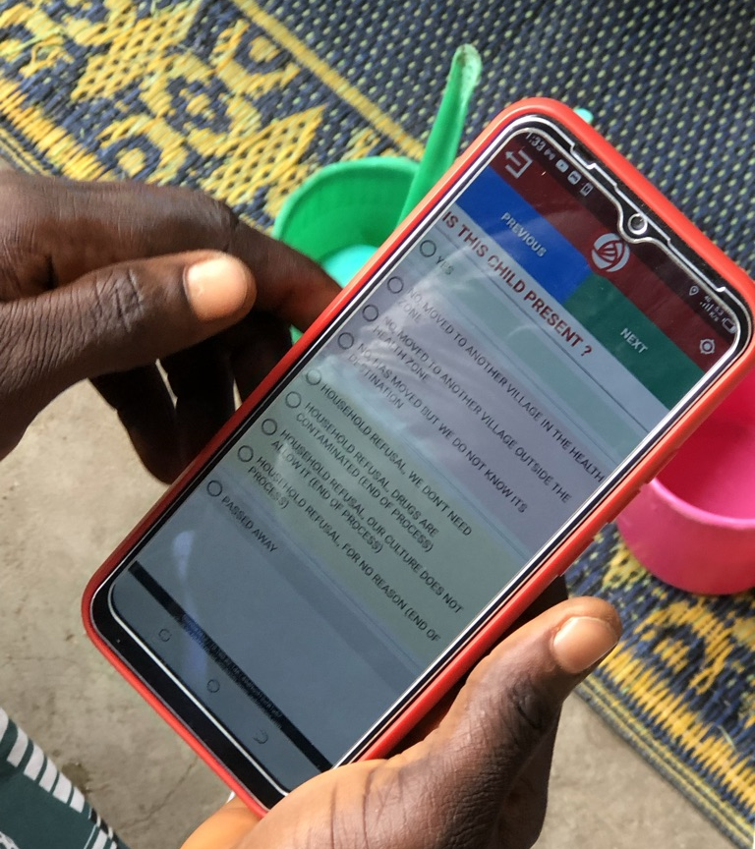
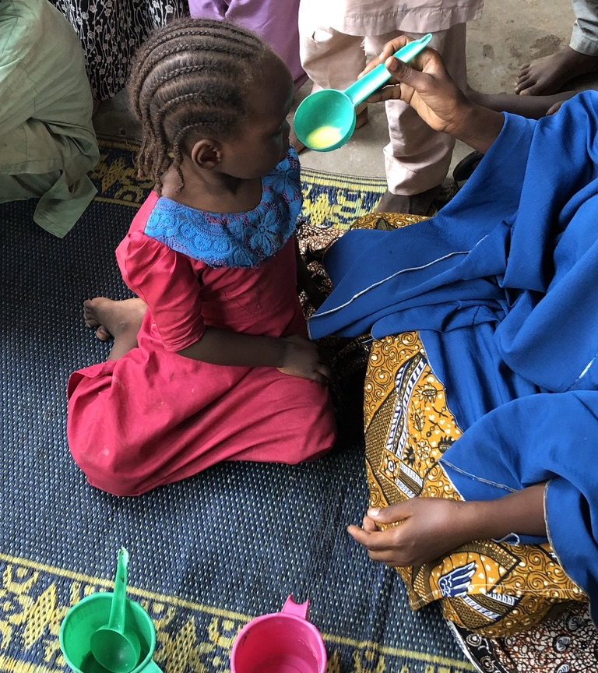

Slide 23
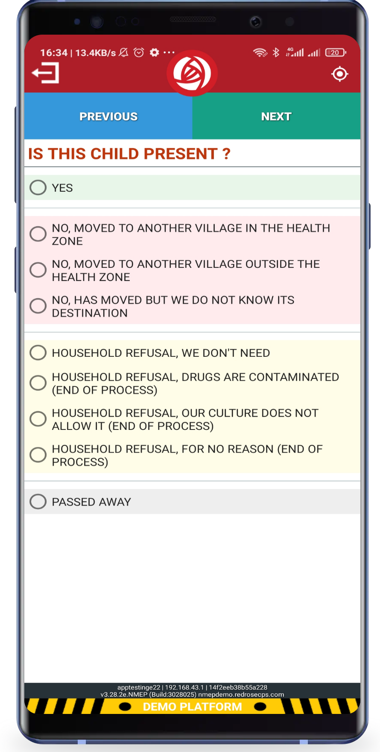
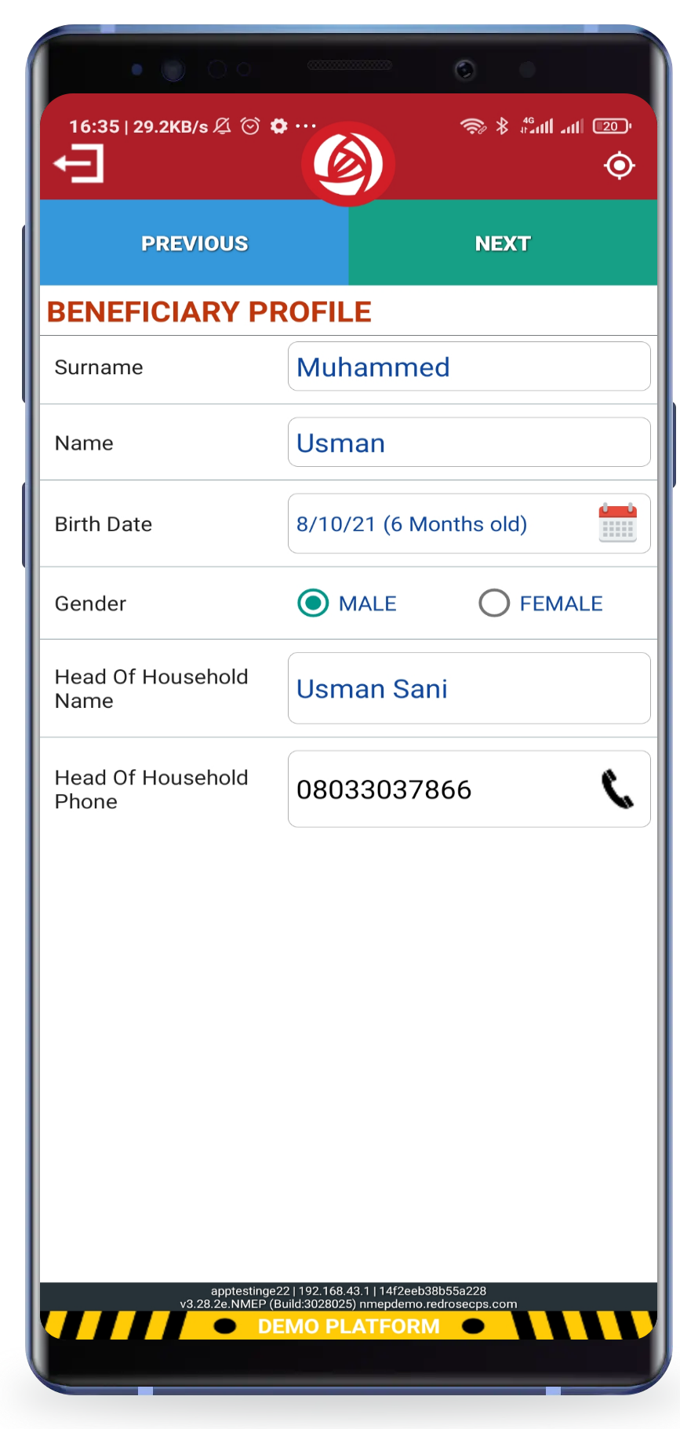
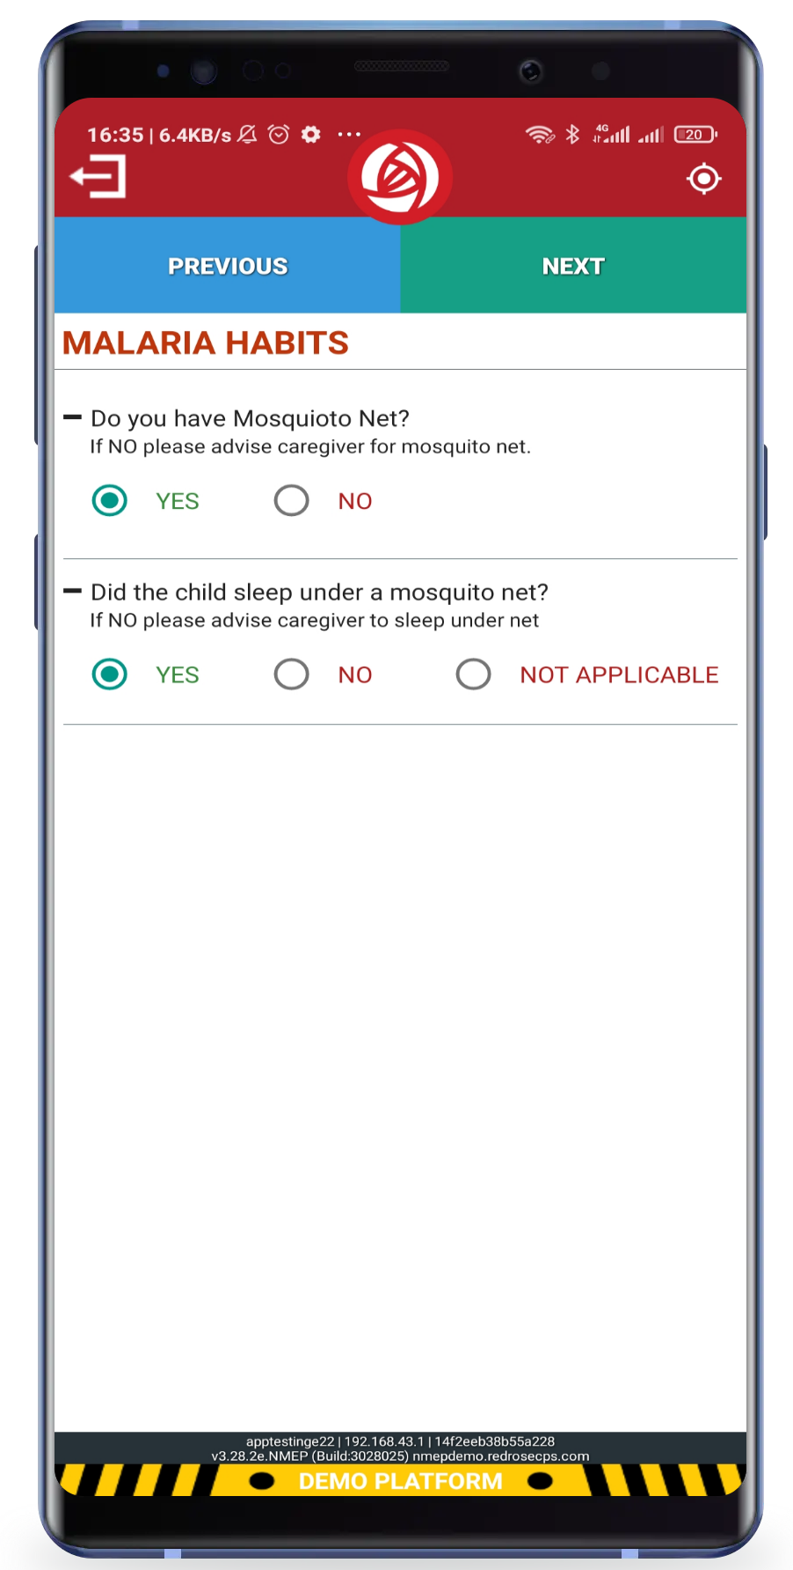

Slide 24
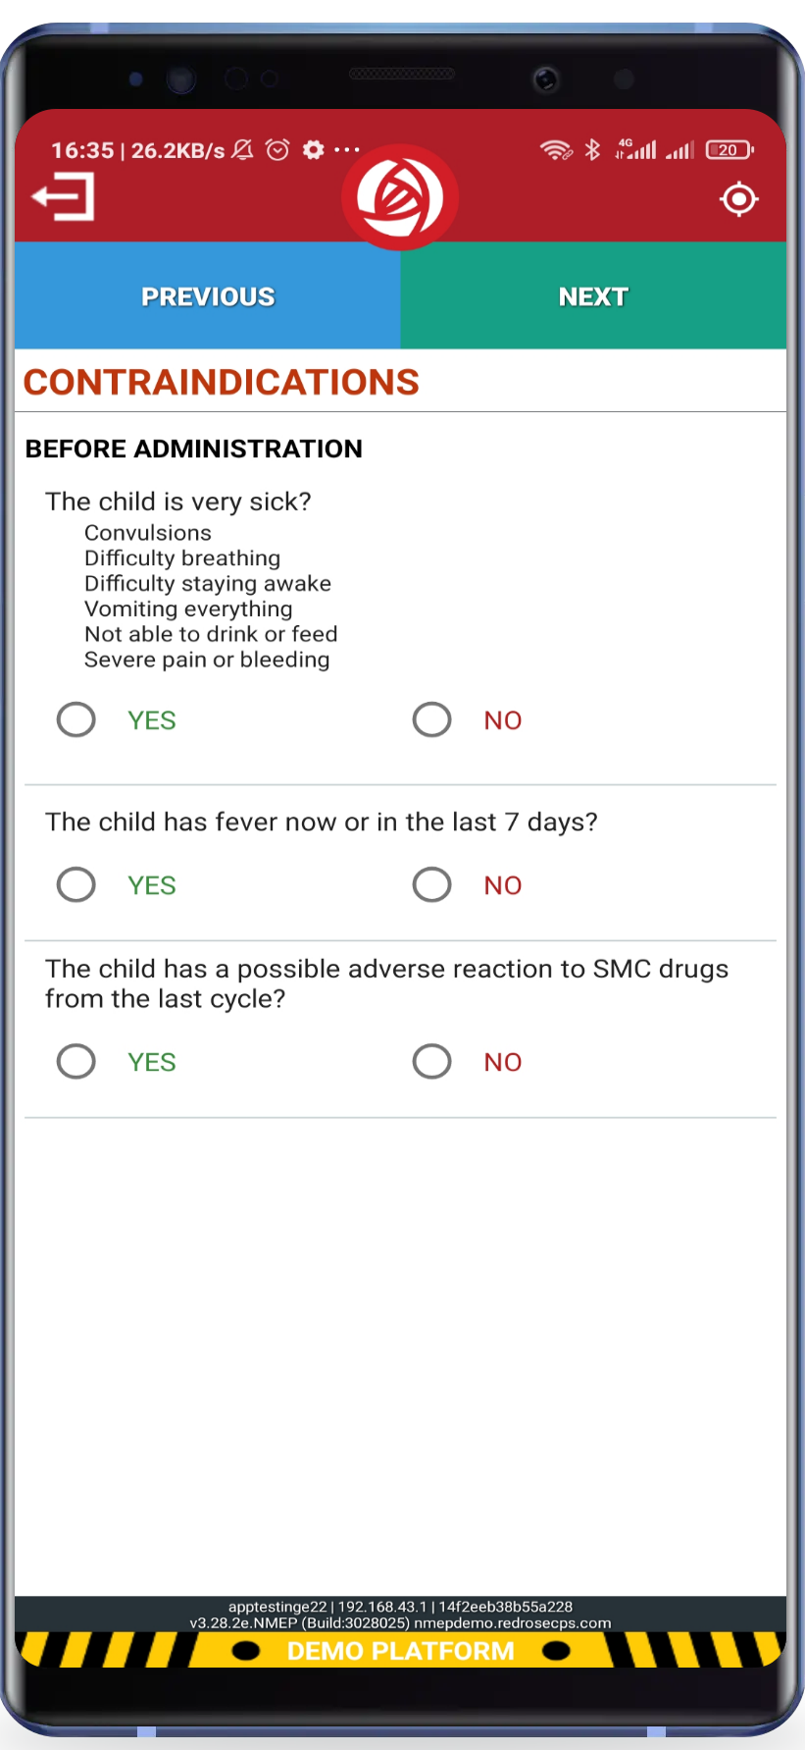
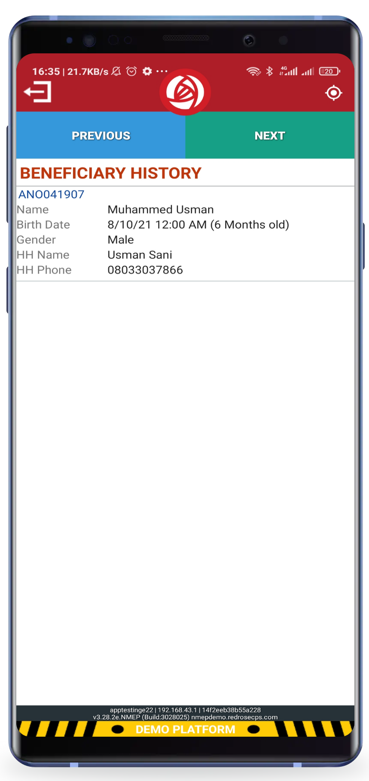
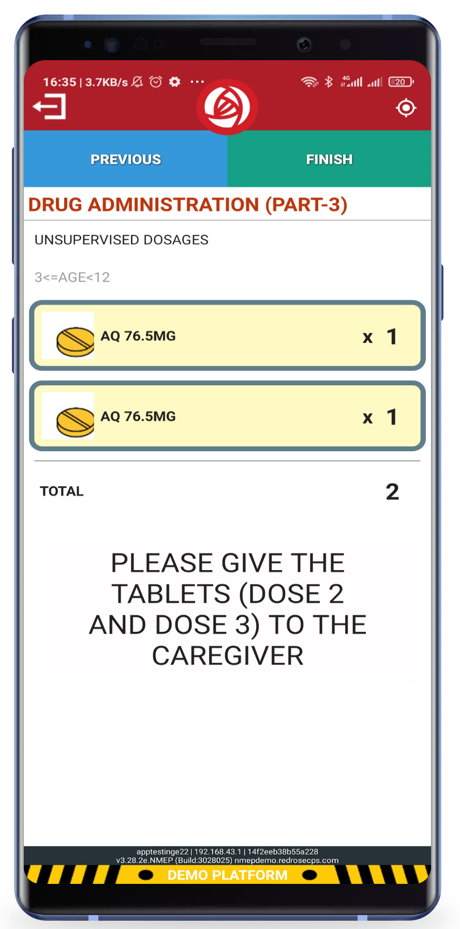

Slide 25
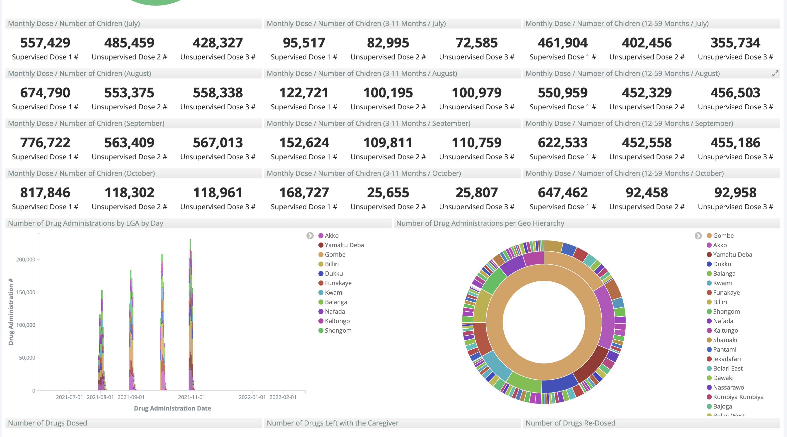

Slide 26
Key lessons learnt / innovation in 2021
Implementation of 5 Cycles in 3 States
The 2020 NMEP led stratification exercise recommended the expansion of SMC implementation from the 9 states within the Sahel region to an additional 11 states and the FCT Abuja from 2021 (making a total of 21)
These new states included Kogi, Nasarawa and Plateau which incidentally had longer periods of annual rainfall that the 9 Sahel states; with the rains usually starting earlier than June
In order to provide more protection to the eligible children (aged 3 – 59 months), an additional cycle was introduced in June in Kogi, Nasarawa and Plateau states
A total of 2,022,419 eligible children were covered during the 2021 SMC round in Kogi (397,198), Nasarawa (771,603) and Platea (853,618) states giving >100% admin coverage
During the period of implementation, some lessons were learnt

Slide 27
Key lessons learnt / innovation in 2021
Microplanning/Database/Training/Payments
Adequate planning for and timely delivery of resources for 5 cycles (against the standard 4) key to successful rollout
Obtaining the relevant national, state and LGA levels of approval, buy-in and support prerequisite for rollout
Selection and documentation of qualified community level personnel absolutely key to successful implementation
Need to emphasize 5-cycles during training of personnel
Resident community level personnel (CDDs, LMs and TA) proven to be more effective and efficient to the campaign
Timely payment of personnel motivated and encouraged continued delivery until the 5th cycle
Communities enthusiastic about SMC

Slide 28
Key lessons learnt / innovation in 2021
Security
Using established state and local level security channels to support SMC implementation provided huge security boost
Use of locals and indigenes for coordination and implementation of SMC in areas of high security threats reduced security risk to personnel, staff and partners
Use of security risk assessment reports before implementation and updated for each cycle ensured staff, partners and personnel safety during SMC distribution
SBCC
Engagement of community leaders as monitors during SMC distribution period strengthened monitoring & community coverage
Political advocacy is critical for success of any program. Early notification of stakeholders for planned activities was a deciding factor for recorded successes of SMC activities in the states
Traditional and religious leaders can be very supportive in mobilising caregivers for the uptake of SMC services

Slide 29
Key lessons learnt / innovation in 2021
Use of regular LQAS feedback mechanism improved subsequent SMC implementation through effective actions and recommendations
Refresher training to CDDs and LM on proper IPC strategy and correct SMC messaging improved quality of SPAQ administration to eligible children
The use of Lead Mothers improved adherence to SMC treatment protocol amongst caregivers

Slide 30
Thank you

