Slide 1
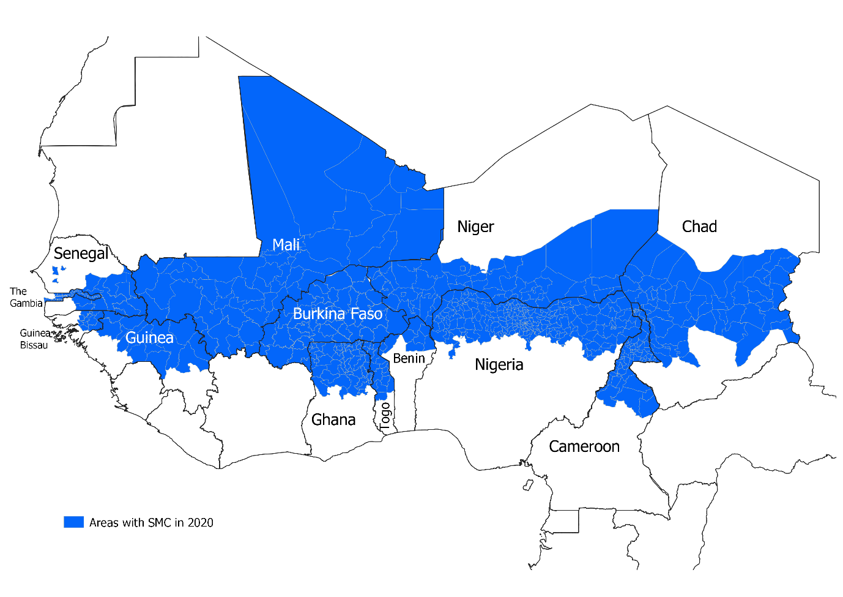
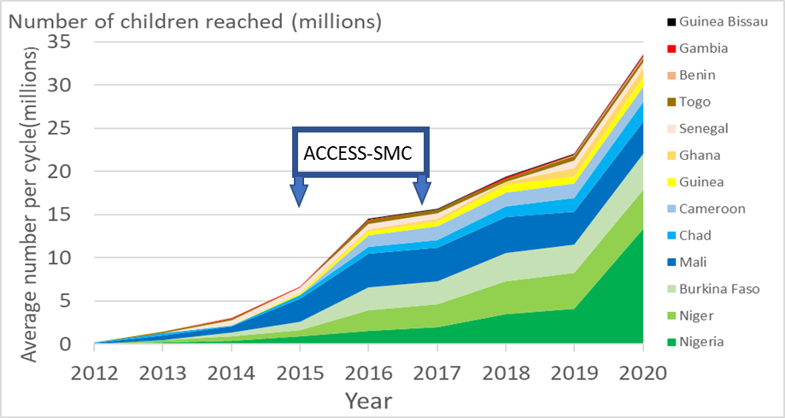
Session IIIb: Monitoring drug resistance and SMC efficacy
SMC in 2020
Cally Roper and Lucy Okell: Monitoring drug resistance to support the ongoing use of chemopreventive treatments
Issaka Sagara: Measuring effectiveness of SPAQ
Charlotte Rasmussen: Chemoprevention efficacy studies
Jean Louis Ndiaye: Monitoring SMC and IPTp efficacy through ante- natal clinics in Senegal

