Slide 1
WHO Malaria Guidelines – Seasonal Malaria Chemoprevention updates
SMC Alliance review and planning meeting 2023
28 Feb, 1-2 March 2023 Conakry, Guinea
Dr. Peter OLUMESE,
Global Malaria Programme
WHO, Geneva, Switzerland.

Slide 2
Main malaria prevention and treatment strategies

Slide 3
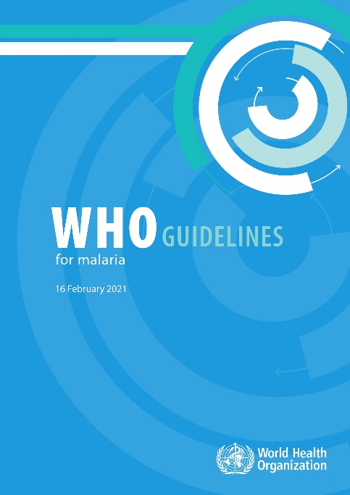
Main malaria prevention and treatment strategies
WHO Guidelines for Malaria (2021)
These consolidated guidelines replace 2 guideline documents on the WHO website: the Guidelines for the treatment of malaria, 3rd edition and the Guidelines for malaria vector control.
The sections in the WHO Guidelines for malaria includes
Prevention (Vector control, preventive chemotherapies and Vaccine)
Case Management
Elimination and prevention of re-introduction
Surveillance
As new evidence becomes available, the recommendations will be reviewed and updated, where appropriate, using WHO’s transparent and rigorous guideline development process.
Published in February 2021;
Latest update – 25th November 2022, and will be updated on a continuing basis
Available online: https://www.who.int/publications/i/item/guidelines-for-malaria

Slide 4
Key antimalarial interventions & strategies
Prevention
Insecticide-treated mosquito nets
Indoor Residual Spraying
Preventive Chemotherapy
IPT in pregnancy (IPTp)
Perennial Malaria Chemoprevention (PMC /IPTi+)
SMC
IPT in School Children
Post Discharge malaria chemoprevention
MDA
Malaria vaccine
Diagnosis & Treatment
Parasite based diagnosis
Microscopy
Rapid Diagnostic Tests
Artemisinin-based combination therapies (ACTs)
Severe Malaria
Artesunate
Case management service delivery areas::
Health facilities
Community Case Management
Private sector
Surveillance, M & E
Routine HMIS
Malaria surveillance and response systems
Household surveys
Health Facility Surveys
Strengthening health systems in endemic countries

Slide 5
Preventive Chemotherapies

Slide 6
Seasonal Malaria Chemoprevention - definition
Seasonal malaria chemoprevention (SMC) is the intermittent administration of a curative dose of antimalarial medicine during the malaria season, regardless of whether the child is infected with malaria.
The objective of SMC is to establish antimalarial drug concentrations in the blood that clear existing infections and prevent new ones during the period of greatest malaria risk.
SMC is recommended in areas of seasonal malaria transmission.

Slide 7
Seasonal Malaria Chemoprevention

Slide 8
Practical information
WHO recommends a combination medicine for SMC that is different from that used for first-line malaria treatment.
The component medicines should have closely matched pharmacology, such that no component is present in the absence of other components for more than a minimal amount of time in order to reduce the risk of new infections encountering only a single drug.
Implementation
Please refer to the Seasonal malaria chemoprevention with sulfadoxine-pyrimethamine plus amodiaquine in children: A field Guide

Slide 9
Chemoprevention recommendations – shift in approach
The updated chemoprevention recommendations provide greater flexibility to NMPs to adapt control strategies to suit their settings.
No longer specify strict age groups, transmission intensity thresholds, numbers of doses or cycles, or specific drugs.
NMPs are encouraged to consider local data to determine how best to tailor chemoprevention strategies to local needs and determine which age groups should be targeted where, for how long, how frequently, and with which drugs.
Further guidance on specificities will be provided through implementation field manuals, based on current available evidence.

Slide 10
Unpacking chemoprevention: SMC
Seasonal Malaria Chemoprevention
Criteria/data for intensity of malaria transmission
Criteria/data for seasonality
Criteria for number of cycles
Criteria/data for target age group determination
Protocol for measuring protective effectiveness
Efficacy and safety of antimalarials SMC alternative to AQ+SP
SMC field implementation manual (2011)
Guideline Criteria for adoption: updated Implementation Field Guide (2nd edition).
CPES protocol
Need development
Updated, 2nd edition, 2023. Publication in progress

Slide 11
Unpacking SMC – further guidance (Field Guide 2nd ed, 2023)
Target area:
malaria transmission is highly seasonal and the majority (>60%) of clinical malaria cases occur within 4 consecutive months
the clinical attack rate of malaria (without SMC) is at least 0.1 episodes per child during the transmission season in the target group
Target population
Children in age groups at high risk of severe malaria are eligible. In most countries with intense seasonal malaria transmission, these are children below 5 years of age.

Slide 12
Unpacking SMC – further guidance (Field Guide 2nd ed, 2023)
Number of cycles
SMC courses should be given at 28-day intervals, beginning at the start of the transmission season and continuing for 3–5 cycles, depending on the local context.
In some settings, three cycles may be sufficient.
Add a fifth cycle if a month on either side of the 4-month season contributes more than 10% of the annual burden
Gains from adding a sixth SMC cycle appear to be minimal and not cost effective
Recommended medicines
The combination of SP+AQ is currently recommended for SMC.

Slide 13
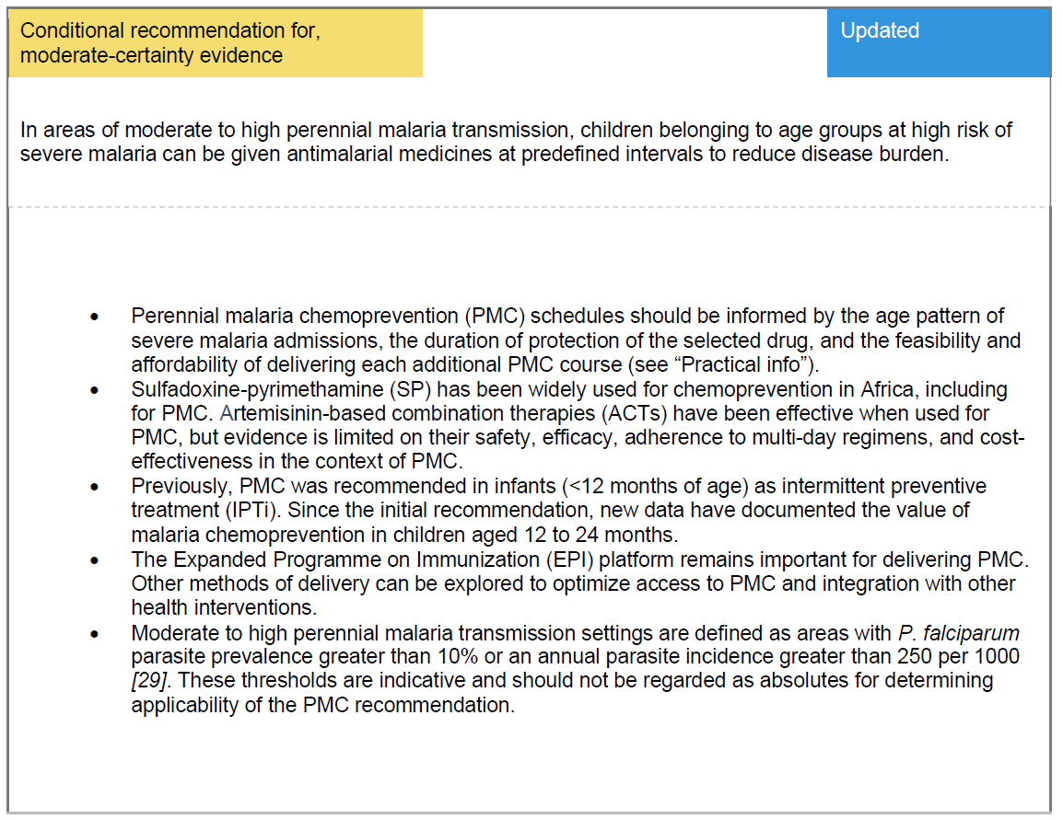
Perennial Malaria Chemoprevention (former IPTi)

Slide 14
Intermittent preventive treatment of malaria in school-aged children (IPTsc)

Slide 15
Post-discharge malaria chemoprevention (PDMC)

Slide 16
Overview - implementation guidance documents status update
SMC
Implementation Field manual 2nd edition
Updated, publication in process
IPTp at community level
New field manual to be developed
PMC
Projects and early implementation underway to provide the evidence required for expansion of IPTi beyond the current recommendation and transition to PMC. – Development of updated implementation field manual – planned.
IPTsc and PDMC
Implementation Guidance document not yet available
Deployment studies and experience required to develop implementation guidance documents

Slide 17
Thank you
Keep our eye on the prize: a world free of malaria

