Slide 1
Seasonal Malaria Chemoprevention (SMC)
2022 Campaign
NIGERIA
Dr Emmanuel Shekarau, SMC Focal Person, NMEP-NIgeria
Prepared for the 2023 SMC Alliance Meeting - Conakry, Guinea

Slide 2
Summary information for 2022 and plans for 2023 campaigns
 | 2022 | 2023
Start and end dates | 2nd Jun – 21st Oct | 1st June – 20th Oct
Number of cycles | 4 cycles in 16 states 5 cycles in 5 states | 4 cycles in 16 states 5 cycles in 5 states
Number of districts targeted | 383 | 383
Number of children covered | 27,638,429 | 28, 638,429
Age ranges covered | 3 – 59 months (<5yrs) | 3 – 59 months (<5yrs)
Coverage (% targeted children receiving all cycles) | 102%
Any plans for campaign digitalization? | Yes | Yes
Any drug resistance testing or efficacy studies performed? (Y/N) | No | Yes

Slide 3
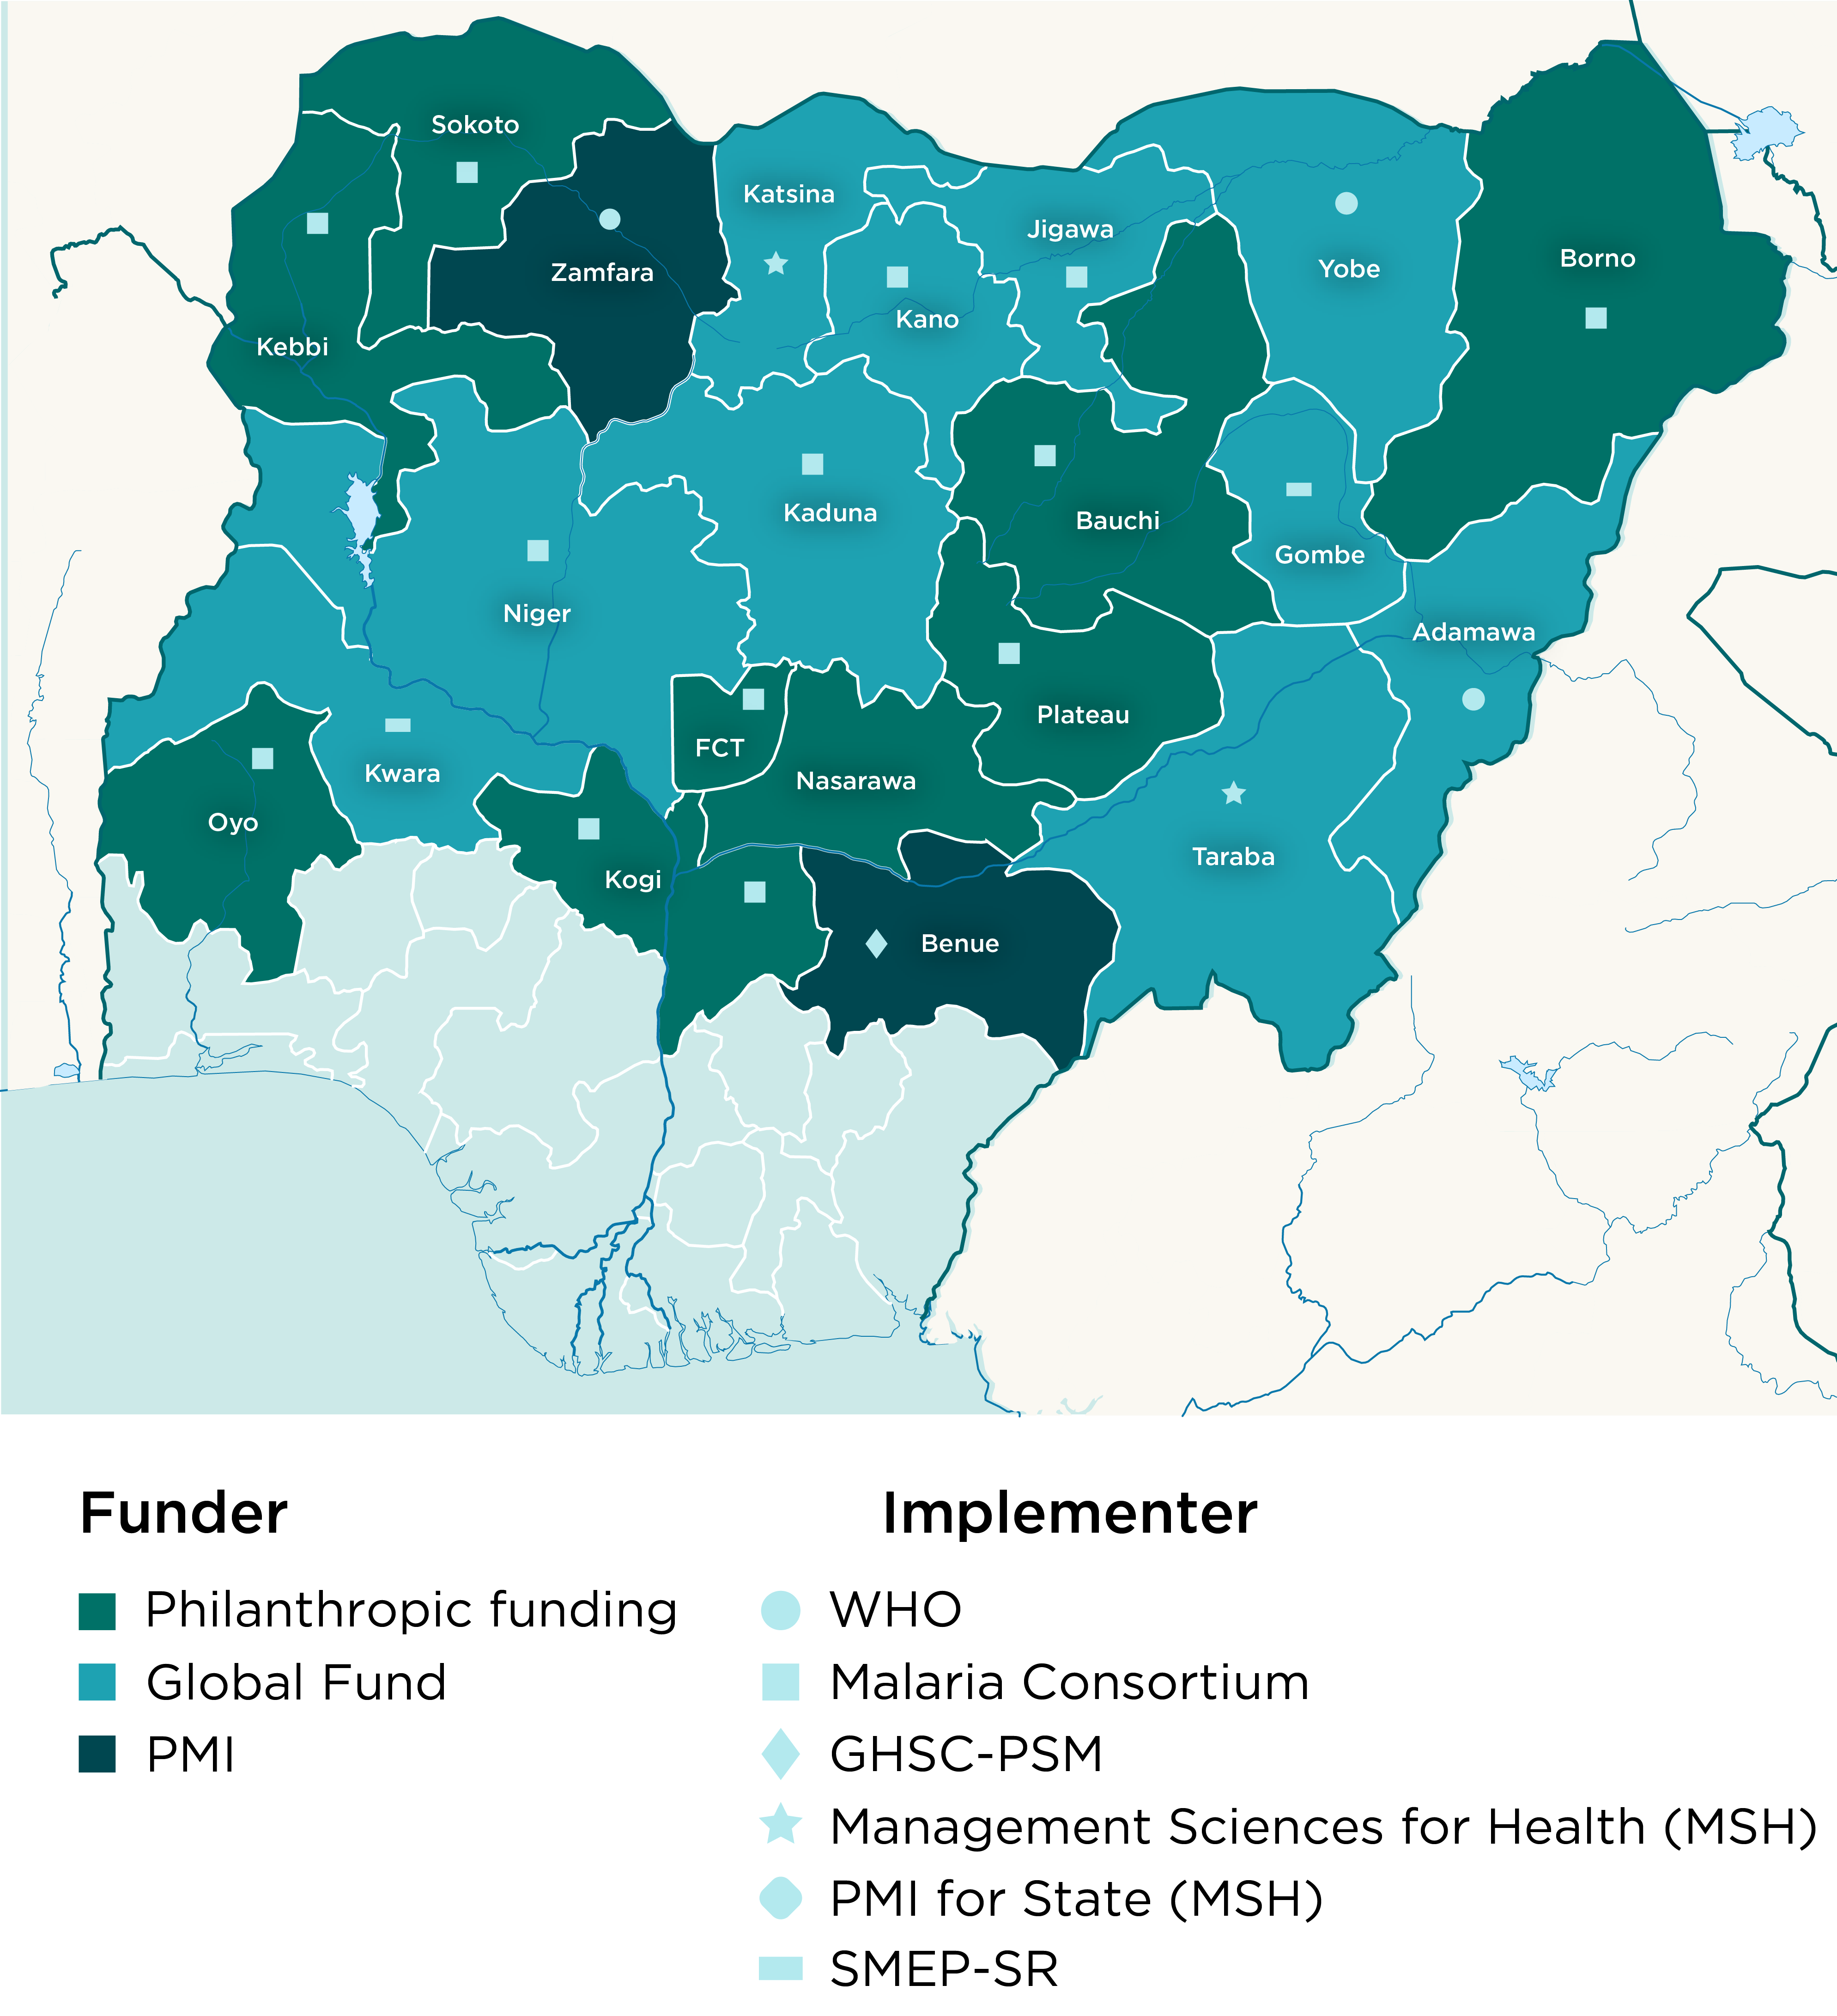
Country map showing SMC implementing districts
2022 map (covered)
2023 map (targets)

Slide 4
Focus Digitalization

Slide 5
Key lessons learnt / innovation in 2022: Focus Digitalization
What was a problem you were trying to solve?
Data driven decision making and informed monitoring were possible using reported data transmitted real-time
Using unique beneficiary IDs, children who received SPAQ are accurately tracked each cycle for the entire round.
The team leveraged on GIS data to identify suspicious activities and strengthen monitoring and supervision during implementation.
The digitization of SPAQ commodity management was piloted with positive outcome that will be used to improve commodity accountability for future implementation.
The use of technology enhanced prompt payment processes contrary to the previous paper base documentation
Digitalization provided a more reliable platform to obtain cohort tracking information.

Slide 6
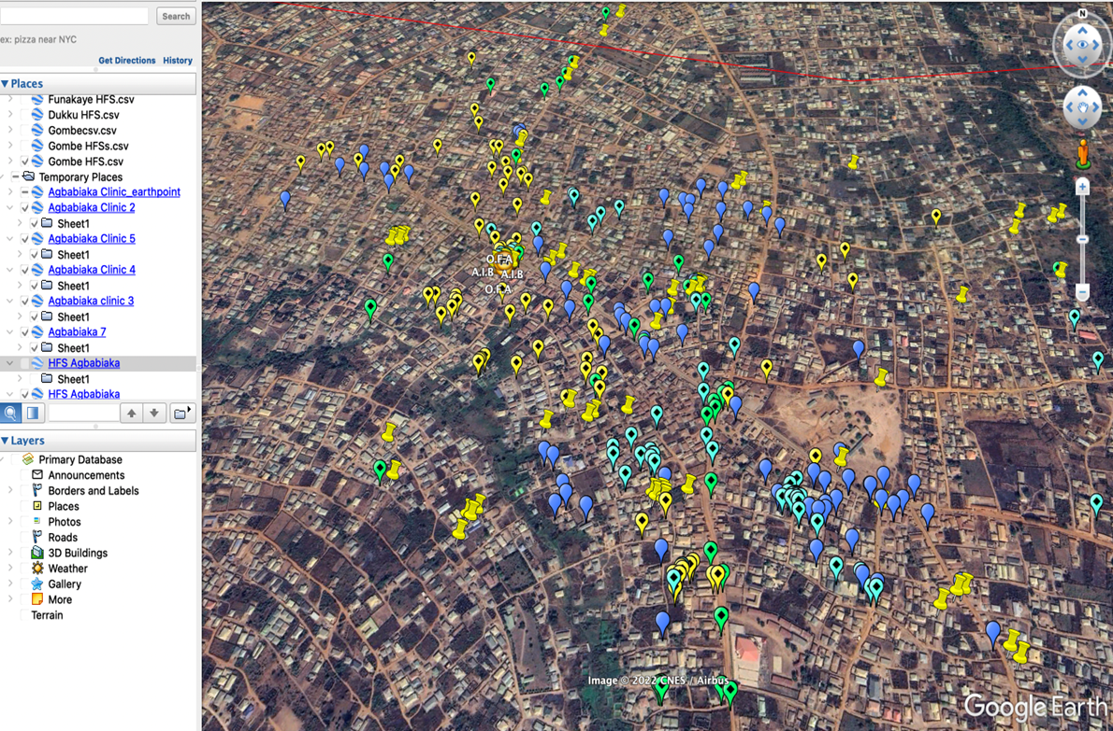
Strengthened monitoring & Supervision
Targeted monitoring
Tracking of field monitors
Validate personnel participation in field activities
Identify suspicious activities

Slide 7
Improved commodity management
SPAQ Commodity tracking
Consumption rate tracking
Daily stock tracking
Daily reconciliation

Slide 8
Improvement in program quality
Realistic cohort tracking data using beneficiary IDs

Slide 9
Key lessons learnt / innovation in 2022: Focus Digitalization
What was the design of the digitalization?
NMEP was tasked with the digitalization of SMC and routine activities in Nigeria​. This involves the use of ICT4D (Information and Communication Technologies), leveraging on the BYOD (Bring Your Own Device) approach to scale up the digitalization to selected states in the country
ICT4D is a compound name used for all digital tools and technologies used for national/international development​, Examples of digital tools: Red Rose, KoboToolBox, Survey CTO, Commcare, ONA, etc.​
Design Objectives
To create a system to fast-track payments of campaign personnel
To improve the SMC data management process, accountability of commodities and overall quality of SMC implementation

Slide 10
Key lessons learnt / innovation in 2022: Focus Digitalization
What challenges did you face
Delayed acceptance of the technology by some stakeholders in at the state level resulted to some inadequacies in cycle 1 implementation
Limited mobile network coverage in difficult terrains affected real-time data reporting during implementation
Low capacity of enrolled personnel as a result of not adhering to selection criteria for Community Distributors
Issues of incompatible devices brought by the Community Drug Distributors which could not be used for the application

Slide 11
Key lessons learnt / innovation in 2022: Focus Digitalization
What would you do differently in the future?
Continue to strengthen SMC processes – Cohort tracking, Re-dose, referral ADRs and SPAQ commodity management​ using digital technologies and tools
Exhaustively utilize the benefits of technology to improve efficiency and quality of service delivery with sustainability in view
Improve the capacity of state and local government staff to leverage on technology, become more efficient and carryout field activities with minimal support

Slide 12
Thank you

