Slide 1
SEASONAL MALARIA CHEMOPREVENTION
MONITORING & EVALUATION SUB-GROUP
Update to the Annual Meeting 2023
SMC M&E Sub-Group of the SMC Alliance
For questions or feedback, email: ceddis@psi.org

Slide 2
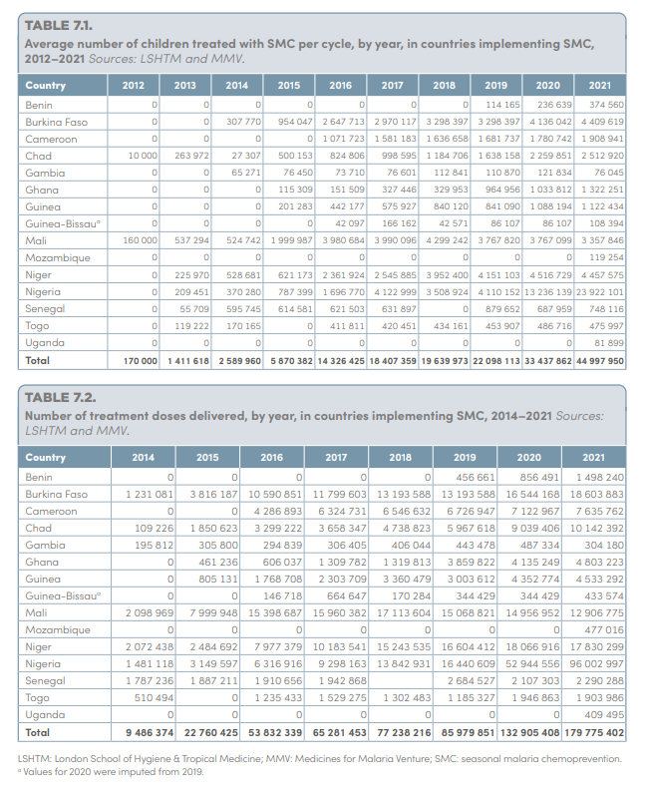

Achievements in 2022
  Supported the World Malaria Report 2022 SMC chapter
  Incorporated SMC M&E Performance Framework into updated WHO SMC Field Manual
https://www.who.int/teams/global-malaria-programme/reports/world-malaria-report-2022

Slide 3
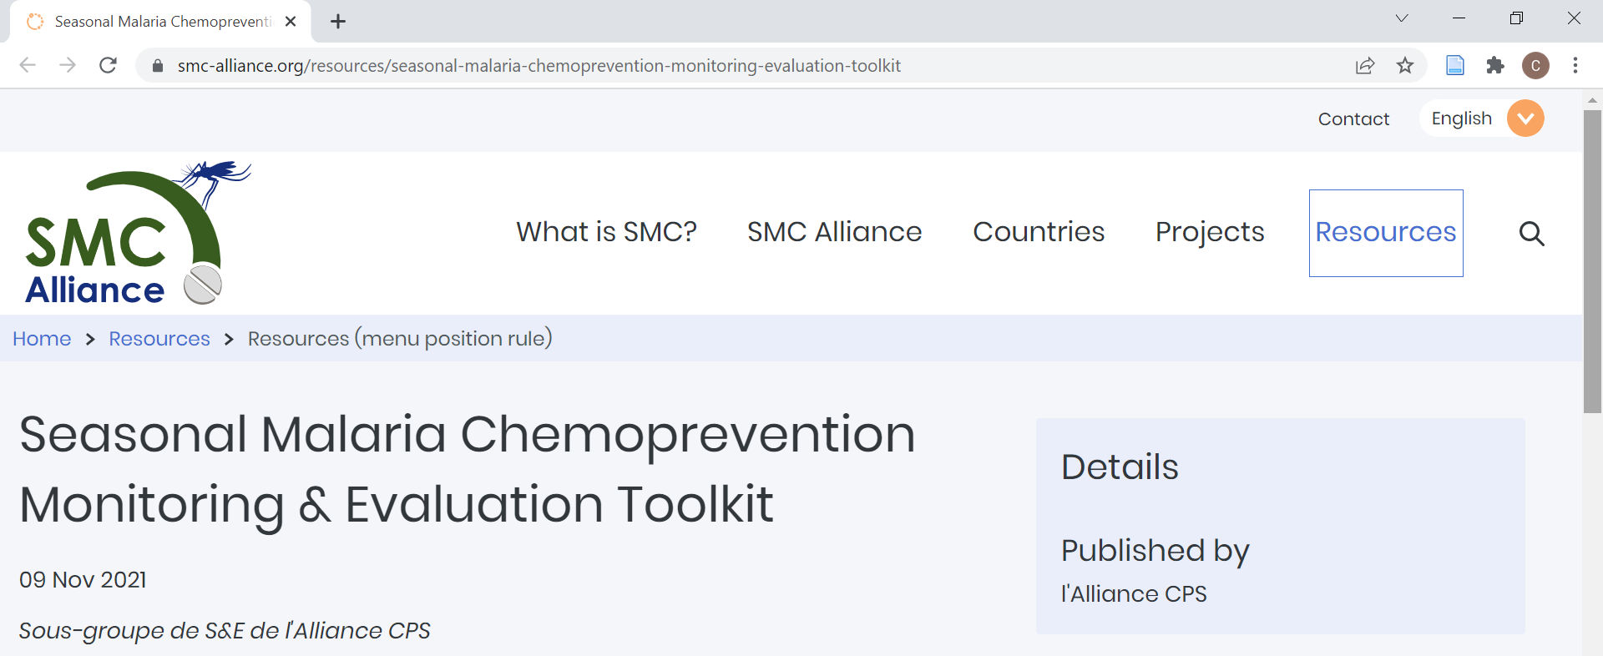
SMC Alliance Website Resources
English: https://www.smc-alliance.org/resources/seasonal-malaria-chemoprevention-monitoring-evaluation-toolkit

Slide 4
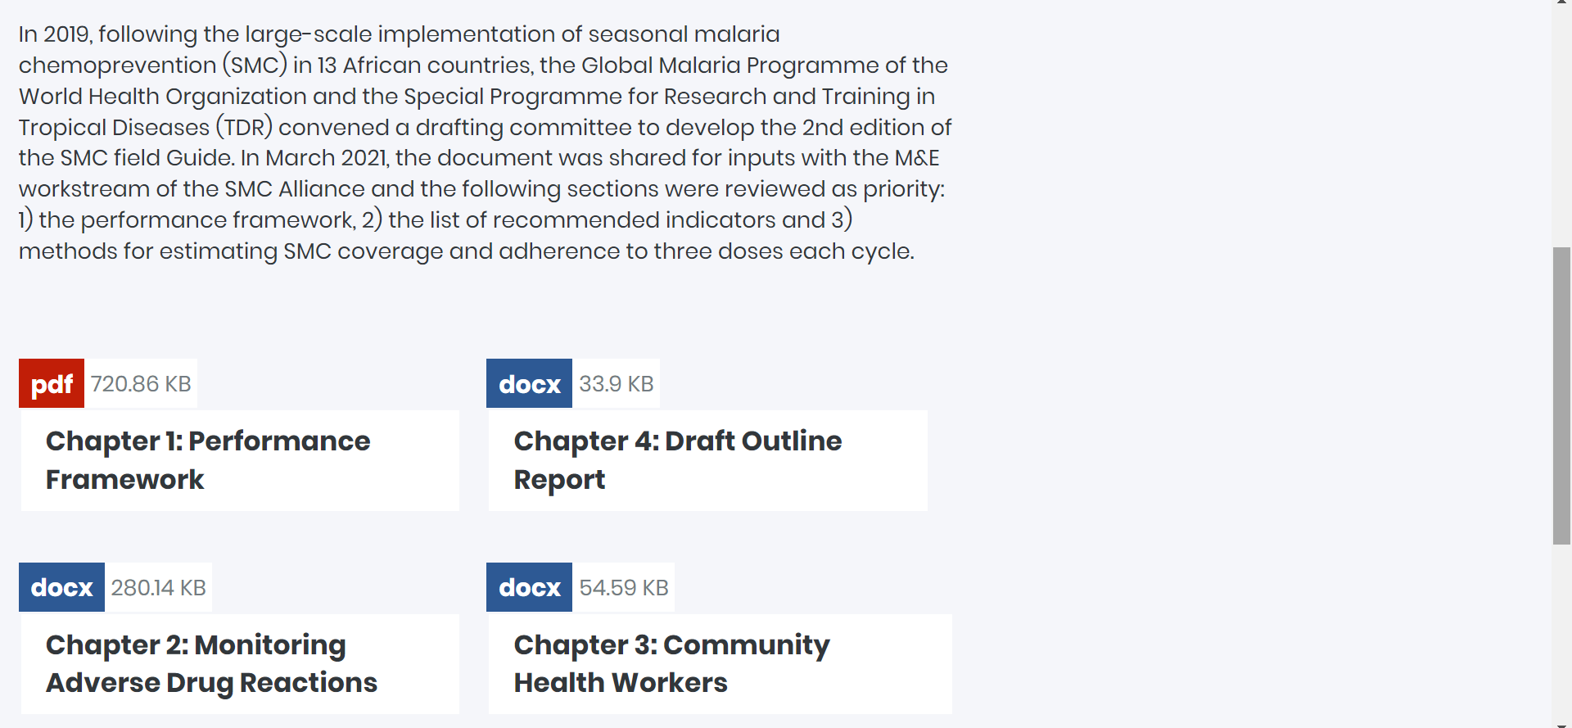
SMC Alliance Website Resources continued

Slide 5
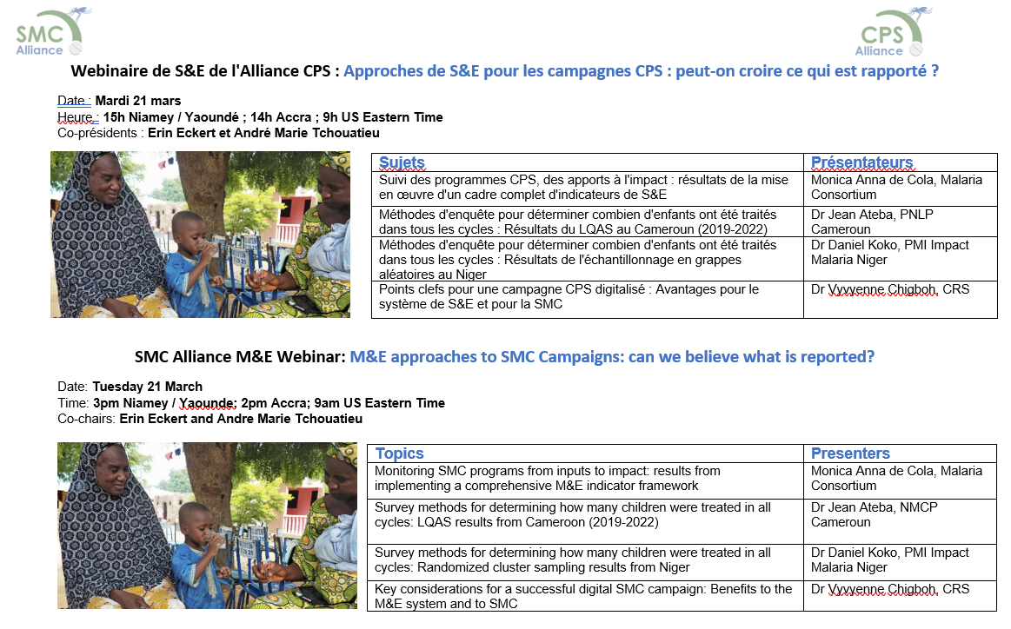
What’s next?

