Slide 1

SMC campaign 2022 in West Africa: regional perspectives
WAHO
RBM
Seasonal Malaria Chemoprevention (SMC) Alliance annual review and planning meeting, Conakry, Guinea 28 Feb - 2 Mar, 2023

Slide 2
Outline
Introduction
Findings from support visits
Best practices
Areas to improve
Recommendations
Conclusion
RBM 2022

Slide 3
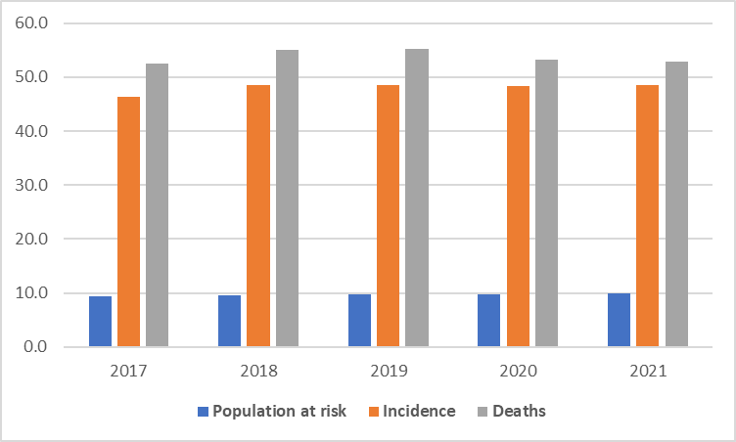
Disproportionate Share of Global Malaria Cases and Deaths in ECOWAS Region
WMR 2022

Slide 4
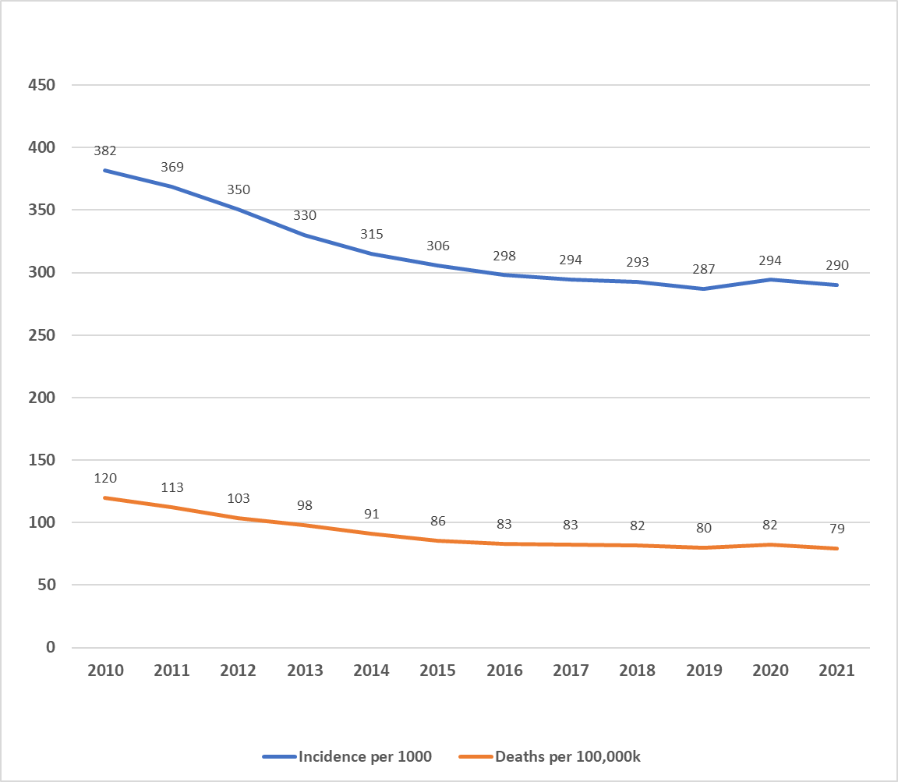
Stagnated Malaria Incidence and Death Rates in ECOWAS Region
Stagnated incidence and death rates since 2017
In 2021, 120 million estimated cases
327,000 deaths
WHO 2020
WMR 2022

Slide 5
SMC in ECOWAS
SMC one of the tools for malaria prevention in the region
Started in 2012
Number of regions has generally increased, >3500 districts in 2022 in all SMC countries
WAHO’s experience strongly via a World Bank-funded SMC/NTD project 2016-2020 in BFA, MLI, NER
  Centralised procurement
  Cross-border collaboration
  Synchronised campaigns
  Joint supervision
  Integrated with NTD
Another project, funded by AfDB, on NTDs in same 3 countries to consolidate gains in cross-border collaboration, 2023-2025

Slide 6
Overview of SMC/NTD Project, 2016-2020
Project Title | Malaria and Neglected Tropical Diseases in the Sahel
Project Development Objective (PDO) | Increase access to and use of harmonised community-based services for the prevention and treatment of malaria and certain neglected tropical diseases in cross-border areas of beneficiary countries
Implementation Period and Budget | World Bank 2016-2020 : US$121 millions US$. (OOAS $ 10 M)
Geographical coverage | 56 border health districts: Burkina Faso (20), Mali (19) Niger (17)
Partners | WHO, CAMEG-BF, WAHO(Regional coordination)
Main intervention strategies | IEC, Integrated seasonal malaria chemoprevention and mass drug administration; surgical repair of trichiasis; hydrocoele removal

Slide 7
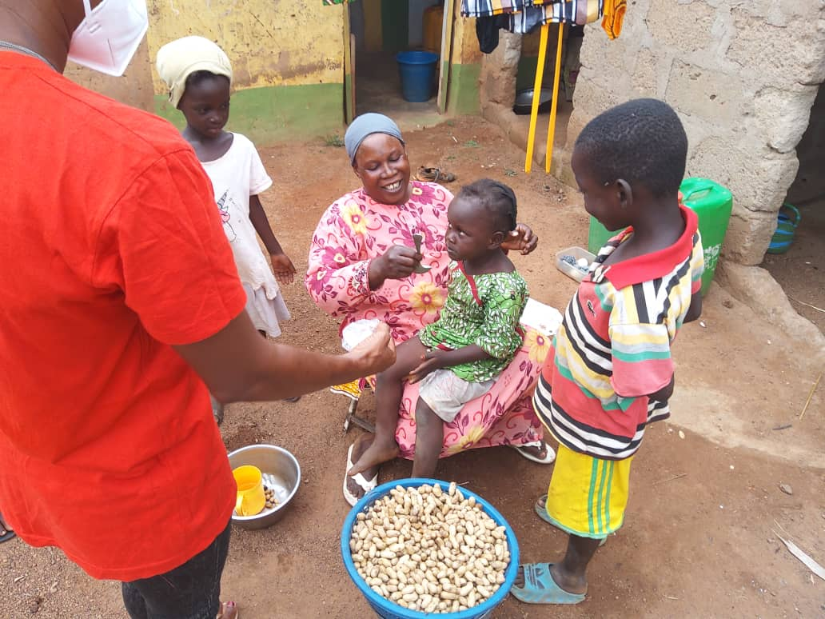
Support visits to countries
Visits to 6 countries in 2021 and 5 countries in 2022
Countries visited in 2022
Benin, Ghana, Niger, Nigeria, Togo

Slide 8
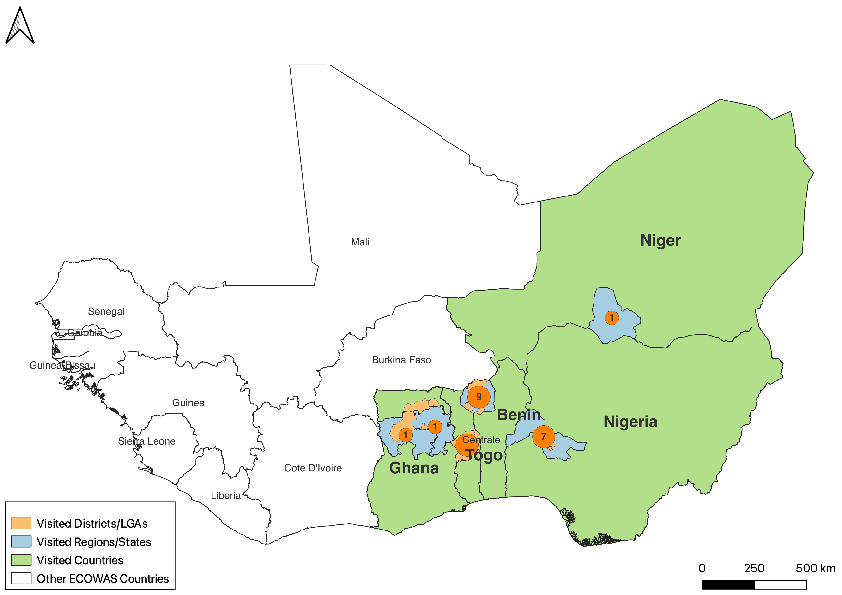
Sites visited by WAHO in 2022

Slide 9
Objectives of Support Visit
Learn at first hand the planning processes, field experiences and data analysis relating to SMC campaigns and provide technical support as needed
Learn about the digitalization of SMC campaigns involving the use of hand-held personal digital assistants for data management
Participate in the supervision of the SMC including the management of drugs and biomedical waste
Participate in the review of daily performance in drug distribution, health promotion, nutrition assessment of children, promotion of the use of insecticide-impregnated nets as well as the management of refusals and side-effects
Provide support in the data collection, collation, quality control and dissemination

Slide 10
Elements in SMC
Microplanning and coordination
Logistics management
Human resource management
Social mobilisation
Service delivery
COVID-19 measures
Health service data management
Pharmacovigilance
Biomedical waste management
Quality assurance
Cross-border collaboration

Slide 11
Characteristics of SMC campaigns
Country | Date | No. of days per round | No. of regions | No. of districts | No. of health facilities | No. of SMC cycles | SMC cycle during support visit | No. of members per distributor team | Drug admin | Nutrition screening | Bednet education | Digitalization | Distribution strategy
Benin | 18 to 23 Aug 2022 | 3 | 1 | 6 | 9 | 4 | 2 | 2 | Yes | No | No | Yes | DDS
Ghana | 8-13 Aug 2022 | 7 | 3 | 4 | 6 | 4 | 3 | 1 | Yes | No | No | Yes | DDS
Niger | 17 to 22 Aug 2022 | 4 | 1 | 7 | 7 | 4 / 5 | 2 | 2 | Yes | Yes | Yes | Yes | DDS + FS
Nigeria | 28 Jul - 01 Aug 2022 | 4 | 1 State |  | 7 | 4 / 5 | 1 | 2 | Yes | No | No | Yes | DDS + FS
Togo | 01 - 03 Sept 2022 | 3 | 1 | 5 |  | 4 | 3 | 2 | Yes | No | No | No | DDS + FS
DDS=door-to-door strategy; FS = fixed strategy

Slide 12
Observations 1/5
No. | Domain | Strengths | Gaps
1 | Microplanning and coordination | Microplans prepared; list of personnel available | Often no maps or tables displayed to illustrate the health communities assigned to the various volunteers and their supervisors
 |  | Regular meetings - physical and virtual
 |  | National and regional supervision teams
2 | Logistics management | Pre-positioning of supplies | No programme bags to transport medicines and consumables by the CHWs or if available, damaged and worn out
 |  | Adequate supply of logistics in terms of drugs, tablets, posters, etc

Slide 13
Observations 2/5
No. | Domain | Strengths | Gaps
3 | Human resource management | Recruiting distributors who live in the community helps increase acceptance because they are known and easily accessible in the event of a reaction | Managing CHWs drop out after training
 |  | Knowledgeable and motivated CHWs and supervisors | More remuneration for CHWs in hard-to-reach communities
CH | Social mobilisation | Posters, T-shirts for volunteers and supervisors | Low visibility of the campaign at the regional and district health directorate (no banners or posters announcing the campaign)
 |  | Posting of key campaign information on boards in the waiting rooms of the health facilities visited; | No information about the campaign at a major mosque in one of the communities. Within 1h, visiting team found 5 care-givers in the vicinity of the mosque who were not aware of the campaign and whose children had not been dosed, even during the preceding round
 |  | Communication about the campaign using multiple channels including radio, churches, mosques, gong gong beaters

Slide 14
Observations 3/5
No. | Domain | Strengths | Gaps
5 | Service delivery | Counselling done prior to drug administration | No DOTS: If the child is absent, distributor leaves the entire treatment is left with the mother for administration
 |  | Mothers were generally requested to lead the administration of medicines to their children. | In a few households, mothers had kept the drugs and not given them to their child on days 2 or 3.
 |  | Community Health Volunteers (CHVs) revisit household on days 2 and 3 | In one case in which the mother started the regimen in reverse with the drug meant for the first day, not yet given while Day 2 drugs had been given
 |  |  | Little effort by the volunteers or supervisors to manage, even when other mothers with whom refusals lived in the same house had accepted treatment
 |  |  | Non-systematic marking of the houses visited
 |  |  | Marking of the house with chalk is only done to indicate that a child has received complete dose in a particular round with no indication of number of eligible children

Slide 15
Observations 4/5
No. | Domain | Strengths | Gaps
6 | COVID-19 measures | CHWs were trained on COVID-19 measures and some wore masks | Community members mostly did not wear mask. Little physical distancing.
7 | Health service data management | Service record integrated into child health card | In some cases, recording of the SMC service delivery in MCH booklets was either not done at all or it was done inconsistently
 |  | Independent rapid evaluation of the campaign, after each round, in one country | No further analysis of the causes and distribution of the refusals and if they were resolved. Notion that the number of refusals was insignificant in percentage terms even if they were large in absolute terms
 |  | Digitalization to different extent in different countries. | Manual data collection and processing is still in effect
 |  | An electronic Kobo Collect checklist was used to guide monitors - assesses the availability and adequacy of SMC data collection tools, health facility workers performance, pharmacovigilance, supply chain management, CDDs performance | To charge the phones in order to use the data collection app was a challenge and so hampered data synchronization

Slide 16
Observations 5/5
No. | Domain | Strengths | Gaps
8 | Pharmacovigilance | Monitoring done through daily review meetings | Poor communication on what to do in case of drug rejection or adverse events
 |  |  | Few supervisors demonstrated inadequate knowledge on Adverse Drug Reactions and management
9 | Biomedical waste management | Waste by burnt in pits dug in the ground | Absence of specific guidelines on the management of biomedical waste (RDT, used masks, etc)
 |  |  | In some centers, waste was disposed at the back of the building.
10 | Cross-border collaboration | Guidan Roumdji district in Niger started cross-border coordination with 3 border districts of Nigeria by creating a WhatsApp group | No cross- border SMC planning with the neighbouring countries

Slide 17
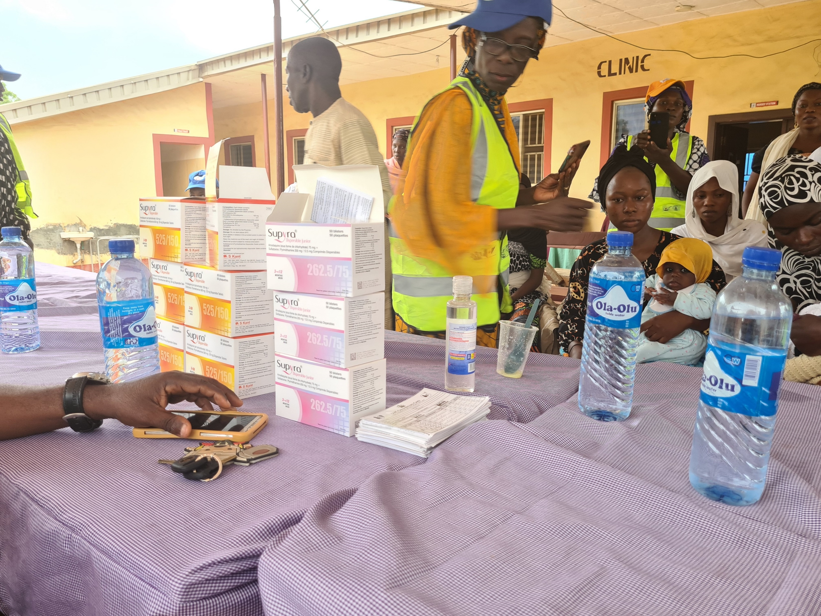
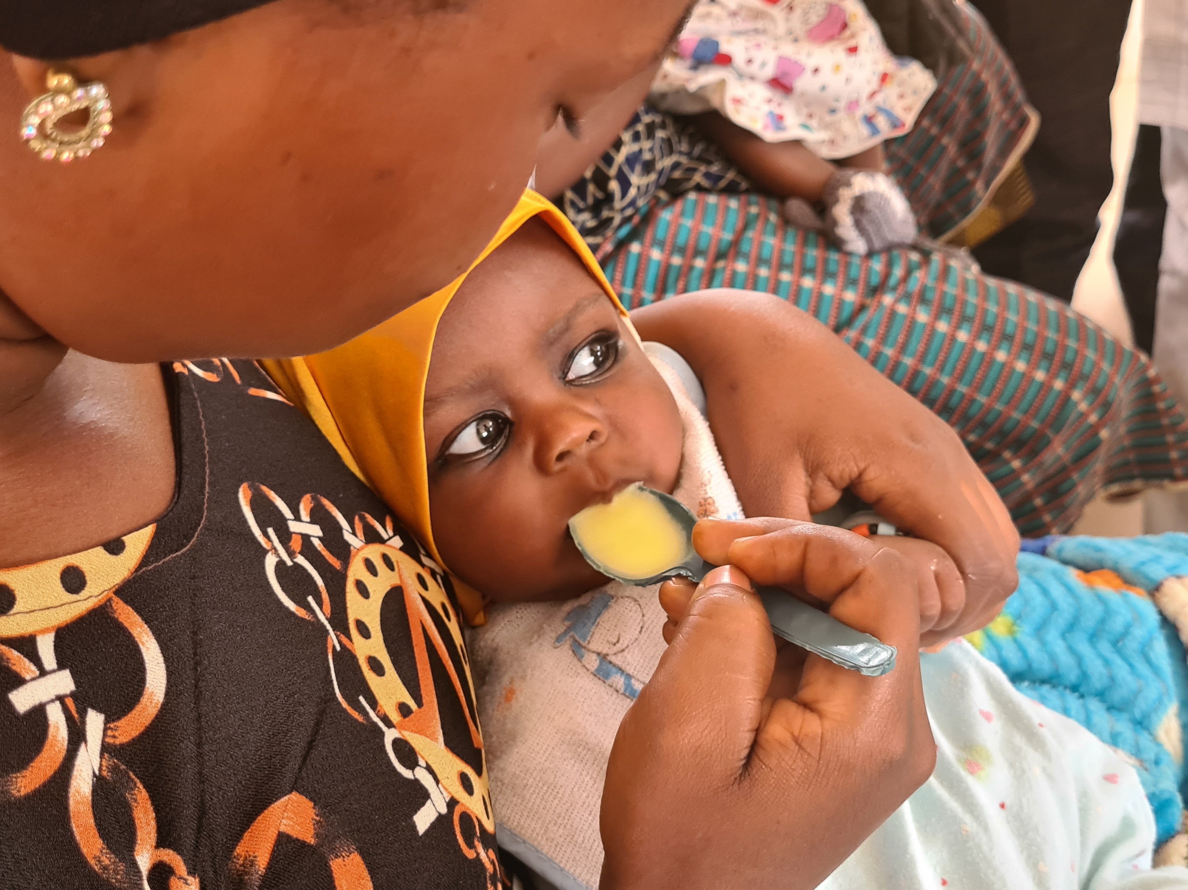

Slide 18
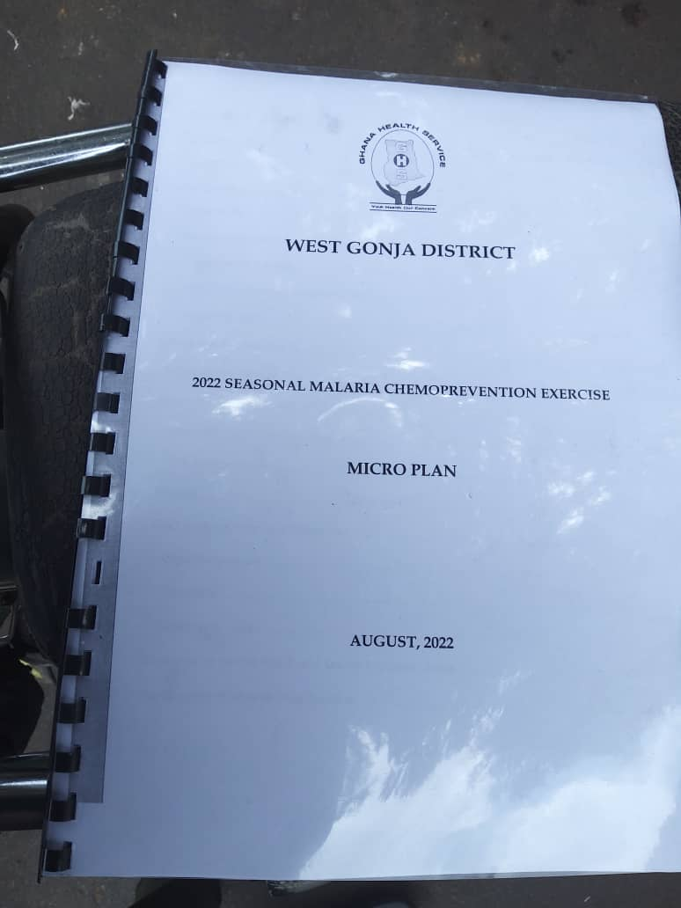

Slide 19
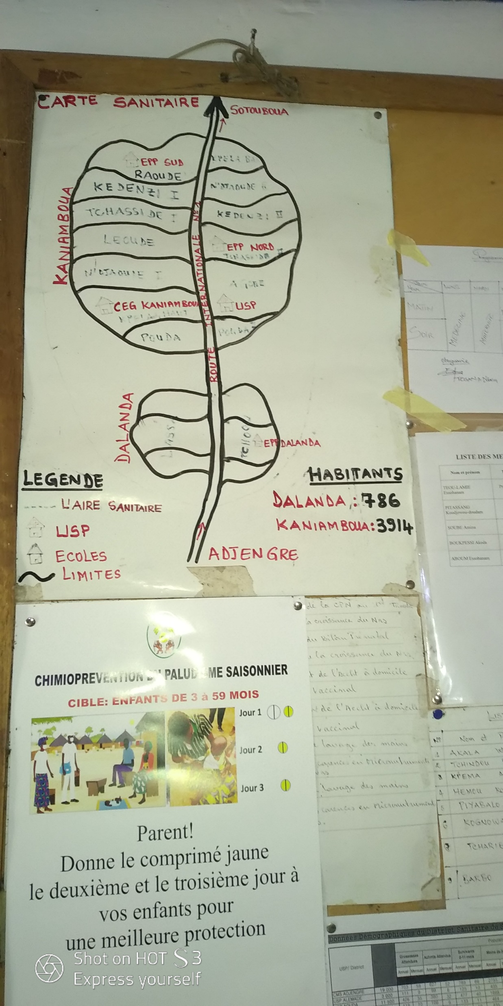
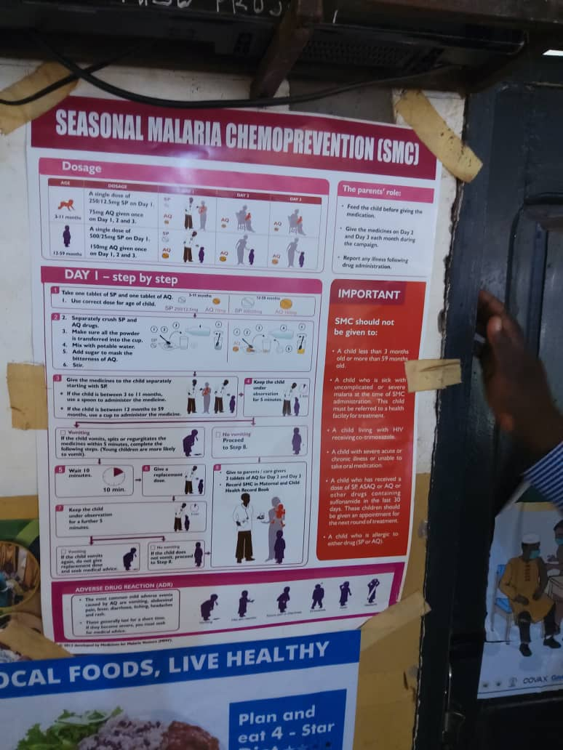

Slide 20
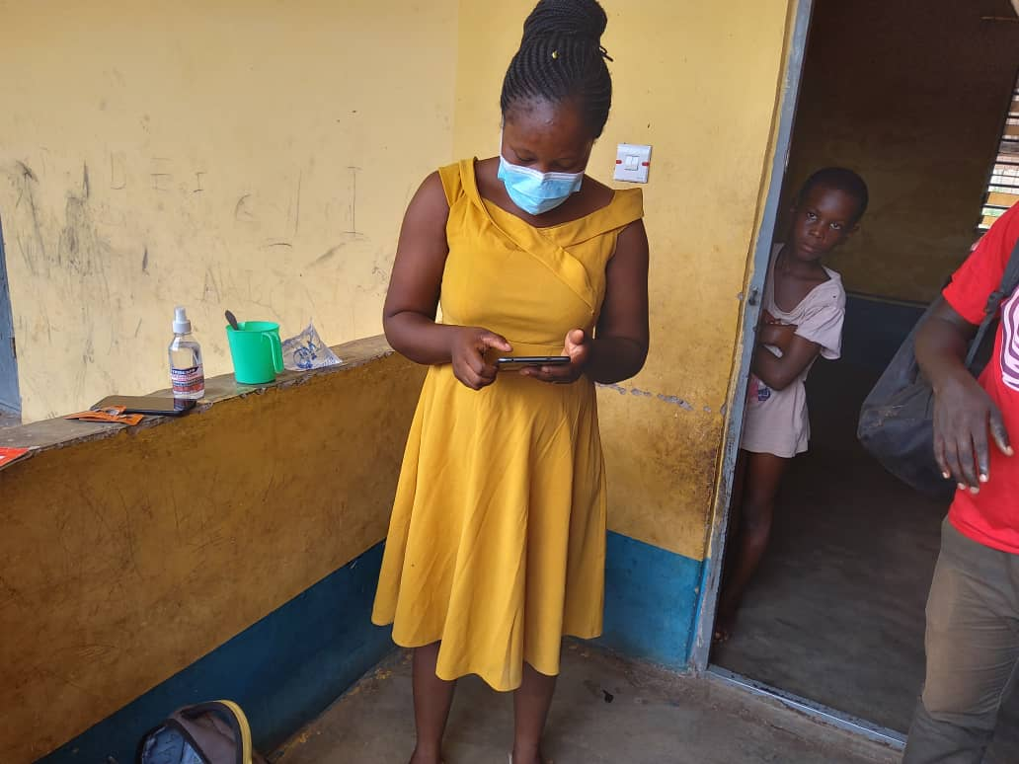
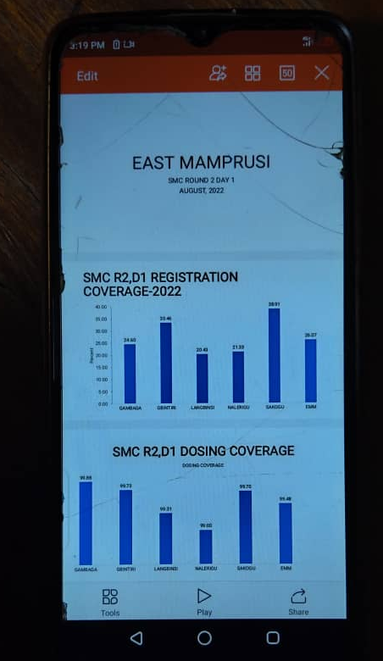

Slide 21
Recommendations 1/2
Human resource selection | Select CDDs from host community
HR motivation | Payment workers adequately in order to motivate them to give in their best at the for the success of the exercise. Payment CDDs in remote areas higher rates
Service record | Supervisors should emphasize the need for DOTs and the proper filling of child record forms by CCDs and the day 2 and 3 by care givers.
Missed opportunities | Adopt a dynamic registration system to permit children encountered who did not normally live in a community or those from adjoining regions to be dosed
Data collection | Provide power banks for the CDDs to prevent interruption of work when their phone batteries are drained
Visibility of campaign | Ensure sufficient visibility materials are provided and displayed

Slide 22
Recommendations 2/2
Pharmacovigilance | Keep vigilance of adverse effect of the drug administration as well as identify areas that needs more attention the in exercise.
Logistics | Provide robust bags for field work
Funding | Increase the effort to provide for domestic SMC campaign funding for sustainability
Scope of services | Include aspects of nutrition screening, health education and service delivery in the SMC
Cross-border collaboration | Explore Cross-border collaboration
COVID-19 measures | Respect COVID-19 prevention protocols, in line with national requirements
Biomedical waste management | More attention to waste management

Slide 23
Areas to strengthen
Social mobilisation
Ensuring complete coverage and complete dosing of eligible children
Cross-border planning, coordination and implementation
Harmonized processes – indicators (registration, dosing coverage), problem of denominators, marking of houses, duration per round
Quality assurance
  Regional and national supervisory support
  Problem solving oriented performance review meetings
  Digitalization of campaign
  House marking
  Post-campaign surveys
Training in new field guidelines

Slide 24
Best Practices
Two performance targets are defined: registration of, at least, 90% of the estimated population of children aged 3-59 months in the district; and dosing of, at least, 95% of the children registered (GHA).
Digitalization of SMC – data collection, cleaning, analysis, reporting
Integrated SMC, nutrition screening (NER)
Independent rapid evaluation of SMC after round 3 (TGO)
Daily coverage survey was carried out via visit to the community and home to ensure coverage of the drug administration (NGA)
Cross-border populations including refugees of Nigeria covered by Niger
Community Health Volunteers (CHVs) revisit household on days 2 and 3 (GHA)

Slide 25
Conclusions
WAHO and prioritise SMC in their malaria programmes
In collaboration with RBM, ALMA and other partners, WAHO to continue to support SMC and other interventions
Gaps in social mobilisation and service delivery coverage
Opportunities to reduce refusals
Increased drive towards digitalization of campaigns
Needs: harmonization of indicators and procedures; harmonize data collection tools; management of waste; integrated campaigns; cross-border collaboration; increased domestic funding

Slide 26
THANK YOU

