Slide 1
The landscape of Malaria chemoprevention
An analysis of need and demand for SMC commodities in sub-Saharan Africa

Slide 2
Background
This deep dive is part of the forecasting project whose objective is to combine available data on ongoing financial investments and strategic national planning for the use and expansion of malaria commodities to produce a consensus view of malaria commodity market trends and support identification of potential supply risks and efficient planning/resource allocation.
Deep dive objectives:
To outline broader context on marketplace for specified commodities
Exploration of demand side and supply side considerations and scenarios for how demand for specified product may evolve
Why chemoprevention:
Updates to the WHO recommendations for IPTp, MDA, PMC & SMC
Introduction of other preventive methods e.g malaria vaccine(s) which may affect the landscape.
The deep dive discusses both PMC & SMC but focus will be on the SMC findings.

Slide 3
Updates to the WHO recommendations for SMC
Previous recommendation (2012) | New recommendation (June 2022)
Geographical restrictions to Sahel subregion | Removal of restrictions based on geography and SP resistance.
Maximum doses stipulated: 4 monthly doses of SMC during the malaria transmission season. | Removed of specifications around monthly cycles
Age: Limited to children under 5 years of age. | Age: SMC use is not limited to children under 5 years of age; use shall be guided by the local area’s risk of severe disease.

Slide 4
Methods
Areas with rainfall seasonality ≥ 60% per the Markham’s Seasonality Index + Pf Prevalence ≥5%
Regions identified as eligible for SMC based on updated WHO recommendations
Population estimates from SMC Alliance and IHME to project the number of children aged 3-
59 months and 5-9 years in these regions
Number of SPAQ treatments
SMC need: SPAQ treatments to all regions that are eligible
SMC demand: SPAQ treatments to all regions that are have implemented SMC in the past, or have ongoing pilots

Slide 5
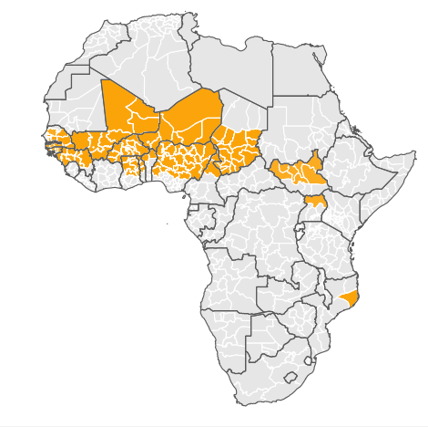
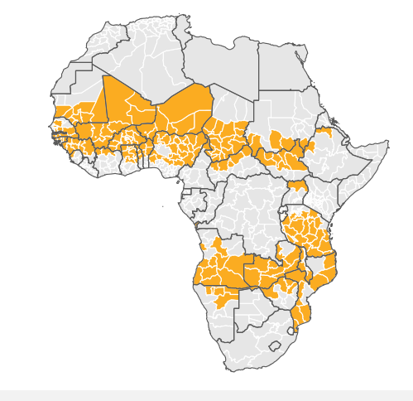
Potential for expansion of SMC under new WHO recommendations
SMC implementing areas (2022)
SMC eligible areas under expanded WHO criteria

Slide 6
The ages 3-59 months population covered with SMC could increase by up to 1.5 times per year if all regions that are eligible for SMC implement it.
TAKEAWAYS
SMC demand is driven by population growth in admin-2 areas already implementing SMC and gradual expansion into other eligible areas with highly seasonal malaria transmission.

Slide 7
Translated to SPAQ treatments, expansion to all eligible areas would double the number of treatments procured between 2021 and 2031.

Slide 8
Considerations for future uptake of SMC
For sustainable expansion of SMC, there needs to be;
1. Evidence of effectiveness of SPAQ in new areas
2. Affordable and safe treatment options, with sufficient supply to meet market demand
3. Effective methods of distribution in age cohorts over 5 years
4. Sufficient funding
In the updated 2022 guidelines, WHO recommends a combination medicine for SMC that is different from the country’s first-line malaria treatment.
Notes:
DHA/PQP - has been shown to have results comparable to those of SPAQ In studies done in Burkina Faso in 2015. However, the commodity cost of a full curative treatment with DHA+PQP is about triple the cost of treatment with SPAQ or AL.
SUPPLY
Supply for SPAQ is sufficient to meet market demand, with 3 manufacturers in the market
FUNDING
SMC has been adequately funded since its inception on 2012, domestically and by partners including the Global Fund, PMI, MSH and GiveWell.
DHA+PQP – study in BFA in 2015 showed similar efficacy level as that of SP+AQ
AS+AQ – studies in Ghana in 2011 showed that this therapy reduced incidence of clinical malaria & parasite prevalence in children<5 years
AL + antiparasitic (albedazole+praziquantel) – studies in Ghana in 2016 -co-administration of IPT for malaria and deworming was associated with a significant reduction in malaria parasite prevalence after interventions in Study Arms 1 and 2 when compared to Control Arm 3, where no antimalarial drug was given, though effect on anaemia was varied.

Slide 9
Conclusions
Scale up of SMC in recent years has been rapid, from 14 million children treated with SMC in 2016, to 45 million in 2021.
Given the sustained interest observed in SMC over recent years, we have projected continued increase in uptake of SMC, driven by expansion to eligible areas and population growth.
However, it is possible that there will be a levelling off or reduction in SMC as countries move towards more targeted deployment approaches and/or have to grapple with budget constraints.
SPAQ for SMC is an inexpensive interventions for commodity procurement, with program delivery being the primary cost consideration for funding.
However, for SMC, use of alternate treatments may be necessary to mitigate resistance. This could have a substantial impact on program costing.
Link to the deep dive: here

Slide 10
THE END
THANK YOU
IVCC
The malaria atlas project

