Slide 1
Global Fund Update Chemoprevention Financing
SMC Alliance – February/March 2023

Slide 2
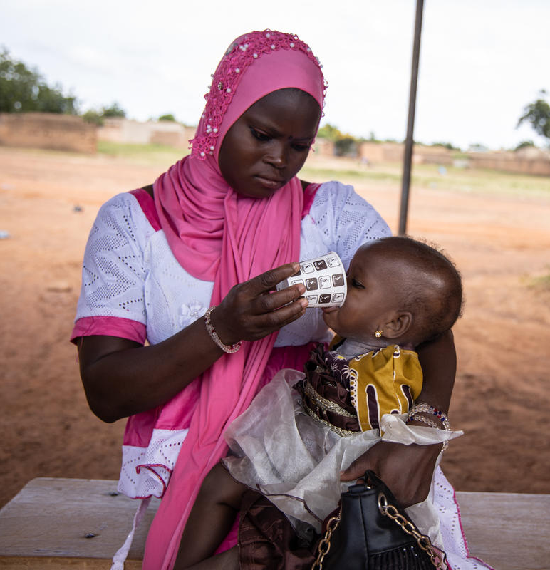
Overview
Global Fund Strategy 2023 – 2028
Moving to the new Grant Cycle (Grant Cycle 7)
    Timelines
    Allocations
    Chemoprevention guidance
Key considerations for funding request

Slide 3
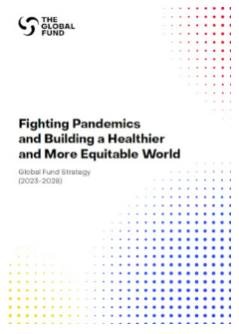
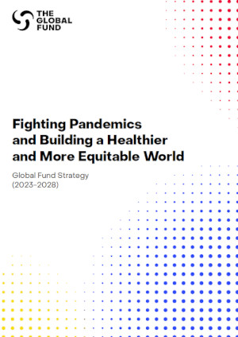
1. Global Fund Strategy 2023-2028
Support in-country capacity for sub-national tailoring and evidence-based prioritization of tailored malaria interventions.
Build capacity for quality data generation, analysis & use at national and sub-national levels.
Ensure sub-nationally tailored planning considers factors beyond malaria epidemiology such as health systems, access to services, equity, human rights, gender equality (EHRGE), cultural, geographic, climatic, etc.
Ensure quality of all commodities and monitor effectiveness.
Deliver all interventions in a timely, people-centered manner.
The new Strategy document is available here.
Malaria Strategy
Objectives
Implement malaria interventions, tailored to sub-national level, using granular data, and capacitating decision-making and action
Ensure optimal and effective vector control coverage
Optimize Chemoprevention
Expand equitable access to quality early diagnosis and treatment of malaria, through health facilities, at the community level and in the private sector, with accurate reporting
Drive towards elimination and facilitate prevention of re-establishment of malaria
Support data driven intervention selection and implementation modality.
Support flexibility on implementation strategies including integration within primary healthcare (PHC) as relevant.

Slide 4
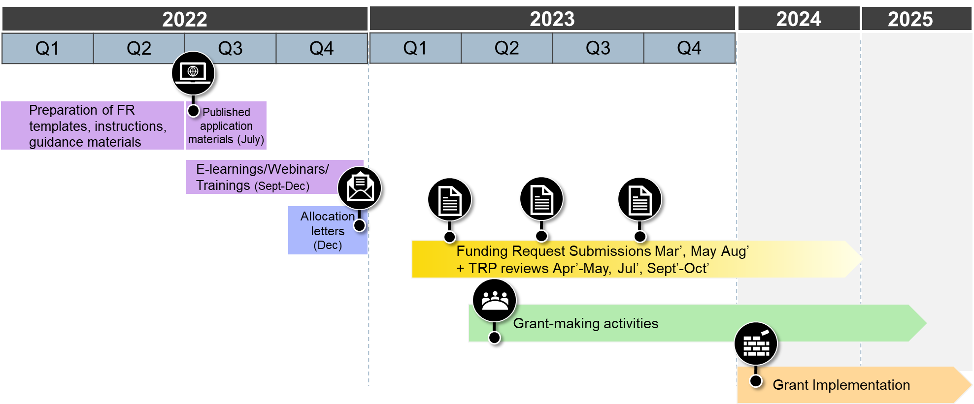
2. Moving into the new Grant Cycle
a. Timelines
Notes:
Grant cycle 6 (current) grants ends 2023-2024 (depending on country)
Allocations for Grant cycle 7 (GC7) have been communicated (January 2023)
Funding requests for GC7 in development now
Funding request submissions for GC7 due Mar – Aug 2023
GC7 grant signings staggered through 2023

Slide 5
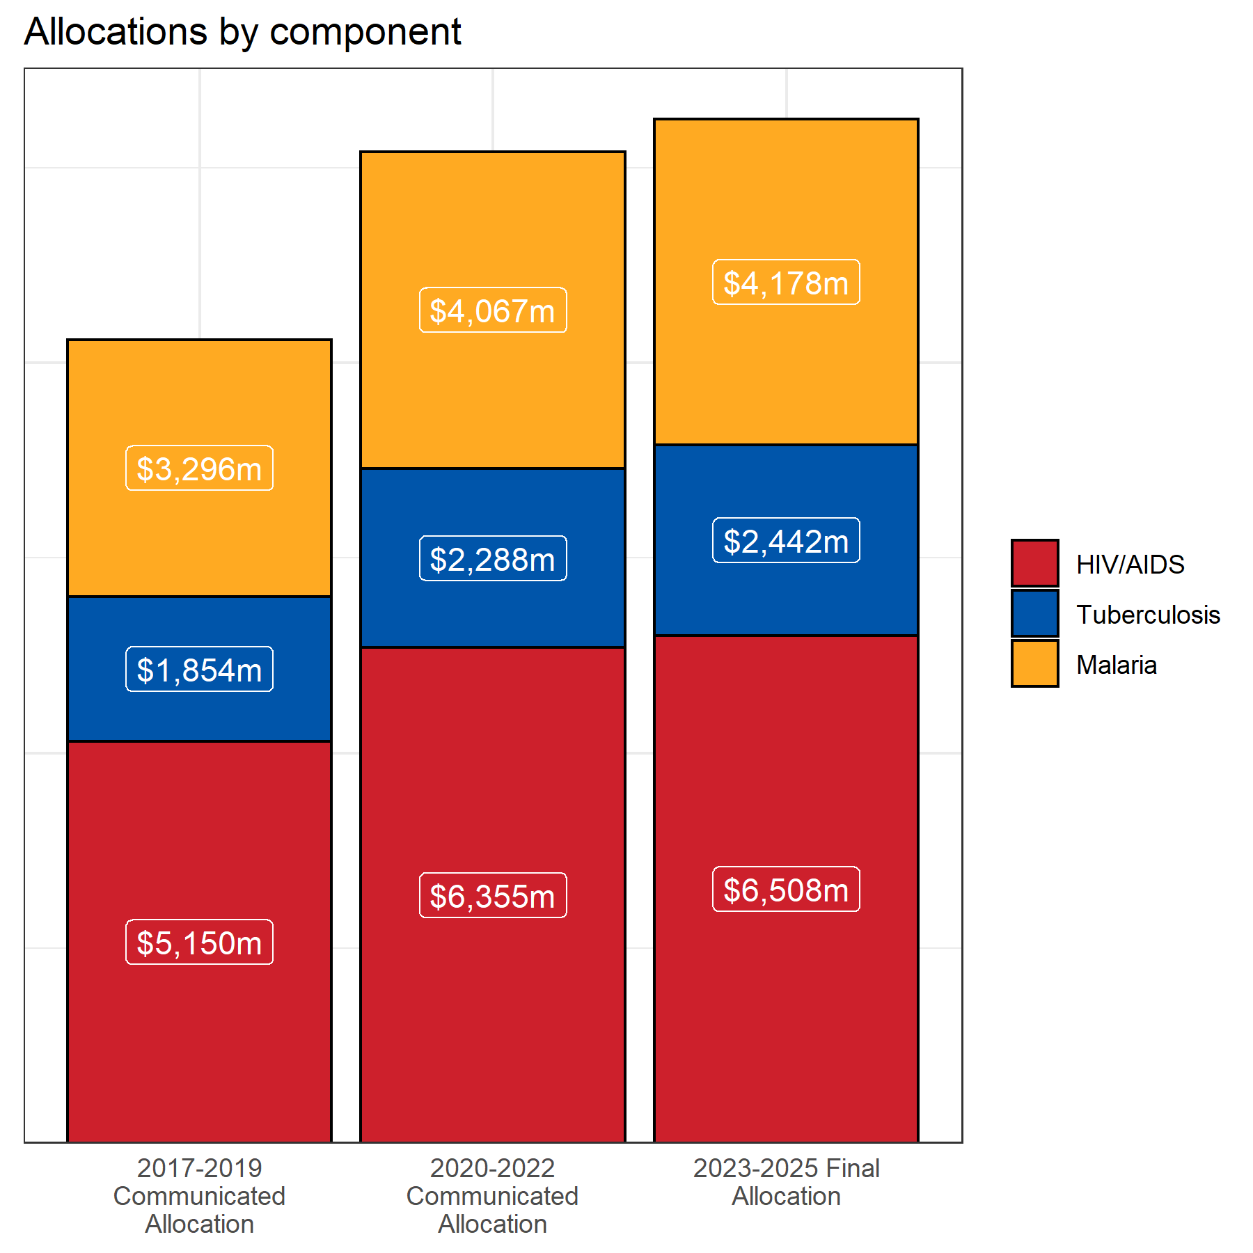
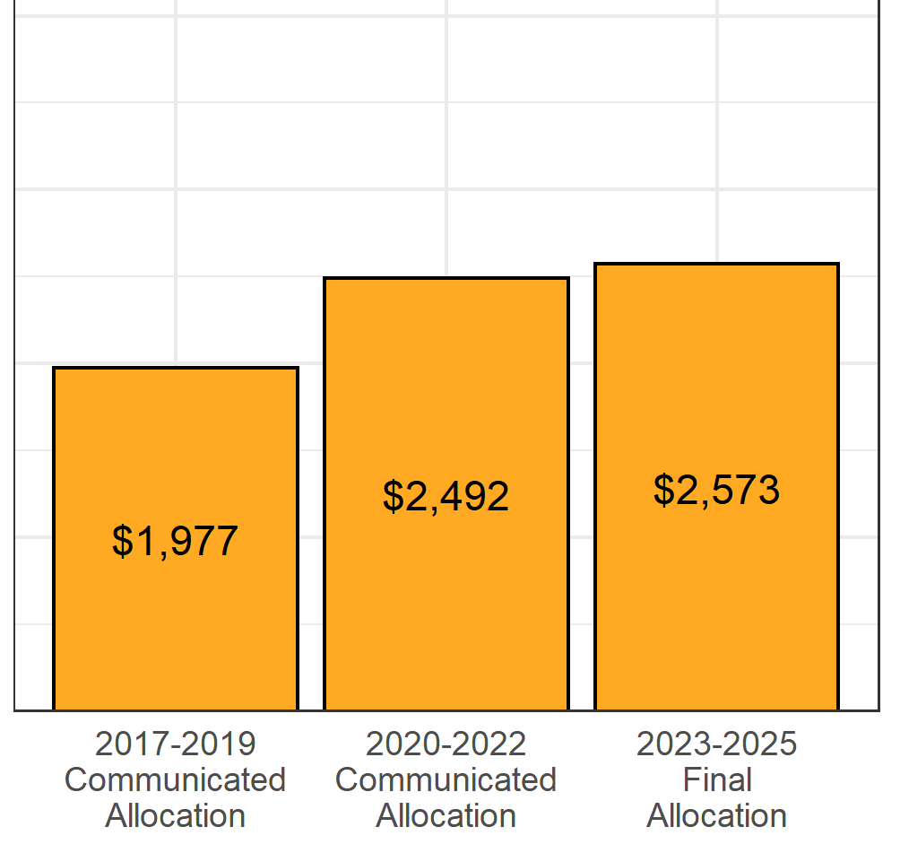
b. Allocations
The new Allocation information is available here.
2. Moving into the new Grant Cycle
Slightly higher resource envelope, malaria funds increase by $111.2 million compared to 2020-2022
 | HIV
 | TB
 | Malaria
Changes in malaria allocation to the 15 highest burden countries
Summary of changes to malaria grants '23-'25 v. '20-'22
22 countries had decreases, average 13%
11 countries stable (0 – 0.5%)
29 countries had increases, average 12%
No malaria specific catalytic funding (though NextGen SI)

Slide 6
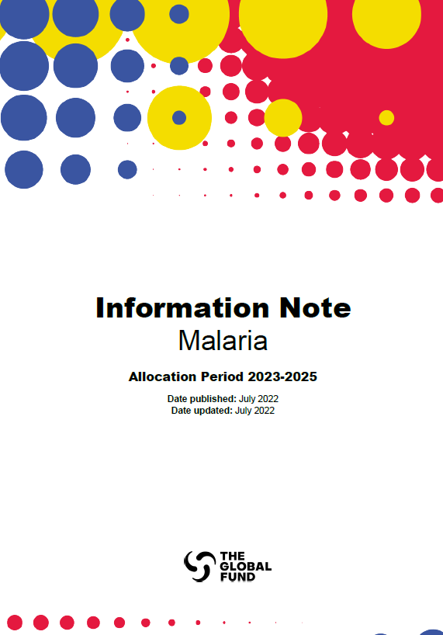
2. Moving into the new Grant Cycle
c. Funding request guidance on chemoprevention
Purpose of Malaria Information Note:
Complements the normative guidance to assist with preparation of the funding requests and to cover Global Fund considerations around procurement and supply chain management etc.
Chemoprevention guidance emphasizes:
  Updated WHO guidelines on options regarding chemoprevention are all eligible for GF support, except the malaria vaccine, which is supported by GAVI.
  Expectation that any chemoprevention strategy may be sub-nationally varied (as appropriate) with consideration given interventions, number of cycles, age range, implementation modality, etc.
  Consideration of RSSH and integration – particularly for malaria in pregnancy – to strengthen the platform on which MIP services depend as well as integration of IPTp at community level (where appropriate). Integration of other services (Vitamin A, malnutrition screening, ITN distribution, etc.) is also encouraged particularly with campaign-style chemoprevention efforts. This includes integration of digital platforms.
The Malaria Information Note is available here.

Slide 7
3. Key considerations for GC7 funding request
Clear description of what interventions you want to deploy where and the evidence used to target that intervention
How you prioritized the intervention mix, given limited resources and considering partner (including government) contribution
What are the lessons learned from previous/current chemoprevention efforts – including:
    Differences in coverage at a subnational level, need for variation in number of cycles and when to start/stop based on regional seasonal differences, etc.
    Differences potentially seen based on gender, age, cultural, linguistic, socioeconomic aspects, mobile and migrant populations, insecurity – which will likely vary at subnational level
    How you will adapt your strategy and implementation to address these challenges – including what you will do subnationally to improve quality implementation
  Consider integration of other interventions and what support will be given to ensure the key RSSH pillars are strengthened (i.e. supply chain, HRH, data systems, ANC and EPI platforms as relevant to your planned interventions).

Slide 8
3. Key considerations for GC7 funding request
Remember to discuss with your CTs on the potential need for advanced procurement for SPAQ due to the long lead times
You can consider piloting/operational research for new chemoprevention interventions (and for modifications of existing interventions)
Quality assurance monitoring and pharmacovigilance support should be integrated
Digital platform support should be integrated
Support for strengthening capacity for evidence-based decision-making/subnational tailoring at national and local level can be included and is highly encouraged
Don’t forget to include any gaps in the PAAR

Slide 9
Thank you

Slide 10
Key Changes in Chemoprevention Modules
Specific Prevention Interventions in NFM3 | Change in NFM4 | Justification
Intermittent preventive treatment (IPT) - In infancy | Perennial Malaria Chemoprevention (PMC) | Change in WHO nomenclature increasing scope of intervention
Mass drug administration | Language adapted to include burden reduction only, transmission reduction included in Case Management “Intensified activities for elimination” module | WHO new guidance released
NEW INTERVENTION | Intermittent Preventive Treatment for School children (IPTsc) | New WHO recommendation and guidance upcoming
NEW INTERVENTION | Post-discharge malaria chemoprevention (PTMC) | New WHO recommendation and guidance upcoming

