Slide 1
SMC 2022 overview
SMC Alliance Annual Meeting
Feb 28 to Mar 02, 2023
Conakry, Guinea
Céline Audibert
Director market research, APM
Defeating Malaria Together

Slide 2
832m treatments delivered since 2012
2022 data are provisional

Slide 3
47.9m children covered on average in 2022
2022 data are provisional

Slide 4
SMC 2022: total number of treatments achieved versus target

Slide 5
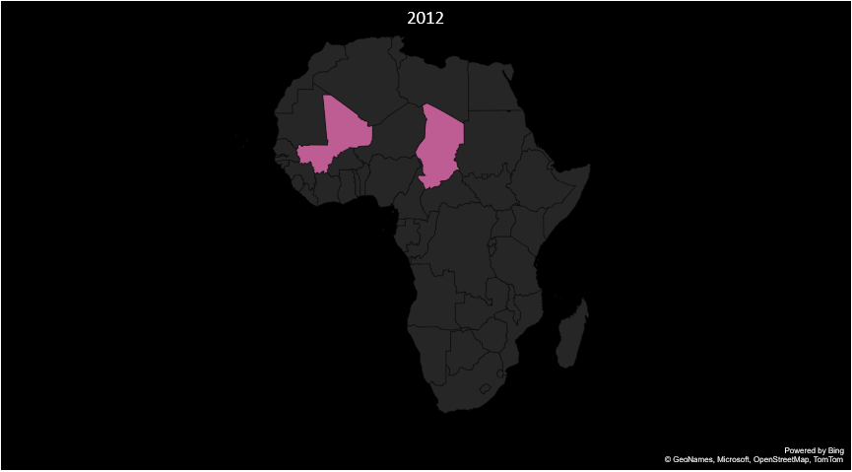
Countries performing SMC

Slide 6
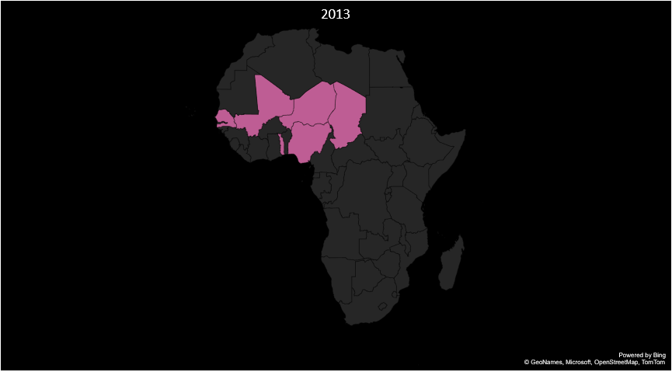
Countries performing SMC

Slide 7
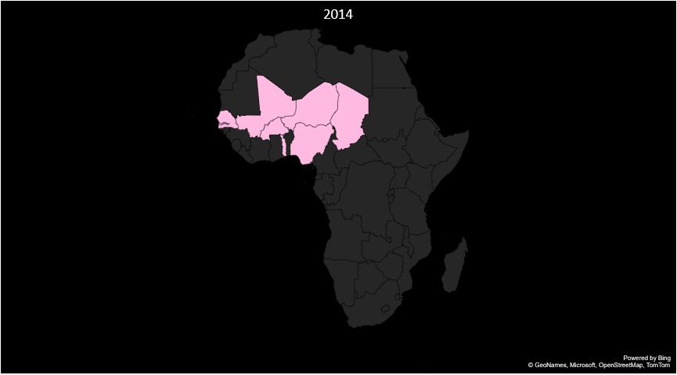
Countries performing SMC

Slide 8
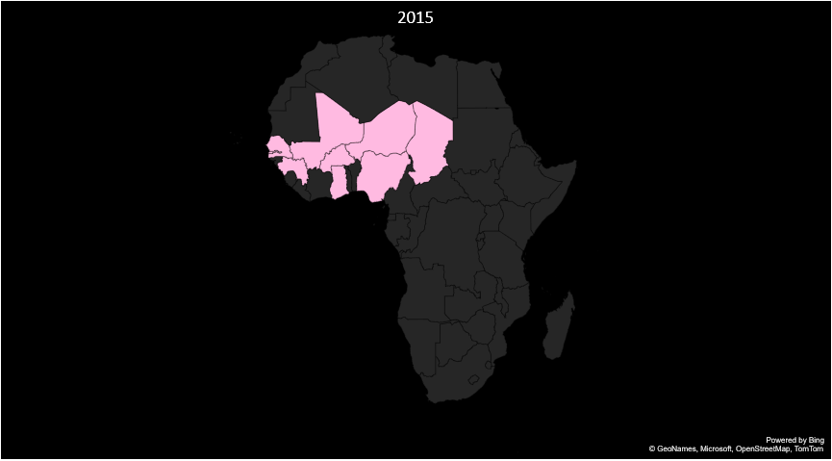
Countries performing SMC

Slide 9
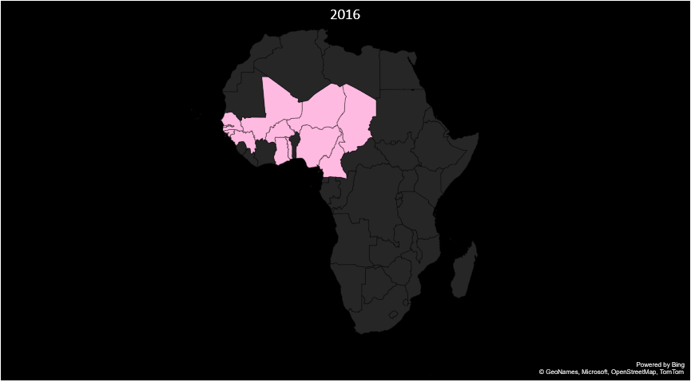
Countries performing SMC

Slide 10

Countries performing SMC

Slide 11

Countries performing SMC

Slide 12

Countries performing SMC

Slide 13

Countries performing SMC

Slide 14
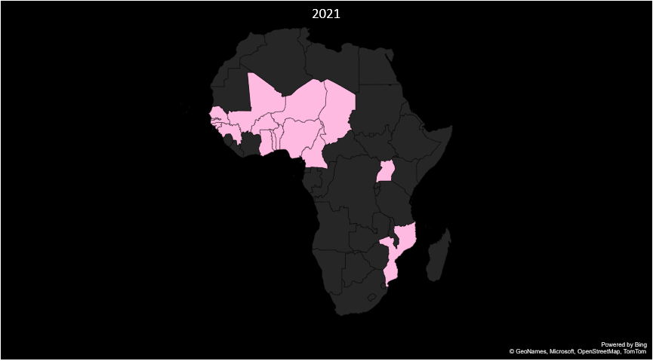
Countries performing SMC

Slide 15

Countries performing SMC

Slide 16
SMC geographical expansion: number of districts providing SMC

Slide 17
Number of children covered at each cycle

Slide 18
Number of children covered per age group

Slide 19
Thank you!

