Slide 1
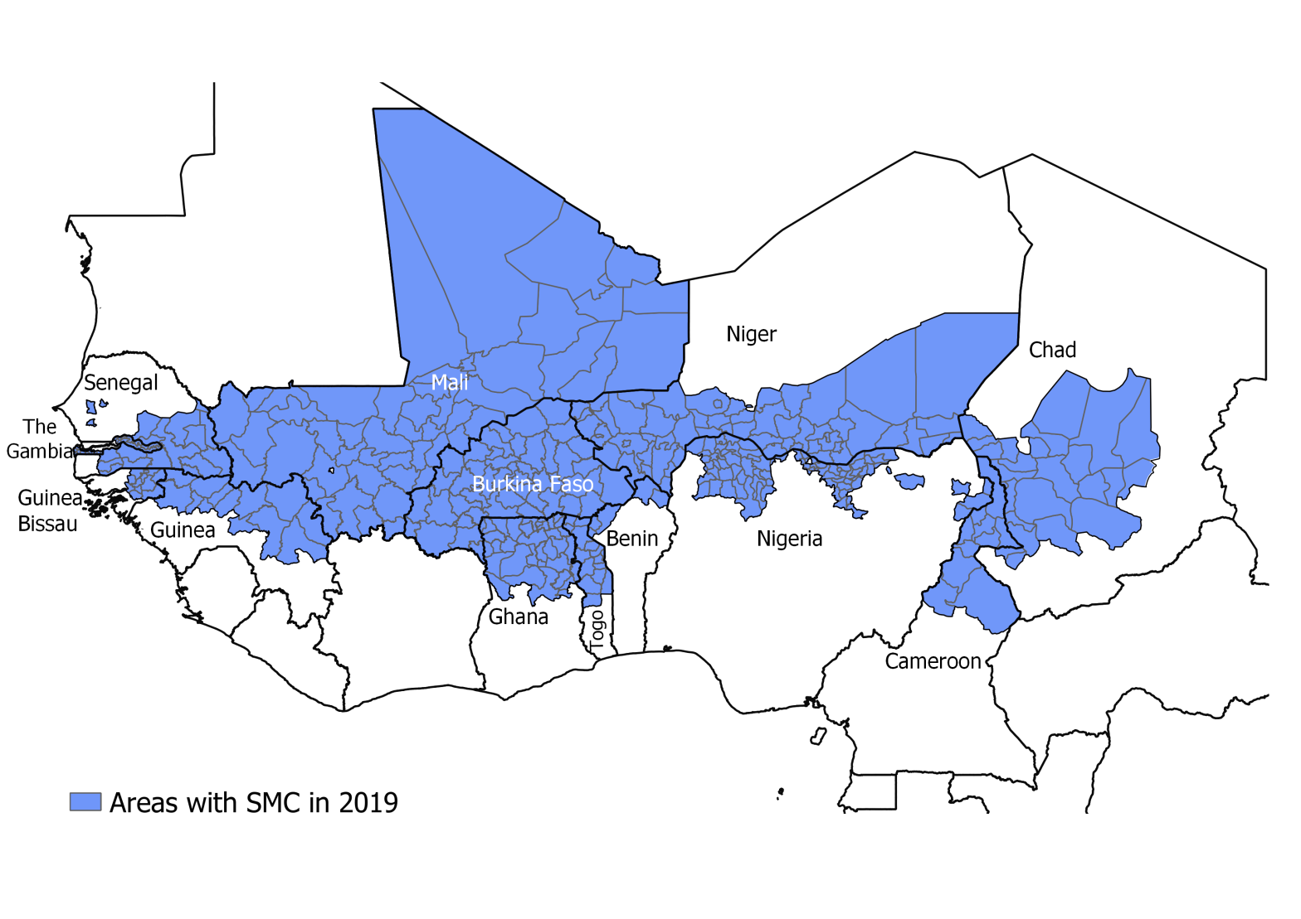
NMCPs from Benin, Burkina Faso, Cameroon, Chad, The Gambia, Ghana, Guinea, Guinea Bissau, Mali, Niger, Nigeria, Togo and Senegal
University of Thies : Jean Louis Ndiaye, Ibrahima Mbaye, Fatimatou Bintou Sall, Amadou Seck, Ndeye Fatou Diop
LSHTM: Paul Milligan, Susana Scott, Lucy Bell
WHO/TDR : Corinne Merle
MMV : Andre Tchouatieu, Abena Poku-Awuku

Slide 2
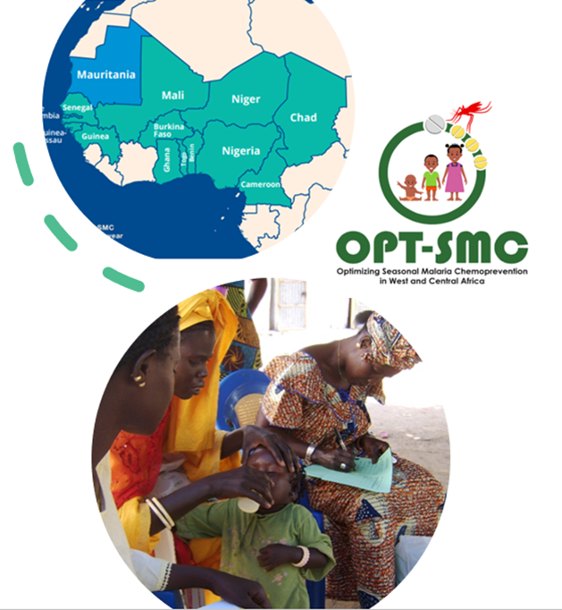
Objectives of OPT-SMC
Strengthening the capacities of the NMPs implementing SMC:
To define research priorities for optimizing SMC effectiveness
To conduct IR/OR projects for improving SMC effectiveness:
interpret and make use of malaria surveillance data
target effectively (high risk populations and periods of the year)
monitor delivery, uptake and effectiveness
Promote inter-country collaboration, sharing of information and expertise

Slide 3
NMCP projects:
Monitor and Evaluate
Ghana: SMC coverage and factors associated with uptake and adherence
Barriers to uptake: Qualitative studies
Guinea: Barriers to SMC uptake in mining areas in Guinea and an improved delivery approach.
Developing New Strategies
Mali : Evaluation of SMC using 3 approaches
Adapting target groups
Togo: Defining optimal SMC strategies in Togo: timing and number of cycles, and age ranges at risk of severe malaria
Started this 2022 SMC campaign
Presented at ASTMH 2021
Benin: Monitoring the effectiveness of SMC in northern Benin using the case-control method.
Analysis ongoing
Senegal: Estimating the delivery costs and cost effectiveness of SMC in southern Senegal
Under ethical review
Presented at ASTMH 2022
Nigeria : Barriers and facilitators of SMC uptake in Nigeria: a qualitative study in 5 States.
Presented at ASTMH 2022
Burkina Faso : Evaluating the determinants of variations in SMC coverage in Burkina Faso
4 urban and 4 rural districts will be compared, Ethics approved, for 2022 SMC campaign
Routine SMC (1st dose given by CHW – Doses 2& 3 given by caregivers)
SMC - DOT (3 doses DOT by CHW)
SMC Plus (1st dose by CHW. Doses 2 & 3 by caregivers followed up by volunteers
Started this 2022 SMC campaign
Cameroon: Effectiveness of using household leaders to improve adherence during SMC
Started this 2022 SMC campaign
Chad: Defining optimal SMC strategies in southern Chad: timing and number of cycles, and age ranges at risk of severe malaria
Niger: Applying the updated WHO SMC guidelines in Niger: timing and number of cycles, and age ranges at risk of severe malaria
Guinea Bissau: Assessment of the impact of SMC on the incidence of malaria in 3 regions: Bafata, Gabu, and Tombali & Comparative malaria trends in age groups <5 years, 5-9 years, 10-14 years (still to be confirmed)
The Gambia: Assessment of adherence to SMC in The Gambia (still to be confirmed)
ongoing
Notes:
The Gambia and Guinea Bissau- outstanding

Slide 4
NMCP: Benin, Burkina Faso, Cameroon, Chad, Ghana, Gambia, Guinea, Guinea Bissau, Mali, Niger, Nigeria, Senegal, Togo and Mauritania
THANK YOU !!!!
Notes:
With funding from the European and Developing Countries Clinical Trials Partnership (EDCTP), the OPT-SMC project will support 14 countries in West Africa and Central Africa to conduct implementation research on SMC, working in partnership with the University of ThièsMa in Senegal, TDR, Medicines for Malaria Venture (MMV), and the London School of Hygiene and Tropical Medicine (LSHTM).

