Slide 1
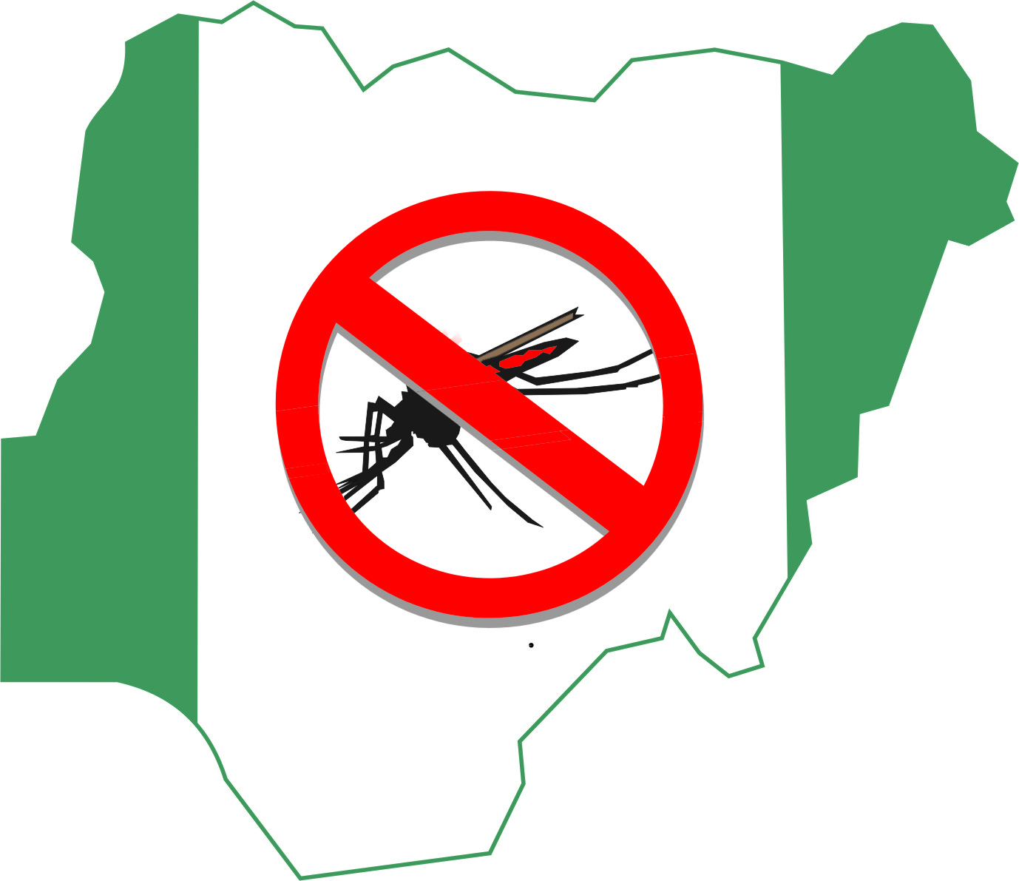
RESEACH ON SMC IN NIGERIA National Malaria Elimination Programme
Our Vision - a malaria free Nigeria;
Our goal – to reduce malaria burden to pre-elimination levels and bring malaria-related mortality to zero

Slide 2
Facilitators and Barriers to Uptake of Seasonal Malaria Chemoprevention (SMC) in Nigeria:
A Qualitative Approach

Slide 3
Study Objectives
Aim is to determine facilitators and barriers to uptake of SMC among children aged 3-59months in selected States in Nigeria
Specifically,
knowledge of malaria whether it affects uptake of SMC, and to examine
perceived effect of SMC on their children's health,
experiences and attitudes of caregivers concerning the concept of SMC,
experiences and attitudes of caregivers concerning the regimen of the chemoprevention
preferred mode of delivery/place of administration of SMC by caregivers
health workers’ attitudes and experiences regarding delivery of SMC
to determine if (ii)-(vi) above affects uptake of SMC
Our Vision - a malaria free Nigeria;
Our goal – to reduce malaria burden to pre-elimination levels and bring malaria-related mortality to zero

Slide 4
Methodology
Purposively selected 5 States:
Kano, Kebbi, Kwara, Nasarawa & Yobe
Two LGAs in each State
Two Wards/Communities in each LGA
Based on geopolitical zone/partner mapping/No. of years of implementation/performance in SMC 2021 round/rural and urban setting
Study Population:
Caregivers-mothers and fathers (slit into those who could write and read and those who could not)
Community-Directed Distributors (CDDs)
Community Leaders
LGA Malaria Focal Person
Director of Public Health/Disease Control and Malaria Programme Manager
National Programme Officers/Partners:
National Coordinator NMEP, Malaria Consortium, WHO, PMI, GF
Our Vision - a malaria free Nigeria;
Our goal – to reduce malaria burden to pre-elimination levels and bring malaria-related mortality to zero

Slide 5
Methodology
Data Collection:
Key Informant Interviews
In-Depth Interviews
Focus Group Discussions
FGDs conducted in local languages (Hausa/Yoruba) translated into English and transcribed verbatim
Interviews conducted in local language or English
State | FGDs | In-depth interviews | Total
Kano | 16 | 24 | 40
Kebbi | 16 | 20 | 36
Kwara | 16 | 20 | 36
Nasarawa | 16 | 21 | 37
Yobe | 16 | 20 | 36
Key Informant Interviews (National level/Partners) |  |  | 5
Total (FGDs & IDIs) | 80 | 105 | 185
Total (FGDs, IDIs & KII) |  | 105 | 190
Methodology
Our Vision - a malaria free Nigeria;
Our goal – to reduce malaria burden to pre-elimination levels and bring malaria-related mortality to zero

Slide 6
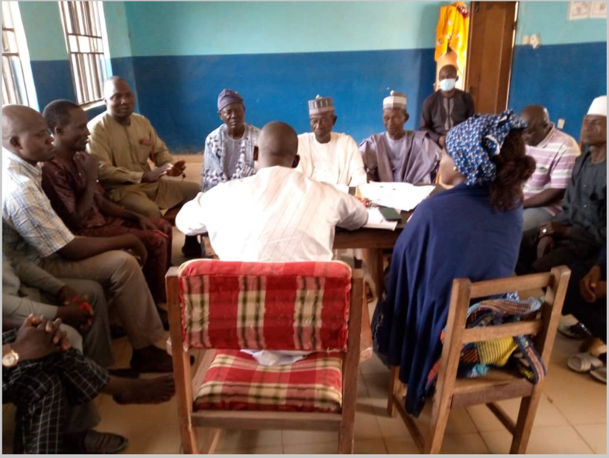
Methodology
Data Analysis
Content Analysis and Thematic Analysis
Ten Thematic Areas identified
Narration of the results produced
Our Vision - a malaria free Nigeria;
Our goal – to reduce malaria burden to pre-elimination levels and bring malaria-related mortality to zero

Slide 7
Results
Ten Thematic Areas identified from analysis:
Major health problems in the communities;
Knowledge of Seasonal Malaria Chemoprevention (SMC) among caregivers;
Extent of SMC’s coverage;
Knowledge of malaria among caregivers and its effect on SMC uptake;
Perceived effects of SMC on children’s health among caregivers;
Caregivers’ experience of and attitude towards SMC;
Barriers to SMC uptake;
Caregivers preferred mode of delivery/place of administration;
Health workers/CDDs experience and attitude regarding delivery of SMC;
Recommendations on how to upscale SMC Uptake

Slide 8
Summary of Facilitators and Barriers
Our Vision - a malaria free Nigeria;
Our goal – to reduce malaria burden to pre-elimination levels and bring malaria-related mortality to zero

Slide 9
Door-to-door Model of Delivery
“…they (the CDDs) work well to ensure children get the drugs. They come to us to administer the drug to the kids. So, their drugs reach every household.”
A male caregiver, Kwara State
“……does not affect home chores and the CDDs do either revisit the next day or leave a message with your neighbors if they do not meet you at home. More so, they come early hours in the morning before people go out.”
A female caregiver, Yobe State
“if the drug is to be distributed at a fixed point, there would be overcrowding and stampede during collection and this will deter some mothers from going to the facilities for collection of drug for their children.”
“Door-to-door is better as it eliminates overcrowding and noise pollution in our facilities”
FGD with female caregivers, Nasarawa State

Slide 10
Attitudes and Behaviours of CDDs
Trust and attitudes of CDDs very important key item: 2 sides of a coin
“some mothers who do not take the drug for their children feel that the Community Drug Distributors were hostile to them.”
FGD with female caregiver, Kebbi State
This is been reiterated by caregivers from Nasarawa State:
“some mothers who do not take the drug for their children feel that the drugs distributors were hostile to them”
FGD with female caregiver, Nasarawa State
Our Vision - a malaria free Nigeria;
Our goal – to reduce malaria burden to pre-elimination levels and bring malaria-related mortality to zero

Slide 11
Attitudes and Behaviours of CDDs: positive attitudes
“offers greater opportunities for engagement between caregivers and CDDs. The CDDs come to enlighten us on the drugs: how best to use it, the time to administer it and how to notice any development that may arise.”
FGD with caregivers, Yobe State
“they (the CDDs) work well to ensure children get the drugs. They come to us to administer the drug to the kids. So, their drugs reach every household.”
FGD male caregiver, Kwara State
“Where we have trust issues is when CDD are not residents/indigenes of the area in question and this trust gap is usually filled by their supervisors who are working in the health facilities of the areas.”
Key informant, Global Fund, Abuja

Slide 12
Real and perceived experience of side effects in children
….most widely reported barrier to SMC uptake..
….Though, most side effects reported were mild or self-limiting
“I observed that my infant experienced weakness for three days after taking the drug, but was very fine after the third day.”
FGD, female caregiver, Kwara State
“.. like I said earlier, some side effects manifest in some children. So, some mothers feel reluctant to accept the drug and administer it to their children.”
FGD, female caregiver, Kebbi State
From a CDD, in Kebbi State:
“.. the challenge we are facing is just that some mothers say they are not happy with it because of the side effects their children have after they are given the drugs.”
Our Vision - a malaria free Nigeria;
Our goal – to reduce malaria burden to pre-elimination levels and bring malaria-related mortality to zero

Slide 13
Ignorance, resistance/skepticism/conspiracy
“those who reject the drugs do so because they think it is harmful to their children.”
A caregiver in rural Kano, FGD
“some people have a belief that their children could be harmed when they take the drugs. That is why they do not accept it. For instance, some people believe that the drugs can cause infertility in the future”
Another caregiver in rural Kano, FGD
“There are few challenges. It is not all the households in his domain that understand the essence of the campaign. While some household are receptive, others do resist, although we usually overcome this by summoning such people to the palace to further enlighten them on the importance and need for their children to partake in the programme. This works because even before we conclude, they call and give permission to allow the SPAQ to be administered on their children.”
A traditional Leader, Nasarawa
Resistance driven by paranoia, hesitancy, skepticism and conspiracy theory has always undermined access to, and utilization of, healthcare in Nigeria
Remember GPEI

Slide 14
Incomplete coverage/shortage of drugs/Hard-to-reach
Reported in Yobe, Nasarawa, Kano, Kwara States
“..there are communities that SPAQ did not reach them. During the last SMC campaign, the SPAQ allocated to the teams was insufficient to cover the entire LGA”
LGA Focal Person, Yobe State
“..that there are some areas, such as Oke-Ero, that are hard to reach. Some of these areas are waterlogged, which make access difficult”
Malaria Programme Manager, Kwara State
“the drugs are inadequate in this community because it does not go round to all, especially here in Daderi, Kokona LGA”
Male caregiver, Nasarawa State

Slide 15
Conclusion
In all study areas, malaria was seen as a major health concern
SMC was widely accepted as a key preventive measure of malaria infection
Generally, Community Drug Distributors were trusted
Caregivers preferred SMC delivered door-to-door than at fixed points
Isolated cases of rejection/hesitancy
Isolated cases of missed households/children
Other facilitators and barriers were identified
Our Vision - a malaria free Nigeria;
Our goal – to reduce malaria burden to pre-elimination levels and bring malaria-related mortality to zero

Slide 16
Recommendations
Address the concerns of the caregivers/programme managers with respect to:
Perceived side effects of the SMC,
Ignorance/skepticisms about SMC,
Shortage of drugs and logistical challenges
Negative attitudes of the CDDs
Strengthen delivery of SMC via house-to-house campaign and
Motivate and support the CDDs to ensure continued trust by the communities
Emphasis on recruiting CDDs from the local communities
Our Vision - a malaria free Nigeria;
Our goal – to reduce malaria burden to pre-elimination levels and bring malaria-related mortality to zero

Slide 17
Country Level Actions
Study result was disseminated widely in-country among all the stakeholders, including at international fora and on-coming effort to publish in a medical journal
Key recommendations were shared with delivery teams during the 2022 national and state level trainings, cascading down to the community drug distributors during the LGA and community level trainings
We have been able to secure funds;
for the revision of training modules
for a workshop on pharmcovigilance; which will produce risk mitigation document among others
Scale up of the use of digital technology for implementation to improve efficiency and accountability of the intervention
Our Vision - a malaria free Nigeria;
Our goal – to reduce malaria burden to pre-elimination levels and bring malaria-related mortality to zero

