Slide 1
SMC Initiation in Bauchi State Nigeria, Feedback and Outcomes from 2 Years Implementation In 2 Districts (Local Government Areas)
Chibuzo Oguoma
Malaria Consortium Nigeria
SMC Alliance Annual Meeting, Conakry - 1 March, 2023

Slide 2
Background
SMC was first implemented in Bauchi state, Nigeria, in 2020, in 10 of the 20 Local Government Areas (LGAs).
This left a gap of 10 LGAs without SMC coverage in Bauchi State.
Malaria Consortium participates in the Korea International Cooperation Agency (KOICA) funded SMC IMPACT project for SMC implementation in 2 of those LGAs – Ningi and Tafawa Balewa.
The objective of the project is to increase the geographic expansion of SMC and increase impact in the Sahel region of Africa.
The funding support is to deliver a total of 2,196,860 treatments to children aged 3 – 59 months over the period January 2021 – December 2022
Two rounds of SMC have been successfully implemented in the two target LGAs of Bauchi State in 2021 and 2022.
The SMC rollout was through the door-to-door approach and 4 cycles were implemented in 2020 – 2021 and 5 cycles in 2022.

Slide 3
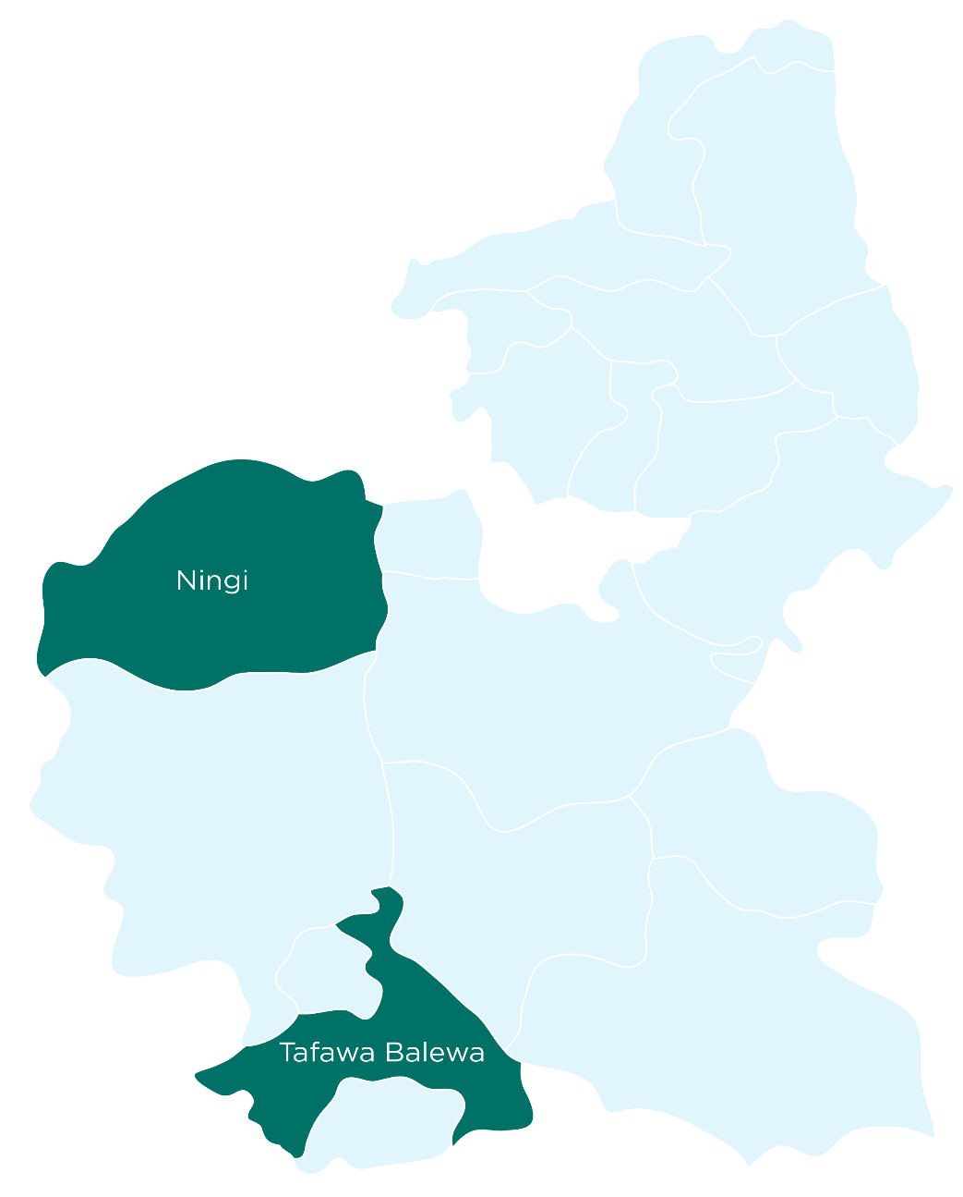
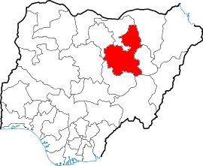
Map of Nigeria Highlighting Bauchi State and Projecting the 2 KOICA Funded LGAs

Slide 4
Year 1 – 2021 Support and Outcomes in the SMC IMPACT LGAs
Indicator (2021) | Ningi LGA | Tafawa Balewa LGA | Total
Target No. Children | 177,107 | 87,776 | 264,883
No. (%) Children Reached | 181,705 (>100%) | 90,200 (>100%) | 271,905 (>100%)
No. (%) Male Children | 93,396 (51.4%) | 46,363 (51.4%) | 139,759 (51.4%)
No. (%) Female Children | 88,309 (48.6%) | 43,837 (48.6%) | 132,147 (48.6%)
End of Cycle HH Survey (1 – 3): End of Round Survey (state-wide) No. Community Level Implementers: Community Distributors Lead Mothers Town Announcers | 74% - 63% N/A 1,340 159 159 | 85% - 94% N/A 686 90 90 | 85 – 94% 94.5% 2,026 249 249
Source: Admin Coverage, EoC 1 – 3 HH Survey & EoR Coverage Survey 2021

Slide 5
Year 2 – 2022 Support and Outcomes in the SMC IMPACT LGAs
Indicator (2022) | Ningi LGA | Tafawa Balewa LGA | Total
Target No. Children | 189,825 | 93,114 | 282,939
No. (%) Children Reached | 195,796 (>100%) | 95,528 (>100%) | 291,324 (>100%)
No. (%) Male Children | 100,639 (51.4%) | 49,197 (51.5%) | 149,836 (51.4%)
No. (%) Female Children | 95,157 (48.6%) | 46,331 (48.5%) | 141,488 (48.6%)
End of Cycle HH Survey (1 – 4) End of Round Survey (state-wide) No. Community Level Implementers: Community Distributors Lead Mothers Town Announcers | 81% - 99% N/A 1,428 172 172 | 88% - 95% N/A 730 93 93 | 81 – 99% 99.3% 2,158 265 265
Source: Admin Coverage, EoC 1 – 4 HH Survey & EoR Coverage Survey 2022

Slide 6
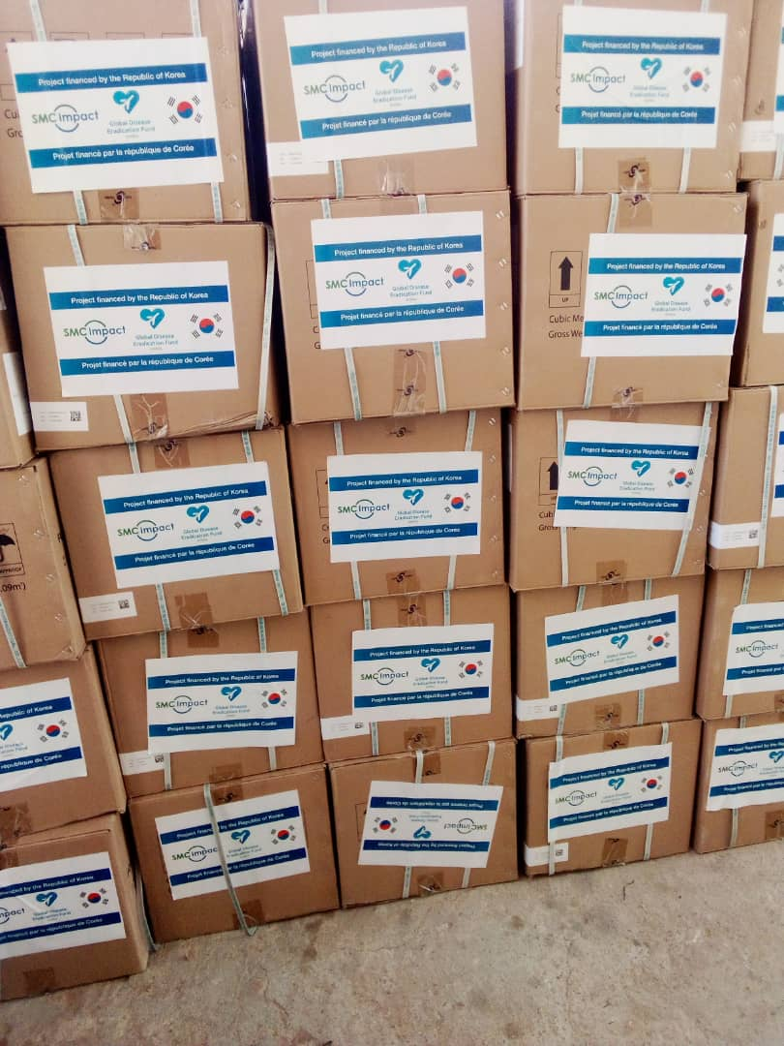
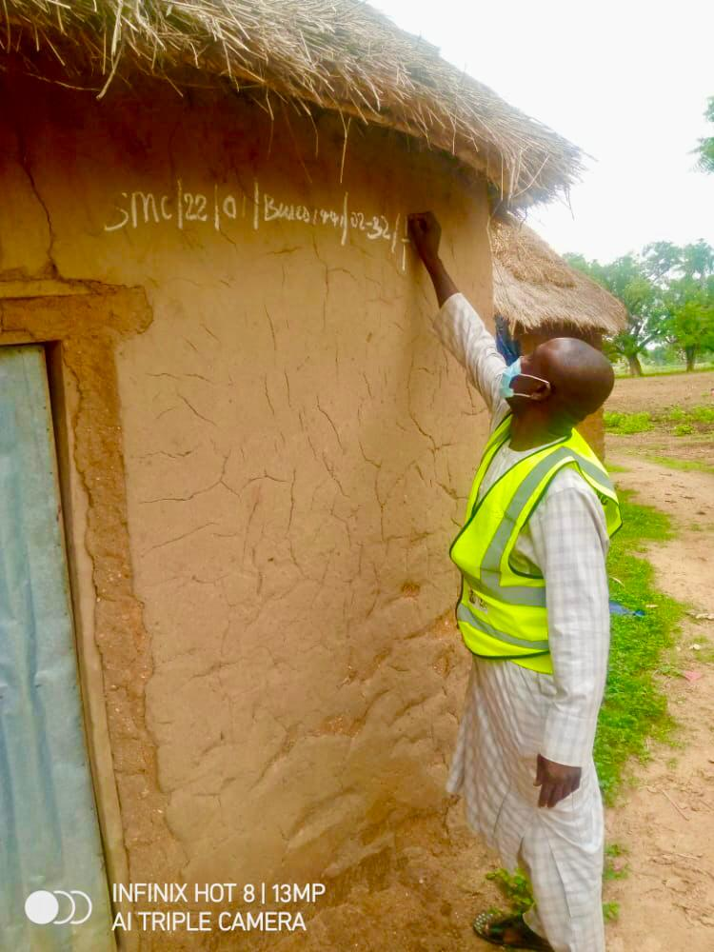
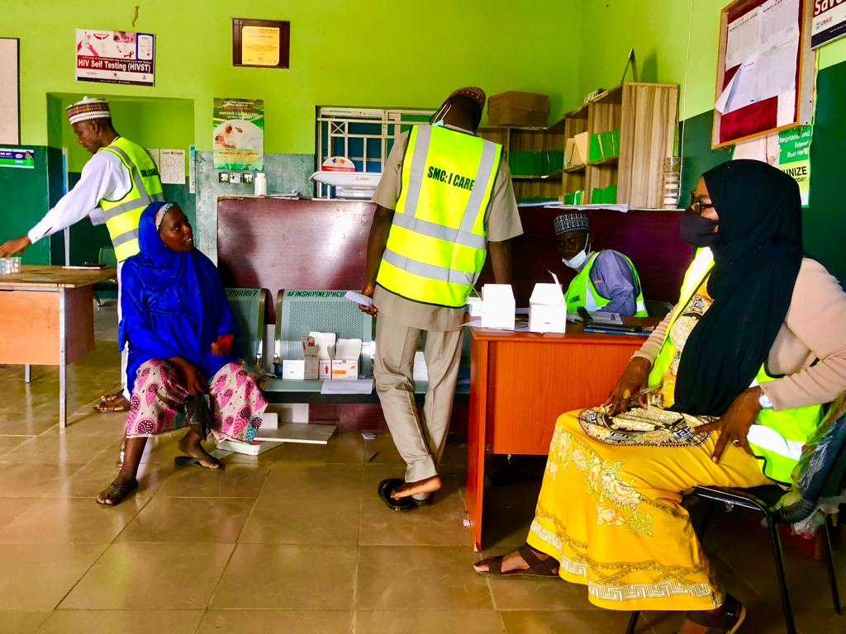
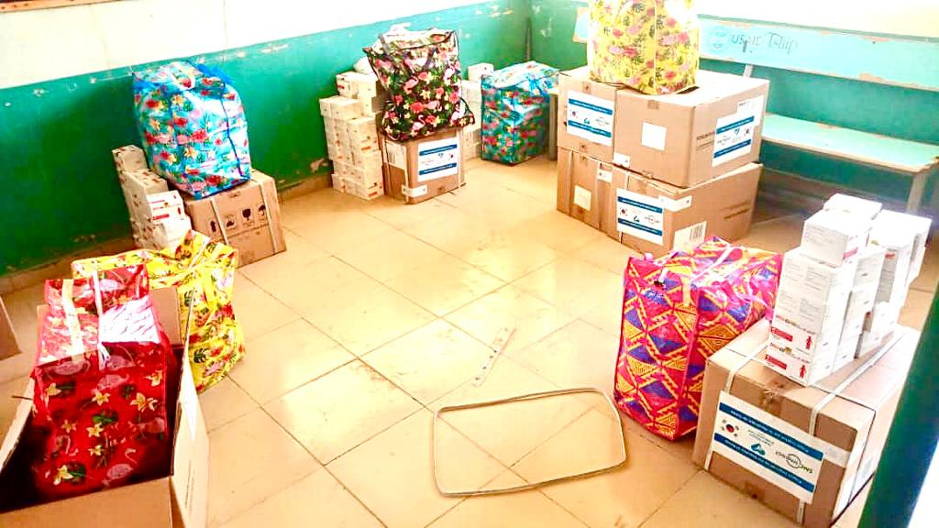
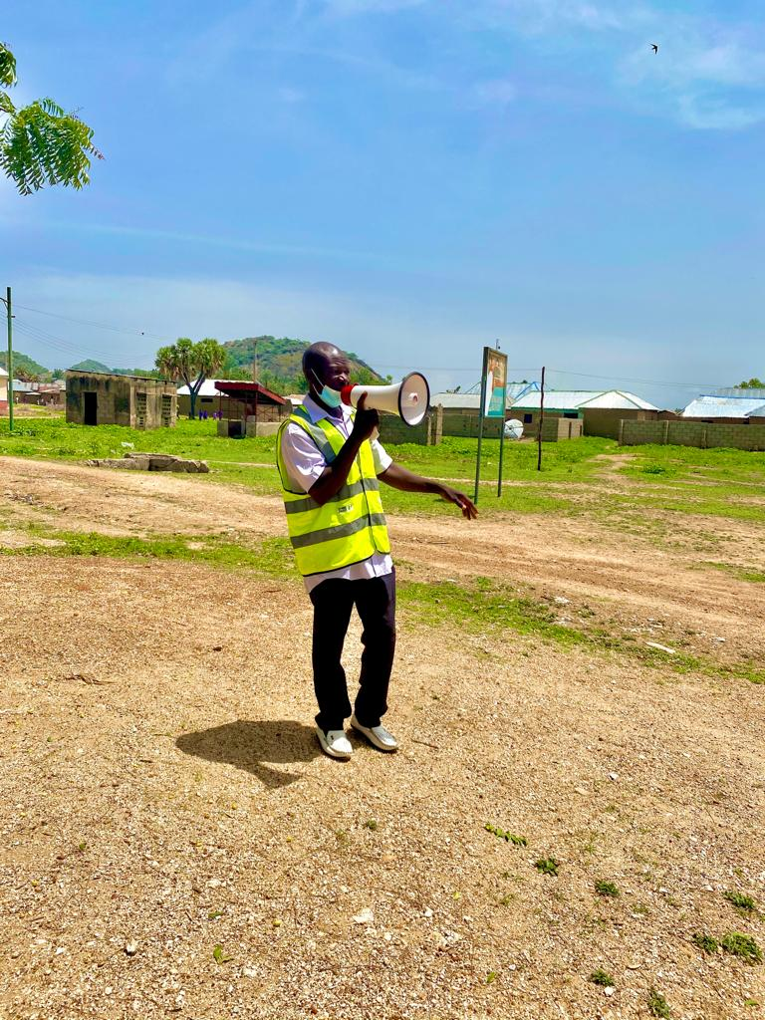
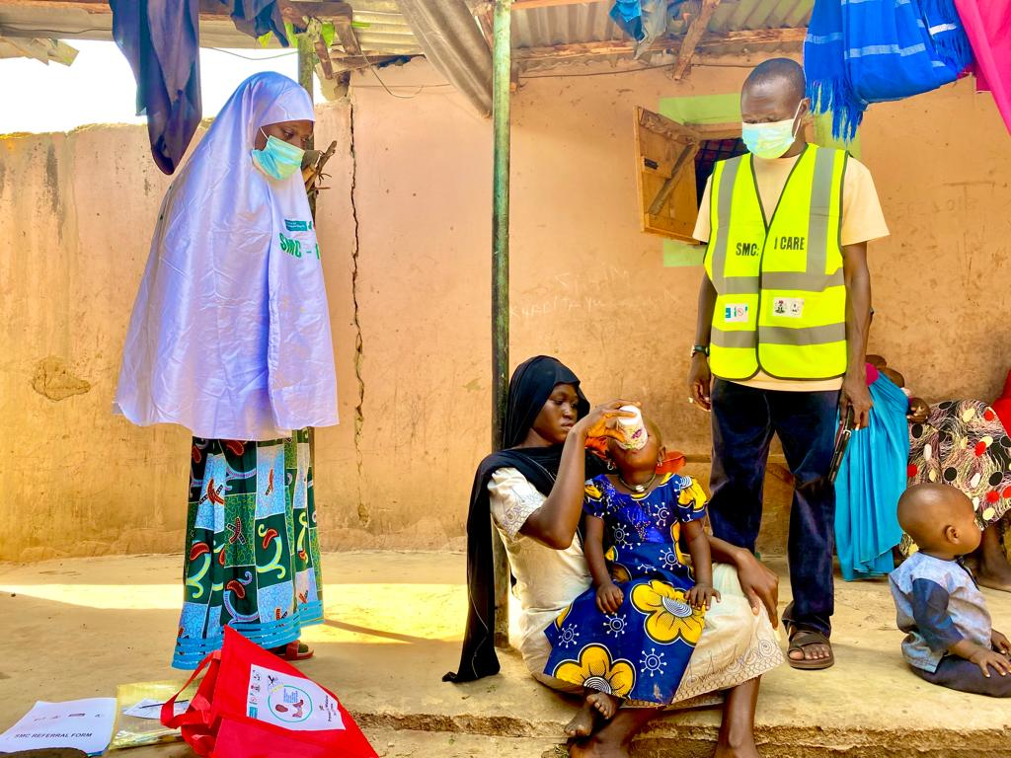
SMC Implementation in SMC IMPACT LGAs

Slide 7
Malaria incidence in the SMC IMPACT LGAs 2021-22
Source: National Health Management Information System, FMoH Abuja

Slide 8
Conclusion
The support from KOICA through the SMC IMPACT project achieved the objectives of expanding geographic coverage and also, impacting on the incidence of malaria in the supported area.
The incidence of malaria reduced from 2020 when Ningi and Tafawa Balewa LGAs were not covered by SMC, with:
an overall 16.8% reduction in both LGAs from 2020 to 2022 annual incidence, with 11.1% reduction for Ningi LGA and 17.0% for Tafawa Balewa LGA; and
an overall 34.9% reduction for both LGAs when restricted to the peak transmissions season (June – October) of 2020 and 2022; with an 18.3% reduction in Ningi LGA and 48.6% reduction in Tafawa Balewa LGA.

Slide 9
Thank you
Obrigado
Merci
malariaconsortium.org/smc

