Slide 1
SMC Alliance Research Priorities

Slide 2
SMC Alliance Research Priorities
In September 2022, Malaria Consortium started a project to define future research priorities for SMC
Currently being led by Dr Sol Richardson, Assistant Professor of Public Health at Tsinghua University, Beijing

Slide 3
Summary of the project
Aim:
To reach consensus on a list of medium-term SMC research priorities (over the next 5 to 10 years)
Secondary objectives:
Develop a list of 10 top research priorities
Conduct an analysis of your anonymised data to investigate whether experts' responses differ according to demographic variables such as field of specialty, gender, country of origin, etc.

Slide 4
Summary of the project
The survey used the eDelphi methodology
A method for identification of a consensus view across subject experts
Conducted online to allow the widest range of respondents
This study:
Consists of three survey waves
Surveys and responses in English or French
Including questions on participant demographics, ratings of research questions, and open fields to suggest new questions

Slide 5
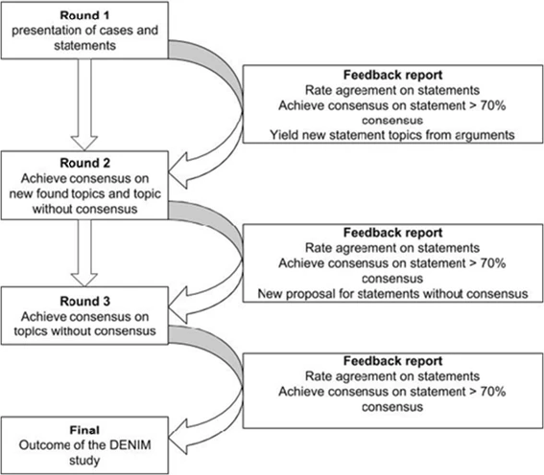
Summary of the project structure
From Harmsen, A.M.K., Geeraedts, L.M.G., Giannakopoulos, G.F. et al. Protocol of the DENIM study: a Delphi-procedure on the identification of trauma patients in need of care by physician-staffed Mobile Medical Teams in the Netherlands. Scand J Trauma Resusc Emerg Med 23, 15 (2015). https: //doi.org/10.1186/s13049-015-0089-z

Slide 6
Summary of the project
Research questions were rated according to 1) their importance, 2) their feasibility, and 3) the degree to which they have already been answered on a five-point Likert scale
Questions covered the following topic areas:
Malaria drug resistance
SMC operations, governance, procurement and programme management
SMC monitoring, evaluation and impact
Safety and pharmacovigilance
Adaptation of SMC delivery models, SMC protocols/criteria for SMC eligibility; introduction of SMC to new geographies; integration with other interventions
Sensitisation and community engagement

Slide 7
Results
Wave 1 preliminary feedback report: Sample characteristics
26 responses to the Wave 1 survey to date, 25 with data
9 responses in French and 16 in English
17 male, 8 female
11 worked for NGOs, 10 for universities/research institutions, 4 in government
12 of 25 respondents based in Africa, 13 countries represented

Slide 8
Results
Wave 1 preliminary feedback report: Sample characteristics
26 responses to the Wave 1 survey to date, 25 with data
9 responses in French and 16 in English
17 male, 8 female
11 worked for NGOs, 10 for universities/research institutions, 4 in government
12 of 25 respondents based in Africa, 13 countries represented

Slide 9
Results
Highest-rated questions (importance scores)
Question | Mean score
Evaluate the feasibility and impact of extension of SMC rounds to five cycles in suitable contexts | 4.33
Evaluate the feasibility and impact of extension of SMC to children aged over five years and identify optimal age ranges for SMC eligibility in different settings | 4.33
Evaluate methods to reduce spitting and vomiting of SMC medicines by eligible children | 4.36
Evaluate and compare impact of new/different drug regimens (e.g. Dihydroartemisinin-piperaquine) on development of drug resistance | 4.38
Evaluate the degree to which eligible children in different transmission settings (i.e. according to seasonality and attack rate) benefit from SMC programs; evaluate differential impact in different settings | 4.38

Slide 10
Results
Lowest-rated questions (importance scores)
Question | Mean score
Design and evaluate policies or interventions to improve motivation and retention of SMC distributors | 2.83
Evaluate delivery of SMC through home visits at different times of day on SMC outcomes | 3.2
Describe the effects of introduction of SMC on national and local political decisionmaking | 3.25
Evaluate effects of different types of emotive content in sensitisation communications to promote knowledge and awareness of SMC | 3.3
importance_evaluate methods for increasing gender balance of SMC distributors | 3.33

Slide 11
Results
Lowest-rated questions (feasibility scores)
Question | Mean score
Monitor corruption in SMC governance and misappropriation of SMC resources, and identify and evaluate appropriate strategies to minimize corruption | 3.50
Investigate at what point should SMC be replaced by targeted or focal mass drug administration (MDA) or other intervention? | 3.58
Azithromycin (AZ) is an effective chemoprotective agent in malaria, and reduces the incidence of respiratory tract infections and diarrhea; investigate the risk of bacterial resistance development with more widespread use of AZ | 3.58
Identify policies or messaging to promote effective market shaping to ensure sufficient supply of SMC medicines, promote competition among supplier and reduce programme costs | 3.58
Investigate the number of SMC rounds (years) after which SMC with SP+AQ becomes less viable due to development of antimalaria resistance in falciparum parasites and reduction in protective efficacy of the intervention | 3.81

Slide 12
Results
Examples of new questions suggested
Question
Impact of using different drugs selecting resistance in opposite direction for case management and chemoprevention
Develop standardized qualitative research tools to understand challenges identified in LQAS surveys
Are there any issues related to the underdosing of overage children mistakenly treated?
Potential negative impact of introducing SMC in countries with PMC
Sustainable strategies for digitising SMC campaigns; multi-campaign use of digital tools
Male partner involvement on acceptability of SMC medicines among rural and urban communities

Slide 13
Discussion
Two questions were particularly polarizing in terms of importance ratings, with both a wide range of scores and a significant difference in responses by country of residence and survey language
Evaluate logistical challenges faced by SMC campaigns, and identify and evaluate strategies to overcome these logistical challenges
Evaluate delivery of SMC through home visits at different times of day on SMC outcomes

Slide 14
Discussion
Next steps
Update outcome data based on any new responses
Compile a list of new questions based on expert suggestions, for inclusion in Wave 2 for rating on their importance and feasibility
Eliminate research questions from the Wave 1 survey which were rated either low on importance or feasibility for Wave 2 (which will be a shorter survey) based on % of respondents giving scores of 4 or 5 (e.g. important or very important)
Conduct analyses to test whether responses differed by participant characteristics (e.g. did respondents in Africa give different ratings to other respondents?)

Slide 15
Discussion
Next steps
Eliminate research questions from the Wave 1 survey which were rated either low on importance or feasibility for Wave 2 (which will be a shorter survey) based on % of respondents giving scores of 4 or 5 (e.g. important or very important)
Build the Wave 2 online questionnaire by mid-March
Discussion of the full Wave 1 results at the next SMC Alliance Research Sub-Committee monthly meeting, including ‘polarizing’ questions.

Slide 16
Discussion
Next steps
In Wave 3, further eliminate questions to reach consensus on a top 10 medium-term research priorities…

Slide 17
Discussion
You can complete the survey on a computer or mobile device. Most respondents take around 20 minutes to complete the survey, but some can spend significantly more or less than that depending on how detailed you want your responses to be.
The survey links, in English and French, are below:
English: https://malariacons.surveycto.com/collect/edelphi_study_survey_wave_1?caseid=
French: https://malariacons.surveycto.com/collect/edelphi_study_survey_wave_1_french?caseid=

Slide 18
Thank you

