Slide 1
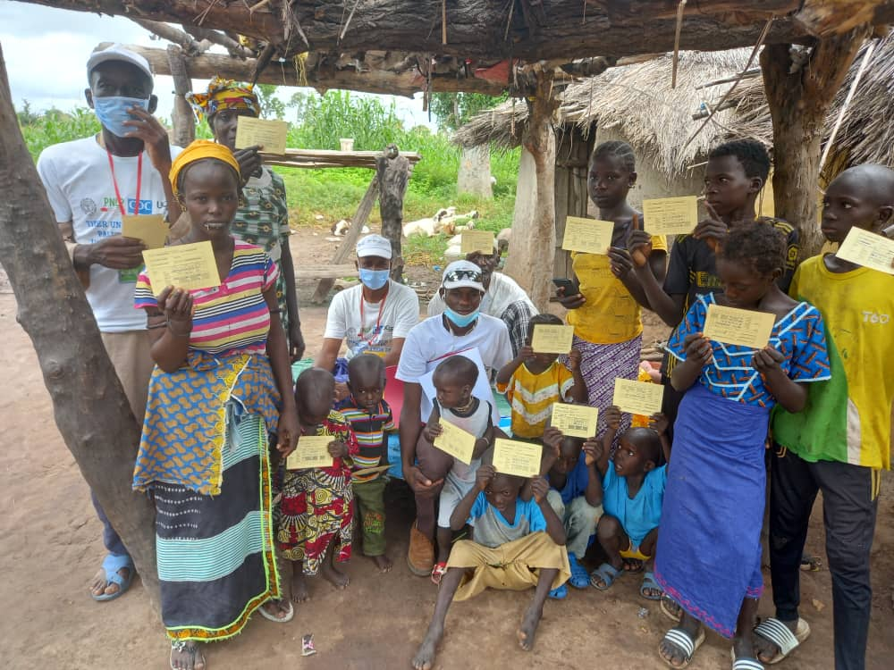
Mass drug administration with dihydroartemisinin-piperaquine and primaquine to reduce malaria in moderate-low transmission setting of Senegal: A cluster randomized controlled trial.
March 2nd 2023
Prof Jean Louis Ndiaye
On behalf of MDA consortium

Slide 2
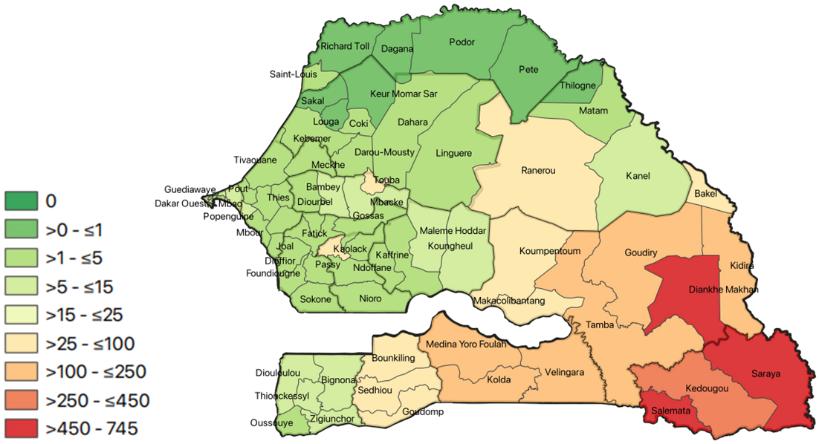
Malaria in Senegal
Senegal has made significant progress in reducing its malaria burden
78% reduction in incidence since 2000
Elimination goal by 2030??
Malaria transmission is seasonal
North = lower transmission: prioritizes pre-elimination activities
Case investigation + RACD
Southeast = moderate-high transmission: prioritizes control activities
SMC, community case management [PECADOM+], LLINs
KKT region counting more than 80% of malaria cases and deaths

Slide 3
Chemoprevention strategies
SMC versus MDA
SMC in Senegal
Used as a burden reduction approach only for children under 10
No impact on transmission parasite reservoir is not targeted.
Need an alternative approach to further reduce burden
MDA considered by NMCP
Feasible approach given door to door delivery infrastructure, community acceptance
MDA vs SMC is a priority outlined in new 2022 WHO treatment guidelines

Slide 4
WHO recommendations- use of MDA
WHO recommends use of MDA in:
MDA can be given in areas of moderate to high transmission of P. falciparum to provide short-term reductions in disease burden.
WHO supports the need for more research on the optimum methods of implementing MDA programs and evaluating their effectiveness. Modelling can help guide the optimum method of administering MDA in different epidemiological circumstances and predict its likely impact

Slide 5
Hypothesis to test
Time-limited MDA with dihydroartemisinin-piperaquine (DHA-PQP) and single, low-dose primaquine in the context of optimized control (effective net, proactive community case management, and SMC) can reduce transmission of Plasmodium falciparum in moderate-low transmission settings sufficiently that the program can switch to case-based response post-MDA to sustain its impact.

Slide 6
Study Objectives
Compare impact of MDA versus SMC on village-level malaria incidence during the implementation and post-MDA year period
Determine whether more MDA villages reach a target parasite incidence (<5 cases/1000) compared to SMC villages
Compare impact of MDA versus SMC on parasite prevalence, drug resistance, and parasite diversity
Determine acceptability and cost-effectiveness of MDA compared to SMC

Slide 7
Study design
523 villages screened
Cluster RCT
60 villages
Villages were excluded if population under 200 and over 800
Ensured a 3 km buffer zone between study villages
523 villages 🡪 111 were eligible for inclusion 🡪 60 were randomly selected such that a 3km buffer zone existed between study villages
412 villages excluded
111 villages met the inclusion criteria
60 villages randomized
(n=20,382 individuals)
30 villages randomized to MDA
(n=10,572 individuals)
6,506 individuals received R1
7,125 individuals received R2
7,256 individuals received R3
30 villages randomized to SMC
(n=3,747 individuals)
2,702 individuals received R1
2,974 ndividuals received R2
3,071 individuals received R3

Slide 8
Study design
Intervention = 3 rounds DP+SLD-PQ to individuals of all ages
Control = SMC to children <10
Participant ineligibility criteria – pregnant women/self-reported illness/allergy to study drugs

Slide 9
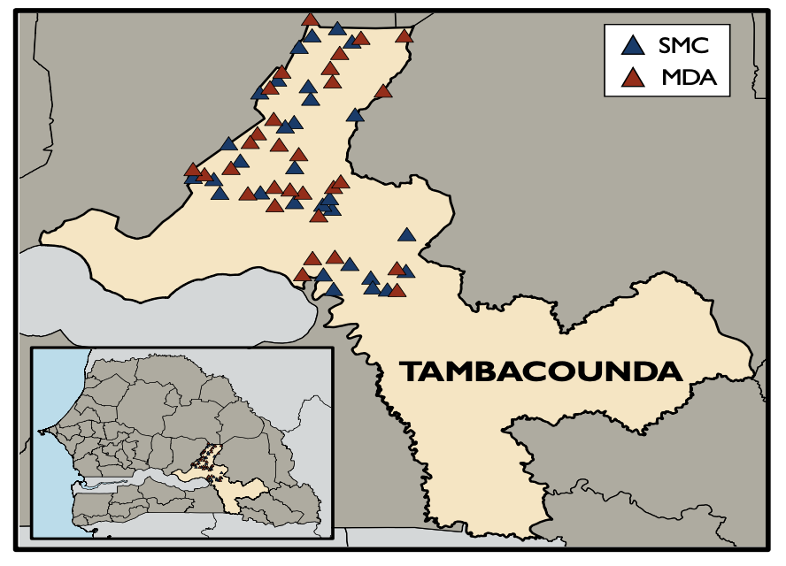
Study site
Conducted in Tambacounda Health district
Optimized malaria control setting
PBO nets distributed in the prior to season
Active case detection (weekly sweeps); 1-2 CHWs/village depending on village size
Malaria prevalence was ~ 6,8% across 60 villages (min=0, max= 30%)
Average malaria incidence was 387 cases/1000 person-year

Slide 10
Study timeline
July-Dec: transmission season
Malaria morbidity data collection
Baseline survey, Dec 10-20
Endline survey, Dec 9-21
PBO net distribution, Nov 2020
Census 2, Nov 2020
Year N+1
follow up
Census 1, Feb 2021
Jan 1, 2020
Jul 1, 2020
Jan 1, 2021
Jul 1, 2021
Jan 1, 2022
Jul 1, 2022
Jan 1, 2023
2020 SMC campaign (all villages)
Round 1: Jul 24-27
Round 2: Aug 31-Sept 3
Round 3: Sept 30-Oct 3
2021 SMC campaign (control)
Round 1: Jul 30-Aug 3
Round 2: Aug 27-30
Round 3: Oct 1-4
2021 MDA campaign (intervention)
Round 1: Jun 21-25
Round 2: Aug 6-11
Round 3: Sept17-21

Slide 11
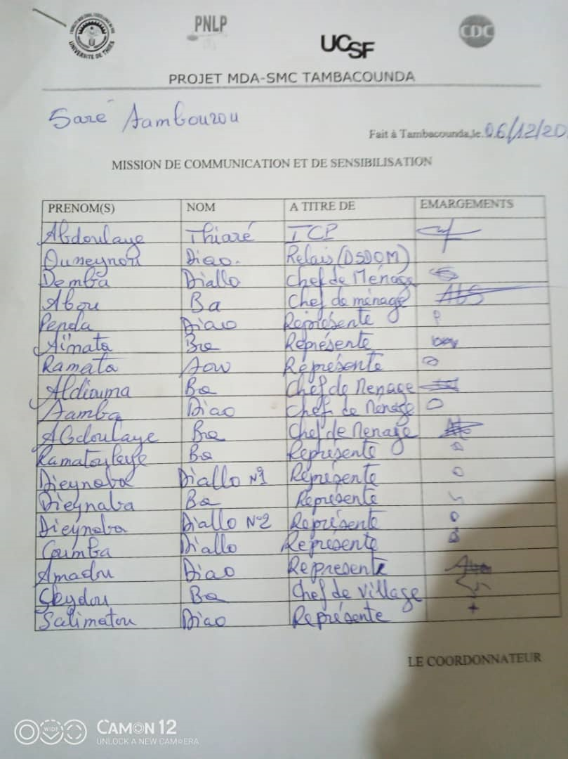
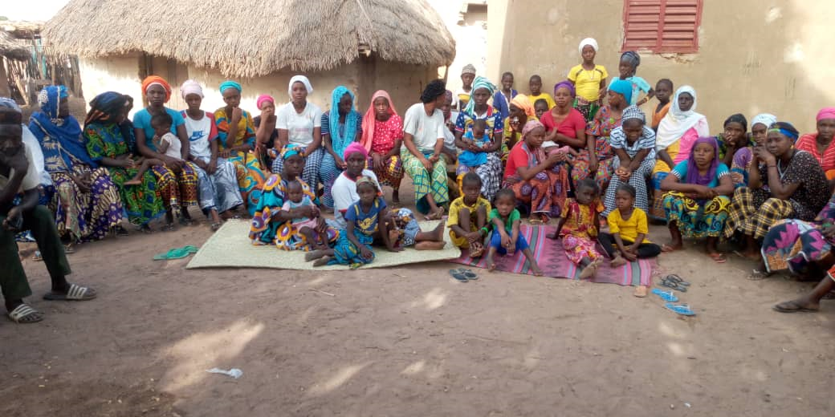
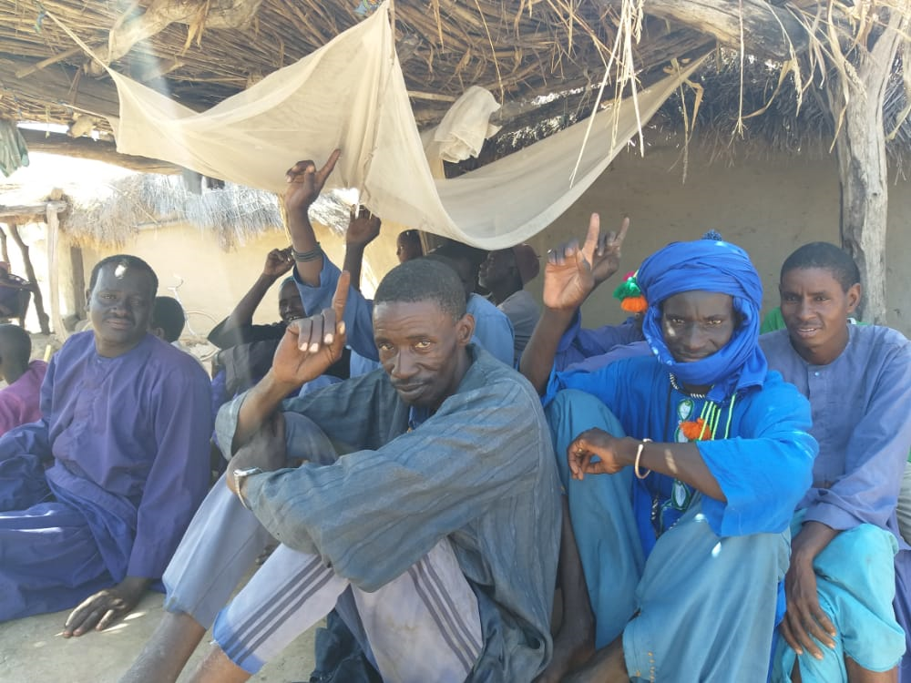
Study procedures
Community engagement activities occurred before and during MDA
Top down meetings with:
Health authorities in presence of NMCP
Head of villages with local health authorities
Head of households in presence of head nurses
Women in reproductive age in presence of Midwifes
Home visits
ICs was taken before round 1 for all 3 rounds
Trainings done with CHWs and HF nurses on protocol, drug distribution, and quality of malaria surveillance data collection.

Slide 12
Study procedures
MDA delivered door to door
DOT for all 3 doses of DHA-PQ and single PQ dose
Focus Groups Interviews and direct observation
Active and passive surveillance used to monitor for adverse events
Adverse events followed up to resolution
Pregnancy testing for women between 13 and 49 YO (each round)
Sensitization campaigns before each MDA round
Supervision visits in all villages

Slide 13
Results

Slide 14
Baseline Characteristics
Characteristics | Total | MDA | SMC
Village-level
Number of clusters | 60 | 30 | 30
By health post, n (%)
Bohe | 9 (15%) | 6 (20%) | 3 (10%)
Dar Salam | 2 (3%) | 1 (3%) | 1 (3%)
Dawadi | 14 (23%) | 6 (20%) | 8 (27%)
Koussanar | 9 (15%) | 5 (17%) | 4 (13%)
Missirah | 6 (10%) | 2 (7%) | 4 (13%)
Neteboulou | 5 (8%) | 2 (7%) | 3 (10%)
Sinthiou Maleme | 15 (25%) | 8 (27%) | 7 (23%)
Presence of DSDOM prior to the study, n (%)
No | 20 (33%) | 10 (33%) | 10 (33%)
Yes | 40 (67%) | 20 (67%) | 20 (67%)
Distance to health post in km, mean (SD) | 14.8 (8.4) | 14.9 (8.6) | 14.6 (8.3)
Population size in 2019, mean (SD) | 322 (168) | 330 (170) | 315 (168)
Population size <10 years of age in 2019, mean (SD) | 119 (62) | 120 (63) | 117 (62)
Baseline microscopy prevalence (%), mean (SD) | 8% (8) | 7% (9) | 9% (8)

Slide 15
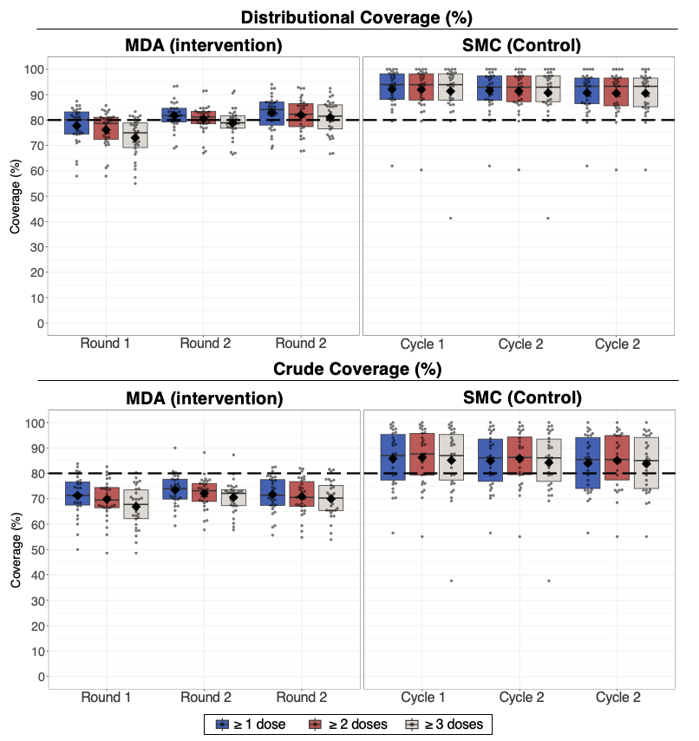
Coverage
High MDA and SMC coverage; many MDA villages had coverage ≥80%.
MDA Distributional Coverage
~80% of participants received at least 1 dose in rounds 1, 2, and 3
Variability between villages
SMC Distributional coverage
>90% of participants received at least one dose of SP-AQ in rounds 1, 2, and 3
Reasons for not taking medication:
Absence (13-21%)
Refusal (1-2%)

Slide 16
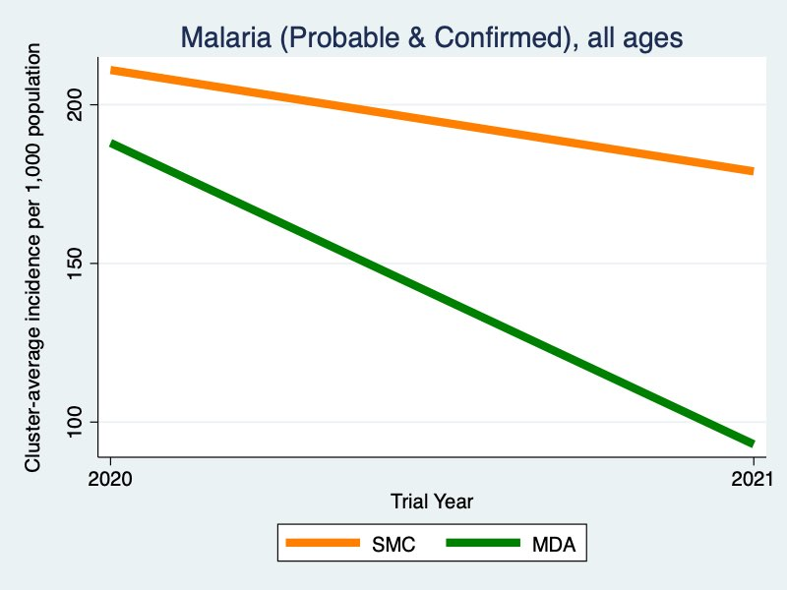
MDA reduced malaria incidence by 53% compared to SMC
MDA resulted in a 53% [95% CI: 29%, 69%] reduction in clinical malaria incidence compared to SMC between 2020 and 2021.

Slide 17
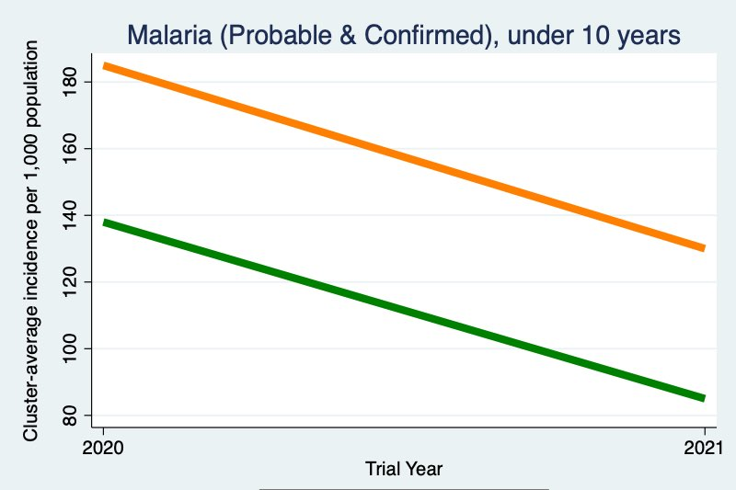
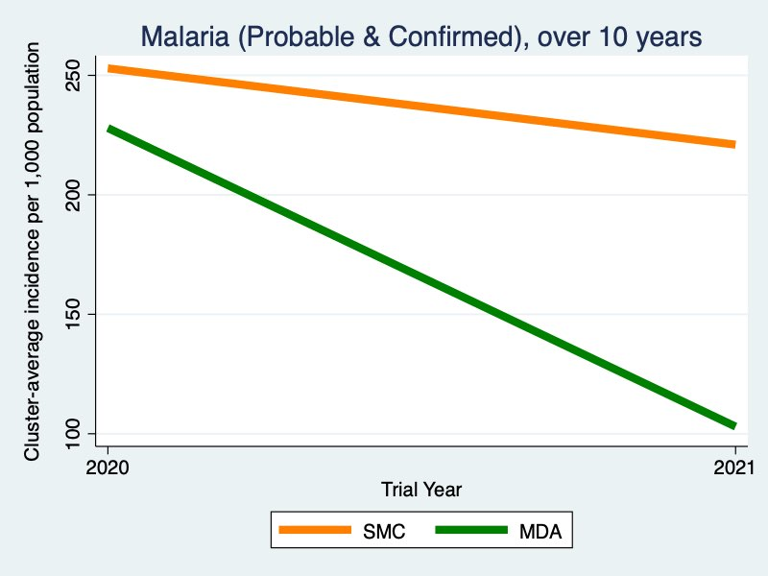
Effects on clinical malaria incidence were greater in those 10+ years
Sub group analysis | Adjusted effect
< 10 years of age | 43% [13%, 63%]
≥ 10 years of age | 59% [37%, 74%]

Slide 18
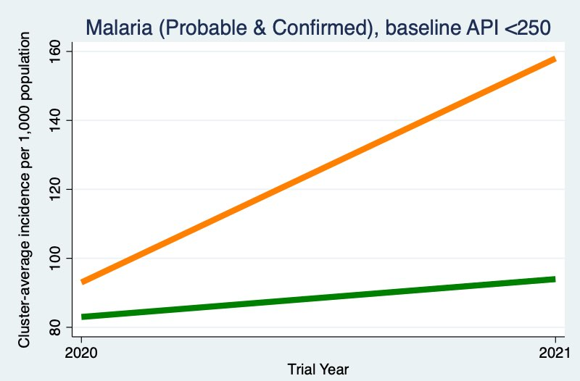
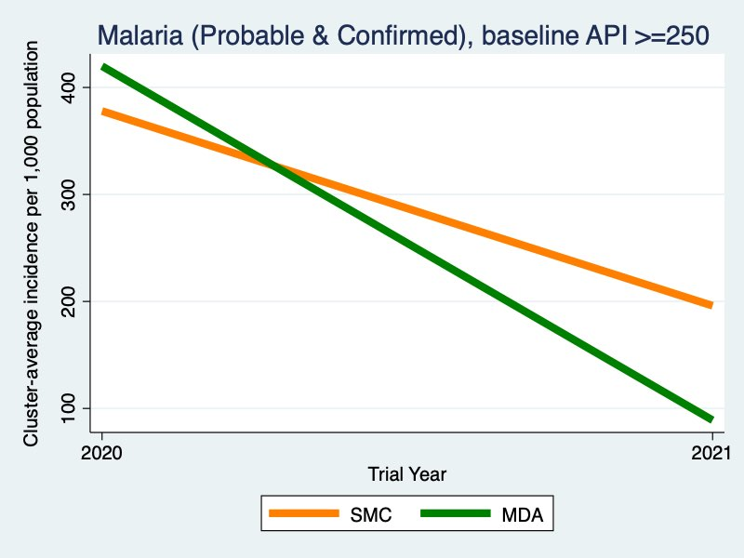
Subgroup Analysis by Baseline Incidence
Baseline API < 250
Baseline Incidence <250 (n=21 cluster MA, 18 cluster SPC)
Intervention effect = 18% [-34%, 50%]
Increases from 2020-2021 onwards are likely to be due to improved case management through DSDOM capacity building.
19/20 of villages without a baseline DSDOM included in this analysis.
Base incidence ≥250 (n=9 WMAs, 12 CPSs)
Intervention effect = 70% [19%, 75%]
Note that the incidence in the graphs is for the July-Dec transmission year.
Baseline API ≥ 250

Slide 19
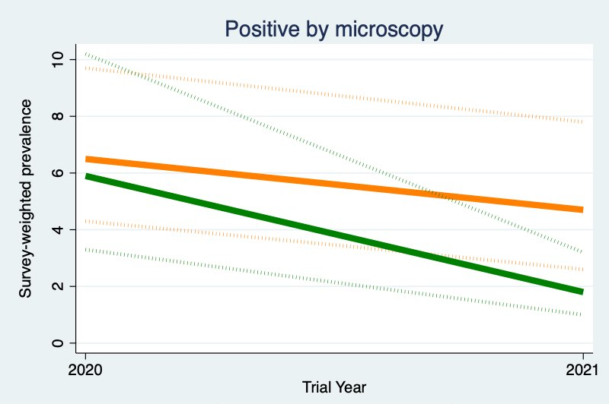
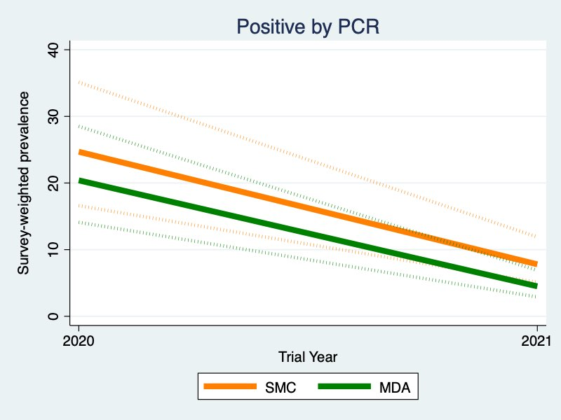
Parasite Prevalence by microscopy and qPCR
Similar trends observed in parasite prevalence results
Prevalence confirmed by microscopy
Effect of intervention = 62% [22%, 81%].
Parasite prevalence confirmed by PCR
Effect of intervention = 43% [-4%, 69%].

Slide 20
Prevalence of resistance molecular markers
Mutations | MDA |  |  | SMC
Mutations | Baseline | Endline |  | Baseline | Endline
PfK13
C580Y | 2% | 0% |  | 0% | 0%
PfDHPS
K540E | 0% | 0% |  | 0% | 0%
A437G | 81% | 87% |  | 81% | 87%
A581G | 0.8% | 0% |  | 0% | 0%
PfDHFR
N51I | 98% | 100% |  | 98% | 100%
C59R | 100% | 100% |  | 100% | 100%
S108N | 32% | 23% |  | 39% | 29%
PfCRT
K76T | 38% | 36% |  | 46% | 44%
PfMDR1
N86Y | 5% | 0% |  | 2% | 0%
Y184F | 66% | 64% |  | 81% | 65%
No strong evidence of resistance selection by the MDA or SMC.
The K13 C580Y mutation is observed at a very low prevalence (0-2%).
No evidence of the PfDHPS K540E mutation;
PfDHPS A581G mutation prevalence observed at 0-0.8%.

Slide 21
Prevalence of AEs (active surveillance) in children <=10, round 3
 | MDA arm | SMC arm | p value
Fever | 14 (4.1%) | 7 (1.4%) | 0.024894
Headache | 2 (0.6%) | 2 (0.4%) | 0.72995
Abdominal pain | 3 (0.9%) | 0 | 0.997
Drowsiness | 1 (0.3%) | 0 | 0.998
Nausea | 2 (0.6%) | 0 | 0.997
Cough | 1 (0.3%) | 0 | 0.998
Influenza like illness | 2 (0.6%) | 2 (0.4%) | 0.72995

Slide 22
Incidence of AEs (active surveillance)

Slide 23
Safety - Passive surveillance
 | MDA | SMC
Passive surveillance
Participants with any AE, n/N (%)¹
All rounds/cycles | 67/20,887 (0.3%) | 73/9,522 (0.8%)
First round/cycle | 46/6,506 (0.7%) | 33/3,202 (1.0%)
Second round/cycle | 13/7,125 (0.2%) | 40/3,174 (1.3%)
Third round/cycle | 8/7,256 (0.1%) | 0/3,146 (0%)
Frequency of adverse events, n
All rounds/cycles | 129 | 99
First round/cycle | 97 | 40
Second round/cycle | 20 | 59
Third round/cycle | 12 | 0
Most common adverse events, n/N (%)
Headache | 33/129 (25.6%)
Abdominal pain | 25/129 (19.4%)
Vomiting | 23/129 (17.8%)
Fever | 22/129 (12.1%)
Other | 26/129 (20.2%)

Slide 24
Acceptability
Participant perceptions of MDA improved over rounds due to perceived reduction in malaria cases, added benefit of malaria prevention for adults, and less bitter taste of drugs.
Active engagement by trusted political and health leaders in the community. Authorities set an example by actively taking drugs in front of community and encouraging community to accept the drugs.
Utilization of experiences and lessons learnt from SMC and other MDA campaigns to improve coverage.
Teams began drug distributions early in the morning before participants left to the field adapting their strategies to the local constraints
Participants were contacted via phone and reached in remote locations to deliver drugs

Slide 25
Reasons for non coverage
Cultural and religious events (e.g., weekly markets, traditional and religious ceremonies) were strong influencers of absences.
Agricultural and livestock season resulting in many absences among community
Several participants intentionally were absent during the campaign or reported a self-reported pre-existing heart conditions as a strategy to not outwardly refuse MDA.
Suspicion that MDA campaign would reduce the fertility and longevity of participants, which were spread through social media campaigns and made worse by negative rumors around COVID-19 pandemic.
Videos were shared through social networks to warn their communities about possible risks related to drugs and vaccines during COVID-19 pandemic.
Experiences of side effects in previous rounds.

Slide 26
Operational challenges
coverage levels were affected by moderate levels of mobility, logistical challenges in accessing remote villages during rainy season
Refusals were more common among adolescents and younger adults who were affected by negative social media messaging around COVID-19 and were thus more fearful and/or suspicious about other public health interventions.
Diversion of human resources in response to COVID-19 pandemic and other public health interventions (e.g., yellow fever immunizations) caused delays in MDA implementation
Pediatric formulation of primaquine required additional time and resources to crush tablets and dissolve in water

Slide 27
Lessons learned
Strong support from key administrative and health authorities, including the District Health Officer, health post nurses, village elders and engagement from the existing community health worker system are drivers of Mass campaign success
Routine district activities (such as mass vaccination, NTDs chemoprevention …) can negatively impact optimal implementation of MDA
Repeated training on drug delivery and dosing guidelines helped to ensure efficient delivery of MDA
It is necessary to have pediatric formulation of primaquine to better implement MDA using such drug

Slide 28
Conclusion
Good acceptability of MDA despite some challenges
High level of coverage
No SAEs
Senegal plan it’s introduction in 2 medical districts in the south region
Tailored strategies needs to be anticipated for nomads and extremely mobile persons during transmission season

Slide 29
Next steps
2022 SMC campaign monitoring; Coverage was ~92-100% in study villages.
Year 2 moribidity data collection under analysis to see if effets were sustained in follow-up year.
Lab analysis – drug resistance markers, serology
Cost effectiveness analysis
Dissemination to communities planned for May 2023
Plan of NMCP is to do MDA in 2 districts

Slide 30
Acknowledgements
PNLP
Fatou Ba
Latsouk G. Diouf
Ibrahima Diallo
Elhadji Doucoure
Standeur N Kaly
Seynabou Gaye
Medoune Ndiop
Doudou Sene
Impact Malaria
Michelle Hsiang
Roly Gosling
Michelle Roh
Kyle Daniels
Moustapha Hama
Cara Smith-Gueye
Tabitha Kibuka
Adam Bennett
Xu We
Thierno Ba
UCAD
Cheickna C S Diawara
Kadiatou Dieng
Tidiane Ndoye
Mouhamadou M. Pouye
Seynabou Sakho
PMI Senegal
Mame Birame Diouf
Alioune Badara Gueye
Katherine Sturm-Ramirez
UIDT Thiès
Elhadj Ba
Abdoulaye Diallo
Elhadji Diouf
Amadou Seck
Aminata Colle Lo
Ndeye Fatou Lo
Sylla Thiam
PMI CDC
Jimee Hwang
Leah Moriarty
Julie Thwing
LSHTM
Ari Fogelson
Paul Milligan
VECTOR LINK
Jean Biyik Abdoulaye Diop
CIGASS
Yaye Dié Dia
Daouda Ndiaye
Abdoulaye Tine
RM Tamba
Bayal Cissé
Tidiane Gadiaga

