Slide 1


Seasonal Malaria Chemoprevention (SMC)
2024 Campaign in Turkana
KENYA
EKAI DAVID LOGIALAN HSC
COUNTY MALARIA COORDINATOR-TURKANA COUNTY
Prepared for the 2024 SMC Alliance Meeting – Abuja, Nigeria

Slide 2
Presentation Outline
Summary Information
Background
Malaria Seasonality in Turkana
The Study Findings
The hard-to reach population.

Slide 3
Summary information for 2024 Campaign
 | 2024
Start and end dates | June
Number of cycles | 5
Number of districts targeted | 1
Number of children covered | 35,000
Age ranges covered | 3 months-59 months
Coverage (% targeted children receiving all cycles) | 100%
Any drug resistance testing or efficacy studies performed? (Y/N) | N
Any gap

Slide 4
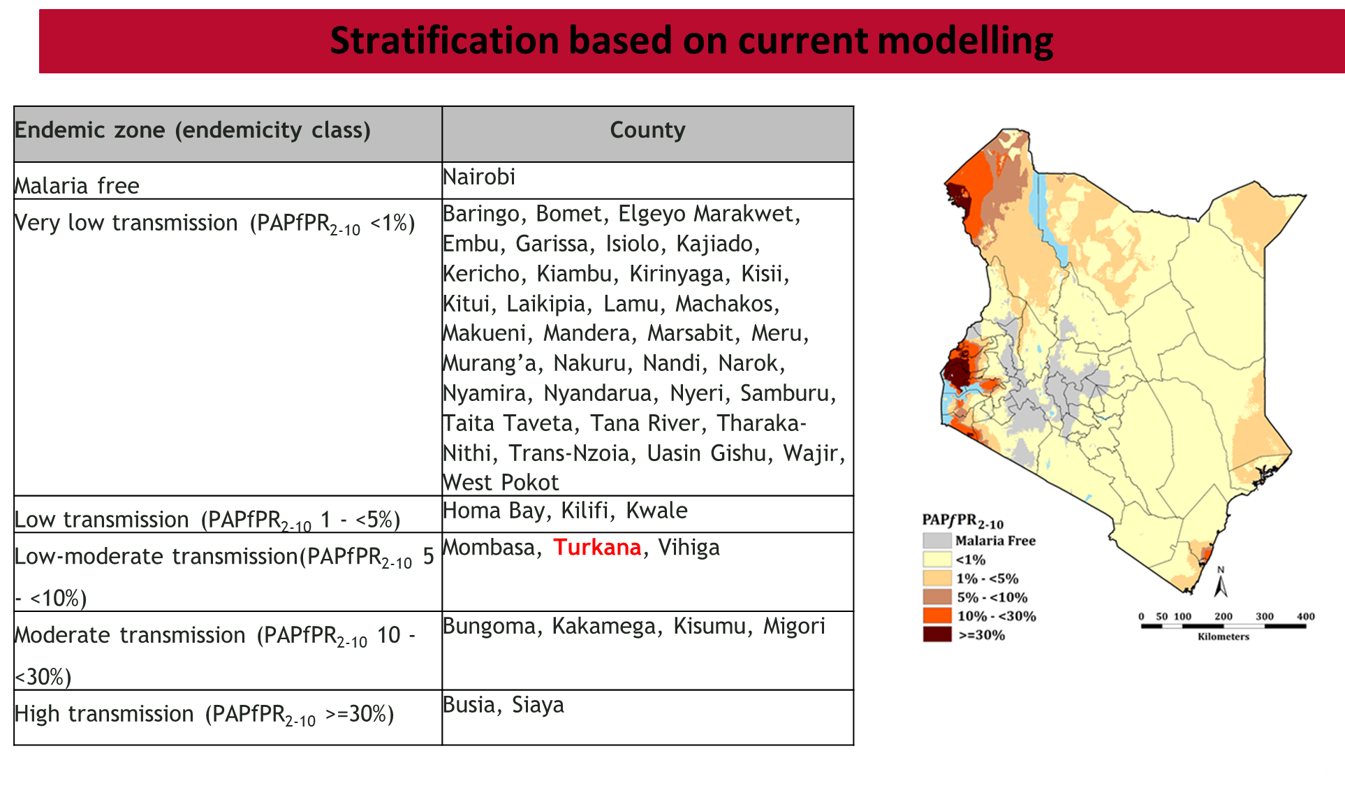

Slide 5
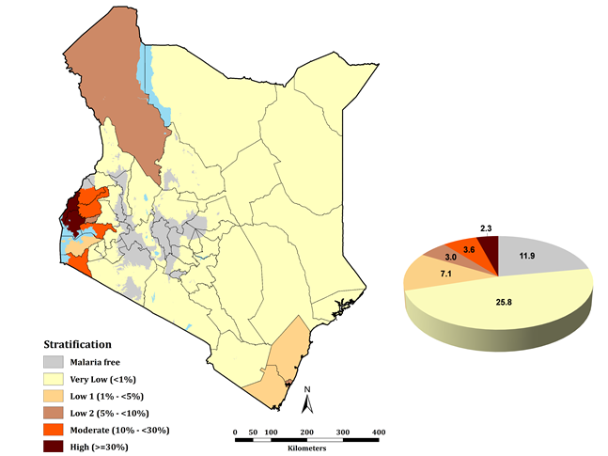
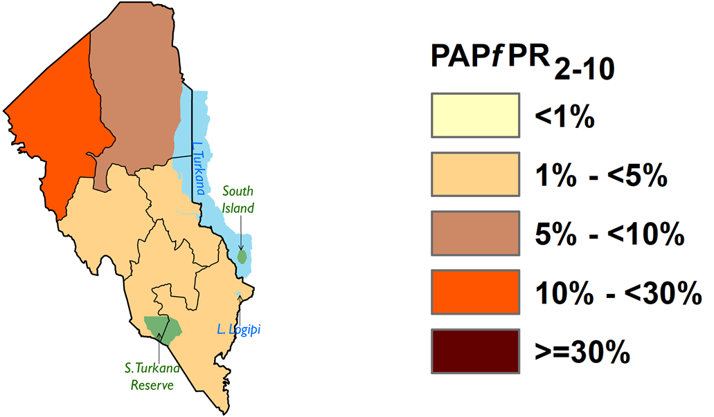
Background of Turkana County in Kenya

Slide 6
  Turkana county is situated in the northwest part of Kenya
Turkana Profile
  Covers an area of 77,000sq kms and neighbors Uganda, South Sudan and Ethiopia. Comprises of 7 sub-counties
Turkana Profile
  Host to refugees with 2 refugee camps; Kakuma refugee camp and Kalobeyei settlement hosting about 300,000 refugees. Total population 1049168; Turkana East 155279, Kibish 41458, Loima 121939, Central 211324, North 74266, South 173655 and West 271267
Turkana Profile
Turkana Profile
Has 282 health facilities, 8 are within the refugee camps.

Slide 7
Source of Livelihood in Turkana
Turkana County
Pastoralists
Agropastoralist
Fishing
Business Community

Slide 8
The case for Turkana
Like Sahel and Karamoja, Turkana experiences strong seasonality of cases
75% of cases in children <5 (DHIS2)
Mobile populations and outdoor sleeping → need alternative prevention interventions
Source: DHIS2

Slide 9
Seasonal Malaria Transmission in Turkana
WHO revised recommendations in June 2022
  Lifted restriction for this to be focused only in Sahel
SMC is NOW recommended in areas of seasonal malaria transmission.
https://apps.who.int/iris/bitstream/handle/10665/354781/WHO-UCN-GMP-2022.01-Rev.2-eng.pdf?sequence=1&isAllowed=y

Slide 10



Proposed:
Operations Research to guide Community-informed Delivery Models for Seasonal Malaria Chemoprevention in
Remote Populations of Northern Kenya (Turkana)
Faculty of Health Science

Slide 11
Phase I
  Community mapping and formative Mixed methods research (Completed)
Phase 2
  Implementation and impact evaluation
Phase 3
  Summative qualitative research

Slide 12
Phase 1- Qualitative Objective
Collect information to inform how to adapt SMC delivery models to meet the needs of this unique community
Specifically:
  Understand the resources families trust for health issues
  Learn where people travel, who travels, and when
  Understand community/leadership structures that are trusted to aid in SMC sensitization
  Identify types of households that may be missed in a mass campaign

Slide 13
Phase 1- Quantitative Objective
Quantify the prevalence of P. falciparum malaria in households with children under 5 years in Turkana North and Turkana Central sub-counties in Turkana, Kenya
Describe factors related to malaria risk such as ITN ownership, travel, treatment seeking and knowledge about malaria

Slide 14
Lessons from Formative Survey In Turkana
Who might be missed:
  Children accompanying caretakers who are involved in herding animals or move with caretakers for farming, charcoal and other daily activities.
  Children affected by their caretakers' struggles with alcohol use.
  Children living with caretakers who are HIV positive.
  Children from families who are in conflict with CHPs due to personal grudges.
  Children whose caretakers have a preference for traditional medicine over modern healthcare.
  Families living very far from health facilities or Community Health Providers (CHPs).
  Children living with disabilities
  Those residing in township areas characterized by high-security walls or guard dogs.
  Children with indigent parents or who are living on the street

Slide 15
Lessons from Formative Survey In Turkana
In the house-to-house activities, we noticed:
  12% of children under 5 were absent on the day of survey
    Up to 15% by the lake
  50% of heads were absent at survey
    This can create a challenge if heads need to be consulted (or present) for their children to take SMC

Slide 16
Focus Reaching Hard-to-Reach Populations

Slide 17
Components of the Innovation for Hard to Reach Population
SMC Community Engagement
SMC Messaging
SMC Delivery

Slide 18
5
SMC Community Engagement
6
  Convene a community committee to guide entry and sensitization:
  This should include Tree of Men, religious and women’s group participants.
  They should be empowered to help design the approach and messages as well as the means/avenues of dissemination.
  The County can advise on who should be selected.
  This will ensure that the community owns the dissemination and identifies ways to reach hard-to-reach groups, nomadic groups etc… Include more diverse perspective/approaches than if we just go with usual methods.
Invite village elders to the daily facility debrief meetings:
  This will foster accountability and ensure the community knows that they are resource people for questions, concerns (a go-between). Ask them to visit households that are unsure or having challenges
4
1
3
2

Slide 19
5
6
SMC Messaging
4
1
Have a ‘AMUA MAPEMA’ (or some better catch phrase!) campaign:
  Encourage families to discuss and decide before DAY 0 so that they are ready, including being available at the household when the CHPs come and not needing to contact the absent head before proceeding
3
2

Slide 20
SMC Delivery Innovation
Identify families in highly nomadic communities who are likely to travel:
  Have them come to a fixed point location on the first cycle.
  . We then follow-up with text messages and visit them when they return to see what they did.
Identify households that are more than 1 hour (?) walk from nearest health facility:
  Give them two courses of SMC and support them with text messages. Find out how well they did on the intracycle surveys.
5
6
4
1
3
2

Slide 21
Questions?
  Can we identify any CHPs who will be migrating?
How can we identify households that will migrate or are very far from CHPs ahead of time?
Can we deploy each CHP with an assistant? Are there opportunities to engage non-health or other overlooked community resources for the door-to-door activities?
Are there opportunities to leverage digital platform household registers?

Slide 22
Acknowledgement

Slide 23
Thank You

