Slide 1
Seasonal Malaria Chemoprevention (SMC)
2023 Campaign
The Gambia
Olimatou Kolley
Prepared for the 2024 SMC Alliance Meeting – Abuja, Nigeria

Slide 2
Summary information for 2023 and plans for 2024 campaigns
 | 2023 | 2024
Start and end dates | August – December | August – December
Number of cycles | 4 | 4
Number of districts targeted | 23 | 23
Number of children covered | 100185 | NA
Age ranges covered | 3-59 months in 14 Districts and 3-120 months in 6 districts | 3-59 Months
Coverage (% targeted children receiving all cycles) | 53% | NA
Any drug resistance testing or efficacy studies performed? (Y/N) | No | No
Any gap | 3 Districts (148,410) | 3 Districts (148,410)

Slide 3
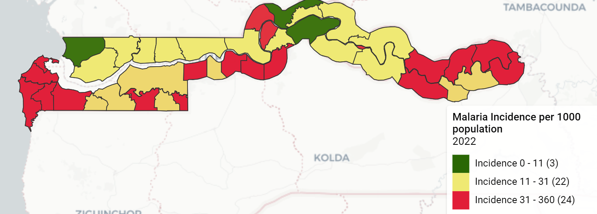
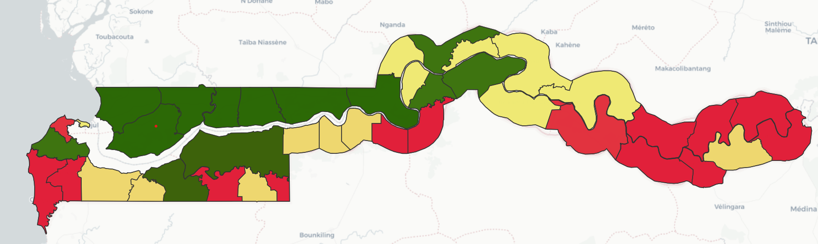
Country map showing SMC implementing districts
2023 map (Covered
2024 map (targets)

Slide 4


Digitization Approach and Use of Data
The Gambia SMC 2023
Ministry of Health
National Malaria Control Programme

Slide 5
PROBLEM WE WERE TRYING TO SOLVE BY USING ICT4D
Quality: Collecting data using paper forms can lead to multiple errors
Speed: using mobile technology for data collection enables enumerators to administer questionnaires faster than using pen and paper leading to time and cost savings for the organization
Real Time: One of the disadvantages of pen and paper data collection is simply how long it takes between the collection and the analysis of data.
Cost: mobile data collection saves money on printing, data entry, transport and storage.
Security: Securing paper-based records is not always easy

Slide 6
Key lessons learnt in 2023: Focus Digitization
What was the design of the digitalization?

Slide 7


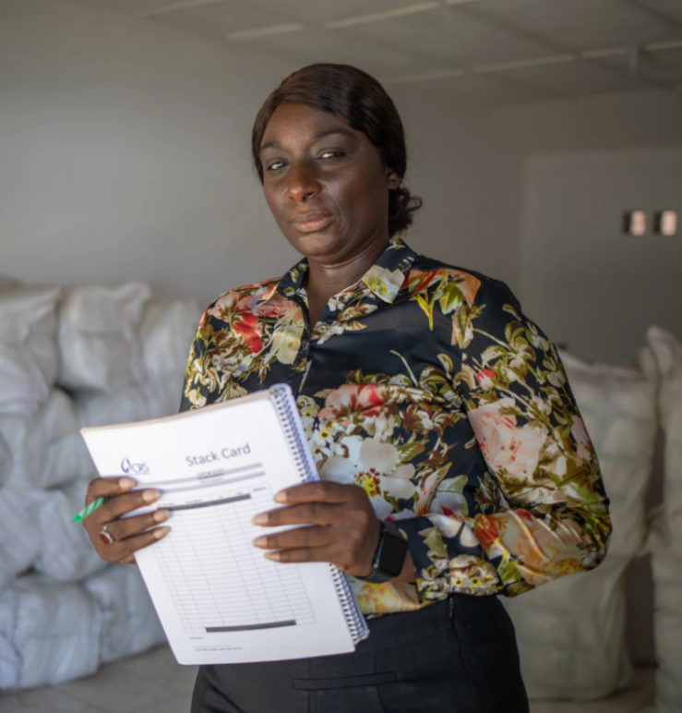
ICT4D in malaria work in The Gambia
ICT4D was adopted in The Gambia’s National Malaria Control Program (NMCP) during the 2014 Mass LLIN Distribution Campaign.
This came as a result of the experience from the 2011 LLIN Mass Campaign which was paper based.
Catholic Relief Services (CRS) bought Apple iPads which were customized with the iFormBuilder App.
Photo by Jason Florio for CRS
Notes:
Add note to this slide

Slide 8






ICT4D in malaria work in The Gambia (cont'd)
iFormBuilder
Real-time data
CommCare
SMC & bednets
Jason Florio/CRS
NMCP & CRS continued to use iFormBuilder for Seasonal Malaria Chemoprevention (SMC) in 2015 and 2016 funded by Unitaid (ACCESS SMC Project) to improve timeliness of reporting and accuracy
of data.
The platform provided real-time data with visualization tools, allowing for timely decision-making, providing feedback to field teams, and improved resource allocation.
iForm Builder was deemed too cumbersome after two years of use.
It was replaced with CommCare, a more user-friendly platform, for the 2017 LLIN and SMC distribution.
CommCare continued to be used for SMC as well as routine bednet distribution at health facilities for populations at risk (pregnant women and children under 1).
Notes:
Add note to this slide

Slide 9
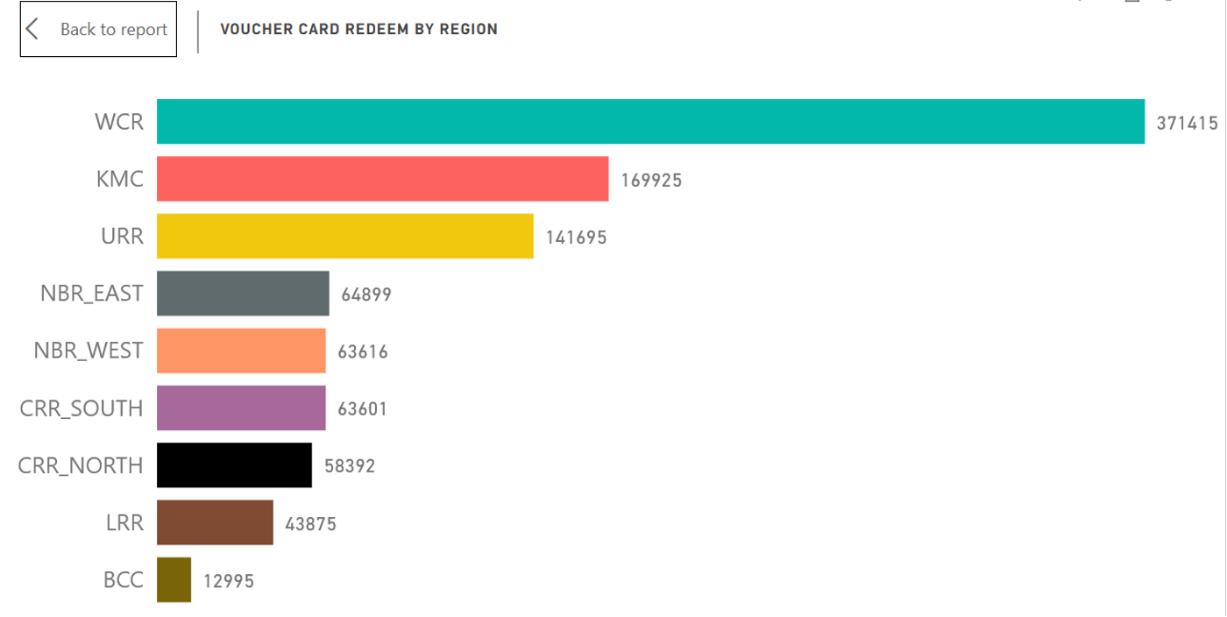
Problems with Commcare
Commcare implementers are required to pay for subscription in order to gain access to the Dimagi managed cloud-based CommcareHQ for data access and management
Limited built-in data analytic tools
No ready-made data visualization dashboards
Limited local capacity

Slide 10
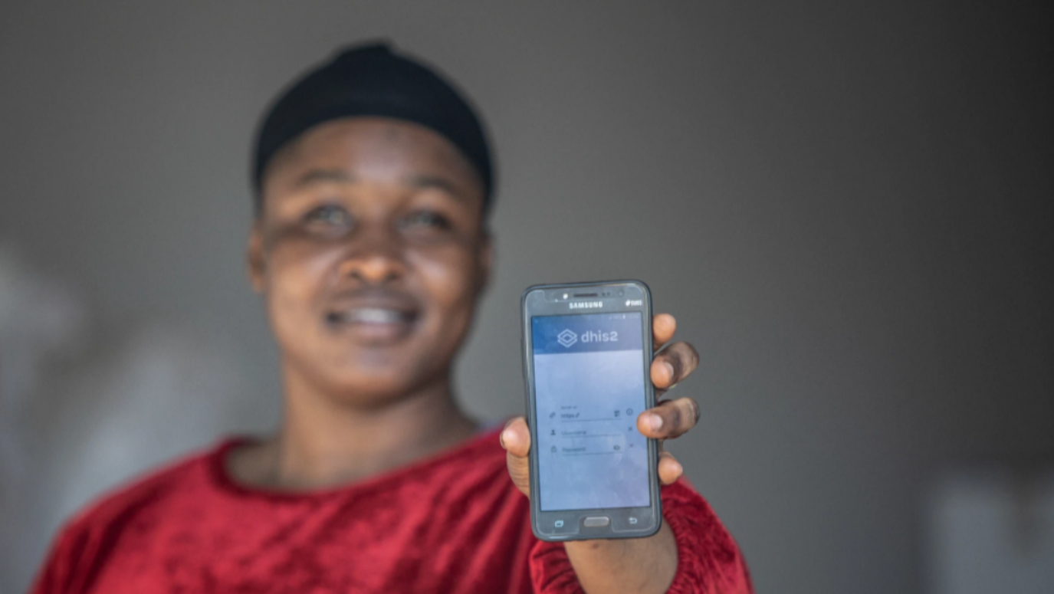

From CommCare to DHIS2 (2021)
DHIS2 is the Ministry's main reporting platform. The NMCP pushed partners to align their reporting.
Provided funding for a pilot using DHIS2 Tracker.
In August 2021, 59 data collectors and 9 team supervisors were trained to pilot the DHIS2 Tracker. The goal: assess the usability of the platform for SMC and possibly scale up its use to replace the CommCare platform.
The training helped participants to:
Understand DHIS2 Tracker
Configure of the DHIS2 tracker mobile application
Use the application for data collection and analysis
Ensure data quality
Photo by Will Baxter/CRS
Notes:
Add note to this slide

Slide 11


Use of DHIS2 Tracker for the 2023 SMC Campaign
Easily Customizable
Open Source & Free
Built-in Data Analytic Tools
Why DHIS2?
01
DHIS2 is easily customizable for different use cases, and the Gambia has a strong team of experienced DHIS2 implementers
03
02
DHIS2 is free to use with no extra or hidden costs attached. It free to manage and customize. It also has a strong community of practice.
DHIS2 has a plethora of built-in data analysis and visualization tools, which simplify the data collection and analysis lifecycle.

Slide 12
LESSON’S LEARNED
There was real time SMC data collection using the DHIS2 tracker.
Data quality checks were done daily i.e. as soon as data collectors sync their data.
The data was analyzed at the end of each day, this helped to identify the areas that were not reached and whether all the children were reached compared to the previous cycle.
Audit trails were available to identify data collectors who were doing wrong data collection to rectify data and for mentoring and coaching
Provided integration of data into DHIS2 used by MOH/HMIS
Made monitoring of data in the field easier

Slide 13
Current use of DHIS2 Tracker in the Gambia
National Health Management Information System
DHIS2 Tracker is currently used as a National Health Data Warehouse
COVID-19 Surveillance & Vaccination
DHIS2 Tracker is currently being used as the National COVID-19 Surveillance and Vaccination Information System
Education Management Information System
DHIS2 Tracker is also being piloted for use as an Education Management Information System (Ministry of Basic & Secondary Education)

Slide 14
Data Analysis & Visualization with DHIS2 Tracker

Slide 15
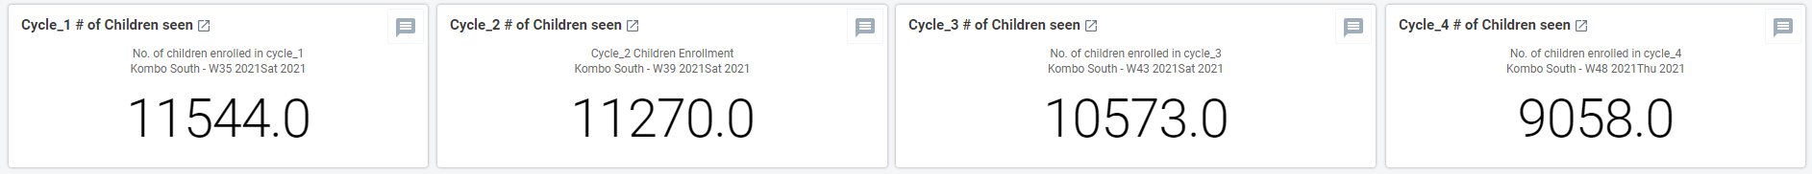
Dashboard showing the Children Treated by Circle in Kombo South

Slide 16
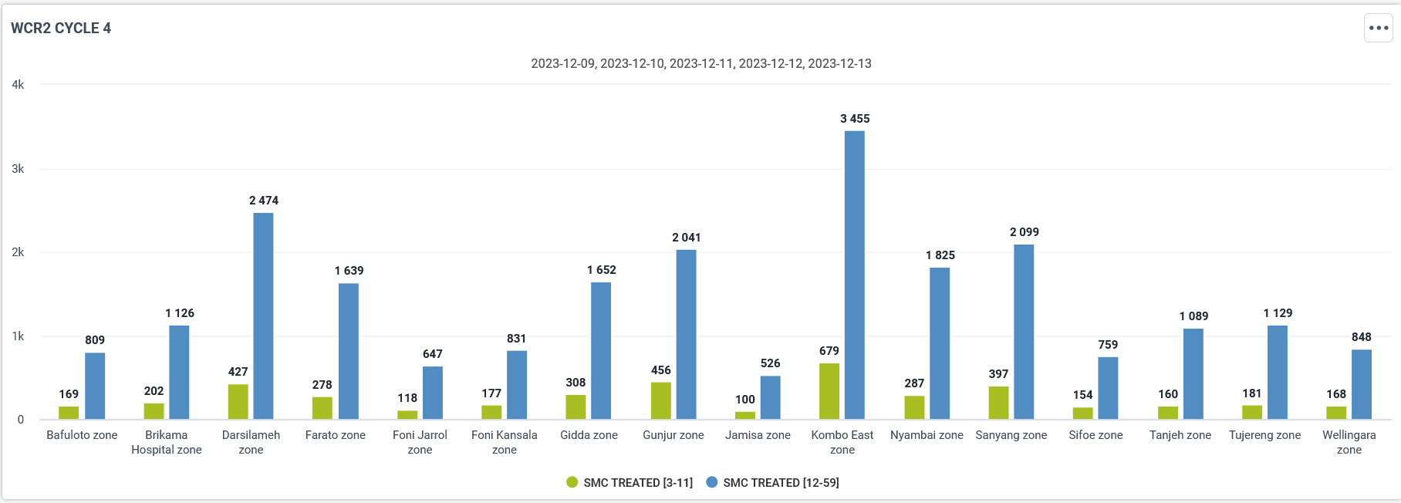
A breakdown of new Enrollment by Circle in Kombo South

Slide 17
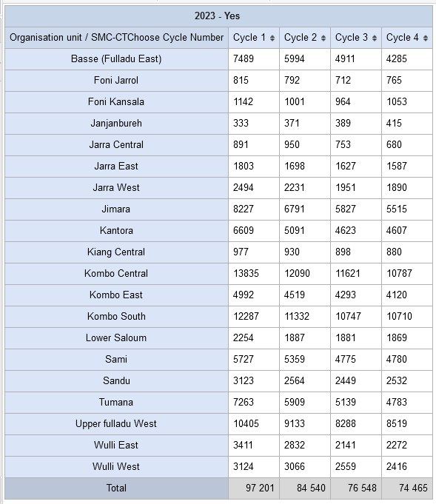
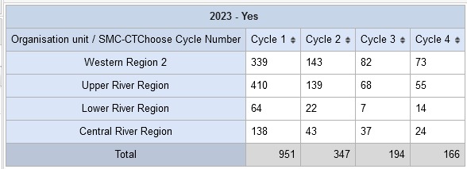
Children treated
Number of Children successfully treated with 1st dose
Number of Children treated by redose

Slide 18
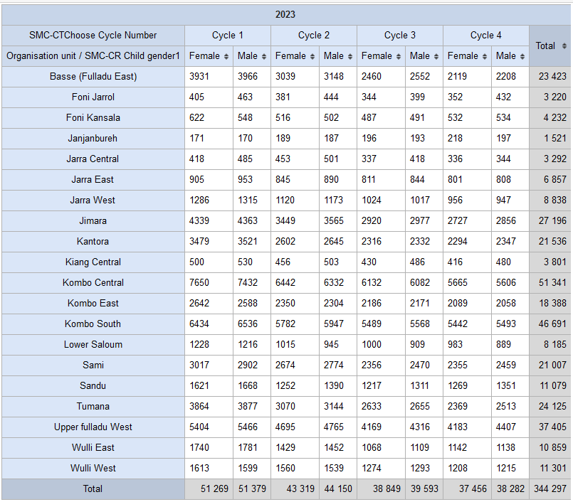
Children treated by gender

Slide 19
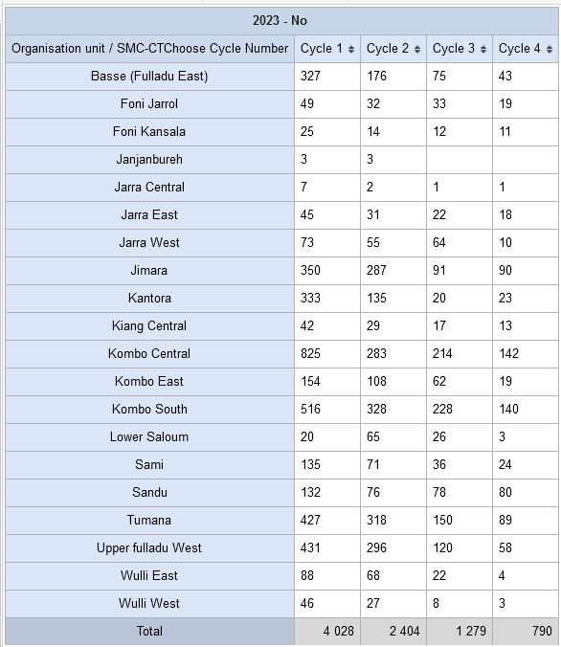
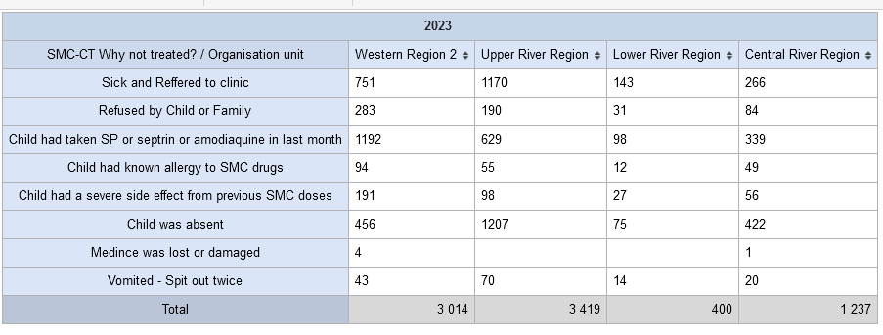
Children who are not treated
Number of children not treated
Reasons for not treating

Slide 20
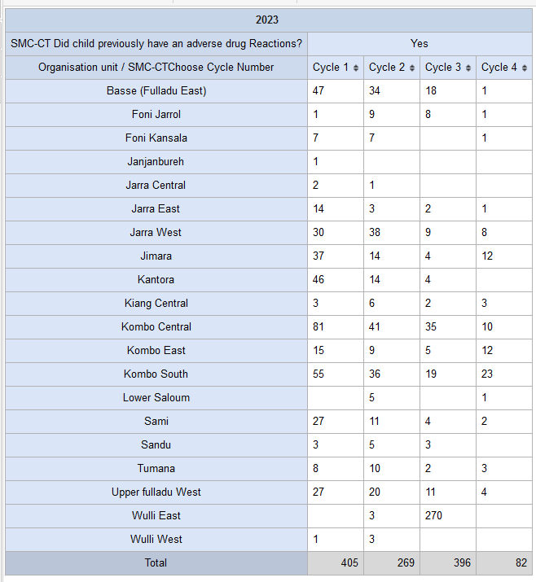
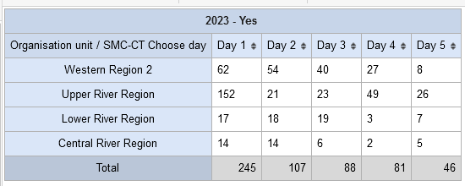
Adverse drug reactions and children taken to the health facility
Children who previously had an adverse drug reaction
Children taken to the health facility

Slide 21
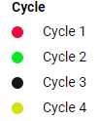
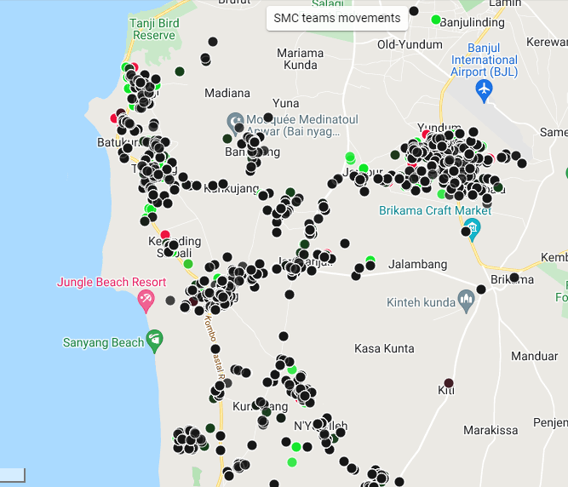
MAP VIEW OF SMC TEAM MOVEMENTS

Slide 22
Challenges deep-dive
Challenge 1
Challenge 2
Challenge 3
Internet Connectivity Issues
There are certain remote areas with no mobile data coverage
Limitations of DHIS2
Although DHIS2 is a dynamic and robust solution, it has its own limitations that hindered the data collection and management such as performance and functionality related issues
Server Capacity & Backup
The production server capacity was insufficient given the amount of data it ended up hosting, which caused a few downtimes. There was no dedicated server for backup as well.

Slide 23
Challenges Continuation
There are no boundaries layer (no shape file) in maps.
Wrong coordinates seen in maps.

Slide 24
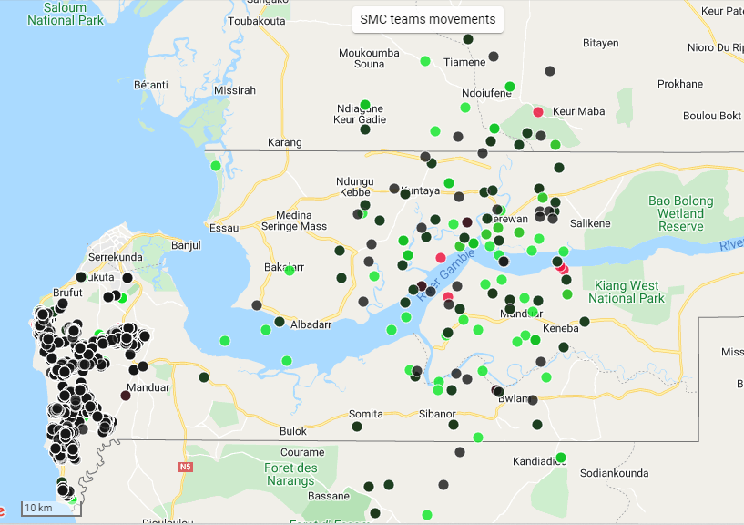
A map showing false coordinates

Slide 25





THANK YOU
Photo by Paul Eagle/CRS
Notes:
Type your notes

