Slide 1
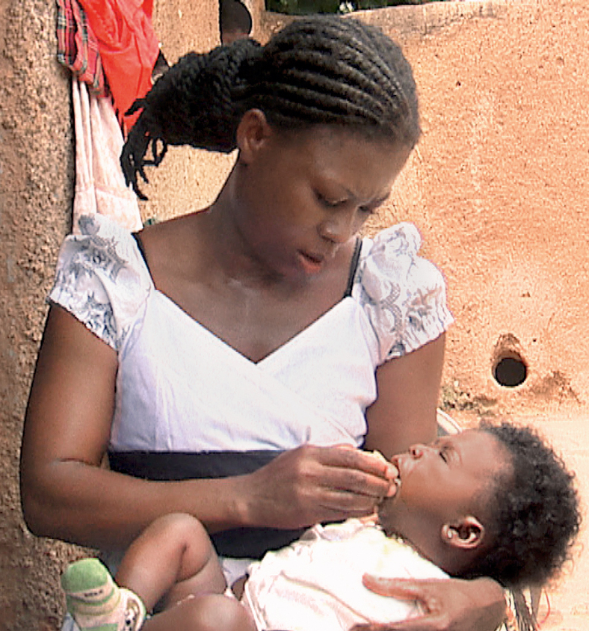


SMC Alliance
Research sub-group
Dr Jean Louis Ndiaye

Slide 2
Agenda
Session | Description | Presenter | Time needed
Welcome and Introduction | Opening remarks and update from the SMC Research sub-group | Jean Louis | 10 mins
Results overview | Overview of the global SMC Research Priorities Background and eDelphi methods Results overview | Kevin | 20 mins
Country level adoption | Q&A session on how these global priorities can be used at national level | All | 20 mins
Wrap up and closing remarks | Summary of the workshop discussions and outcomes Closing remarks and appreciation to the participants and organizers | Kevin Susana/ Jean Louis | 20 mins

Slide 3
Research sub-group
The SMC Alliance research sub-group was set up in April 2021 to serve as a platform for the SMC community to share best practices, lessons learnt, and challenges associated with the SMC research
We are made up of around 80 members and on average 35 members regular attendees on our monthly calls
The sub-group works to support research best practice and information sharing. We have monthly calls including presentations from members and active discussions. The group also organizes symposium submissions at relevant conferences and meetings (e.g. ASHTM) .
The subgroup is co chaired by Susana Scott and Jean Louis Ndiaye.
Everyone interested in joining the subgroup kindly speak to/email Kevin Baker: k.baker@malariaconsortium.org
www.smc-alliance.org

Slide 4
Involvements in 2023
Monthly calls held 9 out of 12 months in 2023, including speakers from a range of organisations engaged in SMC research
SMC Research Priority setting exercise completed using eDelphi process, with over 40 experts in the field feeding into the results
Symposium held at ASTMH in Chicago in October 2023 on chemoprevention
Hybrid meeting held during ASTMH to present the SMC research priorities initial findings
SMC Research priorities presented as oral presentation at RSTMH Annual meeting in December 2023 in London.
www.smc-alliance.org

Slide 5
Planned activities for 2024
Year-round activity (ies)
Monthly calls/virtual meetings on the last Wednesday of the month
Presenters and new topics always welcome!!
Annual meeting activities
SMC Research Priorities workshop
Details of our presence at other events/publications
Symposium submitted on SMC Integration to MIM
Oral presentation on SMC Research Priorities submitted to MIM
Draft manuscript developed for SMC Research priorities
Symposium abstract on SMC Integration being developed for ASTMH
www.smc-alliance.org

Slide 6
Research Subgroup Calendar for 2024
Activity | Deadline for 1st draft
SMC Alliance Annual Meeting | 26 -29th February
Multilateral Initiative on Malaria Conference | 21 – 27th April
World Malaria Day Infographic | 25th April 2023
International Day of the African Child | 16th June
ASTMH Symposium (planned) | 13 – 17th November
Conference on Public Health in Africa | November (TBC)
www.smc-alliance.org

Slide 7
eDelphi results on SMC Research Priorities
Dr Kevin Baker MSc PhD

Slide 8
Project aims and objectives
  On inception, the SMC Alliance Research sub-group, a partnership bringing together representatives of Ministries of Health in African countries where SMC is delivered, UN agency, NGO and research partners, agreed to commission a study on future research priorities for SMC. This work was supported by Malaria Consortium and conducted by Dr Sol Richardson.
  Aim:
  To reach consensus on a list of medium-term SMC research priorities (over the next 5 to 10 years)

Slide 9
Project aims and objectives
  Develop a list of 10 top research priorities
  Ensure a balance of respondents by individual characteristics, professional backgrounds and geographies represented
  Conduct an analysis of the anonymised data to investigate whether experts' responses differ according to demographic variables such as field of specialty, gender, country of origin, etc.
#RSTMH2023 | RSTMH.org

Slide 10
Methods

Slide 11
eDELPHI methodology
“The Delphi method is a process used to arrive at a group opinion or decision by surveying a panel of experts…”
“Experts respond to several rounds of questionnaires, and the responses are aggregated and shared with the group after each round…”
Often employed for scoping and prioritization exercises.

Slide 12
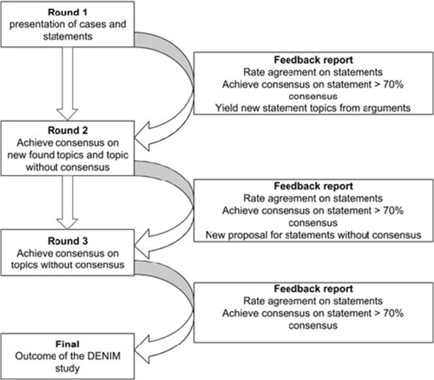
eDELPHI methodology
  From: Harmsen, A.M.K., Geeraedts, L.M.G., Giannakopoulos, G.F. et al. Protocol of the DENIM study: a Delphi-procedure on the identification of trauma patients in need of care by physician-staffed Mobile Medical Teams in the Netherlands. Scand J Trauma Resusc Emerg Med 23, 15 (2015). https: //doi.org/10.1186/s13049-015-0089-z

Slide 13
Initial priority-setting
A workshop was held at the NGO Malaria Consortium among country technical coordinators from five Africa-based offices (Burkina Faso, Chad, Togo, Mozambique and Uganda) to define initial research priorities
These research priorities formed the initial list of priorities which were rated by respondents through successive online surveys

Slide 14
Surveys
Surveys consisted of two Waves (1 and 2) of question rating and elimination, and a Wave 3 final ranking exercise
Potential respondents included experts with significant experience in SMC research or implementation on the SMC Alliance mailing list
Additional respondents were added through snowball sampling of experts suggested by respondents
All surveys were available in English and French, Waves 2 and 3 were also available in Portuguese.

Slide 15
eDELPHI surveys (Waves 1 and 2)
Questions were categorized into eight themes
Respondents rated questions anonymously via SurveyCTO
Surveys included questions on respondent characteristics, including gender, professional background, country of birth, country of residence, etc.
Respondents chose which themes in which to rate research priorities
Research priorities were rated based on
  importance
  feasibility
  the degree to which they had already been addressed.

Slide 16
eDELPHI surveys (Waves 1 and 2)
In Wave 1, respondents were invited to propose new research priorities by topic category, to be rated by their peers in Wave 2
Research priorities with ≥ 70% agreement on their importance and feasibility (i.e. scores of ≥4) were retained for the Wave 2 survey, along with the new questions suggested

Slide 17
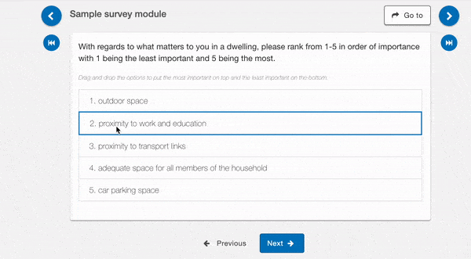
Ranking exercise

Slide 18
Ranking survey and analysis (Wave 3)
Respondents ranked questions from a list of 25 remaining questions with ≥70% agreement on importance and feasibility
Questions were shown in a random order
Final ranking were constructed based on both simple scaled rank score (25 points for 1st rank, one point for 25th rank) and a reciprocal rank score (1 point for 1st rank, 1/25 points for 25th rank) methods.

Slide 19
Results

Slide 20
Survey questions
There were a total of 46 questions at the start of the study following the initial priority setting workshop
These 46 questions were cut down to 22 after rating by respondents in Wave 1
After addition of new questions suggested by respondents, there were a total of 59 questions in Wave 2
These were cut down to 25 after analysis of Wave 2 data and included in the final ranking exercise.

Slide 21
Respondent characteristics
Respondent characteristics |  | Wave 1 |  | Wave 2 |  | Wave 3
Variable | Category | n | % | n | % | n | %
Gender | Man | 19 | 63.3 | 15 | 60.0 | 26 | 63.4
 | Woman | 11 | 36.7 | 10 | 40.0 | 15 | 36.6
Survey language | English | 21 | 70.0 | 16 | 64.0 | 21 | 51.2
 | French | 9 | 30.0 | 6 | 24.0 | 18 | 43.9
 | Portuguese | N/A | N/A | 3 | 12.0 | 2 | 4.9
Country of residence | Africa | 17 | 56.7 | 11 | 44.0 | 27 | 65.9
 | Rest of the world | 13 | 43.3 | 14 | 56.0 | 14 | 34.1
Total |  | 30 | 100 | 25 | 100 | 41 | 100

Slide 22
Respondent demographics
Key
Dark blue: Respondents in both Wave 1 and/or Wave 2, and Wave3
Mid blue: Respondents in Wave 3 but not Wave 1 or 2
Light blue: Respondents in Wave 1 and Wave 2, but not Wave 3
Grey: Any survey wave included respondents born in these countries, but now living elsewhere
Light green: Respondents in initial priority-setting workshop but not eDELPHI surveys

Slide 23
Final rankings
1 | Evaluate the duration of prophylactic protection offered by SP+AQ and other SMC medicines
2 | Evaluate the effect of integrating SMC with other malaria prevention interventions (e.g. vaccines) on development of anti-malarial resistance
3 | Investigate the potential for 'rebound effects' in malaria incidence in older children as a result of SMC campaigns
4 | Evaluate the effect of integrating SMC with other malaria prevention interventions (e.g. vaccines) on SMC impact on malaria-related outcomes
5 | Evaluate and compare impact of new/different drug regimens (e.g. Dihydroartemisinin-piperaquine) on malaria outcomes
6 | Design and evaluate new methods for improving delivery of amodiaquine on Day 2 and Day 3, and impacts on caregiver adherence to the full course of SMC medicines
7 | Evaluate the degree to which eligible children in different transmission settings (i.e. according to seasonality and attack rate) benefit from SMC programs; evaluate differential impact in different settings
8 | Evaluate the impact of SMC on asymptomatic malaria infection among eligible children
9 | Evaluate different strategies for achieving high adherence by caregivers to day 2 and day 3 AQ administration in different transmission contexts
10 | Evaluate the feasibility and impact of extension of SMC to children aged over five years and identify optimal age ranges for SMC eligibility in different settings

Slide 24
Next steps: publication
Authors welcome on the publication – please reach out to Kevin

Slide 25
We need your help!
How should these global research priorities be best used at national level?
  National level workshop/existing meetings?
    How
    Why
    Output?
    Which priorities should be used?

Slide 26
Discussion for each country team
Feedback on the research priorities
Feedback on next steps nationally
1 | Evaluate the duration of prophylactic protection offered by SP+AQ and other SMC medicines
2 | Evaluate the effect of integrating SMC with other malaria prevention interventions (e.g. vaccines) on development of anti-malarial resistance
3 | Investigate the potential for 'rebound effects' in malaria incidence in older children as a result of SMC campaigns
4 | Evaluate the effect of integrating SMC with other malaria prevention interventions (e.g. vaccines) on SMC impact on malaria-related outcomes
5 | Evaluate and compare impact of new/different drug regimens (e.g. Dihydroartemisinin-piperaquine) on malaria outcomes
6 | Design and evaluate new methods for improving delivery of amodiaquine on Day 2 and Day 3, and impacts on caregiver adherence to the full course of SMC medicines
7 | Evaluate the degree to which eligible children in different transmission settings (i.e. according to seasonality and attack rate) benefit from SMC programs; evaluate differential impact in different settings
8 | Evaluate the impact of SMC on asymptomatic malaria infection among eligible children
9 | Evaluate different strategies for achieving high adherence by caregivers to day 2 and day 3 AQ administration in different transmission contexts
10 | Evaluate the feasibility and impact of extension of SMC to children aged over five years and identify optimal age ranges for SMC eligibility in different settings

Slide 27
Questions?
www.smc-alliance.org

