Slide 1
Seasonal Malaria Chemoprevention (SMC) Digitization
2023 Campaign
Nigeria
Dr Emmanuel Shekarau,
SMC Focal Person, NMEP-Nigeria
Prepared for the 2024 SMC Alliance Meeting – Abuja, Nigeria

Slide 2
Summary Information For 2023 and Plans For 2024 Campaigns
 | 2023 | 2024
Start and end dates | 23rd June – 17th Oct | 6th June – 1st Oct
Number of cycles | 4 cycles in 16 states 5 cycles in 5 states | 4 cycles in 16 states 5 cycles in 5 states
Number of districts targeted | 383 | 383
Number of children covered | 28,906,428 | 29,883,309
Age ranges covered | 3 – 59 months (<5yrs) | 3 – 59 months (<5yrs)
Coverage (% targeted children receiving all cycles) | 54%
Any drug resistance testing or efficacy studies performed? (Y/N) | Yes | No
Any gap | No | No

Slide 3
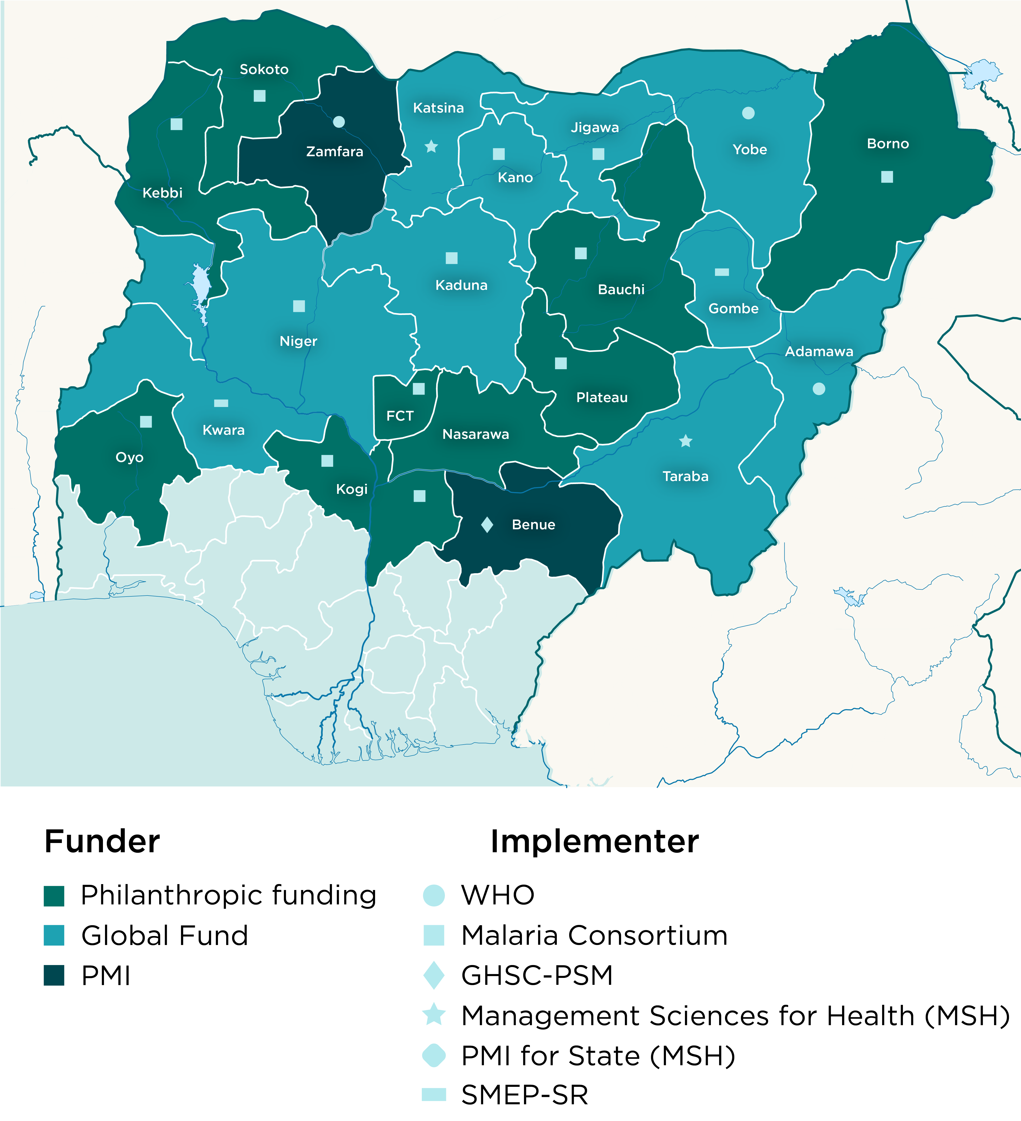
Nigerian Map Showing SMC Implementing States
2023 Map (Covered)
2024 Map (Targets)

Slide 4
Focus Digitization
Digital Leap
In 2021, the National Malaria Elimination Program (NMEP) took a giant leap, tasked with digitizing the Seasonal Malaria Chemoprevention (SMC) campaigns.
Embraced an innovative BYOD approach, utilizing campaign staff's personal devices for fieldwork.
The NMEP One App was introduced to address challenges associated with SPAQ administration, providing a breakthrough in cohort tracking.
2021
2022 - 2023
Digital Scale up
From 2022-2023 the digitalization efforts were scaled up successfully across 11 states including FCT where deployment happened in one cycle.
Achievements included : Enhanced data collection, Realistic cohort tracking, strengthened monitoring, and improved commodity tracking.

Slide 5
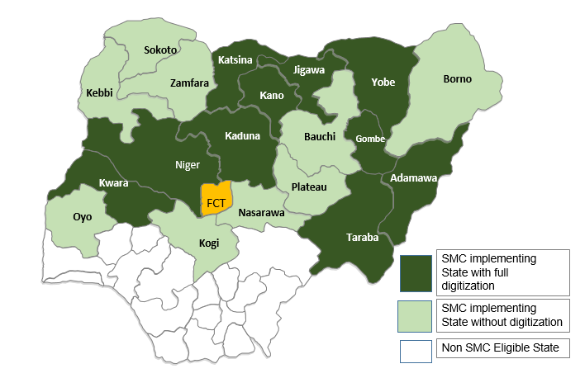
Nigeria Map Showing States with Full Digitalization
Digital Scale up

Slide 6
What was a problem you were trying to solve?
The primary problem that Nigeria sought to address through technology was the inefficiency and limitations associated with traditional, paper-based approaches in implementing SMC campaigns. The challenges included:
Challenges | What we were trying to solve
Data Integration: | Paper-based SMC implementation delayed reporting, had integrity issues, did not allow for efficient integration and analysis of data across multiple cycles.
Retention Assessment | Traditional methods made it challenging to assess the rate of retention of individual children in subsequent SMC cycles.
Limited Visibility: | Inadequate visibility of operations at various levels hindered effective planning, monitoring, and evaluation of mass campaigns and routine activities.
Accountability and Risk Mitigation | Lack of real-time visibility and accountability in the administration of SPAQ presented challenges in risk mitigation and ensuring the proper distribution of medications.
Cumbersome Analyses: | Cumbersome analyses of paper-based data made it challenging to extract meaningful insights, slowing down decision-making processes.

Slide 7
What was the design of the digitalization?
ICT4D Framework: Utilizes a cloud-based solution accessible via web, mobile app, and devices. Scalable design for nationwide implementation. Some tools utilized are: (RedRose, KoboToolBox, Survey CTO, Commcare, ONA, Google earth pro, DHIS2, etc.​)
User-Centric Design: The design prioritized user-friendly interfaces for community drug distributors, health facility workers, and program managers, ensuring ease of use and accessibility
BYOD Approach: Embracing a Bring Your Own Device (BYOD) approach, which allowed campaign staff to utilize their personal devices for fieldwork activities.
Unique Beneficiary ID: Developed a system to assign and track unique identity numbers for eligible children receiving SMC, enabling accurate cohort tracking and individual retention & adherence monitoring.
Improved Monitoring: The geospatial data showing coverage of households during MDA was used for coordinated decision making, guide monitoring and supervision activities and enhance the quality of service delivery.

Slide 8
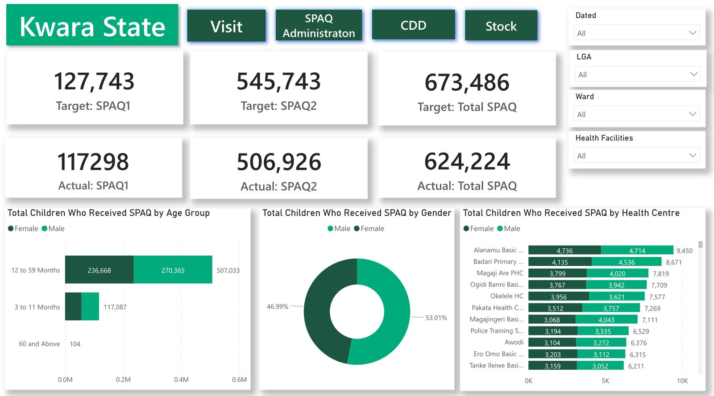
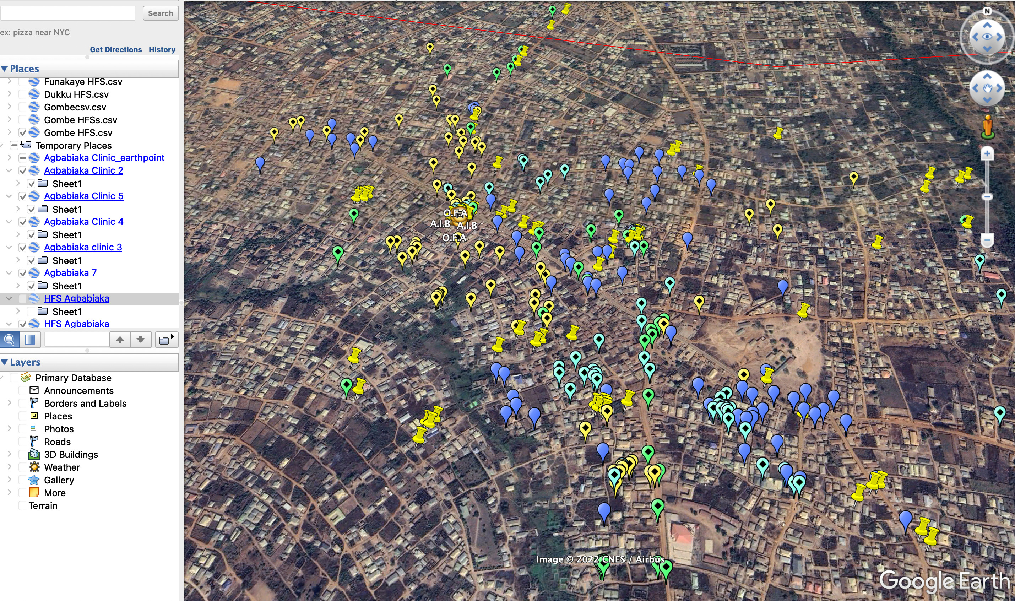
Digitization design
SPAQ Coverage Dashboard
NMEP One App
RRCollect
Geo- Spatial Tracking

Slide 9
Benefit of digitalization
Cohort Tracking
Digitization enhances SMC by enabling accurate and efficient cohort tracking, ensuring precise monitoring of individual adherence, coverage rates, and overall program impact.
Cohort Definition: Seasonal Malaria Chemoprevention (SMC) Cohort tracking, refers to the systematic monitoring and follow-up of eligible children 3-59 months who received the first cycle of SMC as baseline and subsequent cycles, during the high malaria transmission season within a given SMC round.
SMC cohort tracking has been possible with the use of unique Beneficiary ID assigned to each child’s profile on the ICT4D database/platform
The Beneficiary ID is a combination of numbers and alphabets used to identify each unique child on the ICT4D platform/Database. This has proven to be efficient in accurately identifying a child

Slide 10
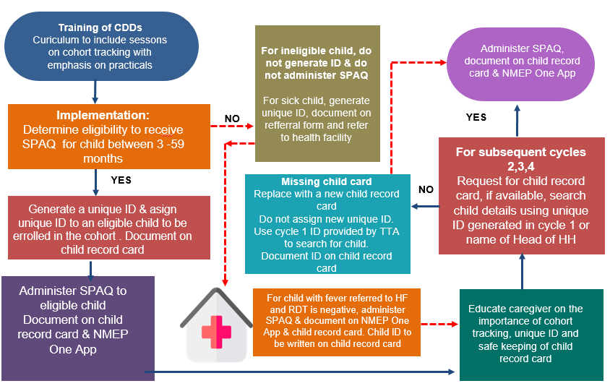
CDD Level Cohort Tracking & Data Collection Process Flow
Administer SPAQ, document on child record card & NMEP One App

Slide 11
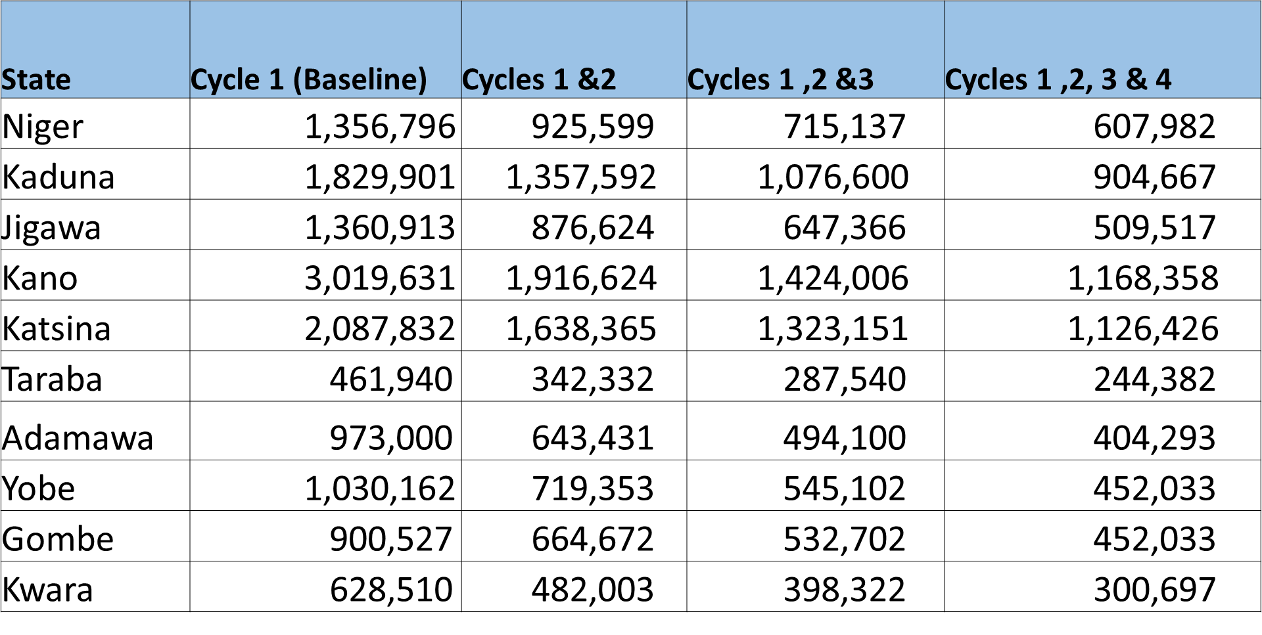
2023 SMC Cohort Tracking Analysis

Slide 12
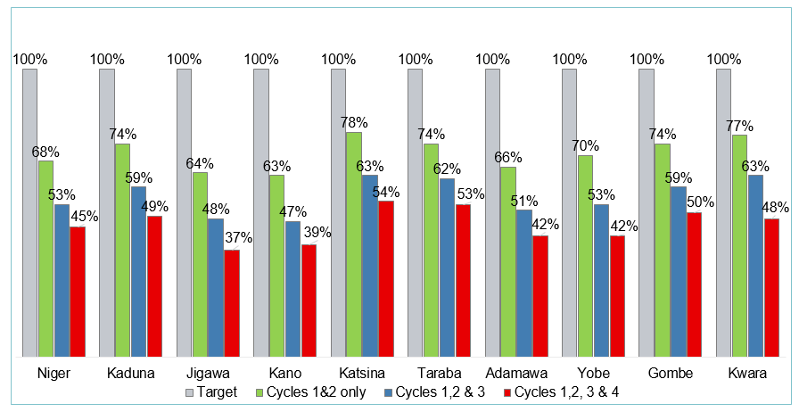
Summary of SMC cohort coverage rate

Slide 13
What challenges did you face?
People
Process
Technology
CDDs entering wrong beneficiary information - age, gender, names, phone number, SPAQ administration details.
CDD selecting wrong child's profile and recording SPAQ administration
New registration of old beneficiaries of previous cycle(s) due to loss of child records card
Odd time administration of SPAQ by CDD teams
Poor mobile network coverage affected real-time data reporting in some areas.

Slide 14
What would you do differently in the future?
Enhance the overall capacity of the state for effective and efficient utilization of the technology solution (NMEP One App)
Beneficiaries would be searched strictly by unique ID, to eliminate duplication.
Implement a restriction on the generation of unique IDs in cycle 2 and provide authorization rights to CDD supervisors or TTA to streamline operations and enhance cohort tracking
Targeted Training
Integration
Upskilling Strategy

Slide 15
What would you do differently in the future?
Targeted Training
Integration
Intensify education of caregivers on the importance of retaining child record card and unique IDs throughout the round
Exhaustively utilize the benefits of technology to improve efficiency and quality of service delivery with sustainability in view
Integration of SMC & ITN campaigns
Upskilling Strategy

Slide 16
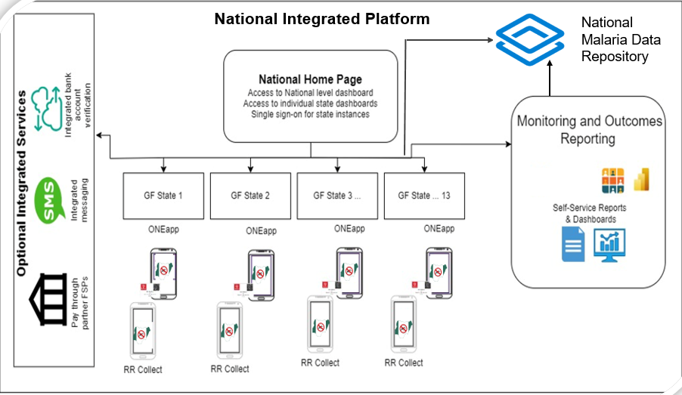
What would you do differently in the future?

Slide 17
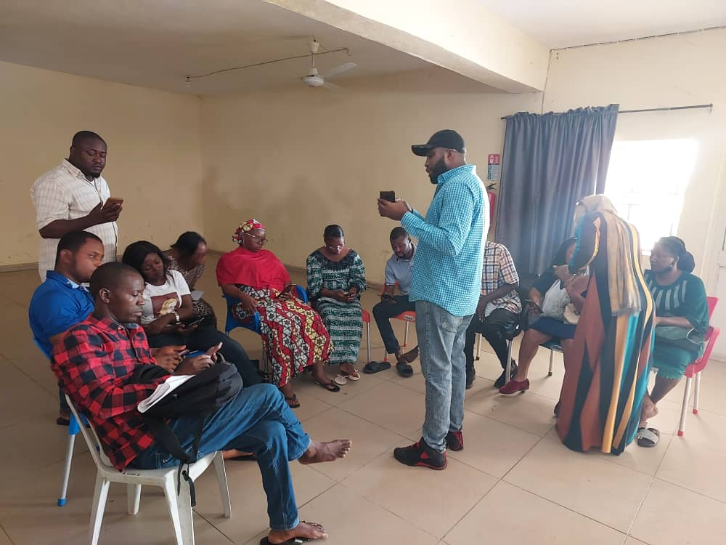
Pictures from the Field
Digital Scale up
TTA Provisioning devices of CDDs
Cluster Supervisors retraining TTAs

Slide 18
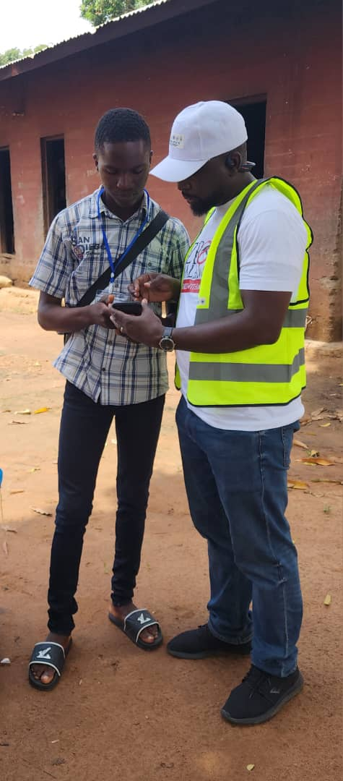
Pictures from the Field
Digital Scale up
A National monitor resolving challenge on a CDD’s device
An Executive Governor administering SPAQ to an eligible child

Slide 19
Thank you

