Slide 1
IPTsc: Recommendation and way forward
Lauren Cohee, MD MSc
28 February 2024
SMC Alliance Meeting

Slide 2
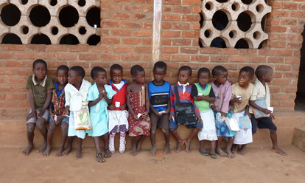






Burden of malaria in school-age children

Slide 3
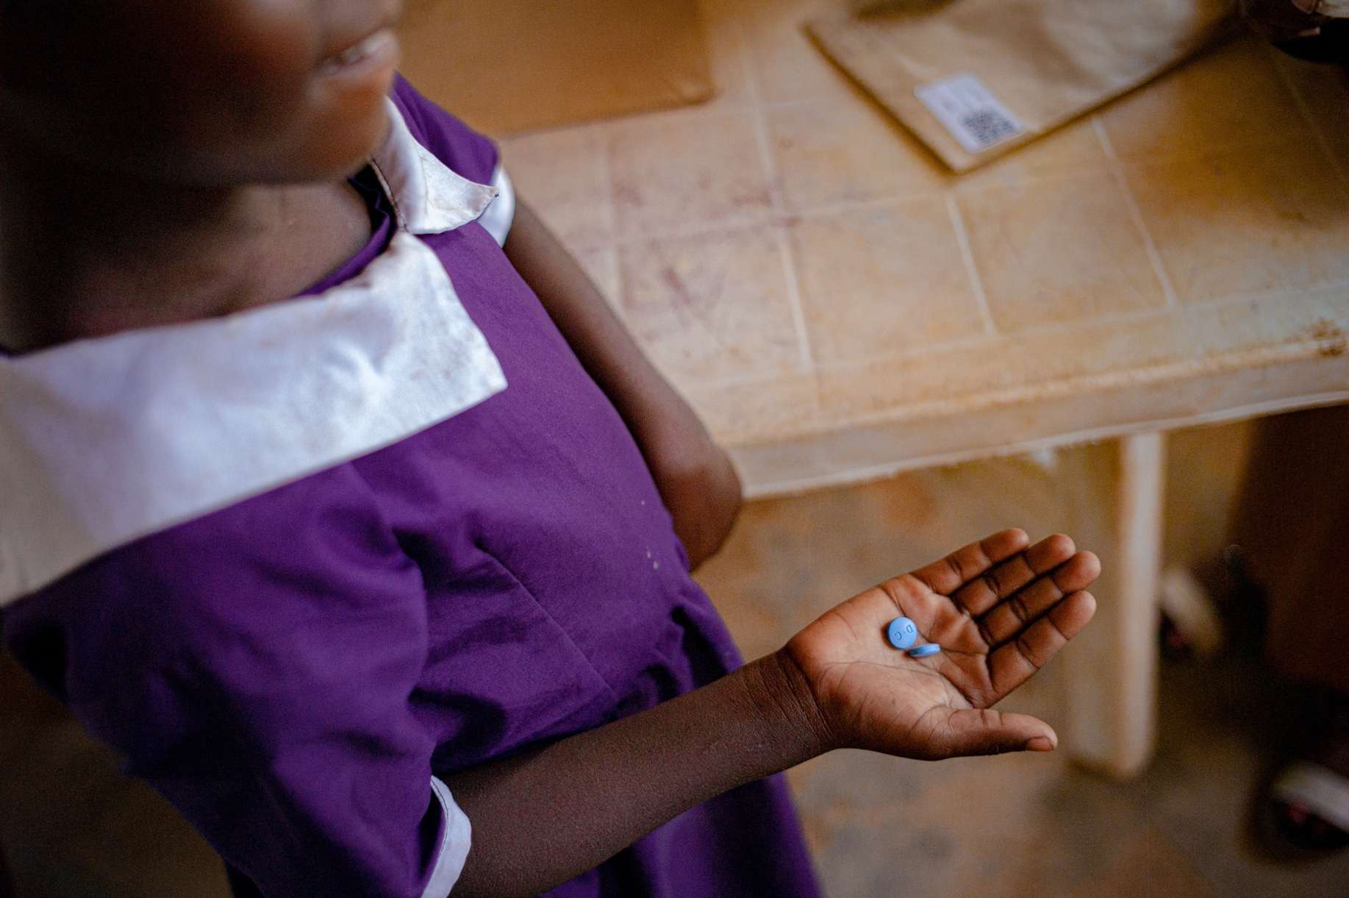
John Williams Photography

Slide 4

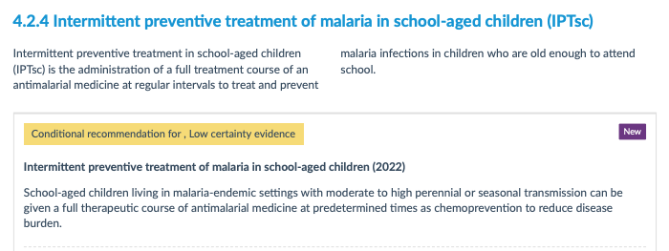

Slide 5

Data → Policy → Priority → Program
  - What does programmatic IPTsc look like?
  - When and where should IPTsc be used?
  - Who will fund IPTsc?
Case management
IPTp
SMC
PMC
LLINs
IRS
IPTsc??
Image adapted from WHO GMP
Notes:
https://www.who.int/teams/global-malaria-programme/guidance-tools

Slide 6
Working group to accelerate malaria control in school-age children (in search of a good name!)
Preliminary Mission Statement: Decrease the burden of malaria in school-age children by supporting multi-sectoral approaches to evidence-generation, implementation and sustainable financing of interventions to reduce malaria in school-age children
Preliminary Desired Outcomes:
Foster partnerships between countries interested in implementing IPTsc (and extended age SMC?)
Ascertain implementation knowledge gaps and approaches to address them
Facilitate coordination among donors, funders, and Ministries of Finance to develop sustainable financing
Identify critical remaining research questions and studies required to address them
Track research, implementation, and funding progress
Develop implementation guide (once further data/information available)

Slide 7
Working group approach
IPTsc Collaboratives
SHIP
Research PROMISE
Steering Committee
IPTsc Collaboratives: Groups of 3-4 countries interested in working together to identify and address barriers and facilitators to addressing malaria control in school-age children. Engaging stakeholders in malaria control, school health, and education.
Research to support Intermittent Preventive treatment Of Malaria In School-aged children to improve Health and Education (Research PROMISE): Partnership of academic researchers in health and education to formulate a research agenda with key study designs and locations to address specific research.
School Health Interventions Best Practices (SHIP): Identify key stakeholders from other school-based health programs to develop lessons learned and opportunities for integrated delivery of school health programs.
Steering
Committee

Slide 8

Current status
Establishing Steering Committee
Capitalizing on MIM – symposium, side meeting
Conducting additional reviews and framework for full economic framework
Developing website
Seeking funding for 1st IPTsc Collaborative (Uganda, Tanzania, Kenya, Malawi)
Photo credit: UNICEF Schools for Africa Croatia
https://www.unicef.hr/en/programska_aktivnost/schools-for-africa/

Slide 9
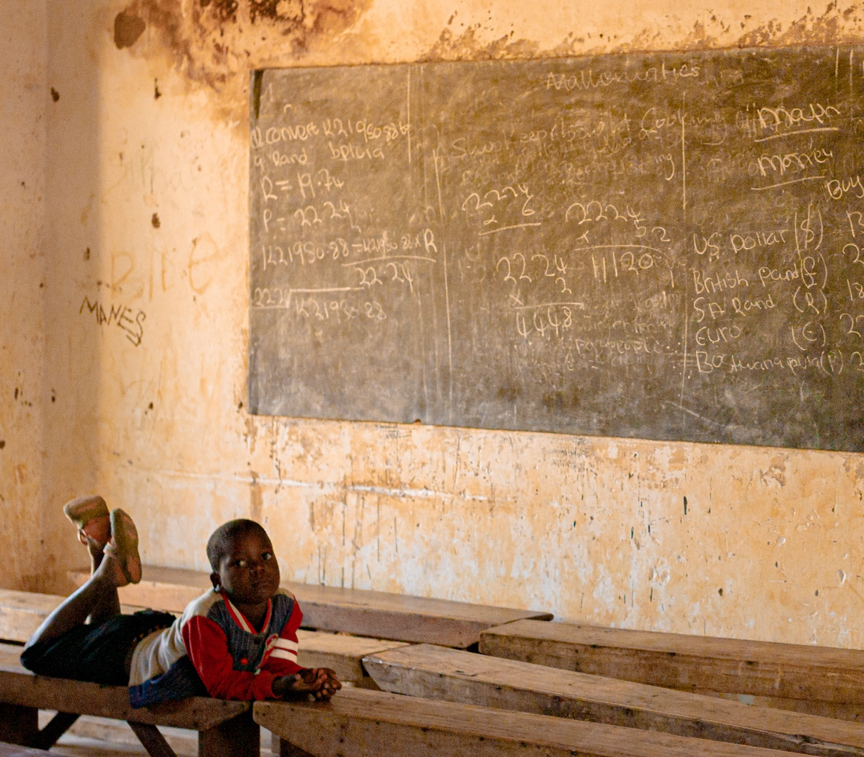
Discussion
Overlaps between IPTsc and extended SMC
  School-based delivery
  Barriers obtaining data on school-age children from routine surveillance
  Mutually beneficial evidence generation
    Severe Disease
    Transmission
    Education
Lessons learned from the Alliance in developing an effective community

Slide 10





Collaborating Institutions and Supporters
Infectious Disease Research Collaboration (IDRC), Uganda
National Institute for Medical Research (NIMR), Tanzania
Kamuzu University of Health Sciences (KUHeS), Malawi
Kenya Medical Research Institute (KEMRI), Kenya
Malaria Research Training Center (MRTC), Mali
Liverpool School of Tropical Medicine (LSTM), UK
University of Maryland School of Medicine, USA
London School of Hygiene and Tropical Medicine (LSHTM), UK
University of Antwerp, Belgium
Swiss Tropical and Public Health Institute (Swiss TPH), Switzerland
Please contact me for questions or to join us:
Lauren.Cohee@lstmed.ac.uk

Slide 11
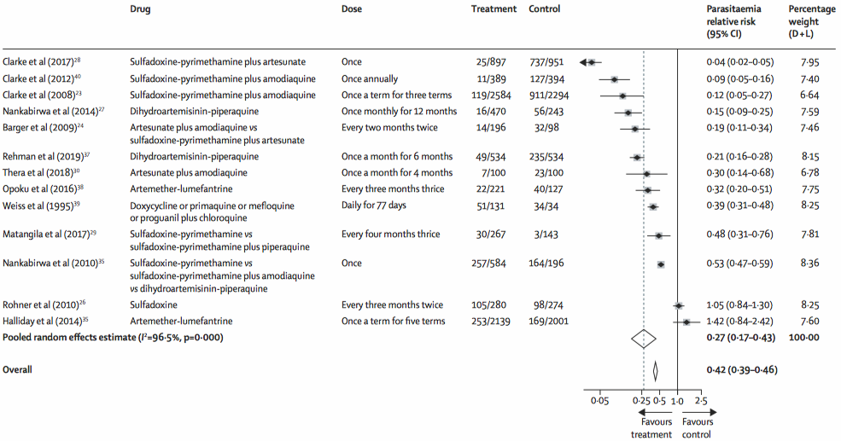
Why low certainty evidence?
Risk of Bias: Serious
  Participants and personnel unblinded
‘Unexplained’ between study heterogeneity
Cohee et al. Lancet Global Health, October 2020

Slide 12
IPTsc Research Needs
Design
  Interval of administration (e.g. monthly versus each term) at different transmission intensities;
  Target age group (6-10, 11-15, 6-15);
  Drugs suitable for use as chemoprevention in school-aged children, single-dose drugs, safe in pregnancy;
Impact
  Effect on community-level transmission;
  Impact on cognition and school performance;
Economics
  Full economic and financial costs of introduction and deployment of IPTsc;
  Cost-effectiveness of combining IPTsc with other school health programmes;
  Costs and feasibility of alternative strategies to deliver malaria chemoprevention to school-aged children;

Slide 13
Health care visits
Decreased learning
↓
Decreased educational
Attainment
↓
Failure to achieve
full potential
↓
Decreased human capital
Acute clinical
malaria
School absences
P. falciparum
infection in a
school-age child
Feeling
unwell
Impaired cognitive
performance
Chronic “asymptomatic”
infection
Impaired cognitive
development
Anemia*
*P. falciparum is an independent cause of anemia, but also exacerbates other multifactorial causes of anemia, e.g. nutritional deficiencies and helminth infections.

Slide 14
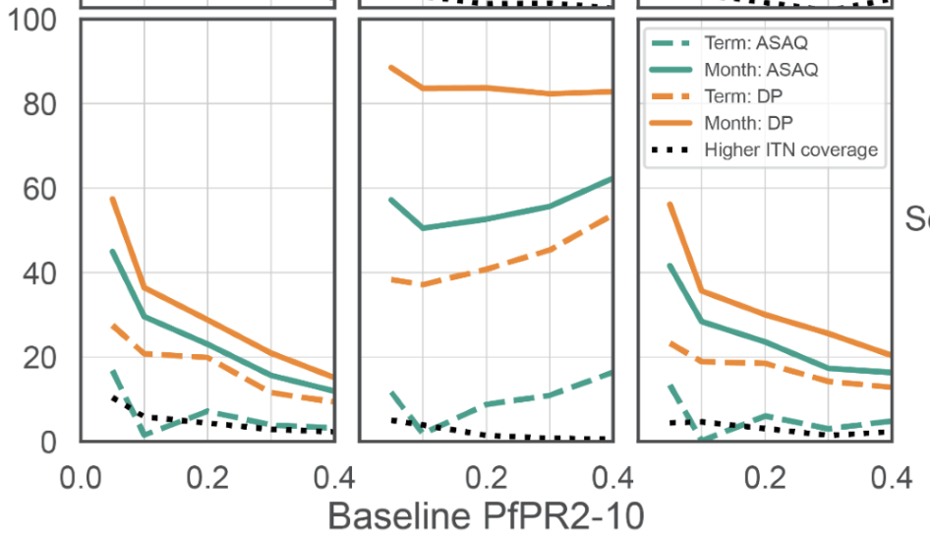

Dynamic modeling of IPTsc on transmission
Ages 0-5
Ages 6-15
Ages 16+
% clinical cases averted
Suresh et al under review Lancet GH

Slide 15
 | IPTsc | Extended SMC
Drug
Delivery platform
Target age group
Impact on clinical malaria
Impact on transmission
Impact on education
Drug resistance

Slide 16
Clinical trial of intermittent preventive treatment vs screening and treatment (Jan-July 2022)
Eligibility and enrollment
(n=750)
Intermittent Preventive Tx (IPT)
(n=250)
All treated w DP
Intermittent Screening & Tx (IST)
(n=250)
hs-RDT screen, if + treat w DP
Randomization
1:1:1 by grade
Intervention 3x during high transmission season
Control (n=250)
Standard malaria education
Outcomes
  Pf infection
  Clinical malaria
  Anemia
  Cognitive tests
  Educational tests
  Household infection prevalence
DP=dihydroartemisinin-piperaquine, hs-RDT=high sensitivity rapid diagnostic test
Funded by Doris Duke Clinical Scientist Development Award

Slide 17
IPT decreased Pf infection, clinical malaria, and anemia
 | Study arm | N (%) | OR | 95% Cl | P-value
Pf infection | Control Arm | 127 (53) | Ref.
 | IPT Arm | 41 (17) | 0.41 | 0.32, 0.53 | <0.0001
 | IST Arm | 58 (24) | 0.43 | 0.33, 0.55 | <0.0001
Anemia | Control Arm | 36 (15) | Ref.
 | IPT Arm | 20 (8) | 0.49 | 0.27, 0.91 | 0.023
 | IST Arm | 32 (13) | 0.85 | 0.50, 1.47 | 0.57
 | Study arm | Cases (n) | IR per 6 months (95% CI) | IRR (95% Cl) | P-value
Clinical malaria | Control Arm | 99 | 0.51 (0.42, 0.62)
 | IPT Arm | 38 | 0.19 (0.14, 0.27) | 0.37 (0.26, 0.55) | <0.0001
 | IST Arm | 107 | 0.56 (0.46, 0.68) | 1.09 (0.83, 1.44) | 0.52
Notes:
In the IPT arm the incidence rate was XX resulting in a 67% protective efficacy [IRR: 0.37 95%CI:0.26-0.54; p-value<0.001]
The incidence of clinical malaria in the IST arm was X.X which was not statistically different from the control arm [incident rate ratio (IRR): 1.02 95%CI: 0.78-1.34; p-value=0.9].

