Slide 1
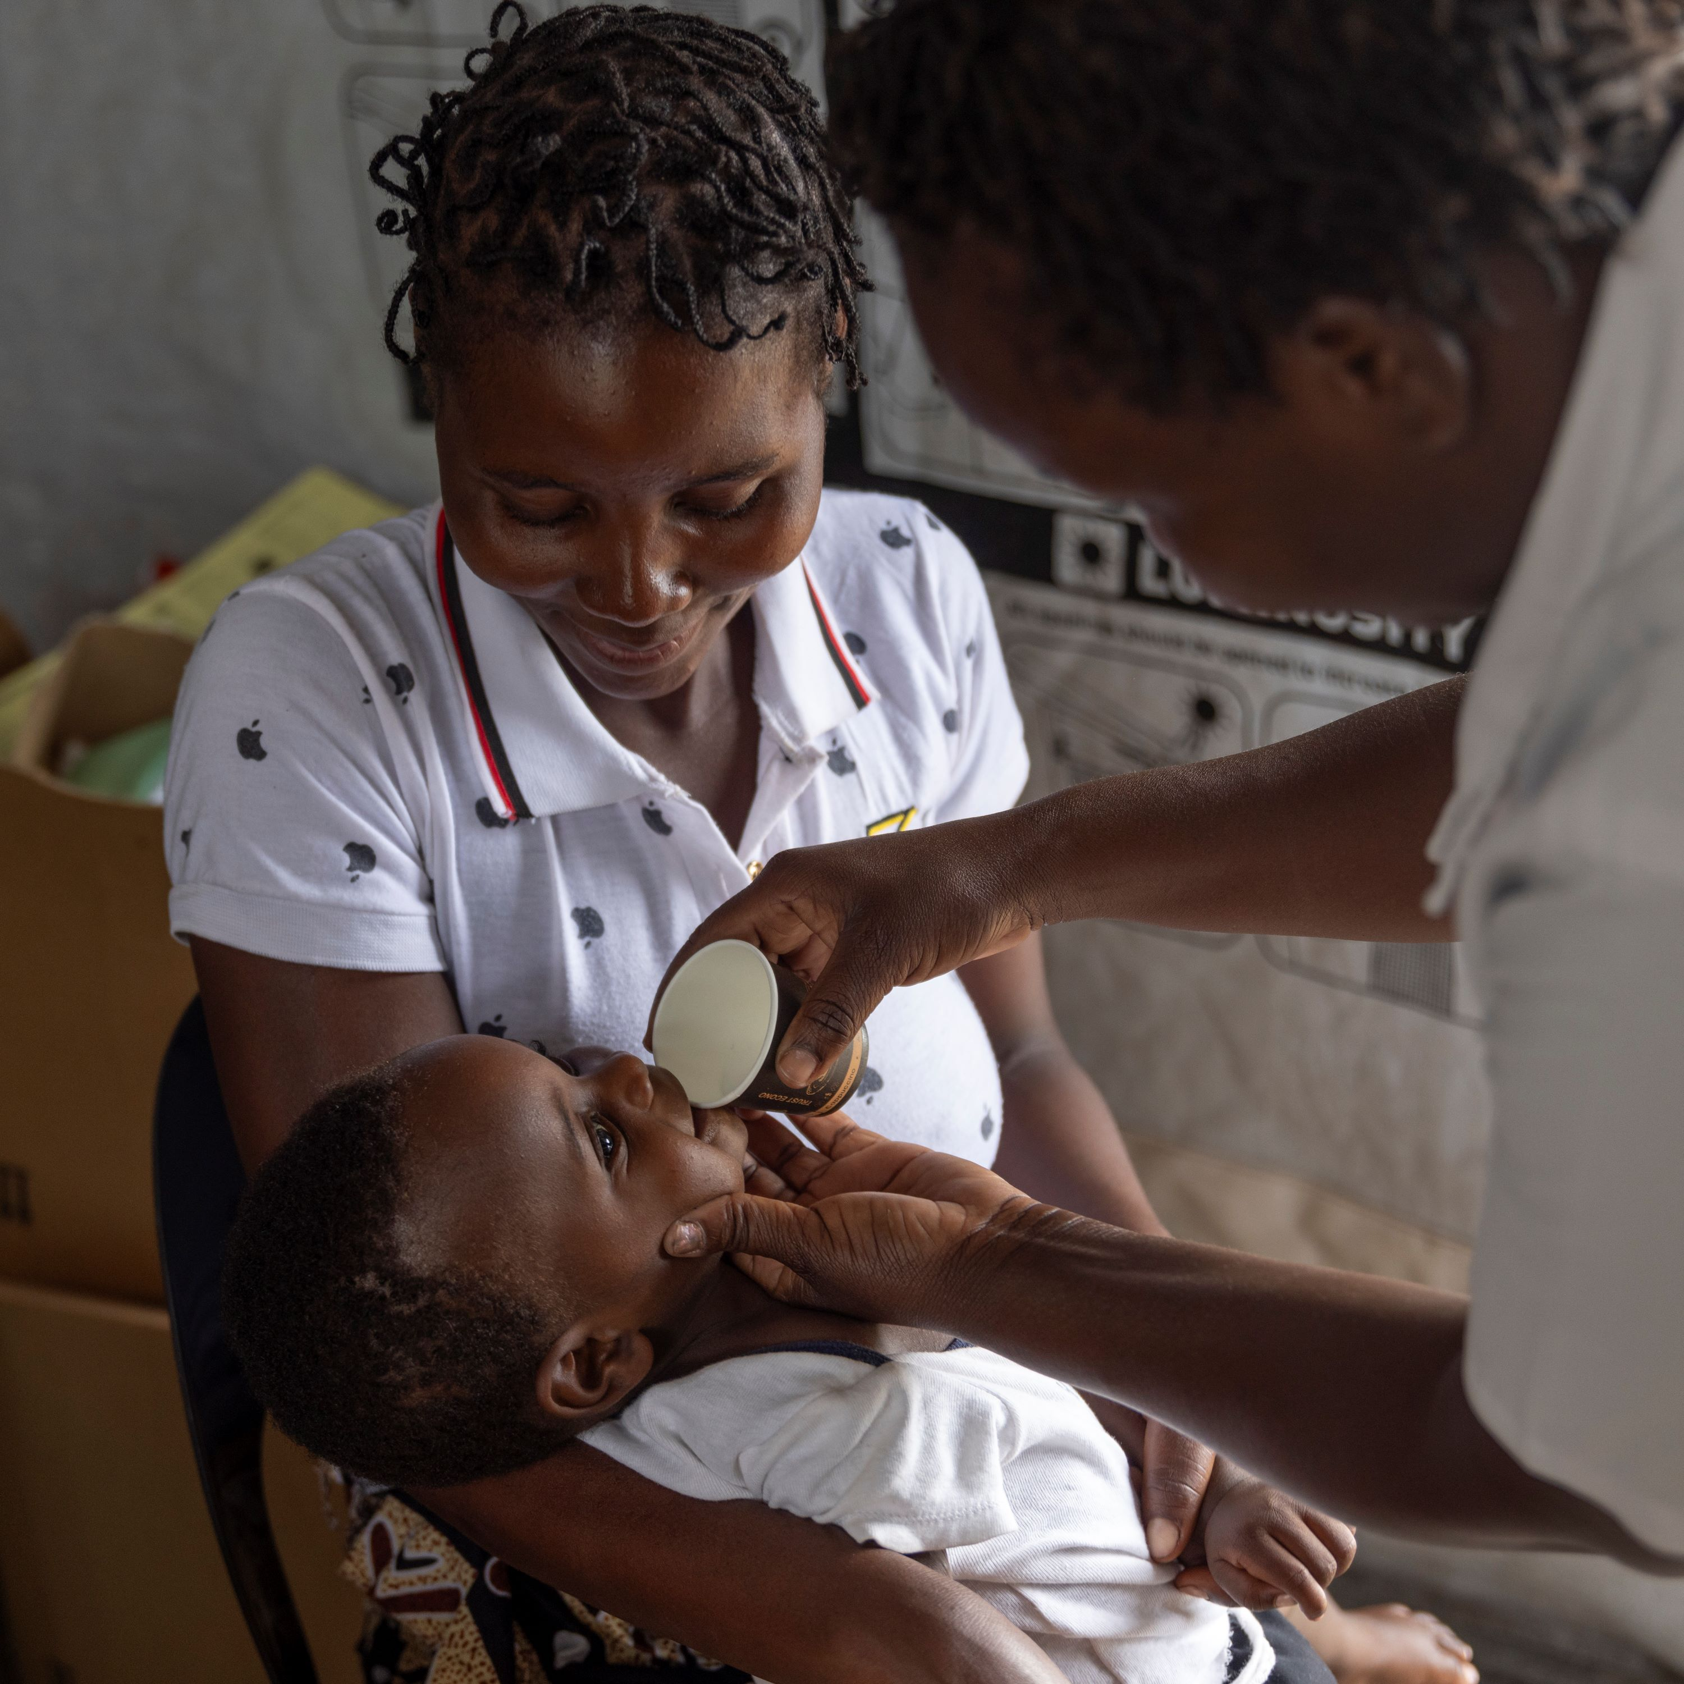
Perennial Malaria Chemoprevention:
UPDATES FROM THE PMC COMMUNITY OF PRACTICE
PRESENTATION TO THE smc alliance
Charlotte Eddis, Project Director, Plus Project
On behalf of the PMC Community of Practice

Slide 2
Reminder of the SMC recommendation (2022)
In areas of seasonal malaria transmission, children belonging to age groups at high risk of severe malaria should be given antimalarial medicines during peak malaria transmission seasons to reduce disease burden.
Eligibility for seasonal malaria chemoprevention (SMC) is defined by the seasonality of malaria transmission and age groups at risk of severe malaria. Thresholds for assessing these criteria change over time and location. Malaria programmes should assess the suitability of SMC based on the local malaria epidemiology and available funding. The added value of a seasonally targeted intervention is likely to be greatest where transmission is intensely seasonal.
Monthly cycles of sulfadoxine-pyrimethamine plus amodiaquine (SP+AQ) have been widely used for SMC in African children under 5 years old and have been shown to be efficacious, safe, well tolerated, available and inexpensive (Thwing et al unpublished evidence).
Source: WHO guidelines for malaria - 16 October 2023 (magicapp.org)

Slide 3
WHO SMC Field Manual clarified seasonality further:
The priority target areas for SMC implementation are those where:
malaria transmission is highly seasonal and the majority (>60%) of clinical malaria cases occur within 4 consecutive months – where data on malaria from the health management information system are unreliable, rainfall data could be used as a proxy for seasonality in incidence (at least 60% of annual rainfall in 4 consecutive months); and
the clinical attack rate of malaria (without SMC) is at least 0.1 episodes per child during the transmission season in the target group.
Source: Seasonal malaria chemoprevention with sulfadoxine–pyrimethamine plus amodiaquine in children: a field guide (who.int) 26 May 2023

Slide 4
What is the WHO guidance for PMC (2022)?
In areas of moderate to high perennial malaria transmission, children belonging to age groups at high risk of severe malaria can be given antimalarial medicines at predefined intervals to reduce disease burden.
  PMC schedules should be informed by the age pattern of severe malaria admissions, the duration of protection of the selected drug, and the feasibility and affordability of delivering each additional PMC course.
  SP has been widely used for chemoprevention in Africa, including for PMC. ACTs have been effective when used for PMC, but evidence is limited on their safety, efficacy, adherence to multi-day regimens, and cost-effectiveness in the context of PMC.
  Previously, PMC was recommended in infants (<12 months of age) as IPTi. Since the initial recommendation, new data have documented the value of malaria chemoprevention in children aged 12 to 24 months.
  The EPI platform remains important for delivering PMC. Other methods of delivery can be explored to optimize access to PMC and integration with other health interventions.
  Moderate to high perennial malaria transmission settings are defined as areas with P. falciparum parasite prevalence greater than 10% or an annual parasite incidence greater than 250 per 1000. These thresholds are indicative and should not be regarded as absolutes for determining applicability of the PMC recommendation.
Source: WHO guidelines for malaria - 16 October 2023 (magicapp.org)
Notes:
Lack of details in updated PMC recommendations raised confusion among some stakeholders.
For example, the only explicit age reference in the PMC guidance is 12- 24 months – stakeholders wondered if that means < 12 months isn't recommended?
Why not offer "suggested" models? Or minimum models?
The new name doesn’t offer immediate clarity: PMC feels more aligned to IPTp than SMC (though it’s SMC and PMC that target the same age group).
WHO could include additional guidance on choice of drugs, for example to recommend against using drugs for PMC that are already used for curative treatment in the same setting (e.g. ACTs)
PMC Guidance says countries should look at:
Age-stratified data: but many HMIS' have data for <5 years only.
Cost-effectiveness: currently this would be assumed but current projects will be looking into this.
Feasibility: countries can assess this but may be more subjective than previously used to in terms of WHO guidance.
New PMC guidance notes that several evidence gaps were identified during the new guidance review process, but that none should prevent adoption and implementation of PMC.

Slide 5
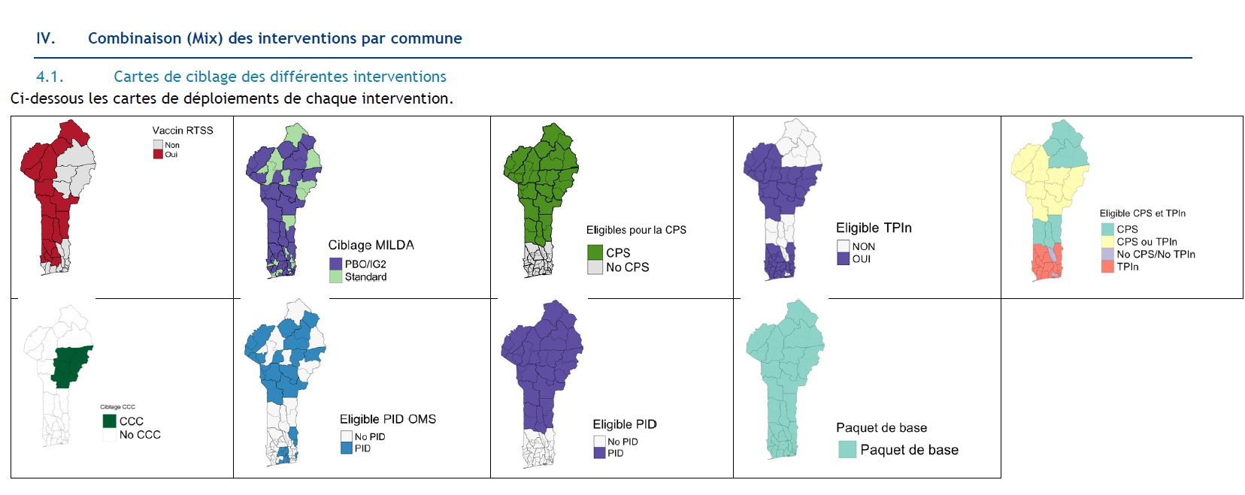
BENIN EXAMPLE
Is it relevant to your country?
Sub-National Tailoring, Prioritization of scarce resources, When and where to layer interventions
Source: PNLP, January 2023, Stratification épidémiologique et ciblage des interventions de lutte contre le paludisme pour la soumission de demande au Fonds Mondiale

Slide 6
Which countries are already implementing PMC?
PMC is implemented through routine health system delivery in Benin, Cameroon, Côte d’Ivoire, and Mozambique (supported by the Plus Project funded by Unitaid and by the Global Fund in Cameroon outside of the Plus Project districts, and by ISGlobal in Mozambique with EDCTP funds outside of the Plus Project districts) as well as in DRC (supported by PATH with funds from GiveWell) and Sierra Leone (the only country to implement IPTi, now also supported by ISGlobal funded by EDCTP).
PMC is implemented in a research context in Nigeria (supported by the Malaria Consortium) and Togo (ISGlobal with funds from EDCTP).
PMC is included in the National Malaria Strategic Plan in Cameroon, Côte d’Ivoire, DRC, Mozambique and Sierra Leone. Burundi has included PMC in their draft Strategic Plan.
Notes:
Need confirmation for Tanzania and Zambia

Slide 7
PMC models by country
Vitamin A
Vitamin A
Vitamin A
Vitamin A
10
14
6
9
12
15
18
24
weeks
weeks
months
months
months
months
months
months
BENIN:
8 target doses
DTP2
DTP3
Measles 1
Measles 2
Vitamin A
Vitamin A
Vitamin A
Vitamin A
10
14
6
9
12
15
18
24
weeks
weeks
months
months
months
months
months
months
CAMEROON:
8 target doses
DTP2
DTP3
Measles 1
Measles 2
Vitamin A
10
14
9
15
18
weeks
weeks
months
months
months
COTE D’IVOIRE:
5 target doses
DTP2
DTP3
Measles 1
Measles 2

Slide 8
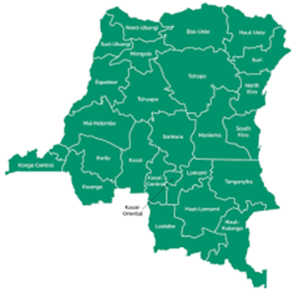
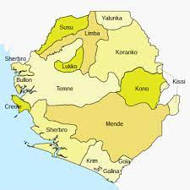
Vitamin A, deworming, micronutrients powders (MNP)
4
9
12
18
months
months
months
months
MOZAMBIQUE
DTP3
Measles/Rubeola 1 (MR1) and pneumococcal conjugate vaccine (PCV13)
Measles, Rubeola 2 (MR2), Vitamin A, deworming, & micronutrient powders (MNP)
Vitamin A
Vitamin A
10
14
6
9
12
15
weeks
weeks
months
months
months
months
DRC:
6 target doses
Measles 1
Measles 2
DTP2
DTP3
10
14
9
weeks
weeks
months
Sierra Leone:
3 target doses
DTP2
DTP3
Measles 1

Slide 9
What research is underway?
 | Plus Project Focus countries |  |  |  | Plus Project | Plus Project and PATH | Malaria Consortium
Evaluation | Benin | Cameroon | Cote d’Ivoire | Mozambique | Zambia, Ghana | DRC | Nigeria
Policy Adoption | X | X | X |  | X | X
Process Evaluation | X | X | X | * |  | X (Operational feasibility) | X (+operational feasibility)
Impact Evaluation |  | X | X |  |  | X
Economic Evaluation | X | X | X | * | X (Decision support tool) | X | X (cost effectiveness)
SP Suitability Evaluation: 1) Genotype mapping 2) PCPI (Parasite Clearance / Prevention Infection) | X | X X | X | X | X X (Zambia) | X | X
X= Evaluation in country; * = Hybrid evaluation approach

Slide 10
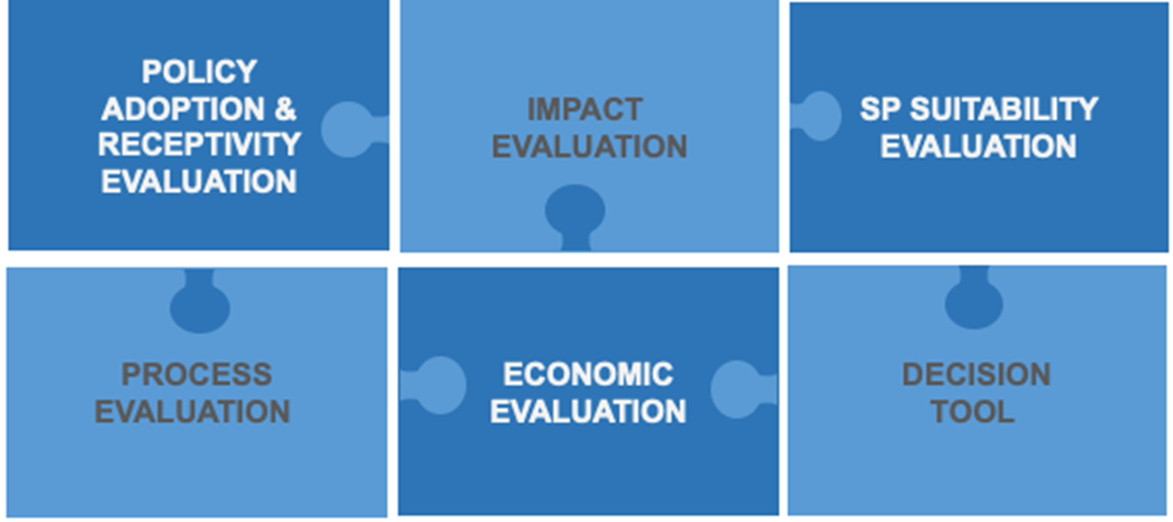
What research is underway?
CAMEROON EXAMPLE:
PLUS PROJECT RESEARCH
Process Evaluation
Did we choose the right delivery models?
What is the effect of PMC on other child health interventions (use of malaria prevention tools, coverage of EPI)?
What can we propose as an overall program theory for rolling out PMC?
Economic Evaluation
What are the costs of implementing PMC at scale and what are the cost savings from malaria cases averted?
Is PMC cost-effective?
What is the budget impact of scaling up PMC in Cameroon?
Impact Evaluation
Does the PMC strategy of 8 doses of SP vs standard of care make any difference in malaria morbidity, mortality and anemia in infants?
Does the distance to health facilities have an effect on the PMC strategy?
SP Suitability Evaluation
What are the SP resistance genotypes in Cameroon?
How do SP resistant genotypes in Cameroon impact SP efficacy for PMC (Parasite Clearance / Prevention Infection study)
Obala et Ntui, CR
Nkolbisson, Ntui et Soa, CR
Soa et Mbankomo, CR
Malentuen, WR

Slide 11
What are the challenges so far?
Coverage of PMC challenged by few EPI visits in the second year of life
  Many countries stop at measles 1 at 9 months, vitamin A is not included in the routine health system yet every 6 months in all countries, and uptake is low at 18 and 24 months
  Solution proposed by some countries (e.g. Benin, Cameroon) is CHW delivery of PMC in the community to children aged above 6 months
Concomitant roll-out of the malaria vaccine and PMC in some places
  Targeting the same age group through the same delivery platform (EPI)
  Solution proposed by the PMC Community of Practice to monitor the real time implementation of both interventions in the districts where they overlap (e.g. Soa)
Since 2010 new genotype 431V and 581G rapidly increasing in prevalence in Cameroon and Nigeria (present at very low levels in Côte d’Ivoire, Burkina Faso).
  In Cameroon higher increases of 431V and 581G in areas using SMC. Could mean 431V and 581G parasites have survival advantage. Threat to SP efficacy
  Solution proposed is that the PCPI study will have SPAQ arm to look at SP efficacy for PMC and SMC. Important to test alternative for PMC (since ACTs not recommended)

Slide 12
Who is the PMC Community of Practice?
Co-chairs: Dr Junior Voundi Voundi, NMCP Cameroon and Dr William Houndjo, NMCP Benin
Secretariat: Representatives from ISGLOBAL, London School of Hygiene and Tropical Medicine, Malaria Consortium, MMV, MSF, PATH, PSI, WHO GMP, WHO AFRO
Members:
NMP and Child Survival (and EPI, Nutrition) units in countries currently implementing PMC pilots
Academic organizations evaluating implementation of PMC pilots
Donor organizations
International organizations enabling PMC implementation projects including MMV, WHO
Anybody else who is interested!
Notes:
Webinars
ASTMH Symposia and abstracts
MIM Symposia and abstracts
PMC and the malaria vaccine concomitant roll-out
Collaborative virtual space hosted by MMV
PMC Implementation Handbook including M&E Framework
Submission of evidence generated by implementation pilots to WHO for review
Advocacy and dissemination of evidence to donors to avoid gaps in funding

Slide 13
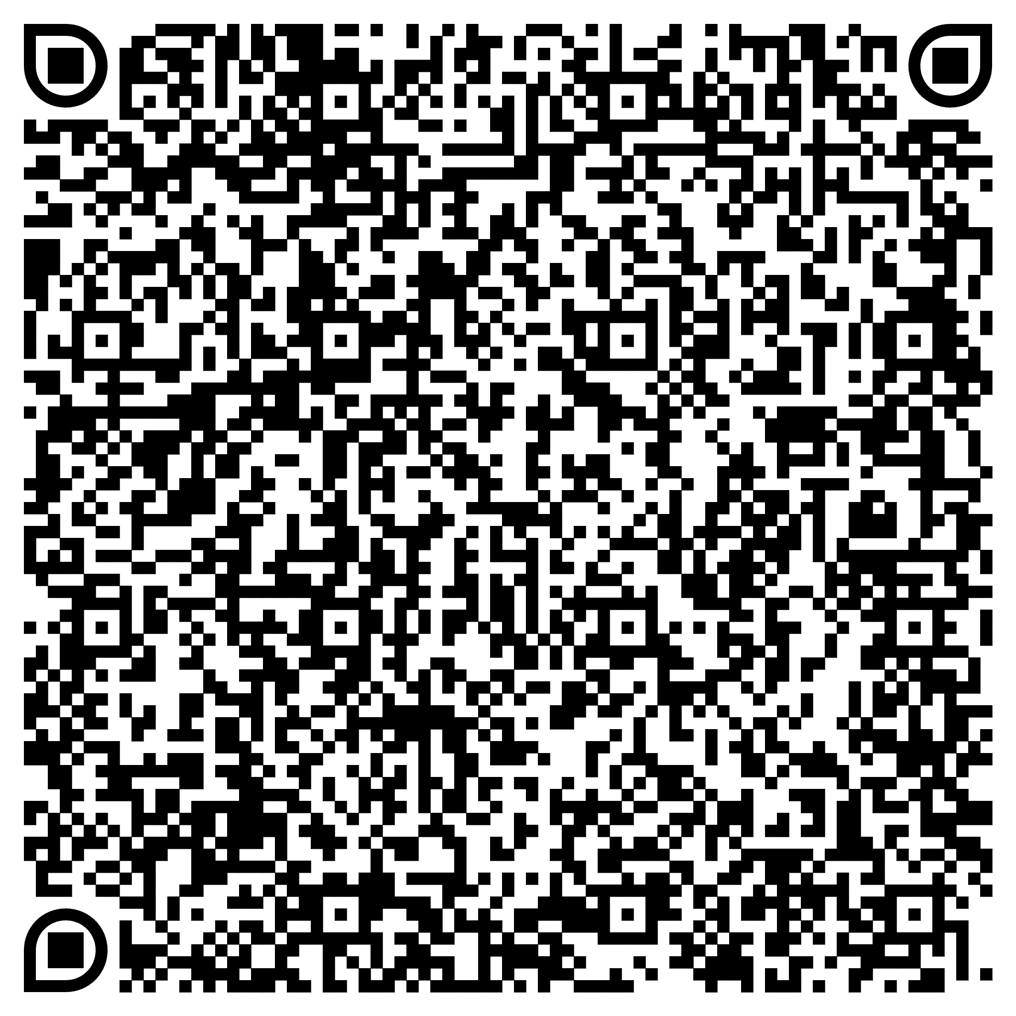
How to get involved?
Biweekly Secretariat meetings: Fridays at 9am Abidjan (“temps universel”)
Virtual COP meetings: ad hoc in the past, quarterly in 2024
MIM side event on the PMC and the malaria vaccine concomitant roll-out: Tuesday evening at the Convention Center in Kigali
MIM face to face COP meeting: Saturday at the Convention Center in Kigali
Webinars
Bulletin
To be added to the mailing list please contact: Charlotte Eddis ceddis@psi.org
To be added to the virtual space: Andre Marie Tchouatieu tchouatieua@mmv.org

Slide 14
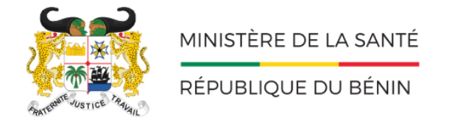


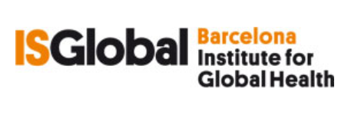
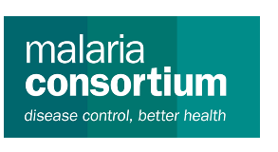
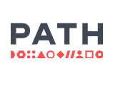


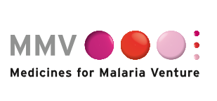
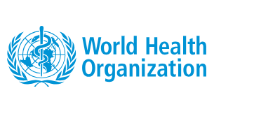
Thank you!

