Slide 1
DIGIT HCM:
Integrated Health Campaign Management
28th February 2024 | An Overview
eGov Foundation
February 2024
All content in this presentation is licensed under CC BY 4.0 unless otherwise noted

Slide 2
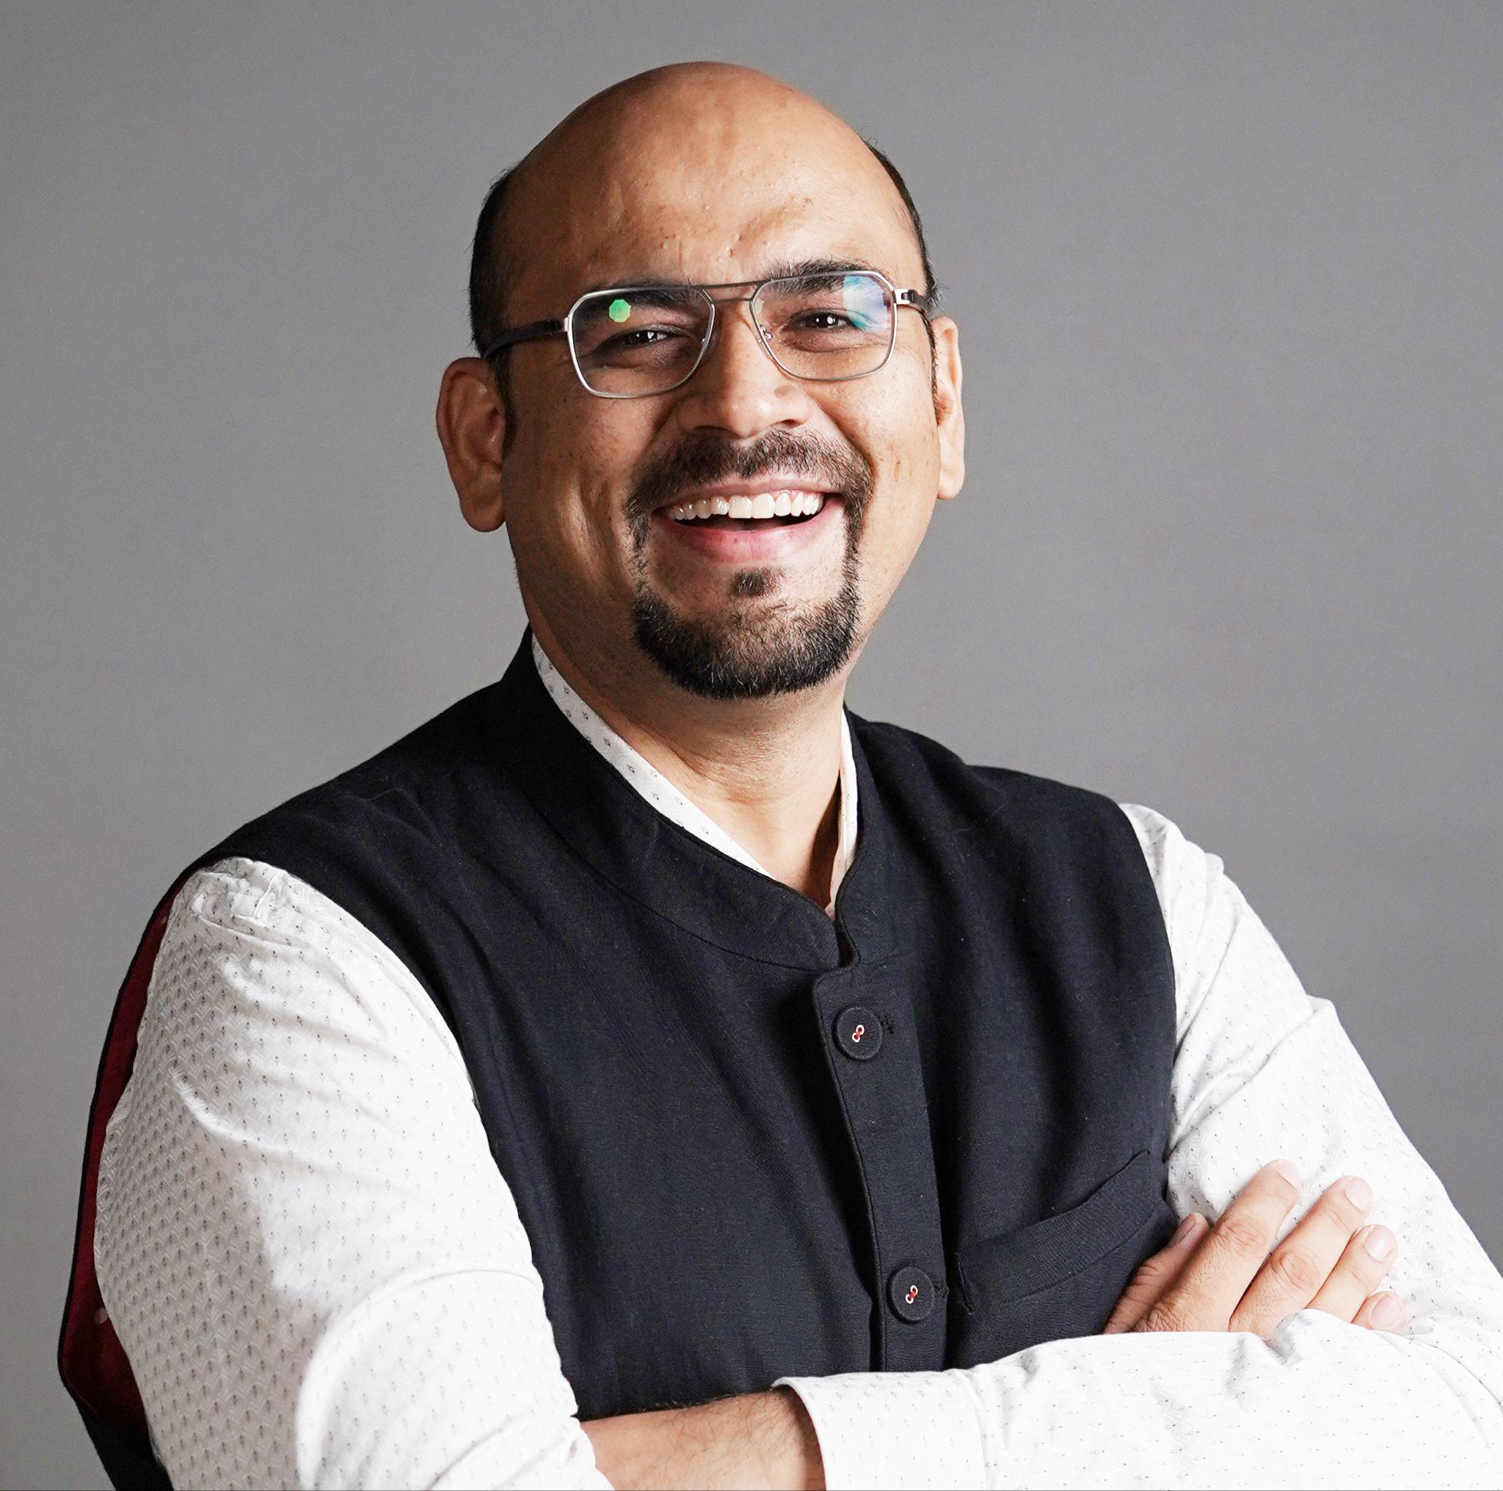
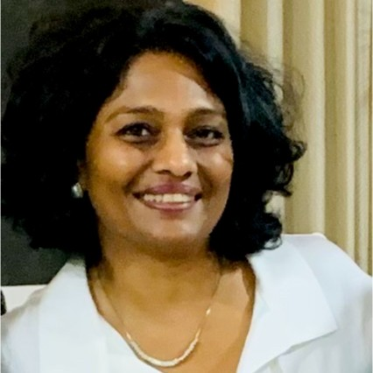
The team here with you today
Varun Basu
VP - Growth & Partnerships
Experience - 20+ yrs
Ecosystems & Partnerships, Strategy, Technology Consulting, Start-ups
Nita Tyagi Director- Growth & Partnerships
Experience - 30 yrs
Ecosystem Building, Digital Platforms Adoption National Health Policy

Slide 3
Agenda for today’s presentation
Who are We
Introduction to eGov Foundation and DIGIT
The Value Proposition
Why Integrated Campaign Management
Why DIGIT HCM
How does transformation look like with DIGIT HCM
Current and Future implementations for DIGIT HCM

Slide 4
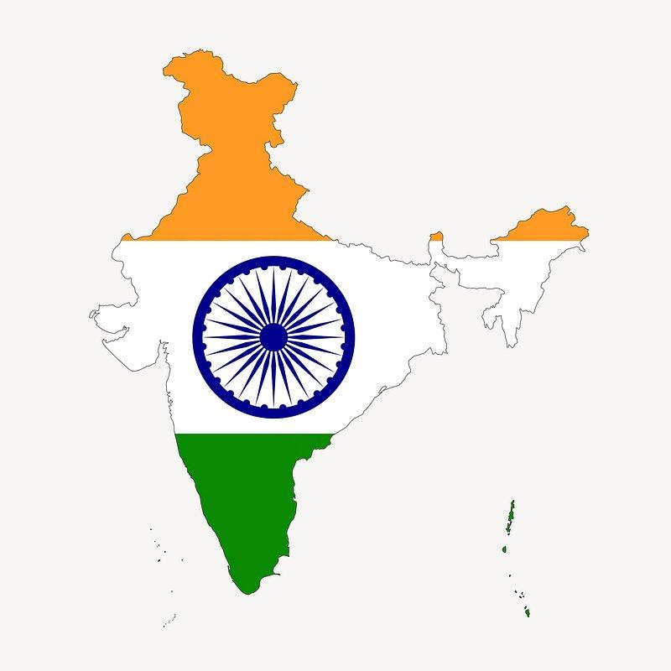
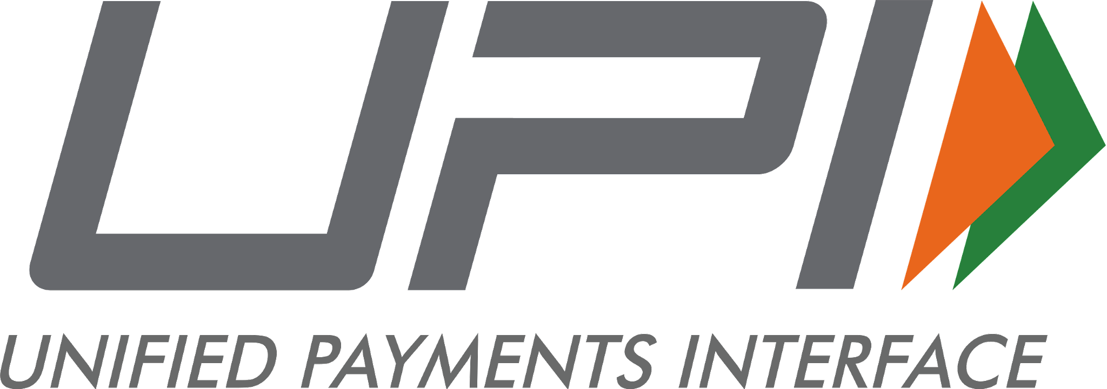
DIGIT stands for Digital Infrastructure for Governance, Impact and Transformation
It has same pedigree as Aadhar & UPI- most successful DPIs, built for scale, truly transformational
1.38 bn issued
80 mn authentications per day
Unique Identity : Access to
social service benefits and subsidies
Public Service Delivery :
Ease of access and Enhance Quality of Life
1bn Citizens served
India
Real Time Payment:
Financial Inclusion & cashless economy
c
300 mn active users
360 mn transactions per day

Slide 5
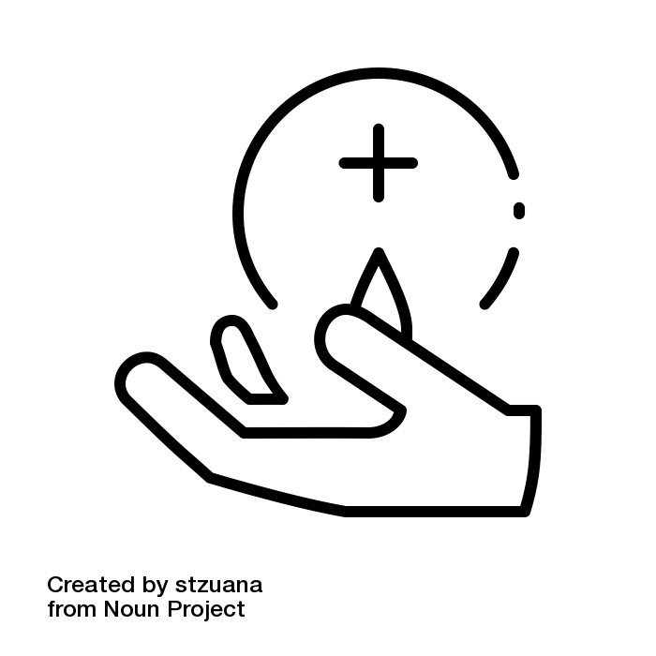
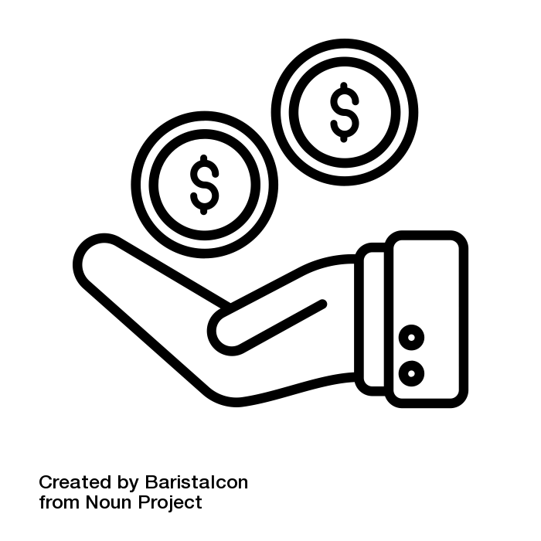
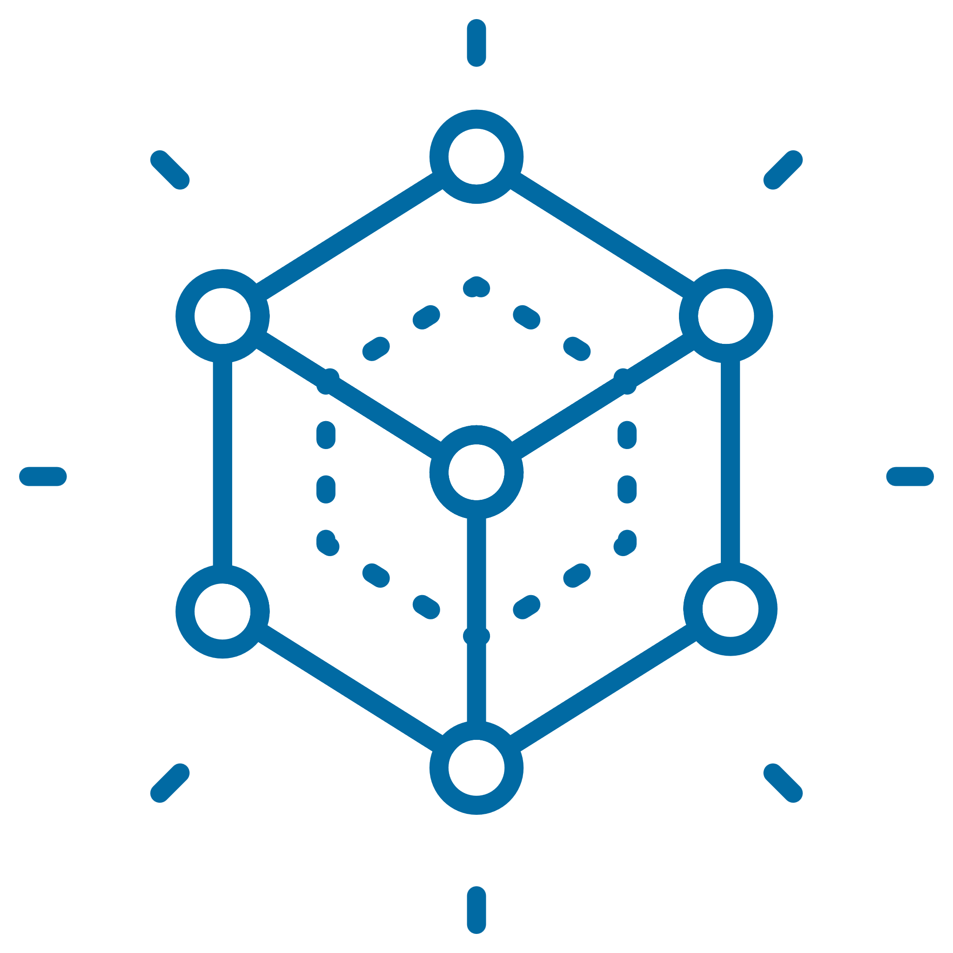
We build Digital Public Infra and partner with governments & markets to catalyse population scale digital transformations in delivery of public services
2 decades , 4 sectors - Local Governance, Public Health, Water & Sanitation, Public Finance Mgmt
7 countries & 16 sub-national Govts
Over 1B citizens served
$2.9B Revenue mobilised
Android like open ecosystem
with 200+ partners
$700mn market on DIGIT network
Path to sustainability :
Govt. of India allocated budget of
$180 Mn to support states
Enhance
Network Capacity
Strategic Pillars
Urban
Sanitation
Current
Focus
SDGs
Build Digital Public Infra
Public Finance Management
Health
Catalyze Market Ecosystems
eGov is a philanthropic organization Supported By
Notes:
eGovernments Foundation is a 20 year old not for profit organization that builds Digital Public Infrastructure. We partner with governments and markets to drive digital transformation in the delivery of public services. Urban mission was one of our first forays into public services domain and over the last 20 years, we have been able to work with the ecosystem players - government and market and together we have now reached a point where in the Government of India has committed a $180mn to support states on the digitalization of their urban mission with DIGIT product. For health, we are taking an Africa first approach. We are new here and this is where we are looking at working with different players in the African health ecosystem to build and learn together on the public health tech ecosystem. Our journey in Africa began with the DIGIT Health Campaign Management product which was built to solve different challenges faced in the campaign execution. We are now going to play a video which summarises the need for having a DIGIT HCM tool and what the tool has to offer. This was something that we had presented last year, so this recap will serve as a refresher for the old participants and set some context for the new participants

Slide 6
Agenda for today’s presentation
Who are We
Introduction to eGov Foundation and DIGIT
The Value Proposition
Why Integrated Campaign Management
Why DIGIT HCM
How does transformation look like with DIGIT HCM
Current and Future implementations for DIGIT HCM

Slide 7
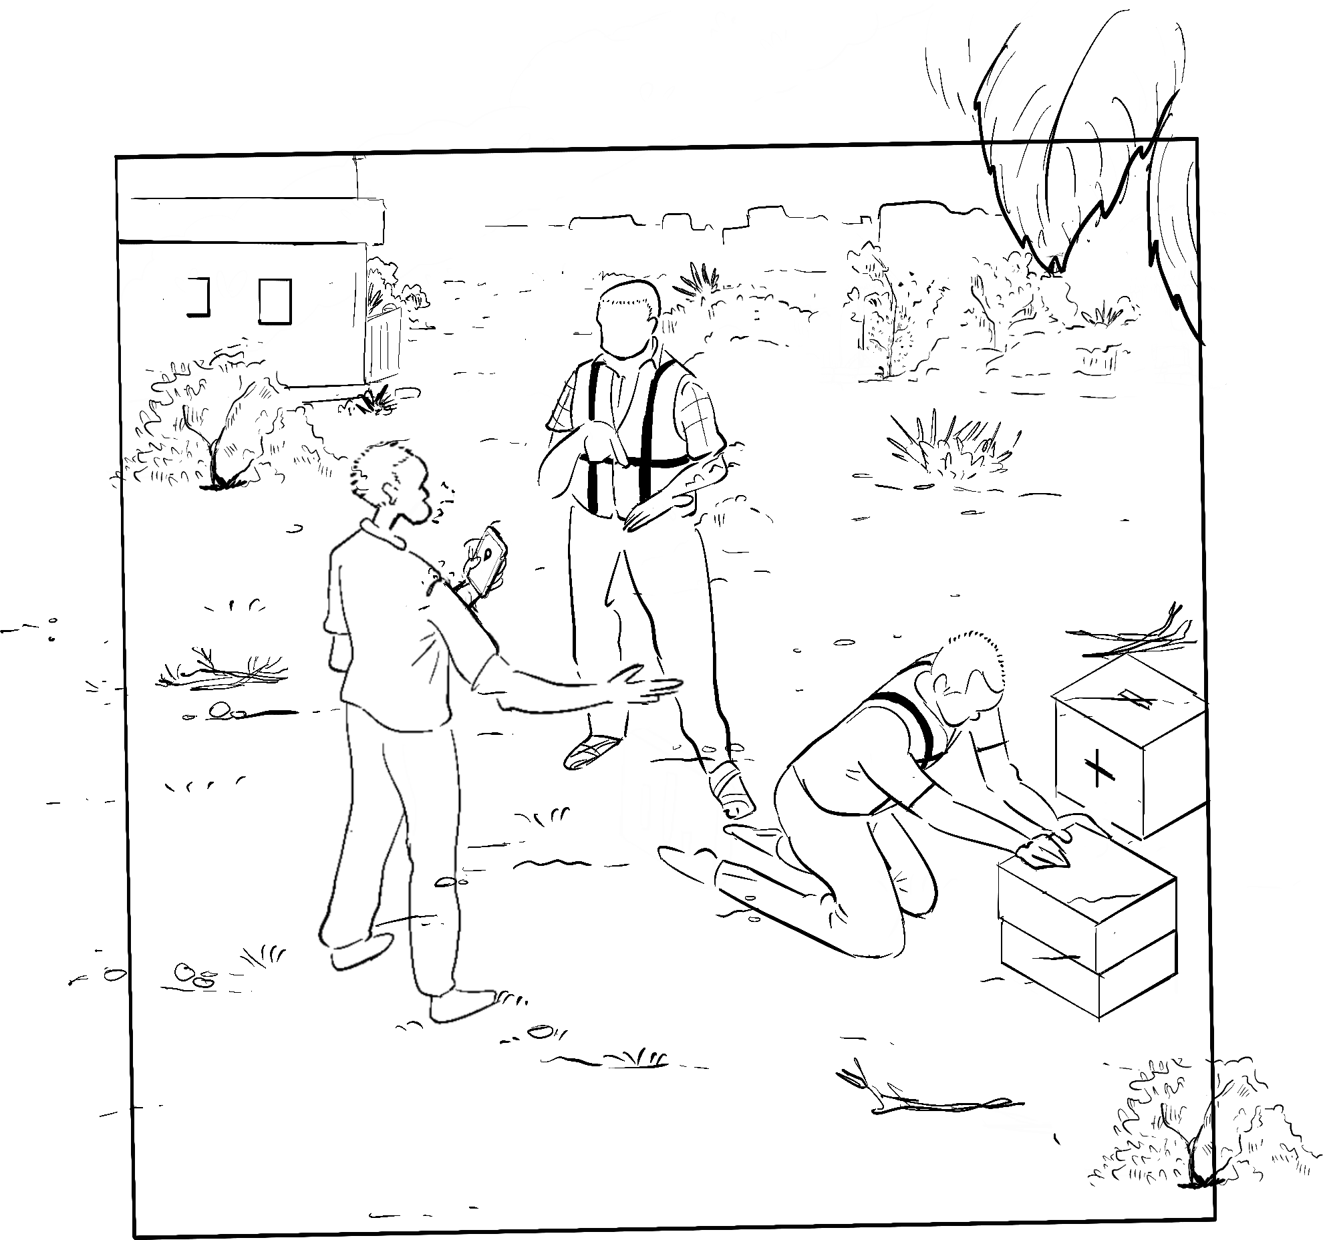
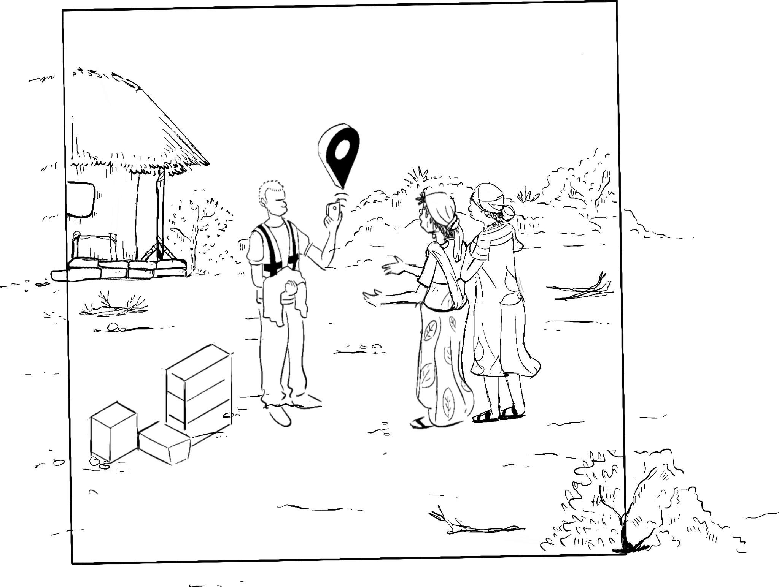
The Problems We Are Solving in Health Campaigns
National Agencies
Health Supervisors
Frontline Workers
No visibility of progress and problems
Poor data to plan and make decisions in run time
Inadequate information and limited resources
Constantly firefighting
Limited training, run-time issues
Repetitive tasks, delayed payments
Low campaign effectiveness
Logistical complexities
Limited
visibility
Siloed
approach
Limited
ownership

Slide 8
DIGIT HCM was built Africa first with…
Notes:
We are already working with and will continue to do so with our partners in the health ecosystem to ensure that

Slide 9
Our Key Principles
One product can be repurposed for all campaigns
Reusable Building Blocks
Enumeration is done once, enriched continuously
Shared data Registries
Data flows across systems, solutions interoperate
Interoperability through Open APIs
Use the building blocks to create new solutions*
Lowers the cost of software and of running programs
Free and open source software
Sovereigns own & evolve digital assets as public infra
*Ecosystem has built 29 solutions on DIGIT Urban
Sovereign-owned Open Infra
Locks-ins & Lack of Agency
Countries own and evolve the digital assets as public infrastructure
Sovereigns do not own systems, lack agency to innovate as needed

Slide 10
Lets watch this film to be aligned on the value proposition for Integrated Campaign Management

Slide 11
So what does
TRANSFORMATION
Look like with DIGIT HCM ?

Slide 12
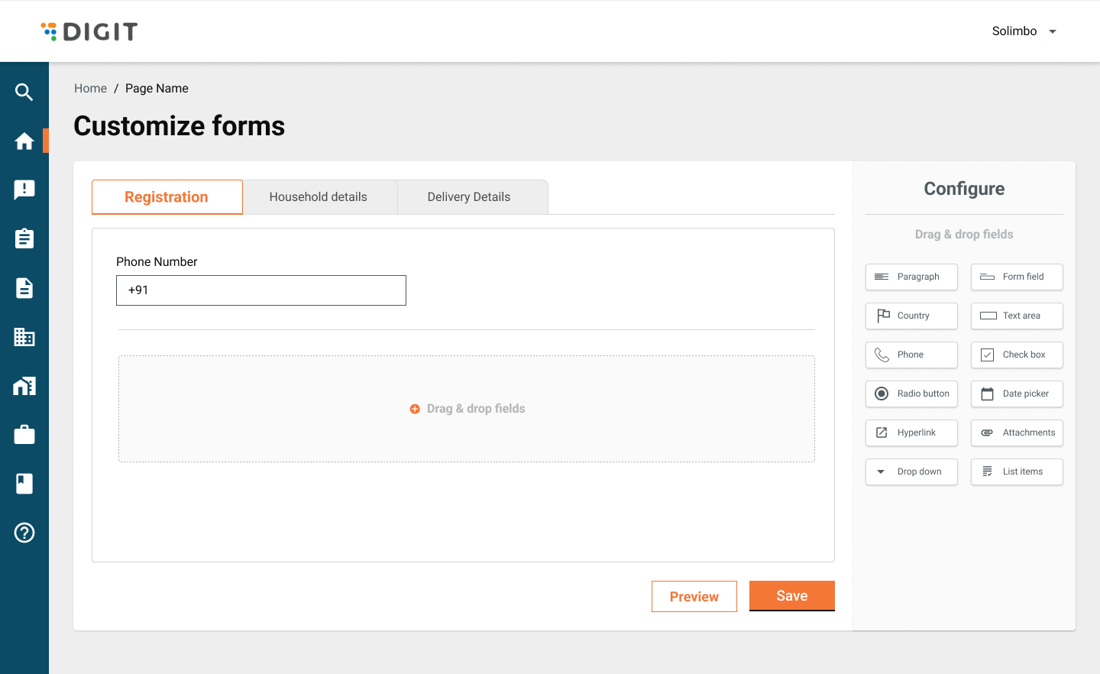
Set-up campaigns in
3 days

Slide 13
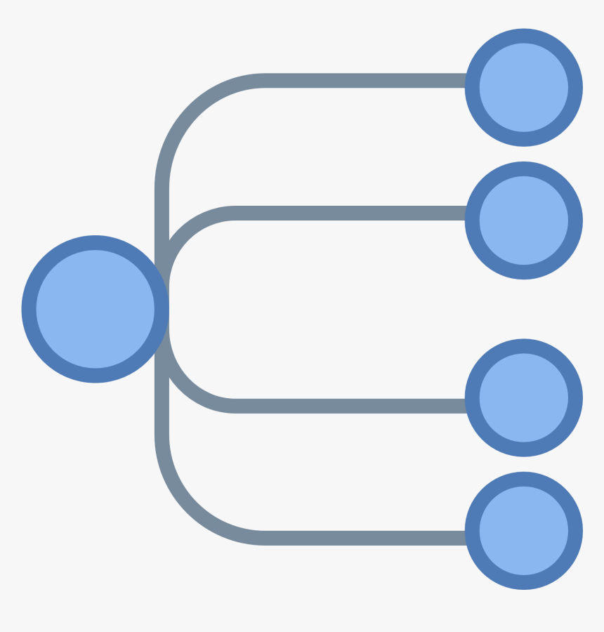
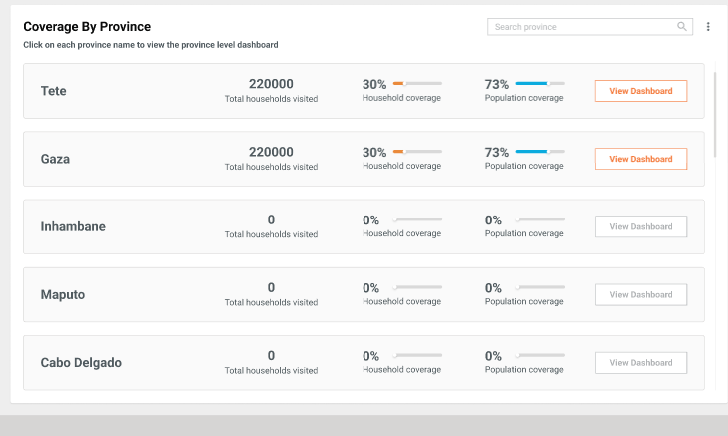
Run 100s
of campaigns simultaneously
All from one system

Slide 14
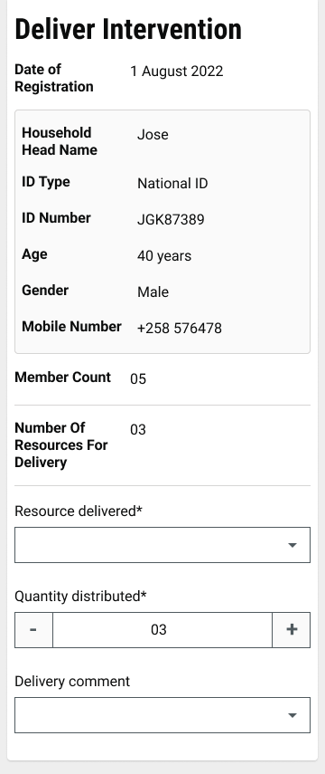
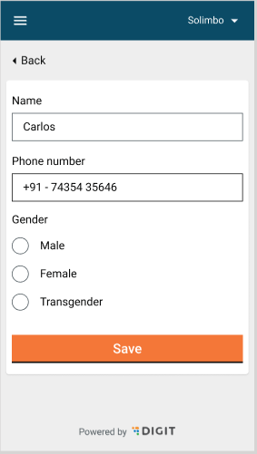
Register in 15 seconds
Record Delivery in 1 minute

Slide 15
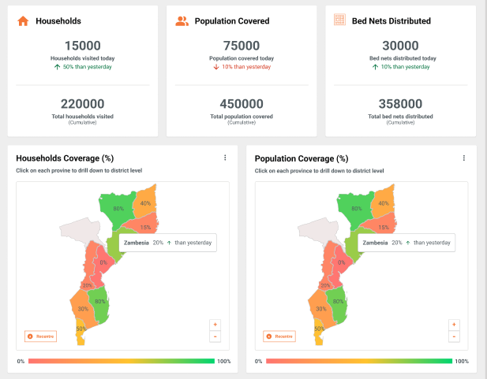
Real Time
dashboards
Make decisions in runtime

Slide 16
Drive Sovereign Health Outcomes
DIGITAL PUBLIC INFRASTRUCTURE
Digital Sovereignty All data and digital assets belong to the country
Strategic Agency National Agencies own and evolve the product
Ecosystem Participation Common standards enable the growth of collaborative local market

Slide 17
Zero licensing cost
Proven at population scale
Everything is reusable

Slide 18
Agenda for today’s presentation
Who are We
Introduction to eGov Foundation and DIGIT
The Value Proposition
Why Integrated Campaign Management
Why DIGIT HCM
How does transformation look like with DIGIT HCM
Current and Future implementations for DIGIT HCM

Slide 19
Current and Future implementation of DIGIT HCM
Bed net campaign at Tete, Mozambique
SMC Campaign in Nampula, Mozambique
Bed net campaign in Bayelsa
Aug - Sep 2023
Feb - May 2024
Feb - May 2024
Oct - Nov 2023
Apr - May 2024
May - June 2024
Bed net campaign at Gaza, Mozambique
National Bed Net Campaign in Liberia
NTD in Kano State
Notes:
Our digital transformation story in Africa began in the month of August when we rolled out DIGIT HCM locally called Salama for the bed net campaign at Tete in Mozambique. This was closely followed by the roll out in Gaza province in November. Over 4.7 mn population was covered as a part of this campaign and over 2.6 mn bed nets were distributed. Door to door simultaneous registration and distribution strategy was followed here. Today, we are in the process of implementing SMC campaign in Mozambique and a bednet campaign (based on door to door registration and fixed post distribution strategy) in Liberia. As you can see, the same platform is able to manage multiple campaign types and multiple strategies/ approaches for the same campaign type.

Slide 20
Ask us anything…

Slide 21
Connect with us at
varun@egovernments.org
nita@egovernments.org
For more details: Visit https://www.digit.org/ & https://egov.org.in/

