Slide 1
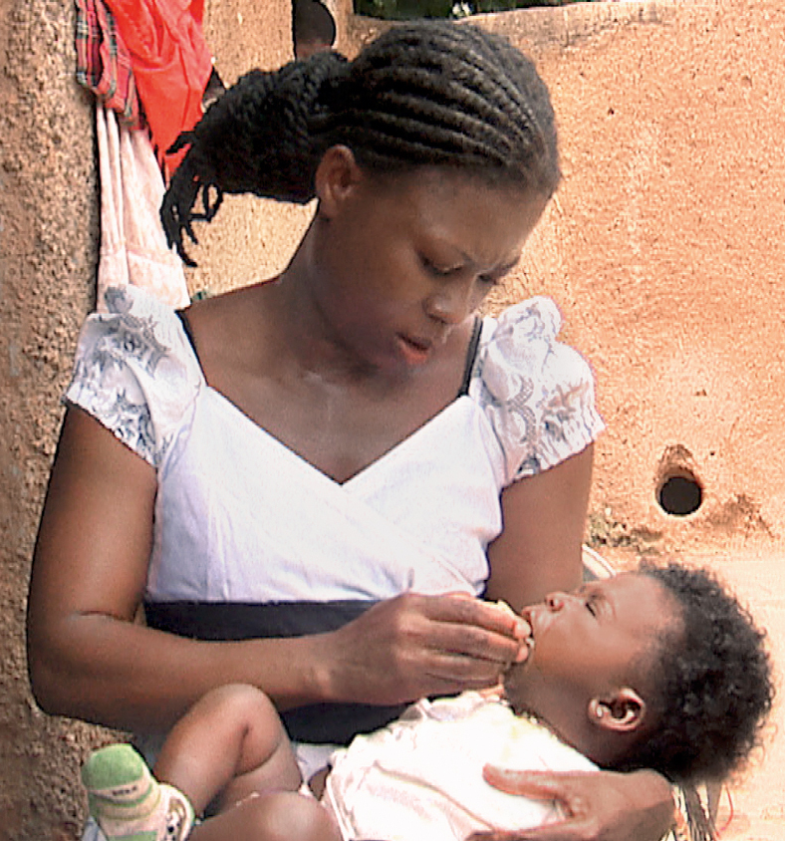
SMC Alliance – Advocacy and communications sub-group

Slide 2
Communications and Advocacy sub-group
The SMC Alliance sub-group on communications and advocacy was set up in April 2022 to serve as a platform for the SMC community to share best practices, lessons learnt, and challenges in communicating about and advocating for SMC.
We are about 10 members and 2 NMPs who are regular attendees. Most of us work on advocacy and communications not SBCC.
Tasks the group could take on include providing communication and advocacy support for:
upcoming events
support to other subgroups
maintaining the SMC Alliance website
Everyone interested in joining the subgroup kindly include your details in the signup form being circulated or speak to/email Ashley Giles: a.giles@malariaconsortium.org
www.smc-alliance.org

Slide 3
Involvements in 2023
Developing 10 years of SMC report and infographic
Organised last annual meeting’s media coverage
International Women’s day social media postings
Managing the SMC Alliance website
ASTMH activities compilation
ASTMH meeting
www.smc-alliance.org

Slide 4
Planned activities for 2024
Year-round activity (ies)
Website – moving to new Remora platform
Annual meeting activities
SMC video and infographic
Annual meeting media coverage
Advocacy and communications on our presence at other events
Multilateral initiative on malaria activities
International Day of the African Child
ASTMH
Conference on Public Health in Africa
www.smc-alliance.org

Slide 5
Advocacy and Communications Subgroup Calendar for 2024
Activity | Deadline for 1st draft
SMC Alliance Annual Meeting | 26 -29th February
Multilateral initiative on malaria activities | 21 – 27th April
World Malaria Day Infographic | 25th April 2023
International Day of the African Child | 16th June
ASTMH (List of events, social media support for symposium if approved and sub-group meeting) | 13 – 17th November
World Malaria Report social media | November (TBC)
Conference on Public Health in Africa | November (TBC)
www.smc-alliance.org

Slide 6
Support for M&E and research subgroup activties
Support to be provided
Advertising in person and virtual activities by email, website and social media
Posting videos and event take aways on website and social media
To help make this a reality
To keep us informed in your planning
Send us video after event
We will contact you for assets to create social media cards and postings
www.smc-alliance.org

Slide 7
Social media presence and new members
Website: www.smc-alliance.org
Follow us on:
Twitter: @SmcAlliance
LinkedIn: SMC Alliance (https://www.linkedin.com/company/93117810/admin/feed/posts/)
Recruit new members – fill out form

Slide 8
Questions?
www.smc-alliance.org

