Slide 1
Estimating Africa-wide SMC coverage
Adam Saddler – adam.saddler@telethonkids.org.au
Malaria Atlas Project
Abuja – Feb 2024

Slide 2
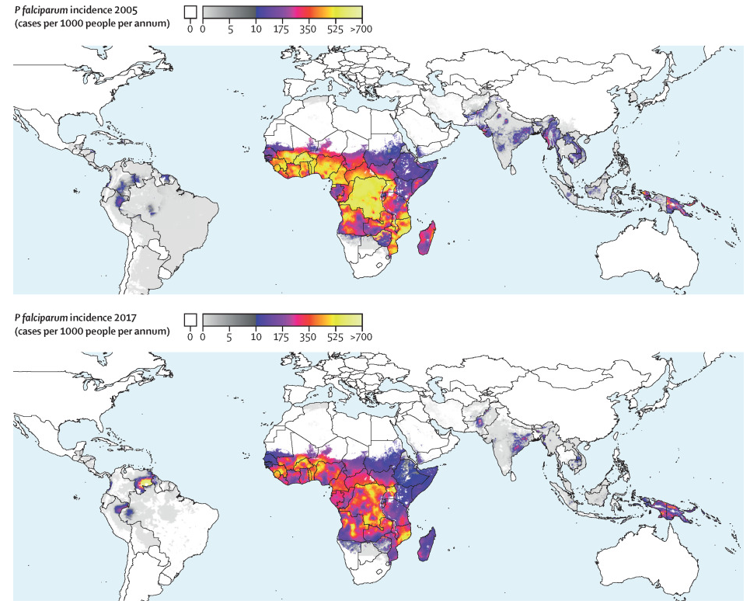
Global burden modelling
WMR (WHO)
MAP produces incidence for high burden African countries
GBD (IHME)
MAP produces prevalence, incidence, and mortality for all endemic countries
Downstream policy uses by others
Global Fund allocation
Recent RTS,S prioritisation exercise
Country risk stratification support (HBHI)

Slide 3
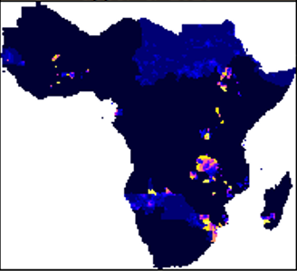
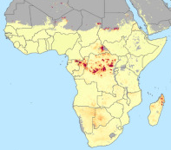
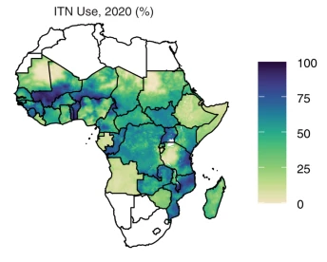
Intervention Modelling | Overview
IRS coverage
ACT effectiveness
MAP tracks trends in malaria and its control
We model intervention coverage because:
Essential input to transmission models
Essential to evaluate impact
Gives insight into mechanics of coverage – system efficiencies and how they might be improved
Spatio-temporal estimates produced for:
Vector Control: ITNs, IRS
Treatment: Care-seeking, proportional drug use, drug-class effectiveness
Time for SMC?
ITN use
Notes:
Framing

Slide 4
SMC coverage data types
Campaign administrative data (MMV via WHO)
Rich subnational data
Mainly day 1 coverage
Tally sheets or delivery numbers
Many estimates over 100%
SMC household surveys (EOC and EOR)
Captures children that are not receiving SMC
Day 1-3 coverage often available
Non-target age-group estimates
Incomplete (geographically)
DHS surveys
Very sparse and inconsistent questioning
Desired outcome: SMC coverage for each admin unit/ month / year
Notes:
Framing

Slide 5
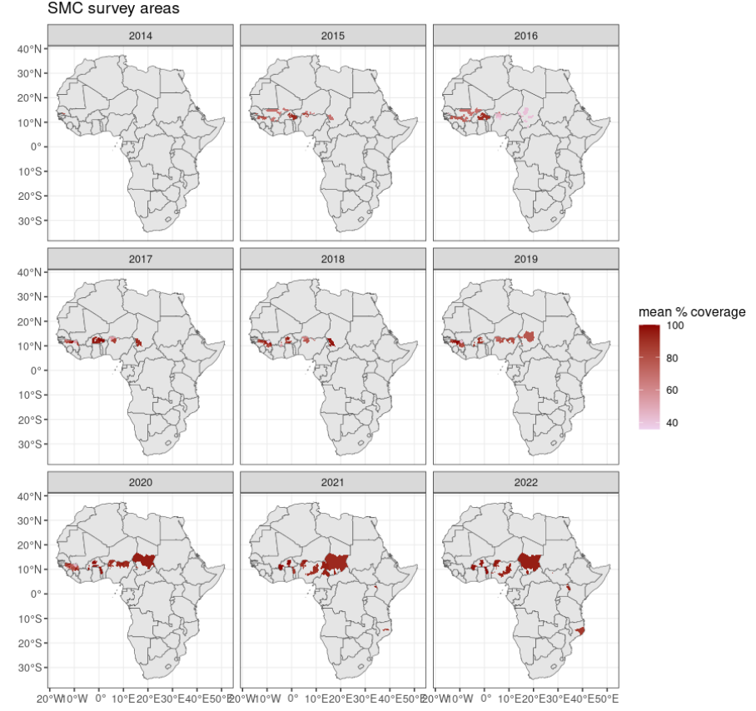
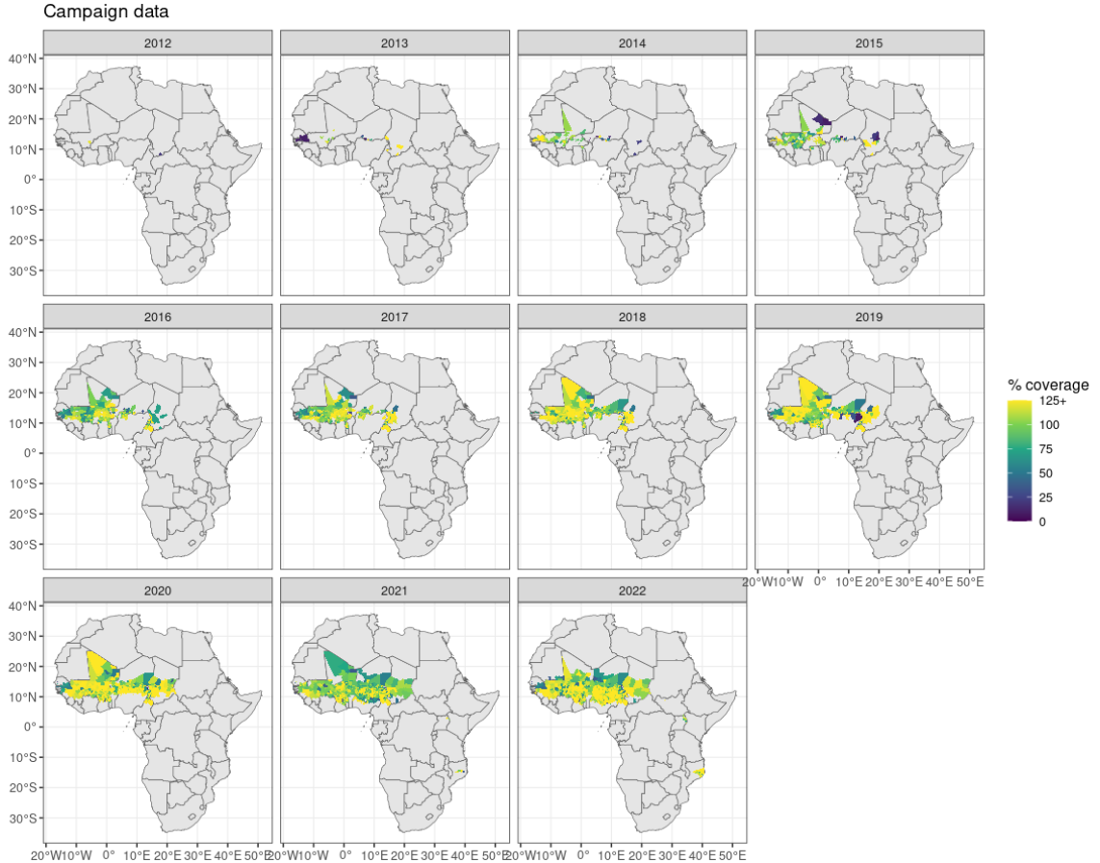
SMC coverage estimation
Notes:
Framing

Slide 6
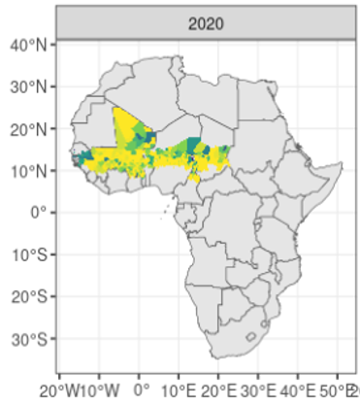
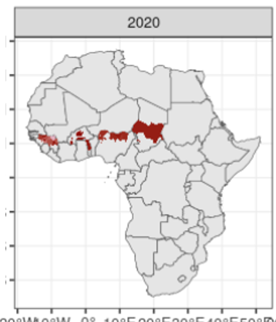
SMC coverage estimation
Admin coverage
Survey coverage
Notes:
Framing

Slide 7
SMC coverage estimation
Current thinking
Use programmatic data – to identify geographical coverage
SMC surveys – for robust estimates of coverage in target age groups
Gap-fill non-surveyed areas
TBC. Conducting sensitivity analysis. Testing different gapfilling methods from simple global trends to spatio-temporal models.
But best to avoid gapfilling…
Notes:
Framing

Slide 8
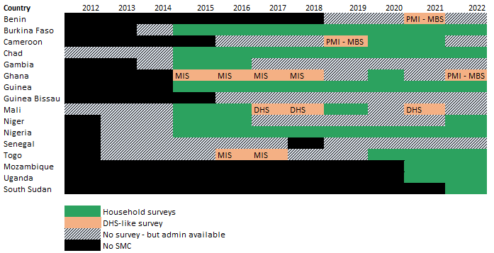
Survey summary
Notes:
Framing

Slide 9
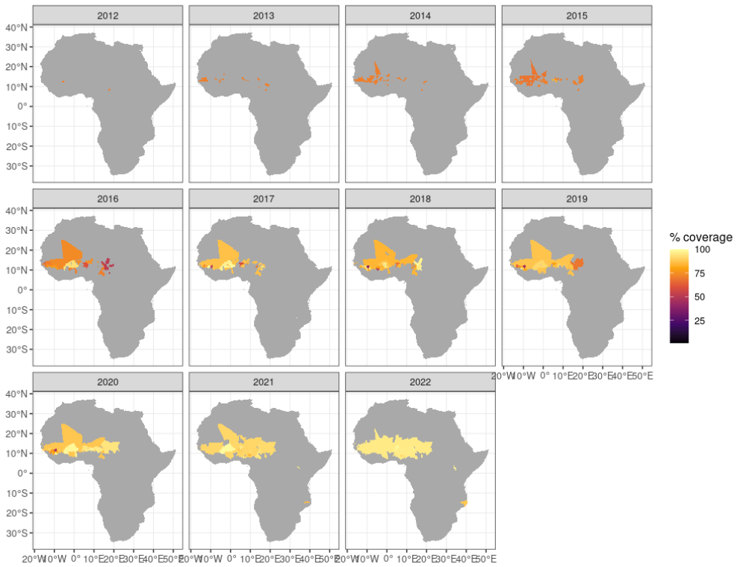
Initial results
Notes:
Framing

Slide 10
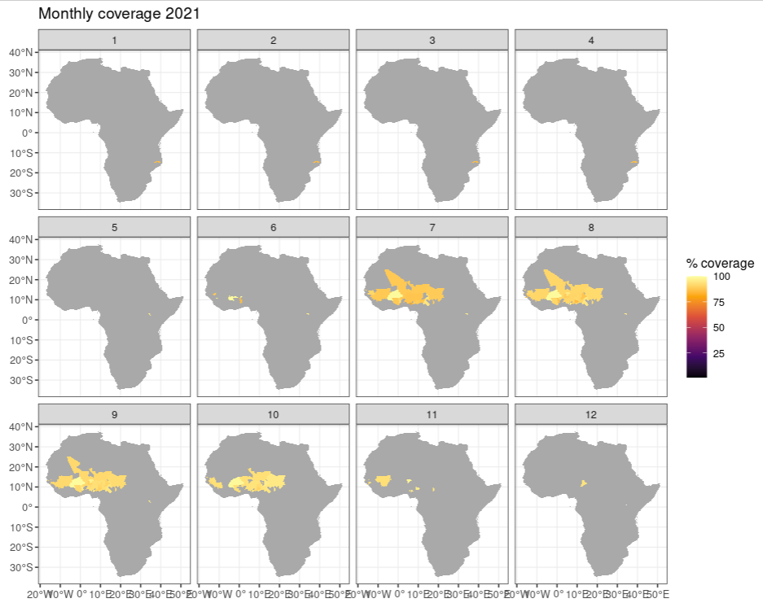

Slide 11
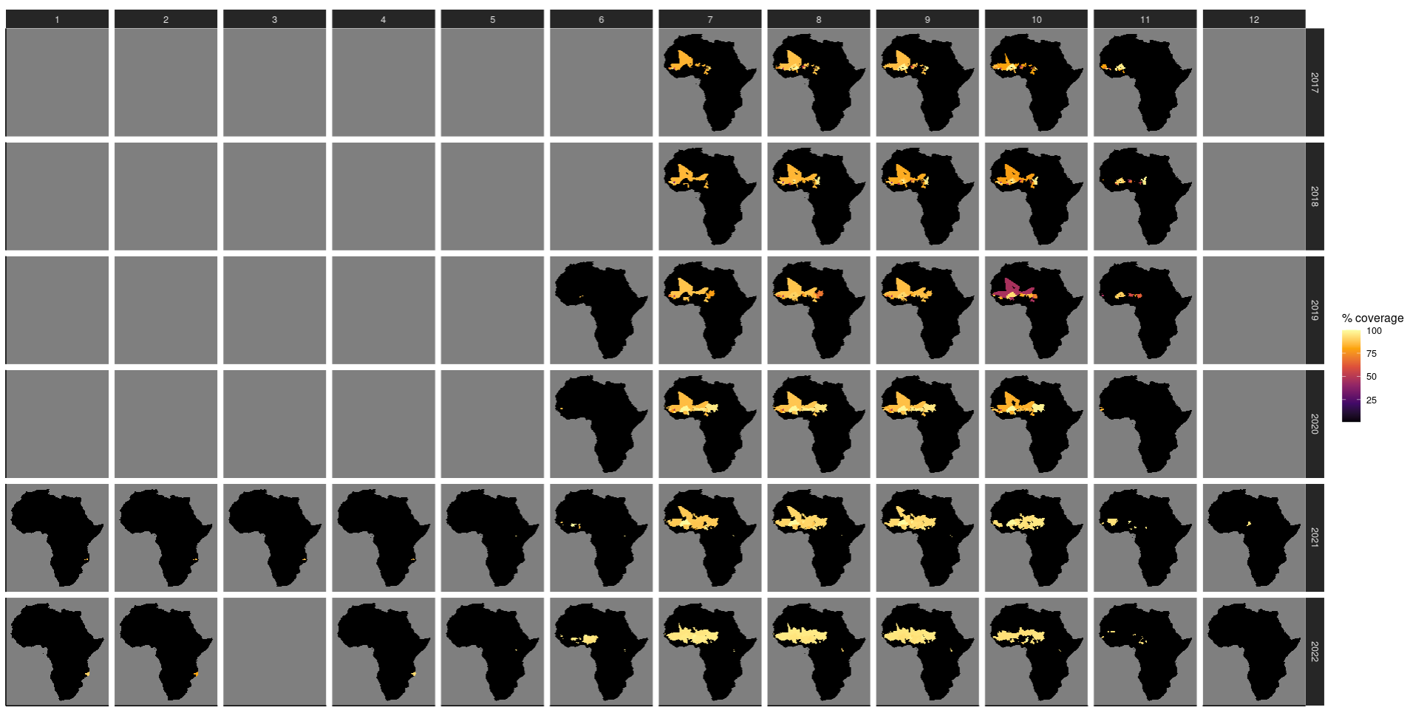
SMC coverage estimation
Notes:
Framing

Slide 12
Discussion topics
Any other surveys?
In country-years without surveys
In areas outside of malaria consortium districts
What is driving the 100%+ coverage in program data?
Denominator issue (incorrect population estimates)
non-target children receiving SMC (age-groups, nomadic populations)
other?
Timing and dates…
Future work
Coverage in non-target age groups
Adherence maps (important for resistance)
Impact
Notes:
Framing

Slide 13
Additional work of interest
EA node
Provision of technical support
Capacity/skills development
Identifying, Prioritizing and Responding to challenging malaria questions
v
Seasonality work
Database:
We collected data for 4 macro-categories of incidence, prevalence, entomological and mortality
Current we have data collected for 47 Sub-Saharan Countries, for a total of n=912 unique sources, and n=4110 of rows in the database
Geospatial maps and analysis:
SMC impact
SMC planning…
v
East Africa
Perth
Notes:
Framing

