Slide 1
Update and forward looking for the control of seasonal malaria
Prof Jean Louis Ndiaye
University of Thiès
SMC Alliance annual meeting
Abuja – Nigeria
Feb 28, 2024

Slide 2
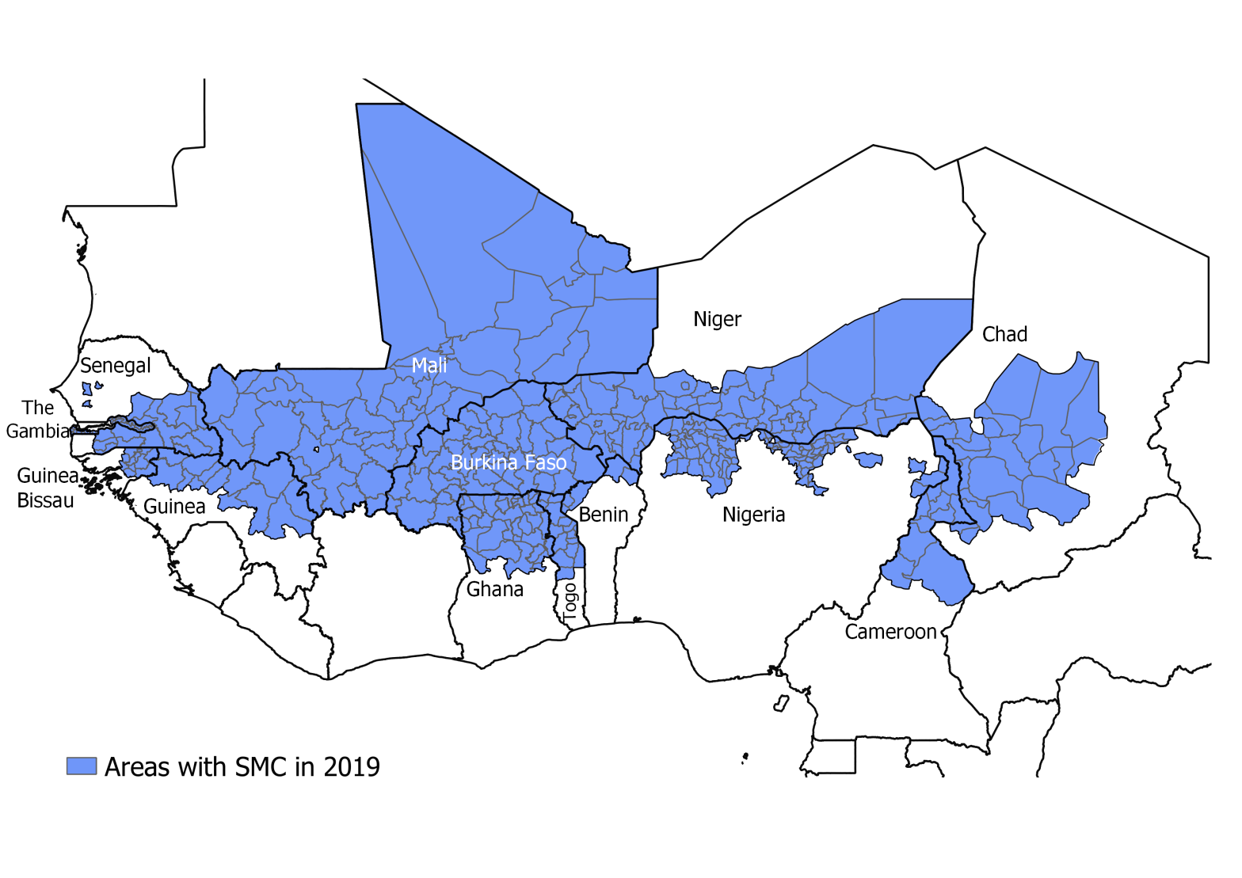
Project team and locations
NMPs from Benin, Burkina Faso, Cameroon, Chad, The Gambia, Ghana, Guinea, Guinea Bissau, Mali, Niger, Nigeria, Togo and Senegal
University of Thies : Jean Louis Ndiaye, Ibrahima Mbaye, Fatimatou Bintou Sall, Amadou Seck, Ndeye Fatou Diop
LSHTM: Paul Milligan, Susana Scott, Lucy Bell
WHO/TDR : Corinne Merle
MMV : Andre Tchouatieu, Abena Poku-Awuku

Slide 3
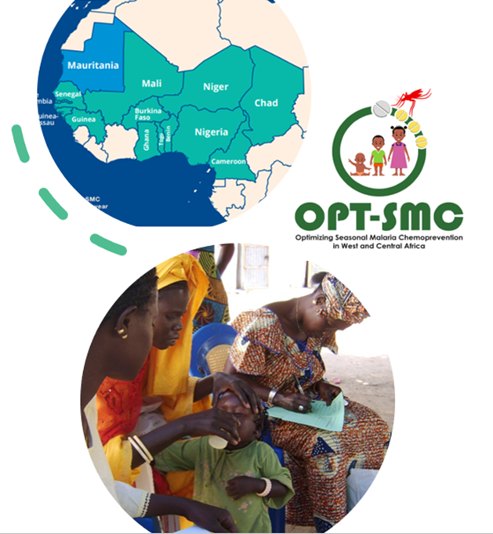
Objectives of OPT-SMC
Strengthening the capacities of the NMPs implementing SMC:
To define research priorities for optimizing SMC effectiveness
To conduct IR/OR projects for improving SMC effectiveness:
interpret and make use of malaria surveillance data
target effectively (high risk populations and periods of the year)
monitor delivery, uptake and effectiveness
Promote inter-country collaboration, sharing of information and expertise

Slide 4
Project Timelines
Project starts
Operational/Implementation research, mentoring and technical assistance
Project ends
WS1: Development research plans
May 2020
WS2: Training on qualitative research
WS3: Introduction of the RTS,S/S (virtual)
WS4: Research training Module 1 (virtual)
WS5:implementation strategies for the RTS,S introduction
WS6 : Data analysis, data interpretation
WS7: Dissemination *
Baseline needs assessment
Coverage survey**
Coverage survey**
Coverage survey**
Coverage survey**
Coverage survey**
SMC campaigns:
Jul-Nov
SMC campaigns:
Jul-Nov
SMC campaigns:
Jul-Nov
SMC campaigns:
Jul-Nov
SMC campaigns:
Jul-Nov
SMC campaigns:
Jul-Nov
M J J A S O N D J F M A M J J A S O N D J F M A M J J A S O N D J F M A M J J A S O N D J F M A M J J A S O N D J F M A
2020
2021
2022
2023
2024
2025
No cost extension
*Workshop dates subject to change
** no specific funding for supporting coverage surveys but through OPT-SMC technical support could be provided for good quality surveys and additional sub-studies for understanding the variation of the coverage.
Notes:
Four year project : 1st May 2020 – Apr 2024
Develop Letter of intent – workshop 1 (May 2020)
2020 SMC campaigns (Jul- Dec 2020): data collection, baseline assessments
Workshop 2: training in OR
2021 SMC campaigns (Jul- Dec 2021): data collection
2022 SMC campaigns (Jul- Dec 2022): data collection
Workshop 3: impact assessment
2023 SMC campaigns (Jul- Dec 2023): data collection
Workshop 4: dissemination

Slide 5
NMCP projects:
Monitor and Evaluate
Ghana: SMC coverage and factors associated with uptake and adherence
Barriers to uptake: Qualitative studies
Guinea: Barriers to SMC uptake in mining areas in Guinea and an improved delivery approach.
Developing New Strategies
Mali :
Adapting target groups
Togo: Defining optimal SMC strategies in Togo: timing and number of cycles, and age ranges at risk of severe malaria
Benin: Monitoring the effectiveness of SMC in northern Benin using the case-control method.
Senegal: Estimating the delivery costs and cost effectiveness of SMC in southern Senegal
Nigeria: Barriers and facilitators of SMC uptake in Nigeria: a qualitative study in 5 States.
Burkina Faso: Evaluating the determinants of variations in SMC coverage in Burkina Faso between urban and rural areas
Cameroon: Effectiveness of using household leaders to improve adherence during SMC
Chad:
Niger: Applying the updated WHO SMC guidelines in Niger: timing and number of cycles, and age ranges at risk of severe malaria
The Gambia: Assessment of adherence to SMC in The Gambia
ongoing
ongoing
Guinea Bissau: Strengthening health management information systems to assess the impact of SMC in three regions in Guinea Bissau
Senegal : Mechanistic Model for cost effective evaluation of SMC delivery
Development stage
Evaluation of SMC using 3 approaches: DOT 3, SMC plus and Classic

Slide 6
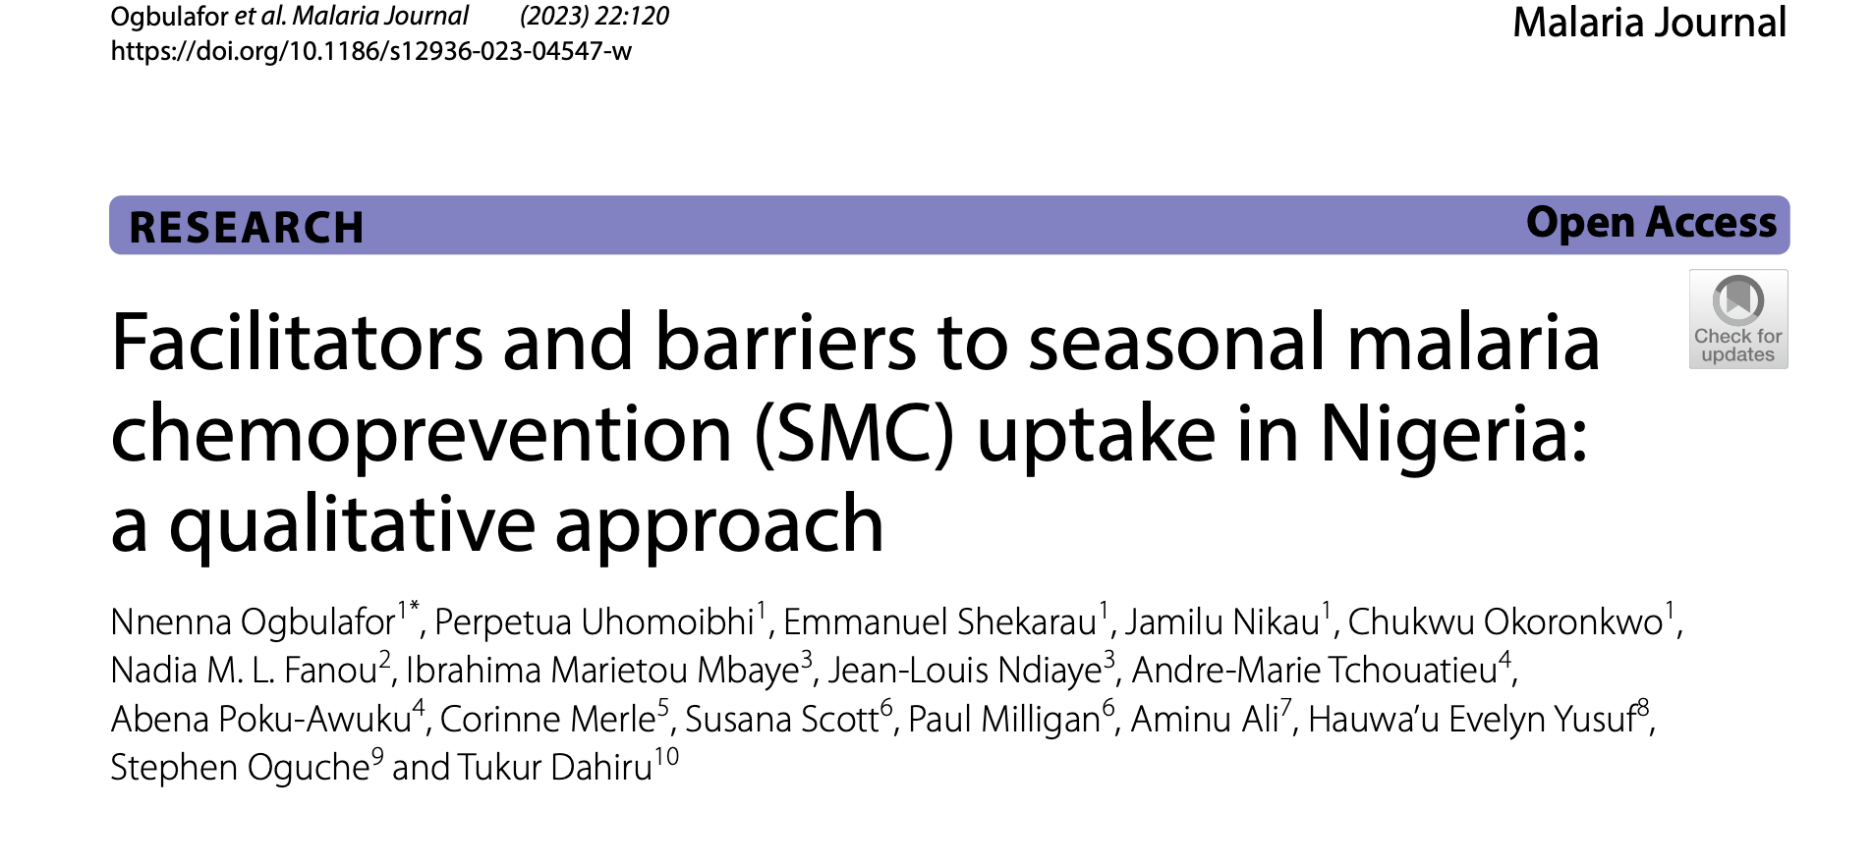
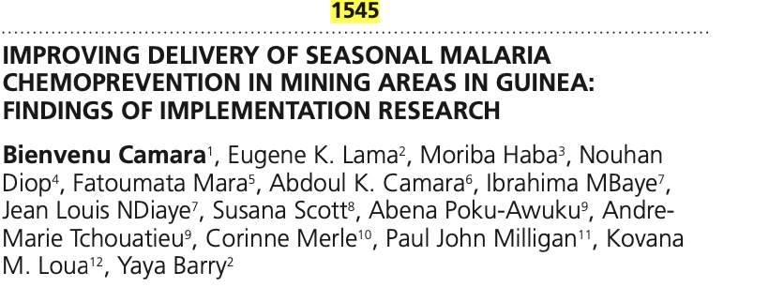
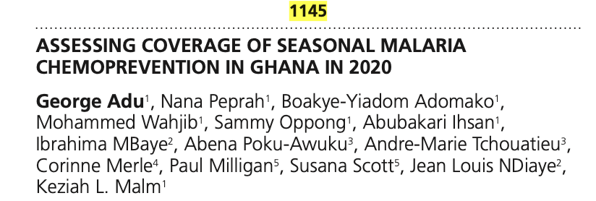
Project updates
13 countries:
3 - complete (Nigeria, Ghana and Guinea)
5 - data collection complete, analysis stage
2 - data collection ongoing
2 – ethics approval, will start this year
1 – still to confirm a project
Conferences:
ASTMH 2021 ( Ghana, COVID work and video job-aids) and 2022 (Guinea and Nigeria)
EDCTP forum – Nov 23, Paris (Guinea, Nigeria, Mali and Burkina Faso)

Slide 7
OPT SMC communication and visibility
Two newsletters every year
OPT-SMC Web page on the SMC Alliance Web site
OPT-SMC project updates at the SMC Alliance annual meetings
World Malaria Day social media activities
OPT-SMC as part of 10 years anniversary of SMC
OPT-SMC on the International Day of the African Child: https://healthpolicy-watch.news/97669-2/
OPT-SMC several webinars
Organizing a webinar on SMC: https://echosante.info/zero-malaria-icf-supports-evidence-for-streamlining-smc-implementation/
Webinars on SMC and vaccines
Meetings with NMPs representatives at ASTMH
Development of OPT-SMC publication / Dissemination plan (2024)

Slide 8
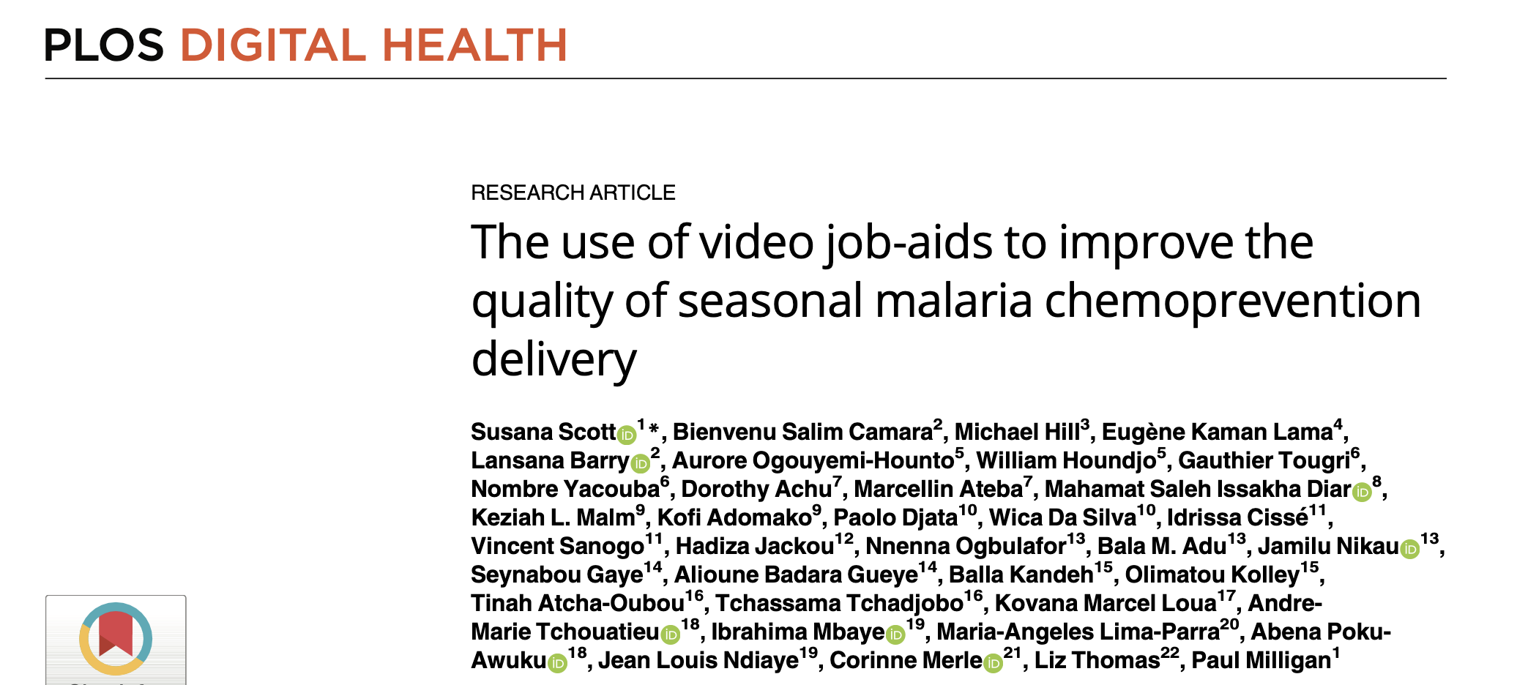
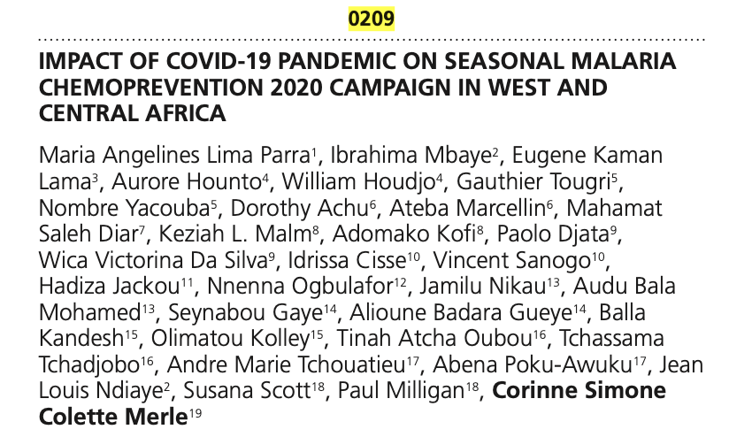
Add on studies to support the project
Standardised protocols for implementation research (WHO funded)
WHO/GMP: collaboration to add SMC module onto the DHIS2 and train countries on how to use it to better interpret their data

Slide 9
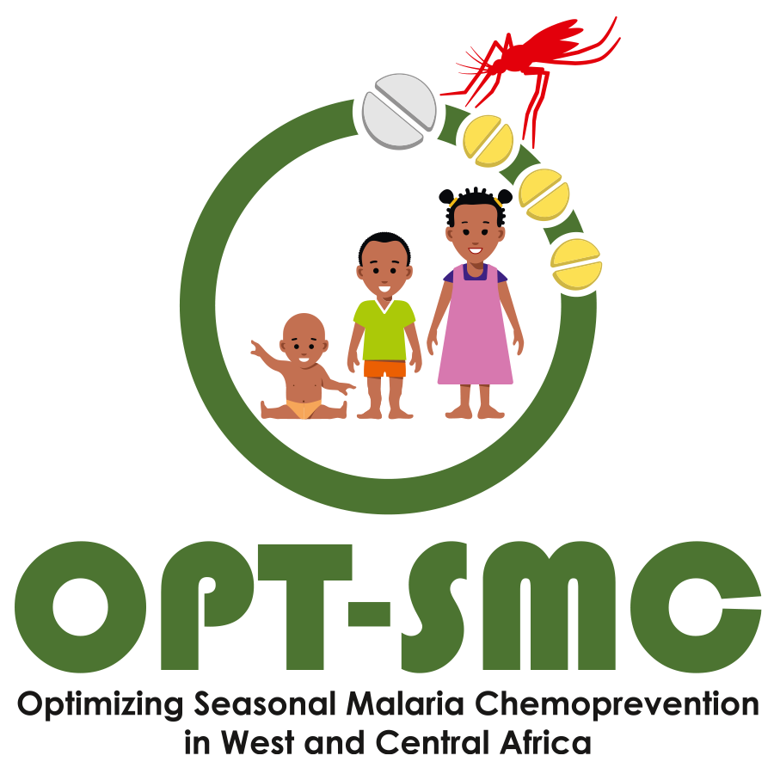
Strengths
Network of 13 countries sharing progress and lessons learnt
1
NMPs leading the research: Identifying priority questions /
Conducting research an putting the findings into practice
2
3
Providing technical support and strengthening capacity in IR methods
4
Facilitating collaboration between NMPs and local research institutions / partners
5
Frequent communication with each NMP and bringing all partners together through regular webinars and in-person meetings
6
Bi-lingual project (sometimes tri) – strong emphasis to be inclusive to all

Slide 10
Common themes that came out
1
Mistrust : safety, suspicion about drugs provided free, not effective communication, distributors not from local community
2
Need to adapt delivery to local factors
3
Importance of qualitative research to understand community perspectives and then take these into account when planning SMC delivery
4
Challenges of delivery in areas with security problems
5
Implementing the recommendations from the various research might involve some additional cost

Slide 11
Forward look for the control of seasonal malaria
A constant search for better SMC optimization
2018: WHO ➔ progress in malaria control had stalled ➔ importance of optimising the use of proven interventions ➔ OPT-SMC
WHO 2022 guidelines on malaria
Where should we do SMC?
When to start? How many cycles?
Age range? (High risk of severe disease)
Need for improved surveillance data for severe disease and greater granularity
New implementation field guide
Notes:
Countries must adopt a constant attitude of optimising their HPC strategy
Already in 2018, the WHO had noted that progress in malaria control had stalled , and had raised the importance of optimising the use of proven malaria control interventions, which gave rise to the idea of the OPT-SMC project.
In its latest guidelines on malaria of June 2022, the WHO recognizes the need to adapt strategies to the local epidemiology, particularly in relation to the following questions: Where to start SMC, When to start, How many cycles? Which age group should be targeted?
Hence the need for countries to improve surveillance data collection and make it more detailed in order to better define local epidemiology and guide intervention strategies.
Also, worth noting that the new WHO SMC implementation field guideline raises practical questions about optimising SMC.

Slide 12
Forward look for the control of seasonal malaria
New interventions on the horizon ± in combination with SMC
Malaria vaccine from 2024
Monoclonal antibodies?
Long Acting Injectable antimalarials ?
Similar implementation challenges to ensure that all children are reached
Network approach of OPT-SMC maybe helpful
Notes:
For seasonal malaria control, in addition to SMC, we have new interventions on the horizon that might be or not combined with SMC. Among these we have
- the malaria vaccine that countries should begin to implement from 2024 with its set of challenges for good coverage of children, given the low EPI coverage in some countries
- We also have the monoclonal antibodies and
- the long acting injectable antimalarials
For these new interventions, the same challenges of implementation to reach all children could be encountered and an approach similar to that of the OPT-SMC project could be of great help to support countries in adopting these new strategies.

Slide 13
NMP: Benin, Burkina Faso, Cameroon, Chad, Ghana, Gambia, Guinea, Guinea Bissau, Mali, Niger, Nigeria, Senegal, Togo and Mauritania
THANK YOU !!!!

