Slide 1
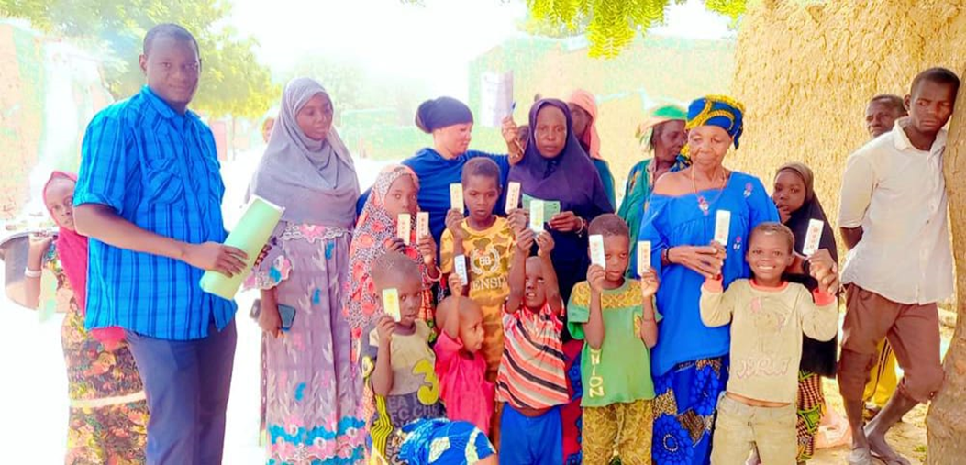
SMC-IMPACT
UPDATE in 2023
SMC Alliance Annual meeting February , 28, 2024

Slide 2
Objectives of SMC Impact
Contributing to cover the remaining gaps for the current eligible target (Nigeria)
Contribute to the body of evidence about
Efficacy and cost effectiveness of increasing SMC to 5-10 years old ((Niger and The Gambia)
Additional impact of adding one month of SMC coverage during the transmission season and relative cost increment (Guinea and Mali)
Development of SPAQ presentation for 5-10 years old
Contributing to increase knowledge about Pyramax® and introduction in malaria endemic countries as an alternative therapeutic solution (Guinea and The Gambia)

Slide 3
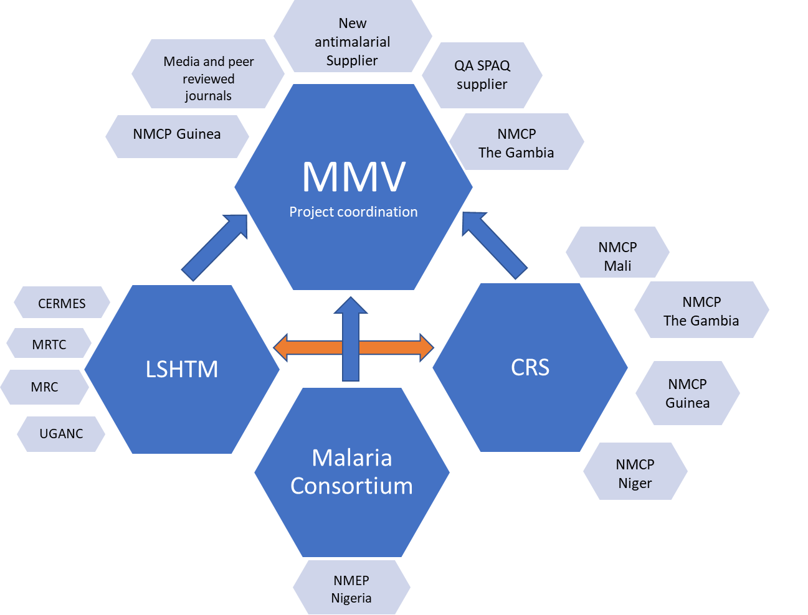
Project structure; countries and partners
Project duration : December 2020–June 2025
Malaria Consortium, CRS, LSHTM and MMV have worked together in the pass on the Access SMC project to successfully scale up SMC
Confidential – internal use only

Slide 4
Project location
The Gambia (Upper River and Central River regions),
Guinea (Dabola health district, Faranah region), ·
Mali (Yanfolia and Niena districts in the Sikasso region)
Nigeria (Ningi and Tafawa Balewa local government areas [LGAs], Bauchi State)
Niger (health district of Damagaram Takaya, Zinder region)

Slide 5
Key achievements so far
In The Gambia, Guinea and Mali, the total numbers of children reached were:
In Nigeria, the total number of children reached :
IN 2021 | IN 20232 | IN 2023
115,414 ( 3–59 mths) 22,368 (60–119 mths) | 116, 537 83,207 | 120,000 83,917
IN 2021 | IN 2022 | IN 2023
• 271,905 (3–59 mths) | 291,176 | 304,623

Slide 6
Key achievements in 2023
Economic evaluation of the project in Mali, Niger and Guinea has been completed by LSHTM together with local partners
Qualitative and quantitative data , financial data used for the evaluation
Data analysed and, preliminary results published at ASTMH 2023

Slide 7
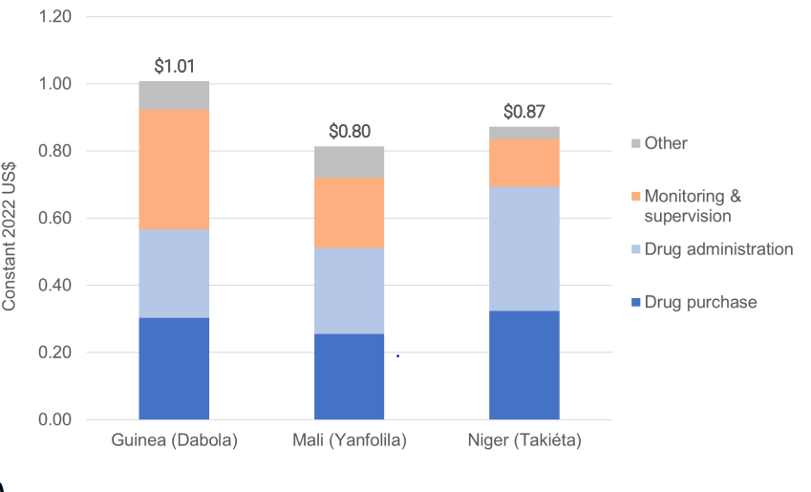
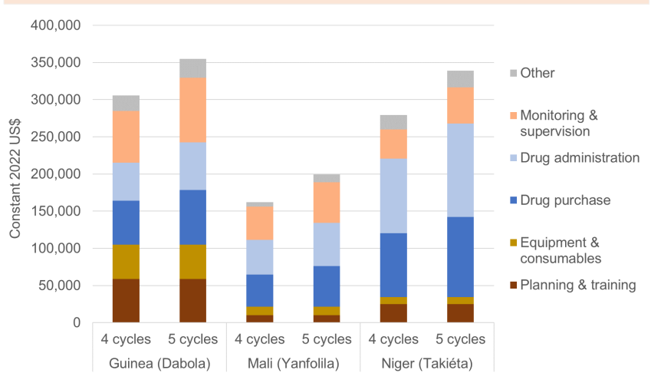
Key drivers of incremental cost were drug administration, drug purchase, and monitoring & supervision. Together, they were 92% of the additional cost in Guinea, 89% in Mali, and 96% in Niger
Incremental costs of delivering SMC per 5th cycle per child were higher in Guinea ($1.01) than in Mali ($0.80) or Niger ($0.87) due to higher monitoring & supervision costs
Adding a 5th cycle increased total costs of delivering SMC by 16% in Guinea (Dabola), 22% in Mali (Yanfolila), and 21% in Niger (Takiéta), indicating economies of scope as the incremental costs of a 5th cycle were less than the average cost per cycle of in a 4 cycles strategy.

Slide 8
Key achievements in 2023
Outcome 4 on quality assured higher strength of SPAQ developped:
Meetings of the advisory group, to define the SPAQ dosage for children 5-10 years old (a consensus was reached)
The PV data from Senegal has been reviewed ( 03-59 monts and 5-10 years) and preliminary analysis done
A technical note was written and sent to the WHO’s Global Malaria Program concerning the SPAQ for 5-10 YO
Discussions are ongoing with the SMC-Alliance group to conduct a study to address this data gap

Slide 9
Context and introduction

Slide 10
Key achievements in 2023
Outcome 5: Health workers trained on the use of PA as treatment for uncomplicated malaria in children in The Gambia and Guinea
Introduction of PA in the national guideline in Guinea in 2022
Training of health workers in Siguiri
Distribution planned for 2022 was delayed until early 2023
One field visit done to continue advocacy in Siguiri
Number of treated children not yet available
But good tolerance and acceptability of PA by the patients and prescribers

Slide 11
Way forward
Implement the 2024 SMC activities as planned
Sustainability: Phase out of the Project in the 5 countries
follow-up on the sustainability of the project in the different countries
Field visit at the end of the Project
Discussions with the Alliance SMC to implement a cross-sectional study to review data and determine the burden of malaria within the 5-10 years old

Slide 12
Project phasing out
 | Actions | MAIN CHALLENGES | OBSERVATIONS
NIGERIA | Adequate training of state, LGA and community levels for SMC implementation (HR for SMC). Improved government/private sector funding for malaria control/elimination. Engagement with state to take over SMC at the exit of donor |  | SMC will continue in the 2 LGAs with direct support from MC under Philanthropic funding
THE GAMBIA | Advocating for the continuation of SMC in 5-10 years old through Global Fund (GC7) or through PMI activities. | Difficulties in reaching the children during school time The Gambia policy not allowing SMC in the school settings Absence of caretakers due to farm work | Not yet confirmed
Niger | Advocating for the Continuity of extension of SMC to children 5 to 10 year in the SMC-Impact areas. Advocating for the continuation of activities under Global Fund GC7 grant. | RAS RAS | Damagaran and Takaya will continue under GF

Slide 13
Project phasing out 2
 | Actions | MAIN CHALLENGES | OBSERVATIONS
MALI | Including the intervention in the concept note to be continued within GC7 Advocating for the continuation of SMC-Impact activities through Global Fund (GC7) or through PMI activities. There is a remaining drugs for a 5th cycle in the project's District, There should be discussion and advocay for operational costs to be included in GC7 | low involvement of certain District Health Teams; Failure to adapt the times when distribution teams visit households, Low coverage of children by distributors (between 30 to 40 children treated/day); Absence of caretakers due to farm work . | Waiting for the GC7 results
GUINEA |  | Low coverage for children aged 3 to 11 months; Low use of the sharing sheet. Failure to control the population target leading to overruns in terms of coverage | Continue the activities of the 5th cycle under financing from the Global Fund (GC7).

Slide 14
Publication plan
Working title: Cost and cost-effectiveness of extending SMC to a fifth cycle in Guinea, Mali, and Niger
Target journal: Lancet Global Health
Working title: Process and coverage of extending SMC to a fifth cycle in Guinea, Mali, and Niger
Target journal: Lancet Global Health
Working title: Process, coverage, costs, impact, and cost-effectiveness of extending SMC to children under 10 in Niger
Target journal: PLOS Global Public Health
Working title: Process and coverage of extending SMC to a fifth cycle in two districts in Mali
First/lead author: Issaka Sagara
Working title: SMC and ITN coverage in Guinea 2021-2023:
Bienvenu Camara
Working title: Coverage of SMC and insecticide-treated nets in two districts in Niger
Moustapha Mahaman Lamine/Ibrahim Alkassoum
Working title: Efficient allocation of SMC resources to maximise health outcomes in 17 countries in sub-Saharan Africa. Lead author: David Bath

Slide 16
Thank you

