Slide 1
SEASONAL MALARIA CHEMOPREVENTION MONITORING & EVALUATION SUB-GROUP
Update to the SMC Alliance Annual Meeting 2024
SMC M&E Sub-Group of the SMC Alliance
For questions or feedback, email: suzanne.vanhulle@cr.org

Slide 2
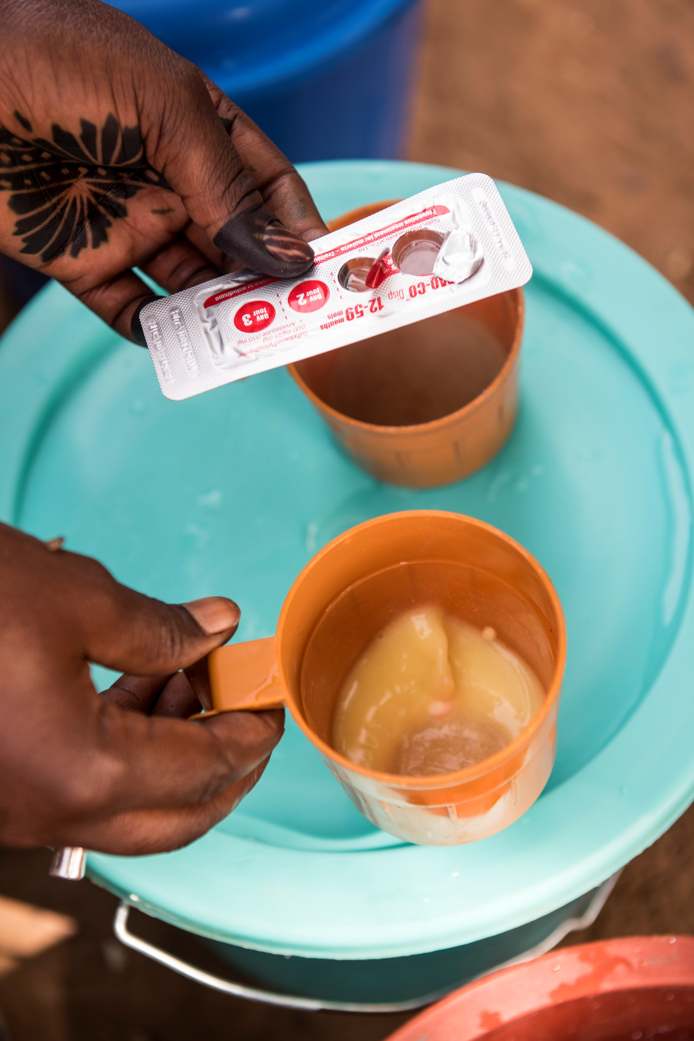
Terms of the Reference
First met on 6 November 2020
Terms of Reference finalized in January 2021
Purpose: provide a platform where members of the SMC community can share challenges and best practices in M&E, and can discuss and collectively develop and harmonize tools
Membership: balance of scientific and programmatic knowledge and experience, as well as geographic representation
Annual focus area: to support NMP and WHO efforts on the annual World Malaria Report chapter on SMC

Slide 3
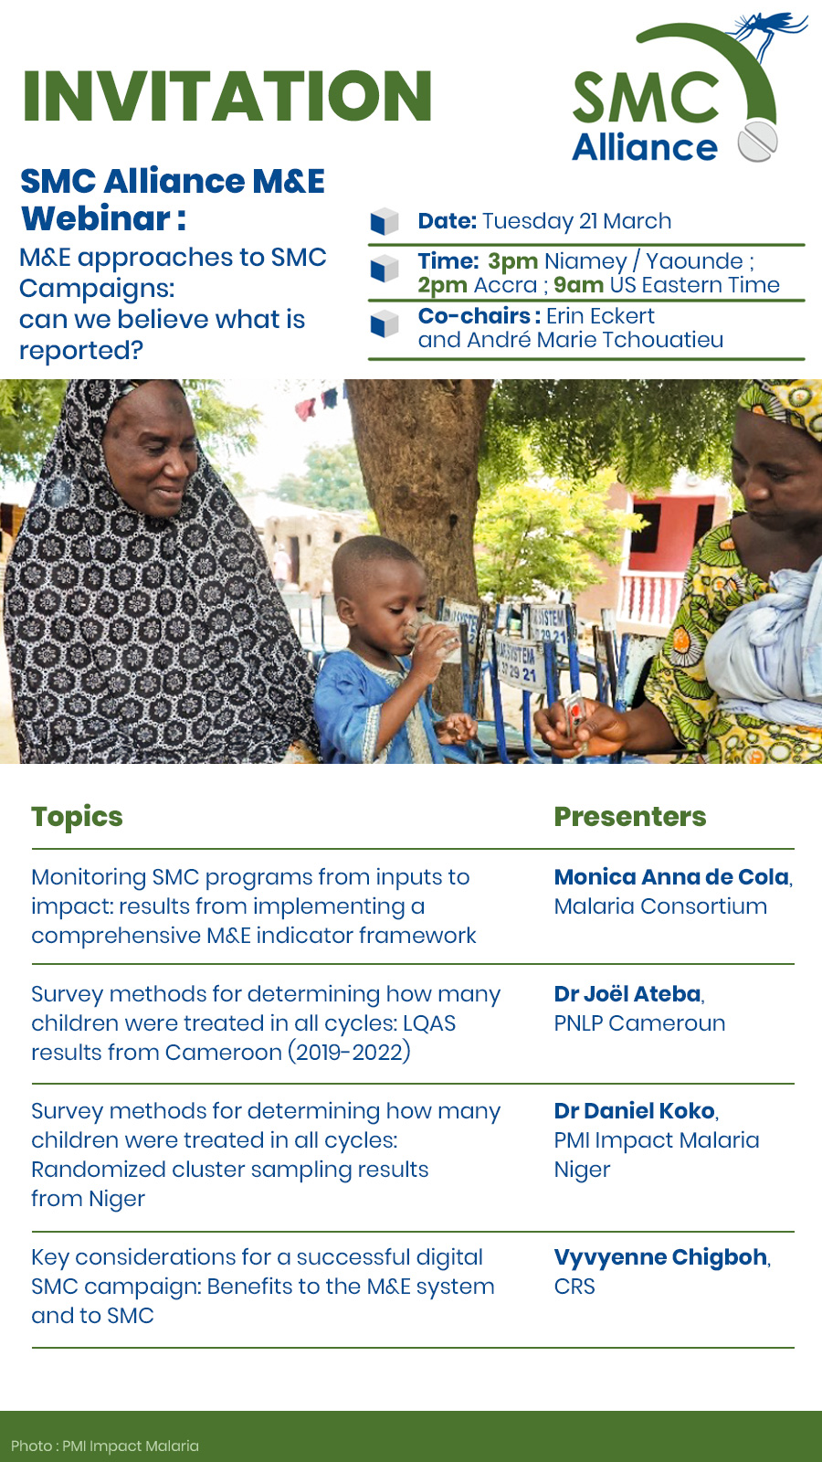
Achievements in 2023 : Webinar Series (March)
Recording

Slide 4
Achievements in 2023 : Webinar Series (July)
Recording

Slide 5
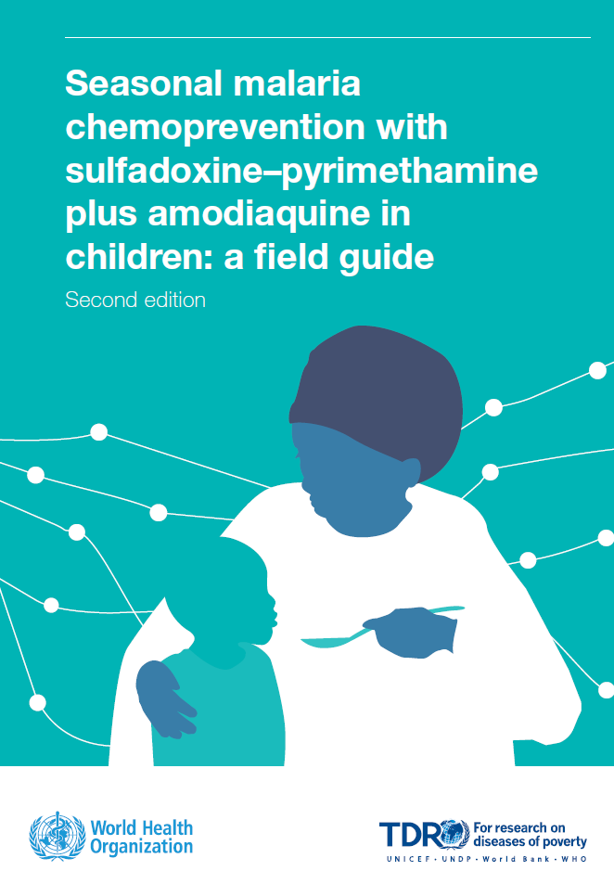
Achievements in 2023 - Continued
Contributed to Chapter 5 (M&E) of
WHO’s SMC Field Guide
Webinar Series (September): Recording link

Slide 6
Plans for 2024
Webinar Series – Continued:
Monitoring resistance markers (need to monitor, but no standard approach)
Using statistical models for impact evaluations
Cost effectiveness & Cost per DALYS averted
Country consultations on the SMC M&E Toolkit (i.e. better understanding how countries are using the SMC indicators in the toolkit and challenges)
Annex to the SMC Field Guide: Compendium of Sample SMC Data Collection and M&E Forms
Support the World Malaria Report 2024 SMC chapter

Slide 7
Plans for 2024 – Inputs from attendees
What are the SMC-related M&E challenges that you are facing?
What would you like the M&E sub-group to focus on to help you better monitor and evaluate your SMC campaigns?
Please provide your inputs!
For questions or feedback, please email: suzanne.vanhulle@crs.org

