Slide 1
Emergency And Hard-to-Reach Populations
Seasonal Malaria Chemoprevention (SMC)
2023 Campaign
South Sudan
Dr. Aleu Pioth Akot
Director General -SMOH Northern Bahr el Ghazal State
Prepared for the 2024 SMC Alliance Meeting – Abuja, Nigeria

Slide 2
Summary information for 2023 and plans for 2024 campaigns
 | 2023 (Achieved) | 2024 (Plan)
Start and end dates | 10th August to 3rd Nov-203 | 24 June to 14 Oct-2024
Number of cycles | 4 cycles | 5 cycles
Number of counties targeted | 2 | 2
Number of children covered | 67,563 | 67,000 (starts June 2024)
Age range covered | 3-59 months | 3-59 months
Coverage (% targeted children receiving all cycles) | 100% | 100%
Any drug resistance testing or efficacy studies performed? (Y/N) | Yes | No
Any gap | Unmet need for SMC from counties outside what was targeted

Slide 3
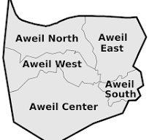
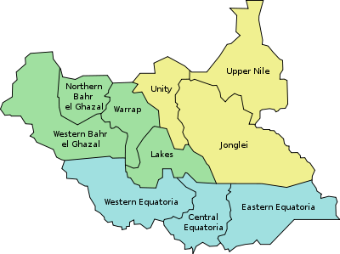
Country map showing SMC implementing Counties

Slide 4
Focus Initial Implemntation experience

Slide 5
Key Lesson learnt in 2023: Focus initial implemntation
What was a problem you were trying to solve?
Reduce malaria infection morbidity and mortality among children aged 3-59 months who are in high risk in rainy season through Improved access to SMC medicine
Mitigate economic shocks faced by households exacerbated by high out of pocket costs (for treating malaria).

Slide 6
Key lessons learnt in 2023: Focus initial implementation
What was the design of the implementation?
Door to door approach for directly observed SPAQ administration
Community-led approach for SPAQ distribution and administration
Behavioral change communication
Local ownership through local actors leading engagements and accountability efforts

Slide 7
Key lessons learnt in 2023: Focus initial implementation
What was impact of SMC?
SMC was significantly associated with 82% lower odds of caregiver-reported RDT-confirmed malaria (SMC effectiveness study South Sudan 2024)
40% reduction in malaria incidences in Aweil South County between 2022 and 2023(DHIS2)
100% administrative coverage for 2023 Round [67,563/63,133]
High demand of SMC from community
No adverse drug effects were registered

Slide 8
Key lessons learnt in 2023: Focus initial implementation
What challenges did you face?
Due to limited resources unmet need for SMC from communities not targeted was not met
Prolonged flood limited access to beneficiaries for SPAQ
Low capacity of volunteers affected quality of services provided [Some couldn’t appropriately read and write]
Low interest by caregivers affected coverage due to unmet high expectations [they wanted to directly benefit from the intervention]
Notes:
A few caregivers sometimes were not interested in SMC because there was no direct benefit for them

Slide 9
Key lessons learnt in 2023: Focus initial implementation
Lessons Learned
Local actors [Religious & cultural] were instrumental in attaining SMC acceptance and uptake – their opinions are WEIGHTY
After seeing the effectiveness of SMC, some caregivers would enroll children 60 months plus in anticipation they would be protected from malaria.
Some caregivers didn’t see the need of using mosquito after their children received SPAQ thus a call to orient them on comprehensive mitigation of malaria
Upon experiencing the effectiveness of SMC, government stakeholders advocated for the scaleup to non targeted locations

Slide 10
Key lessons learnt in 2023: Focus initial implementation
What would you do differently in the future?
Co-opt health facilities to share SMC information during health education sessions and during outreaches
Employ sustainable peer-led capacity building efforts led by BHWs
Considerations for a caregiver-led approach for SPAQ administration could be more sustainable.
South Sudan has highest child, infant and maternal mortality ; and lowest poverty index in the world
So
There is high need / demand of SMC and expansion in all high burden states

Slide 11
Thank you

