Slide 1
Regional partnerships for strengthening implementation research to improve access to SMC
Jean Louis Ndiaye
University Iba Der Thiam, Thies
11th EDCTP Conference; Paris, France
8th November 2023

Slide 2
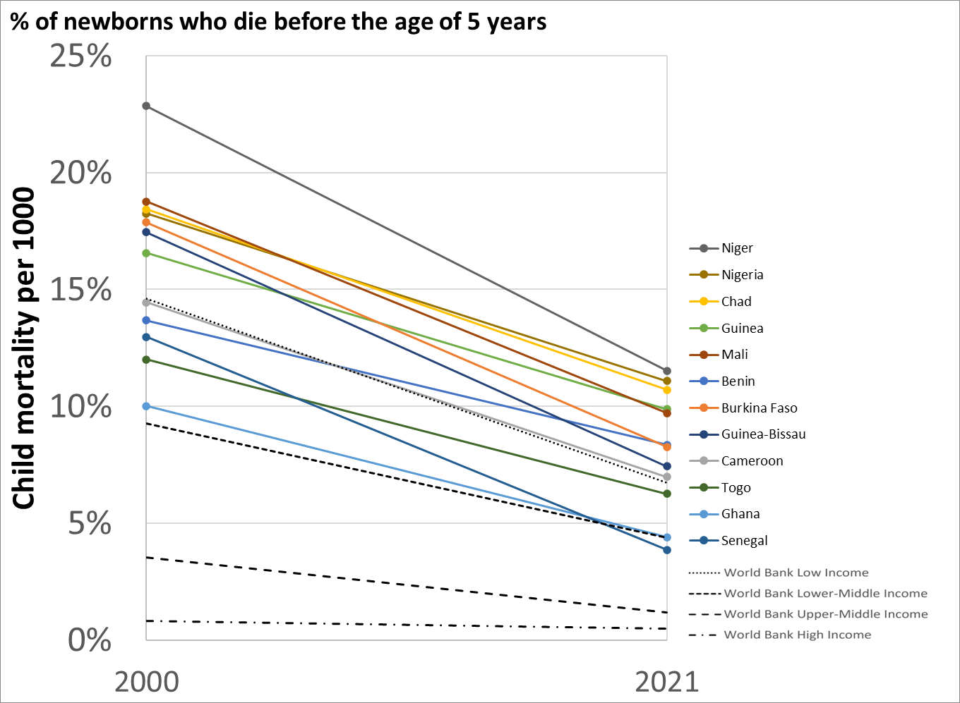
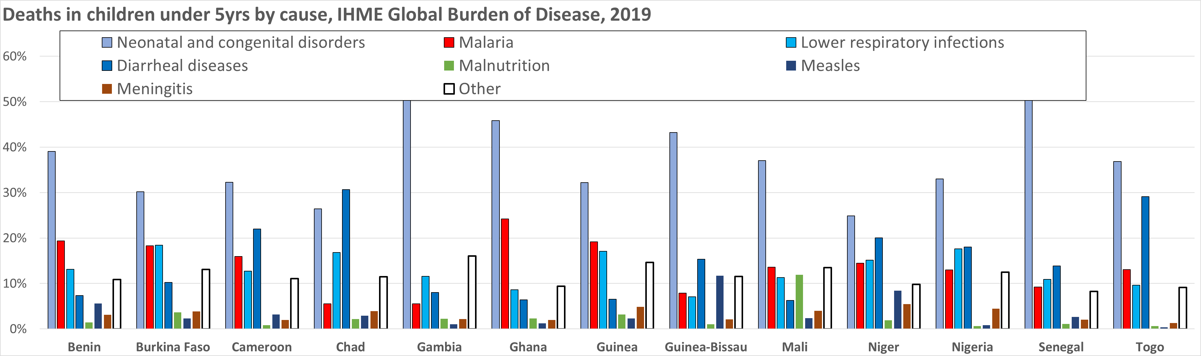
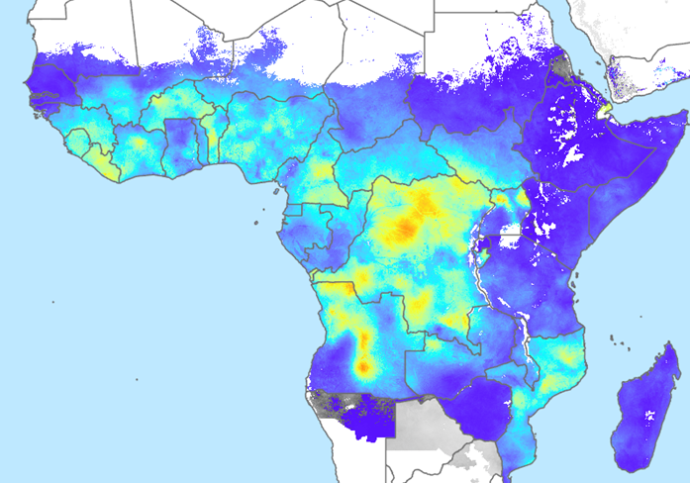
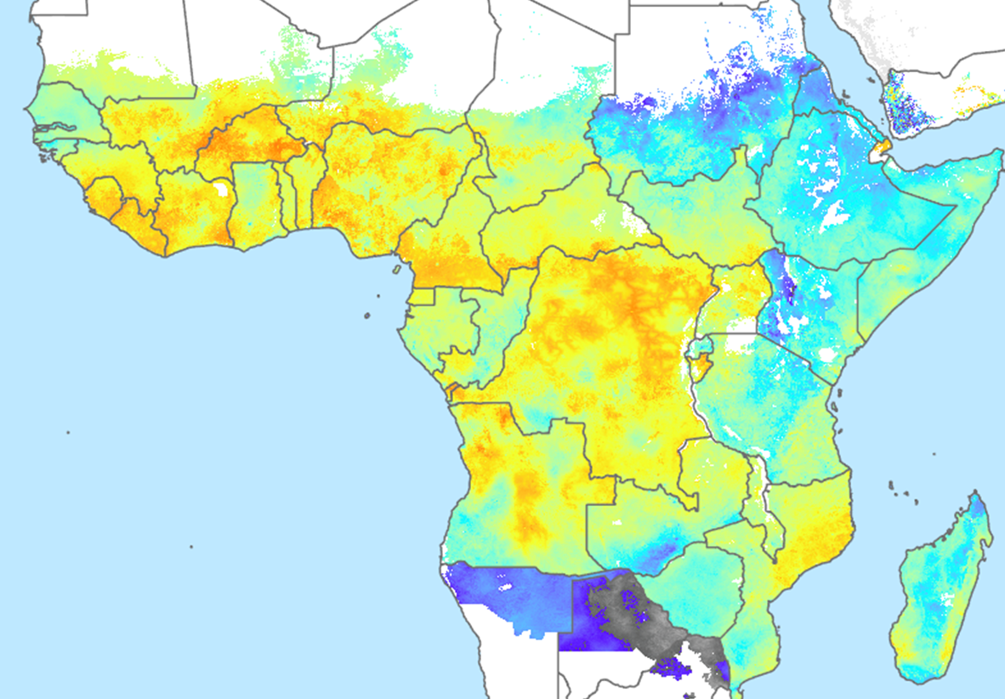
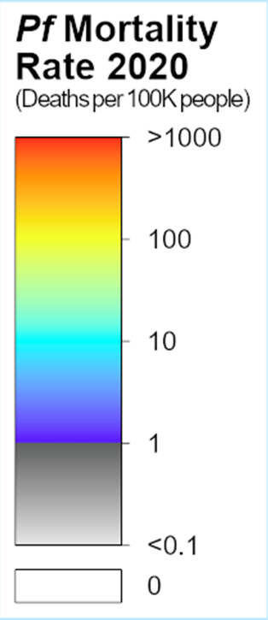
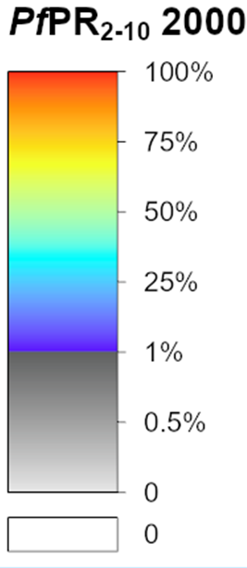
United Nations Inter-Agency Group for Child Mortality Estimation (2023) ourworldindata.org/child-mortality
World’s highest rates of under-5 mortality are in sub-Saharan Africa
Malaria remains a leading cause of death in young children
50% of global malaria deaths occur in 12 countries in W and C Africa with highly seasonal transmission
WHO (2018) consultation on universal access to core malaria interventions “implementation of seasonal malaria chemoprevention should be extended to all suitable areas, aiming at full coverage”
https://cdn.who.int/media/docs/default-source/malaria/mpac-documentation/mpac-april2018-universal-access-core-interventions-session8.pdf?sfvrsn=1c2c1e25_2&download=true
https://malariaatlas.org/
Notes:
In 2018 WHO analyses showed that key malaria indicators had not improved since 2015. The need to make full use of proven tools was emphasized. There was an emphasis on SMC and its focus on countries with a very high burden of malaria mortality. Although child survival has improved, child mortality (% dying before age of 5) remains above 10% in most of the SMC countries, and malaria remains a leading cause of death. The maps produced by the malaria atlas project highlight the areas of high prevalence and high malaria mortality. OPT-SMC was a response to the 2018 WHO call, and focusses on 13 countries in these high burden regions.

Slide 3
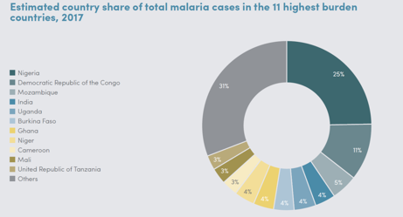
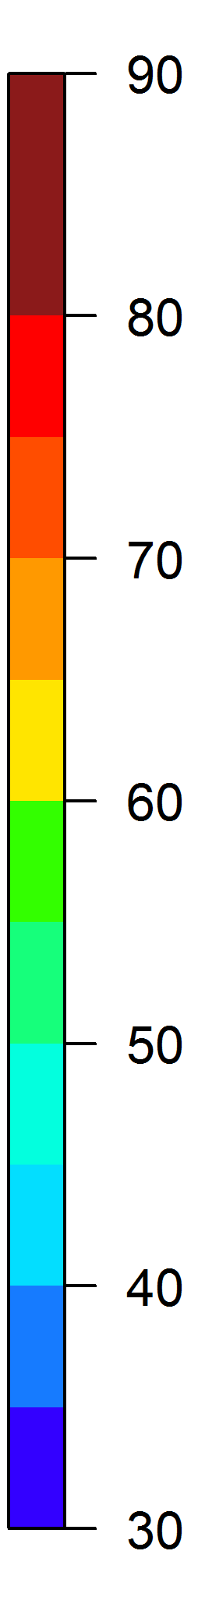
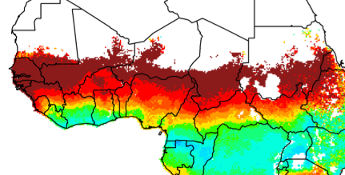
Seasonal Malaria Chemoprevention (SMC):
the monthly administration of
anti-malarial medicine usually for 3-4-5 months during the rainy season where malaria is highly seasonal
6 of the 11 high burden countries include SMC-eligible regions – Sahel region
Seasonality: % of total annual malaria burden in 5 consecutive months
SMC in 2019
A total of 85million treatments were administered in 2019 in 13 countries.
An estimated 22million children were reached
73% of target population (30.3m) > Gap of 8.3m
Most countries don’t have reliable coverage estimates
Not all children are getting the full SMC treatment
High coverage is possible but not achieved everywhere

Slide 4
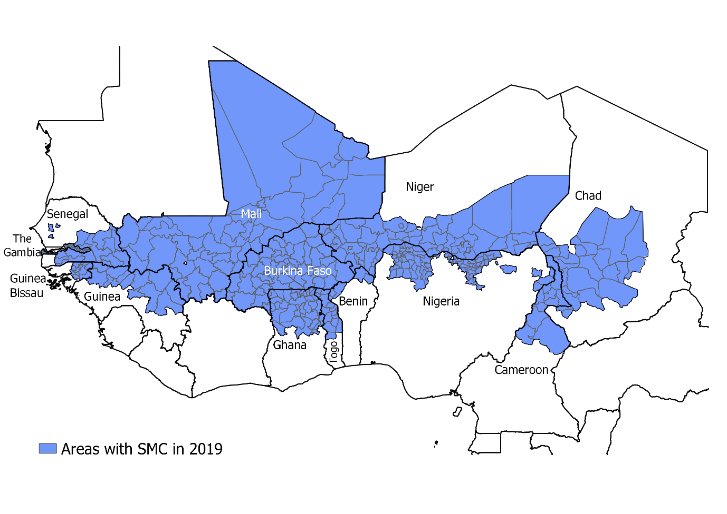
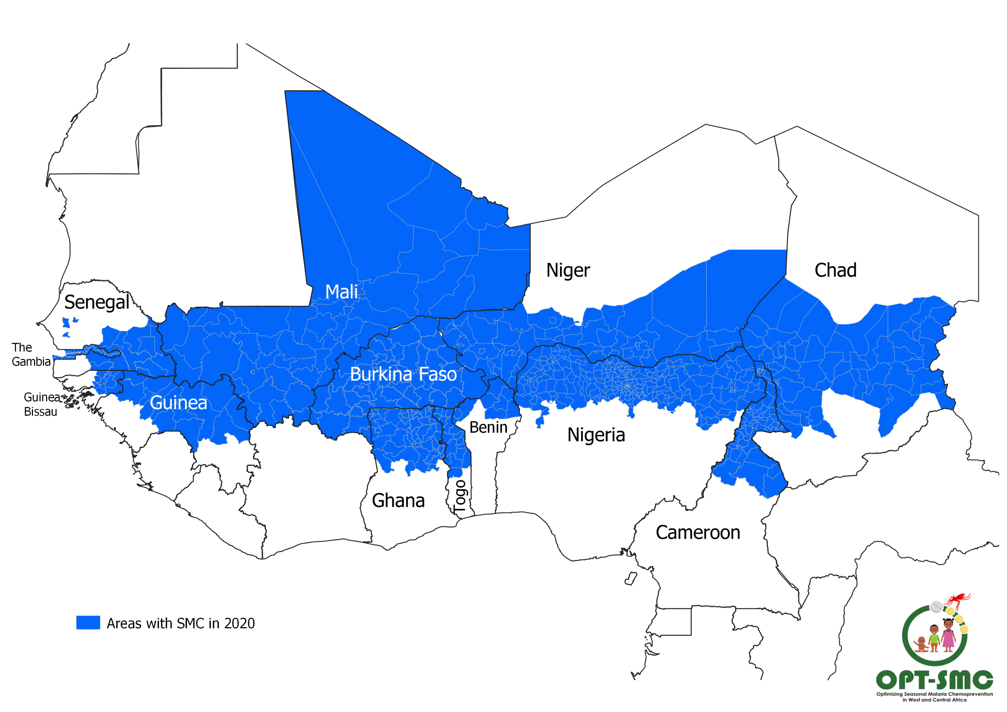
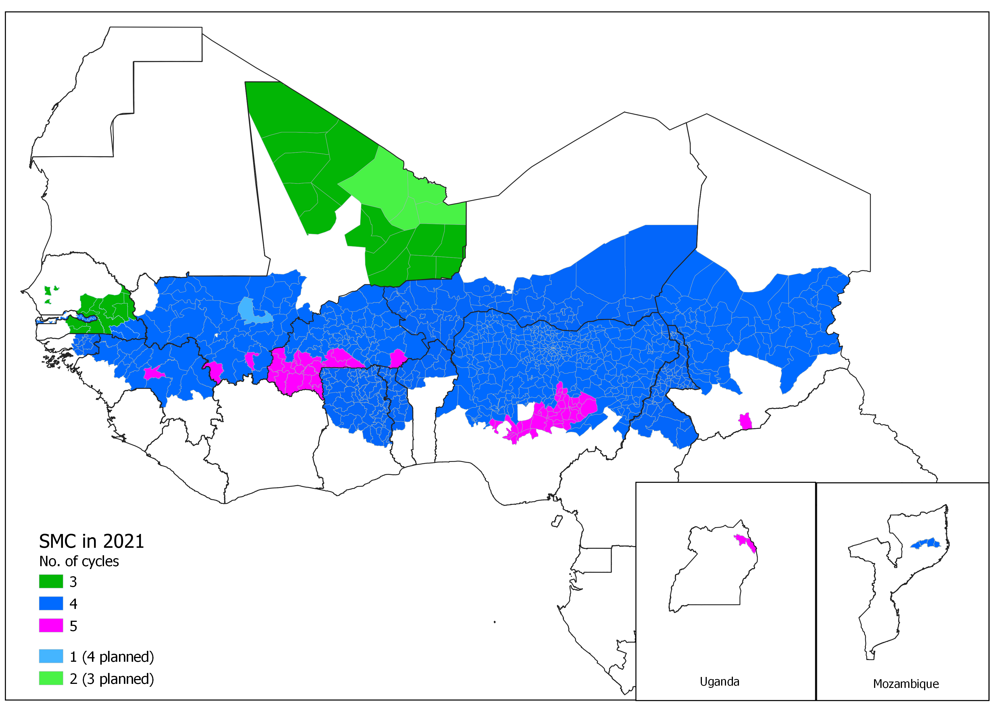
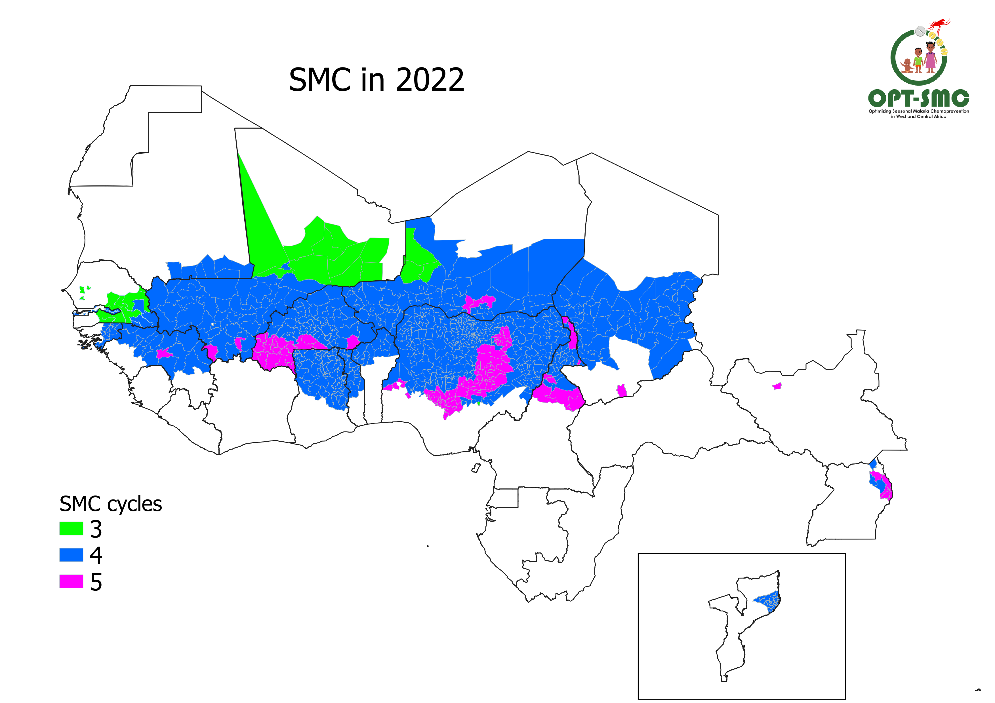
2019
2020
2021
Notes:
SMC has been a public health success story, with strong donor support, NMPs have scaled up SMC to virtually all priority regions, and more recently have extended to 5 cycles in the areas where there is a high burden just outside the 4-month window that was previously covered. It is also successfully rolled out outside the Sahel in East and south Africa (Tanzania, Uganda and Mozambique)

Slide 5
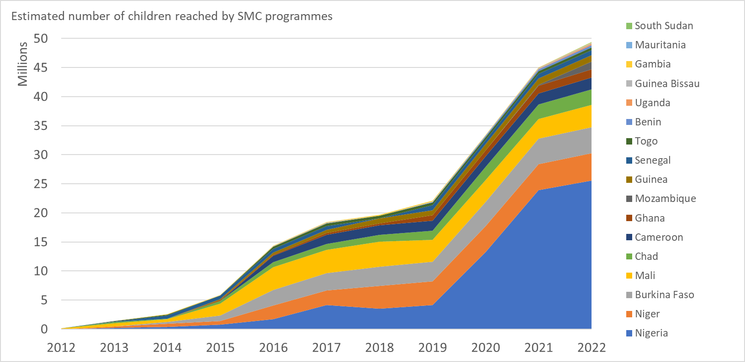
2012-2022
Notes:
Although SMC programmes now reach all the priority regions, coverage is variable. The last time there was systematic monitoring of coverage using standardized methods across multiple countries was in ACCESS-SMC project, these data showed that very high coverage is achievable with door to door campaigns, but was not being achieved everywhere. The project aimed to support NMPS to identify barriers, develop approaches to overcome them, and monitor their application.

Slide 6
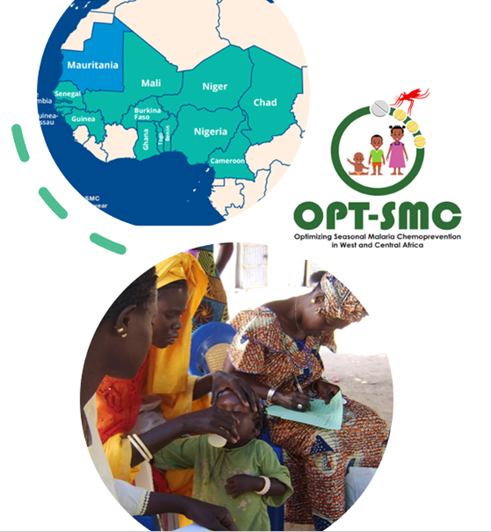
Objectives of OPT-SMC
Strengthening the capacities of the NMPs implementing SMC:
  To define research priorities for optimizing SMC effectiveness
  To conduct IR/OR projects for improving SMC effectiveness:
  interpret and make use of malaria surveillance data
  target effectively (high risk populations and periods of the year)
  monitor delivery, uptake and effectiveness
Promote inter-country collaboration, sharing of information and expertise

Slide 7
Project Timelines
Operational/Implementation research, mentoring and technical assistance
Project starts
Project ends
WS1: Development research plans
May 2020
WS2: Training on qualitative research
WS3: Introduction of the RTS,S/S (virtual)
WS4: Research training Module 1 (virtual)
WS5:implementation strategies for the RTS,S introduction
WS6 : Data analysis, data interpretation
WS7: Dissemination *
Baseline needs assessment
Coverage survey**
Coverage survey**
Coverage survey**
Coverage survey**
Coverage survey**
SMC campaigns:
Jul-Nov
SMC campaigns:
Jul-Nov
SMC campaigns:
Jul-Nov
SMC campaigns:
Jul-Nov
SMC campaigns:
Jul-Nov
SMC campaigns:
Jul-Nov
M J J A S O N D J F M A M J J A S O N D J F M A M J J A S O N D J F M A M J J A S O N D J F M A M J J A S O N D J F M A
2020
2021
2022
2023
2024
2025
No cost extension
*Workshop dates subject to change
** no specific funding for supporting coverage surveys but through OPT-SMC technical support could be provided for good quality surveys and additional sub-studies for understanding the variation of the coverage.
Notes:
Four year project : 1st May 2020 – Apr 2024
Develop Letter of intent – workshop 1 (May 2020)
2020 SMC campaigns (Jul- Dec 2020): data collection, baseline assessments
Workshop 2: training in OR
2021 SMC campaigns (Jul- Dec 2021): data collection
2022 SMC campaigns (Jul- Dec 2022): data collection
Workshop 3: impact assessment
2023 SMC campaigns (Jul- Dec 2023): data collection
Workshop 4: dissemination

Slide 8
NMCP projects:
Monitor and Evaluate
Ghana: SMC coverage and factors associated with uptake and adherence
Barriers to uptake: Qualitative studies
Guinea: Barriers to SMC uptake in mining areas in Guinea and an improved delivery approach.
Developing New Strategies
Mali :Evaluation of SMC using 3 approaches: 3 days DOT , Community SMC and Standard SMC
Adapting target groups
Togo: Defining optimal SMC strategies in Togo: timing and number of cycles, and age ranges at risk of severe malaria
Benin: Monitoring the effectiveness of SMC in northern Benin using the case-control method.
Senegal: Estimating the delivery costs and cost effectiveness of SMC in southern Senegal
Nigeria: Barriers and facilitators of SMC uptake in Nigeria: a qualitative study in 5 States.
Burkina Faso: Evaluating the determinants of variations in SMC coverage in Burkina Faso between urban and rural areas
Cameroon: Effectiveness of using household leaders to improve adherence during SMC
Chad: Development stage
Niger: Applying the updated WHO SMC guidelines in Niger: timing and number of cycles, and age ranges at risk of severe malaria
The Gambia: Assessment of adherence to SMC in The Gambia
ongoing
ongoing
Guinea Bissau: Strengthening health management information systems to assess the impact of SMC in three regions in Guinea Bissau
Senegal : Mechanistic Model for cost effective evaluation of SMC delivery

Slide 9
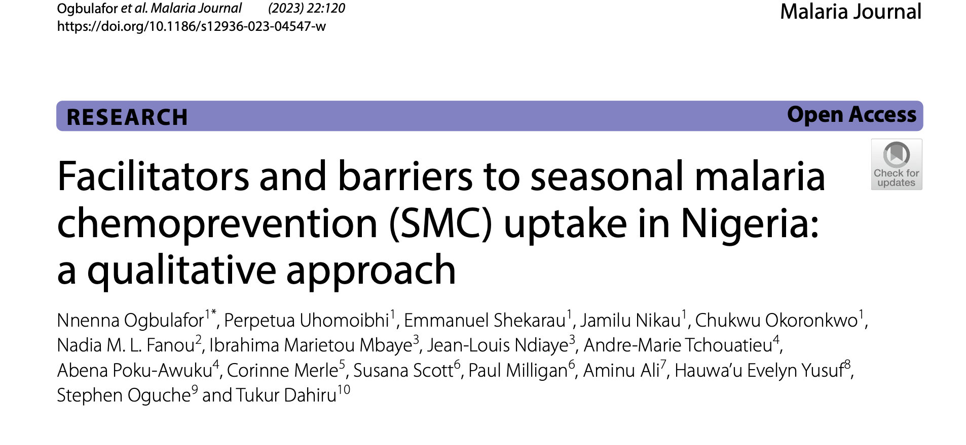
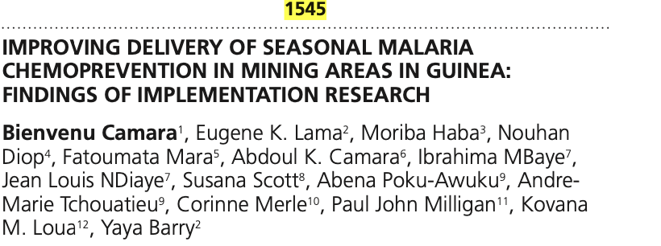
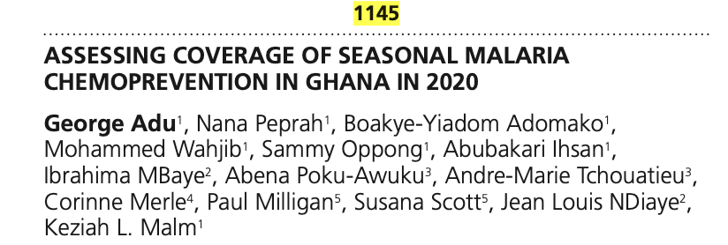
Project updates
13 countries:
  3 - complete (Nigeria, Ghana and Guinea)
  5 - data collection complete, analysis stage
  2 - data collection ongoing
  2 – ethics approval, will start this year
  1 – still to confirm a project
Conferences:
  ASTMH 2021 ( Ghana, COVID work and video job-aids) and ASTMH 2022 (Guinea and Nigeria)
  EDCTP forum – Nov 23, Paris (Guinea, Nigeria, Mali and Burkina Faso)

Slide 10
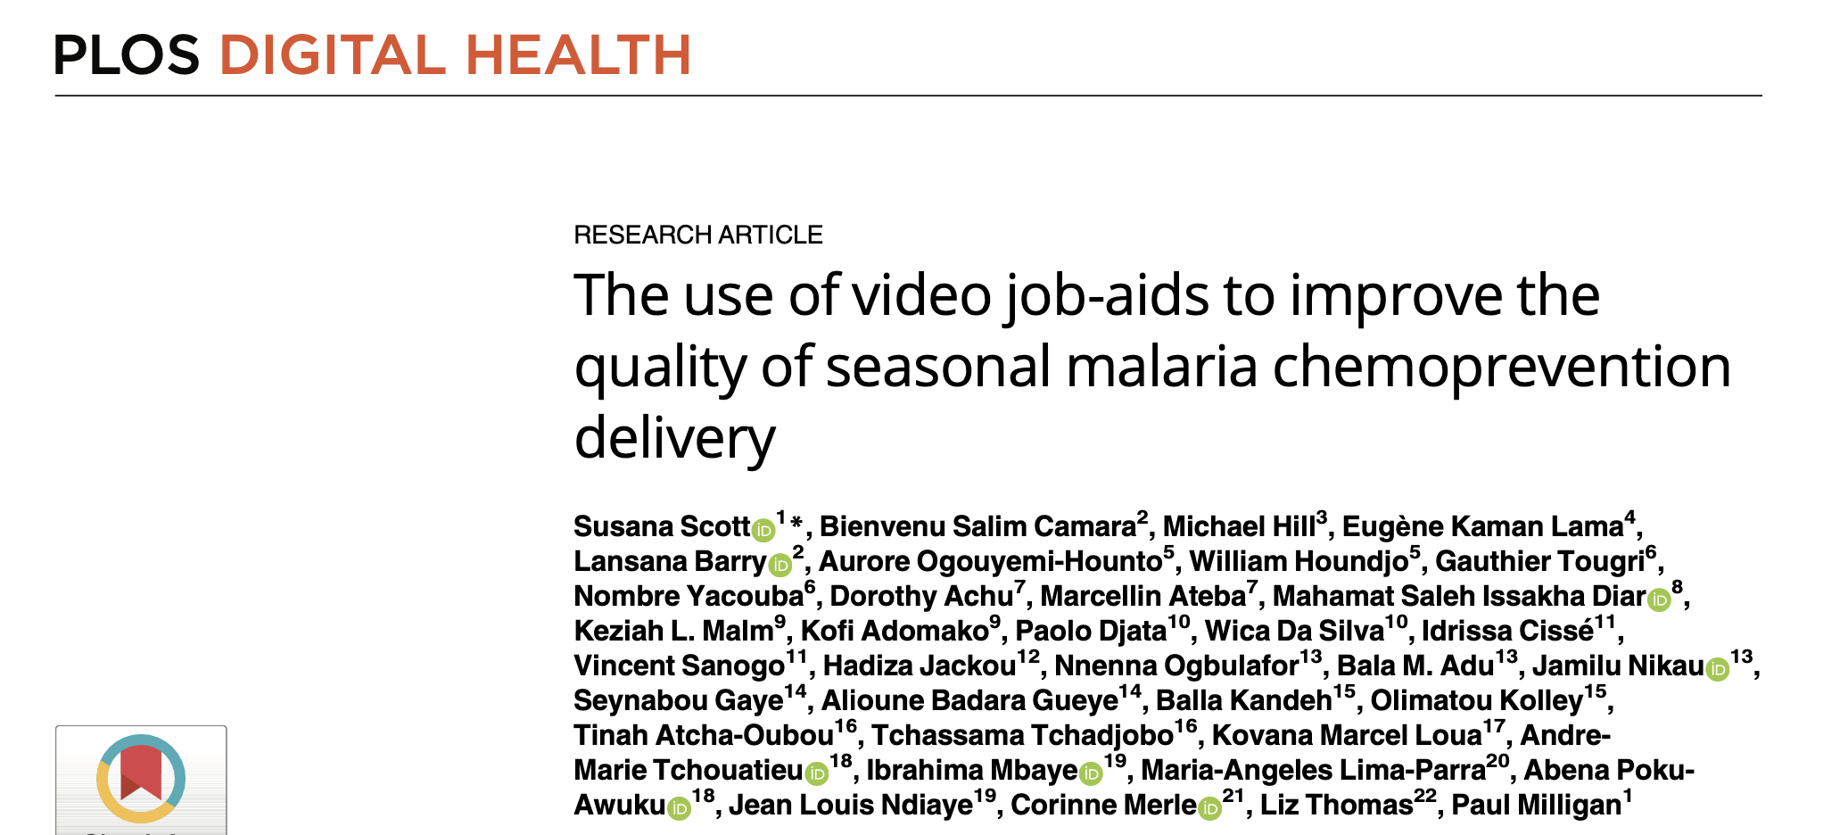

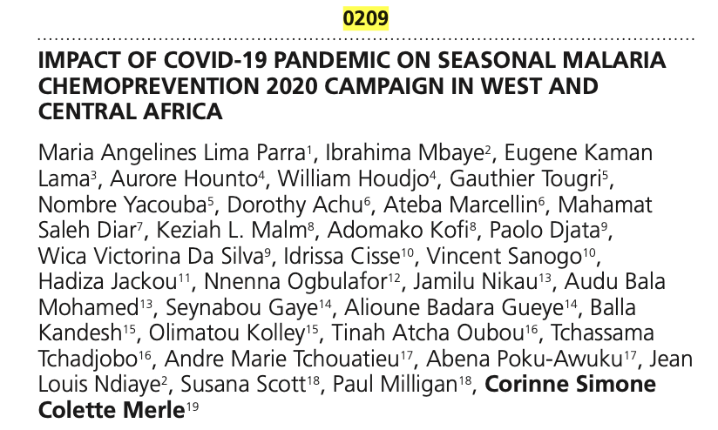
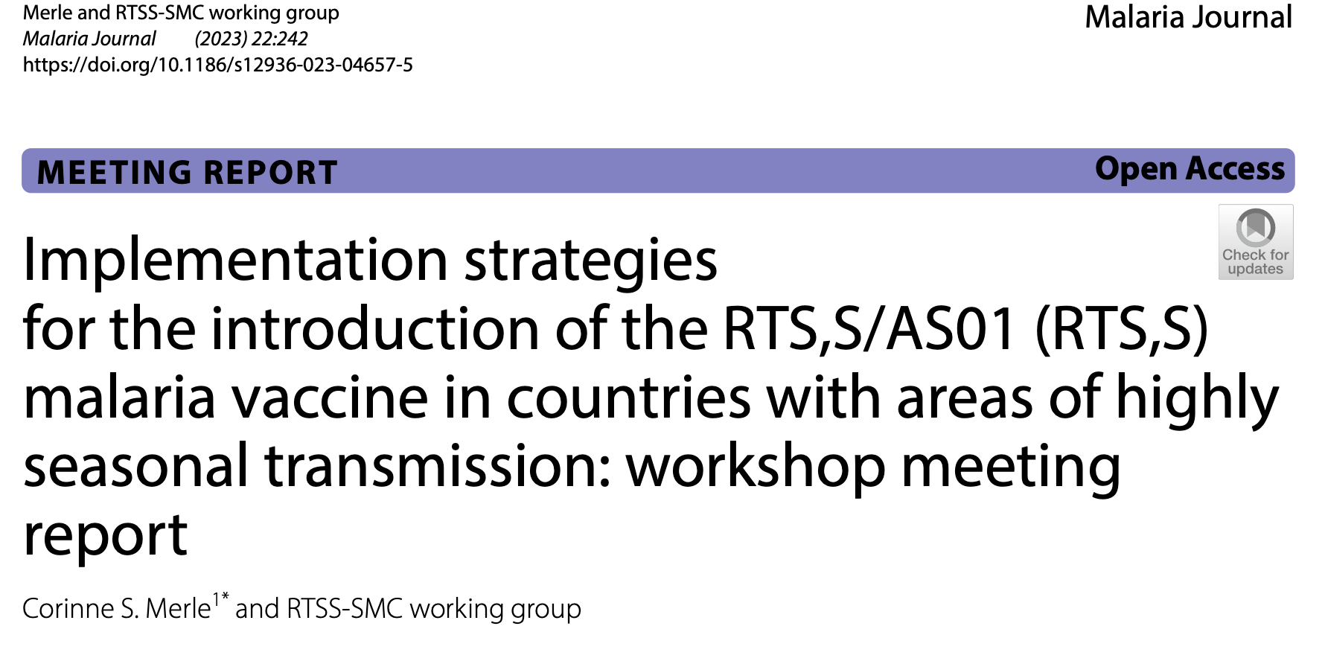
Add on studies to support the project & further collaborations
Standardised protocols for implementation research (WHO funded)
WHO/GMP: collaboration to add SMC module onto the DHIS2 and train countries on how to use it to better interpret their data
Contribution to the revision of the WHO SMC Implementation field guide (2nd edition)

Slide 11
OPT SMC communication and visibility
Two newsletters every year
OPT-SMC Web page on the SMC Alliance Web site
OPT-SMC project updates at the SMC Alliance annual meetings
World Malaria Day social media activities
OPT-SMC as part of 10 years anniversary of SMC
  OPT-SMC on the International Day of the African Child: https://healthpolicy-watch.news/97669-2/
OPT-SMC several webinars
  Organizing a webinar on SMC: https://echosante.info/zero-malaria-icf-supports-evidence-for-streamlining-smc-implementation/
  Webinars on SMC and vaccines
Meetings with NMPs representatives at ASTMH (2022 – 2023)
Development of OPT-SMC publication / dissemination plan (2024)

Slide 12




NMCPs from Benin, Burkina Faso, Cameroon, Chad, The Gambia, Ghana, Guinea, Guinea Bissau, Mali, Niger, Nigeria, Togo and Senegal
University of Thiès : Ibrahima Mbaye, Fatimata Bintou Sall, Amadou Seck, Ndeye Fatou Diop
LSHTM: Paul Milligan, Susana Scott, Lamin Leigh
WHO/TDR : Corinne Merle
MMV : André Tchouatieu, Abena Poku-Awuku
THANK YOU !!!!

Slide 13

NMCPs from Benin, Burkina Faso, Cameroon, Chad, The Gambia, Ghana, Guinea, Guinea Bissau, Mali, Niger, Nigeria, Togo and Senegal
University of Thies : Ibrahima Mbaye, Fatimatou Bintou Sall, Amadou Seck, Ndeye Fatou Diop
LSHTM: Paul Milligan, Susana Scott, Lucy Bell
WHO/TDR : Corinne Merle
MMV : Andre Tchouatieu, Abena Poku-Awuku
THANK YOU !!!!
NMCP

Slide 14

NMPs: Benin, Burkina Faso, Cameroon, Chad, Ghana, Gambia, Guinea, Guinea Bissau, Mali, Niger, Nigeria, Senegal, Togo and Mauritania
THANK YOU !!!!
Notes:
With funding from the European and Developing Countries Clinical Trials Partnership (EDCTP), the OPT-SMC project will support 14 countries in West Africa and Central Africa to conduct implementation research on SMC, working in partnership with the University of ThièsMa in Senegal, TDR, Medicines for Malaria Venture (MMV), and the London School of Hygiene and Tropical Medicine (LSHTM).

Slide 15

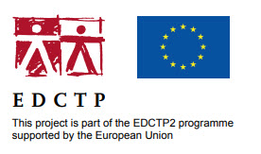


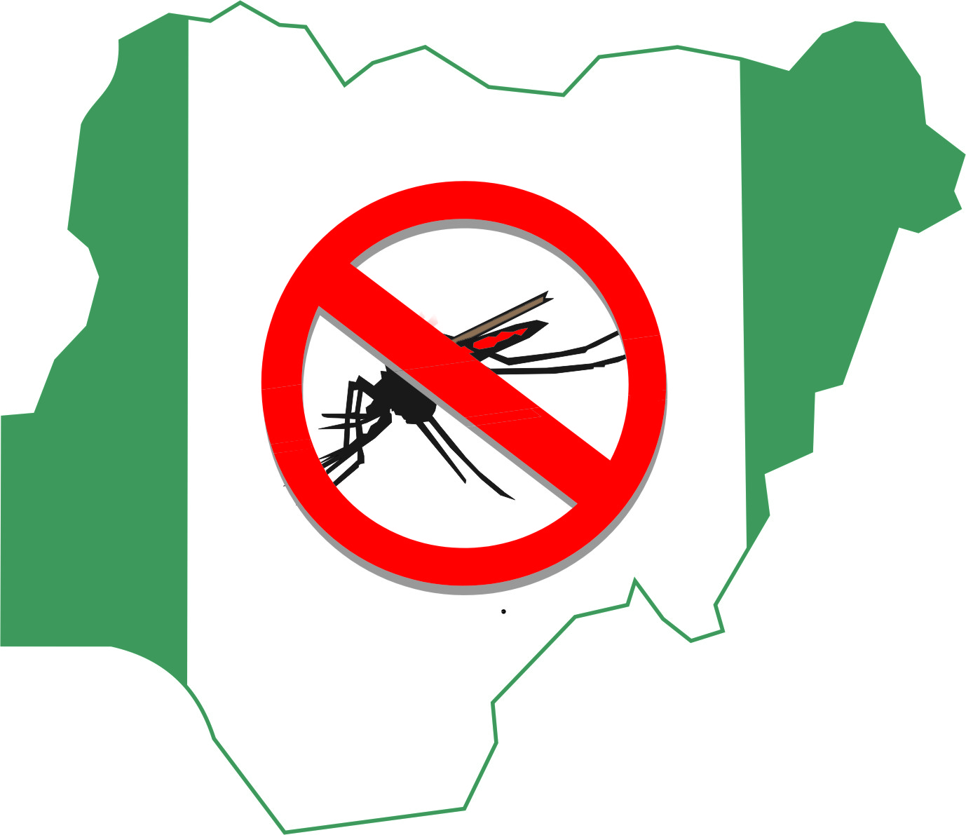



SCALING UP SMC IN NIGERIA: COMMUNITY PERCEPTION AND PUBLIC ENGAGEMENT: A QUALITATIVE STUDY IN 5 STATES
DR. NNENNA OGBULAFOR
NATIONAL MALARIA ELIMINATION PROGRAMME
ABUJA, NIGERIA
EDCTP FORUM
7-10 NOV 2023 PARIS, FRANCE

Slide 16
Introduction of Seasonal Malaria Chemo-prevention
SMC was adopted in 2014 in Nigeria following WHO recommendation in 2012 and in-country pilot in 2013
SMC was scaled up in 2022 to all the eligible states (21) in the country
A total of 27,638,429 children were reached with SMC in 2022

Slide 17
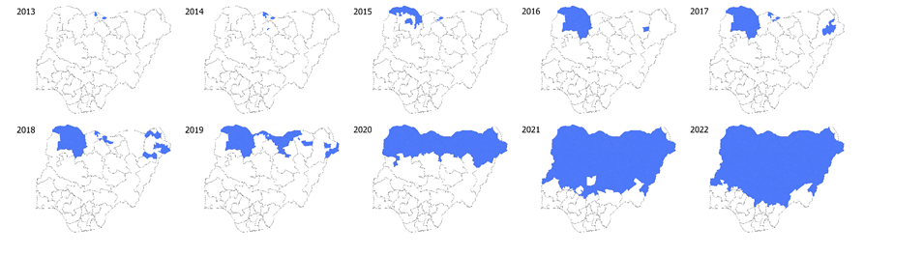
Milestones in SMC Implementation
Maps of Nigeria Showing Coverage 2013-2022
All the states in the Northwest, North East and Northcentral

Slide 18
Facilitators and Barriers to Uptake of Seasonal Malaria Chemoprevention in Nigeria: A Qualitative Approach
Aim: To determine facilitators and barriers to uptake of SMC among children aged 3-59 months in Five States in Nigeria
Specifically:
  knowledge of malaria whether it affects uptake of SMC, and to examine
  perceived effect of SMC on their children's health,
  experiences and attitudes of caregivers concerning the concept of SMC,
  experiences and attitudes of caregivers concerning the regimen of the chemoprevention
  preferred mode of delivery/place of administration of SMC by caregivers
  health workers’ attitudes and experiences regarding delivery of SMC
  to determine if (ii)-(vi) above affects uptake of SMC

Slide 19
Methodology
Purposively selected 5 States:
  Kano, Kebbi, Kwara, Nasarawa & Yobe
  Two LGAs in each State
  Two Wards/Communities in each LGA
  Based on geopolitical zone/partner mapping/No. of years of implementation/performance in SMC 2021 round/rural and urban setting
Study Population:
  Caregivers-mothers and fathers (slit into those who could write and read and those who could not)
  Community-Directed Distributors (CDDs)
  Community Leaders
  LGA Malaria Focal Person
  Director of Public Health/Disease Control and Malaria Programme Manager
National Programme Officers/Partners:
  National Coordinator NMEP, Malaria Consortium, WHO, PMI, GF

Slide 20
Methodology
State | FGDs | In-depth interviews | Total
Kano | 16 | 24 | 40
Kebbi | 16 | 20 | 36
Kwara | 16 | 20 | 36
Nasarawa | 16 | 21 | 37
Yobe | 16 | 20 | 36
Key Informant Interviews (National level/Partners) |  |  | 5
Total (FGDs & IDIs) | 80 | 105 | 185
Total (FGDs, IDIs & KII) |  | 105 | 190
Data Collection:
  Key Informant Interviews
  In-Depth Interviews
  Focus Group Discussions
  FGDs conducted in local languages (Hausa/Yoruba) translated into English and transcribed verbatim
  Interviews conducted in local language or English
Data Analysis:
  Content Analysis and Thematic Analysis
  Narration of the results produced
  Ten Thematic Areas identified

Slide 21
RESULTS
Ten Thematic Areas Identified from Analysis
Major health problems in the communities;
Knowledge of Seasonal Malaria Chemoprevention (SMC) among caregivers;
Extent of SMC’s coverage;
Knowledge of malaria among caregivers and its effect on SMC uptake;
Perceived effects of SMC on children’s health among caregivers;
Caregivers’ experience of and attitude towards SMC;
Barriers to SMC uptake;
Caregivers preferred mode of delivery/place of administration;
Health workers/CDDs experience and attitude regarding delivery of SMC;
Recommendations on how to upscale SMC Uptake

Slide 22
Summary of Facilitators and Barriers using the Health Belief Model
FACILITATORS | BARRIERS
Favourable attitude towards SMC by Care- givers | Real time experience of side effect in children
Improved sweet flavor of the drug formulation | Perceived side effects of SMC drugs
Friendly CDDs | Lack of awareness, Resistance/Skepticism
Trust on CCDs | Unfriendly attitude of CCDs
Mode of delivery via Door-to-door approach | Alleged/Perceived inefficacy of the medicines
Social desirability – Malaria a major health problem in children | Incomplete coverage/shortage of medicines
Support and empower Lead Mothers (LM) | Mistrust/induced rejection
 | Poor remuneration of CCDs

Slide 23
Quotes to Support the Themes
(Community Perception)
Model of Delivery via Door-to-Door
“…they (the CDDs) work well to ensure children get the drugs. They come to us to administer the drug to the kids. So, their drugs reach every household.”
A male caregiver, Kwara State
“……does not affect home chores and the CDDs do either revisit the next day or leave a message with your neighbors if they do not meet you at home. More so, they come early hours in the morning before people go out.”
“if the drug is to be distributed at a fixed point, there would be overcrowding and stampede during collection and this will deter some mothers from going to the facilities for collection of drug for their children.”
“Door-to-door is better as it eliminates overcrowding and noise pollution in our facilities”
FGD with female caregivers, Nasarawa State
A female caregiver, Yobe State

Slide 24
Quotes to Support the Themes
Attitudes and Behaviours of CDDs – (2 Sides of the Coin)
“ some mothers who do not take the drug for their children feel that the Community Drug Distributors were hostile to day” (Negative)
“……offers greater opportunities for engagement between caregivers and CDDs. The CDDs come to enlighten us on the drugs: how best to use it, the time to administer it and how to notice any development that may arise.” (Positive)
” they (the CDDs) work well to ensure children get the drugs. They come to us to administer the drug to the kids. So, their drugs reach every household “ (Positive)
“Where we have trust issues is when CDD are not residents/indigenes of the area in question and this trust gap is usually filled by their supervisors who are working in the health facilities of the areas”
FGD with female caregiver in Kebbi state
FGD with caregivers, Yobe State
FGD male caregiver, Kwara State
Key informantGlobal Fund, Abuja

Slide 25
Barriers to Uptake
“those who reject the drugs do so because they think it is harmful to their children.”
A caregiver in rural Kano, FGD
“some people have a belief that their children could be harmed when they take the drugs. That is why they do not accept it. For instance, some people believe that the drugs can cause infertility in the future”
Another caregiver in rural Kano, FGD
“There are few challenges. It is not all the households in his domain that understand the essence of the campaign. While some household are receptive, others do resist, although we usually overcome this by summoning such people to the palace to further enlighten them on the importance and need for their children to partake in the programme. This works because even before we conclude, they call and give permission to allow the SPAQ to be administered on their children.”
A traditional Leader, Nasarawa
Resistance driven by mistrust, hesitancy, skepticism and conspiracy theory has always undermined access to, and utilization of, healthcare in Nigeria

Slide 26
Incomplete Coverage/Shortage of Drugs/Hard-to-Reach
Reported in Yobe, Nasarawa, Kano, Kwara States
“..there are communities that SPAQ did not reach them. During the last SMC campaign, the SPAQ allocated to the teams was insufficient to cover the entire LGA”
LGA Focal Person, Yobe State
“..that there are some areas, such as Oke-Ero, that are hard to reach. Some of these areas are waterlogged, which make access difficult”
Malaria Programme Manager, Kwara State
“the drugs are inadequate in this community because it does not go round to all, especially here in Daderi, Kokona LGA”
Male caregiver, Nasarawa State

Slide 27
Quotes from Stakeholdersand Funders
“We have made it one of the key factors to the hired personnel how much they are going to be paid before the work begin and we try to pay that exact amount,, we promised them. People may not be completely satisfied with the remuneration but a good number of them are happy with it”.
(WHO Stakeholder, Abuja).
“….the feedbacks we get from the field personnel, supervisors, and the rest show the need for increase in remuneration. This need is very pronounced where particularly the CDDs are not from the area where they are working. They spend a lot of money on transportation and this makes us to fear that it might affect the policy of delivery.”
(Malaria Consortium Stakeholder, Abuja)
“…. We face the challenges of late payment. When we are about to start the second cycle, the CCDs refuse to participate/implement it. I have to start persuading them by sending them messages, assuring them that the money will soon be paid”.
(Programme Manager, Kwara State)
“To ease financial burden, government should make deliberate effort at harnessing domestic fund for SMC. Furthermore, since the driving cost for SMC is on payment of personnels, volunteerism at the community level should be promoted to reduce cost”.
(US President Malaria Initiative Stakeholder, Abuja)

Slide 28
Key Findings and Recommendation
Key Findings:
In all study areas, malaria was seen as a major health concern
SMC was widely accepted as a key preventive measure of malaria infection
Caregivers preferred SMC delivered door-to-door than at fixed points
Generally, Community Drug Distributors were trusted
Isolated cases of rejection/hesitancy
Isolated cases of missed households/children
Isolated concerns on perceived side effects and safety of medicine
Shortage of medicines during drug distribution
Recommendation:
Address the concerns of the caregivers and programme managers with respect to the identified facilitators and barriers

Slide 29
Country Level Actions
Study result was disseminated widely in-country to all the stakeholders, including at international fora
Key findings and study results were shared with delivery teams during the 2022 national and state level trainings and cascaded down to the Community Drug Distributors (CDDs) during the LGA and community level trainings
Secured funds from partners:
  for the revision of training modules to strengthen communication about SMC safety and effectiveness
  increase involvement of state-level PV coordinators through a workshop on pharmacovigilance that produce a Risk Mitigation Document among others
  scale-up of the use of digital technology for implementation to improve efficiency and accountability

Slide 30
Country Level Actions
Findings from the routine SMC Programmatic Assessment (LQAS) in 2022 and 2023, showed very marked increase in acceptance of SMC among other findings
Measures to avoid local shortages of SMC drugs (maintaining microplanning allocations)
emphasis on recruiting distributors from the local community
Intensified advocacy for SMC funding across all levels of government
The study has since been published in Malaria Journal (Ogbulafor et al. Malaria Journal (2023) 22:120 https://doi.org/10.1186/s12936-023-04547-w)
Second manuscript in preparation for another publication

Slide 31



Slide 32


Evaluating the determinants of variations in SMC coverage in Urban areas in Burkina Faso
Aissata BARRY
NATIONAL MALARIA PROGRAMME
BURKINA FASO
EDCTP FORUM
7-10 NOV 2023 PARIS, FRANCE

Slide 33
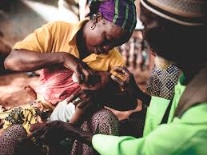
Research Team
Principal Investigator
Dr Tougri Gauthier, MD
General coordinator
Dr Sié Ali, MD, PhD
Co-investigators
Dr Ourohiré Millogo, MD, PhD, epidemiologist,
Dr Kagoné Moubassira, MSc, PhD, socio-anthropologist,
Mr Dao Boulaye, health assistant in epidemiology
Mr Ouédraogo Moussa MSc, Sociologist
Mme Sawadogo N. Hélène, MSc, Sociologist

Slide 34
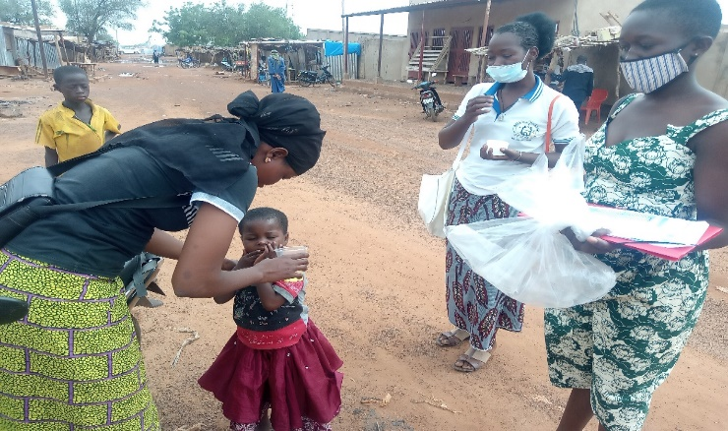
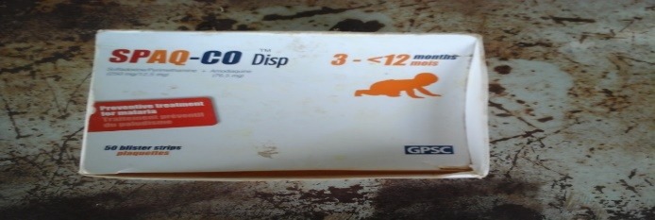
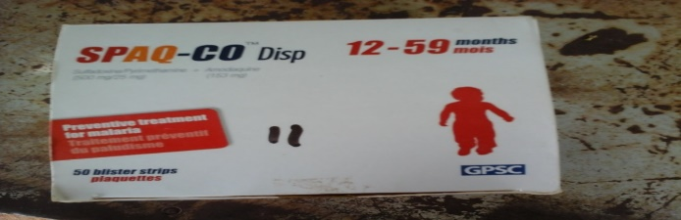
Study rationale
SMC is one of the most cost-effective interventions in the era of malaria eradication
SMC adopted in 2014 in Burkina Faso and expanded to all district in 2016
Given over 4-5 rounds from July to November to all children aged 3 to 59 months
SMC coverage across the SMC region in Burkina Faso is high (>80%)
However, there are disparities between urban and rural health districts, with lower coverage in urban areas compared to rural areas

Slide 35
Study Objectives
Primary objective
Determine the reasons for the disparity in the coverage of SMC campaigns between urban and rural areas
Secondary objectives
Compare barriers and facilitators in the adoption of SMC in urban versus rural areas
Identify best practices for improving the coverage and quality of SMC
Propose realistic and relevant actions to improve SMC coverage in Burkina Faso

Slide 36
Study Site
  4 urban districts (low SMC performance)
  Baskuy
  Nongr-Maassom
  Dafra
  Do
  5 rural districts with better performance
  Ouahigouya
  Dédougou
  Karagasso Vigué
  Zorgho
  Pouytenga
2 Local health facilities (LHF) Selected per district = 18 urban and rural LHF in total

Slide 37
Study Population
  Mothers or legal guardians of children aged 3-59 months;
  Fathers;
  Community distributors;
  Health facilities Head and EPI managers;
  Head and EPI managers at district level;
  Regional health directors and input managers;
  Decision-makers at central level (SP/Palu; PADS);
  Other Stakeholders (PMI; UNICEF; Malaria Consortium);

Slide 38
Methodology
  Qualitative approach using semi-structured interview guides adapted to the different targets;
  Focus Group Discussions (FGDs)
  In-depth interviews (IDIs)
    86 IDIs and 44 FGDs were conducted
    October 10 to November 10, 2022

Slide 39
Conceptual framework
This framework was used to guide the themes during the qualitative study
Programmatic factors (central and regional authorities, districts, health centres
Planning,
Procurement,
Training,
Supervision,
Communication,
Distribution scheme
Impact SMC: reduction of malaria incidence
Increase in SMC Coverage
Community factors
Geographical coverage
Social mobilisation
Eligible population
Acceptability
Accession
Medication factors
Safety
Resistance
Side effects

Slide 40
Number of interviews
IDIs | Number
TFPs (Unicef ; JHPIEGO ; USAID) | 3
Central level (SP/Palu ; PADS) | 3
Rgional level (DRS, input managers) | 10
District level (MCD, EPI managers) | 16
Peripheral level (ICP, EPI managers) | 30
Community distributors | 6
Mother or Guardian | 8
Father of children | 6
Total | 86
FGDs | Number
Mother or Guardian | 15
Father of children | 13
Community distributors | 16
Total | 44

Slide 41
Data Analysis
Interviews were recorded, transcribed and coded using Nvivo12 qualitative analysis software
Thematic analysis was used for data exploration

Slide 42
Ethical considerations
  Ethical approval from the National Ethic Committee (CERS): deliberation No. 2022-06-135 of June 13, 2022
  Survey authorization No. 2022-4247/MSHP/SG/INSP of October 24, 2022
  Informed and free consent obtained from all study participants
  Anonymity required

Slide 43
Challenges of SMC delivery in Urban Areas
High population mobility in urban areas
Problem in estimating the target population (underestimation or overestimation of SMC targets)
« …we often find percentages higher than 100%, and we've even seen places where we've reached 150%, 160% or 170%. So on the one hand because the population was underestimated at the start, and on the other, because of the displaced population" (IDI_Act. District-N).

Slide 44
Challenges of SMC delivery in Urban Areas
Population density and the expansion of major cities do not help full coverage
« …Ouagadougou is too vast and [...] even if you get up one day and want to supervise, you can't go from door to door checking all the doors in an area to see if they all received the drug ". (IDI, Act. DS. C)

Slide 45
Challenges of SMC delivery in Urban Areas
Insufficient training (although in urban centers, CDs are not community relays)
«It's not a training course, we call it a debriefing, because on the eve of the activity we first call all the actors to see if they are available, because here we don't have relays like those in rural areas, they're more like volunteers, most of our volunteers are students" (IDI, Act. CSPS_C).

Slide 46
Challenges of SMC delivery in all areas
These factors are not specific to urban districts:
  Insecurity as an obstacle to geographical coverage in areas facing major security challenges
  The campaign period, when people in rural areas are more preoccupied with fields work
  Overlapping of SMC rounds with other malaria control interventions
  Non-supervision of the three doses
« You know that at the moment there is an overlap of activities, so somewhere there is a lack of coordination, but sometimes not everything depends on us, there are certain things that depend, there are certain things that don't depend, that's it. [...] Sometimes there has to be a preparatory meeting here and there are certain actors who are called to other localities by the central level to carry out activities, you understand" (IDI, Act. DRS_N).

Slide 47
Community Perceptions of SMC in Urban Areas
Negative perception of free healthcare interventions
« As it's something free, they think it's to kill their children and there are others who say that as in Africa women give birth a lot, it's also to reduce fecundity. Other women, when they only see health workers coming, flee with their children" (IDI_Femme allaitante_BM).

Slide 48
Community Perceptions of SMC in Urban Areas
Population hesitancy in the context of COVID-19
«"The population was initially a little hesitant because at a certain point, with the advent of COVID, people wondered whether it wasn't the drugs" (IDI, Act. CSPS_C).

Slide 49
Community Perceptions of SMC in Urban Areas
Doubts and mistrust in urban intellectual circles
"In Ouagadougou, we're in intellectual areas, so when you go out, you have to be prepared for everything, because there are others who want to see if you have a mission order, who sent you, and they'll even check the notice first, because you know that there are fakes, well we're not going to say fakes but street drugs [...] so people have doubts. The area is full of old people, because the old people are retired teachers, retired gendarmes, retired lawyers, so they're a bit suspicious of everything that goes on here" (IDI, Act. CSPS_C).

Slide 50
Facilitating factors in Rural Areas
Support and guidance from community leaders
Use of Community Health Workers ‘community relays” in rural areas and their proximity to the population improves the acceptability of the campaign
« Each team has a coverage area and as the CRs live in the community and it is the rainy season, if they have to get there early enough to administer the drug to the children, they will do so, they can wait until they return from the fields to administer them, they may also go to the fields to reach them" (IDI, Act. DRS_N)

Slide 51
Facilitating factors in Rural Areas
In rural districts, children are less socially isolated, so it's easy to group them together and administer the product (home-field-market)
The use of public criers, a much more appropriate channel for circulating information in rural areas
« I think that the town crier is always the best choice, given that we live in areas where other channels are not always accessible. When it comes to posters or flyers for example, you have to be able to read to get the message. The town crier, on the other hand, goes out and meets people where they are. So, I think they're always the best people to talk to". (IDI, PTF_CE)

Slide 52
Facilitating factors in Rural Areas
The continuation of the campaign by community relays beyond the campaign days improves coverage in rural areas
In rural districts, children are less socially isolated, so it's easy to group them together and administer the product (home-field-market)
The use of public criers, a much more appropriate channel for circulating information in rural areas
« I think that the town crier is always the best choice, given that we live in areas where other channels are not always accessible. When it comes to posters or flyers for example, you have to be able to read to get the message. The town crier, on the other hand, goes out and meets people where they are. So I think they're always the best people to talk to". (IDI, PTF_CE)

Slide 53
Best Practices to improve the coverage and quality of SMC in Burkina Faso
Involvement of an extra person specifically for communication during administration in the households;
Organization of performance feedback meetings to enable stakeholders to share their experiences;
Production of T-shirts for CDs and supervisors to raise the profile of the campaign;
Administration of drug by the child's mother or guardian under observation on day 1

Slide 54
Best Practices to improve the coverage and quality of SMC in Burkina Faso
Diversification of communication channels and culturally adapted messages;
Introduction of recreational activities to reward a group of children who have not contracted malaria thanks to good administration by the mother
Availability of inputs before the start of the campaign
Use of toys or sweets to encourage children during treatment

Slide 55
Recommendations
Digitized the campaign to improve data quality for better decision-making;
Recruit a sufficient number of CDs who know and control their coverage areas;
Involve community leaders in distribution (women's leaders, youth leaders, leaders of associations, etc.) in large towns;
Give priority to students trained in health schools when recruiting CDs in large towns;
More time of training in urban districts

Slide 56
Recommendations
Improve support for supervisors and CDs and make resources available;
Maximize on the dynamism of the CDs and their level of education in order to face the questions of intellectual populations;
Involve private health-care structures in order to reach children from privileged backgrounds
Use social media networks for communication in urban centers, and start raising awareness a month before the campaign begins

Slide 57
Recommendations
Collaborate with the Ministry of Education and day-care centers in order to reach children who escape the doorstep;
Integration of the SMC into the routine activities EPI;
Switch to supervised administration of the three doses;
Set up fixed sites at markets and “yaars”;
Involve and motivate community leaders (Imam, priest, chief, etc.)

Slide 58
Conclusions
The study identified the challenges to SMC delivery in urban areas and the factors that have facilitated its adoption in rural Burkina Faso
Good practices adopted by some rural health facilities have enabled them to achieve high coverage performance
These strategies should be applied in urban areas in order to improve coverage and the quality of SMC

Slide 59
Merci de Votre Aimable Attention

Slide 60
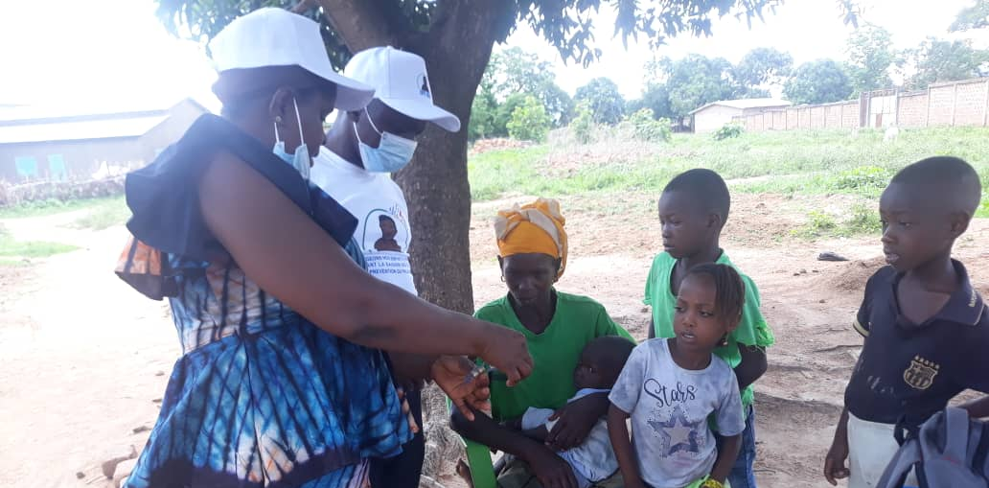

Optimizing SMC delivery in Guinea
An implementation research in the Siguiri mining zone
Bienvenu Salim Camara, Alioune Camara, Eugène K Lama, Moriba Haba, Ibrahima Mbaye, Jean-Louis Ndiaye, Susana Scott, Abena Polku-Awuku, Andre-Marie Tchouatieu, Corinne Merle, Kovana M Loua, Paul J Milligan
Paris, November 8, 2023
Notes:
Thank you!
As thesis, we explored health seeking behaviours for febrile illnesses post-Ebola virus disease outbreak in Guinea, taking the case of children under 5 years in a malaria endemic zone.
The expression Ebola virus disease is abbreviated EVD in my slides, but for easy communication I will use the term Ebola
As thesis, we explored health seeking behaviours for febrile illnesses post-Ebola virus disease outbreak in Guinea, taking the case of children under 5 years in a malaria endemic zone.

Slide 61
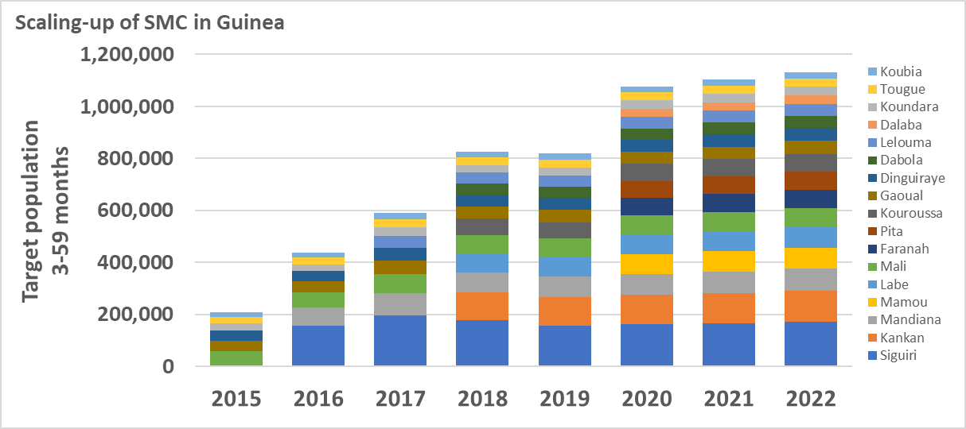
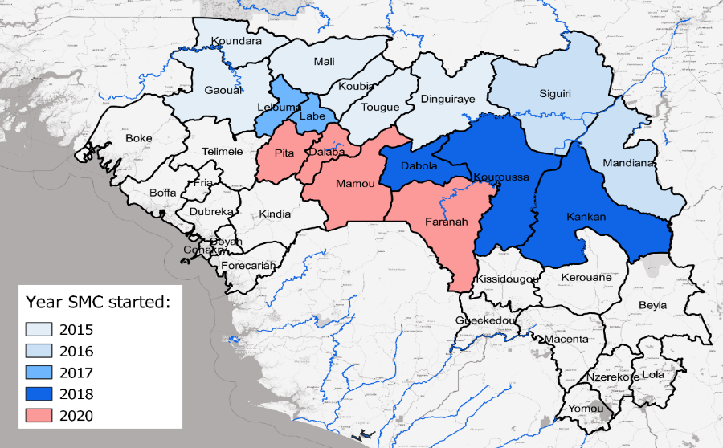
Introduction (1/3)
SMC in Guinea
4 cycles
5 cycles in Dabola since 2021
Mutualization since 2019
Scale-up of SMC in Guinea
Notes:
The context of our study is that Guinea was one of the countries affected by the West-African EVD outbreak from 2013 to 2015.
Countrywide, more than 3 thousands and 3 hundreds people were infected, of which more than 2 thousand people died.
Poor strategy planning to control the outbreak led to community misperception, fear and mistrust in the health system.
In fact, people refrained from attending health facilities. Although this was not focused on malaria only, one of our studies conducted in 7 districts showed that facility attendance significantly dropped for under 5 children during the EVD outbreak.
Though the EVD outbreak is over, communities might still suffer fears related to it, and this may still influence health-seeking behaviours.
The problem that triggered our research is that in Guinea, health seeking behaviours post-EVD were not yet surveyed. Existing studies based only on facility data.

Slide 62
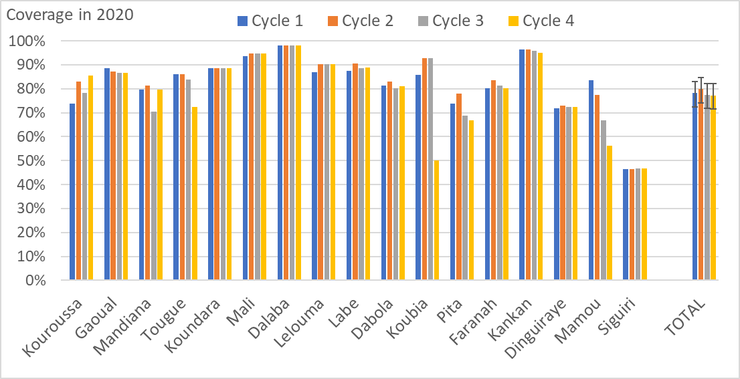
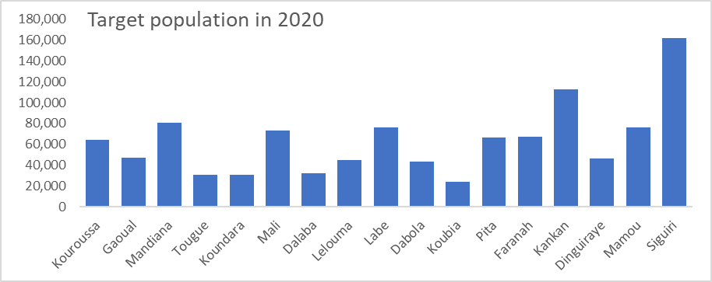
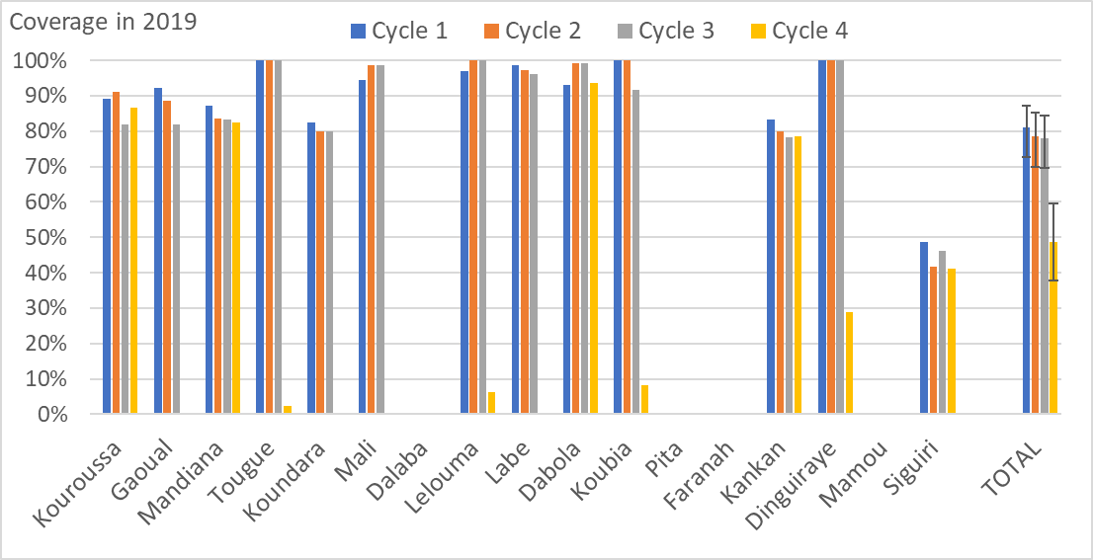
Introduction (3/3)
SMC uptake
Consistent low coverage in Siguiri prefecture (2019-2020)
  Some villages not covered
  Implementation challenges
Notes:
The context of our study is that Guinea was one of the countries affected by the West-African EVD outbreak from 2013 to 2015.
Countrywide, more than 3 thousands and 3 hundreds people were infected, of which more than 2 thousand people died.
Poor strategy planning to control the outbreak led to community misperception, fear and mistrust in the health system.
In fact, people refrained from attending health facilities. Although this was not focused on malaria only, one of our studies conducted in 7 districts showed that facility attendance significantly dropped for under 5 children during the EVD outbreak.
Though the EVD outbreak is over, communities might still suffer fears related to it, and this may still influence health-seeking behaviours.
The problem that triggered our research is that in Guinea, health seeking behaviours post-EVD were not yet surveyed. Existing studies based only on facility data.

Slide 63
Objectives
In Siguiri prefecture
To understand facilitating factors and barriers to SMC uptake
To adapt the SMC delivery strategy to optimize uptake
To assess effectiveness of the adapted strategy on SMC uptake
Notes:
Given this situation, the objective of this study was to assess whether EVD memories control health-seeking behaviours for under-5-year children with febrile illnesses post-EVD outbreak in Guéckédou district, Guinea, in order to restore communities’s perceptions about health services.
Specifically, we sought:
To compare health service utilization for febrile illnesses post-EVD with pre-EVD;
To assess EVD-related fears among caregivers;
To assess health-seeking options post-EVD and factors associated with utilized cares;
And to explore reasons for health-seeking behaviours post-EVD.

Slide 64
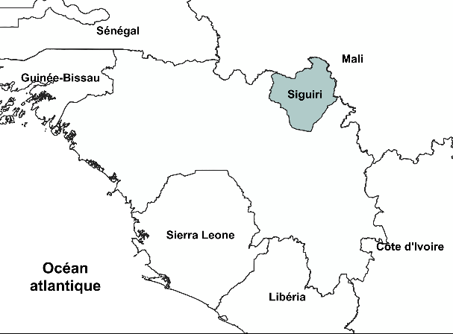
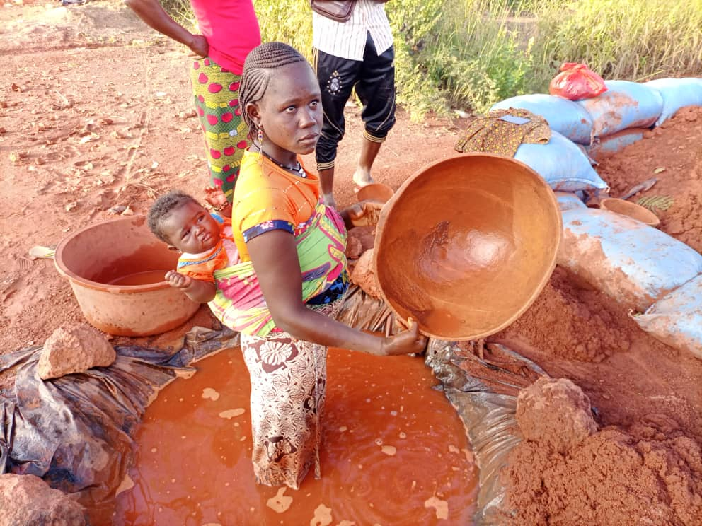
Methods (1/2)
Guinea
West Africa
Over 13 M. inhabitants
33 districts
Siguiri prefecture
Over 800.000 inhabitants
Cosmopolitan
Gold-mining area
Doko sub-prefecture
Notes:
Guinea is located in West Africa and comprises 33 districts.
The study was conducted in Guéckédou district, which was the epicentre of the EVD outbreak and has a prevalence of 61% of malaria.
We precisely conducted the study in 2 sub-districts, the most affected by the EVD with 60 reported cases, and a less affected sub-district with only one case reported.

Slide 65
Methods (2/2)
Baseline qualitative research (October 2020)
  Focus groups, IDIs, informal conversations, observations
  With community, SMC providers (managers, distributors)
Designing the pilot SMC strategy (September 2021)
  Participatory (community, providers, researchers)
  Stakeholder mapping, consultations, activities programming
Evaluating the effect of the pilot strategy (July-Oct. 2021)
  Surveys before and after the SMC 4th cycle
  1234 children surveyed in intervention and control areas
Notes:
Guinea is located in West Africa and comprises 33 districts.
The study was conducted in Guéckédou district, which was the epicentre of the EVD outbreak and has a prevalence of 61% of malaria.
We precisely conducted the study in 2 sub-districts, the most affected by the EVD with 60 reported cases, and a less affected sub-district with only one case reported.

Slide 66
Findings (1/14)
Facilitators to SMC uptake
Community’s perspectives
  Perceived effectiveness of SMC
  Perceived economic benefits of SMC
Providers’ perspectives
  Cooperation between local authorities, partners and community
  On the job supervision
Notes:
As main findings of the study,
In the EVD-affected sub-district, facility attendance for under-5 febrile illnesses dropped during the outbreak, but in the post-outbreak, we found that it had recovered even beyond pre-EVD levels, as also indicate the monthly median numbers.

Slide 67
Findings (2/14)
Barriers to SMC uptake
Community’s perspectives
What is free is ‘’a poisoned gift’‘
“Here, when they [distributors] say it's for free, some people think it is a poisoned gift; they think it's to make their children sick " Father of a child
Notes:
As main findings of the study,
In the EVD-affected sub-district, facility attendance for under-5 febrile illnesses dropped during the outbreak, but in the post-outbreak, we found that it had recovered even beyond pre-EVD levels, as also indicate the monthly median numbers.

Slide 68
Findings (3/14)
Barriers to SMC uptake
Community’s perspectives
Doubts about treatments to healthy children
“You know, it's usually when someone is ill that he is given medicine; so people have doubts when we ask their children to swallow medicine when they are not ill" SMC Distributor
Notes:
As main findings of the study,
In the EVD-affected sub-district, facility attendance for under-5 febrile illnesses dropped during the outbreak, but in the post-outbreak, we found that it had recovered even beyond pre-EVD levels, as also indicate the monthly median numbers.

Slide 69
Findings (4/14)
Barriers to SMC uptake
Community’s perspectives
Some distributors seen as outsiders
“SMC is not easy here […] They are many in the community here, as soon as they see you are a foreign body [not native], they refuse everything you asks for [about SMC] " SMC Distributor
Notes:
As main findings of the study,
In the EVD-affected sub-district, facility attendance for under-5 febrile illnesses dropped during the outbreak, but in the post-outbreak, we found that it had recovered even beyond pre-EVD levels, as also indicate the monthly median numbers.

Slide 70
Findings (5/14)
Barriers to SMC uptake
Community’s perspectives
Influence of COVID-19 on trust toward SMC
Perceived risk of adverse reactions to SMC
Perceived excessive number of preventive medications
Non-retention of SMC record cards
Notes:
As main findings of the study,
In the EVD-affected sub-district, facility attendance for under-5 febrile illnesses dropped during the outbreak, but in the post-outbreak, we found that it had recovered even beyond pre-EVD levels, as also indicate the monthly median numbers.

Slide 71
Findings (6/14)
Barriers to SMC uptake
Providers’ perspectives
  Distributors living far from their distribution areas
“Some [distributors] are sent to villages more than 20 or 30 km away for SMC; by the time they get there, many of the children's parents are already in the farm." SMC Distributor
Notes:
As main findings of the study,
In the EVD-affected sub-district, facility attendance for under-5 febrile illnesses dropped during the outbreak, but in the post-outbreak, we found that it had recovered even beyond pre-EVD levels, as also indicate the monthly median numbers.

Slide 72
Findings (7/14)
Barriers to SMC uptake
Providers’ perspectives
  High assigned workload related to the working hours
“It's difficult to have 80 children a day. We struggle, but we can have 30, 35, sometimes 50 children... there are many parents who refuse" SMC Distributor
Notes:
As main findings of the study,
In the EVD-affected sub-district, facility attendance for under-5 febrile illnesses dropped during the outbreak, but in the post-outbreak, we found that it had recovered even beyond pre-EVD levels, as also indicate the monthly median numbers.

Slide 73
Findings (8/14)
Barriers to SMC uptake
Providers’ perspectives
  Distributors leaving work for some of the monthly cycles
“"...no, last month I was in Kankan, I had gone to the school for exams, so the head of the health centre replaced me with someone else...when I came back, I took over again" SMC Distributor
Notes:
As main findings of the study,
In the EVD-affected sub-district, facility attendance for under-5 febrile illnesses dropped during the outbreak, but in the post-outbreak, we found that it had recovered even beyond pre-EVD levels, as also indicate the monthly median numbers.

Slide 74
Findings (9/14)
Barriers to SMC uptake
Providers’ perspectives
  Insufficient number of local advocates (community mobilisers)
“For the health centre, you have two, sometimes three [social mobilisers] who have to go round many villages to raise awareness in the households; which is not feasible in reality" Head of Health center
Notes:
As main findings of the study,
In the EVD-affected sub-district, facility attendance for under-5 febrile illnesses dropped during the outbreak, but in the post-outbreak, we found that it had recovered even beyond pre-EVD levels, as also indicate the monthly median numbers.

Slide 75
Findings (10/14)
Barriers to SMC uptake
Providers’ perspectives
  Distributors unfamiliar with their distribution areas
  Some distributors’ lack of technical knowledge about SMC
  Remuneration considered too low
  Lack of field visits by some local supervisors
  Mobility of households
Notes:
As main findings of the study,
In the EVD-affected sub-district, facility attendance for under-5 febrile illnesses dropped during the outbreak, but in the post-outbreak, we found that it had recovered even beyond pre-EVD levels, as also indicate the monthly median numbers.

Slide 76
Findings (11/14)
Pilot SMC strategy (points of adaptation) – Cycle 4
Selection criteria for distributors
  Each pair: one from neighbourhood, one literate
  Available to work throughout the season
Distributors’ workload
  Number of distributors increased to allow more time in households
  Workload reduced from 80 children to 40 to treat per day
Community mobilization
  Local/neighbourhood advocates for community mobilization
  Broadcasting messages on local radio
Notes:
As main findings of the study,
In the EVD-affected sub-district, facility attendance for under-5 febrile illnesses dropped during the outbreak, but in the post-outbreak, we found that it had recovered even beyond pre-EVD levels, as also indicate the monthly median numbers.

Slide 77
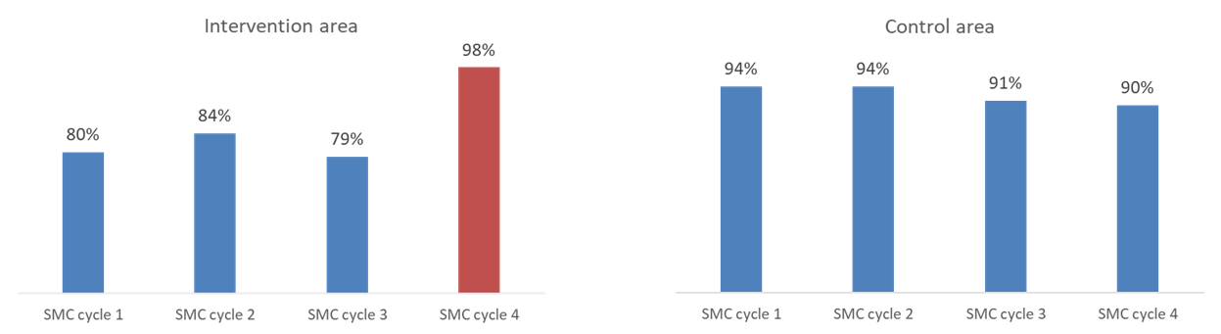
Findings (12/14)
Evaluation of the pilot SMC strategy
SMC coverage increased
Notes:
As main findings of the study,
In the EVD-affected sub-district, facility attendance for under-5 febrile illnesses dropped during the outbreak, but in the post-outbreak, we found that it had recovered even beyond pre-EVD levels, as also indicate the monthly median numbers.

Slide 78
Findings (13/14)
Evaluation of the pilot SMC strategy
Caregiver trust in the SMC programme increased
Notes:
As main findings of the study,
In the EVD-affected sub-district, facility attendance for under-5 febrile illnesses dropped during the outbreak, but in the post-outbreak, we found that it had recovered even beyond pre-EVD levels, as also indicate the monthly median numbers.

Slide 79
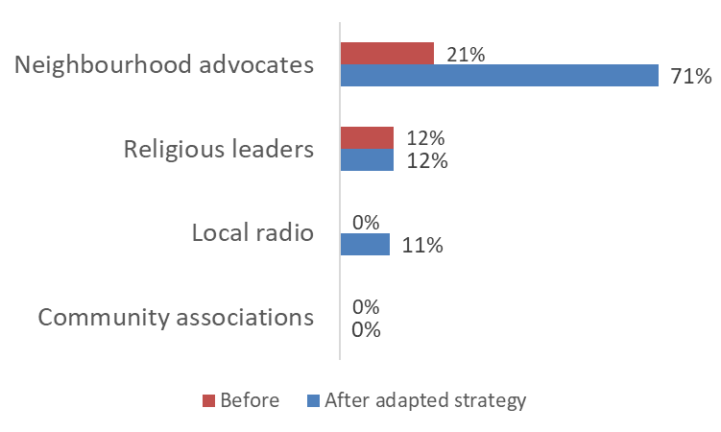
Findings (14/14)
Evaluation of the pilot SMC strategy
Neighbourhood advocates were effective in strengthening community mobilization
Notes:
As main findings of the study,
In the EVD-affected sub-district, facility attendance for under-5 febrile illnesses dropped during the outbreak, but in the post-outbreak, we found that it had recovered even beyond pre-EVD levels, as also indicate the monthly median numbers.

Slide 80
Conclusions
To optimize uptake of SMC, delivery approaches need to be adapted to local contexts
Using local distributors increased trust
Increasing the number of distributors increased cost but made it possible to cover a high proportion of eligible children
Local advocates were effective in strengthening community mobilization
Need for research to understand barriers to putting these findings into practices (scaling up)
Notes:
As main findings of the study,
In the EVD-affected sub-district, facility attendance for under-5 febrile illnesses dropped during the outbreak, but in the post-outbreak, we found that it had recovered even beyond pre-EVD levels, as also indicate the monthly median numbers.

Slide 81
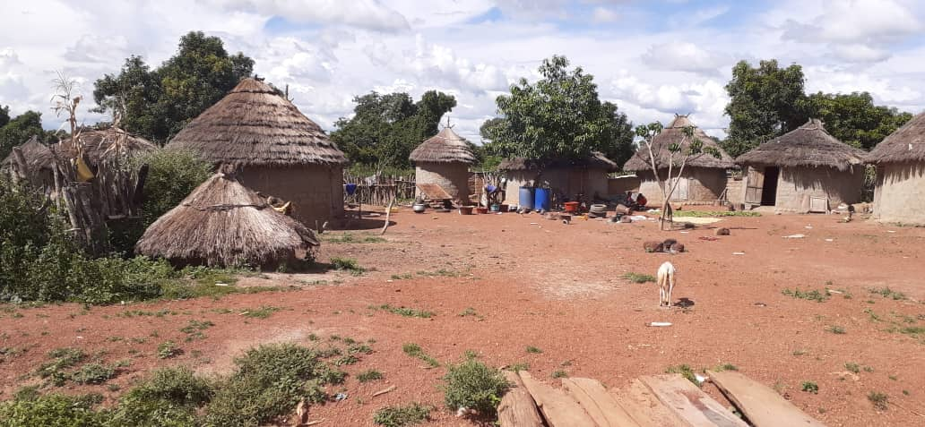
Merci
Thank you
Notes:
Thank you for your attention

Slide 82



EDCTP FORUM
8 NOV 2023 PARIS, FRANCE
Evaluating three approaches to improve coverage and adherence of SMC in Dioila, Mali
Dr. Mady CISSOKO
National Malaria Control Program, Mali

Slide 83

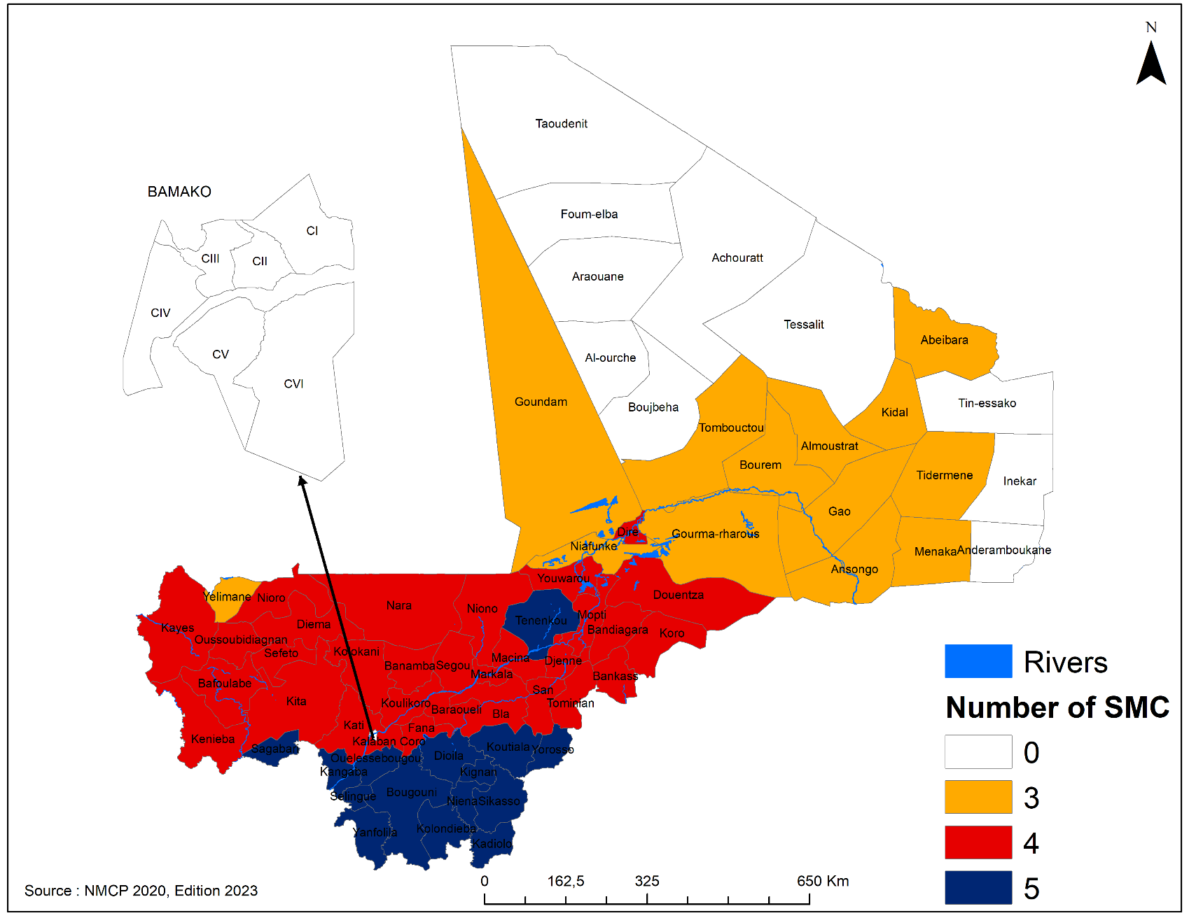
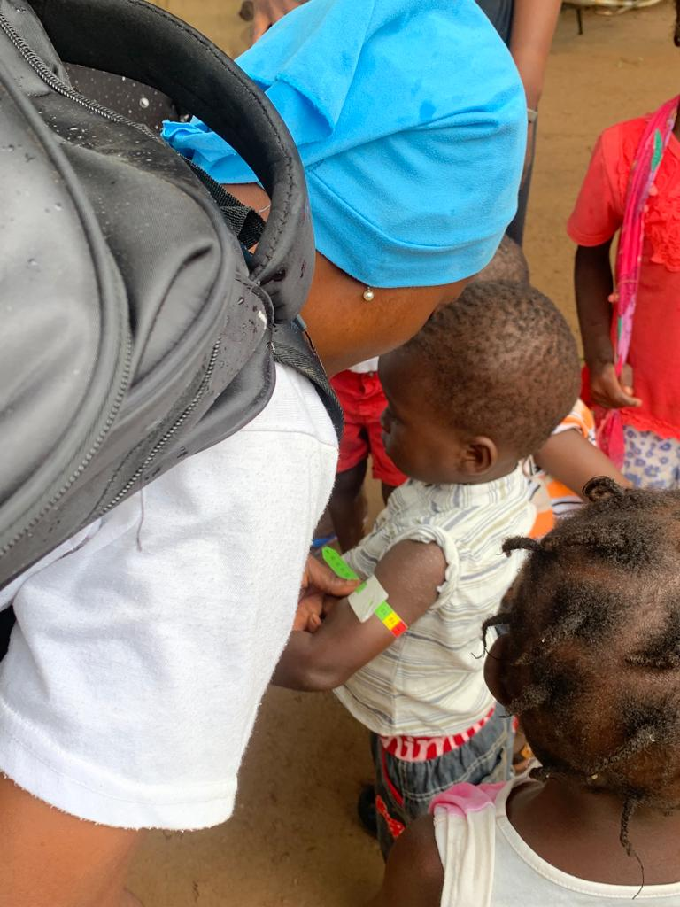
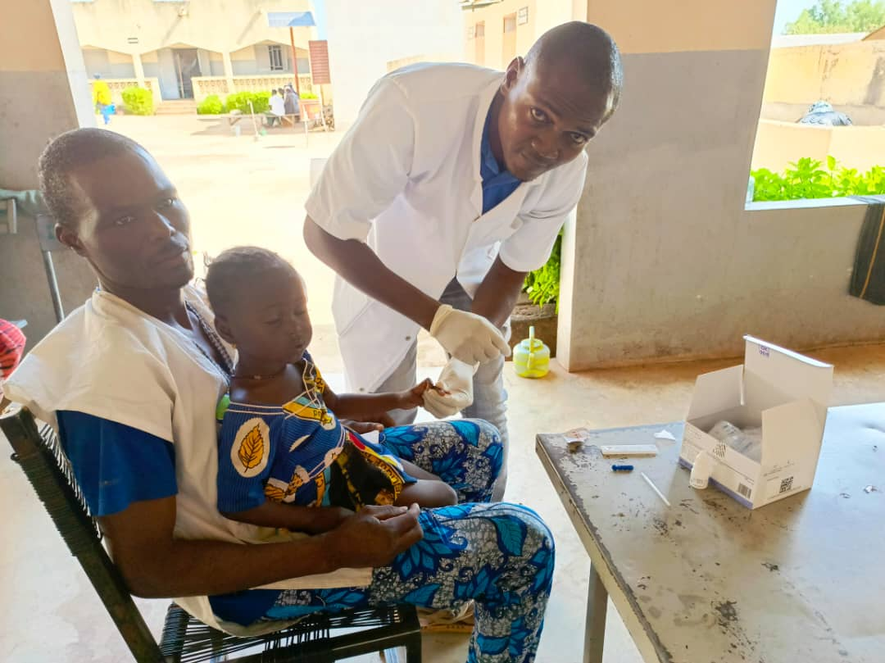
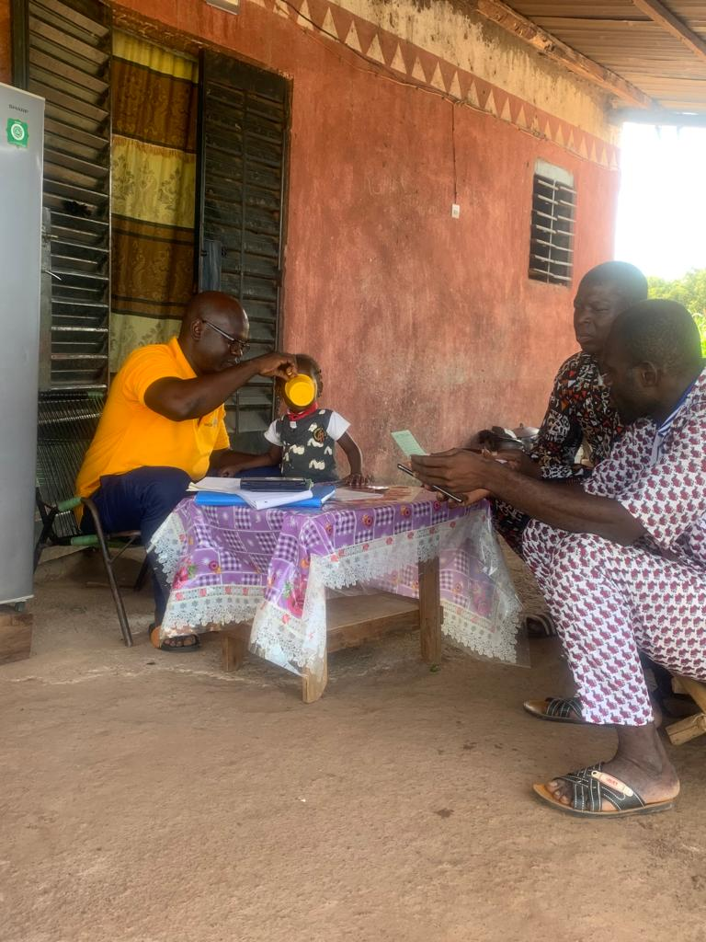
Background
SMC was adopted by Mali in 2012 for children aged from 3 to 59 months
Stratification in 2020 showed that SMC should be implemented in 53 Health Districts with 3 and 5 cycles reflecting the duration of the malaria season
Mixed delivery mode: door-to-door, fixed and mobile
Delivery strategy: First dose by SMC drug distributors and remaining doses by parents at home
SMC in Mali includes: screening for malnutrition, testing suspected malaria cases and administering SPAQ

Slide 84
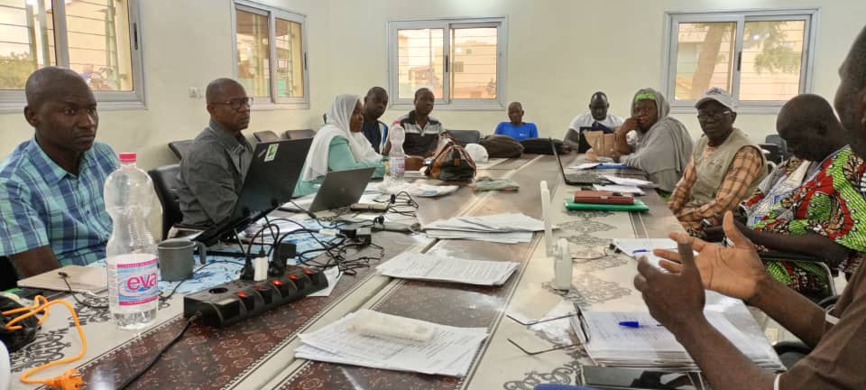
Rationale for this study
Some issues raised from previous studies:
Variable levels of coverage across the areas
Questions about adherence to the 2nd and 3rd dose of amodiaquine (AQ)
Absence of parents at the time of administrators visits
Importance of effective communication about SMC campaigns
Increase of malaria incidence in children

Slide 85
Objectives
Research questions:
Can SMC coverage and adherence be improved, compared to standard SMC, by using locally recruited community monitoring volunteers (cSMC) to follow up on 2nd and 3rd doses uptake?
Is this strategy as effective and less costly than 3 days of DOT (SMC distributors visiting on each children of the 3 days)?
Specific objectives:
  Assess feasibility of the two approaches and their impact on SMC coverage and adherence
  Understand community perceptions about adherence and attitudes to the interventions
  Estimate costs
  Monitor the incidence of malaria in children in the study areas

Slide 86
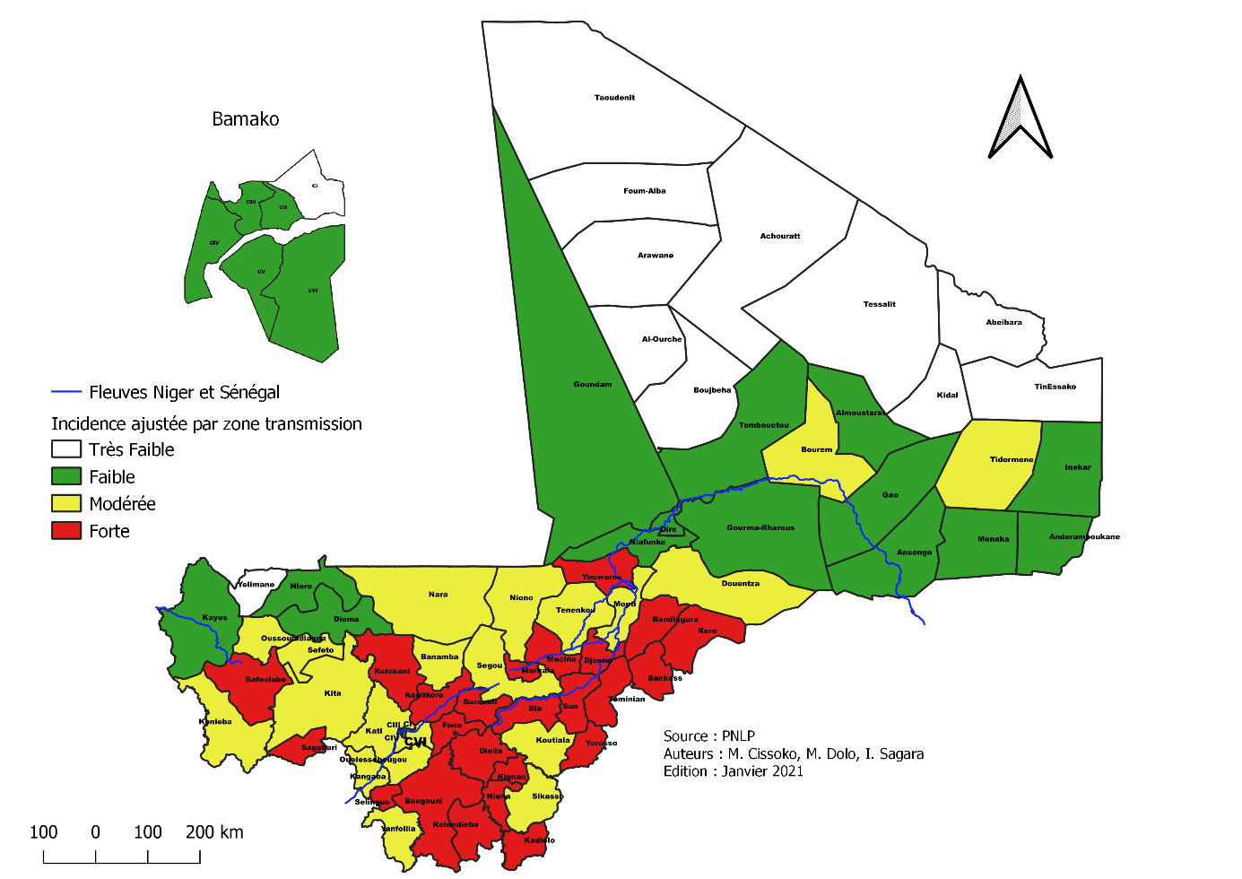
Methodology
Choice of study site
  Dioila health district (included 44 health areas, and 1 district hospital) in a high transmission area
  Malaria season: high transmission period is between July and November
  6 health areas selected for this study that had a high incidence in children under 5s between 2019-2021
Target population :
  child aged 3-59 months and their parents
  health providers

Slide 87
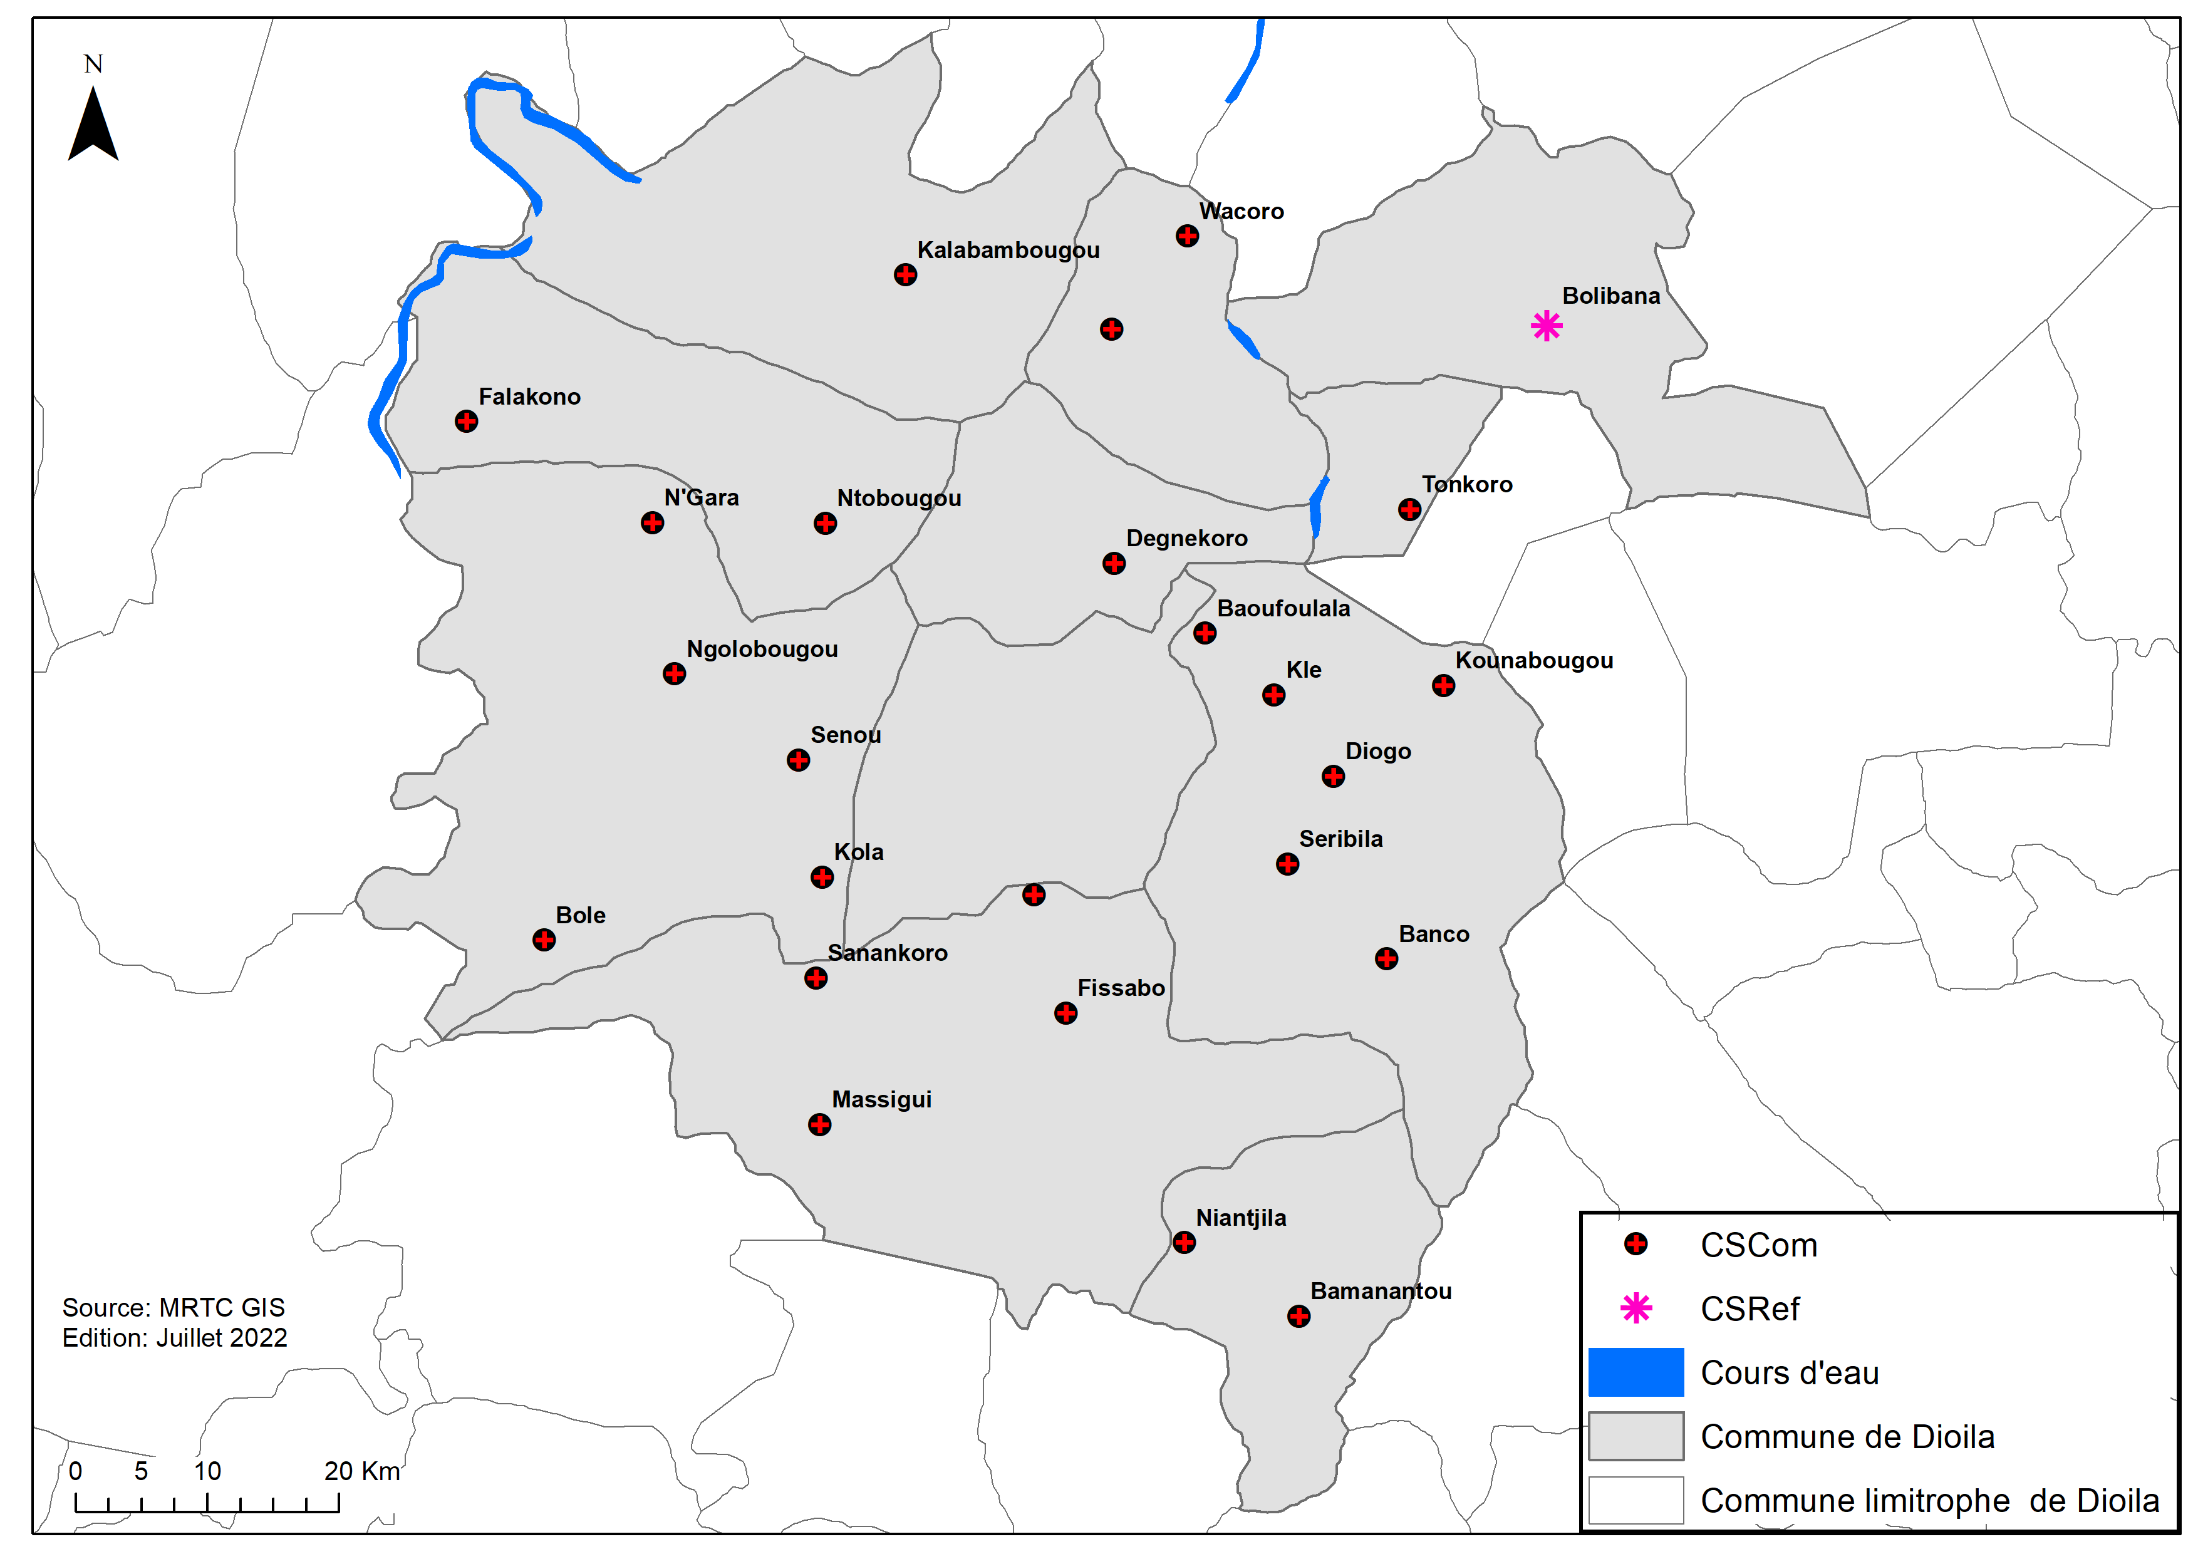

Methodology
Delivery approaches
6 health areas selected in the Dioila health district
  2 areas: SMC (standard SMC)
  2 areas: cSMC (Community approach, local volunteers visit to assist with doses 2 and 3)
  2 areas: DOTs (SMC team visits on 3 days to supervise all 3 doses)
SMC
DOTs
SMC
cSMC
cSMC
DOTs

Slide 88
Description of the interventions (1)
Standard SMC: Distributors in teams of 2, work for 5 days each month, visit each household once to administer the first dose and leave the blister with the caregiver to administer doses on day 2 and day 3.
cSMC: Same as standard SMC but in addition, local community volunteers visit for doses 2 and 3 to: explain about SMC; explain how to write on the SMC card if the child received the daily dose; check the blister pack; if the AQ dose has not been used then assists the caregiver to administer and to complete the SMC card.
DOTS: Distributors in teams of 2, work for 3 days each month, and visit each household 3 times (on day 1, day 2 and day 3).

Slide 89
Description of the interventions (2)
cSMC volunteers are chosen by the health association of the village, with the head of the health centre.
An incentive of 6000CFA per month per volunteer is paid to the association.
Training is organised by the head of the health centre before the first SMC cycle in July
Notes:
This slide shows the incentives paid to SMC distributors and to the community volunteers. cSMC volunteers are chosen by the health association of the village, with the head of the health centre. An incentive of 6000CFA per month per volunteer is paid to the association. Training is organised by the head of the health centre before the first SMC cycle in July.

Slide 90
Description of the interventions (3)
Strategy | No. of villages | Target population | Number of distributors | Number of community volunteers | Children per pair of distributors | Children per volunteer | Days worked per cycle Distributors Volunteers
Standard SMC | 32 | 6816 | 48 |  | 284 |  | 5
DOTS | 37 | 8078 | 200 |  | 81 |  | 3
cSMC | 20 | 2190 | 12 | 53 | 365 | 41 | 5 | 6
In the standard SMC area, 48 distributors worked over 5 days each month to cover a target of 6816 children
In the DOTs, 200 distributors over 3 days to cover 8078 children
In cSMC, 12 distributors worked over 5 days and 53 volunteers worked over 6 days to cover 2190 children each month

Slide 91
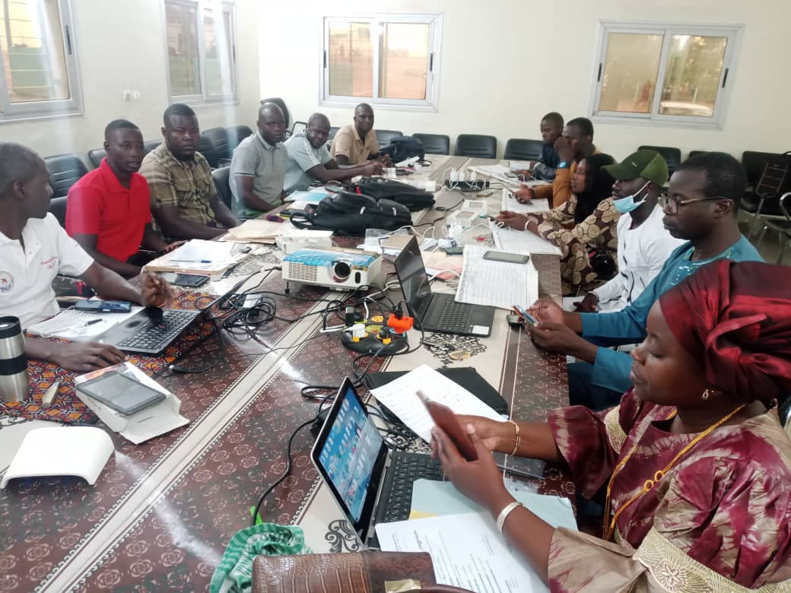
Study timeline and data collection
Passive malaria case detection
July
August
September
October
Training community volunteers
SMC cycles
Household survey
  Household survey:
    after last SMC cycle to measure coverage in the previous 4 cycles and adherence to the daily doses :
      4 villages were selected in each health area, 30 households per village, a total of 240 households in each approach, and all children in the selected households were surveyed
      SMC card inspected for dates of treatment and recording of daily doses
      parents were asked about treatment adherence and blister packs inspected for left-over medication
    Data were collected using the Kobocollect electronic questionnaire
  Malaria surveillance: Individual patient records from clinic registers 2019-2022
  Costs: Approximate additional costs estimated, added to the previous estimate of SMC costs
  Qualitative data collection: 16 interviews with health providers, distribution agents, community leaders, and key informants. 3 focus groups, 2 with female and 1 with men.

Slide 92
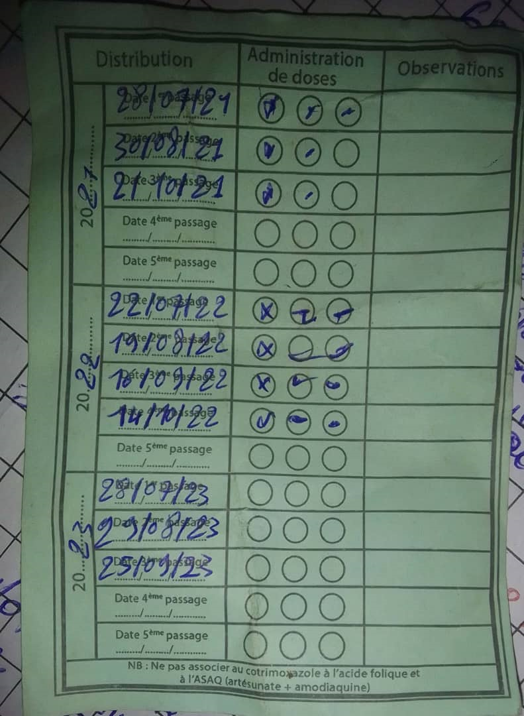
Results: Household survey
Very high adherence (according to SMC card, blister pack inspection, and parents recall) in all three strategies
High coverage of 4 cycles in all three strategies

Slide 93
Results: Cost of different delivery approaches
 | Standard | cSMC | DOTs
Cost per child per cycle (CFA) | 2 246 CFA | 2 845 CFA | 3 071 CFA
Costs were estimated from the additional cost of DOTs and cSMC, above costs of standard SMC (additional training, supervision, and volunteer/distributor costs), per child per cycle, added to the previous estimate of the cost of SMC per child in Mali (0.86 USD per cycle per child, Diawara et al. Malaria Journal 2021 20:128)
DOTs cost is 37% higher than for standard SMC
cSMC cost is 27% higher than for standard SMC

Slide 94
Qualitative findings: adherence
With standard SMC, not all children who received the first dose received all the second and third doses:
"There is too much wastage in the standard SMC strategy, because the drugs are given to other people, they don't give them to their children, then their children will not be protected against malaria." EIA-LEAD-H-CSCO
" If you try to see, there are a lot of parents of children who don't give these other two doses that have been given to them." FGD-FEMMES-CSCOM-Falakono-Participant 2.
After the campaign, packets of SMC pills were seen on garbage dumps in some families, indicating that those doses weren't administered.

Slide 95
Qualitative findings: DOTs and cSMC
DOTs:
"We think it's a good strategy as P2 just said, there were women who threw away the rest of the drugs instead of giving those other two doses to their children." FGD-FEMMES-CSCOM-WACORO-P3. M-CENTRAL-DIOILA
cSMC:
"For me, they have to continue with the strategy with community monitoring because mothers of children are not the same. There are some who give all the doses correctly but others do not give the other doses entrusted to them at all." EIA-LEAD-H-CSCOM-SANANKORO-TEGUERE.
"If you see that the volunter have been asked to visit the families to see if the doses are being administered, all this is for the success of the SMC. When you spend money on a job, you'll have to follow up to see if it's done right. For me, follow-up is very important in this work." FGD-MEN-CSCOM-SANANKORO-TEGUERE-P9.

Slide 96
Incidence rates of clinical malaria 2020-2022, in children under 5 (in red) and older age groups (in blue), in the three zones. Intervention (DOTs and Community) took place in under 5’s in 2022.
Trends over time differ between the intervention and control areas. Using the data for the older age group to control for this, the estimate of the intervention effect from Poisson regression, is 22% (95% confidence interval -5% to 42%), p=0.098.
Intervention
22% (-5%,42%) p=0.098
Although there is no clear evidence of an intervention effect, the data do not exclude a benefit (data are consistent with a benefit), but there is wide uncertainty.

Slide 97
Conclusions
The study was planned to evaluate two alternative delivery strategies to address concerns about variable SMC coverage and poor adherence.
3day DOTs is becoming more widely used due to concerns about adherence but DOTs is costly and there is limited evidence about poor adherence and the benefit of DOTs
We evaluated a community strategy to promote adherence using local volunteers.
Qualitatively, caregivers and distributors highlighted poor adherence and the need for the strategy.
There were positive attitudes to the strategy, and it was less costly than DOTs.
Reported adherence in surveys was high with all strategies but may be affected by reporting bias. Objective methods (measure drug levels) may be needed.
Adherence is a potential concern but simpler strategies than 3day DOTs by SMC teams, may be more effective.

Slide 98
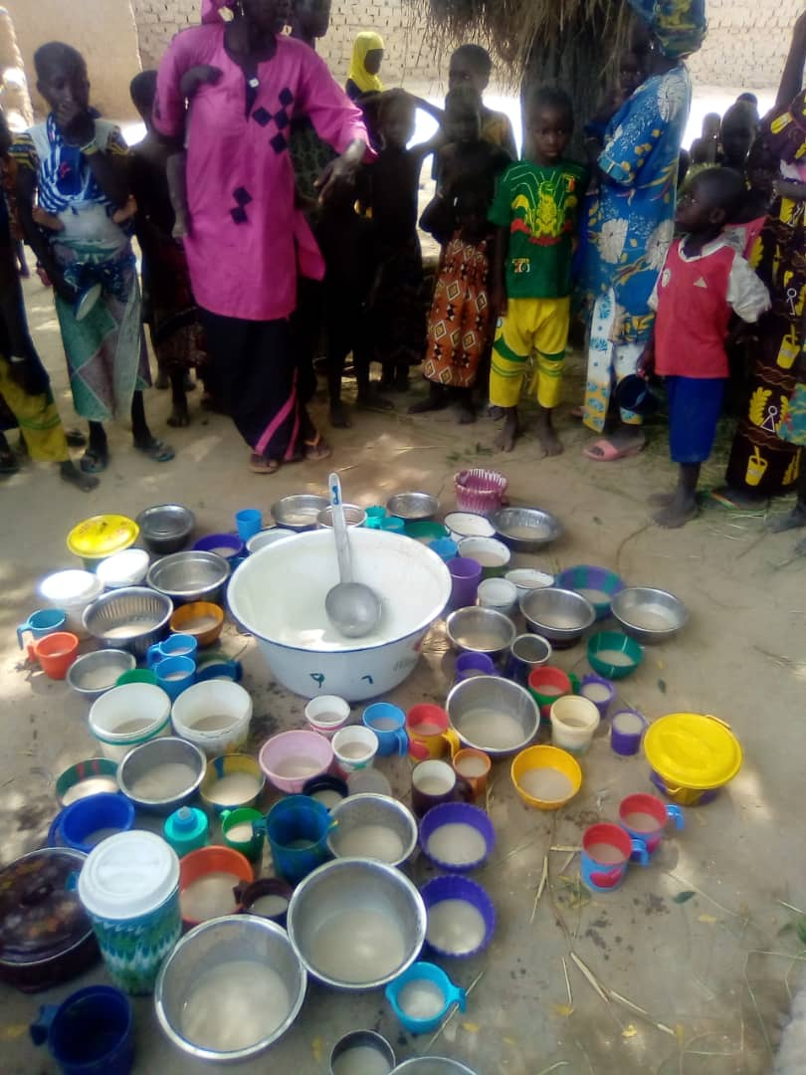
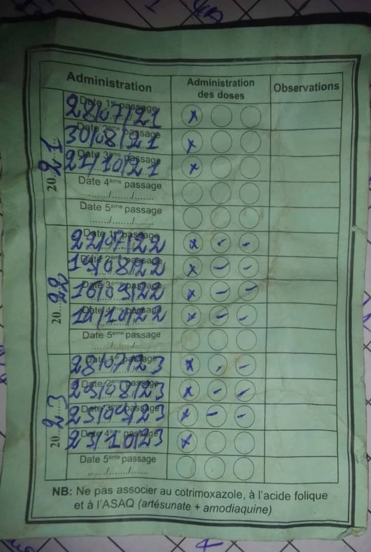

Use of PNLP results:
  USAID PMI: KN in the Djenné Health District for the SMC

Slide 99




Slide 100


Slide 101
Results: Delivery of 2nd and 3rd dose on the 4th cycle
 | % doses administered by the distributor or volunteer and by the caregiver
DOTs
2nd Dose
SMC drug distributors | 94%
Parents/Caregivers | 6%
3rd Dose
SMC drug distributors | 92%
Parents/Caregivers | 8%
cSMC
2nd Dose
Community monitoring agents | 85%
Parents/Caregivers | 15%
3rd Dose
Community monitoring agents | 83%
Parents/Caregivers | 17%

Slide 102


Slide 103
Summary and forward looking for the control of seasonal malaria
Fatimata B. SALL
University of Thiès, Senegal
EDCTP FORUM
7-10 NOV 2023 PARIS, FRANCE

Slide 104
Strengths
Network of 13 countries sharing progress and lessons learnt
1
NMPs leading the research: Identifying priority questions /
Conducting research and putting the findings into practice
2
3
Providing technical support and strengthening capacity in implementation research methods
4
Facilitating collaboration between NMPs and local research institutions / partners
5
Frequent communications with each NMP and bringing all partners together through regular webinars and in-person meetings
6
Multi-lingual project – strong emphasis to be inclusive to all

Slide 105
Common themes that came out
1
Mistrust : safety, suspicion about drugs provided free, not effective communication, distributors not from local community
2
Need to adapt delivery to local factors
3
Importance of qualitative research to understand community perspectives and then take these into account when planning SMC delivery
4
Challenges of delivery in areas with security problems
5
Implementing the recommendations from the various research might involve some additional cost

Slide 106


Forward looking for the control of seasonal malaria
→→→→→→ Optimizing SMC
WHO 2022 guidelines on malaria (Sub-national tailoring)
  Where should we do SMC?
  When to start? How many cycles? When to stop?
  Age range? (High risk of severe disease)
Need for improved surveillance data for severe disease and greater granularity

Slide 107


Forward looking for the control of seasonal malaria
Potential future interventions
  Monoclonal antibodies?
  Long Acting Injectable antimalarials ?
Similar implementation challenges to ensure that all children are reached
Network approach of OPT-SMC may be helpful

Slide 108

NMP: Benin, Burkina Faso, Cameroon, Chad, Ghana, Gambia, Guinea, Guinea Bissau, Mali, Niger, Nigeria, Senegal, Togo and Mauritania
THANK YOU !!!!

Slide 109


