Slide 1


South Sudan
SMC Alliance Annual Meeting 2025
Lomé – Togo
Feb 25 – 28, 2025
SMC Implementation in Wedweil Refugee Settlement

Slide 2
The Humanitarian Situation in South Sudan
  South Sudan has endured insecurity since its independence in 2011
  Currently, 9.3 million people in South Sudan require humanitarian assistance, amounting to 69% of the population.
  South Sudan is now hosting over half a million refugees across 30 locations in the country, mainly in refugee camps in Maban, Jamjang, Wedweil, and Gorom
  The arrival of over 878,000 Sudanese refugees from Sudan complicates the humanitarian crisis in South Sudan
  The Wedweil refugee camp in Aweil West, accommodates 16,538 residents, primarily women (55.1%) and children (49%) .
Notes:
The arrival of over 878,000 Sudanese refugees since April 2024 complicates the humanitarian crisis in South Sudan

Slide 3





The Burden of Malaria in South Sudan
  In 2022, the country reported an estimated 2.8 million cases and 6,680 deaths
  With approximately 7,630 new cases and 18 fatalities daily, South Sudan has one of the highest malaria incidence rates in the region
  Malaria accounts for 40% of hospital consultations and admissions, 33.9% of hospital deaths and 25% of deaths in children under five
  High prevalence contributes to illness, mortality, and strains the health system. South Sudan shares 1.5% global burden of malaria for 12 million population
  SMC approach is part of NMCP strategic plan 2021-2025

Slide 4
Malaria in Children (Malaria Indicator Survey 2023)
Fever prevalence: 57.5% of children (42% in 2017 ) had a fever in the 2 weeks preceding the survey.
Care seeking for fever: Advice or treatment was sought for 61% of children (78% in 2017) with a fever in the 2 weeks preceding the survey; 25% of children with a recent fever received timely care following fever onset.
Source of advice or treatment: Among children with a recent fever for whom care was sought, 46% received advice or treatment from a government hospital, 9% from a private hospital/clinic, 1% from a shop.
Testing: 24.6% of children with a recent fever had blood taken from a finger or heel for testing.
Type of antimalarial drug used: Among children under age 5 with a recent fever who took antimalarial drug, 44.9% received artemisinin-based combination therapy (ACT).
Anemia: 8% of children aged 6-59 months have a hemoglobin level below 8 g/dl. In the 2017 SSMIS a threshold of 7.0 g/dl was used for severe anaemia, and 7% of children were below that threshold.
Malaria Prevalence: 52.6% of children aged 6-59 months tested positive for malaria using RDTs (32% in 2017). 17.8% of children aged 6-59 months tested positive for malaria with microscopy.

Slide 5
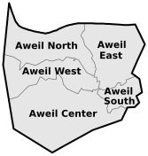
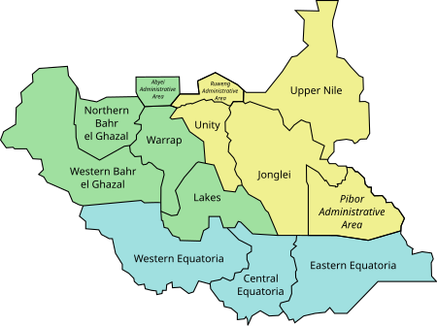
SMC Intervention Area
SMC is implemented in Wedweil Refugee Settlement Intervention
SMC Intervention Areas

Slide 6





Implementation Modality
Local ownership through local actors (Camp Leaders) leading engagements and accountability efforts
Door to door approach for directly observed SPAQ administration
Daily security clearance before entering camp
Behavioral change communication, using local language, Arabic
Data informed decision-making engagements for local solutions

Slide 7

Children who have accessed SMC

Slide 8
Contribution of SMC intervention on Malaria Reduction

Slide 9






SMC results in Wedweil Refugee Settlement
(End of round evaluation 2024)
94.4% (95% CI: 92.5-95.9) Knowledgeable about the age eligibility for SMC
98.6% (95% CI: 97.4-99.4) Caregivers of eligible children accepted SMC
92% 95% CI: 91.1-93.7) Caregivers heard of SMC
97.7% (95% CI: 96.4-98.7) eligible children completed the three-day SPAQ course (day 1 SPAQ and day 2 and 3 AQ)
91.2% (95% CI: 89.1-93.1) SMC card retention
93.6% Caregivers understand SMC

Slide 10
Challenges of Implementing SMC in Refugee communities
Frequent influx and movement of refugee populations within camps or across the border makes it difficult to consistently reach eligible children with SMC doses
Lack of understanding about malaria prevention and the importance of SMC among refugees, particularly new arrivals led to low uptake of the SMC
Some refugee communities had negative cultural beliefs and practices that influenced adherence SMC uptake
Due to the high mobility of refugee populations, challenges were registered in tracking the coverage and effectiveness of SMC
High cost of implementation in context of South Sudan

Slide 11
Justification for SMC Scale-Up in Refugee communities
SMC is part of NMCP strategic plan, SMC should continue and expand
SMC is feasible and acceptable in refugee camps
82% lower odds of malaria cases compare to control county (Effectiveness study results)
Clear seasonality pattern from Jul to Nov are peak months for malaria morbidity in SS
The difference in morbidity is 60% in NBEG, but other states below 60% are due to under reporting (60% reporting) in South Sudan
Children enrolled in chemoprevention efficacy study were symptomless till day 28

Slide 12
Lessons learned
Upon experiencing the effectiveness of SMC, government stakeholders advocated for the scaleup to other non targeted refugee camps such as Maban, Jamjang and Gorom
Some caregivers didn’t see the need of using mosquito nets after their children received SPAQ thus a call to orient them on comprehensive mitigation of malaria
Local actors [Camp leaders] were instrumental in attaining SMC acceptance and uptake – their opinions are WEIGHTY
After seeing the effectiveness of SMC, some caregivers would enroll children 60 months plus in anticipation they would be protected from malaria
The influx of refugee children strained the available resources. Besides, covering the refugee settlement refugee required much more human resources than had been planned for to ensure appropriate coverage

Slide 13
Sstakeholder thoughts about SMC
"There were new arrivals all the time, which meant that many eligible refugee children were coming in. We had to occasionally have to increase on the drug distribution team to ensure all the incoming and existing refugee eligible children were covered". (Refugee Settlement SMC supervisor)
"This drug (SPAQ for SMC) is safe, has no side effects, and effectively prevents malaria in the children who consistently receive it and take it as recommended”. (Clinical Officer from PHCC in Aweil West County)
“...many children have survived...in the past, some children might have died on the way before reaching the facility. But over the last two years, the SMC program has been supporting these children, and there has been no mortality rate during this period. (Local Chief, Aweil West).
“Based on our data analysis, especially at the facility level, the mortality rate for children under 59 months is much lower compared to previous years.” (SS MoH official).

Slide 14
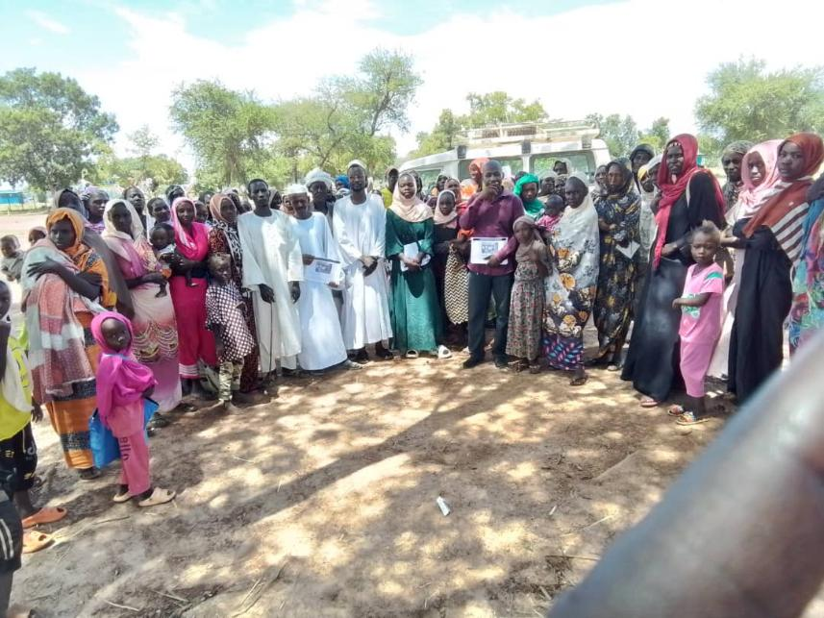
Photos
Caregivers from Wedwiel refugee settlement (Aweil West) pose for a photos with their facilitator (man in purple shirt) after a community sensitization session on SMC

Slide 15
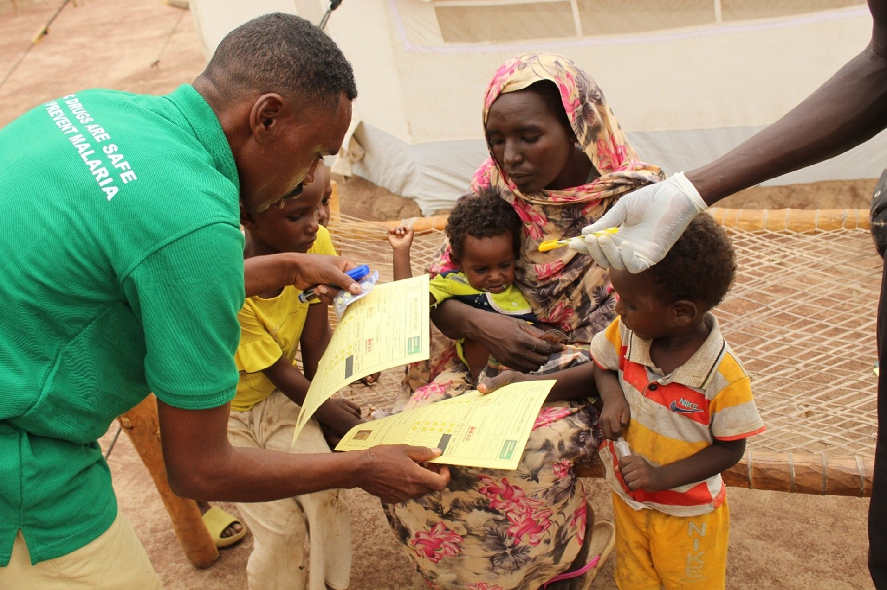
Photos
A camp leader of Wedweil refugee camp validating the child health card of a child during administration of SPAQSMC

Slide 16
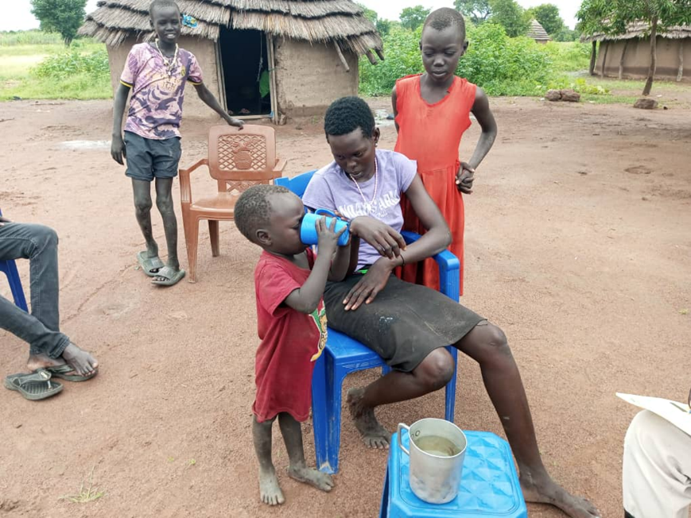
Photos
A child takes a dosage of SPAQ on his own during cycle 2 of SMC

Slide 17
Merci, Akpe, Thank you, Obrigado

