Slide 1
WHO Malaria Guidelines & Guidance:
Seasonal Malaria Chemoprevention (SMC)
SMC Alliance Annual Meeting 2025
25-28 Feb
Lomé, Togo
Dr. Peter OLUMESE,
Global Malaria Programme
WHO, Geneva, Switzerland.

Slide 2
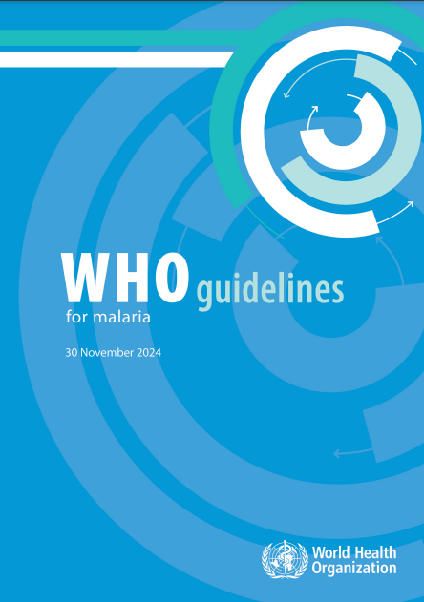
Main malaria prevention and treatment strategies
WHO Guidelines for Malaria (2021)
  These consolidated guidelines replaced 2 WHO guidelines the Guidelines for the treatment of malaria, 3rd edition and the Guidelines for malaria vector control.
  The consolidated WHO Guidelines for malaria include
    Prevention (vector control, preventive chemotherapies and vaccines)
    Case management
    Elimination and prevention of re-introduction
    Surveillance*
  As new evidence becomes available, the recommendations will be reviewed and updated, where appropriate, using WHO’s transparent and rigorous guideline development process.
Current 8th update published on 30 November 2024, to be updated on a continuing basis (moving towards living guidelines)
Available online: https://www.who.int/publications/i/item/guidelines-for-malaria
* Not developed following the WHO guidelines development process

Slide 3
Preventive Chemotherapies

Slide 4
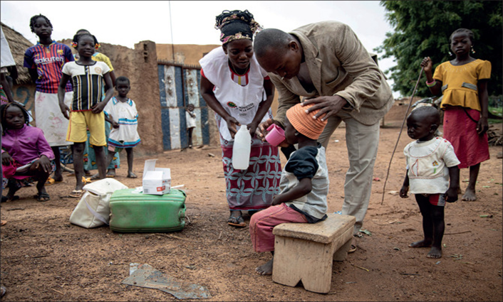
Preventive Chemotherapy
Intermittent Preventive Treatment of Malaria in Pregnancy (IPTp)
Seasonal Malaria Chemoprevention (SMC)
Perennial Malaria Chemoprevention (PMC)
Intermittent Preventive Treatment of Malaria in school children (IPTsc)
Post Discharge Malaria Chemoprevention (PDMC)
Mass Drug Administration (MDA)

Slide 5
Malaria Chemoprevention – principle and strategy
The intermittent administration of a curative dose of antimalarial medicine during the malaria season, regardless of whether the individual is infected with malaria.
The objective is to establish antimalarial drug concentrations in the blood that clear existing infections and prevent new ones during the period of greatest malaria risk.
WHO recommends medicines (monotherapy or combination) that is different from nor part of the combination partner that is used for first-line malaria treatment.
For combinations, the component medicines should have closely matched pharmacology, such that no component is present in the absence of other components for more than a minimal amount of time in order to reduce the risk of new infections encountering only a single drug.

Slide 6
Chemoprevention recommendations – shift in approach
The updated chemoprevention recommendations provide greater flexibility to NMPs to adapt control strategies to suit their settings.
NMPs are encouraged to consider local data to determine how best to tailor chemoprevention strategies to local needs and determine which age groups should be targeted where, for how long, how frequently, and with which drugs.
Further guidance on these specificities are provided through implementation field manuals, based on available evidence.

Slide 7
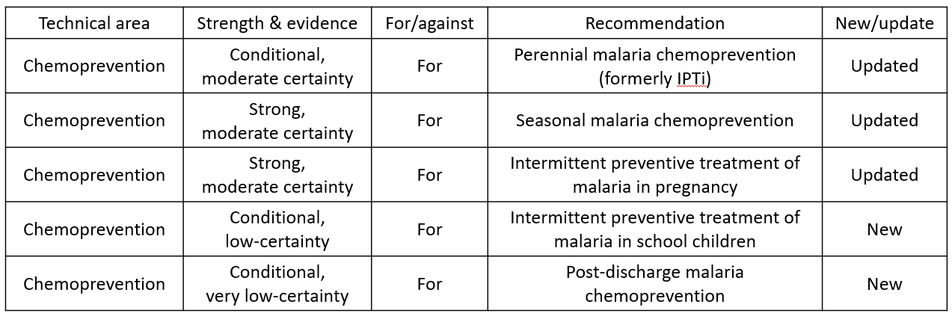
Summary of new and / or updated recommendations
Strong recommendation for
Conditional recommendation for

Slide 8
Seasonal Malaria Chemoprevention

Slide 9
Implementation field guide
Update implementation field guide (2013) to reflect current Guidelines recommendation
  specify age groups, transmission intensity thresholds, numbers of doses or cycles, or specific drugs.
  26 May 2023
  https://www.who.int/publications/i/item/9789240073692

Slide 10
further guidance (Field Guide 2nd ed, 2023)
Target area:
  malaria transmission is highly seasonal and the majority (>60%) of clinical malaria cases occur within 4 consecutive months
  the clinical attack rate of malaria (without SMC) is at least 0.1 episodes per child during the transmission season in the target group
Target population
  Children in age groups at high risk of severe malaria are eligible. In most countries with intense seasonal malaria transmission, these are children below 5 years of age.

Slide 11
further guidance (Field Guide 2nd ed, 2023)
Number of cycles
  SMC courses should be given at 28-day intervals, beginning at the start of the transmission season and continuing for 3–5 cycles, depending on the local context.
    In some settings, three cycles may be sufficient.
    Add a fifth cycle if a month on either side of the 4-month season contributes more than 10% of the annual burden
    Gains from adding a sixth SMC cycle appear to be minimal and not cost effective
Recommended medicines
  The combination of SP+AQ is currently recommended for SMC.

Slide 12
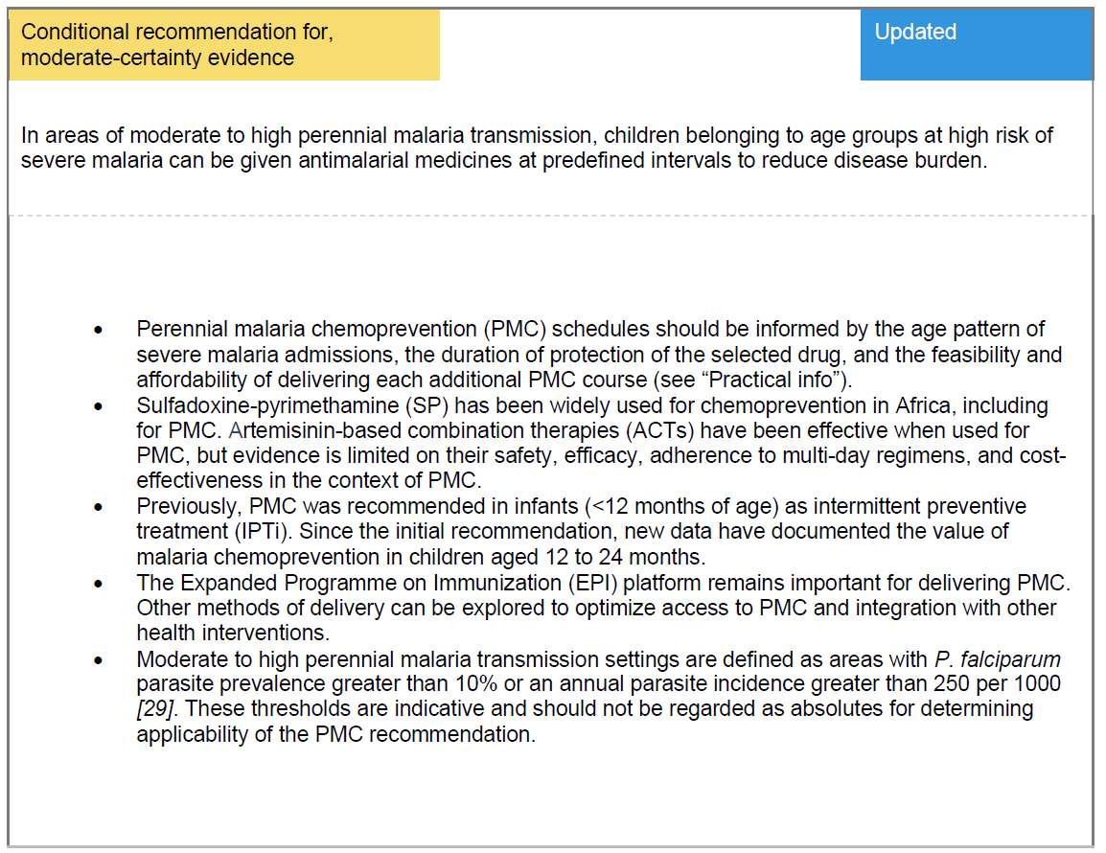
Perennial Malaria Chemoprevention (former IPTi)

Slide 13
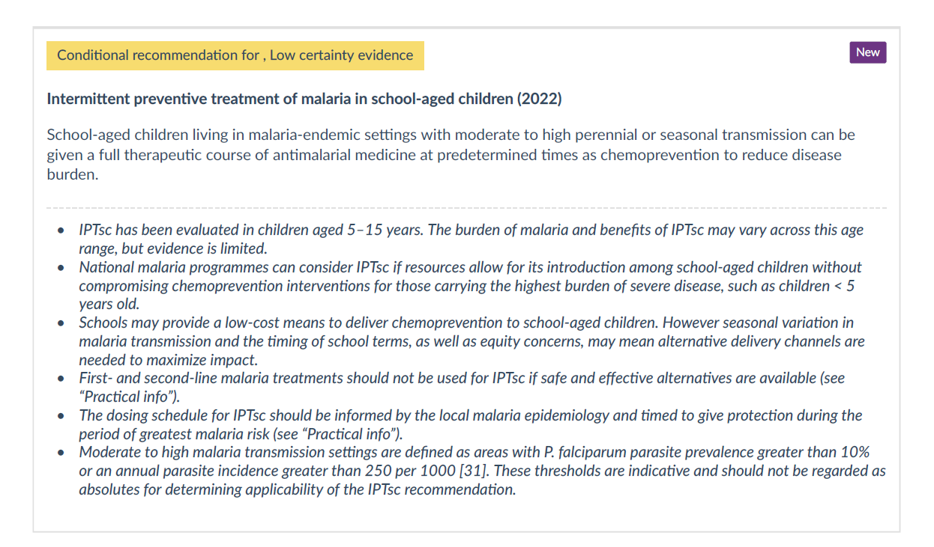
Intermittent preventive treatment of malaria in school-aged children (IPTsc)

Slide 14
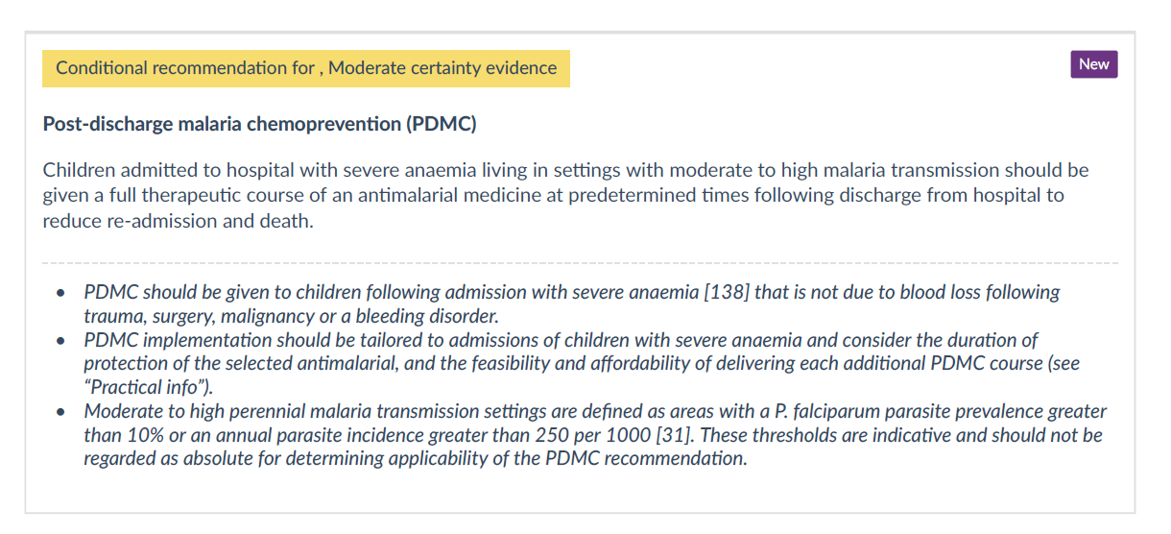
Post-discharge malaria chemoprevention (PDMC)

Slide 15
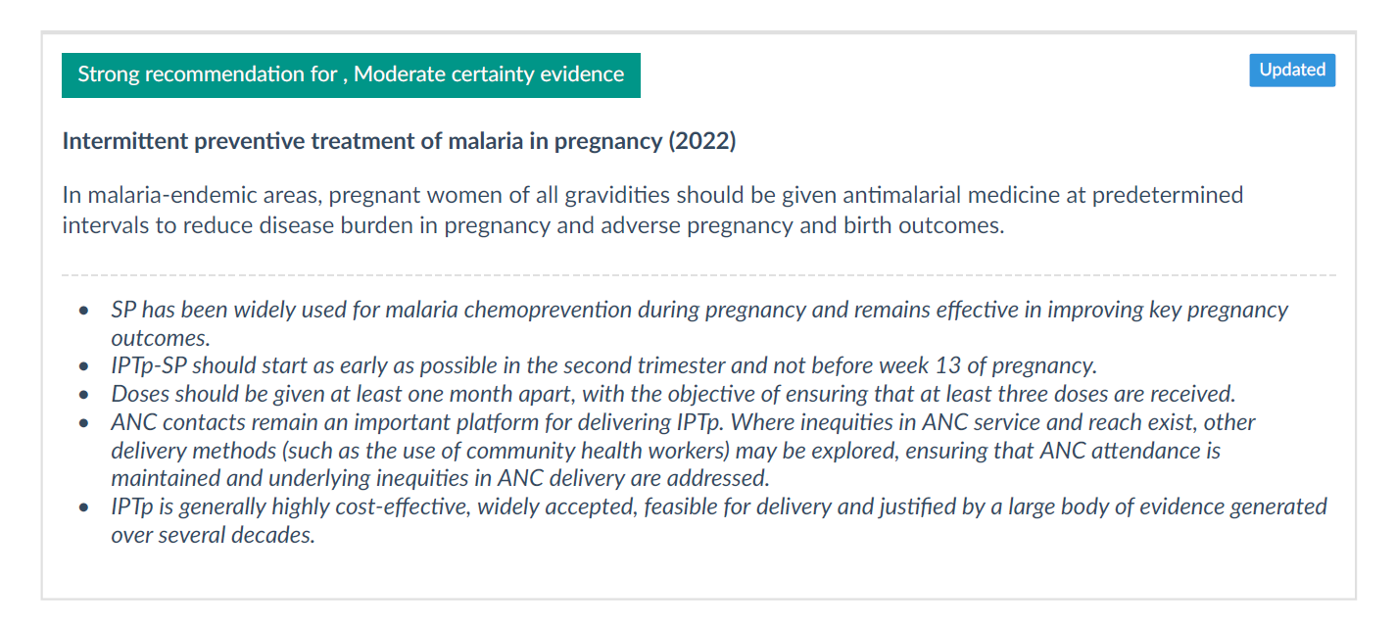
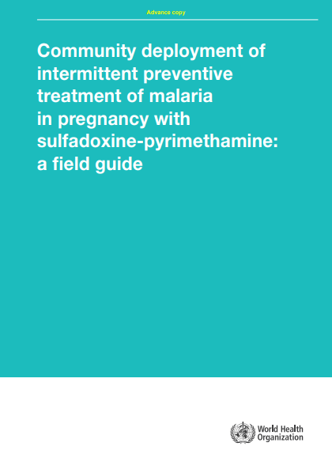
Intermittent preventive treatment of malaria in pregnancy (IPTp)

Slide 16
Malaria Vaccine
As of October 2023, WHO recommends two vaccines for the prevention of Plasmodium falciparum malaria in children:
  RTS,S/AS01 (RTS,S) in 2021, and
  R21/Matrix-M (R21) in October 2023.

Slide 17
Key antimalarial interventions & strategies
Prevention
Insecticide-treated mosquito nets
Indoor Residual Spraying
Preventive Chemotherapy
IPT in pregnancy (IPTp)
Perennial Malaria Chemoprevention (PMC /IPTi+)
SMC
IPT in School Children
Post Discharge malaria chemoprevention
MDA
Malaria vaccine
Diagnosis & Treatment
Parasite based diagnosis
  Microscopy
  Rapid Diagnostic Tests
Artemisinin-based combination therapies (ACTs)
Severe Malaria
  Artesunate
Case management service delivery areas::
  Health facilities
  Community Case Management
  Private sector
Surveillance, M & E
Routine HMIS
Malaria surveillance and response systems
Household surveys
Health Facility Surveys
Strengthening health systems in endemic countries

Slide 18
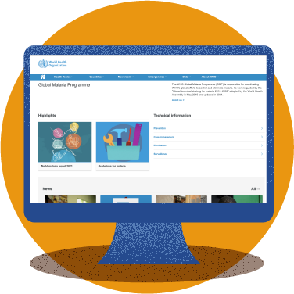
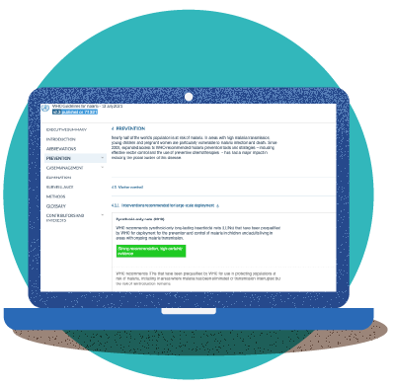
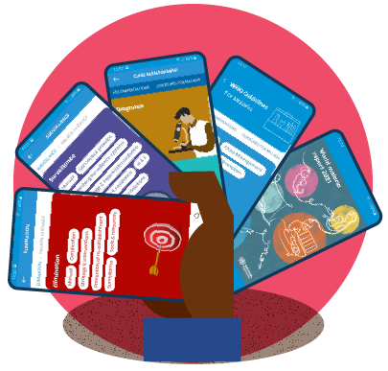

How to access WHO malaria guidance
1
WHO Global Malaria Programme website
2
3
WHO Malaria Toolkit app
MAGICapp

Slide 19
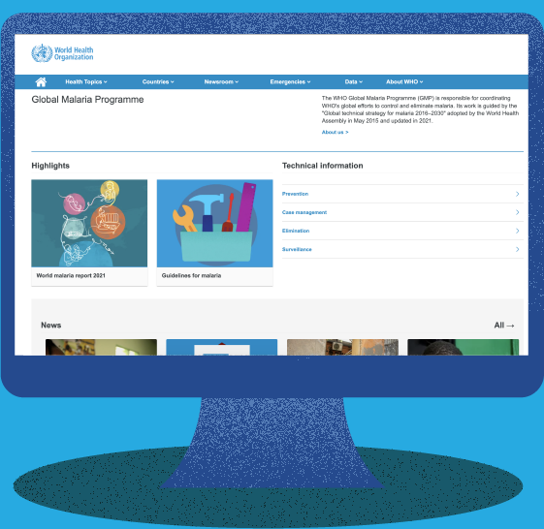
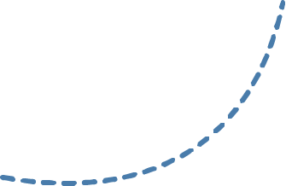
Ways to access WHO malaria guidance
1
The WHO Global Malaria Programme website is the main gateway through which national malaria programmes and partners can access the most up-to-date malaria guidance.
The new consolidated WHO Guidelines for malaria bring together all current WHO recommendations on malaria in one easy-to-navigate web-based platform.
They are a living resource that will be updated periodically as new evidence becomes available.

Slide 20
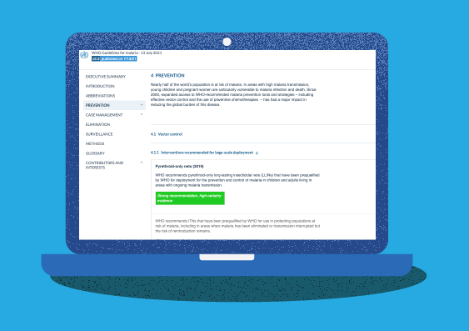
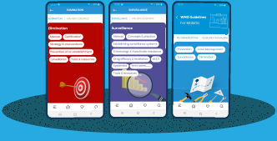
Ways to access WHO malaria guidance
WHO’s malaria guidance can also be found on 2 digital platforms:
2
3
Through MAGICApp, you can access a consolidated set of all WHO malaria guidance, including:
All WHO recommendations can also be accessed through an easy-to-navigate mobile "Malaria Toolkit app".
The app is available for iOS devices and Android devices.
In addition to the WHO recommendations, it provides the latest data and trends from the World malaria report.
All official WHO recommendations
Operational manuals
Handbooks
Frameworks
And links to other resources

Slide 21
Thank you

