Slide 1
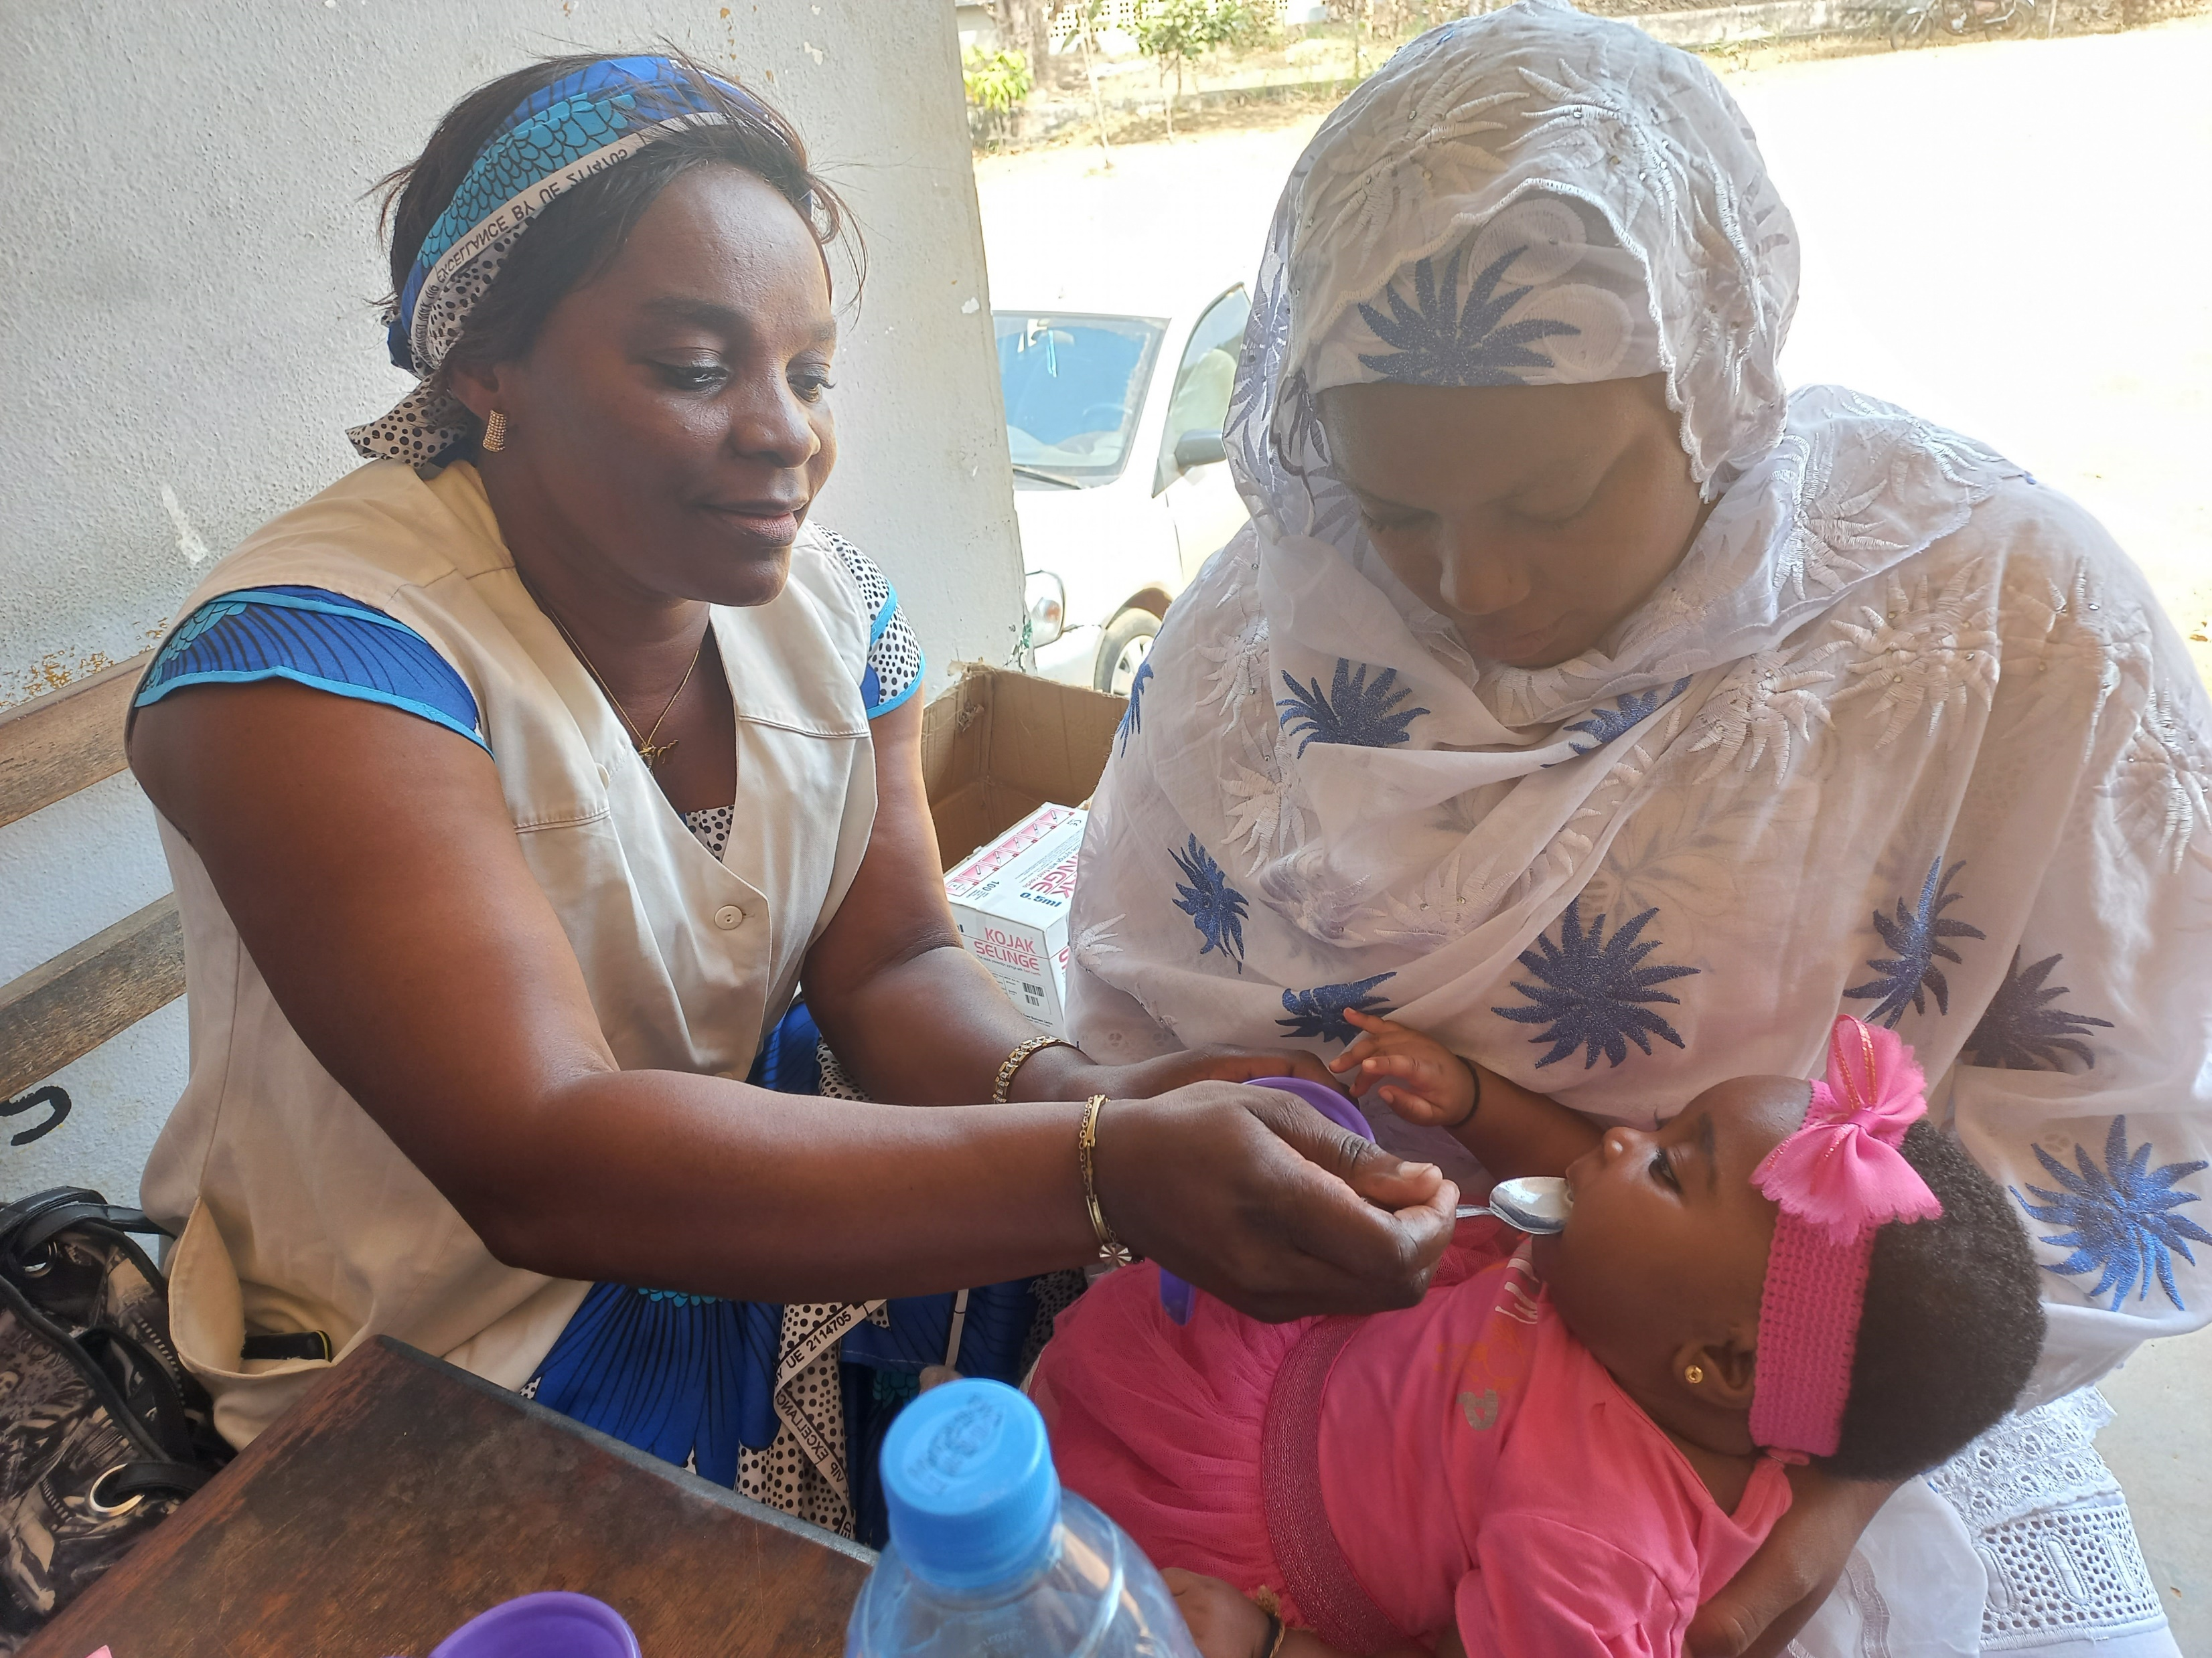
SMC Alliance Annual Meeting
February 27, 2025
Session VIII:
Overview of the PMC
Community of Practice
Junior Voundi Voundi, Head of Chemoprevention
Unit, National Malaria Control Program, Cameroon, and PMC Community of Practice Co-Chair
Mother Arama and Baby Ruamiswaa attending EPI vaccination clinic to receive PMC, Cameroon

Slide 2
WHO has recommended PMC for children since 2022
In areas of moderate to high perennial malaria transmission, children belonging to age groups at high risk of severe malaria can be given antimalarial medicines at predefined intervals to reduce disease burden.
PMC schedules should be informed by the age pattern of severe malaria admissions, the duration of protection of the selected drug, and the feasibility and affordability of delivering each additional PMC course.
SP has been widely used for chemoprevention in Africa, including for PMC. ACTs have been effective when used for PMC, but evidence is limited on their safety, efficacy, adherence to multi-day regimens, and cost-effectiveness in the context of PMC.
Previously, PMC was recommended in infants (<12 months of age) as IPTi. Since the initial recommendation, new data have documented the value of malaria chemoprevention in children aged 12 to 24 months.
The EPI platform remains important for delivering PMC. Other methods of delivery can be explored to optimize access to PMC and integration with other health interventions.
Moderate to high perennial malaria transmission settings are defined as areas with P. falciparum parasite prevalence greater than 10% or an annual parasite incidence greater than 250 per 1000. These thresholds are indicative and should not be regarded as absolutes for determining applicability of the PMC recommendation.

Slide 3
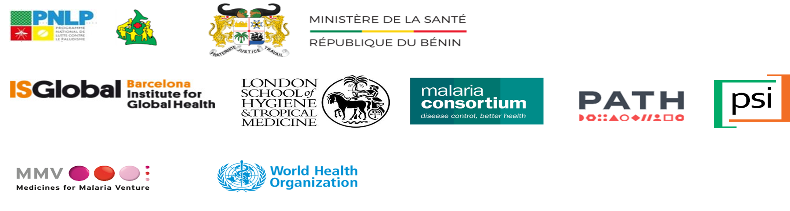

PMC Community of Practice
A collaborative platform for National Malaria Programs (NMPs), Expanded Programs on Immunization (EPIs), implementation partners and other stakeholders.
Aims to support the adoption and implementation of PMC across countries.
Objectives:
  Exchange plans, lessons learnt, and good practices regarding PMC implementation
  Discuss PMC implementation research evidence
  Share resources to support PMC implementation
Current activity: Producing a collaborative international PMC Operational Handbook
Co-chairs:
Dr. Junior Voundi Voundi, NMCP Cameroon
Dr. William Houndjo, NMCP Benin
Biweekly Secretariat meetings: Fridays at 9am Abidjan
Secretariat Members:
To be added to the virtual space:
Andre Marie Tchouatieu tchouatieua@mmv.org
To be added to the mailing list:
Charlotte Eddis ceddis@psi.org

Slide 4
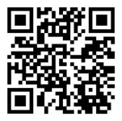
PMC COP Operational Handbook
The handbook provides a comprehensive operational guide for PMC planning, implementation, monitoring, and integration into national health programs, based on experiences and lessons learned from ongoing PMC projects and programs across countries.
April 2024
June 2024
July 2024
Sept -Dec 2024
January 2025
Feb 2025
8th MIM Society Conference Kigali - 1st PMC CoP in-person Meeting - Overview of the Zero Draft operational handbook – Group work by Chapter to collect inputs
In country consultations (TWG, Advisory groups etc.) to receive feedback on the handbook
PMC Operational Handbook Technical Review - Chapter by chapter (Team call)
Second draft (Both French and English version) - hosted on MMV SharePoint and link shared with all CoP members for final inputs
PMC Operational Handbook final version (French and English) - working with graphic designer for layout
8th SMC Alliance Meeting, Lomé -Share PMC operational handbook with Stakeholders
July 2024
1st draft PMC Operational – Translation into French version - Both versions shared with broader PMC CoP members
HANDBOOK DEVELOPMENT TIMELINE

Slide 5
PMC COP Operational Handbook
PMC involves the administration of full treatment courses of antimalarial medication (primarily Sulfadoxine-Pyrimethamine (SP)) at predefined intervals to prevent malaria in young children.
- WHO recommends PMC for children at high risk in malaria-endemic regions.
- PMC has been shown to reduce malaria cases, severe malaria, anemia, and hospital admissions.
- Various studies have confirmed its effectiveness, with SP being the most used drug due to its safety, affordability, and ease of administration.
- Countries should develop policies based on their malaria burden, drug resistance patterns, and existing health programs.
- PMC is best delivered through routine health programs, leveraging contact points like child vaccination, Vitamin A distribution, and well-child visits.
- The handbook provides a step-by-step process for countries to incorporate PMC into their malaria control strategies.
- Facility based delivery (e.g., during routine immunization).
- Outreach strategies in remote areas via temporary health posts.
- Mobile teams for hard-to-reach populations.
Community-based administration by trained CHWs.
- Training is essential for healthcare providers, CHWs, and policy makers.
- Focus areas include PMC administration, supply chain management, community engagement, and pharmacovigilance.
PMC
Delivery
Models
What is
PMC?
Background
&
WHO
Guidelines
Training &
Capacity
Building
- Regular supervision ensures quality service delivery.
- M&E frameworks track coverage, adherence, impact, and side effects.
- Countries should integrate PMC data collection into existing health information systems.
Policy
Development
Supervision,
Monitoring
and
Evaluation
(M&E)

Slide 6
PMC COP Operational Handbook
- Community awareness campaigns are critical for PMC adoption.
- Health workers, caregivers, and local leaders should be engaged through radio, interpersonal communication, and visual aids.
- Common misconceptions about PMC, such as safety and necessity, must be addressed.
- PMC can be combined with the new RTS,S and R21 malaria vaccines, as well as existing child health programs.
- Synergies between PMC and immunization programs maximize reach and effectiveness.
- Proper stock management of SP and other commodities is essential.
- Countries should follow the FEFO (First Expired, First Out) principle to prevent wastage.
- Quantification must consider population size, drug wastage, and demand forecasting.
- Surveillance systems must track adverse effects and resistance patterns.
- SP is generally well-tolerated, but potential side effects include skin conditions
Social and
Behavior
Change (SBC)
&
Community
Engagement
Logistics &
Supply Chain
Management
Integration
with
Malaria
Vaccines
& Other
Interventions
Pharmaco-
vigilance
&
Safety
Monitoring

Slide 7
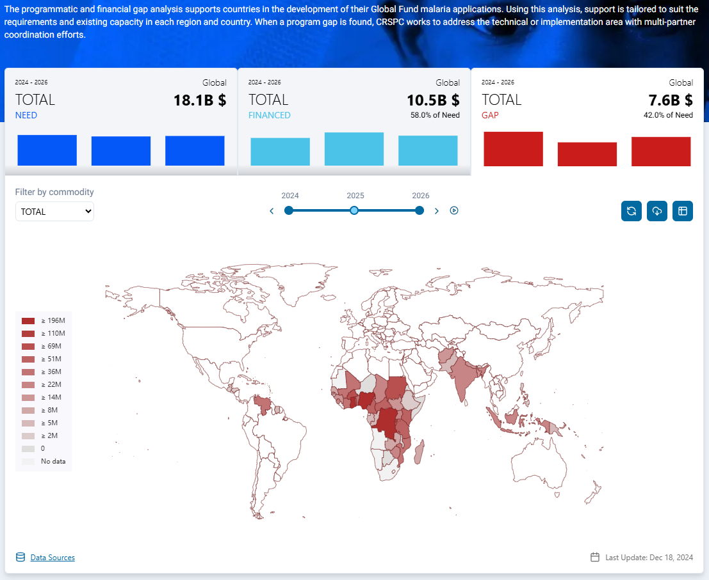
RBM Dashboard and CRSPC Gap Analysis
Background
An analysis of the RBM Partnership to End Malaria Global Malaria Dashboard, specifically the CRSPC Programmatic and Gap Analysis, revealed that certain key interventions, such as PMC, the malaria vaccine, and other chemoprevention strategies (IPTsc, PDMC, etc.), are not included in the financial gap assessment.

Slide 8
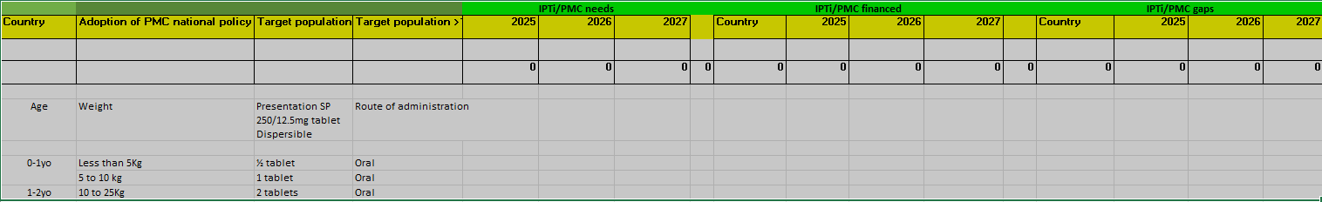
RBM Dashboard and CRSPC Gap Analysis
Calls for Action
It is crucial to conduct a financial gap analysis for PMC and other malaria chemoprevention interventions that are currently missing from the Dashboard.
The PMC Community of Practice (CoP), co-chaired by Dr. Williams Houndjo (Benin) and Dr. Junior Voundi (Cameroon), has developed an Excel file to facilitate data collection on the funding gaps for PMC (below)

Slide 9
RBM Dashboard and CRSPC Gap Analysis
Calls for Action
The CoP for PMC is ready to provide support to countries for the quantification
https://extranet.who.int/prequal/medicines/prequalified/finished-pharmaceutical-products
S Kant Healthcare Ltd | 12 Apr, 2021
Macleods Pharmaceuticals Ltd | 1 Jul, 2021
Universal Corporation Ltd | 22 Aug, 2022
Guilin Pharmaceutical Co Ltd | 30 Jul, 2023
Ipca Laboratories Ltd | 25 Apr, 2024

Slide 10
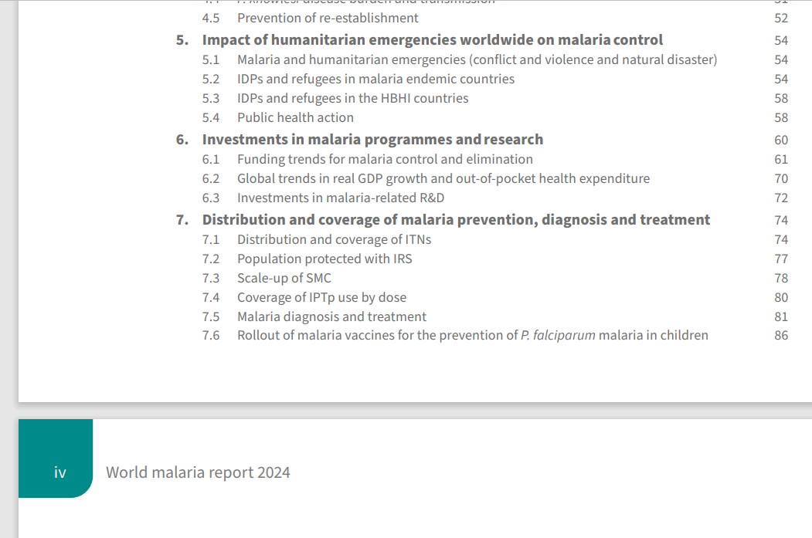
The PMC COP has been asked by WHO GMP to centralize and send PMC data for the World Malaria Report 2025…
7.7 Introduction of PMC (and IPTi)

Slide 11
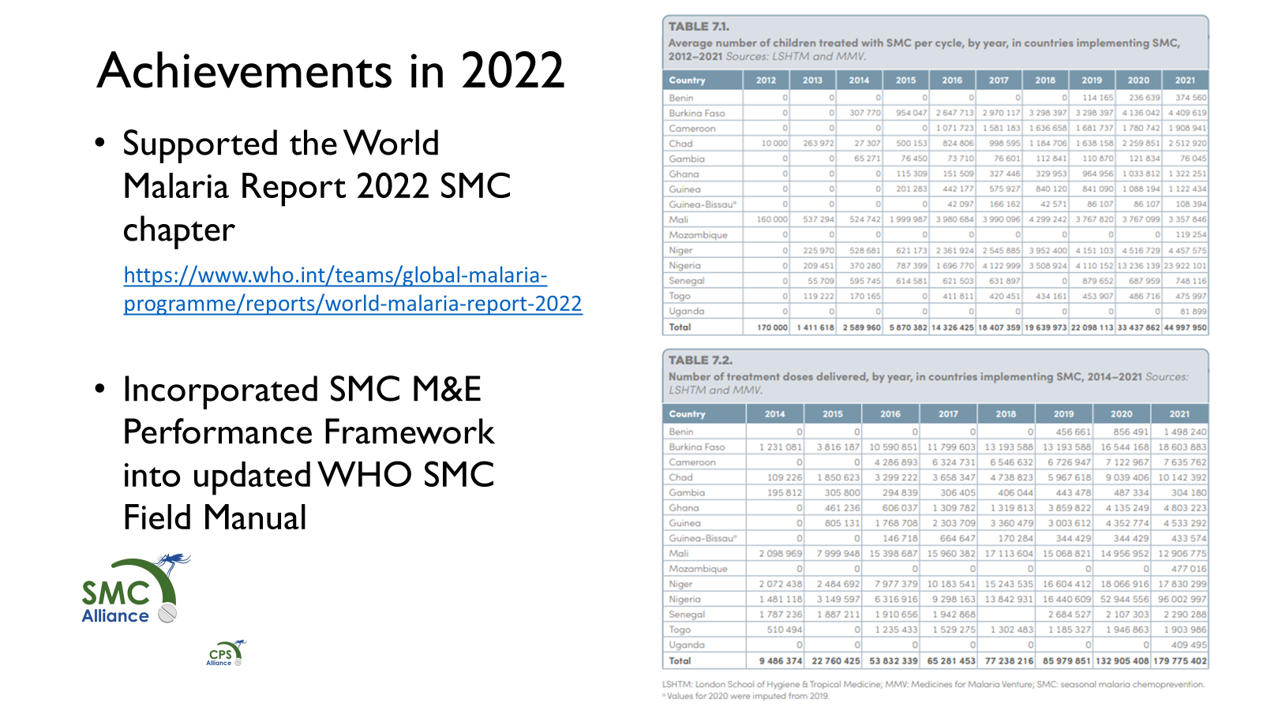
…just as the SMC M&E subgroup does

Slide 12
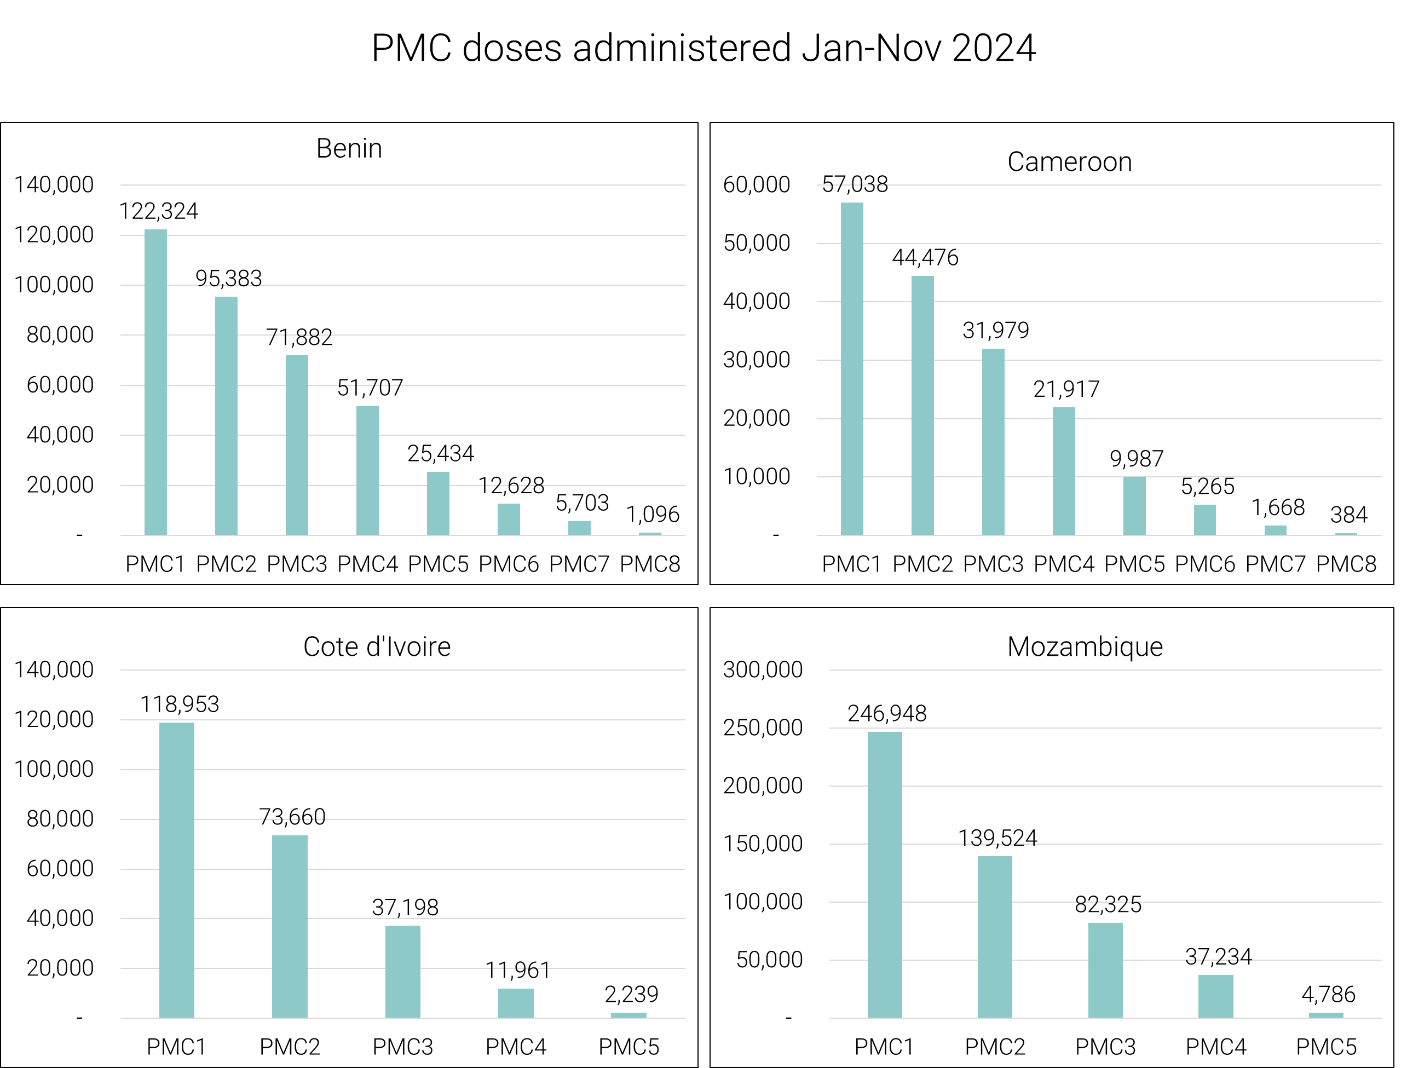
…and the sentinel indicator is: number of children who received at least 1 dose of PMC in 2024

Slide 13
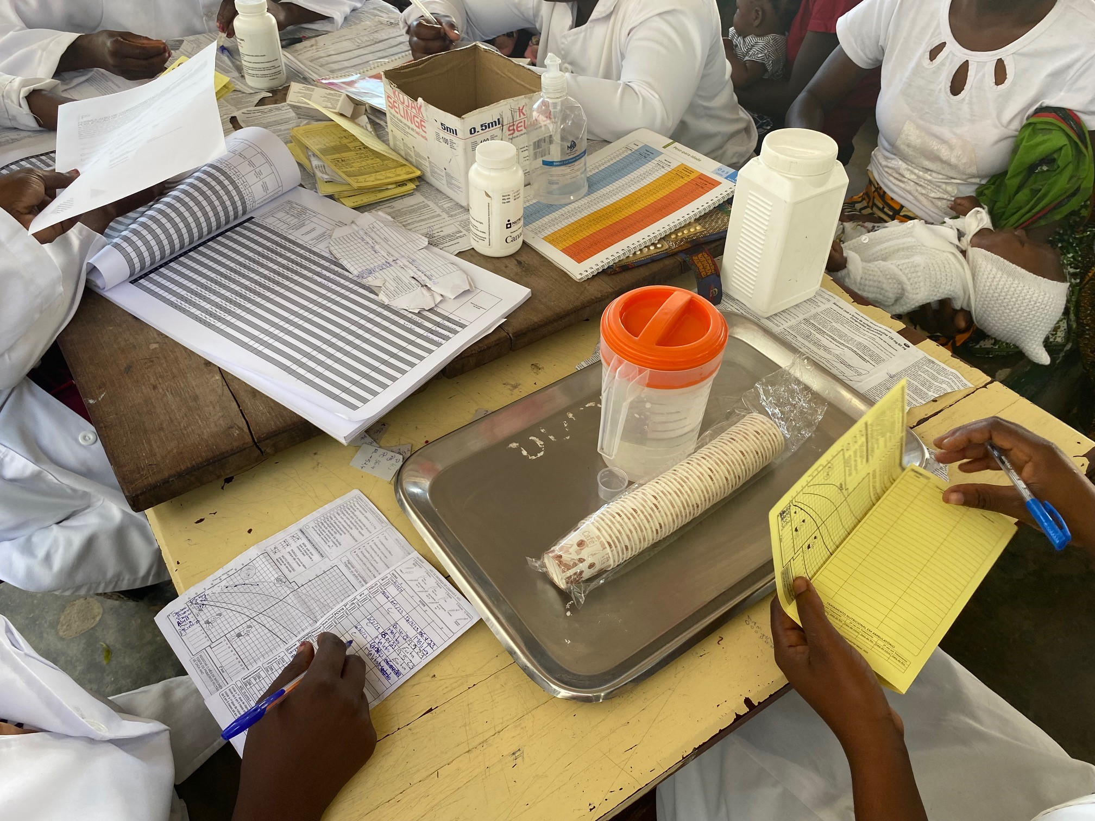
…so we are setting up a PMC M&E Sub-Group!
Call for members:
NMCP Data Managers from all PMC or IPTi implementing countries
Open to other interested parties
Format:
Teams call, in English, French and Portuguese
Please contact me Dr Junior Voundi Voundi:
juniorvoundi.jv@gmail.com
M&E tools as well as PMC tools
Photo credit: Unitaid Plus Project in Mozambique

Slide 14

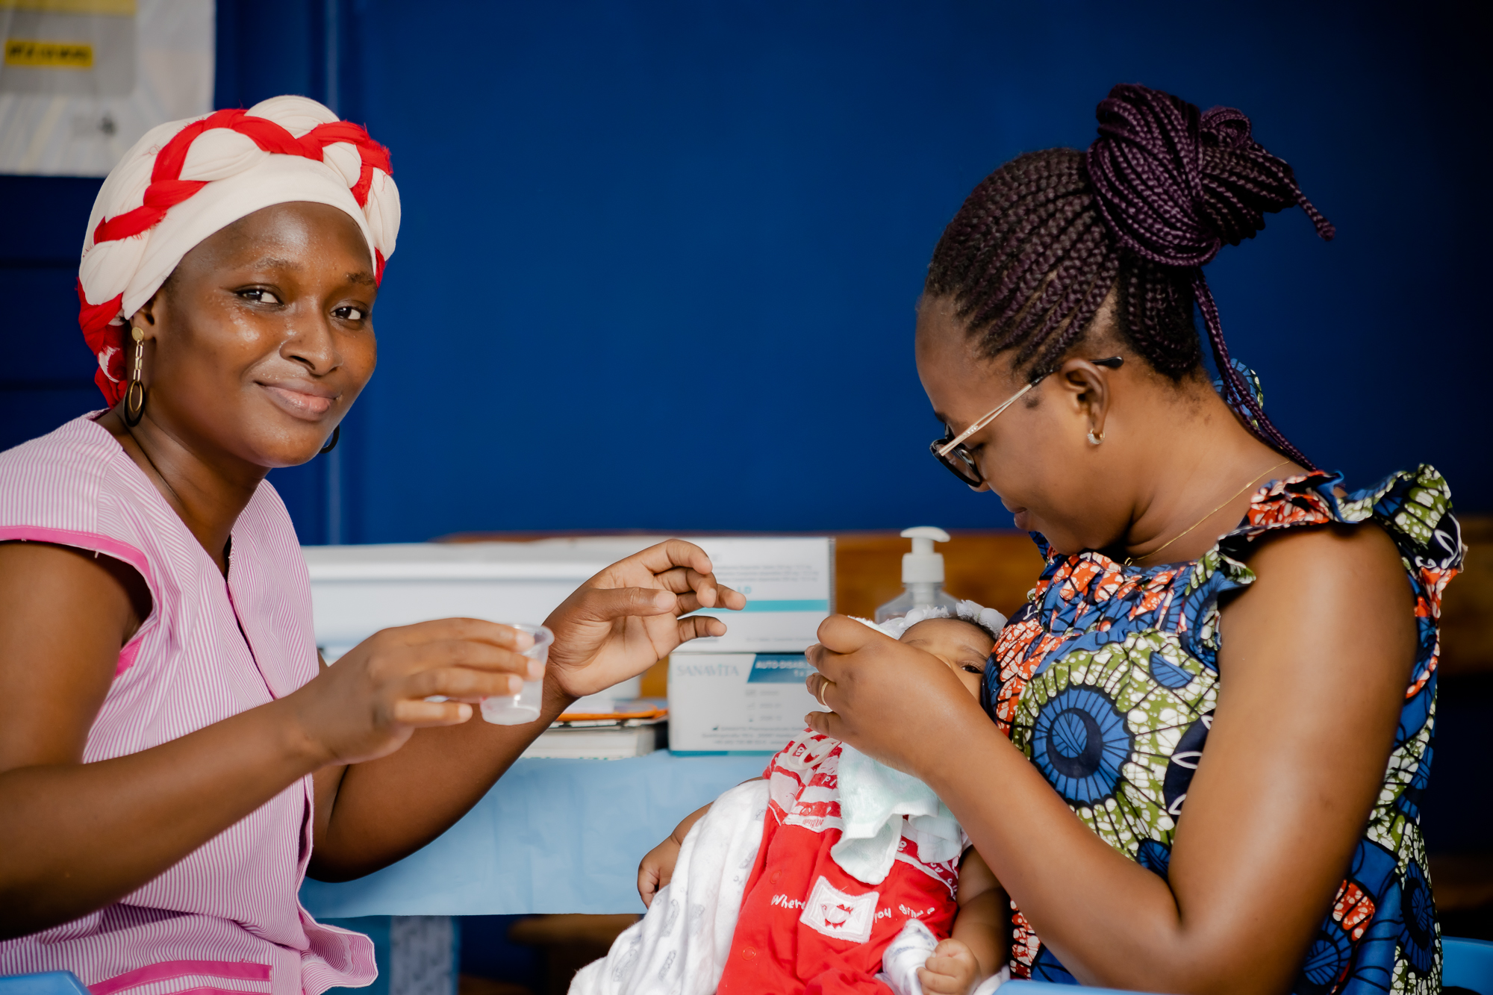

Learnings from the
Unitaid Plus Project on Perennial Malaria Chemoprevention (PMC)
Charlotte Eddis
Plus Project Director, PSI
Health worker Sylla N’Dessou (left) showing mother Topka Nee Konga Sylive how to properly administer PMC to her young child during a photoshoot for SBC materials in
Côte d’Ivoire.
Photo credit: Unitaid Plus Project in Côte d’Ivoire

Slide 15
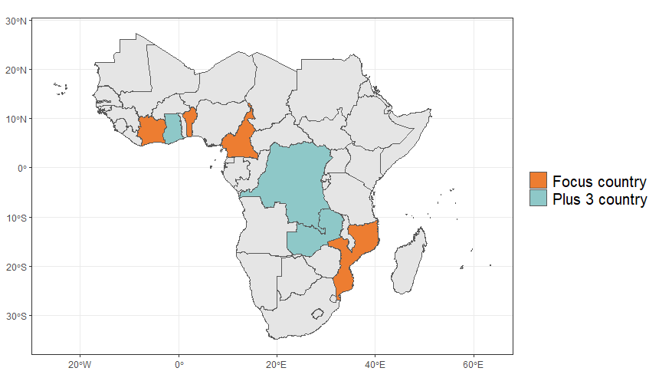
The Unitaid Plus Project
Goal
Reduction in morbidity and mortality due to malaria and anemia in children under two in countries adopting PMC
In Benin, Cameroon, Côte d’Ivoire, and Mozambique, co-design, implement, and evaluate country-adapted models of PMC integrated into existing health systems.
Light-touch evaluations and policy adoption support in DRC, Ghana, and Zambia.
Outcomes
(1) Increased access to high-quality PMC among children under two in each focus country (2) Evidence generated to catalyze sustained uptake of PMC in the focus countries and others in SSA
Conduct a package of evaluations including policy adoption, impact, process, economic, and SP resistance mapping to help countries decide where and how to scale PMC.​
Share learnings from implementation experience and research evidence broadly to help other countries decide if and how to use PMC as part of their malaria chemoprevention strategies.
August 2021 – October 2025; funded by Unitaid (www.unitaid.org).
Notes:
Talking points (to be added):

Slide 16
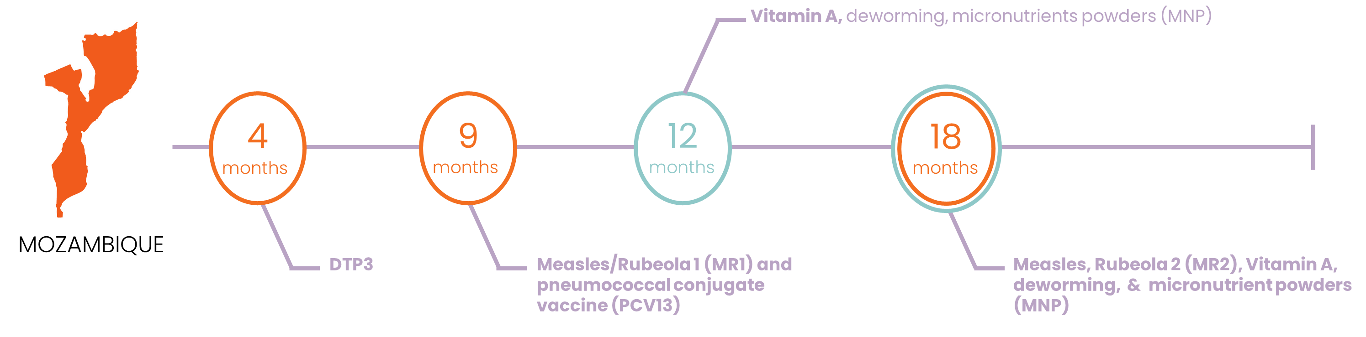
The original schedules in the 4 Focus Countries
Vitamin A
Vitamin A
Vitamin A
Vitamin A
10
14
6
9
12
15
18
24
weeks
weeks
months
months
months
months
months
months
BENIN:
8 doses
DTP2
DTP3
Measles 1
Measles 2
Vitamin A
Vitamin A
Vitamin A
Vitamin A
10
14
6
9
12
15
18
24
weeks
weeks
months
months
months
months
months
months
CAMEROON:
8 doses
DTP2
DTP3
Measles 1
Measles 2
Vitamin A
10
14
9
15
18
weeks
weeks
months
months
months
COTE D’IVOIRE:
5 doses
DTP2
DTP3
Measles 1
Measles 2
Vitamin A, deworming & micronutrients
Measles 2, Vitamin A, deworming, micronutrients
4
9
12
18
months
months
months
months
DTP3
Measles 1 & PCV
MOZAMBIQUE:
4 doses
First year of life (0-11 months)
Second year of life (12-24 months)

Slide 17
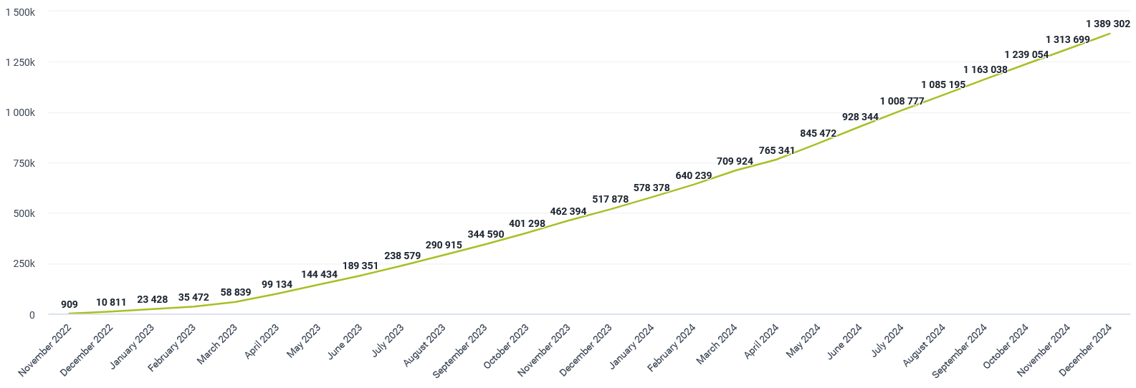
As of November 2024, 1.3 million PMC doses have been given in the 4 focus countries…
Cumulative number of SP doses administered during the life of the Plus Project in the Plus Project-supported districts

Slide 18
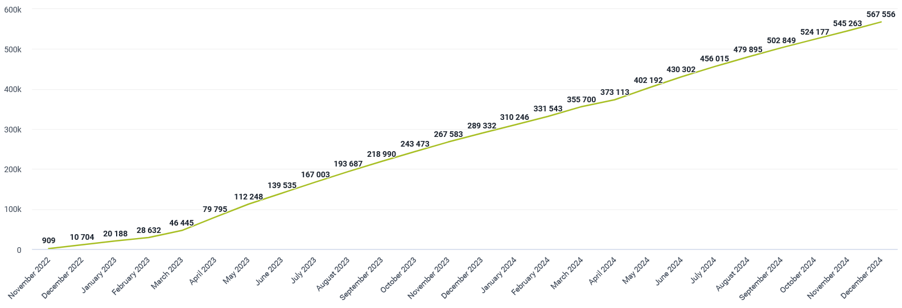
…reaching over ½ million children
Cumulative number of children reached with at least one dose of PMC during the life of the Plus Project in the Plus Project-supported districts

Slide 19
There is a challenge reaching children in the second year of life...
PMC doses administered Jan-Dec 2024

Slide 20
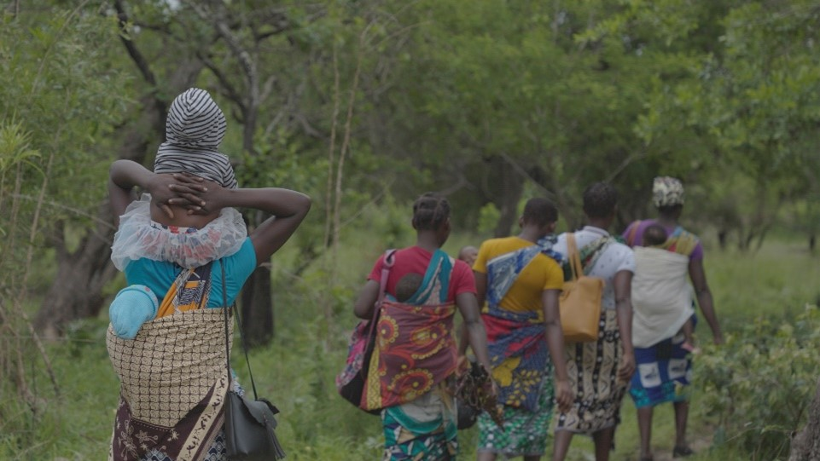
Worth the Walk: Protecting Children from Malaria in Mozambique
A group of women in Sofala province, Mozambique walking four hours to the Healthy Child Consultation, including with children in the second year of life, November 2023. Photo credit: Mwangi Kirubi

Slide 21
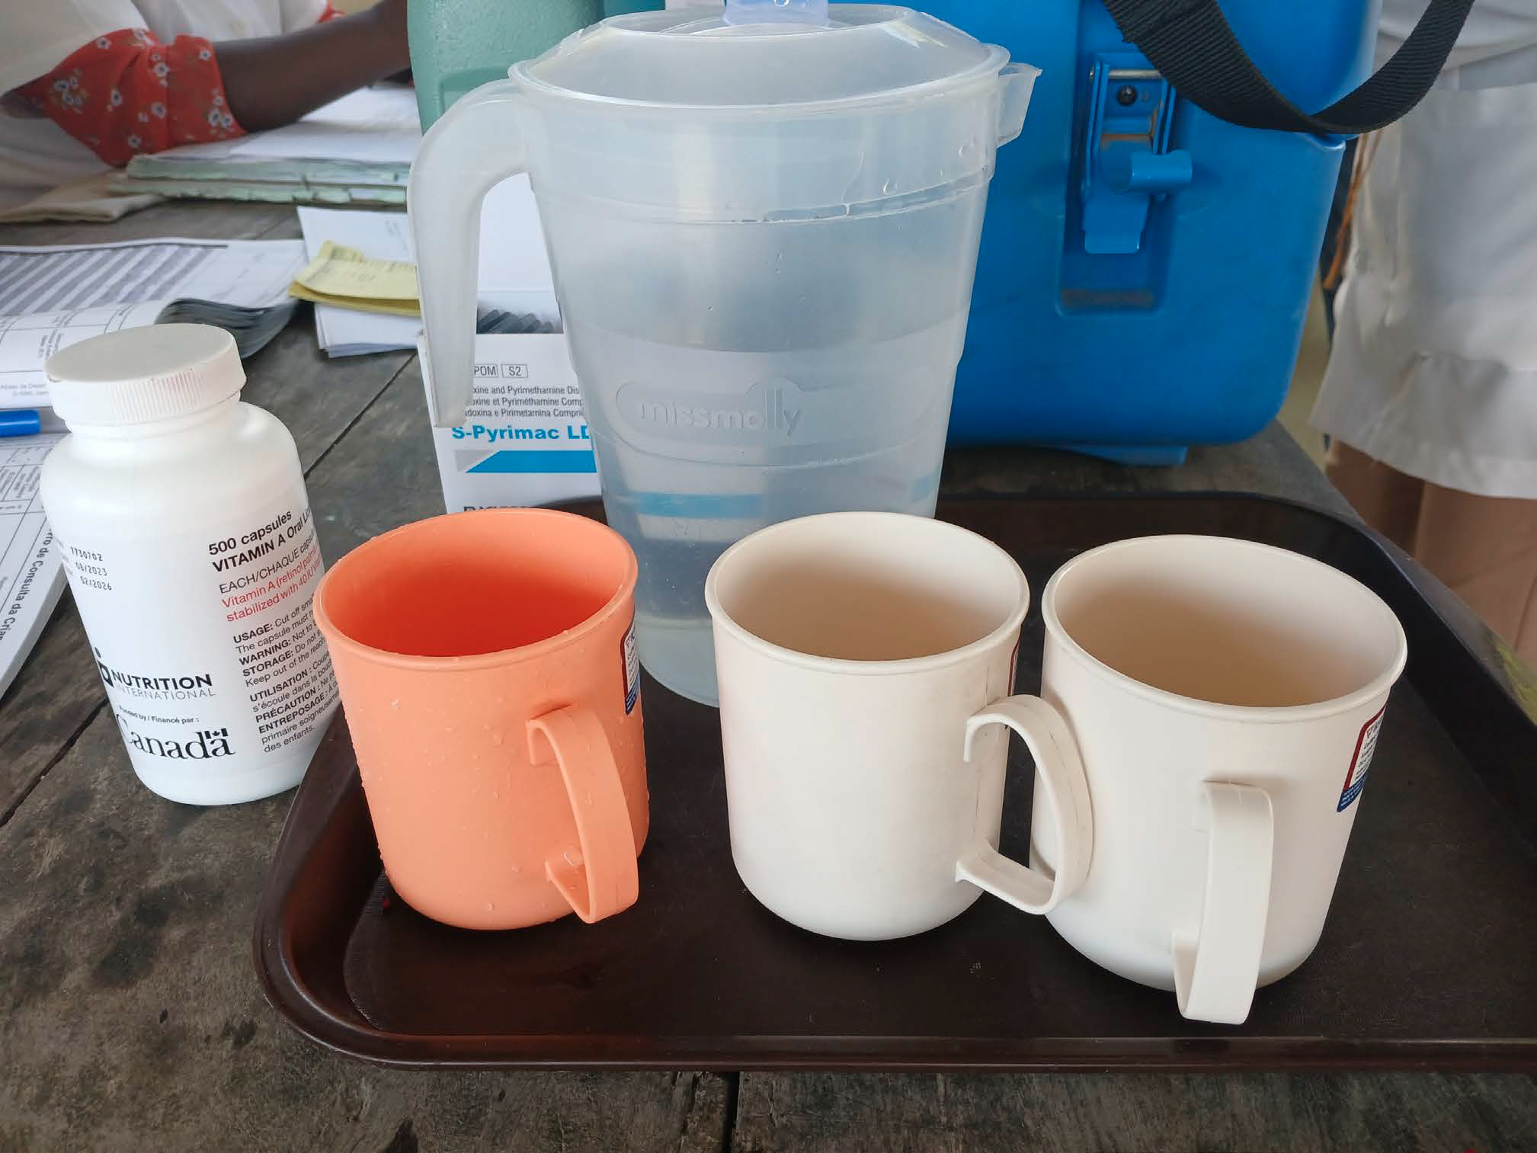
Existing evidence for Perennial Malaria Chemoprevention
WHO Recommendation based on 10 randomized control trials and Cochrane Review Esu et al 2021
PMC (at least 3 doses of SP) probably reduces:
  Clinical Cases by 22%;
  Severe malaria by 8%;
  Anemia by 18%
  All cause hospital admissions by 15%
  All cause mortality by 7%
Cost-effective:
  Low cost of SP and minimal impact on EPI programs
Safety of 4 doses of SP annually = 8 doses in first 2 years of life demonstrated through SMC at scale over 10 years

Slide 22
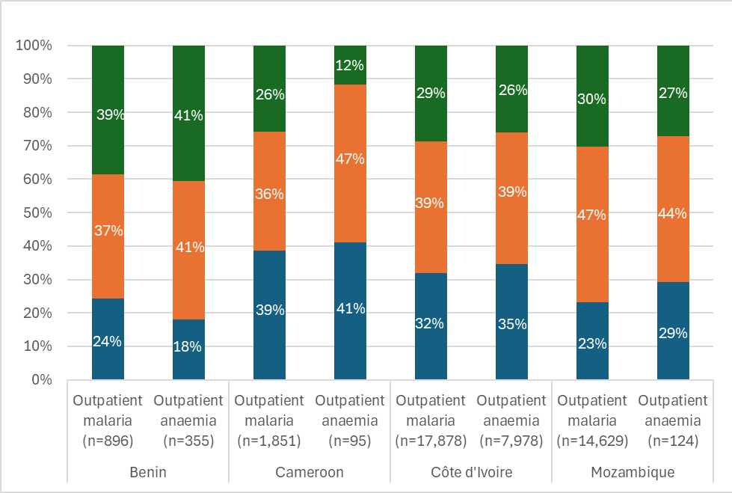
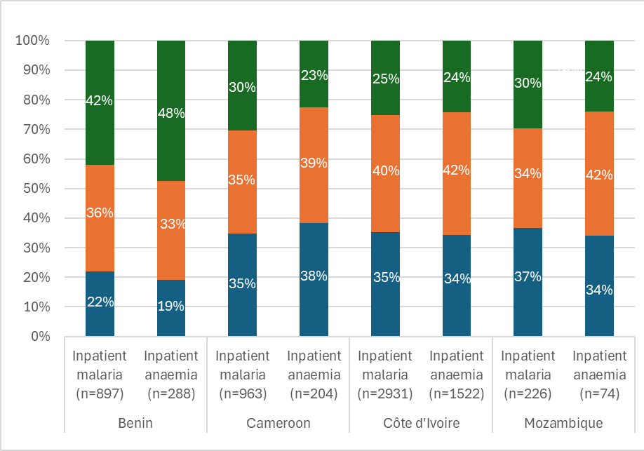
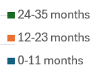
Burden is similar in 1st , 2nd and 3rd year of life in all 4 Focus Countries
Age distribution of outpatient malaria and anemia
Age distribution of inpatient malaria and anemia
Cote d’Ivoire, Benin et Cameroun: Jan – Dec 2022; Mozambique: Février 2022- Dec 2023
Source: Plus Project, LSHTM, Economic Evaluation Work Package Round 1

Slide 23
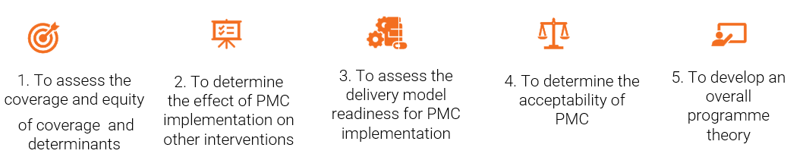
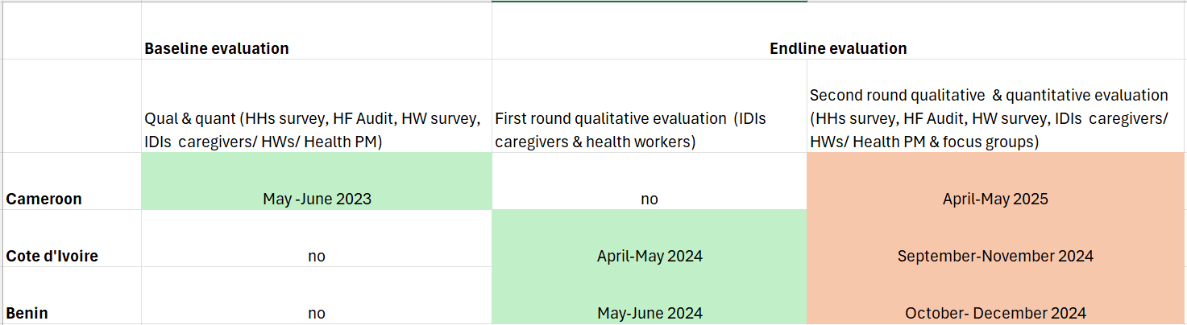
The Process Evaluation’s objectives & timeline
Notes:
To set the scene
I can delete this, if you think it is not necessary
Notes on co-design: Held co-design workshops which convened key stakeholders to collaboratively design a PMC model tailored to each country's context. Co-design the PMC model for each country using existing contacts at health centers and community level, including the number of contacts and the corresponding age. Some countries also decided on the geographical areas of implementation for the project-supported PMC.

Slide 24
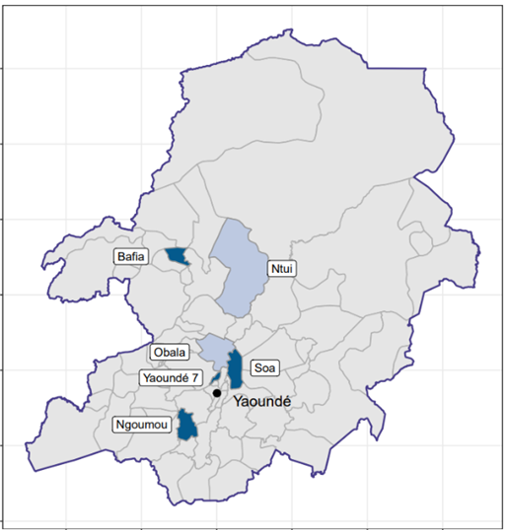
Interesting findings from Cameroon HH survey
Household survey of children aged 12 – 35 months conducted in catchment areas of 20 selected health facilities. Caregivers selected using adapted EPI random walk sampling method
#1 Coverage of immunization and vitamin A
#2 Coverage by delivery methods
#3 Vaccination dropout rate & unvaccinated children
Notes:
Notes on co-design: Held co-design workshops which convened key stakeholders to collaboratively design a PMC model tailored to each country's context. Co-design the PMC model for each country using existing contacts at health centers and community level, including the number of contacts and the corresponding age. Some countries also decided on the geographical areas of implementation for the project-supported PMC.

Slide 25
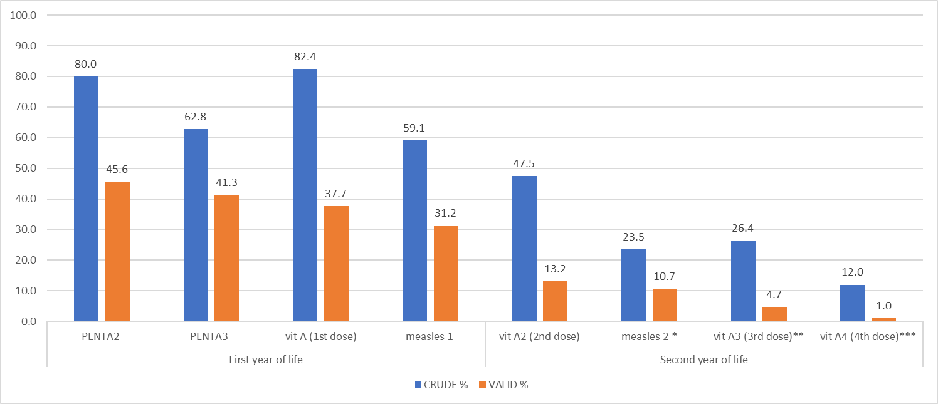
Baseline coverage of individual PMC co-interventions (N=1,199)
*** excluding children younger than 15 months (denominator 1,035 instead of 1,199)**** excluding the ones younger than 18 months (denominator 887 instead of 1,199) ***** excluding the ones younger than 24 months (denominator 588 instead of 1,199)
Notes:
Gap between crude and valid (due to missing vaccination cards), high coverage with early doses that decreases with each contact with large drop in coverage in 2nd year of life with measles 2,
High coverage of 1st VitA dose (6 months), rapidly drops for 2-4 doses .
Coverage of individual doses in line with DHS 2018 coverage data and WUENIC (WHO & UNICEF WHO/UNICEF estimates of national immunization coverage 2022)

Slide 26
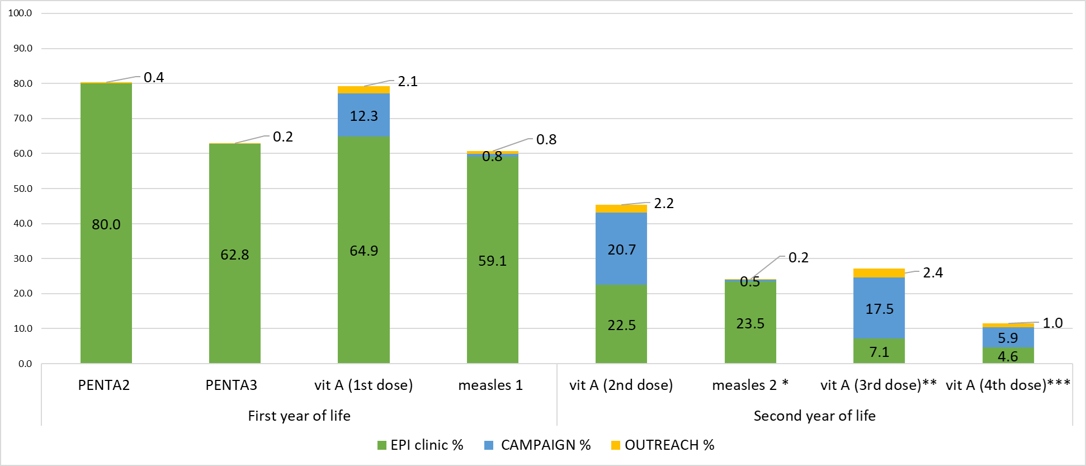
Crude coverage by delivery methods
* Excluding the children younger than 15 months (denominator 1,049 instead of 1,199) ** Excluding the children younger than 18 months (denominator 898 instead of 1,199) *** excluding the children younger than 24 months (denominator 592 instead of 1,199)
Notes:
Difference between coverage of individual dose and cumulative doses is due mostly by vit A being delivered by “nutrition and child week” (and not recorded in vaccination cards). 27% (82%-55%) of children receiving the first dose of vitamin A hadn’t received DPT2 & DPT3 (this is a potential way that could be used to find zero dose or dropped out children)
From our baseline it seems that the proportion of vaccines received by outreach delivery method is very low. Need to see if it is the same is happening in CdI/ Benin and at end of the study evaluations ( we expect differences, seeing the support of PSI to outreach interventions)

Slide 27
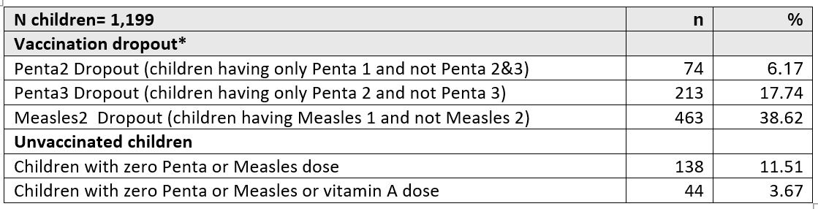
Vaccination dropout rate & unvaccinated children
*the proportion of children who did not get the subsequent vaccine among those who received the first vaccine
Notes:
Vaccination dropout was estimated as the proportion of children who did not get the subsequent vaccine among those who received the first vaccine. A generalized estimating equation was used to assess determinants of the dropout rate and findings were presented using an adjusted odds ratio with 95% confidence interval (this will be presented in the science meeting)
Under vaccinated and unvaccinated/ zero dose children (defined as children who did not received any dose of PENTA)
Here I will just say:
About 20% of our children had PENTA 2 but not PENTA 3 “les perdu de vue”
About 40% of our children had measles 1 and not measles 2
11% didn’t have any of PMC co-interventions vaccine–in line with DHS 2018 results: zero dose children/ les enfants a dose zero- A lot of work to do to reach those children!
Determinants of the dropout rate: Poor wealth quintile, advanced maternal age,, and limited health prevention knowledge & behavior contributed to not receiving any vaccines

Slide 28
Key themes: Impact and cost-effectiveness
Coverage (doses in children) drives impact
  Burden is equal in 1st , 2nd and 3rd year of life in all 4 Focus Countries
  We need to work to improve coverage/ attendance of EPI (and PMC) in the second year of life *beneficial for child health programs*
  Improving outreach and/ or community delivery channels will improve coverage but likely increase costs
Change our thinking from delivery of n number of doses to an opportunistic approach like IPTp
  Similarly to IPTp we offer PMC at every EPI visit
    Programmatically easy to do
    Maximize the opportunity that children are protected
    Multiple doses of SP are safe (SMC delivers 3-5 doses 1 month apart from 3 months to 5 years old)

Slide 29
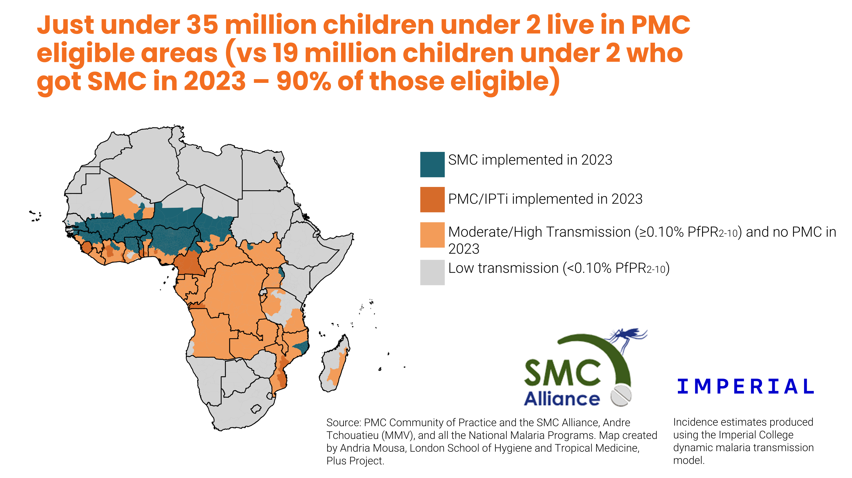
Key themes emerging from the research: Policy
PMC as an equity issue
  19 million children under the age of 2 years receive SMC at high cost
  35 million children in non-SMC areas without chemoprevention (PMC)
  Huge unmet need
PMC and malaria vaccine as a single EPI intervention
  In countries where both are being rolled out we see great acceptability and feasibility
  Target similar age range, neither providing 100% protection

Slide 30
Initial Program Theory for PMC
Caregivers
IF (context + intervention)
malaria is perceived as a threat and a priority problem, children are felt to not be fully protected already or would be better protected by alternative/additional interventions, PMC is understood as being protective against malaria, the timing and places of delivery of each of the doses are known and convenient, caregivers experience of each dose is encouraging (positive interactions with healthcare providers), they have appointments written in child’s booklet (& receive reminders?), and no concerning side effects
THEN (outcome) children will receive the scheduled doses of PMC
BECAUSE (mechanism) the caregiver’s general attitude towards PMC will be positive, the perceived effectiveness high, the burden perceived to be low and the self-efficacy high
Notes:
An intervention works because of the decisions that those involved make
Mechanisms are the triggers of these decisions – eg., perceived effectiveness, self-efficacy
Through our in-depth interviews and focus group discussions we
Identify mechanisms that explain how coverage of PMC is achieved
Determine what contexts influence coverage of PMC positively by activating these mechanisms
Contexts are multi-factored, multi-level, and most importantly are fluid
Interventions interact with and lead to changes in context
initial programme theory
revised programme theory
country specific and cross country

