Slide 1
Intermittent Preventive Treatment in school-aged children (IPTsc) overview
Lauren Cohee, MD MS
8th SMC Alliance Annual Meeting – February 2025

Slide 2
Outline
  Rationale for targeting school-aged children with either IPTsc or extended-age SMC
  Summarize WHO recommendations
  Discuss progress toward and barriers to implementation at country-level

Slide 3
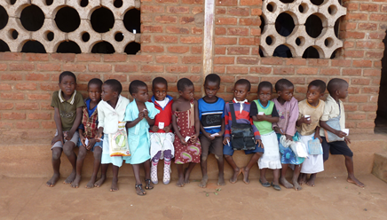







Slide 4
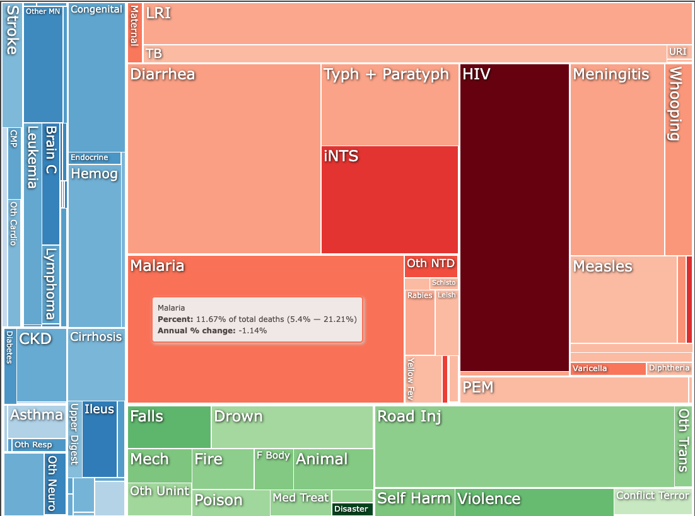
Malaria is the leading cause of death in 5-14yo in sub-Saharan Africa
Institute for Health Metrics and Evaluation (IHME).
GBD Compare Data Visualization. Seattle, WA: IHME, University of Washington, 2020.
Available from http://vizhub.healthdata.org/gbd-compare. (Accessed 27Sept2023)
Notes:
In Sierra Leone, 40% of deaths in this age group are due to malaria.

Slide 5
Clinical malaria is common in school-age children
→ Costs to families and health systems
Malawi ICEMR. unpublished data

Slide 6
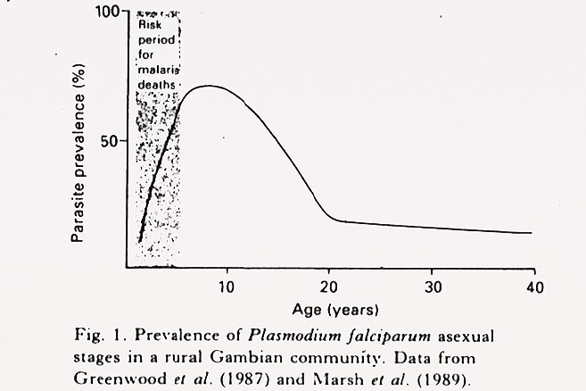

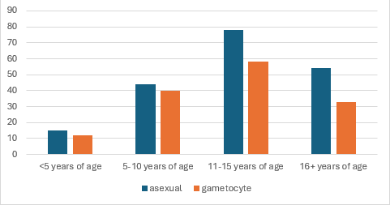
Parasite prevalence peaks in school-age children
Parasite prevalence by age group in
community survey from Sapone, Burkina Faso
The children in whose blood there may be very numerous parasites do not appear ill They run about or attend school and present none of the well-known symptoms of a malarial attack.
Drakeley et al. unpublished data

Slide 7
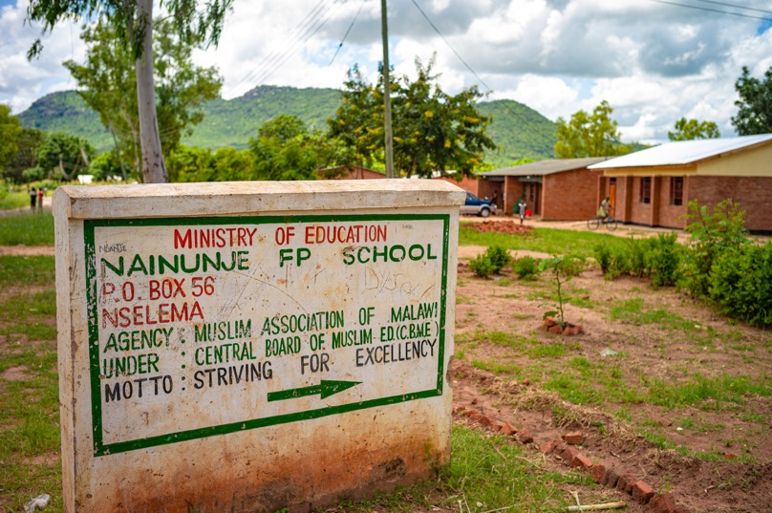
Consequences of high prevalence
52% parasite positive
22% anemic
19% report feeling unwell
School-absences, decreased cognitive function, decreased learning
= Failure to achieve full potential
Sixpence et al. Lancet eClinicalMedicine, 2024
Notes:
OR 1.5 for anemia is parasite positive

Slide 8

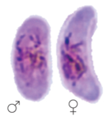



School-age children are the primary reservoir of community transmission
Infected
+
Infectious
+
Bitten
=
Reservoir

Slide 9
How should we address this burden?

Slide 10
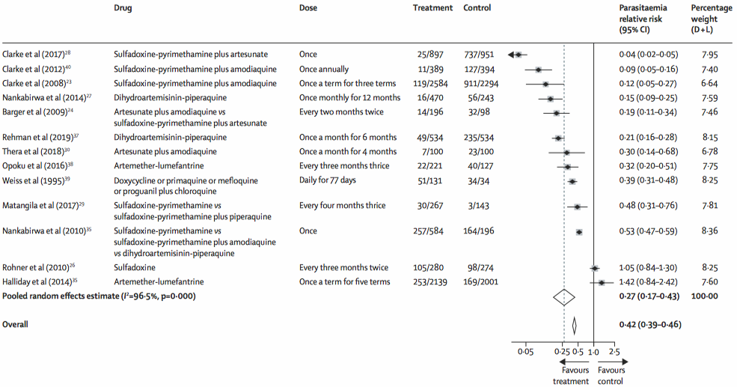
One problem – Two Approaches
Intermittent Preventive Treatment in school-age children
(IPTsc)
Extended-age Seasonal Malaria Chemoprevention (extSMC)

Slide 11
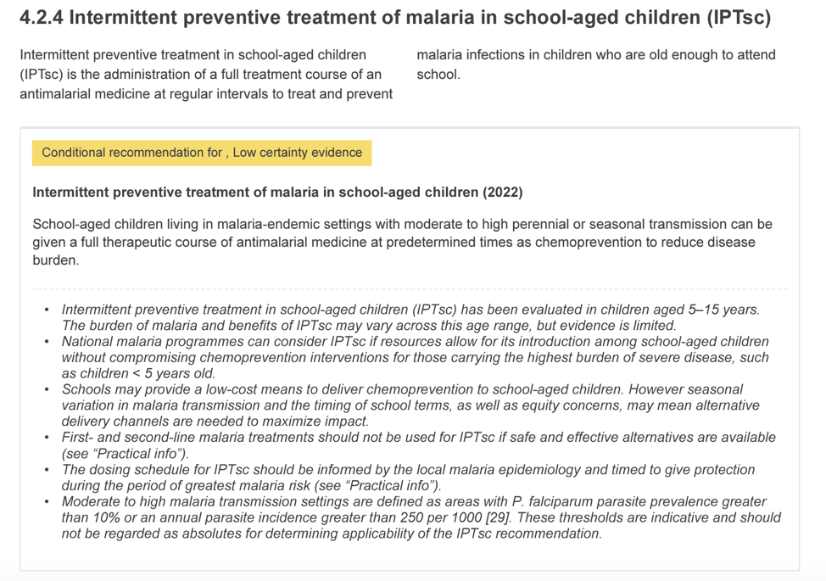
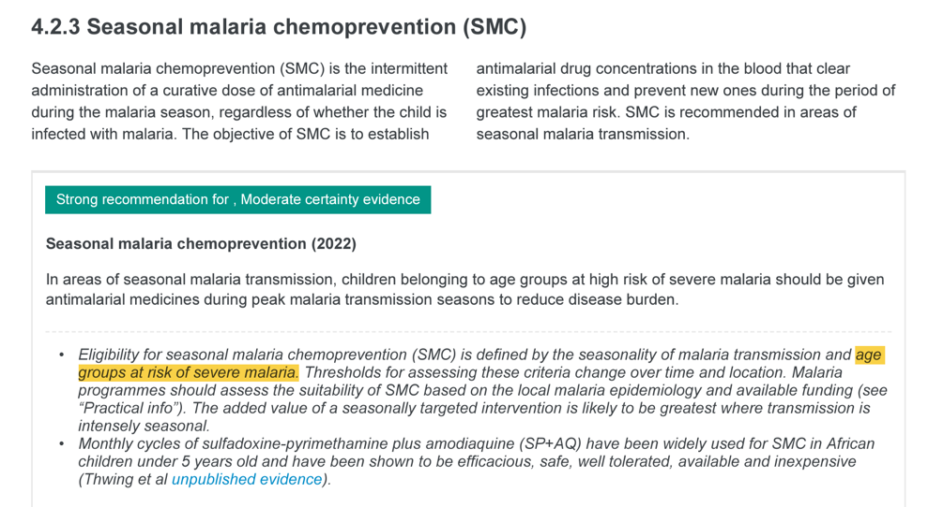
WHO guidelines

Slide 12
 | More the SAME than Different | IPTsc | extSMC
What? | Antimalarial drugs given at regular intervals to clear and prevent infections | ✓ | ✓
 | Not first-line drugs | ✓ | ✓
Where? | Areas with Seasonal transmission | ✓ | ✓
 | Perennial, but focus on high seasons | ✓
How? | Community-delivery | ✓ | ✓
 | School-based (fixed point) | ✓ | ✓
Who? | Age groups based distribution of malaria disease | ✓ | ✓ 3-59mo included
 | 5-10 year olds | ✓ | ✓
 | 10-15 year olds | ✓ | ✓

Slide 13
Chemoprevention to school-aged children is:
Extended-age SMC – If SMC IS also provided to younger children
IPTsc – If SMC is NOT provided to younger children

Slide 14
IPTsc progress
Pilots
Tanzania – complete
Nigeria – baseline prevalence survey done, pilot anticipated in 2025
Uganda – pending funding
Implementation
Tanzania: Next presentation

Slide 15
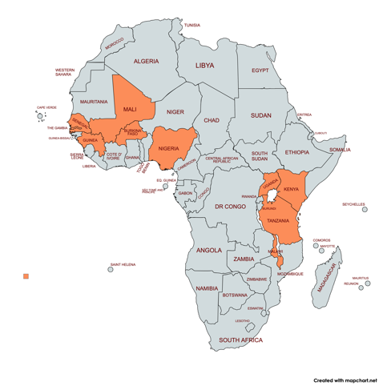
Barriers to IPTsc + extSMC
Ability to stratify data to determine burden in this age group
Support for tailoring interventions to setting
Quantification of community and societal benefits
  Including harmonization of metrics between the two approaches
Cost-effectiveness and cost-benefit analyses to inform prioritization
Funding
*Forthcoming report from Malaria in School Age Children Pre-Meeting at MIM 2024

Slide 16

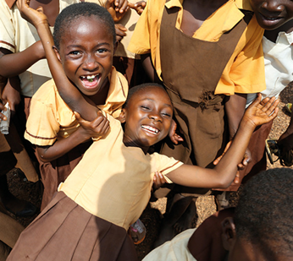
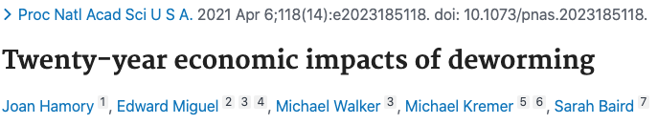
Targeting school-age children now – how do we do MORE with less?
Opportunity to integrate with other school health interventions, especially school-feeding in which there is considerable domestic investment already
Schools as platforms (fixed-points) for delivery of other interventions (SMC, nets…)
Need to invest in human capacity
Image by ChatGPT

Slide 17
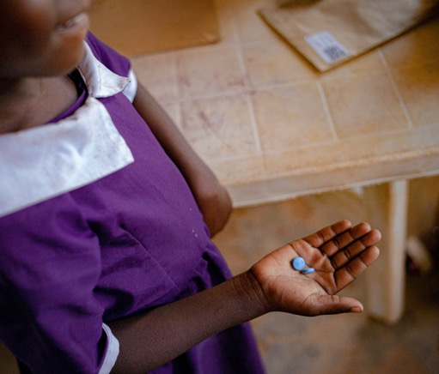
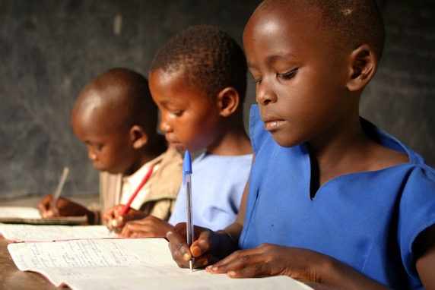
Conclusions
Burden of malaria in school-age children is high and has individual, community, and societal consequences
Individual-level benefits of extSMC and IPTsc are clear
Guidelines ≠ support for implementation
Country-level interest and commitment is present and growing, but support is needed
Opportunity to do more with less?

Slide 18







Akpe, Merci, Obrigado, Thank you!
To discuss or to join a working group focused on school-age children, please contact me:
Lauren.cohee@lstmed.ac.uk

Slide 19
Spare slides

Slide 20
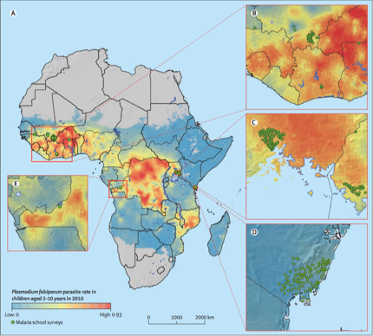
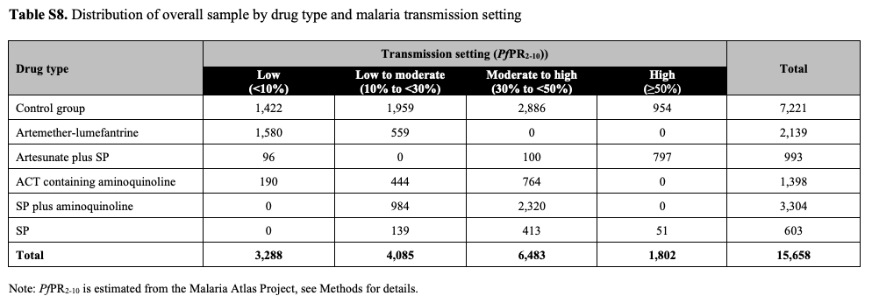
Chemoprevention!
Cohee et al. Lancet Global Health, October 2020

Slide 21
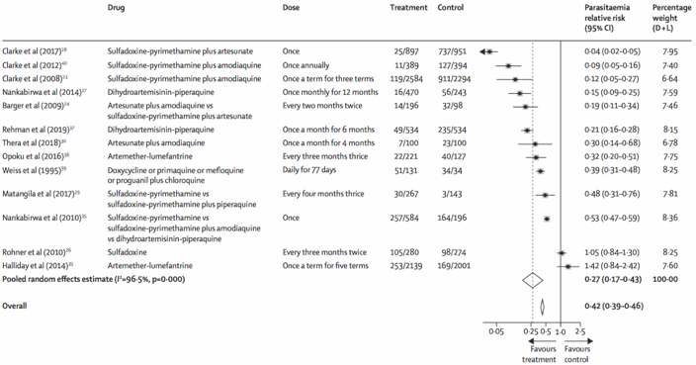




Chemoprevention!
  50% decrease in clinical malaria
  54% decrease in prevalence of infection
  15% decrease in anemia
Increases in sustained attention in older children
Decreased prevalence in the surrounding community
(one IPTsc study + one SMC in older children)
Cohee et al. Lancet Global Health, October 2020

