Slide 1
SEASONAL MALARIA CHEMOPREVENTION MONITORING & EVALUATION SUB-GROUP
2024 achievements & 2025 plans
SMC Alliance Annual Meeting
Lome, Togo
SMC M&E Sub-Group of the SMC Alliance
For questions or feedback, email: suzanne.vanhulle@cr.org

Slide 2
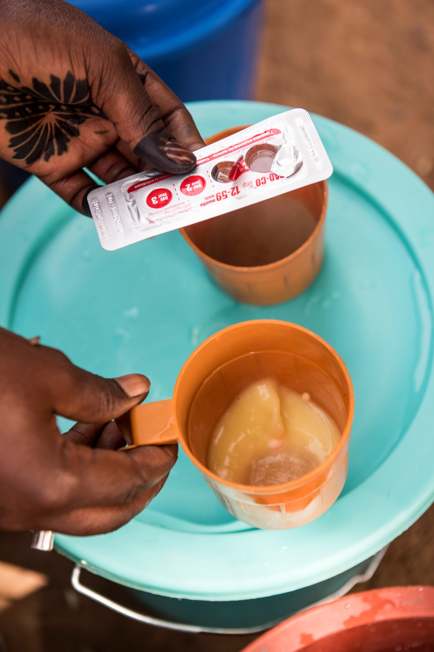
Terms of the Reference
First met on 6 November 2020
Terms of Reference finalized in January 2021
Purpose: provide a platform where members of the SMC community can share challenges and best practices in M&E, and can discuss and collectively develop and harmonize tools
Membership: balance of scientific and programmatic knowledge and experience, as well as geographic representation
Annual focus area: to support NMP and WHO efforts on the annual World Malaria Report chapter on SMC

Slide 3
Achievements against 2024 workplan
Workplan activity | 2024 Achievements
Webinar series | Decided to have webinar series occur in 2025 and gather ideas from this annual meeting
World Malaria Report 2024 | MMV provided inputs to WHO for the SMC chapter
Country Consultation on the SMC Performance Framework from the SMC Alliance M&E Toolkit | Pre-country consultations took place across approximately 15 countries to gather initial feedback from countries Results: Nearly all countries were familiar with the SMC Performance Framework; therefore, the sub-group determined that full consultation to take countries through the performance framework was not necessary. Instead, countries expressed that support around data quality approaches would be needed.

Slide 4
Achievements against 2024 workplan
Workplan activity | 2024 Achievements
Collecting a compendium of sample SMC M&E data collection forms from countries | During the pre-consultation on the SMC Performance Framework, countries agreed that they would be willing to share their SMC M&E data collection forms Identified the SMC Alliance website as a repository for these forms Collections of tools/forms to take place in 2025
Supporting WHO GMP on the development of the DHIS2 SMC Dashboard & Module | SMC M&E sub-group provided feedback on a first version of the dashboard and indicators

Slide 5
Achievements against 2024 workplan
Workplan activity | 2024 Achievements
RBM’s Surveillance, Monitoring & Evaluation working group annual meeting | PSI presented on behalf of the sub-group to RBM’s SM&E Working Group in Nairobi on June 28th Presentation provided an overview of the 2023 achievements of the sub-group, plans for 2024, and opportunities to collaborate with the SM&E Working Group.
ASTMH 2024 – Side meeting | Conducted a side meeting during ASTMH 2024 in New Orleans Gathered ideas for our 2025 workplan, discussed other 2024 workplan activities, and announced the future launch of a co-chair.

Slide 6
Plans for 2025 – We need your inputs!
Continue with some activities from 2024
2025 Workplan – Ideas welcome at www.menti.com with code: 2458 5226
What would you like the M&E sub-group to focus on to help you better monitor and evaluate your SMC campaigns?
Sur quoi aimeriez-vous que le sous-groupe S&E se concentre pour vous aider à mieux suivre et évaluer vos campagnes CPS ?
2025 Webinar Series – Ideas welcome at www.menti.com with code: 2458 5226
Please share topics/themes that you would like to see presented during a webinar in 2025
Veuillez partager les sujets/thèmes que vous aimeriez voir présentés lors d’un webinaire en 2025

Slide 7
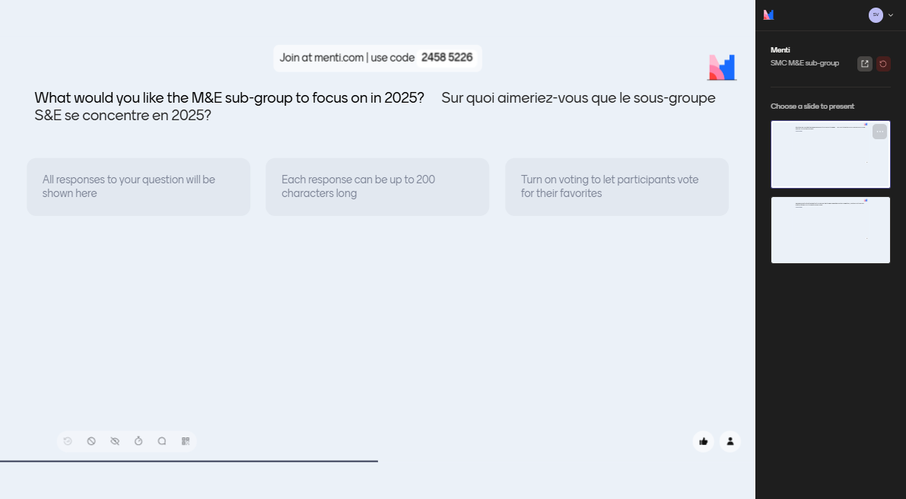

Slide 8
Announcements
Please join today’s afternoon side meeting of the SMC M&E sub-group
Focus on challenges with data quality methodologies and how the sub-group can support you
Open to everyone. Encouraging SMC NMP staff to join!
Time: 15:30 – 17:00
Location: Main conference room
Opening for one co-chair position
Applications and/or nominations are welcome until March 7th, 2025
If you have any questions on the sub-group, please email me at: suzanne.vanhulle@crs.org or speak to any of the sub-group members who will be attending today’s side meeting

