Slide 1





Scaling up IPTsc: lessons learned from field implementation
Dr. Geofrey Makenga
National Institute for Medical Research (NIMR), Tanga,Tanzania.
Global Health Institute, University of Antwerp, Belgium.
Dr. Abdallah Lusasi
Head, Malaria Case Management NMCP. Tanzania

Slide 2
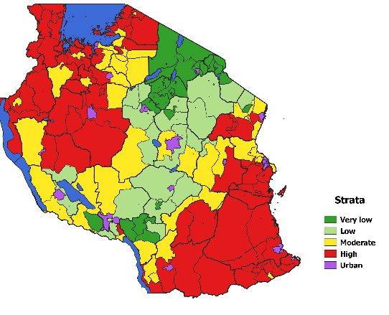
Situation in Tanzania
There are areas that remain high endemic despite available efforts for malaria control: School aged children are the main players
Muheza: high season 2013
Muheza : Low season 2014
Source: NMCP Guideline 2020
Source: NIMR-TRACTION project
Notes:
Separate the slides
Touch base on age disaggregation

Slide 3
Situation in Tanzania
Source: NIMR-TRACTION project
Notes:
Separate the slides
Touch base on age disaggregation

Slide 4
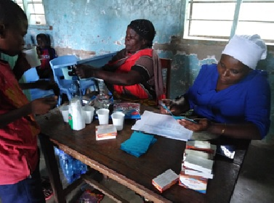
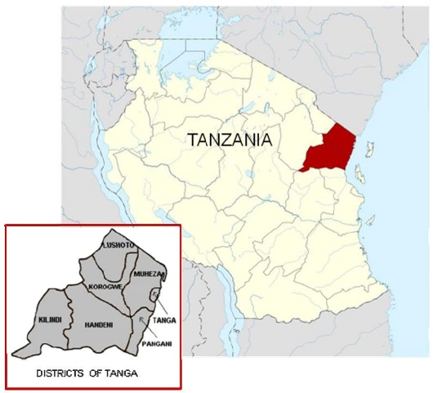


Muheza Study set up ( 2years follow up)
Screening
Enrollment
Randomization
DP
ASAQ
Control
(Makenga et al, 2020)
INTERVENTION AND SAMPLE COLLECTION (N=1566)
 | Month 0 | Month 4 | Month 8 | Month 12 | Month 16 | Month 20
DRUGS
BS*, DBS, HB | * |  |  | * |  | *
URINE, STOOL
Outcomes measured at 12 and 20 months:
Change from baseline in mean haemoglobin (Hb)
Prevalence of parasitaemia
Incidence of clinical malaria:
Cognitive and psychomotor function (change from baseline)
INTERVENTION
REBOUND EFFECT
AE TRACKING

Slide 5
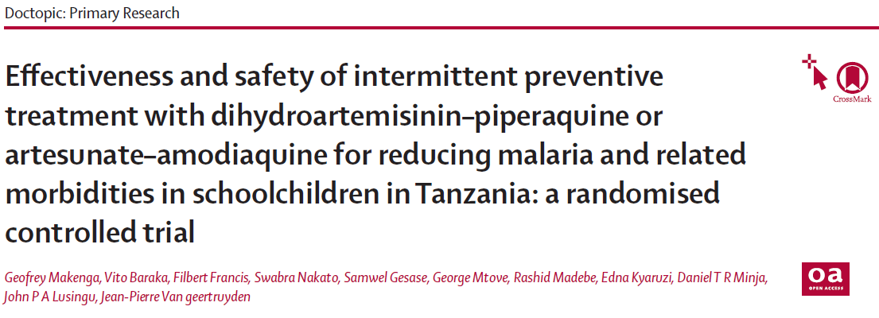
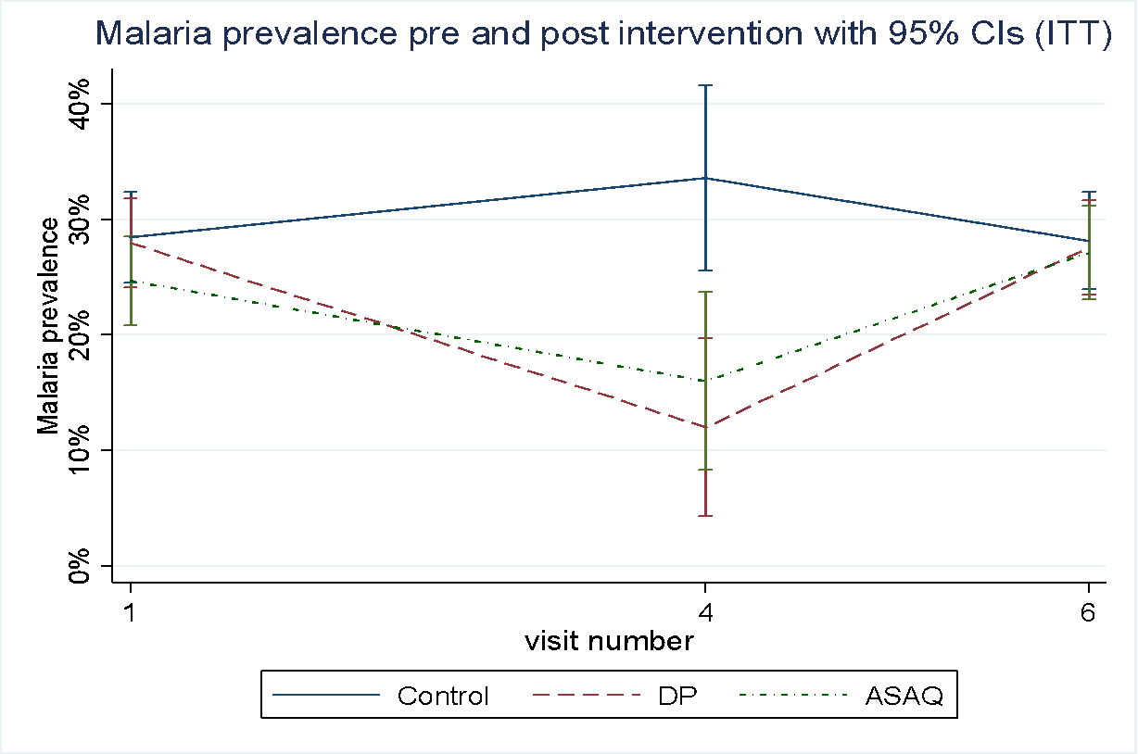
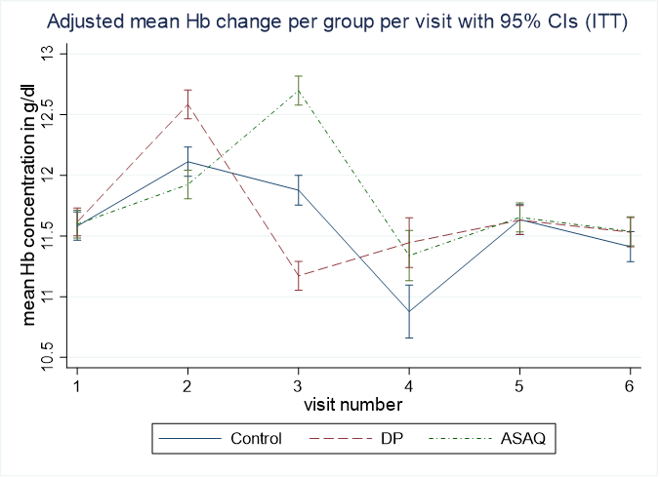
Clinical trial findings
with IPTsc
Without IPTsc
Protective effect (PE)
Hb: DP and ASAQ increased by 0.5g/dL
Prevalence of parasitaemia decreased: by 64% in DP; 52% in ASAQ
Clinical malaria: decreased by 20% DP; 19% ASAQ
At 20 months: no difference
IPTsc needs to be continuous
DP=Dihydroartemisinin-Piperaquine, ASAQ=Artesunate-amodiaquine

Slide 6
Lessons from the Muheza study- clinical trial
Both DP and ASAQ were safe and was effective in reducing malaria parasitaemia prevalence and clinical malaria in schoolchildren and increasing haemoglobin
IPTsc needs to be continuous, one year alone is not enough to shrink the reservoir
School teachers can implement IPTsc, making future implementation feasible
Makenga et al, 2023. Lancet GH.

Slide 7
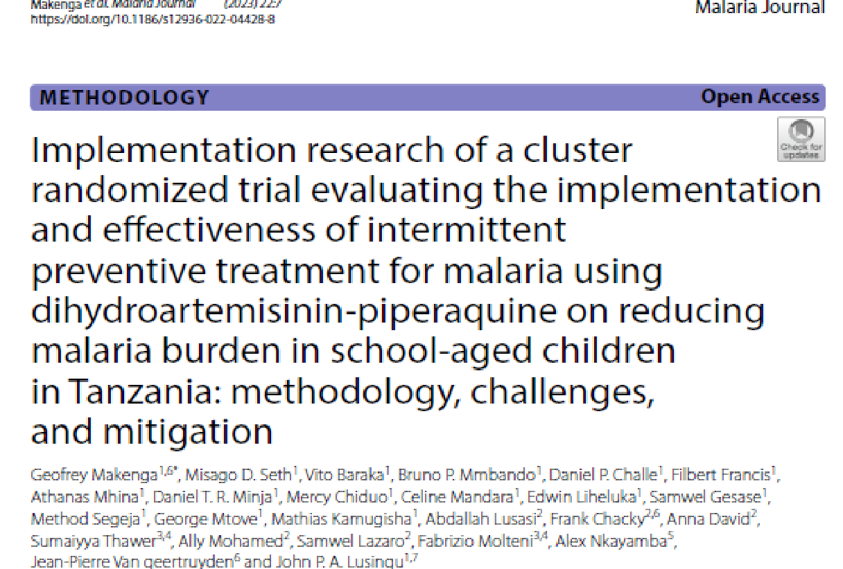


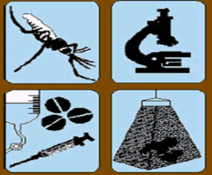
National Institute for Medical Research (NIMR), Tanga Centre, Tanga. Tanzania
National Malaria Control Programme (NMCP). Tanzania
President's Office Regional Administration and Local Government (PORALG), Tanzania
Makenga et al,2023; Malaria Journal.

Slide 8
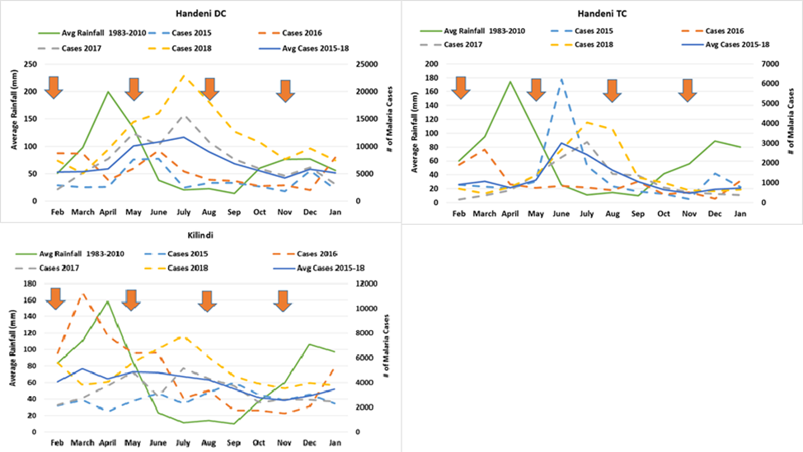
Handeni (DC &TC) and Kilindi: Rain and malaria pattern
Drugs were administered before the malaria peak season.
Months: March, August and November

Slide 9
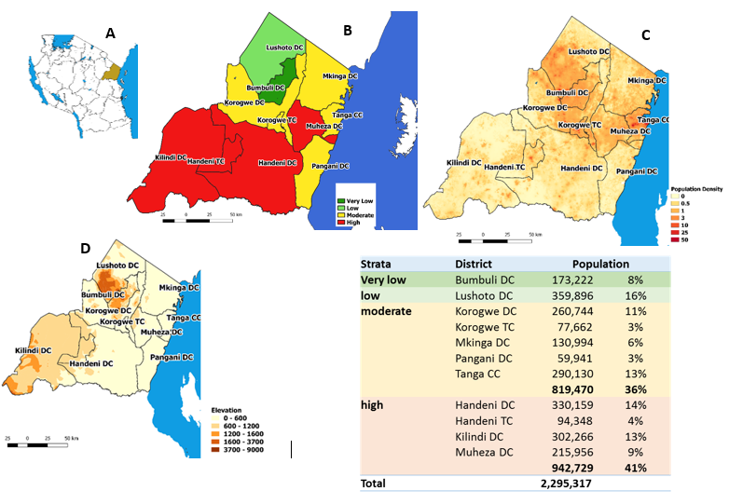
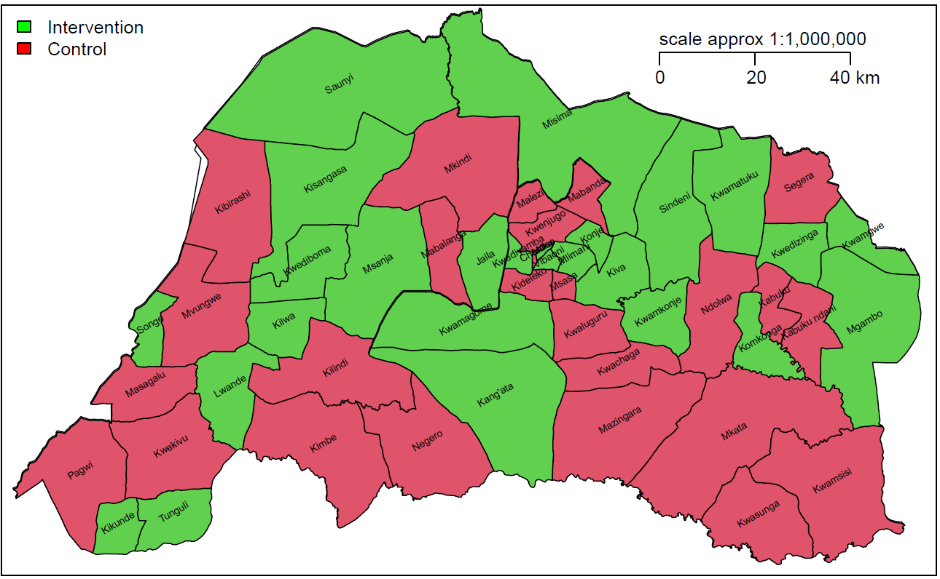
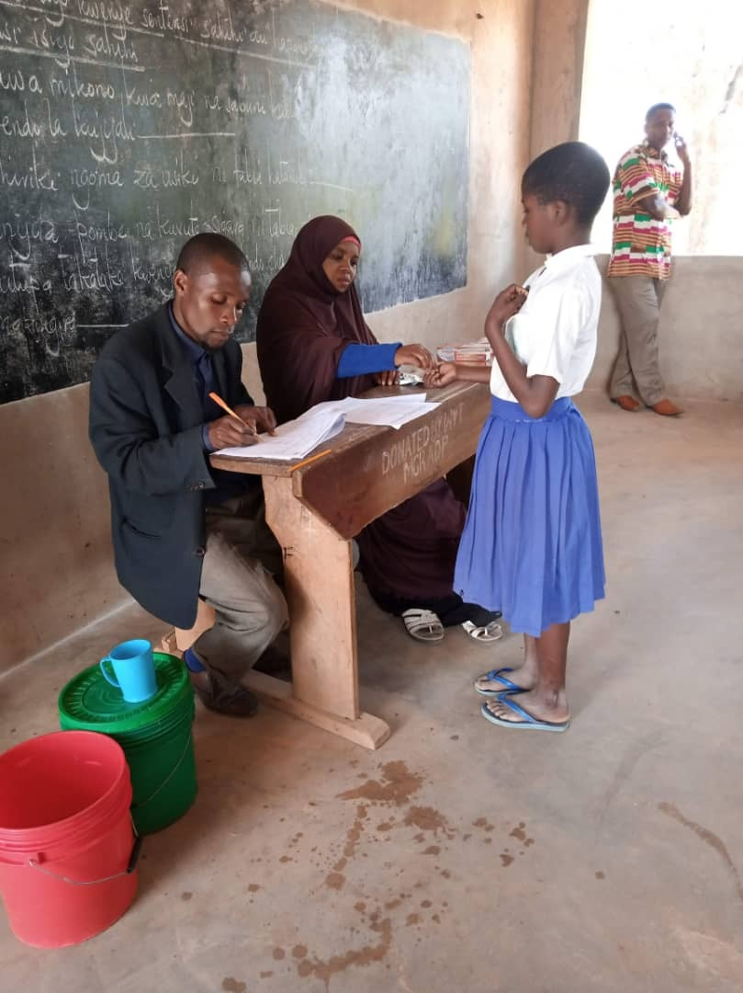
Pilot implementation design
Districts profile
Handeni DC
20 wards, 117 schools
Handeni TC
12 wards, 33 schools
Kilindi DC
20 wards, 111 schools
32 wards, 144 schools
# Wards randomized as clusters
DP
10 wards
Control
10 wards
DP
16 wards
Control
16 wards
Notes:
Again a slide here on the general methods, one slide with non-technical results, and one slide with implications for programmatic implementation

Slide 10
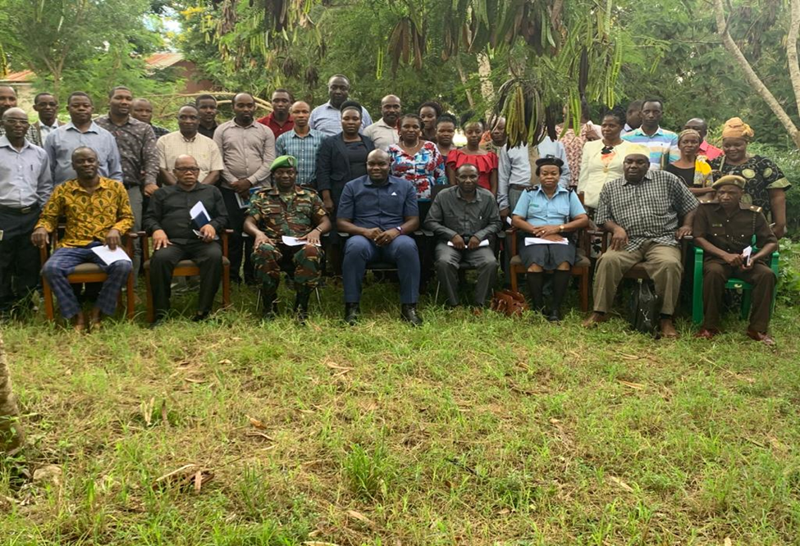
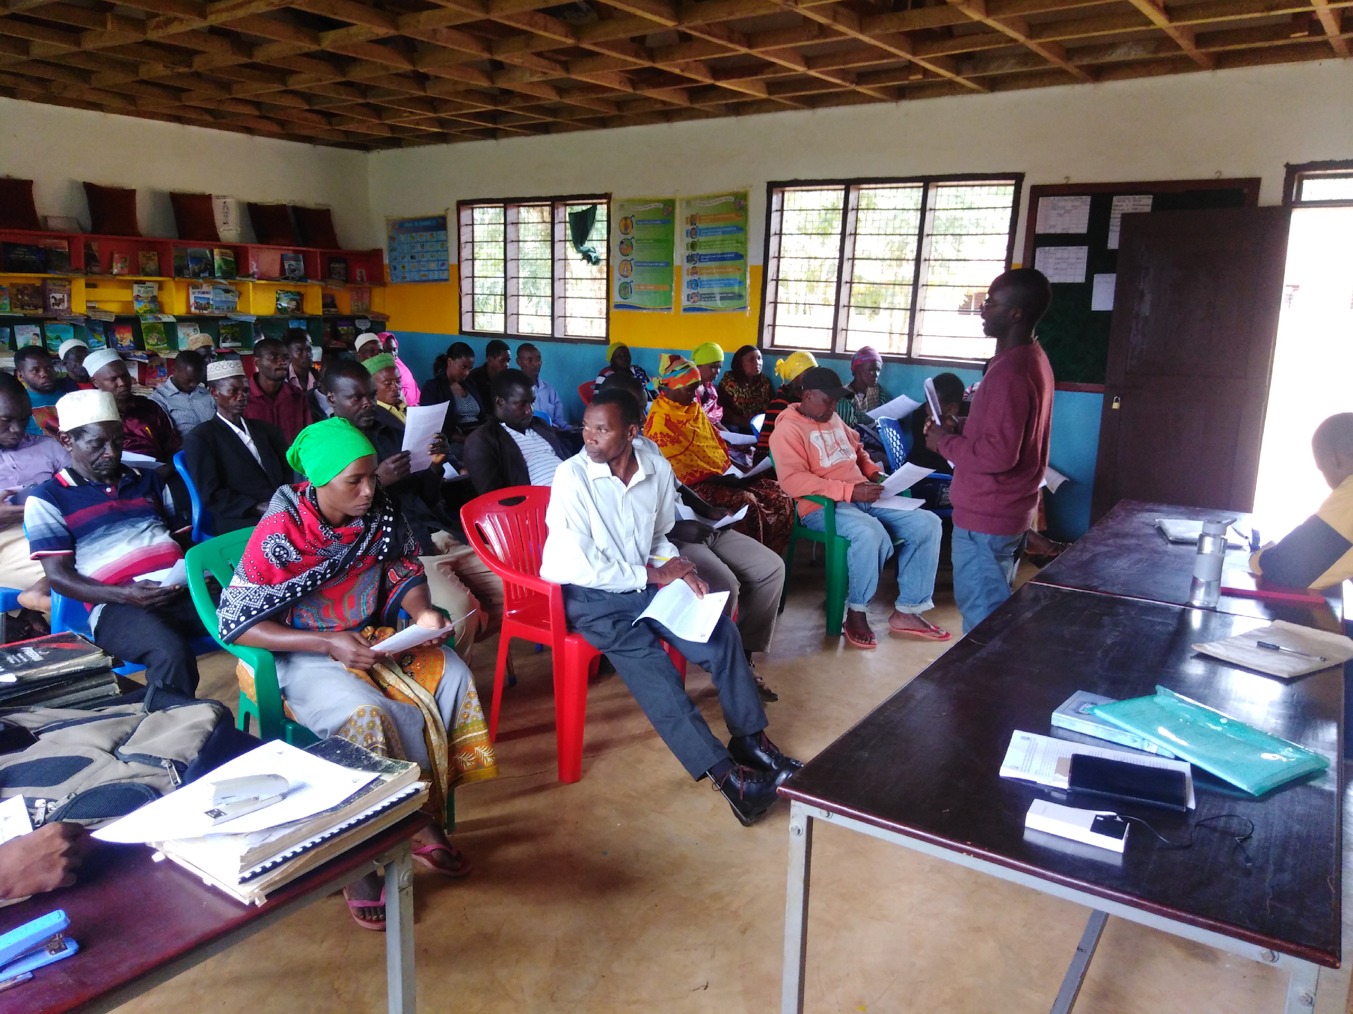
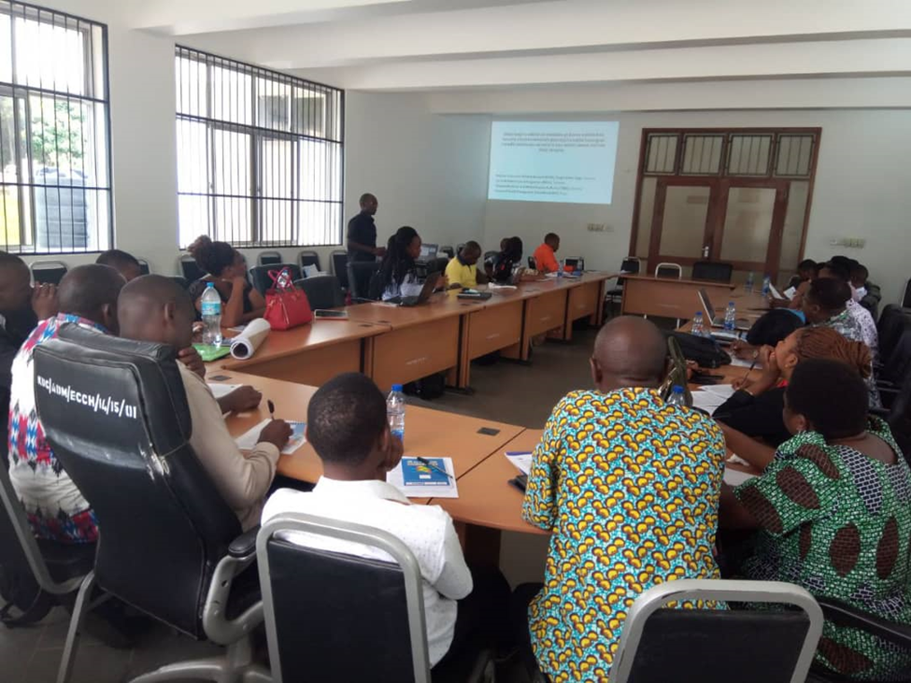
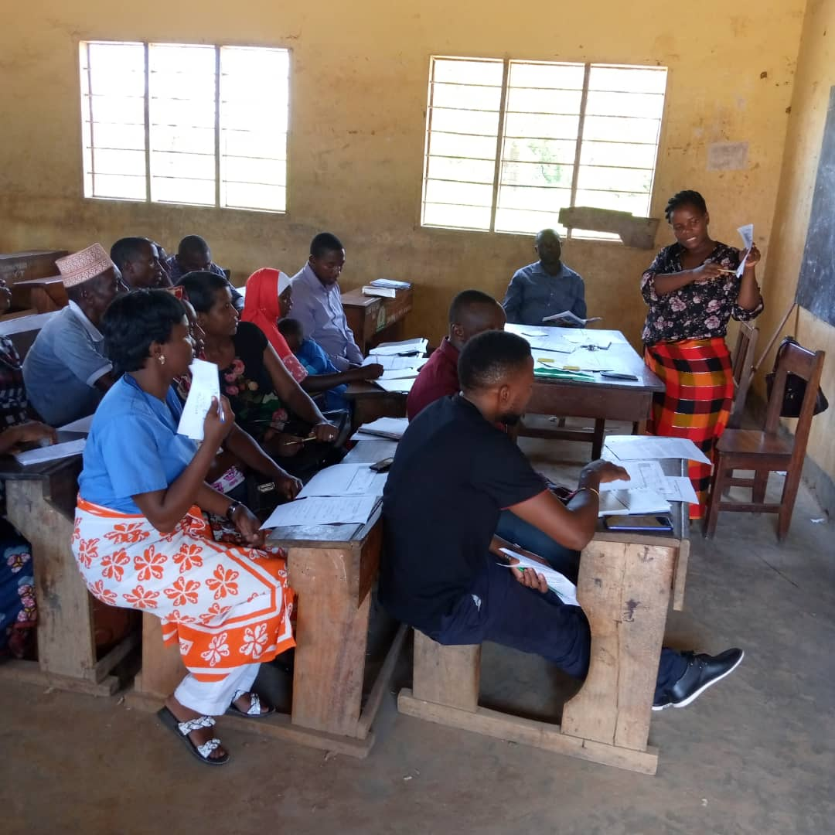
Implementation approach: community and trainings
PHC meeting Handeni TC and DC (Feb 3)
School meetings
National and District team monitoring the program
Stakeholders meeting
(National and Regional level)
Strategic plan with CHMT
(District level)
District Primary Healthcare Committee
(District level stakeholders)
Training of Trainers (ToT)
(CHMT / Medical personnel from each ward)
Community level sensitization
(School committee/ village leaders and parents meetings / school food discussions)
Cascade trainings and Pharmacovigilance
ToT train school health teachers
(in each respective ward)
Health teachers train other teachers
(at each respective schools)
Teachers implement IPTsc administration
(WEO and CO do supervision)

Slide 11
IPTsc % coverage by complete DP dose per district per round
26 wards were involved, 127 primary schools with over 73,000 pupils were reached.
Coverage was maintained at higher rates for completed dose, showing good acceptance among the communities that participated.
DP was administered by teachers, a three days course (taken once per day, DOT) based on bodyweight
The coverage is also reflected by routine data on school attendance at the respective district
Notes:
26 wards were involved, 127 primary schools with over 73,000 pupils were reached.
Coverage was maintained at higher rates for completed dose, showing good acceptance among the communities that participated.
DP was administered by teachers, a three days course (taken once per day, DOT) based on bodyweight
The coverage is also reflected by routine data on school attendance at the respective district

Slide 12
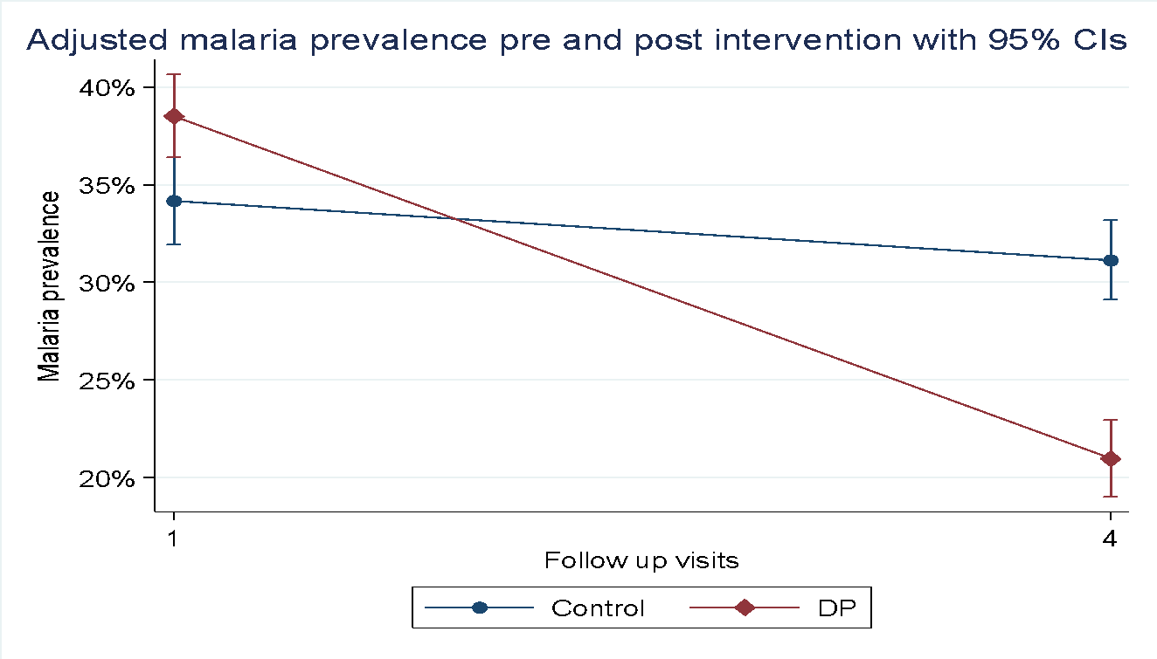
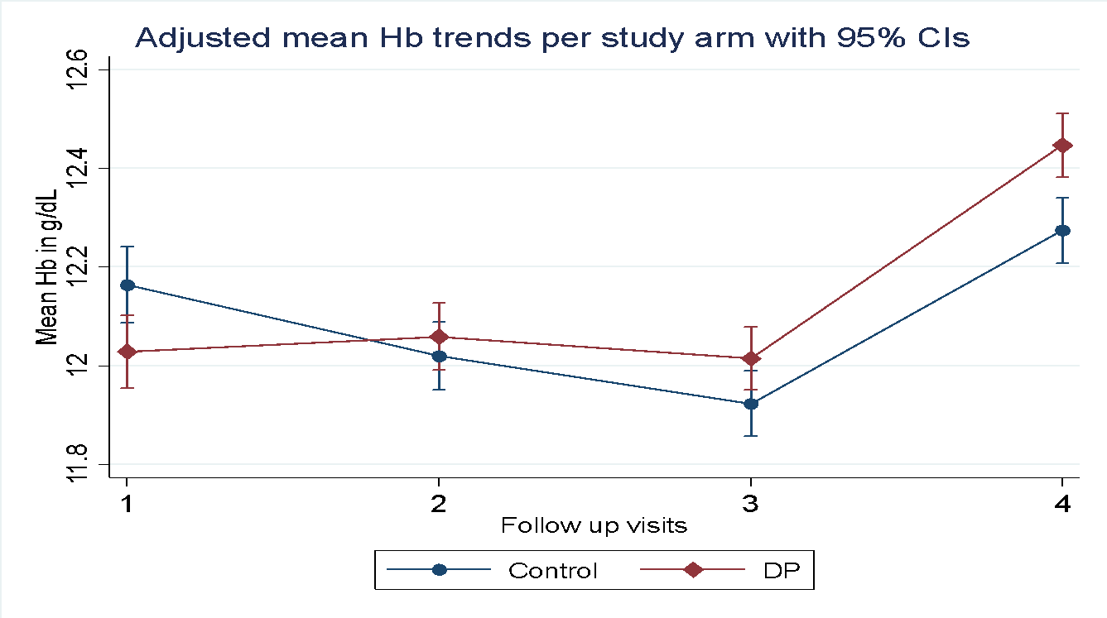
Malaria parasitaemia reduction following IPTsc
Malaria prevalence reduction
Increase in mean Hb from baseline
 | DP |  |  |  |  |  |  | Control |  |  |  |  |  |  | **Reduction by difference in difference (DP vs Control)
 | Baseline (M0) |  | Month 12 |  | Difference (M0-M12) |  |  | Baseline (M0) |  | Month 12 |  | Difference (M0-M12) |  |  | Cluster adjusted prevalence change (95% CI) |  | P-value | % Reduction by IPTsc *
 | N | Prev% | N | Prev % | Diff % (95%CI) |  | p-value | N | Prev % | N | Prev % | Diff % (95%CI) |  | p-value
All | 1939 | 38.6 | 1818 | 20.7 | 17.8 | (14.9-34.2) | 0.036 | 1749 | 34.1 | 1718 | 31.1 | 3.0 | (-14.2-20.3) | 0.729 | -14.5 | (-22.0--6.9) | <0.001 | 81.5
High strata | 1504 | 48.5 | 1384 | 27.2 | 21.3 | (1.4-41.2) | 0.041 | 1316 | 44.1 | 1306 | 40.3 | 3.9 | (-17.2-24.9) | 0.719 | -17.3 | (-25.8--8.8) | <0.001 | 81.2
Low strata | 435 | 4.4 | 434 | 0.2 | 4.1 | (-6.7-15.0) | 0.458 | 433 | 3.7 | 412 | 1.9 | 1.7 | (-10.3-13.8) | 0.776 | -2.4 | (-5.8-1.0) | 0.175 | 58.5
High strata=prevalence >=10%
Low strata=prevalence <10%
Generally, IPTsc reduced malaria parasitaemia prevalence by 81.5% overall.
Reduction was lower in low strata (i.e. areas with <10% malaria prevalence)

Slide 13
Impact of IPTsc Clinical malaria
Summary on protective effect (DP vs Control) at different rounds during the intervention period
 | IPTsc round |  | risk ratio (95% CI) |  | PE (95% CI) |  | NNT (95% CI) |  | P-value
 | Round 2 (8 months) | All | 0.53 | (0.41-0.68) | 47 | (32.2-59.4) | 47 | (34-75) | <0.0001
 |  | High strata | 0.44 | (0.31-0.64) | 56 | (36.3-69.5) | 53 | (37-92) | <0.0001
 |  | Low strata | 0.70 | (0.49-1.01) | 30 | (48.6-51.4) | 47 | (24-2234) | 0.0241
 | Round 3 (12 months) | All | 0.59 | (0.51-0.68) | 41 | (31.3-48.9) | 70 | (55-97) | <0.0001
 |  | High strata | 0.46 | (0.37-0.56) | 54 | (44.2-62.6) | 60 | (48-80) | <0.0001
 |  | Low strata | 0.89 | (0.71-1.12) | 11 | (-11.9-29.2) | 191 | (65-209) | 0.1531
IPTsc was effective on reducing malaria cases In school aged children by 41% overall but was more effective in high endemic strata [prevalence >10%] (54%) than in lower strata [prevalence <10%] (11%)

Slide 14
Policy recommendations
We recommend IPTsc strategy administered at regular intervals as a complementary control strategy against Plasmodium falciparum malaria among school-aged children.
IPTsc delivery schedule should mimic malaria seasonality in the targeted communities, three times a year in areas with bimodal rainfall seasons, and twice a year in areas with a single unimodal rainfall season (note: if using a long-acting drug like DP)
Continuous monitoring of drug safety, malaria prevalence trends, and an assessment of markers of drug resistance should accompany the delivery of IPTsc strategy
For equity reasons (reaching school aged children not enrolled at schools), social welfare department should be involved together with village health committee or similar local body to support access to eligible children not at school
Notes:
Policy recommendations to whom?

Slide 15
National implementation: Monitoring &Evaluation plan
What we are doing
Ideal situation, we would like to do:
Currently we collect data on IPTsc coverage
(number received / school children enrolled)
This is monitored in each round
Tanzania conducts seasonal malaria parasitaemia survey (SMPS) every 2 years
This helps monitor prevalence plus molecular PCR evaluation for markers of resistance, genetic diversity etc in school children
DHIS2 data monitoring in affected areas (incidence of disease in all age groups)
Limited due to age aggregation in the current system (<5yo, >=5yo)
Develop approaches for sustainable capture of age-disaggregated clinical data
This will help capture not only cases in the school aged children but also the community at large
Digitize IPTsc implementation and M&E tools-Linking to available malaria composite database
Link to school enrollment system –capturing other interventions such as bednets distribution, MDA for NTDs and other nutritional assessments
Measure the direct impact of programmatic IPTsc on the health of school-age children
Using cross sectional (SMPS-parasitaemia and anemia) and longitudinal outcomes (facility based –incidence)
Measure the indirect impact of programmatic IPTsc on education
Education indicators (performance, absenteeism, cognitive and psychomotor scores)
Measure the impact of programmatic IPTsc on transmission
Using data captured on age disaggregated data
Community wide survey at least once in a year or two years to assess level of parasitaemia and transmission in the community
Capacity building-biostatistics, molecular epidemiology , health economics, and implementation research

Slide 16

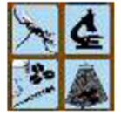
NATIONAL STRATEGY FOR IPTsc IMPLEMENTATION
Dr. Abdallah Lusasi
Head of Case Management-NMCP, Tanzania.

Slide 17
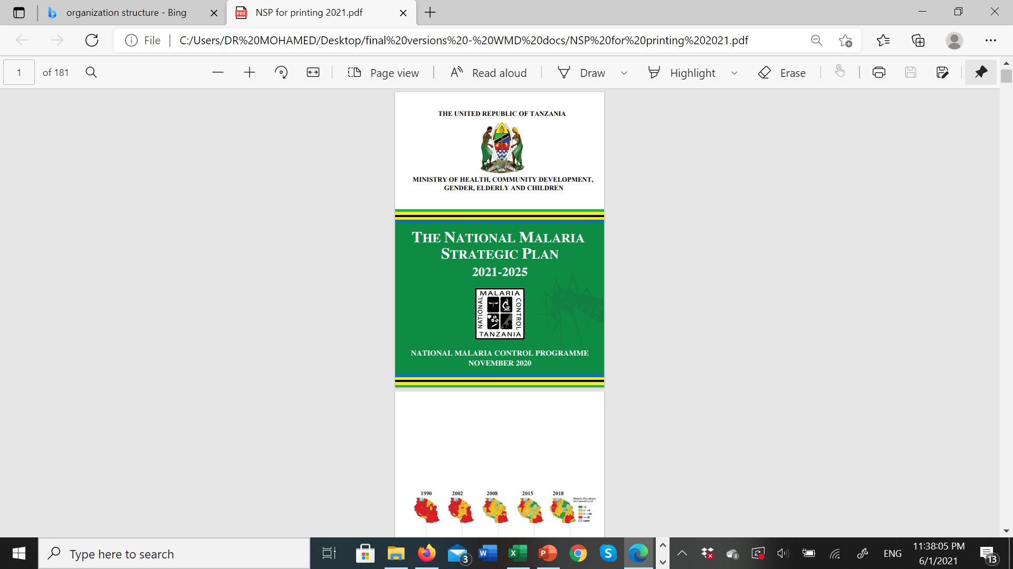
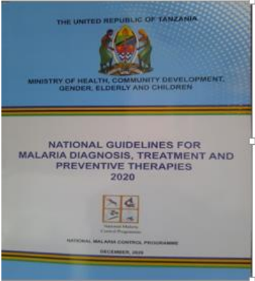
IPTsc in National Strategic Plan
The guideline now includes IPTsc as a strategic preventive strategy recommended to moderate and high endemic strata for malaria burden reduction
To prevent the occurrence of mortality related to malaria infection through
universal access to appropriate
  - Diagnosis
  - Treatment and
  - Targeted provision of preventive therapies for vulnerable groups.
Notes:
Should these guidelines be the other way around? The strategic plan comes after the guidelines for treatment, preventions, etc, correct?

Slide 18
Program design and funding
Identified 57 moderate to high burden councils in which to implement IPTsc based on stratification exercises and included to this in the GC7 request
Funding was received to conduct IPTsc as part of targeted disease burden reduction in 4 councils with high transmission.
The program started implementing IPTsc with DP in 2024 for five councils and will continue in 2025
Notes:
What about the 5th district? Should the role of CRS be included here or elsewhere?
Should we merge this with the Maps.

Slide 19
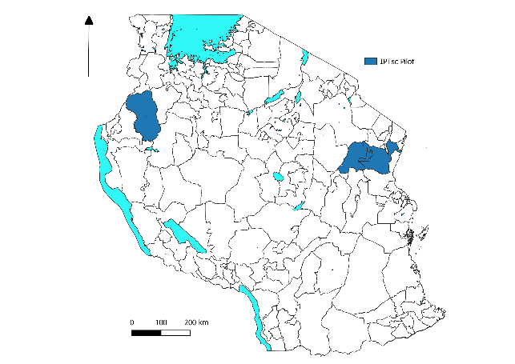
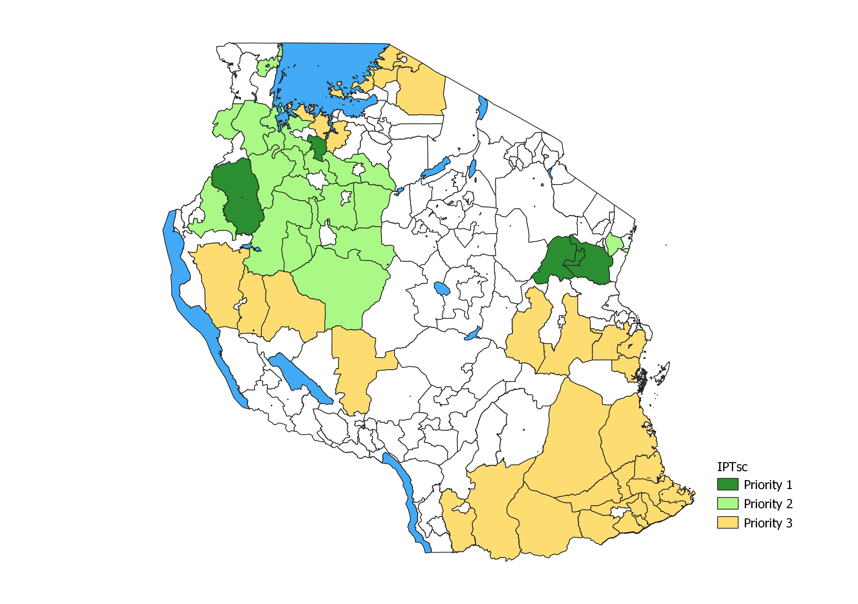
IPTsc intervention & priority area.
Operational research of IPTsc in Tanga (Handeni DC, TC and Kilindi) through NIMR- Tanga.
IPTsc operational implementation done in Kigoma (Kibondo DC) through Swiss TPH, NIMR and NMCP.
Right (Map) IPTsc priority area for scale up in 2024 to 2025, depending on funding availability.

Slide 20
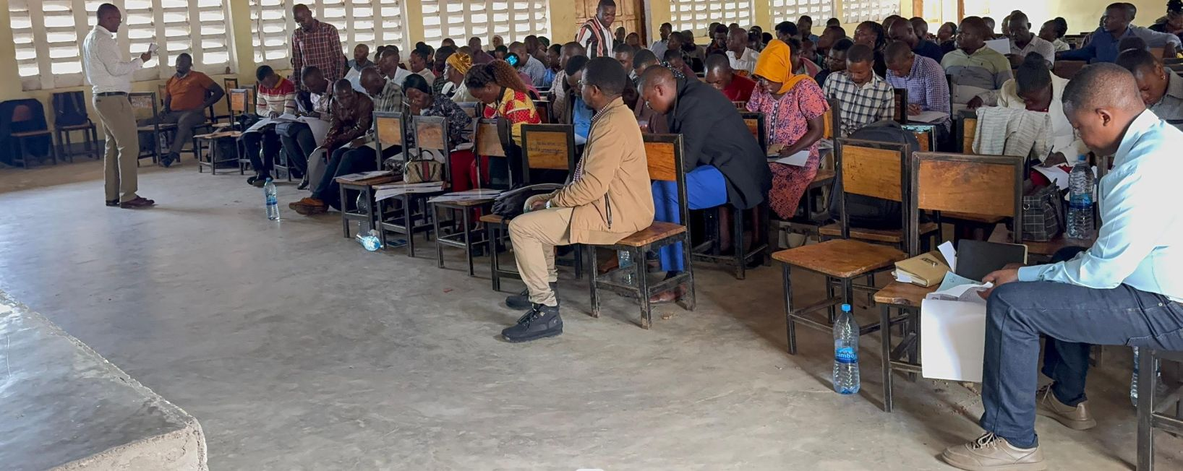
IPTSc Implementation: Advocacy meetings
Advocacy meeting conducted at Region and Council level Tanga (Handeni, DC, TC and Kilindi DC) Kigoma (Kibondo DC) and Geita (Nyanghwale DC).
Training to supervisers and DTOTs (MFP, Pharmacist, DSHCo, DHIS.
Training to School teachers and Health Facility.

Slide 21
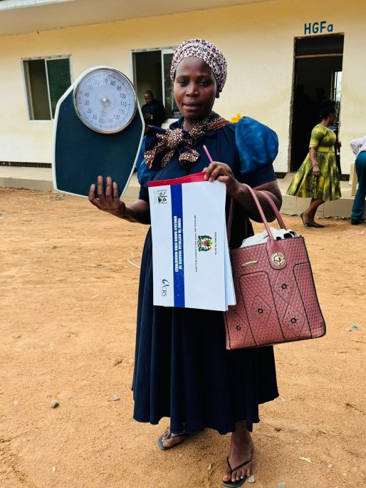
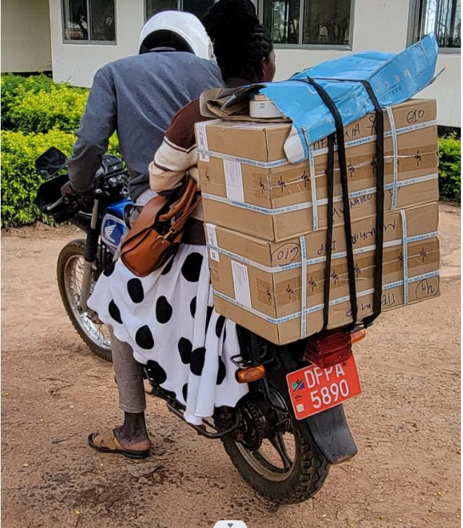
IPTSc operations: logistics and supply.
Distributed equipments
  Weighing scale and register, tally sheet, Summary sheet.
Distributed medicine
  DP to the nearby health facility.

Slide 22
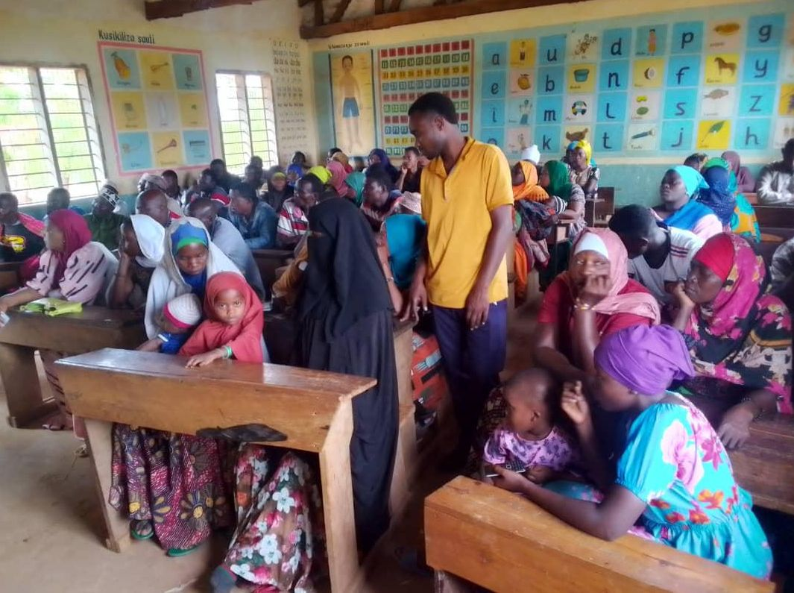
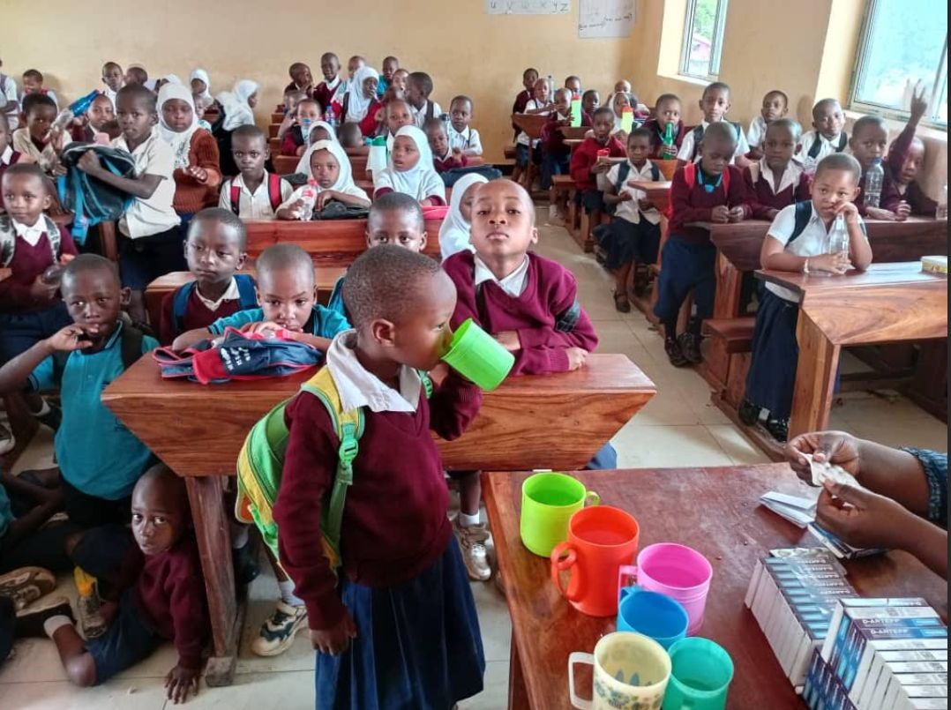
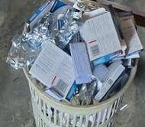
IPTSc operation: Advocacy and dispensing
Conducted advocacy meeting
  School village health commitee team and parents.
Conducted dispensing to pupils at schools during the school hours.

Slide 23
IPTSc implementation coverage
IPTSC. Implementation done in September (Kibondo only) and December (all 5 DC).
S/N | REGION | COUNCIL | WARD | TOTAL SCHOOL | TOTAL PUPILS | PUPILS RECEIVED DRUG | COVERAGE PERCENTAGE
1 | KIGOMA | Kibondo DC* | 19 | 98 | 62,621 | 48,670 | 78%
2 | TANGA | Handeni TC | 12 | 49 | 22,497 | 18,619 | 83%
 |  | Handeni DC | 21 | 138 | 86,105 | 64,633 | 75%
 |  | Kilindi DC | 21 | 134 | 70,352 | 52,999 | 75%
3 | GEITA | Nyang’hwale DC | 15 | 78 | 47,910 | 39,370 | 82%
 | Total |  | 88 | 497 | 289,485 | 224,291 | 79%

Slide 24
Progress
2025:
New consignment of DP drug to arrive end of March 2025
In 2025 all 5 councils will start round 1 of the year on April 2025, then July/Aug and then Nov/Dec
In each district there is a need to train more supervisors to help ensure teachers and communities are well informed and implement IPTsc well [Supervisors include health facility in charges and ward education officers]
Documents:
Posters for awareness and SOP for drug dispensing
Algorithms on case management in an area already deploying IPTsc
IPTsc rounds:
Currently we run on 3 rounds strategy as piloted
Depending on drug we use in the future the number of rounds might be modified, however with consideration not to interfere educational calendar
Registers, summary reporting forms, AE monitoring forms, Drug accountability forms

Slide 25
Scale-up plan
To increase more eligible councils
Use of / collaborating with implementing partners on implementation
We are grateful that CRS supported implementation in 2/5 councils in the last year
We hope more partners can join us for other councils as well, given the tangible need
Strengthen M& E plan
Improve health system DHIS2 system –capture age disaggregated data
To enhance a more stable environment for implementation
Utilising the biannual SMPS and malaria stratification practice to identify eligible councils.
Utilise available surveys for assessment of community impact and transmission

Slide 26
Lessons learned to date
IPTsc operated in an environment where all members of the community are well informed, which improves coverage
Out of school children can be reached through the local social welfare officers and CHWs:
We observed this in Kibondo and Handeni DC
School teachers can deliver IPTsc at a high coverage and offers great opportunity for integration with other school led initiatives
Deworming, school feeding, micronutrient supplementation, school net distribution
Notes:
Composite Management Information System

Slide 27







Co-authors / collaborators
NIMR
Tanzania
NMCP
Tanzania
  Dr. Bruno P. Mmbando
  Dr. Misago D. Seth
  Dr. Vito Baraka
  Mr. Daniel Challe
  Mr. Filbert Fransis
  Mr. Athanas Mhina
  Dr. Daniel Minja
  Dr. Mercy Chiduo
  Dr. Celine Mandara
  Mr. Edwin Liheluka,
  Dr. Samwel Gesase,
  Mr. Method Segeja
  Dr. George Mtove
  Mr. Mathias Kamugisha
  Prof. John P.A. Lusingu
Dr. Samwel Lazaro
Dr. Abdallah Lusasi
Mr. Frank Chacky
Ms. Anna David
Dr. Ally Mohamed
Dr. Fabrizio Molteni
Dr. Sumaiyya Thawer
  Dr. Alex Nkayamba
  Mr. Joel Kibona
  Mr. Yuda Nkirila
  Ms. Jackline Frugence
  Prof. Jean-Pierre Van geertruyden
  Gwen lemey
  Christopher Delgado
  Prof. Hilde Bastaeans
  Peter Vermeiren
  Jan Vervoort
  Swabra Nakato
Acknowledgement
  Pupils, parents /guardians
  All teachers
  Ministry of Health Tanzania, University of Dar es Salaam (DUCE)
  Local government officials, ward, district and region levels
  Malaria team from each district (DMFP, DNTDCo, na DSHCo)
  TMDA, NMCP, PORALG
  NIMR and NMCP Staff
  The Global Fund
  VLRIOUS, EDCTP
  Almighty God, for all achievements

