Slide 1
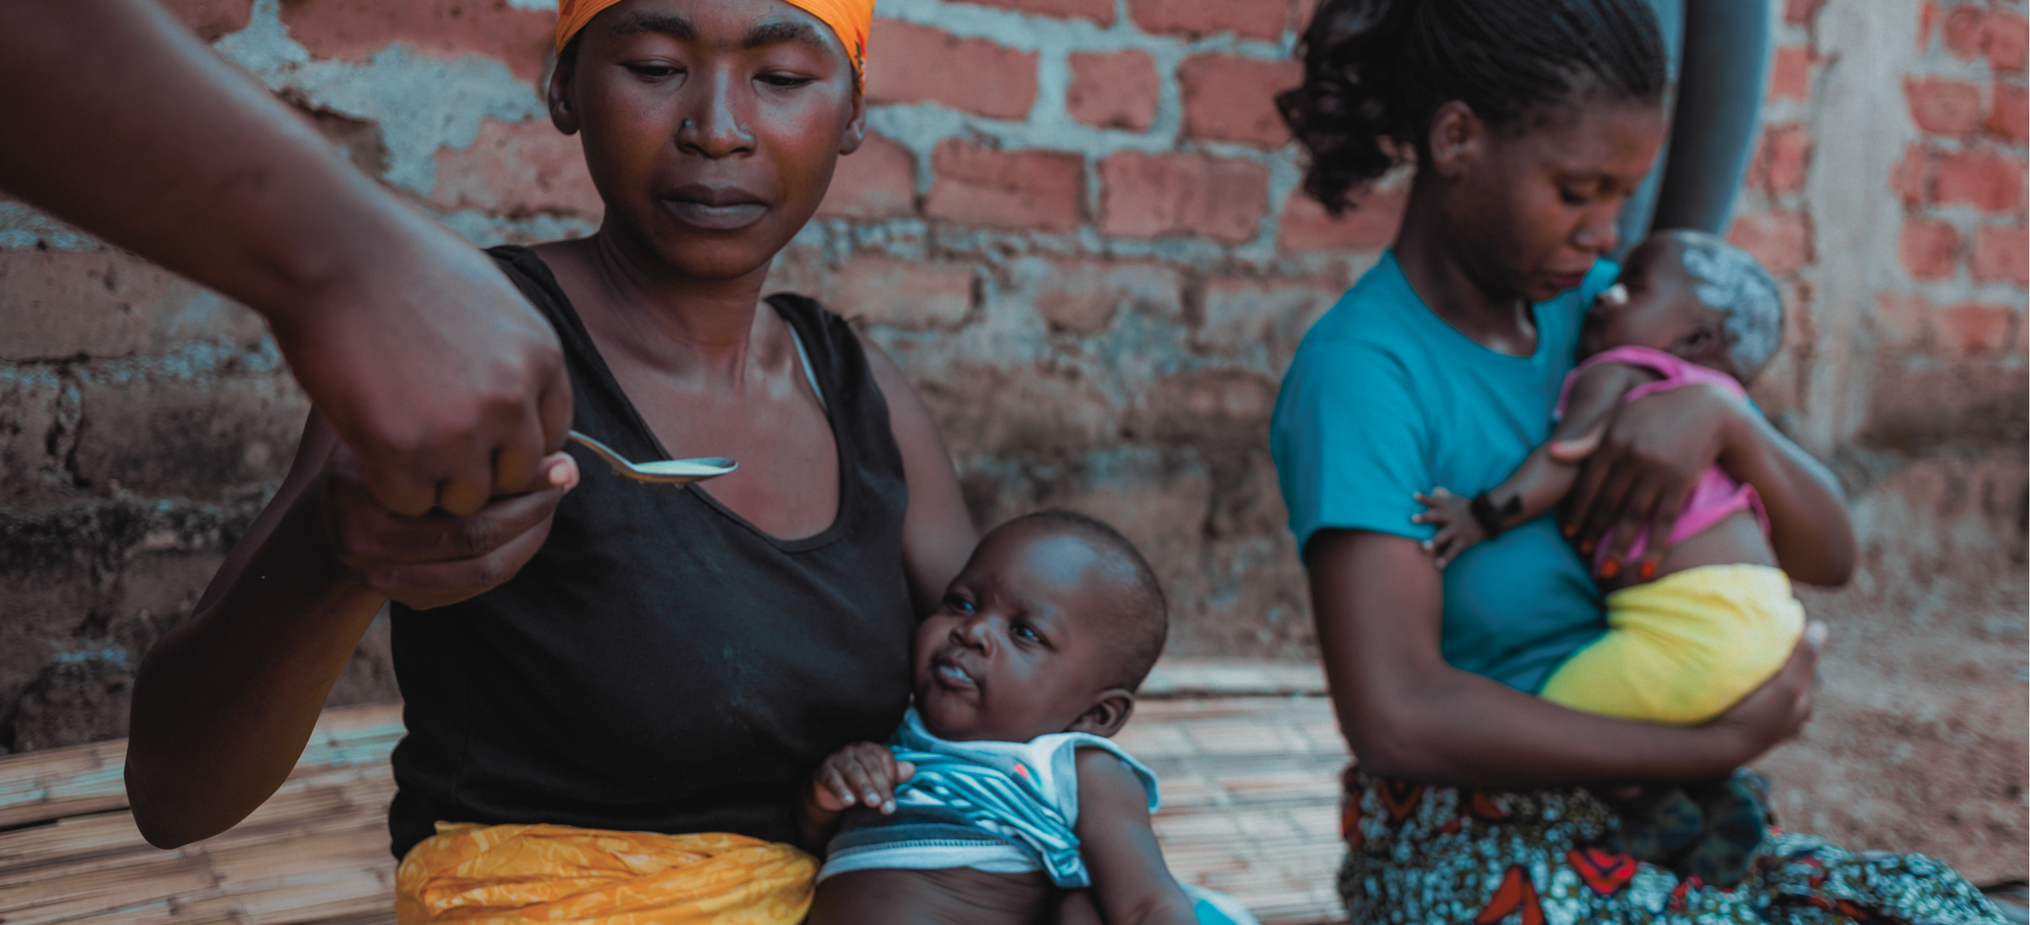


SMC Alliance
Advocacy & Communications subgroup
2024 in Review
Photo credit: Malaria Consortium

Slide 2
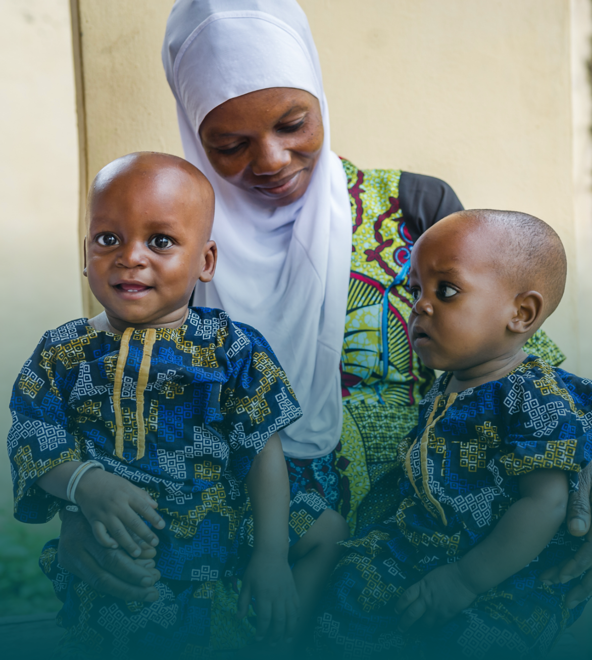
Overview
  Set up in April 2022, it serves as a platform for sharing best practices, lessons learned, and challenges in communicating and advocating for SMC with other stakeholders
  Mostly advocacy & communications focus, not social behavior change
Role & responsibilities
  Communicate and promote upcoming SMC activities or events of SMC Alliance members
  Support production and dissemination of relevant publications and information on SMC policies, tools and resources
  Maintain SMC Alliance website and digital content

Slide 3
Membership structure (2024)
  Co-chairs:
    Abena Poku-Awuku (Medicines for Malaria Venture)
    Mohammad Bala (pls provide)
  Secretariat: Ashley Giles (Malaria Consortium)
  Members: Regular attendees included around 18 members, with 6 NMPs
Thank you for their services and participation!
Membership structure (2025)
  Co-chairs:
    Taylor Prochnow (PSI / Plus Project)
    Hajarah Nakendo (Uganda Parliamentary Forum on Malaria)
  Secretariat: Celia Yeung (Malaria Consortium)
  Members: Open to all

Slide 4







Key activities & achievements in 2024
A&C subgroup election
World Children’s Day
World Malaria Report
2024 ASTMH
annual meeting
SMC Alliance consultancy
Regular member update meetings
Notes:
(Note: Please double check the following statements and feel free to edit/add any missing items.)
1. A&C Subgroup Election
- Taylor Prochnow and Hajarah Nakendo were elected as the new co-chairs.
- Malaria Consortium continued to act as the subgroup secretariat.
2. World Children’s Day
- The subgroup developed and shared key messages for World Children’s Day, building on previous content from the Day of the African Child.
- Members coordinated to use and cross-post content on social media to maximize exposure and impact.
- MMV published an op-ed on World Children's Day.
3. World Malaria Report
- The subgroup prepared for the launch of the World Malaria Report, focusing on the theme of gender and equity.
- Efforts were made to use the SMC map for communications purposes.
- Relevant country-level or organizational responses were republished or summarized on the SMC Alliance website.
4. 2024 ASTMH Annual Meeting (Please double check the facts)
- Taylor, Hajarah, Abena, Akinola & Christian attended the ASTMH meeting.
- An SMC Alliance lunch was held, and a document highlighting SMC/chemoprevention sessions was presented.
- An Advocacy and Communications meeting was held at ASTMH.
- MMV managed a booth and co-hosted a sponsored symposium with TDR.
- Malaria Consortium and PSI/Plus Project participated and presented at ASTMH.
5. SMC Alliance Consultancy
- A consultant was selected to document learnings and best practices from the SMC Alliance.
- A steering group was formed to work out the deliverables and timelines.
- Malaria Consortium handled the contract and coordinated the works with the consultant.
- The consultancy results were presented at the SMC Alliance meeting earlier this week, with plans for both inward-facing and outward-facing outputs.
6. Regular member update meetings were held throughout the year.

Slide 5


2025 1st Advocacy & Communications
subgroup meeting
Date: Friday, 28 February, 2025​
Time: 14:00 – 15:00 GMT​
Venue: Fazao room, 1/F, Hôtel 2 Février, Lomé OR via Zoom​
​Agenda: ​
  The future direction and focus of the A&C subgroup​
  How to support the possible launch of a new chemoprevention umbrella group through marketing, communications, and advocacy activities
Please invite or refer your colleagues who may be interested.
Everyone is WELCOME to join our meeting.
Notes:
If anyone wants to join the meeting via Zoom, please speak to Celia Yeung from Malaria Consortium for the Zoom link, or email: smcalliance.communications@malariaconsortium.org. Thanks.

Slide 6





Follow us on
www.smc-alliance.org
www.linkedin.com/company/smc-alliance/
@SmcAlliance
New members are WELCOME to join us!
Please speak to Celia Yeung (Malaria Consortium) or email to
smcalliance.communications@malariaconsortium.org

Slide 7

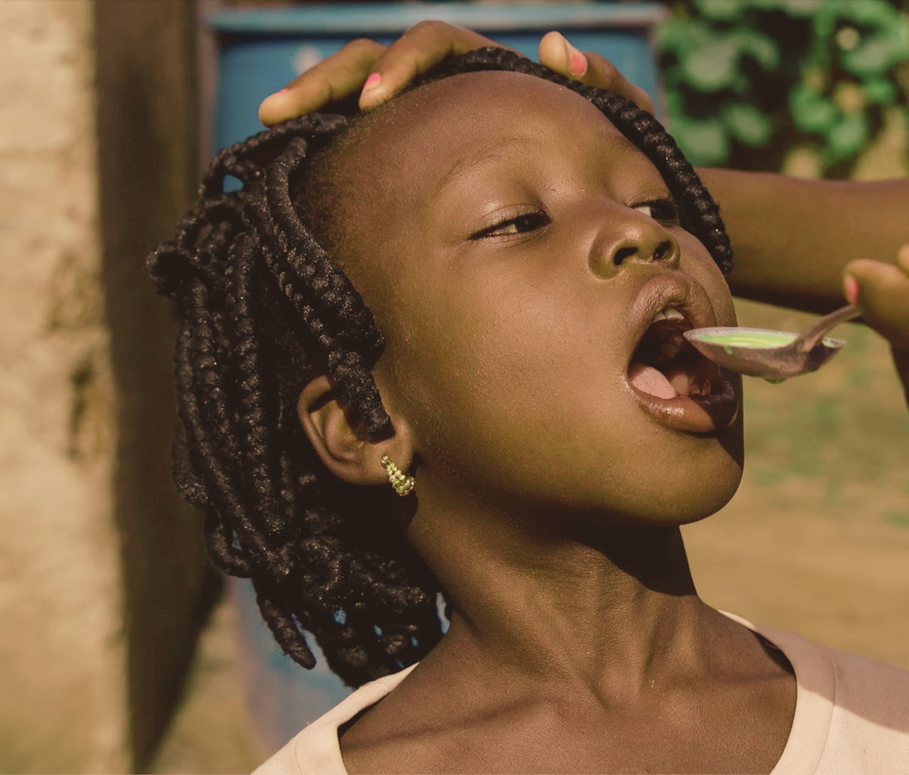
Thank You
Any questions?
Photo credit: Malaria Consortium

