Slide 1


Drs. Jane Nabakooza & Nuwa Anthony
Uganda
SMC Alliance Annual Meeting 2025
Lomé – Togo
Feb, 25 – 28, 2025
Integrating SMC with other health interventions such as vaccines, or other chemoprevention work

Slide 2
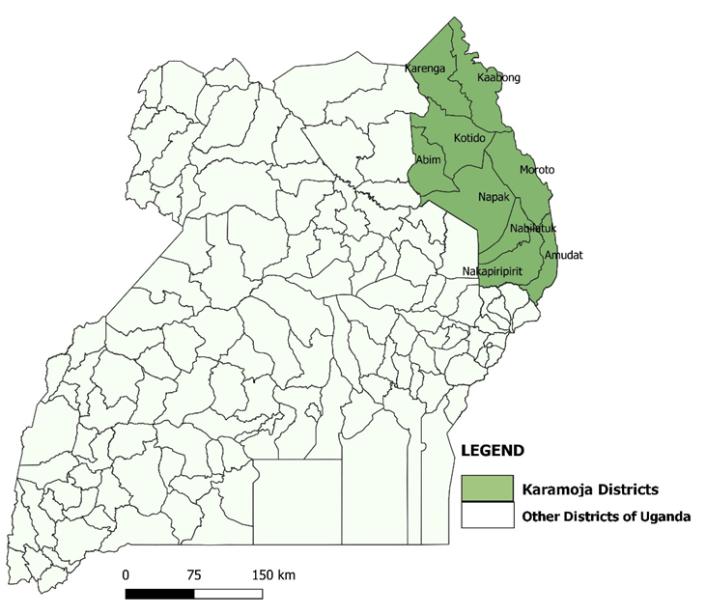
SMC implementation in Uganda
Nine districts
Total population: 1,496,117 (census, 2024) and Approximately 300,000 children under 5.
Malaria incident highest among children under 10 years,
No: SMC cycles per round: 5
Eligible children: 3-59 years
Map of Uganda showing SMC recommended area: Karamoja Subregion

Slide 3
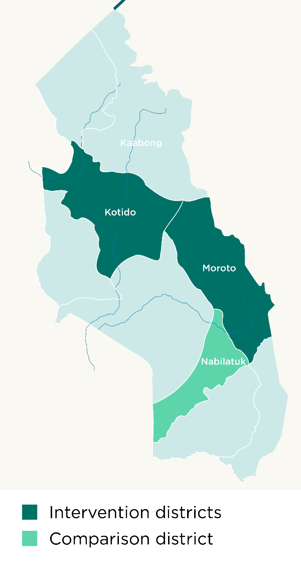
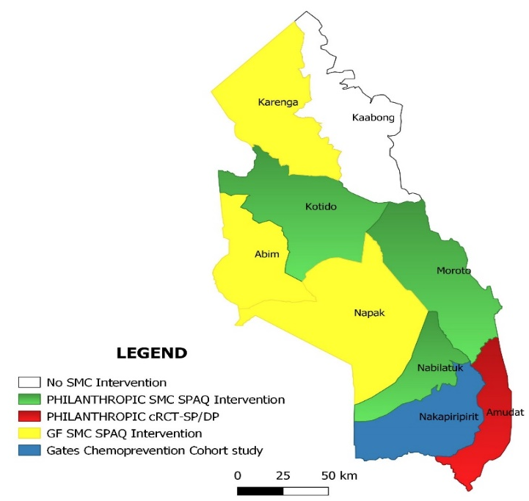
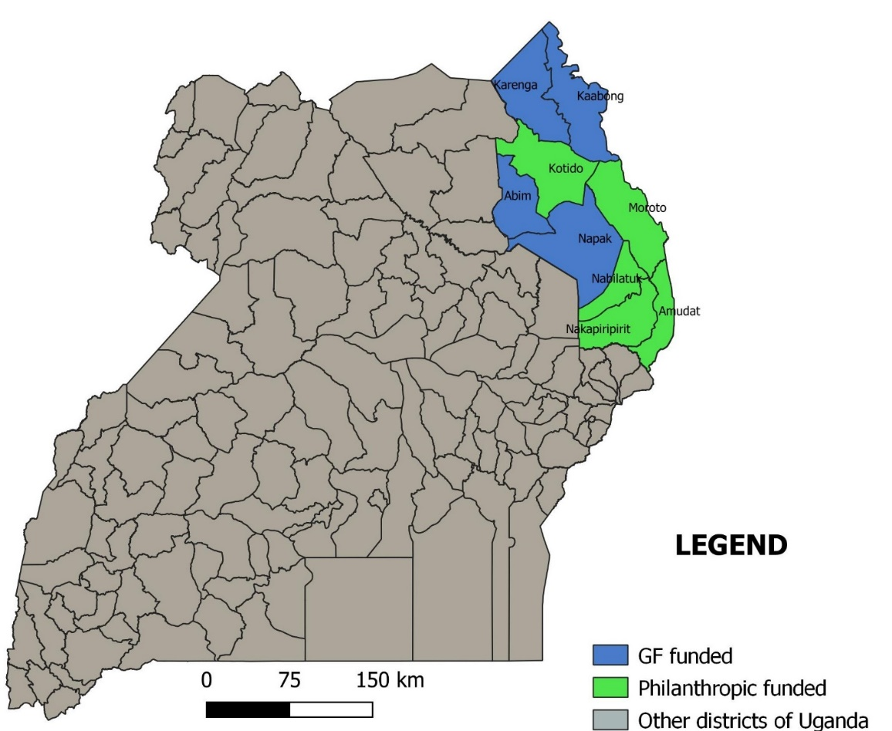
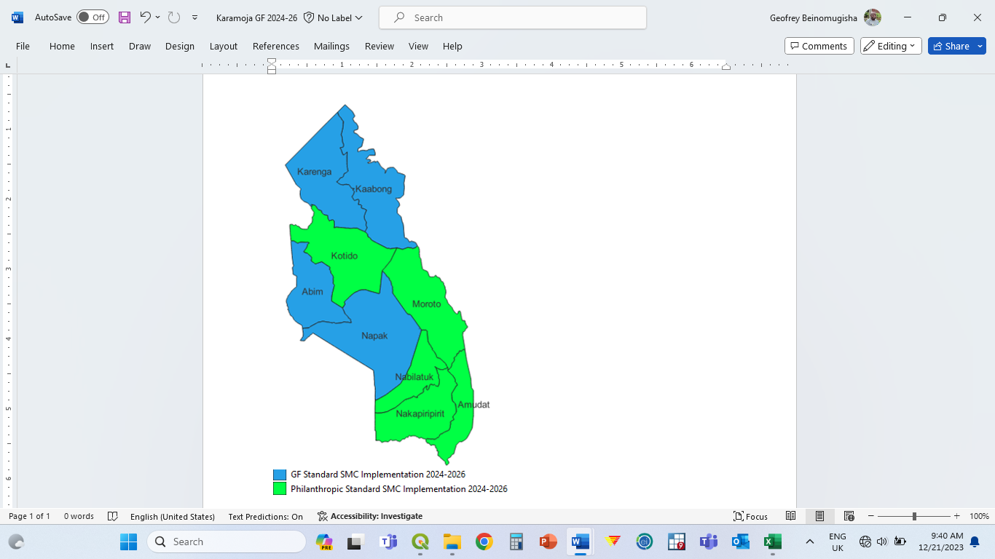

SMC IMPLEMENTATION AREAS 2021-2024
2021-(YR-1)/ROUND-ONE
2022-(YR-2)/ROUND-TWO
Year | Target population | # covered | % covered
2021 | 83,000 | 88,033 | 106%
2022 | 230,000 | 211,600 | 92%
2023 | 257,171 | 261,136 | 102%
2024 | 282,357 | 287,245 | 101%
2024-(YR-IV)/ROUND- FOUR
2023-(YR-III)/ROUND- THREE

Slide 4
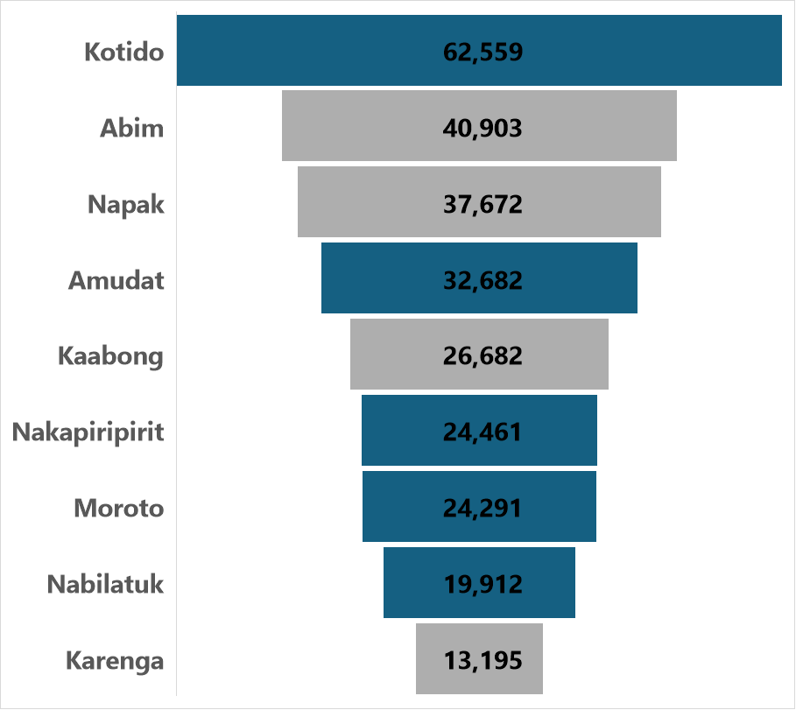
Target No. of Children for SMC in 2024

Slide 5

Total No. of Children Reached in Cycle 1 to 5 (May to Sept 2024)

Slide 6
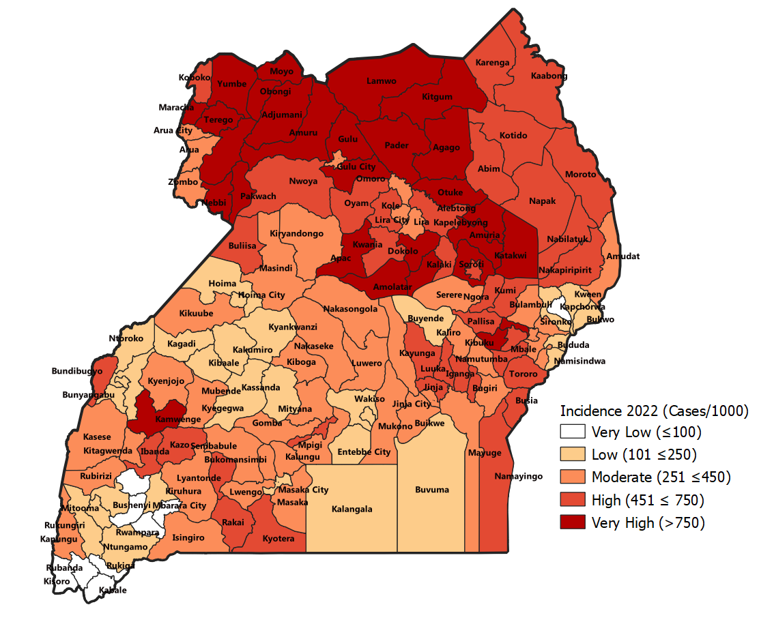
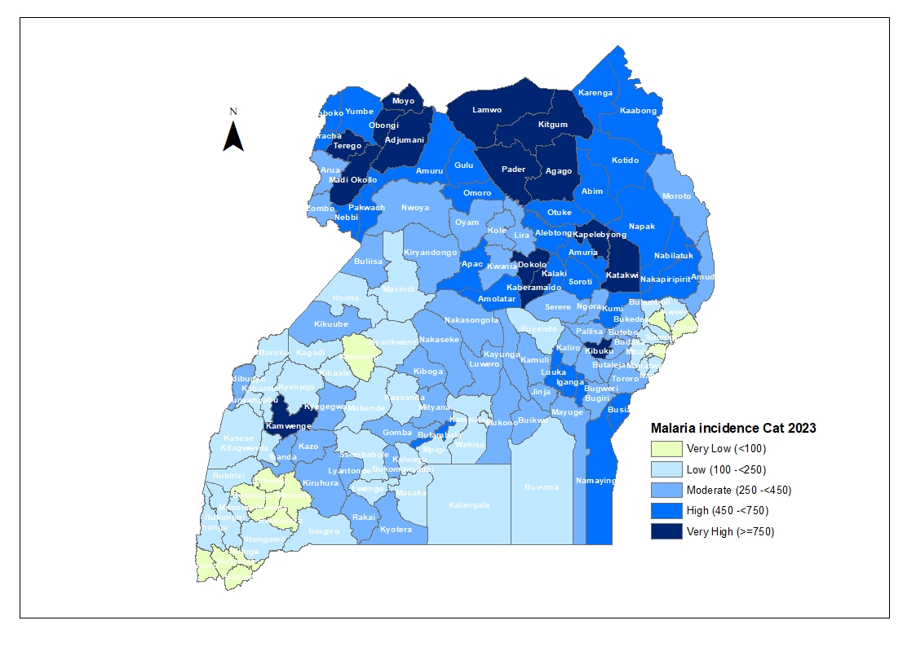
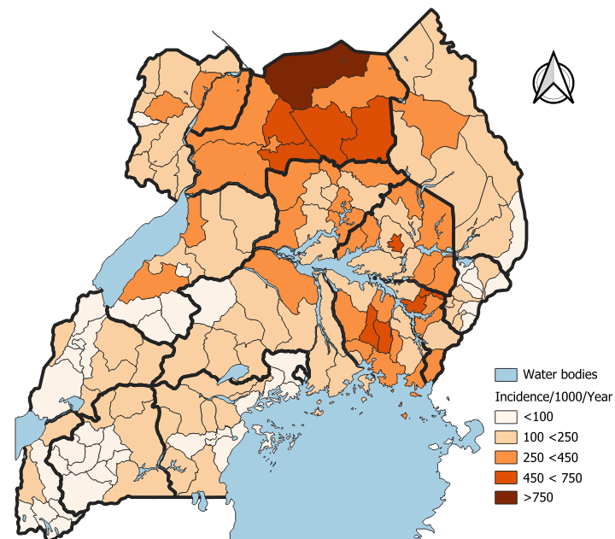
Malaria Incidence : 2022 -2024
Malaria Incidence 2022(Ref for the prioritization
Malaria Incidence 2023
Malaria incidence June- 2024(180/100)

Slide 7
Karamoja Malaria U5 Deaths 2020-2024

Slide 8
Integration of SMC with other interventions

Slide 9
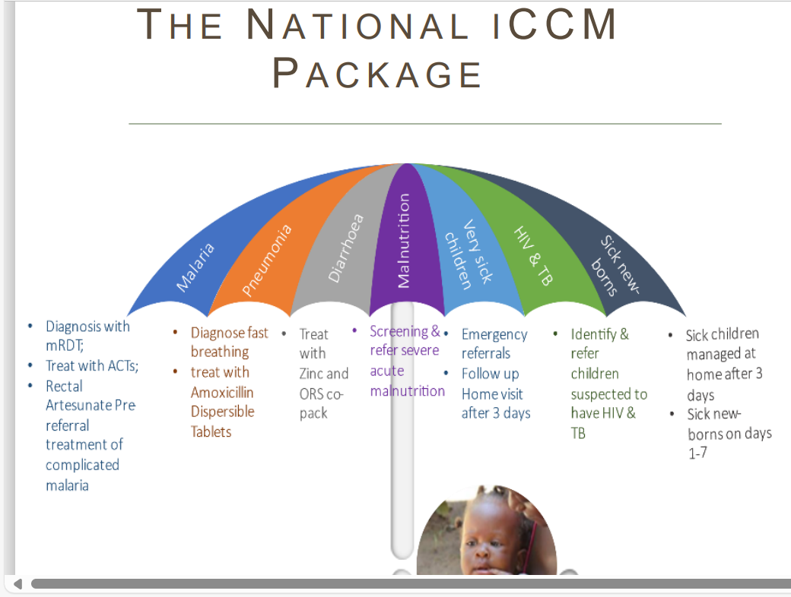
iCCM package in Uganda
Focus on common childhood diseases: The primary focus is on identifying and treating malaria, pneumonia, and diarrhea in children under five years old
Community health workers (CHWs): Trained Village Health Team (VHT) members are the key actors delivering iCCM services within their communities.
Home-based care: VHTs typically operate from their homes, conducting home visits to assess sick children and provide treatment.
Referral system: In case of severe illness, VHTs are trained to refer patients to healthcare facilities for further management.
Government initiative:The Ugandan Ministry of Health actively promotes and supports the implementation of the iCCM strategy.

Slide 10
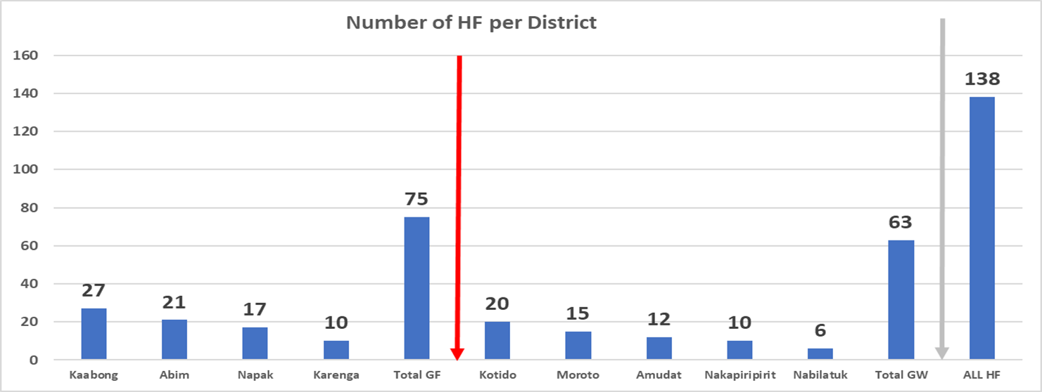
Number of Health Facilities and Village Health Teams (VHTs) per district
6,338 VHTs
3,444 VHTs
2,894 VHTs
949 VHTs
1138 VHTs
888 VHTs
469 VHTs
856 VHTs
580 VHTs
749 VHTs
454 VHTs
255 VHTs

Slide 11
1.Integration of SMC with other interventions: iCCM:
Intervention integrated into SMC | Point of Integration | Activities | Outcome
Integrated community Case Management(Iccm) | Governance &Leadership | SMC & ICCM in the community Health strategy. SMC and iccm oversight is by community health department(MOH),Health assistant (HF) SMC planning & guidelines consider key iccm activities. Local leaders do oversight for both SMC and iCCM | Strengthened coordination; joint planning and performance reviews. Improved efficiency in the planning and implementation iccm,SMC and other community interventions.
 | Human resource | Recruitment – same VHTs doing iccm were recruited to implement SMC. SMC training modules emphasize test and treat ( in case of any identified sick children ) & appropriate referral. Technical support supervision teams for Iccm & SMC are the same( VHT coordinators, Health assistant & HF in charges . | Maintenance of motivated iccm teams Sustenance of knowledge and skills
 | Service delivery | Screening for fever, test &treat during the house to house SPAQ administration. Referral of very sick children. | Quality SMC implementation. Increased completed referrals Timely diagnosis and treatment of children with fever
 | Commodity ,supply chain management | Monitoring of iccm commodity stock availability. Supporting emergency orders and redistribution. Delivery ,storage and reversal logistics management of SMC commodities aligned to that of iccm. | Reduced stock outs of iccm commodities. Increase access to care.
 | Health information management. | SMC home record/card &reporting tools capture children with fever/malaria and referrals. Use of digitalized supervision tools. | Improved documentation, reporting Better quality data and reporting Increased data use
 | Community engagement and mobilization | Utilize same channels to mobilize communities for SMC, iCCM and other interventions | Reduced communication costs.

Slide 12
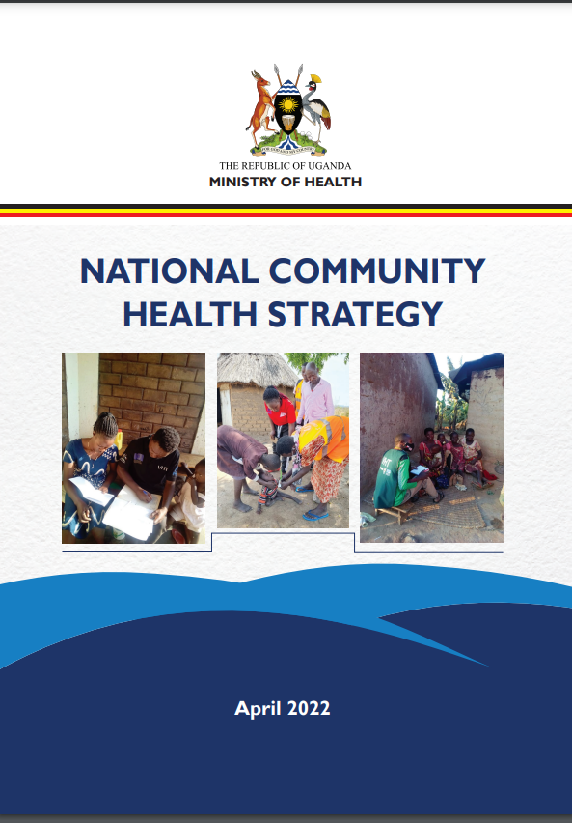
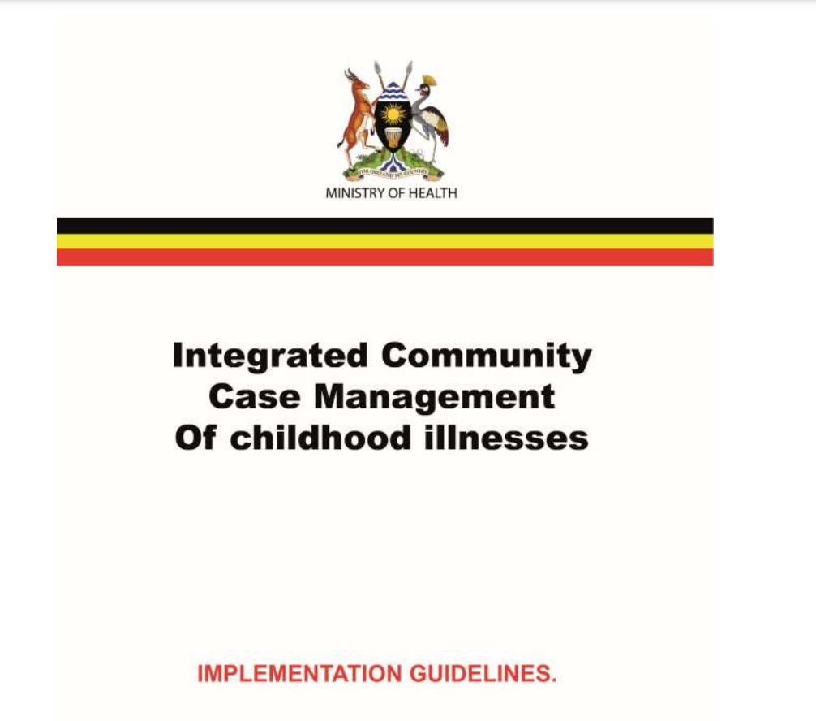
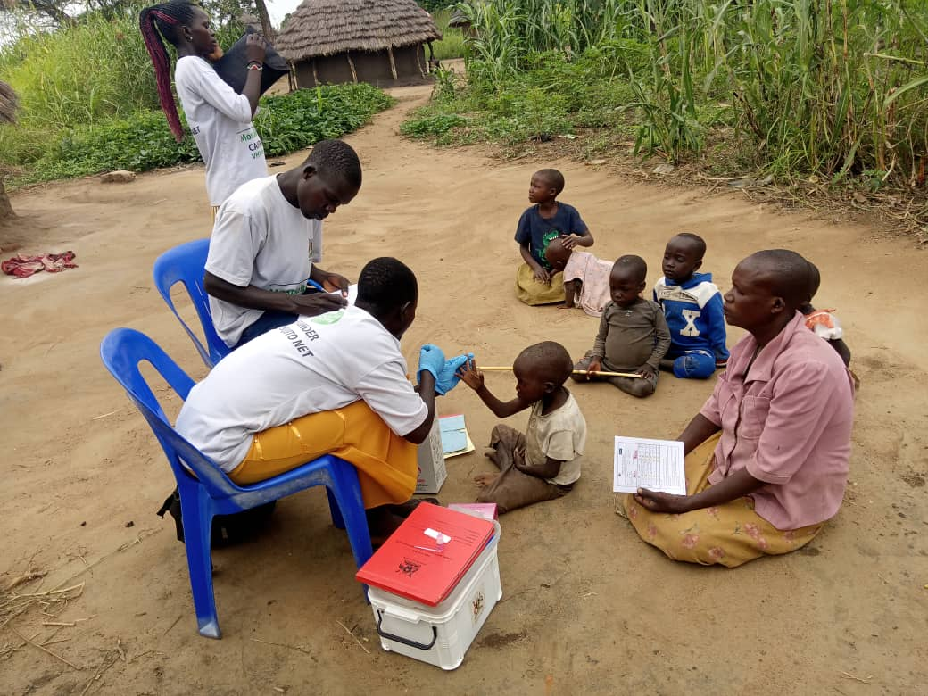
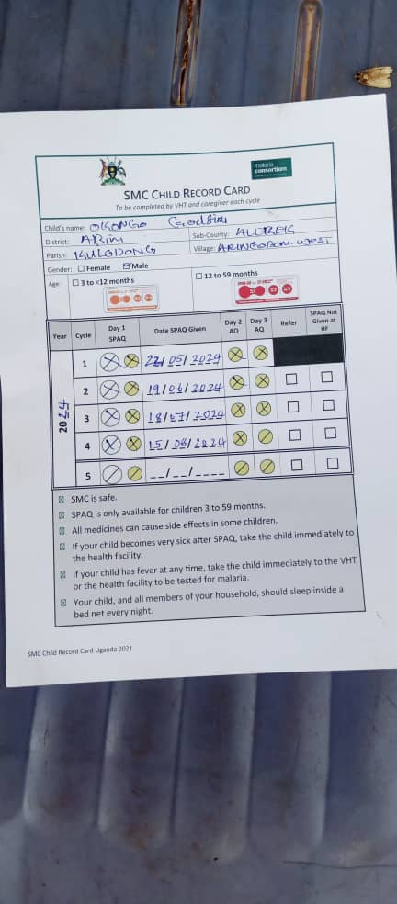
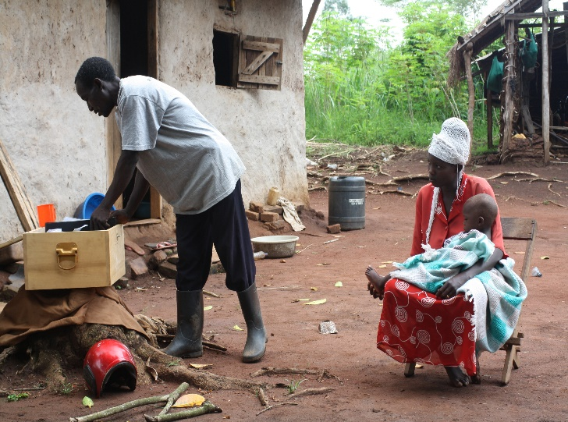
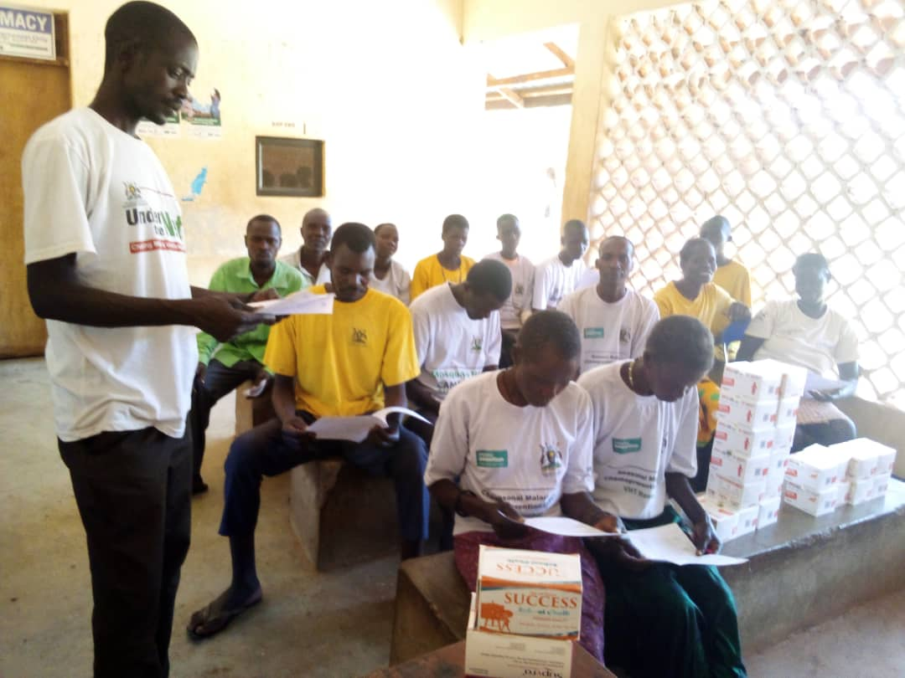
Using the Iccm implementation guide,VHT identifies a sick child during SMC & documents in the SMC card
Iccm,SMC are considered in the strategy & oversight is by the Community health department
A child with a fever before giving SPAQ in Napak district
Same iccm VHTs(2,894) across the 9 districts selected, trained & equipped to deliver SMC
VHTs carry iccm Kits(Respiratory timers) mRDTs, antimalarial, Amoxicillin and Zinc) during the H-H SMC SPAQ distribution.
Children reported to be unwell are tested for malaria & provided with relevant treatment (positives-ACTs, Negatives-SPAQ)

Slide 13
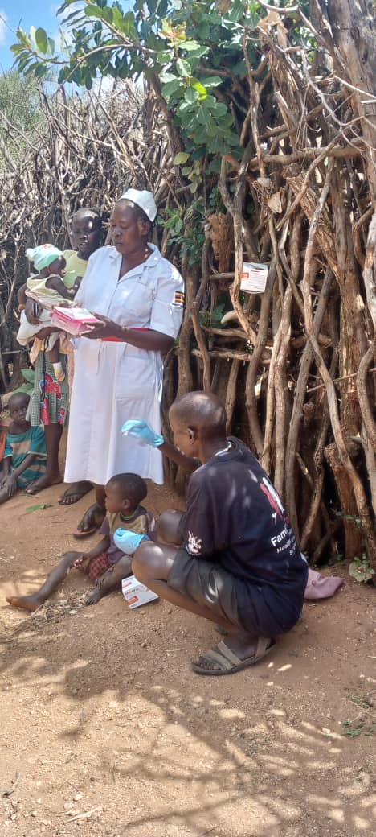
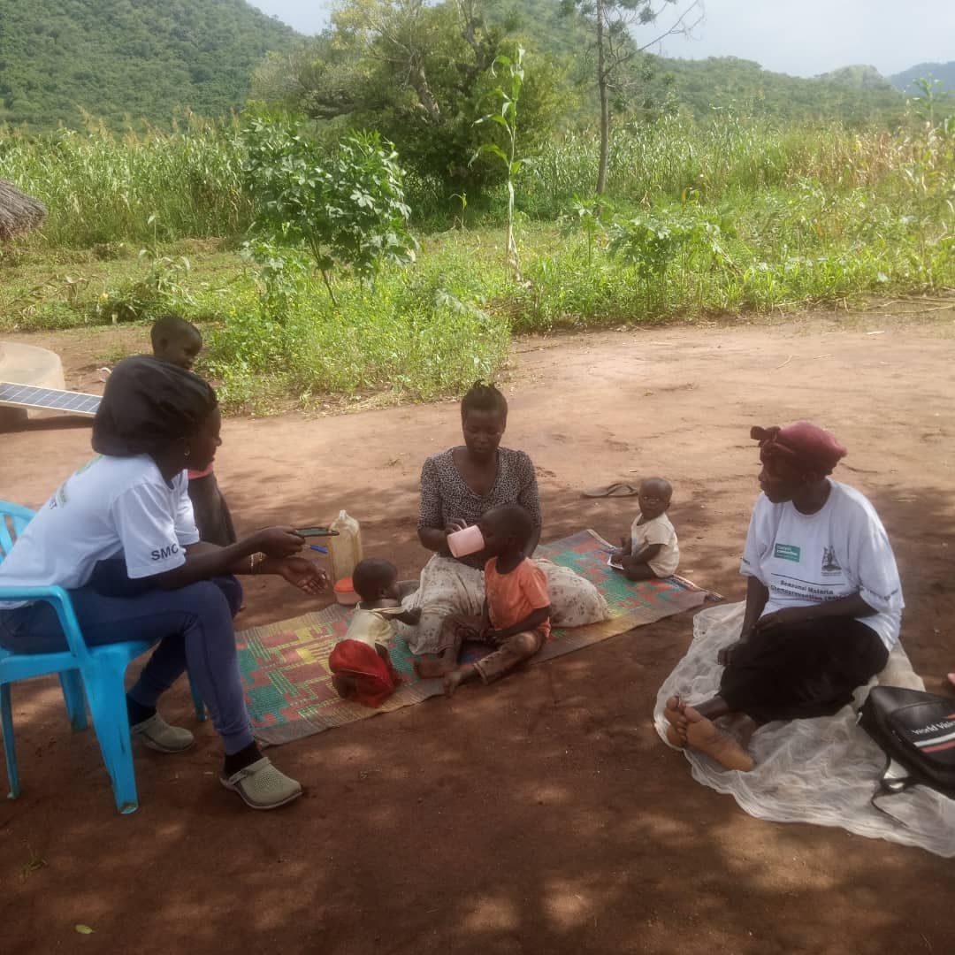
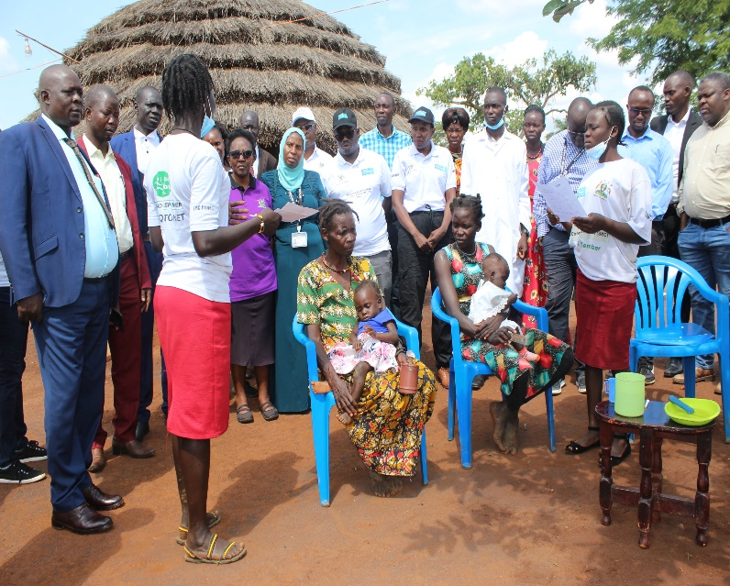
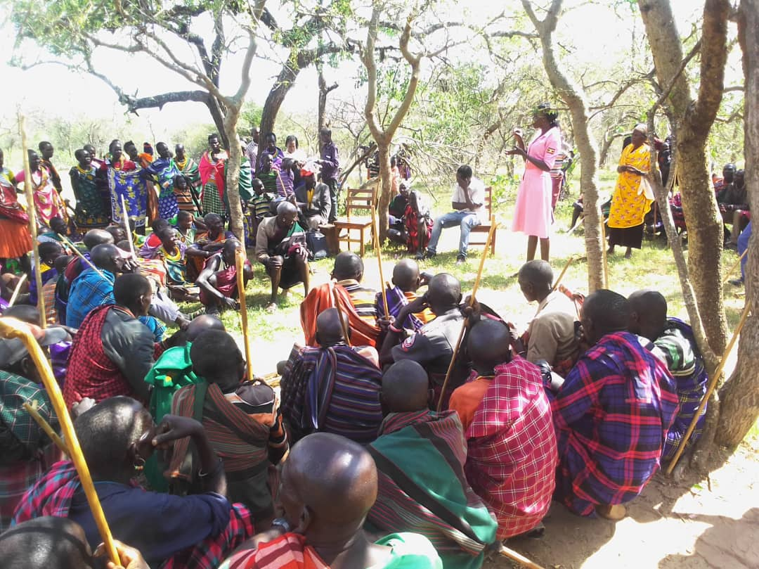
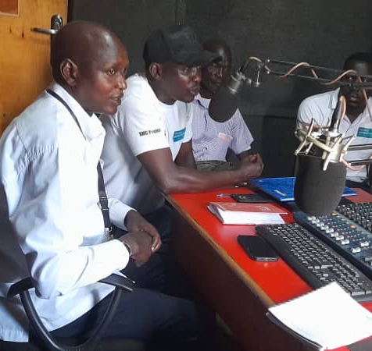
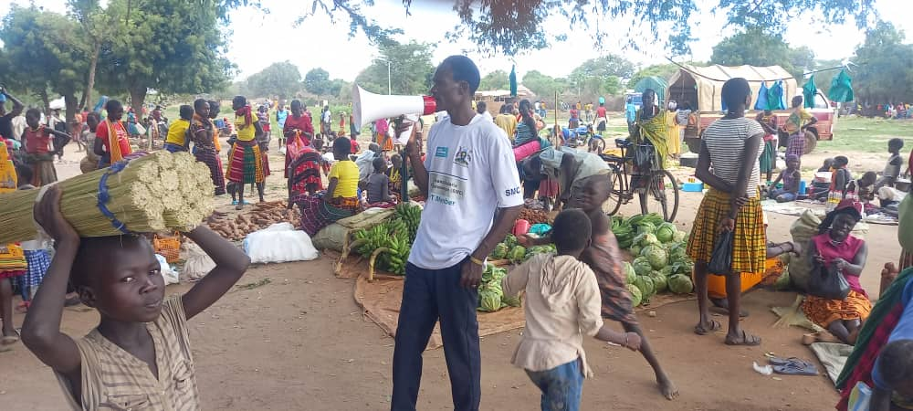
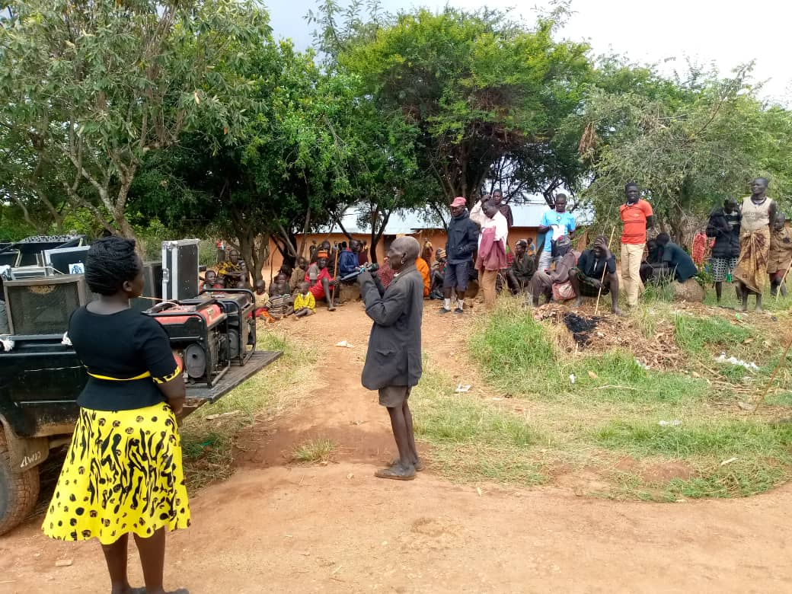
Same National, regional district teams that supervise iccm do oversight for SMC.
Health facility in-charges &Health assistants supervise iccm& SMC for their respective catchment areas.
Parish VHT coordinators supervise both iccm &SMC implementation.
1
2
3
3
2
1
Communication for SMC,ICCM and other interventions conducted in an integrated way using different channels .

Slide 14
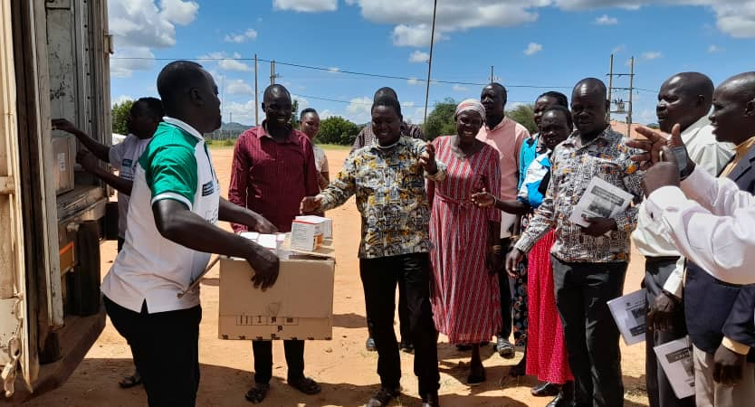
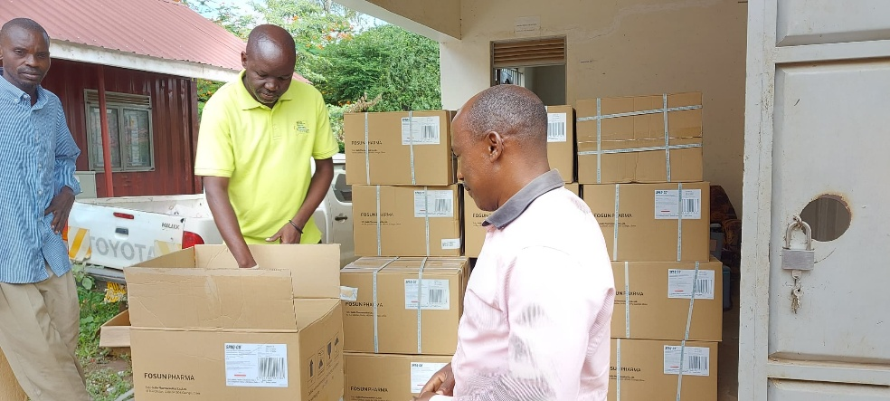
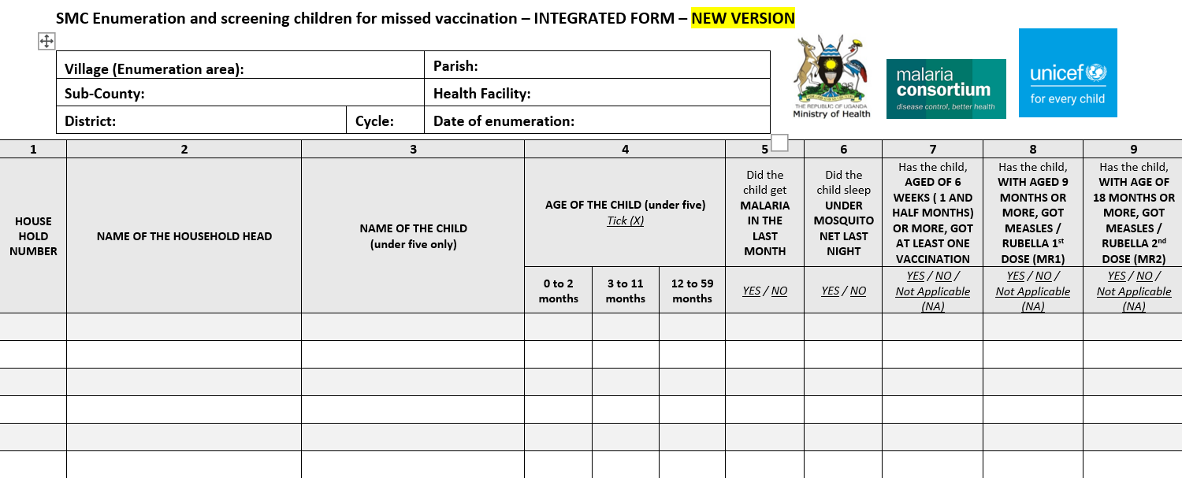
The delivery, storage and reversal logistic management of both SMC and iCCM are addressed together
During enumeration exercise, we assess the service uptake including LLINs, Zero dose

Slide 15
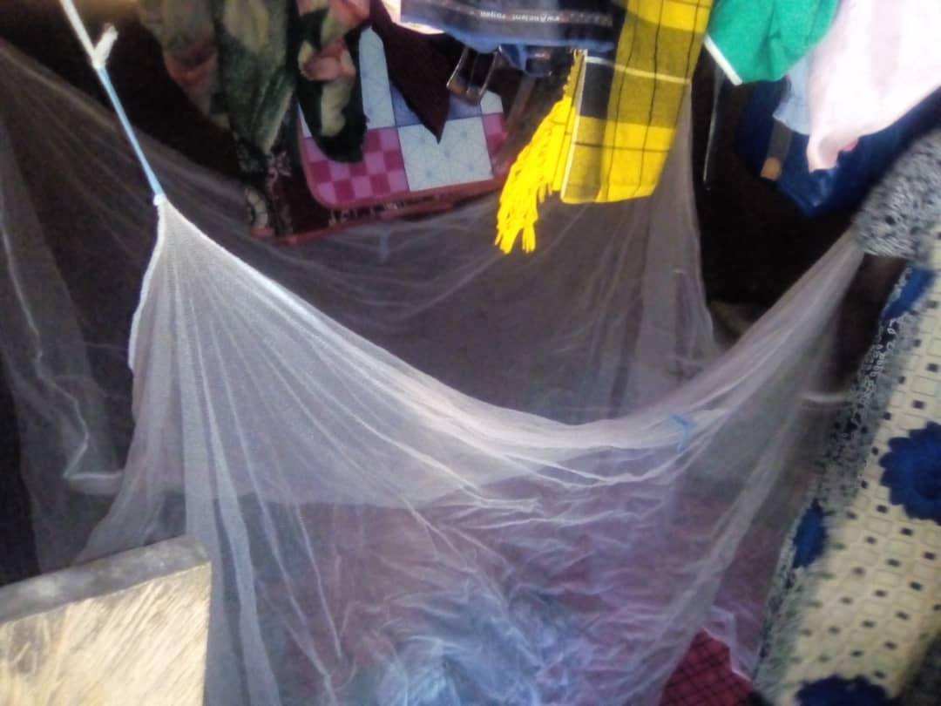
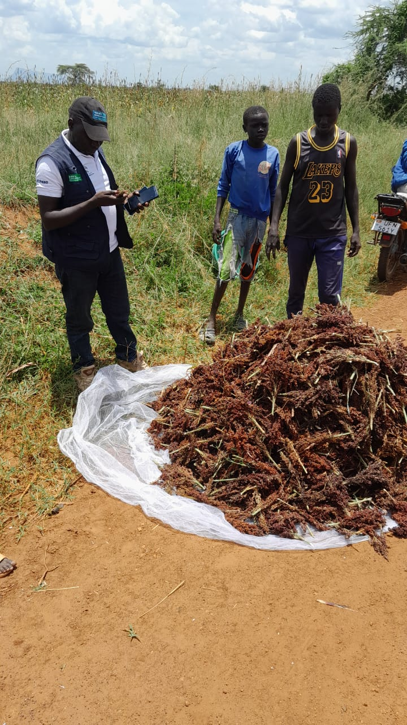
2.Integration of SMC with Other interventions:Long lasting Insecticidal Nets (LLINs)
Net Use:
LLINs distributed in December 2023 in all the 9 districts in Karamoja region
Same SMC/iCCM VHTs registered all 318,415Households in the communities in the 9 districts
753,173 LLINs distributed to Household members
6,338 VHTS, 276 HWs, DHMT, MC staff, MoH personnel also monitor net availability and use during SPAQ distribution in the 9 SMC districts
During supervision of SMC SPAQ distribution, supervisors are encouraged to;
  Identify practices of LLINs abuse/misuse.
  Advise communities on correct ,consistent use and care
Outcomes :
Improved consistent ,correct use & reduced misuse /abuse plus better net care

Slide 16
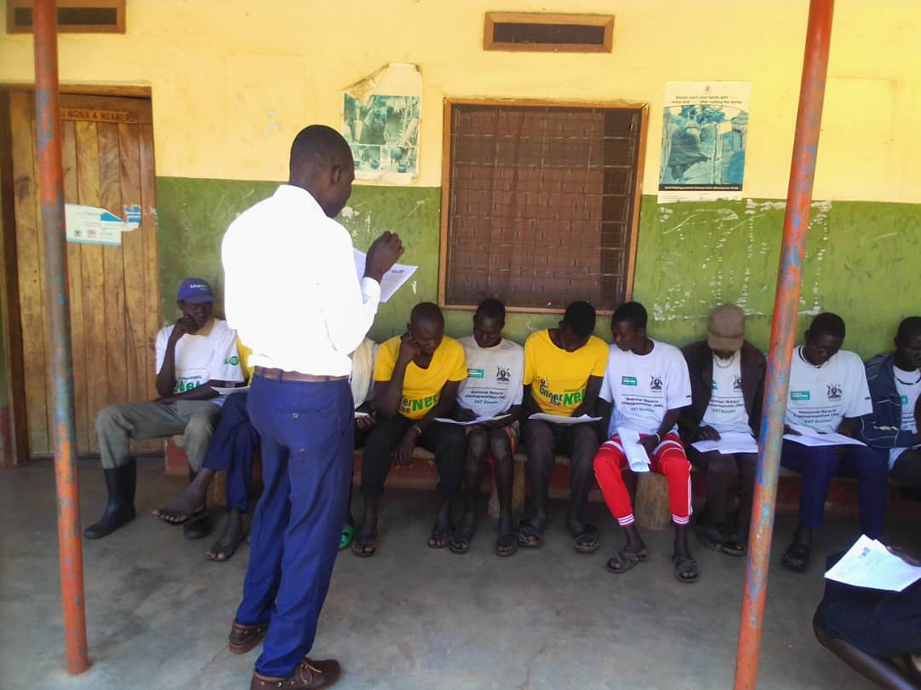
3.Integration of SMC with Other interventions: _Identification and immunization of zero-dose children
In Karamoja, immunisation coverage is sub-optimal or low, exposing children at risk.
Integrated the screening for under-immunization with SMC Child Enumeration allowing for early identification of children at risk in 2,929 villages
  240,523 children (88%) reached/identified
  20,071 (8%) children who missed OPV3
  10,396 (4%) children who missed DPT1
  20,416 (9%) children who missed IPV2
  21,149 (9%) children who missed MR1
  54,435 (23%) children who missed MR2

Slide 17
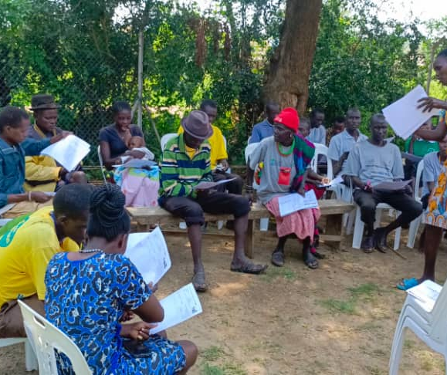
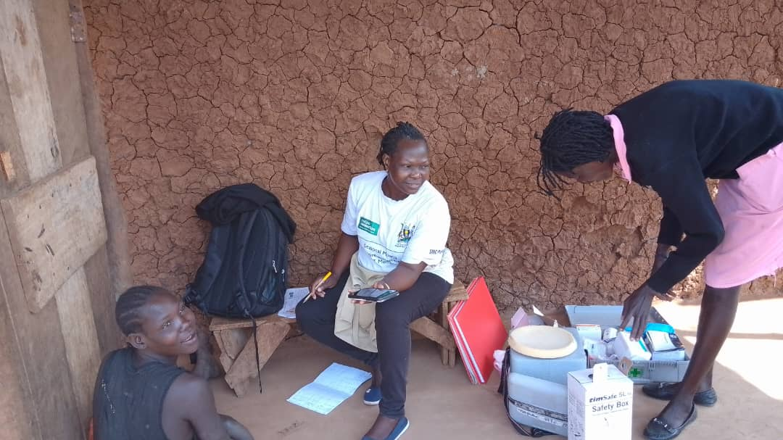
Integration of SMC with Other interventions: Identification and immunization of zero-dose children
Key lessons
It is feasible to use VHTs for identification and mobilization of children who missed vaccines doses
Identification of children who missed vaccines doses does not add additional workload for VHTs when integrated into enumeration done prior to SPAQ distribution
The screening and registration exercise can identify villages that need targeted interventions such as outreaches to increase vaccination coverage

Slide 18
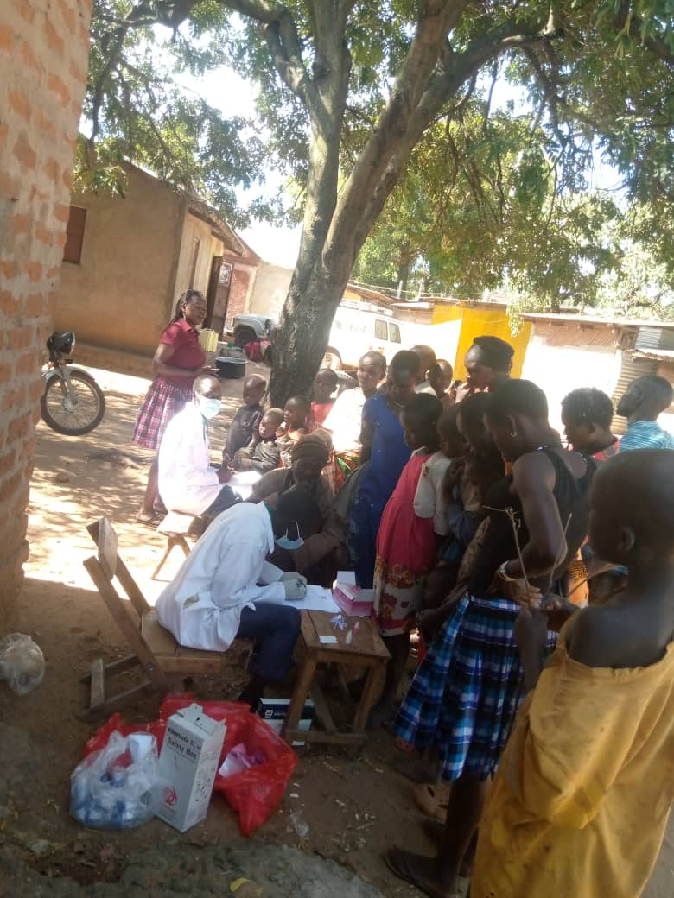
4.Integration of SMC with Other interventions: Test & Treat outreaches
Malaria hot spot mapping;
  Health facility workers and VHTs use data to routinely identify villages with a high malaria burden.
  Community outreaches for test and treat are planned to target these areas.
Mapping and identification of underserved geographical areas and populations
  Other interventions such as immunization, deworming and nutritional assessments are also conducted

Slide 19
Interventions considered for further integration;Malaria Vaccine ,PDMC,LLINs
Malaria Vaccine Integration
Post Discharge Malaria Chemoprevention
LLINs’ distribution campaigns:
Advocacy: Include Malaria vaccine advocacy and sensitization activities to be part of those planned under SMC.
Capacity building : Information on Malaria vaccine plus the roles of each actor will be part of the planned orientation for providers at all levels of SMC implementation.
Guidelines and Tools: SMC tools to be updated to include information On Malaria Vaccine introduction.
Enumeration and house hold visits VHTs : Profiling and identification of children eligible for receiving the vaccine/zero dose/drop-out will be part of this exercise.
End of cycle and round surveys – provide an opportunity to assess coverage and reduce zero dose /missed doses& strengthen 2YL for better MV4 uptake
Utilize community health systems to mobilize & sensitize community plus improving access through community out reaches.
Follow up – HWs collaboration with VHTs will follow up /check on survivors of severe malaria during home visits/enumeration, medicines’ distribution distribution and at data collection during surveys.
Administration of PDMC medicines- as they implement SMC HWs and VHTs will give PDMC medicines SM survivors.
Assess acceptability ,demand and utilization of PDMC as part of the surveys.
Implementation:LLINs’campaign activities to be aligned to SMC implementation .
HH registration will be replaced by SMC enumeration.
Joint advocacy ,sensitization and orientation for LLINs and SMC.
Key milestones of the LLINs distribution campaign(2026) aligned to the SMC cycles.
  Cycle1;enumeration/registration.
  Cycle2: Distribution and hang up.
  Cycle3:Followup and reinforcement of hang up.
  Cycle 4: Monitor and respond to use and care practices .
  Cycle 5: Continue engaging community for proper LLIN use and care.
These integration efforts are currently possible in the 9 districts( Karamoja sub-region) with SMC

Slide 20
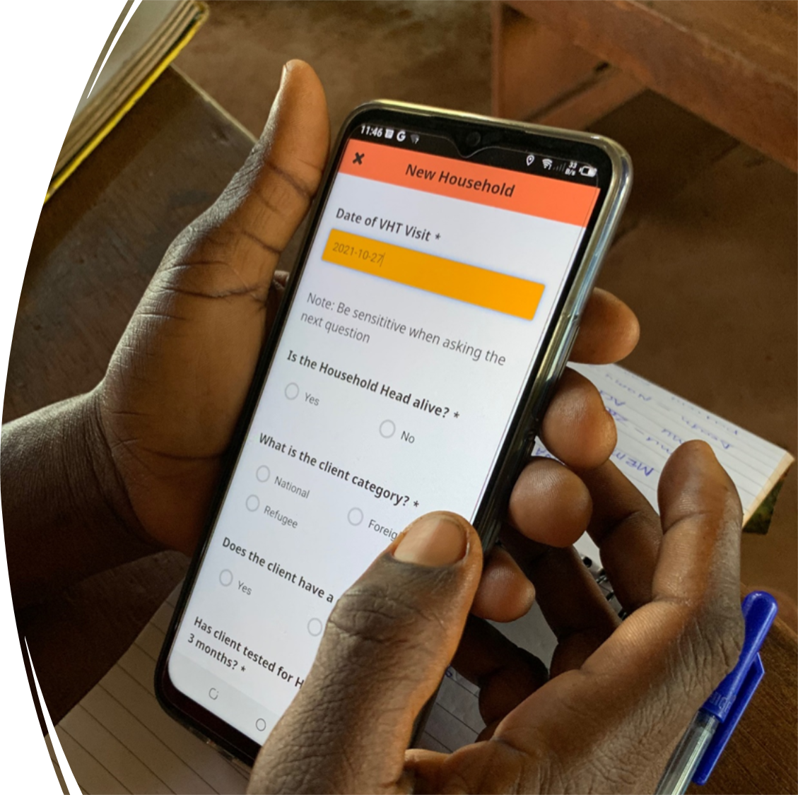
Others : Digitization of community health data, IPTp…
Equipping and skilling community health workers to embrace the data digitization.
  During SMC VHT supervisors report electronically.
  LLIN campaign 2023 utilized digitized data systems for documentation and reporting.
All community health interventions are to be integrated with in the current Electronic community health system.
Digitization to enable sustained, effective community health- (ICCM, Immunization, Nutrition, SMC, LLINs).
The purpose for digitizing community health system and empowering personnel at that level to utilize them is to improve reporting and quality of service delivery at the community level.
Intermittent Preventive Treatment of Malaria in Pregnancy .
  Identification and profiling pregnant women for appropriate ANC attendance& improve IPTp uptake.
  Linkage and referral of Pregnant women to ANC for IPTp.
  Follow up of Mothers .

Slide 21
. Strengths, opportunities and challenges/gaps
Strengths
  The success stories associated with SMC ;
    the consistent optimal coverage
    acceptability
    impact- reduction in incidence & all cause u5 mortality
Opportunities;
  Ministry of health top leadership prioritizes and promotes integration.
  The increasing call for the country to intensify efforts for elimination-proposal to target the sub-region for elimination.
  The availability of the National Community Health Strategy(NCHS) 2021/22 – 20225/26.
  Digitalization of health services to enable integration of data for information (HEALTH INFORMATION AND DIGITAL HEALTH STRATEGIC PLAN 2020/21-2024/25)
Mitigation measures/innovations around challenges.
  Joint planning and performance reviews at National & sub-national levels.
  Routine data driven mentorships,coaching and technical supportive supervision.
  Digitization of data tools and systems
  Promoting increased& sustained use Malaria surveillance charts
Challenges/gaps
  Slow adaptation of innovations and revised processes, tools.
  Inadequate coordination of stakeholders with vertical programming and implementation.
  Irregular availability of commodities and supplies.
  Data utilization at sub-national level is low.

Slide 22


Acknowledgments
District local government
Communities in Karamoja
UGANDA NATIONAL MALARIA ELIMINATION DIVISION

Slide 23
Merci, Akpe, Thank you, Obrigado

