Slide 1
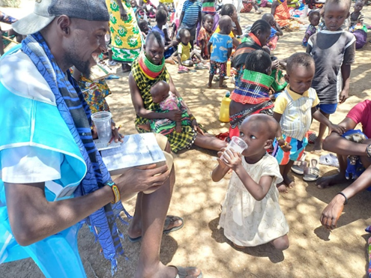
Innovations in SMC delivery in hard-to-reach areas of Turkana, Kenya
David Ekai, Malaria Coordinator, Turkana
SMC Alliance Annual Meeting,
Lome, Togo
26th February 2025

Slide 2
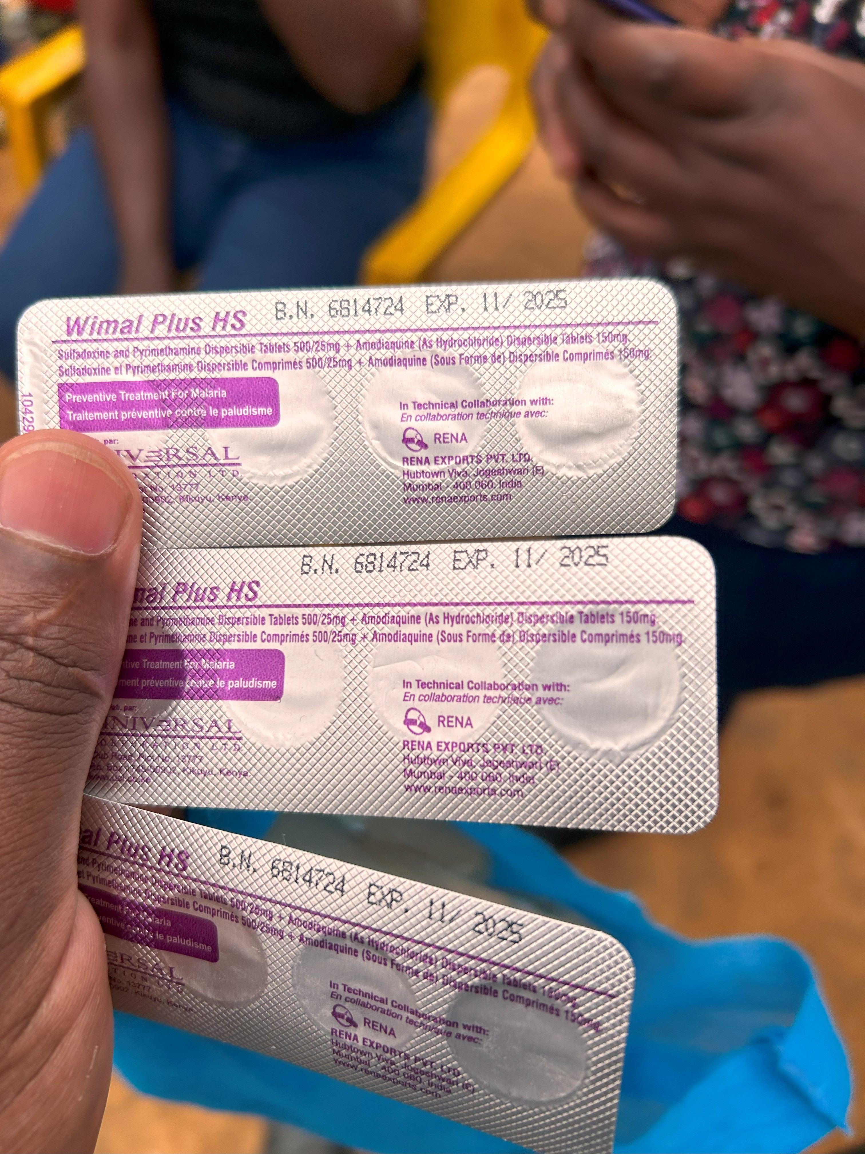
Outline
Why SMC in Turkana, Northwest Kenya?
Operational innovations
Evidence informed SMC campaign
Inter-cycle assessments
Impact of introduction SMC in Turkana
Challenges & Adaptations
Plans for Round 2

Slide 3
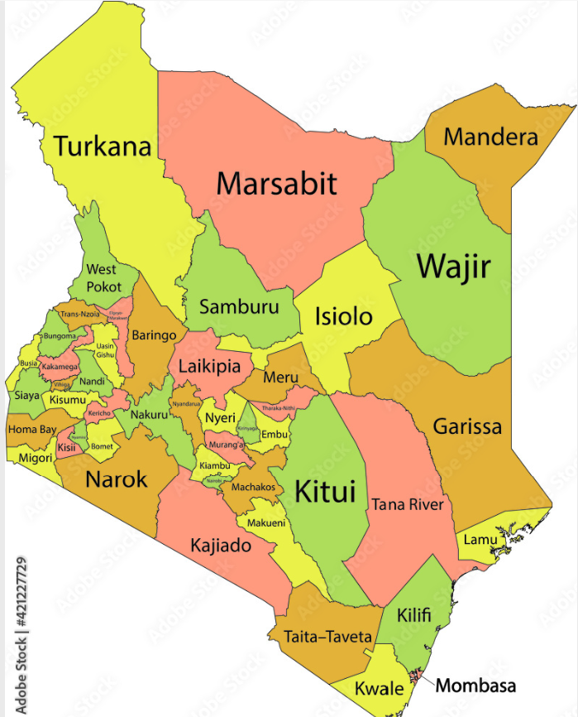
Why SMC in Turkana
Like Sahel, Turkana experiences strong seasonality of cases and high burden in young children
  30% of cases in children <5
  65% of cases occur between June-October
  The clinical attack rate is 1 episode per child per year (10 times higher than the WHO criteria)
Monthly malaria cases confirmed by microscopy in Turkana over three calendar years
Source: DHIS2

Slide 4
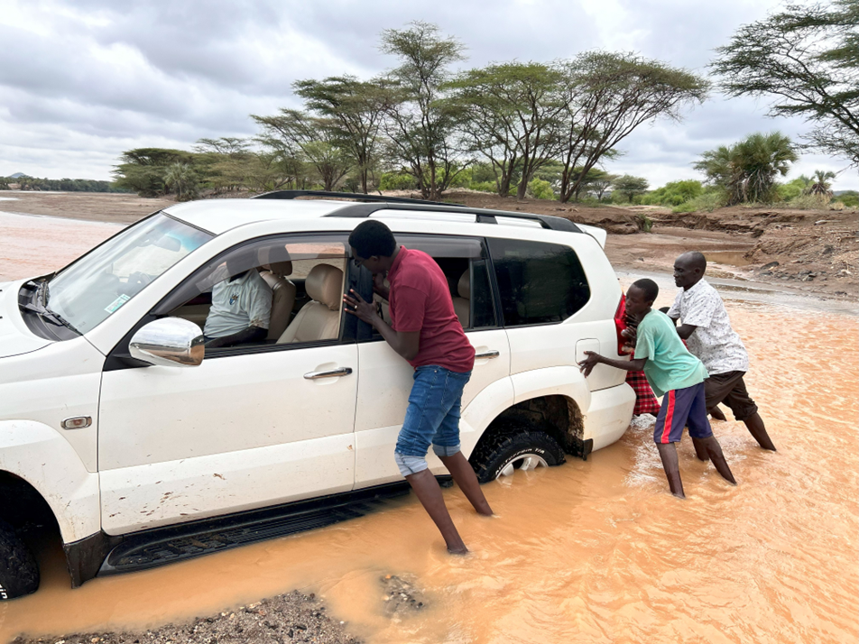
Operational Innovations/Adaptations to reach the “Hard to Reach”
Evidenced Informed SMC Campaign (baseline evaluation)
Use of existing community personnel for Social Mobilization including the use of Village Mobilizers etc.
Prepositioning of SMC drugs to overcome the challenges presented by the harsh terrains and floods
Integration of SMC with other public health campaigns i.e. Polio Campaign to leverage on Community Health Workforce as well as Public Awareness Campaign resources.
.
Adaptive learning through the inter-cycle assessments
Notes:
(Cycle 5 reached the highest beneficiaries)
Two months stocks supplied with preference on the hard to reach facilities…Coupled with monthly monitoring to check the supply levels.

Slide 5
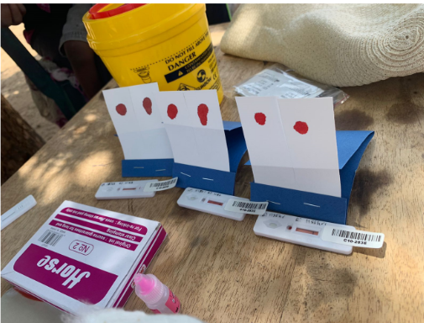
Evidenced Informed SMC Campaign
Goal
A baseline evaluation was undertaken in October 2023 to evaluate the burden of malaria infection and to learn more about how families and communities seek treatment for fevers and prevent malaria. Information from this study was crucial for planning and scaling up the SMC approach in Turkana.
Objectives
  Quantify the prevalence of asymptomatic P. falciparum malaria in children under 10 years of age in Turkana North and Turkana Central sub-counties in Turkana, Kenya.
  Map the health resources that communities turn to for febrile illness or medical advice during different seasons of travel

Slide 6
Evidenced Informed SMC Campaign:
Findings and Recommendations
  Quantitative findings:
    Participant and Household Characteristics
      Bednet use – 57% of responded did not own any bed net while 78% did not sleep under a bed net the night before the survey.
    Prevalence of Asymptomatic P. falciparum Malaria
      Out of 1,286 eligible individuals who were tested, 20% were positive.
  Qualitative findings and recommendations
    SMC delivery approaches mix -tailored to hard-to-reach communities based on context:
      In urban areas, health facility centralized distribution to supplement door-to-door and/or CHP efforts was preferred.
      In more rural, interior areas: door-to-door CHP approach was proposed, supplemented by integrated outreaches to reach pastoralists and people further in the interior.
    Opportunities for integration identified e.g. One-Health& Other Public Health Campaigns
    Timing of campaign identified i.e. during the weekend, market days to reach larger numbers.
    Sensitization and mobilization through community leaders (chiefs, village and ward admins, village elders, religious leaders, ECD teachers, group leaders of women groups, youth groups, fishermen groups, business groups)
    Identified possible challenges to SMC implementation: Physical access, terrain, acceptability, reach

Slide 7
Inter-cycle assessments informed program adaptation
Purpose: Adaptive assessment of awareness, coverage, quality of delivery, side effects of SMC delivery between cycles to improve for subsequent cycles especially among hard-to-reach communities
Post Cycle | Method | Adaptation
Cycle 1 | Household Survey - Total of 188 households, which had 252 children eligible to receive SMC | Reinforce counselling by CHPs including information about potential adverse reactions to encourage improved uptake.
Cycle 2 | HH Survey - 125 households across five villages far from the health facility, located in tough terrain or with scattered households were purposefully selected | Leverage existing community structures and personnel including village elders, to encourage HHs that are not linked to a CHP are able to access SMC Implement plan for mop-up activities to increase SMC coverage Refresher training for CHPs
Cycle 3 | Community dialogue in hard-to-reach villages previously mapped before cycle 3, to verify the delivery of SMC to the population using the proposed strategies, including fixed-point distribution | Collaborate with other ministries, such as veterinary services and local administration to help identify additional villages that require SMC services. Enhance Community Engagement for Fixed-Point by involving village elders in the mobilization process and to provide a specific day for community gathering. Reevaluate and complement Door-to-Door Strategy distribution with fixed-point distribution to reduce burden on CHPs and lower program costs.

Slide 8
SMC coverage (proportion of children under five reached/Cycle)
Source: DHIS2
27,206 children received all 5 cycles of SMC (71%)

Slide 9
Impact of SMC on clinical malaria (Preliminary Results)
SMC reduced malaria cases by 71%
Incidence Rate Ratio*:
0.289 [0.126-0.666]
*Estimate adjusted for bednet use, child age, gender, sleeping outside, clustering and village-level prevalence.

Slide 10
Challenges & Adaptation
Challenge | Solution/Adaptation
Vast distances and difficult terrain: Turkana Central Sub-County is characterized by remote and sparsely populated villages with rough terrain, including hills, swollen river Kerio and lake Turkana. These geographical features made it difficult for CHPs to access certain villages, especially those located on the other side of the river. | Use of integrated outreaches as well as prepositioning of drugs has aided with mitigating the geographical challenges
Malaria Outbreak in Turkana: A malaria outbreak in Turkana central sub county including neighboring sub-counties in the middle of the SMC campaign complicated efforts to control malaria among children under five years | Enhance case surveillance and rapid response. Community sensitization and ensure availability of malaria commodities.
Community distributors/CHP related: Competing activities, non –compliance with protocols | Frequent mentorship to address quality service delivery.
Inadequate resources to support the scale up of SMC in neighboring sub-counties that had a high burden of disease. The main costs arose from vehicle use in the vast area for monitoring, supervision, outreach services and drug prepositioning. | Leverage on resources available for other public health campaigns as well as advocacy for the Government to procure SMC drugs and RDTs beyond the pilot.

Slide 11
Plans for SMC Round 2
For better coverage, map and register communities/villages more completely, especially those without CHPs, new villages, households at the edges of existing villages at ward level.
Phased digitalization of SMC campaign using the Government - owned Electronic Community Health Information System (eCHIS)
Age group expansion to include children 5 – 9 years in Turkana Central Sub County
Possible integration with malnutrition screening and referrals at fixed-points.
Policy Advocacy and Resource Mobilization
Update National guidelines
If resources are available, a costing analysis is recommended to inform scale-up.

Slide 12
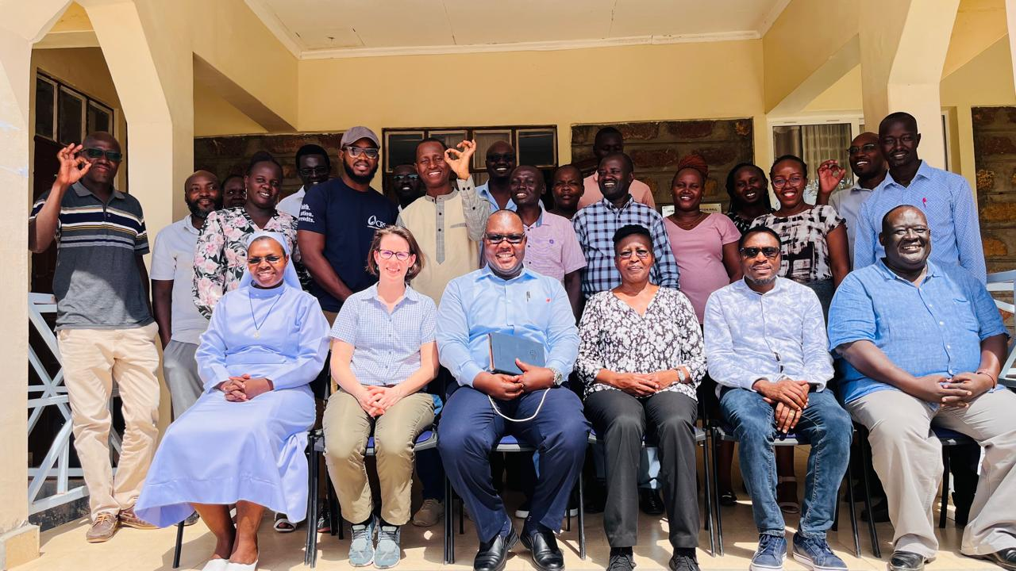
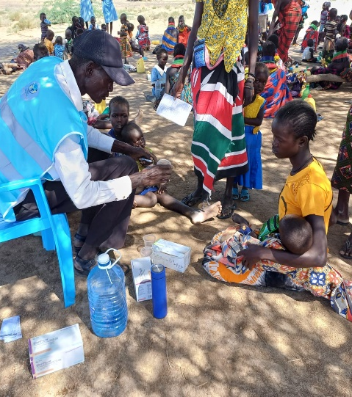
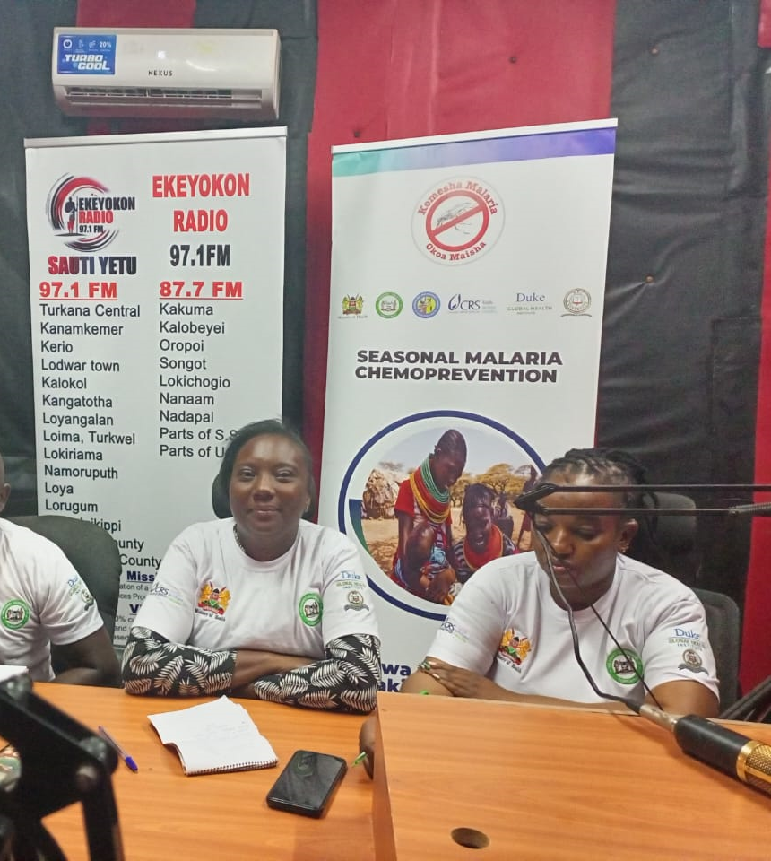
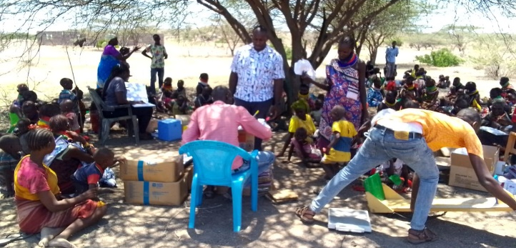

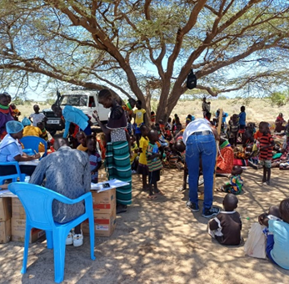
Contact us
David Ekai, Malaria Coordinator, County Government of Turkana (dlogialan@gmail.com)
Dr. Paul Rumosia, Deputy Head of National Malaria Control Program, Ministry of Health, Kenya (paul.rumosia@health.go.ke)
Dr. Edwin Mbugua, Health, Nutrition and Social Services, Sector Lead, Catholic Relief Services (edwin.mbugua@crs.org )
Thank you

