Slide 1
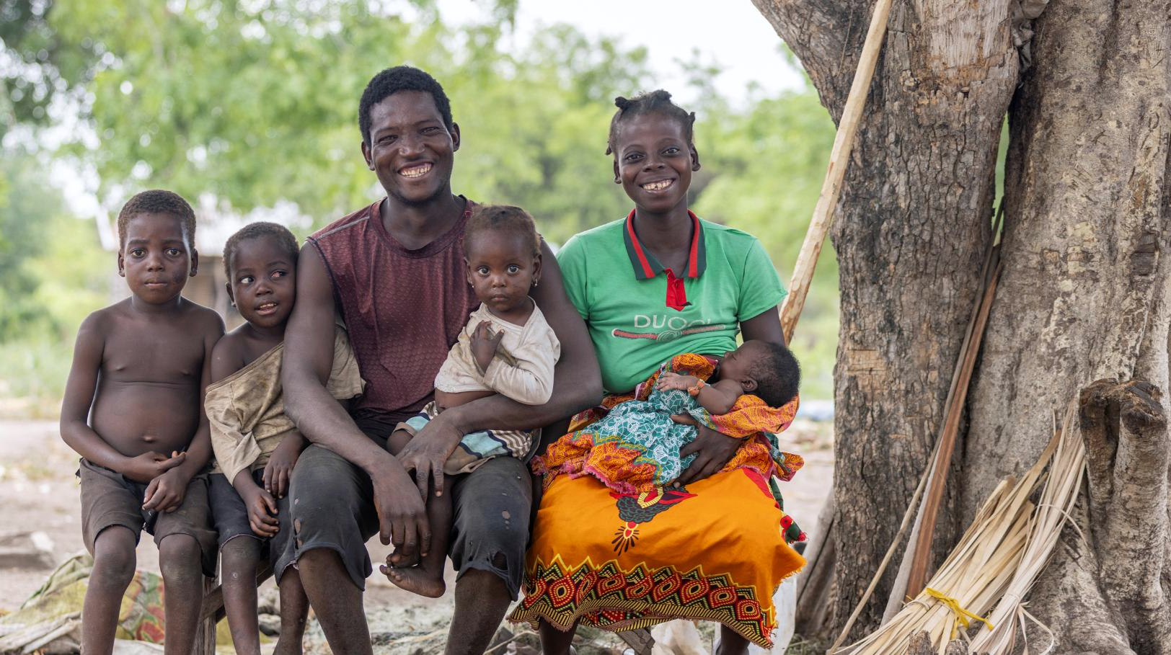
Rebranding Proposal
From SMC Alliance to
Malaria Chemoprevention Alliance
Credit: PSI

Slide 2


Why a Malaria Chemoprevention Alliance?
Malaria risk extends beyond children aged 3–59 months, including infants, young children, and school-aged children
As efforts continue to prevent malaria, there is an equity gap when targeting children, especially in perennial settings, integrating the intervention that is most appropriate for the setting, and accessing preventive services
Other chemoprevention approaches (e.g. PMC, IPTsc, PDMC) are approved by WHO but are at earlier stages of uptake, advocacy, evidence and visibility compared to SMC
It is time for them to transition from project-led collaboration among researchers and implementers to a more formal mechanism, which the SMC Alliance is
The same stakeholders are involved in implementing or researching more than one chemoprevention intervention, and do not have time to attend multiple meetings
A broader alliance could unify efforts, strengthen the collective voice of chemoprevention, and better position malaria prevention across a child life course and beyond
Credit: Malaria Consortium

Slide 3
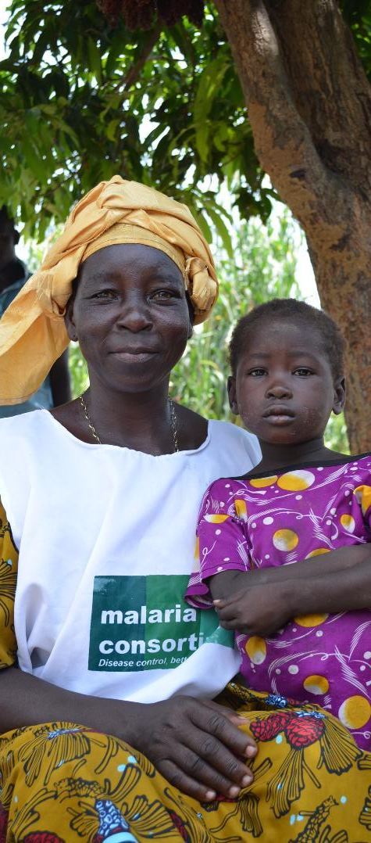

What is the Alliance?
An umbrella platform bringing together SMC and other malaria chemoprevention initiatives, including PMC, IPTsc, PDMC
A space for shared lessons and learning, coordinated advocacy, and strategic alignment
Complementary to vector control and malaria vaccines
A unified alliance that strengthens coherence, influence, and impact of malaria chemoprevention across a child life course and beyond
Credit: Malaria Consortium

Slide 4

What are the objectives?
Strategic
Unify malaria chemoprevention efforts at global, regional and country levels to expand protection against malaria across a child life course
Technical & programmatic
Facilitate knowledge sharing, learning and research to generate and apply evidence-based chemoprevention interventions
Advocacy & financing
Strengthen advocacy, improve resource mobilisation, and efficient use of chemoprevention investments
System &
integration
Promote integration and innovation by leveraging chemoprevention infrastructures with other child health interventions
Notes:
(Note: Please double check the following statements and feel free to edit/add any missing items.)
1. A&C Subgroup Election
- Taylor Prochnow and Hajarah Nakendo were elected as the new co-chairs.
- Malaria Consortium continued to act as the subgroup secretariat.
2. World Children’s Day
- The subgroup developed and shared key messages for World Children’s Day, building on previous content from the Day of the African Child.
- Members coordinated to use and cross-post content on social media to maximize exposure and impact.
- MMV published an op-ed on World Children's Day.
3. World Malaria Report
- The subgroup prepared for the launch of the World Malaria Report, focusing on the theme of gender and equity.
- Efforts were made to use the SMC map for communications purposes.
- Relevant country-level or organizational responses were republished or summarized on the SMC Alliance website.
4. 2024 ASTMH Annual Meeting (Please double check the facts)
- Taylor, Hajarah, Abena, Akinola & Christian attended the ASTMH meeting.
- An SMC Alliance lunch was held, and a document highlighting SMC/chemoprevention sessions was presented.
- An Advocacy and Communications meeting was held at ASTMH.
- MMV managed a booth and co-hosted a sponsored symposium with TDR.
- Malaria Consortium and PSI/Plus Project participated and presented at ASTMH.
5. SMC Alliance Consultancy
- A consultant was selected to document learnings and best practices from the SMC Alliance.
- A steering group was formed to work out the deliverables and timelines.
- Malaria Consortium handled the contract and coordinated the works with the consultant.
- The consultancy results were presented at the SMC Alliance meeting earlier this week, with plans for both inward-facing and outward-facing outputs.
6. Regular member update meetings were held throughout the year.

Slide 5
Malaria Chemoprevention Alliance
How will it work?
Overarching alliance
SMC
IPTsc
(e.g. LERN Malaria)
PMC
PDMC
Others
Workstreams by intervention or theme (including
Member alliances / organisations)
Advocacy & Communications Subgroup
Cross-cutting subgroups / supporting functions
Research Subgroup
M&E Subgroup
Operations Support Subgroup (New)
This structure allows for gradual integration, recognizing current branding, funding, and operational realities
Notes:
(Note: Please double check the following statements and feel free to edit/add any missing items.)
1. A&C Subgroup Election
- Taylor Prochnow and Hajarah Nakendo were elected as the new co-chairs.
- Malaria Consortium continued to act as the subgroup secretariat.
2. World Children’s Day
- The subgroup developed and shared key messages for World Children’s Day, building on previous content from the Day of the African Child.
- Members coordinated to use and cross-post content on social media to maximize exposure and impact.
- MMV published an op-ed on World Children's Day.
3. World Malaria Report
- The subgroup prepared for the launch of the World Malaria Report, focusing on the theme of gender and equity.
- Efforts were made to use the SMC map for communications purposes.
- Relevant country-level or organizational responses were republished or summarized on the SMC Alliance website.
4. 2024 ASTMH Annual Meeting (Please double check the facts)
- Taylor, Hajarah, Abena, Akinola & Christian attended the ASTMH meeting.
- An SMC Alliance lunch was held, and a document highlighting SMC/chemoprevention sessions was presented.
- An Advocacy and Communications meeting was held at ASTMH.
- MMV managed a booth and co-hosted a sponsored symposium with TDR.
- Malaria Consortium and PSI/Plus Project participated and presented at ASTMH.
5. SMC Alliance Consultancy
- A consultant was selected to document learnings and best practices from the SMC Alliance.
- A steering group was formed to work out the deliverables and timelines.
- Malaria Consortium handled the contract and coordinated the works with the consultant.
- The consultancy results were presented at the SMC Alliance meeting earlier this week, with plans for both inward-facing and outward-facing outputs.
6. Regular member update meetings were held throughout the year.

Slide 6
Terms of Reference (TOR)
Membership
Participation in the Alliance is open and non-exclusive. The Alliance encourages broad involvement of individuals, institutions and countries representing working on chemoprevention interventions.
Institutional
Membership is open to all interested institutional partners, including National Malaria Programs, civil society, implementing partners, technical partners, donors, research institutions, etc.
Institutions may be represented by no more than 2 representatives (for voting purposes).
National Malaria Control Programs implementing chemoprevention are automatically considered members
Individual
Professionals, associated with (but not representing) any of the types of institutions listed above, with credible expertise and experience in a field(s) relevant to the Alliance.
Credit: Malaria Consortium

Slide 7
Terms of Reference (TOR)
Governance
2 co-chairs: (one of whom is from a National Malaria Program). Responsible for:
Stewardship of the Alliance
Establishment and guidance of the Working Groups;
Preparation and chairing of Alliance meetings;
Representation of Alliance in all RBM/CRSPC mechanisms;
Promote strategic linkages and collaboration with other regional networks
Secretariat: Responsible for :
Coordination and organisation of Alliance meetings in collaboration with Co-chairs.
Support to secure facilities for meetings (rooms, conference call facilities, etc.)
Keeping and publishing minutes of the meetings, and the annual report
Coordinating the maintenance of Alliance website,
Maintenance of the membership list
Credit: Malaria Consortium

Slide 8
Terms of Reference (TOR)
Workstreams
Groups that represent each intervention area
SMC, PMC, IPTsc, PDMC
New chemoprevention interventions to come
Subgroups
Cross-functional areas
Research
Advocacy and Communications
M&E
Operations support (new)
Credit: Malaria Consortium

Slide 9
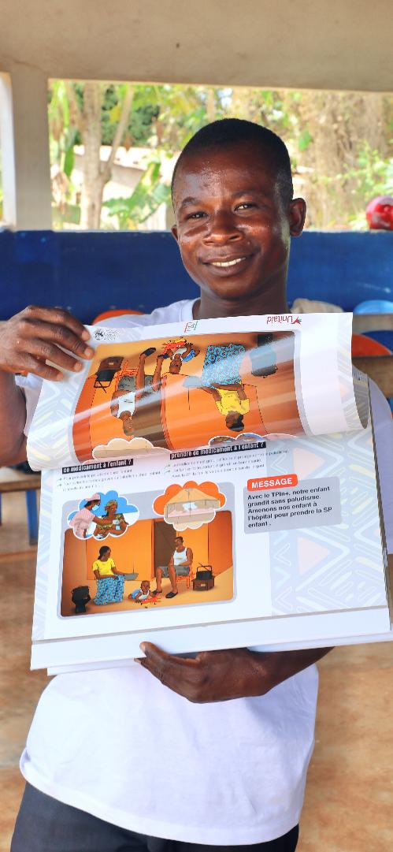
Branding and naming
Prefer a simple, descriptive name and avoid overly complex acronyms
The new logo and branding elements considerations
Could remain similar to current logo to maximise member, audience recognition and decrease costs with rebranding
Could be different from the current SMC Alliance’s logo and branding to distinguish itself as a new platform
SMC Alliance will likely remain for the time being due to its high brand recognition and reputation among SMC countries and communities (to be discussed)
Credit: PSI

Slide 10
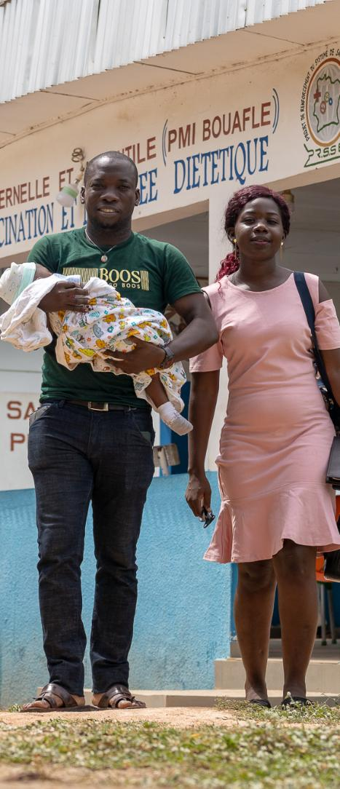



New logo and colour tone (Proposed)
Option 1:
Option 2:
Interpretation:
An alliance for malaria chemoprevention that provides preventive intervention for population-wide protection.
Credit: PSI

Slide 11
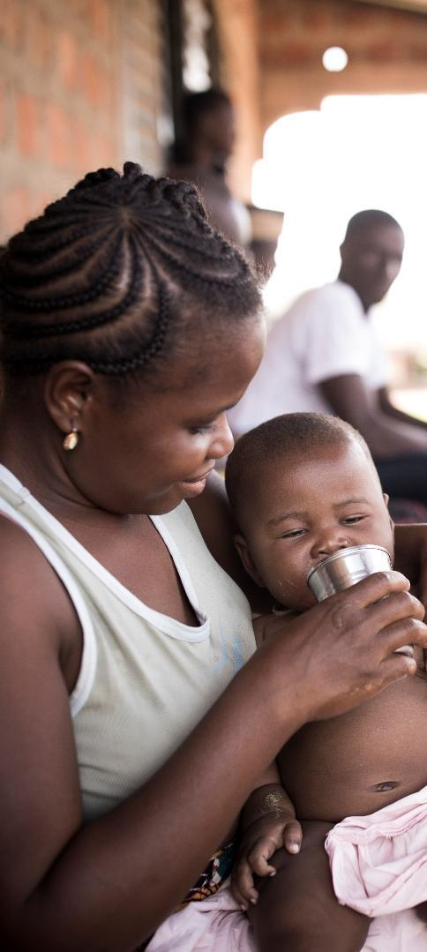
Website and communications
Reflecting budget considerations and opportunity to streamline existing platform, suggest transforming the current SMC Alliance into the Malaria Chemoprevention Alliance website
Creating simple, light-touch landing page, outlining the Alliance’s :
vision, mission, and objectives
key messages
governance, etc.
From the Alliance homepage, create subpages that direct to member alliance landing pages
This approach minimises duplication and maintenance efforts, while reinforcing unity and cross-promotion
Credit: MMV

Slide 12
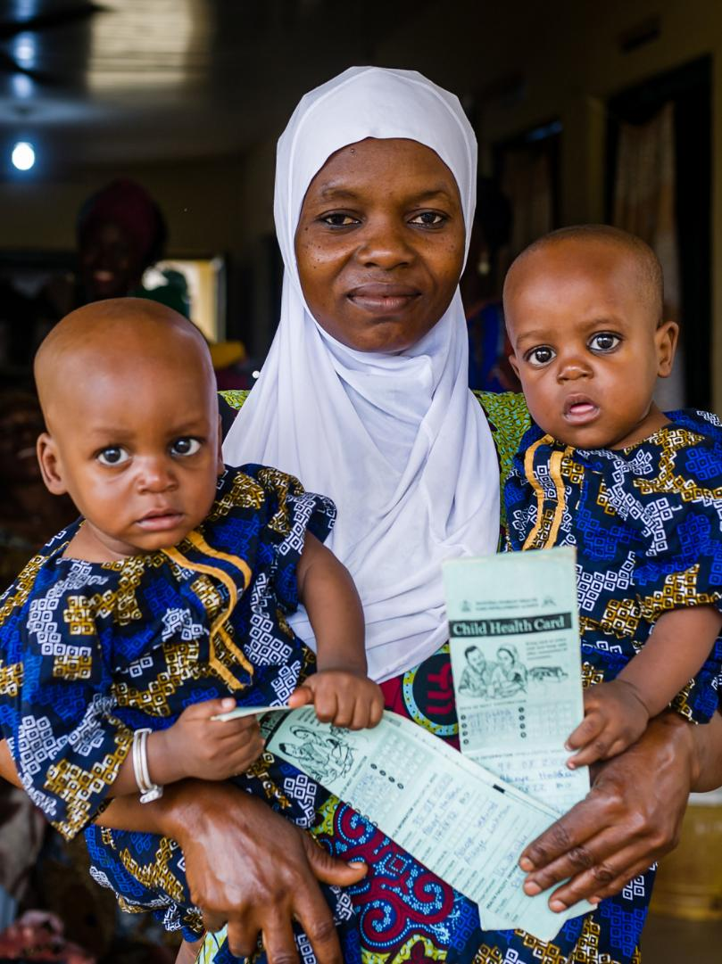

Decisions and next steps
Agreement on the new Alliance’s name and logo
Guidance on next steps for:
vision and mission statements
key messaging
governance framework
branding elements
announcement timeline and plan
Join our discussion on next steps during the business meeting Friday, 27 Feb, after the closing ceremony and lunch
Credit: Malaria Consortium
Notes:
If anyone wants to join the meeting via Zoom, please speak to Celia Yeung from Malaria Consortium for the Zoom link, or email smcalliance.communications@malariaconsortium.org. Thanks.

Slide 13
Thank You
Any questions?

